Slide 1

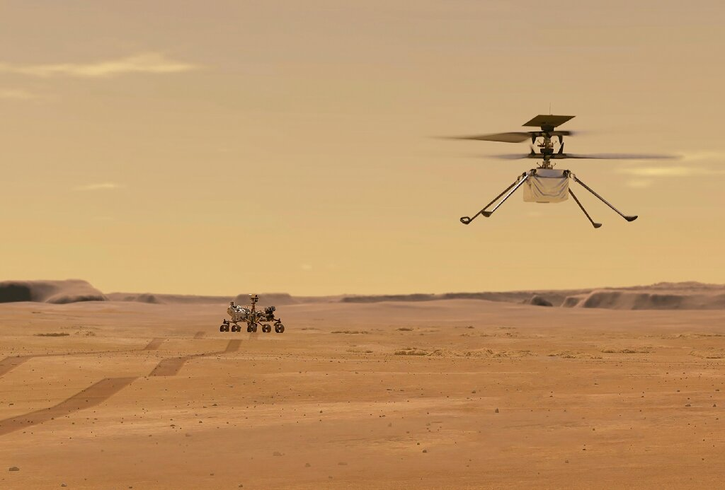
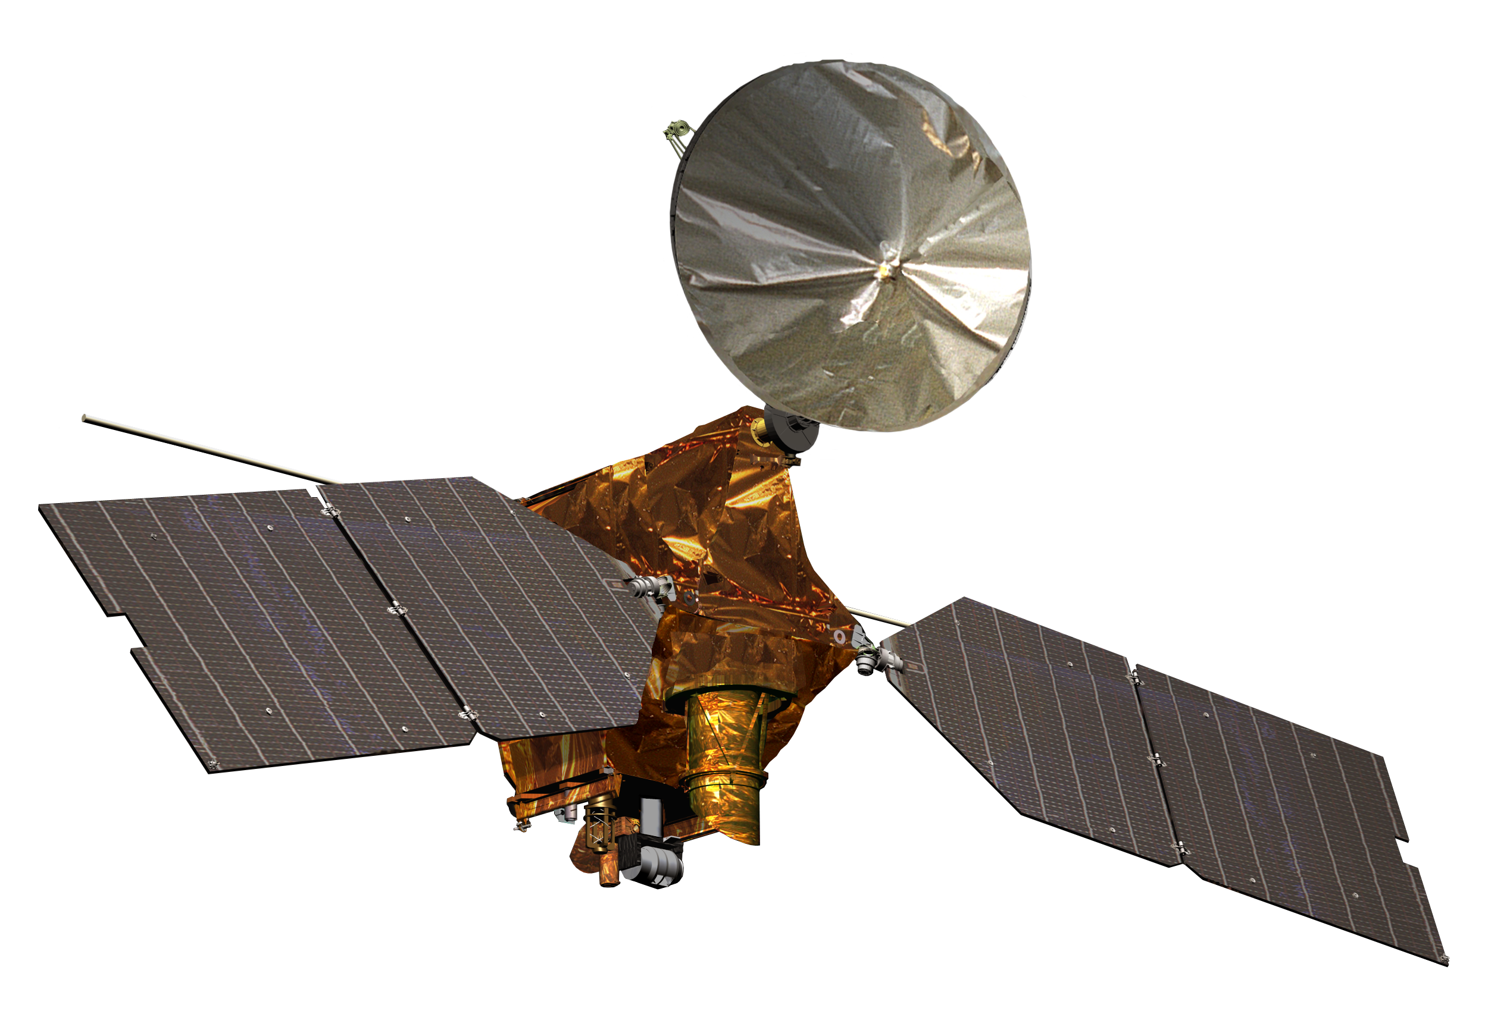
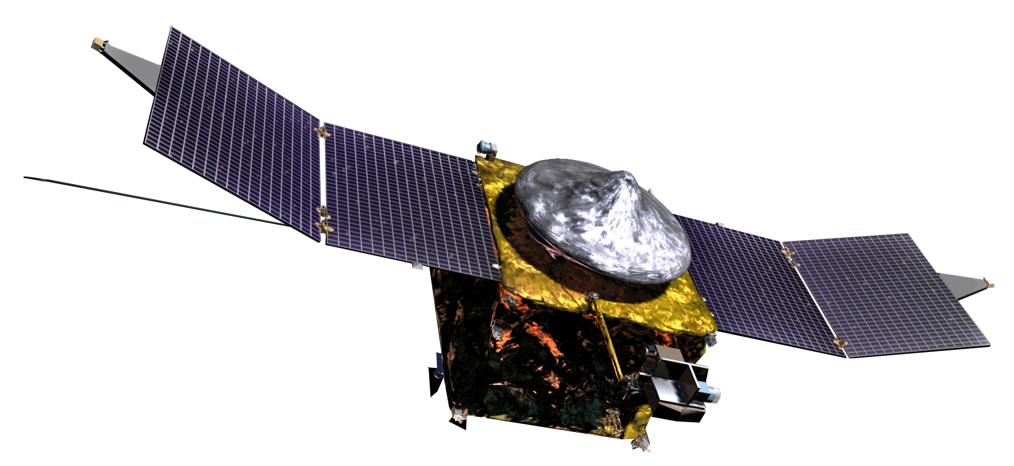
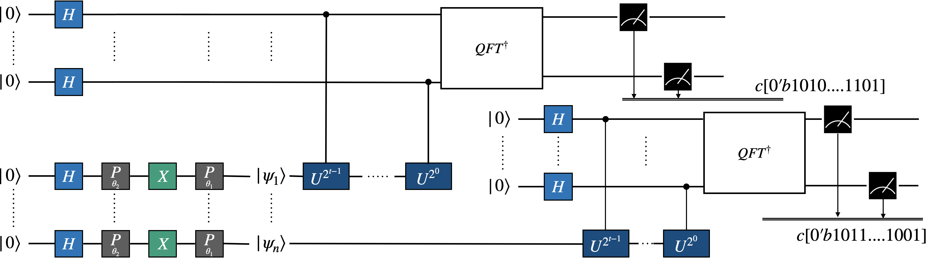
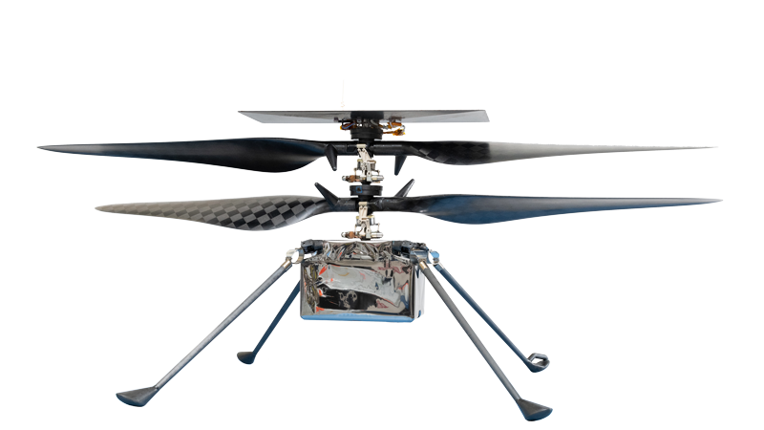
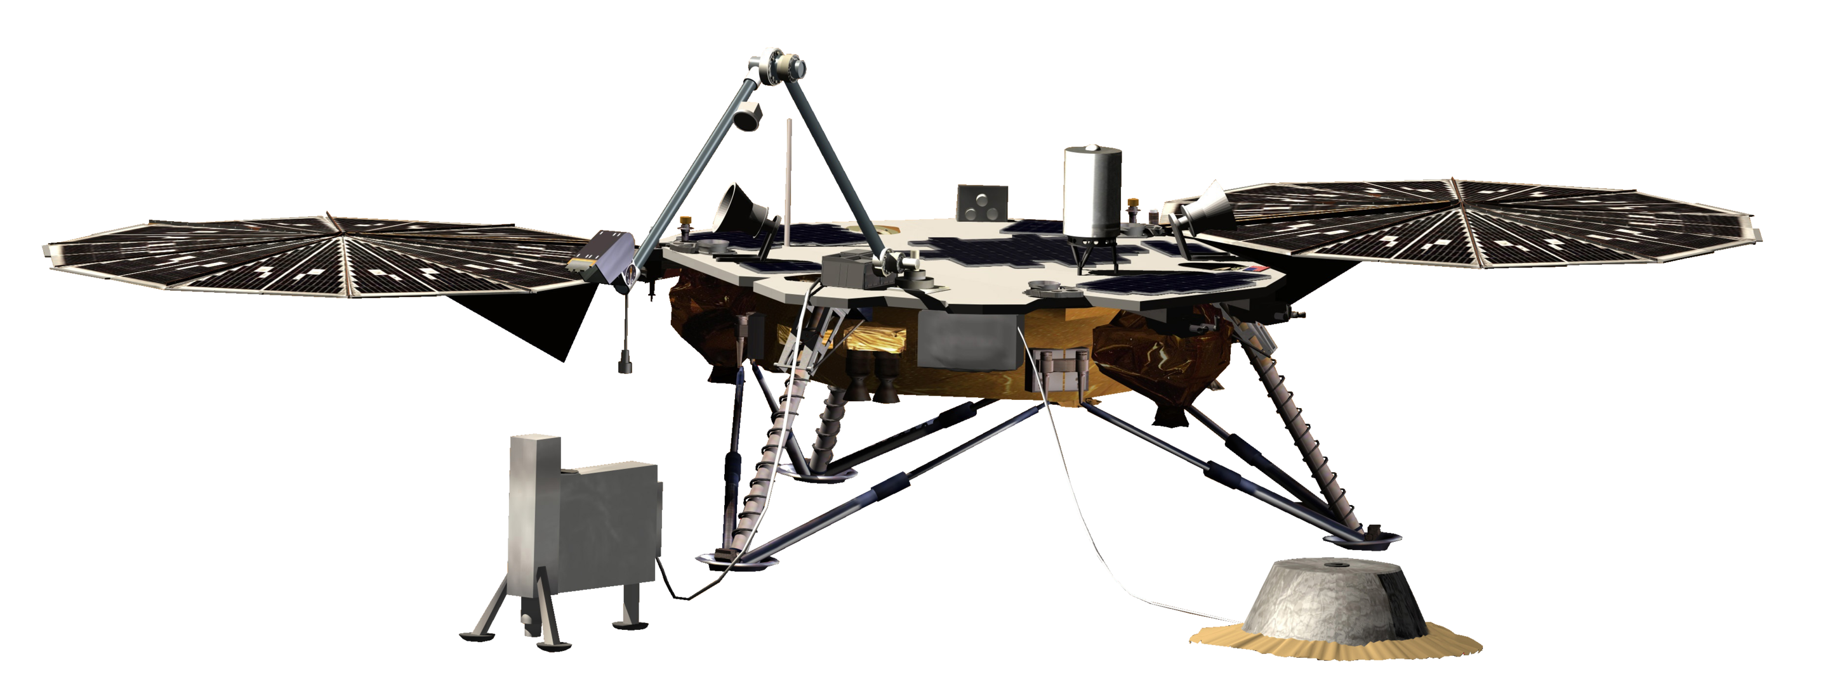
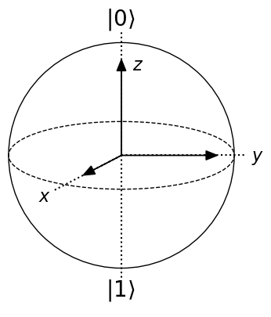
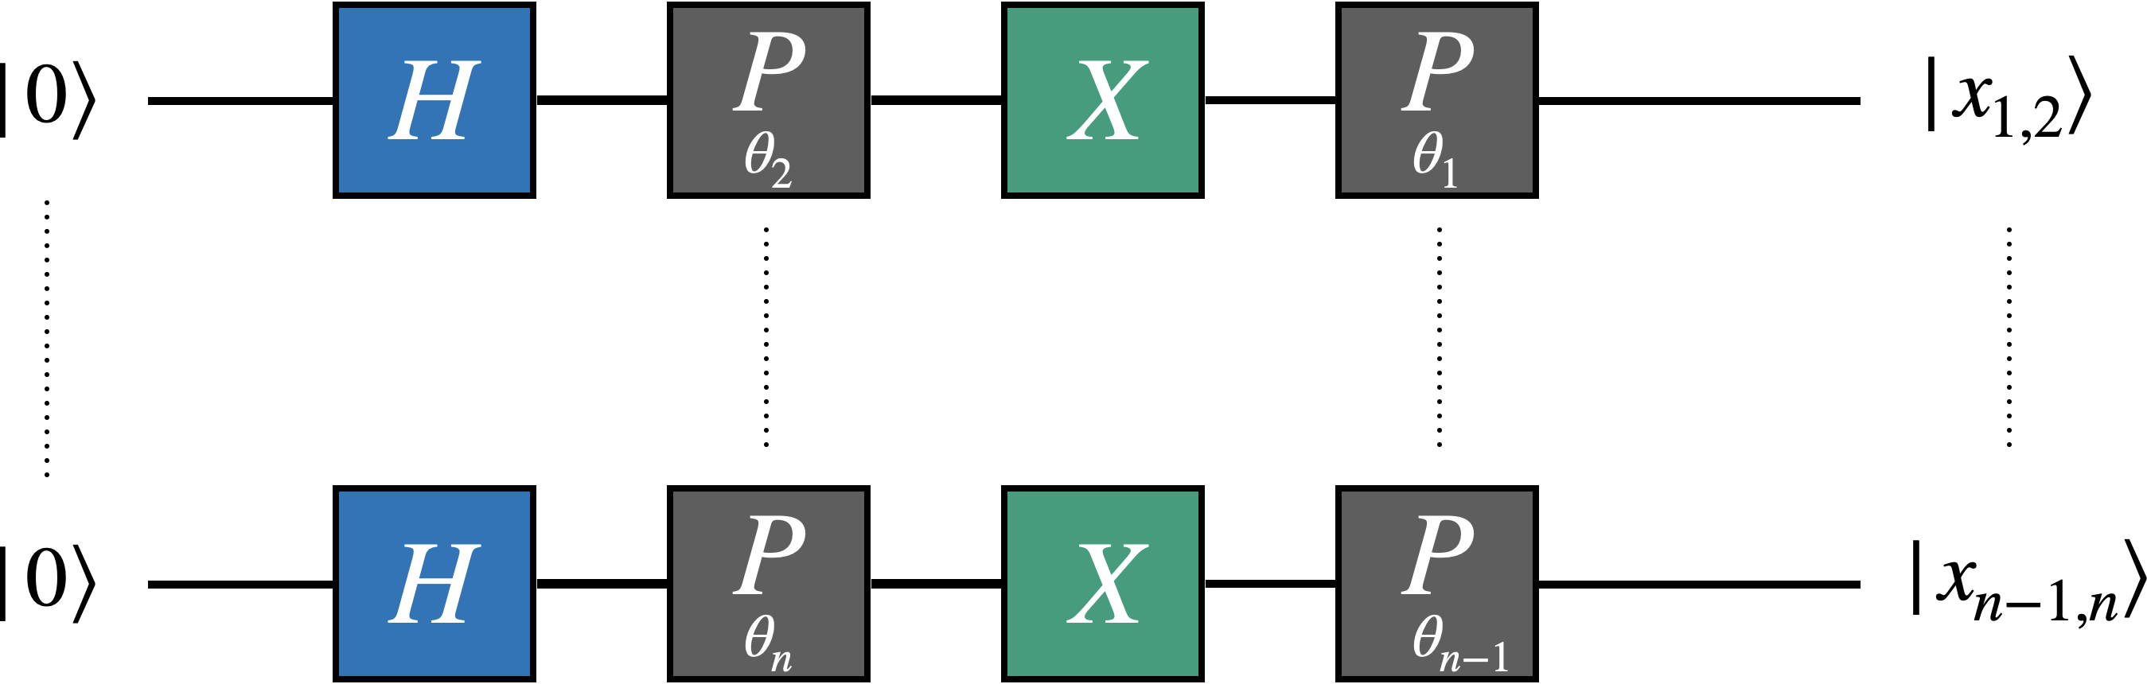
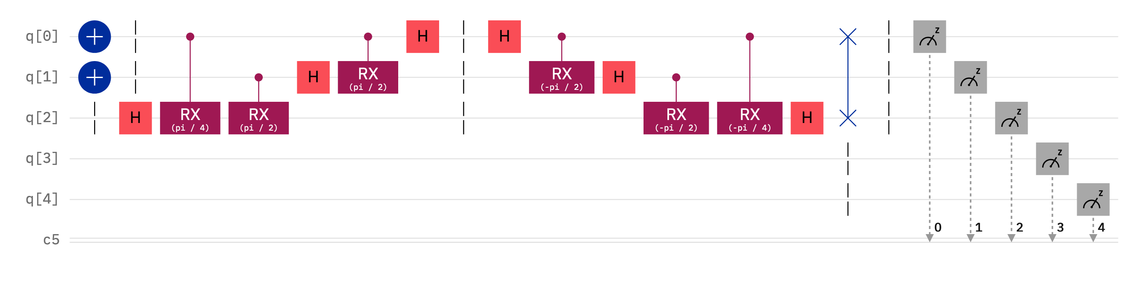

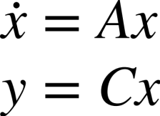
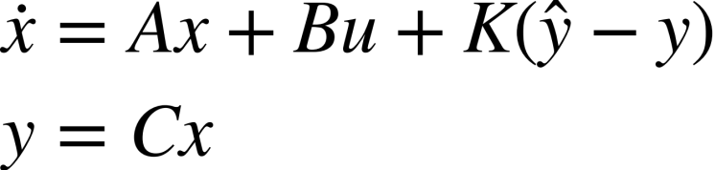
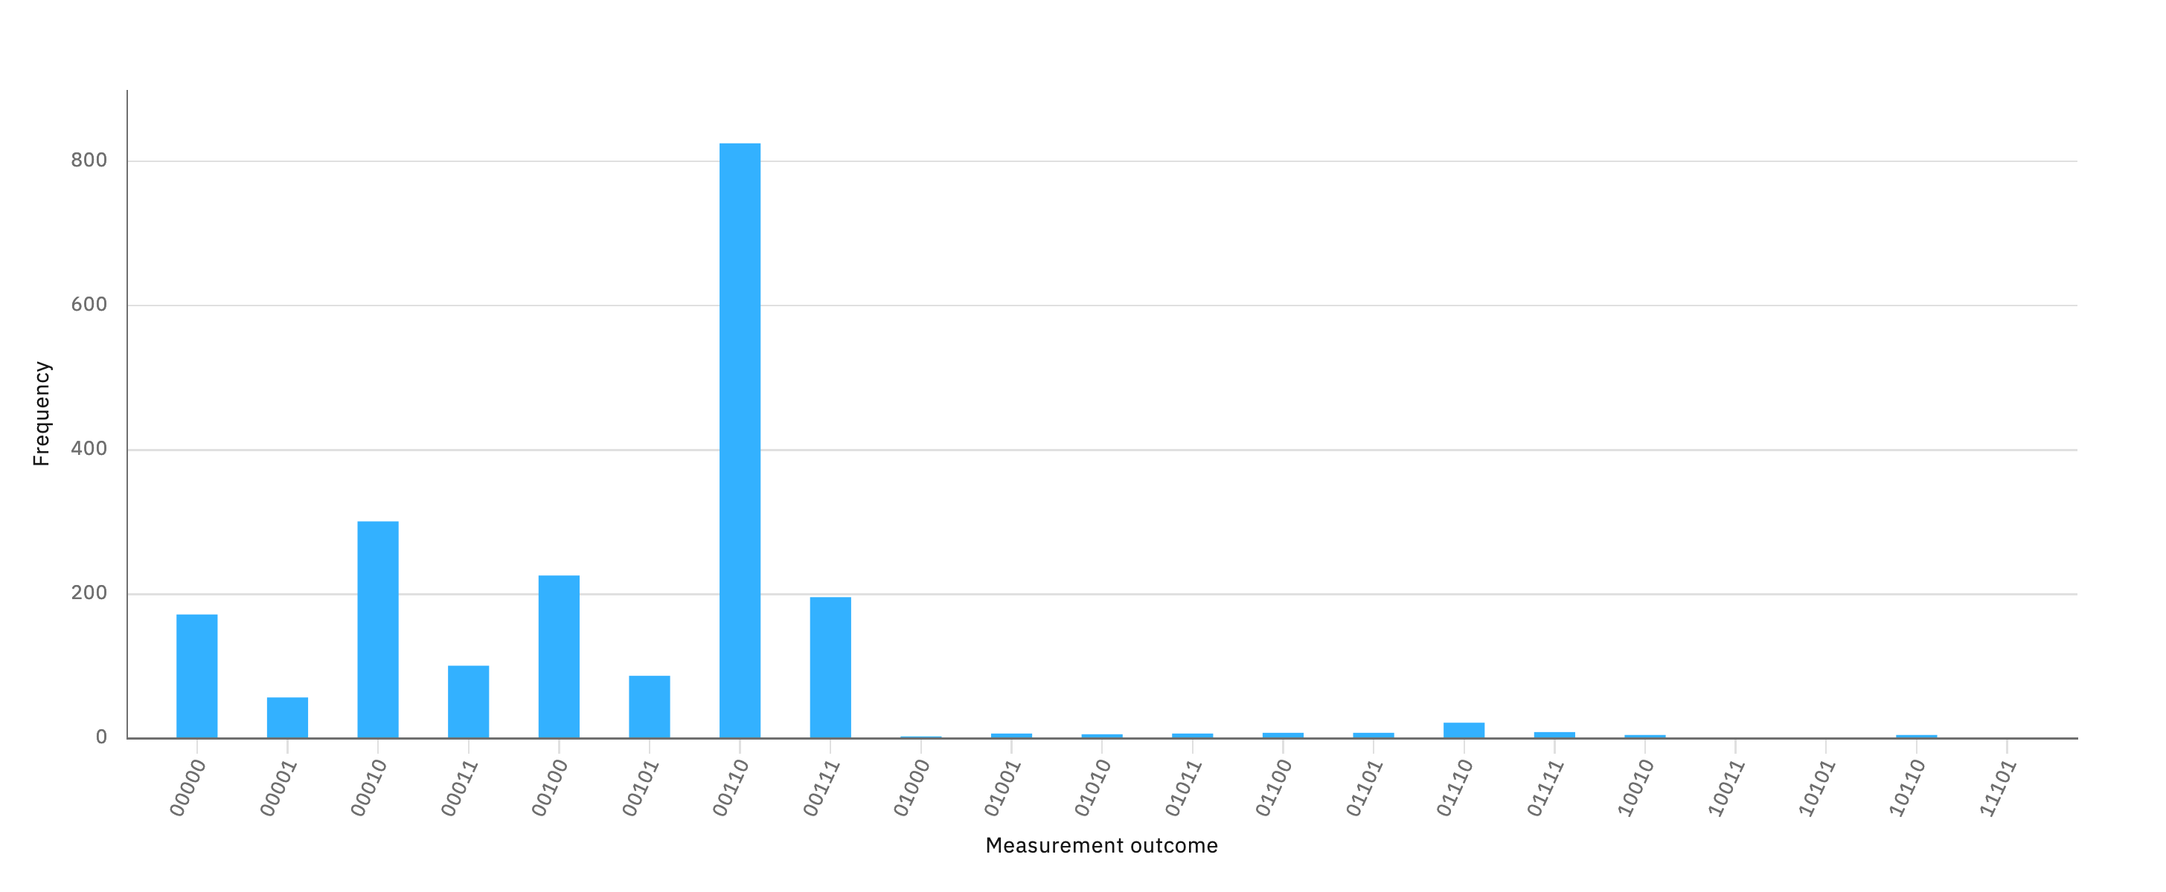
National Aeronautics and Space Administration
Quantum-based Distributed Estimation for Multi-Agent Planetary Exploration
Author: Vinod P. Gehlot, JPL Postdoctoral Fellow (347N)
JPL Collaborators: Saptarshi Bandyopadhyay(347N), Amir Rahmani (GS 347N),
Marco B. Quadrelli (GS 347D), and David S. Bayard (GS 3434)
External Collaborator: Prof. Mark J. Balas (Texas A&M University)
orbiting
agents
The Quantum ODE Solver
communication
network topology
aerial
agents
t-Output Qubits
t-classical bits
surface agents
t-Output Qubits
Goal
Develop the theoretical understanding and quantitative analysis of a quantum-based distributed estimation methodology that will be used for large-state distributed estimation tasks.
n-Ancillary Qubits
t-classical bits
Core Elements of the Quantum ODE Solver
Benefit
Develop the theoretical understanding and quantitative analysis of a quantum-based distributed estimation methodology that will be used for large-state distributed estimation tasks.
1
ODE Solver: State Vector Encoding
This circuits enables the arbitrary encoding of any state vector of a ODE initial condition or state vector.
Key Technical Challenges
Current state-of-the-art Quantum algorithms only address scalar or vector differential equations; Estimation Problems involve vector and matrix differential equations.
Quantum Circuits are fundamentally Unitary, and robotics/spacecraft are not.
2
ODE Solver: Quantum Phase Estimation (QPE) and Quantum Fourier Transform (QFT)
Approach
Develop a series of fundamental quantum algorithms that directly address robotic distributed estimation problems.
QPE and QFT are the core elements ODE solver. QPE and QFT together compute the exponent of the eigenvalues of a system thereby solving a linear ODE. The example below shows the QFT and inverse QFT results of the integer 6 or 0b’110.
Accomplishment: A Path to Solving Ordinary Differential Equations (ODE) using General Quantum Circuits
Key Takeaway
ODEs describe the dynamics for all robotic problems, and solving ODEs using Quantum Circuits will eventually lead to Quantum Algorithms for Distributed Estimation of Multi-Agent Systems
Using 5-Qubits on IBM-Belem Falcon r4T
Processor
National Aeronautics and Space Administration
Jet Propulsion Laboratory
California Institute of Technology
Pasadena, California
www.nasa.gov
Publications:
(In-Review) V.P. Gehlot, M.J. Balas, M.B. Quadrelli, S. Bandyopadhyay, D. S. Bayard, A. Rahmani, “A Path to Solving Robotic Linear Differential Equations Using Quantum Computing,” Journal of Robotic and Autonomous Vehicles, ASME, 2023.
Author Contact Information:
vinod.p.gehlot@jpl.nasa.gov
Poster Number: PRD-T#013
Copyright 2022. All rights reserved.

