Slide 1

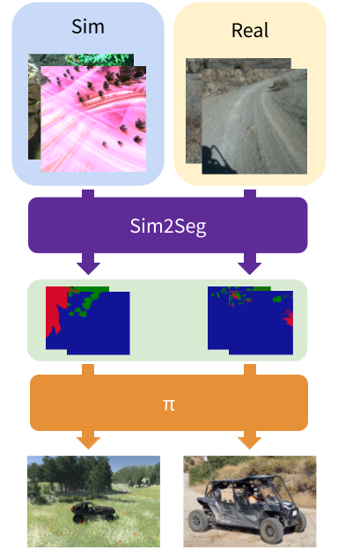

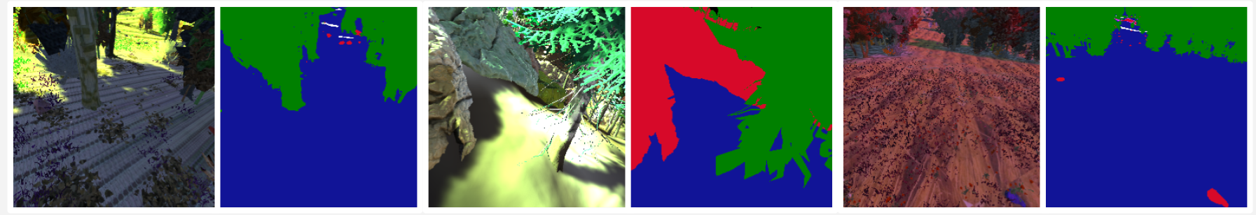
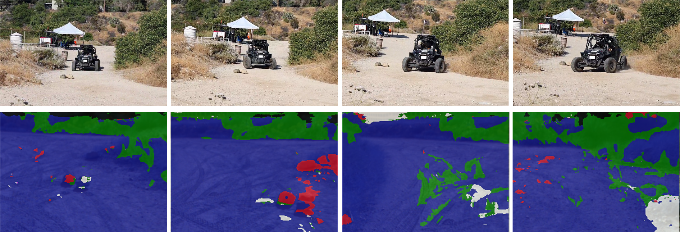
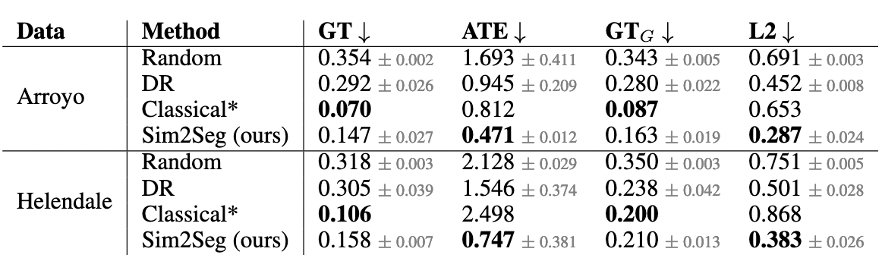
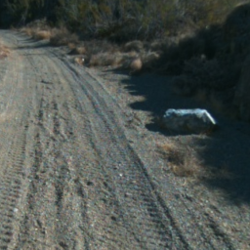
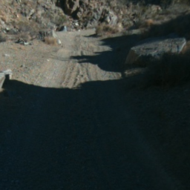
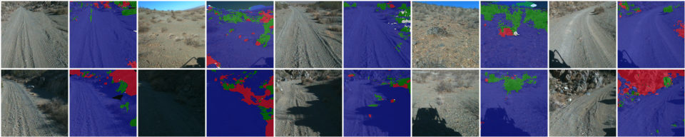
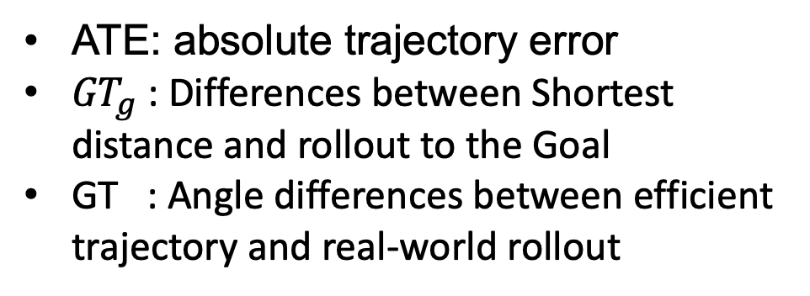
National Aeronautics and Space Administration
End-to-end Off-road Autonomous Driving Without Real Data
Author: Sunggoo Jung, JPL Postdoctoral Fellow (347J)
Stephen James*, Pieter Abbeel*, Ali Agha (347J)
*UC Berkeley
BACKGROUND AND OBJECTIVES
MOTIVATION
Properly designed classical autonomous driving software stacks can indeed perform well in a range of scenarios
However, they do suffer from error propagation through each of the modules, and tend to require a large engineering overhead.
APPROACH
A sim-to-real method designed with the challenges of off-terrain autonomous navigation in mind.
learning to translate randomized simulation images into simulated segmentation and depth maps, subsequently enabling real-world images to also be translated.
Project Page
METHODOLOGY
Translate randomized simulation images into segmentation images
Zero-shot transfer of Realworld inference
Bridging the visual sim-to-real gap
  Texture randomization
  Camera position and intrinsic randomization
  Lighting color and direction randomization to varying scenes
Policy identifies the rock as an obstacle
Creates a trajectory to navigate around it.
CONCLUSION AND FUTURE WORK
ATE: absolute trajectory error
${GT}_{g}$ : Differences between Shortest distance and rollout to the Goal
GT : Angle differences between efficient trajectory and real-world rollout
Still challenging sim-to-real visual gap
Qualitative zero-shot transfer results of our final sim2seg model
With sufficient domain-randomization, we can achieve strong performance in the unseen and quite different real-world environments
These sample observations are taken from our offline evaluation dataset.
Generic trail observation. Note that this is still tricky, as it looks different from our simulator environments.
National Aeronautics and Space Administration
Jet Propulsion Laboratory
California Institute of Technology
Pasadena, California
www.nasa.gov
Publications:
Sim-to-Real via Sim-to-Seg: End-to-end Off-road Autonomous Driving Without Real Data (Accepted to the CoRL 2022)
Author Contact Information:
+1 818 696 6403
Sunggoo.Jung@jpl.nasa.gov
Poster Number: PRD-T#020
Copyright 2022. All rights reserved.

