Slide 1

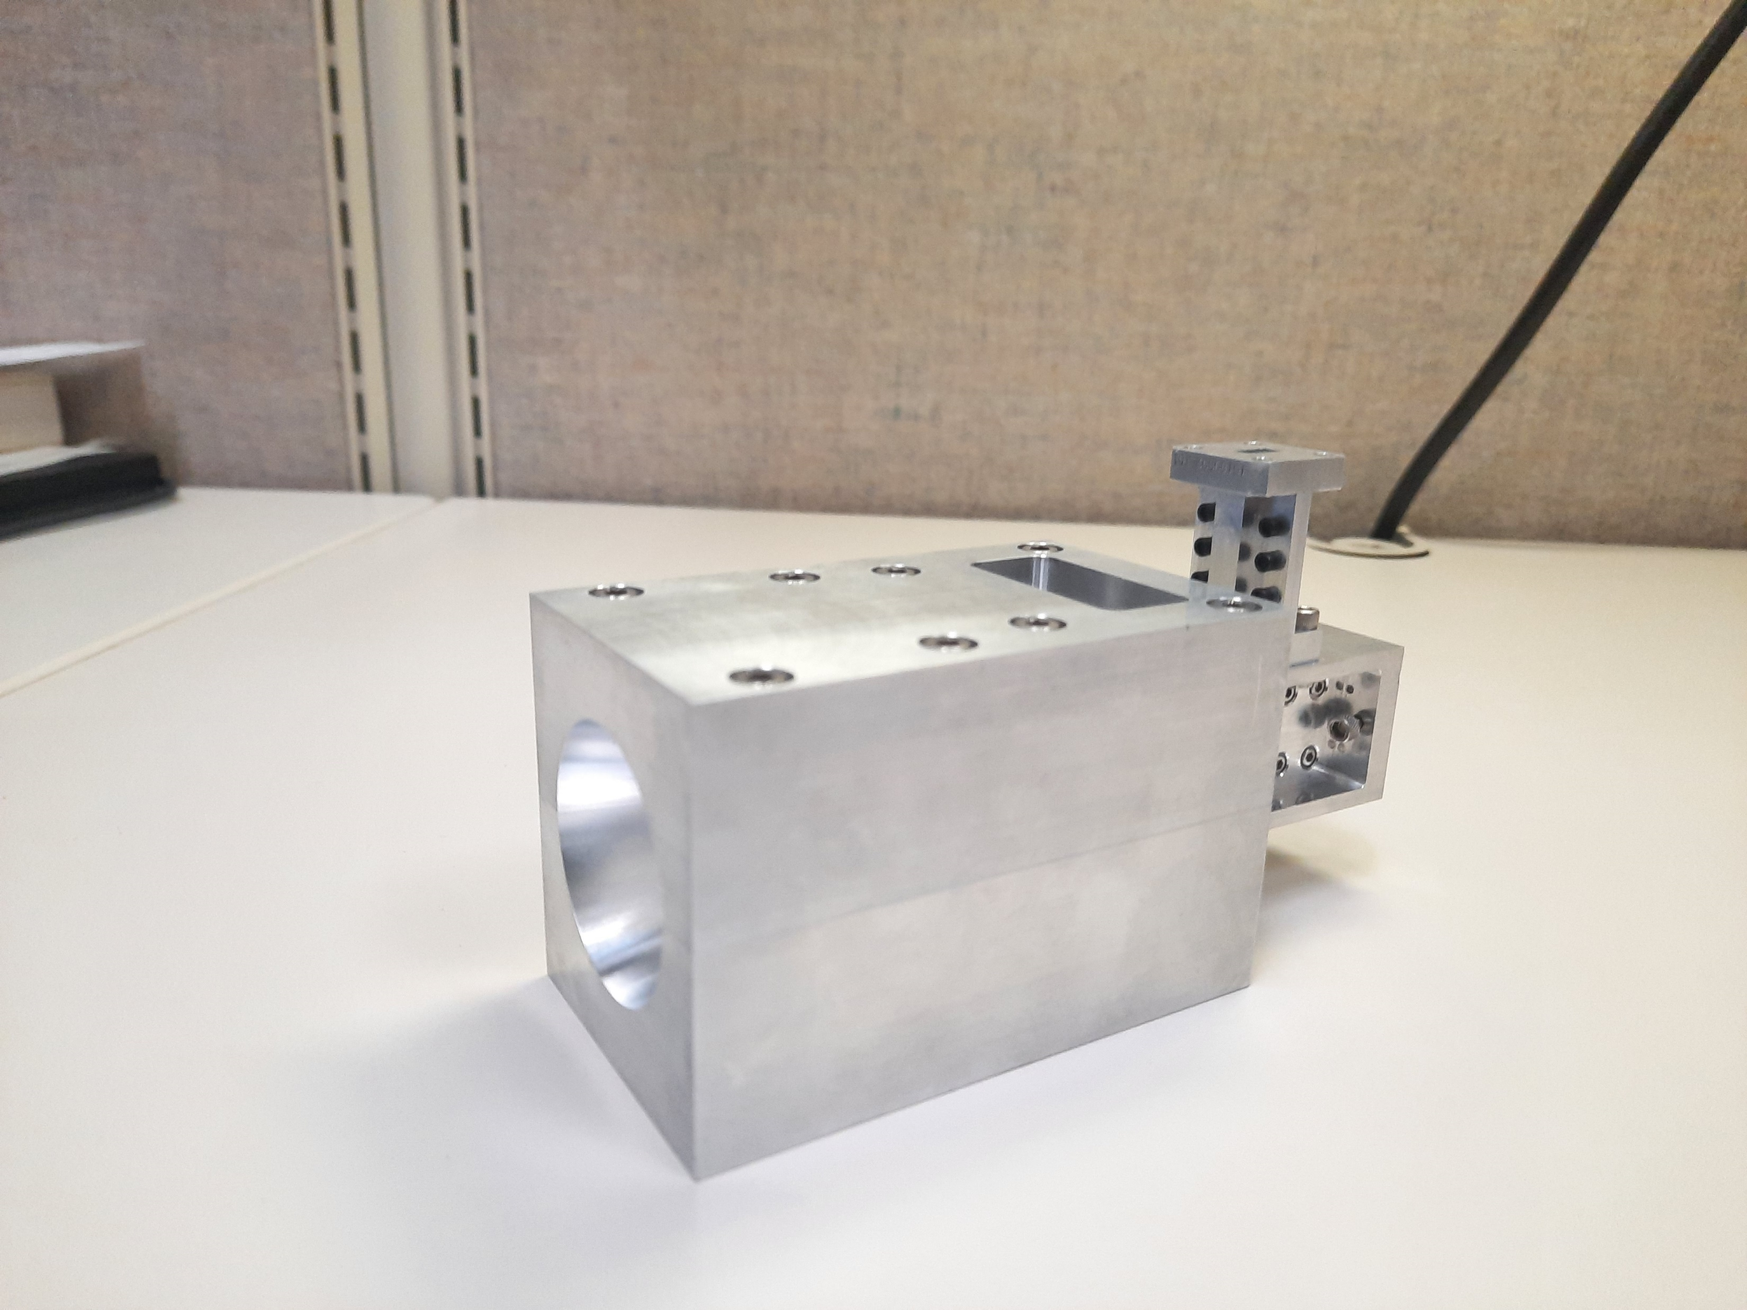
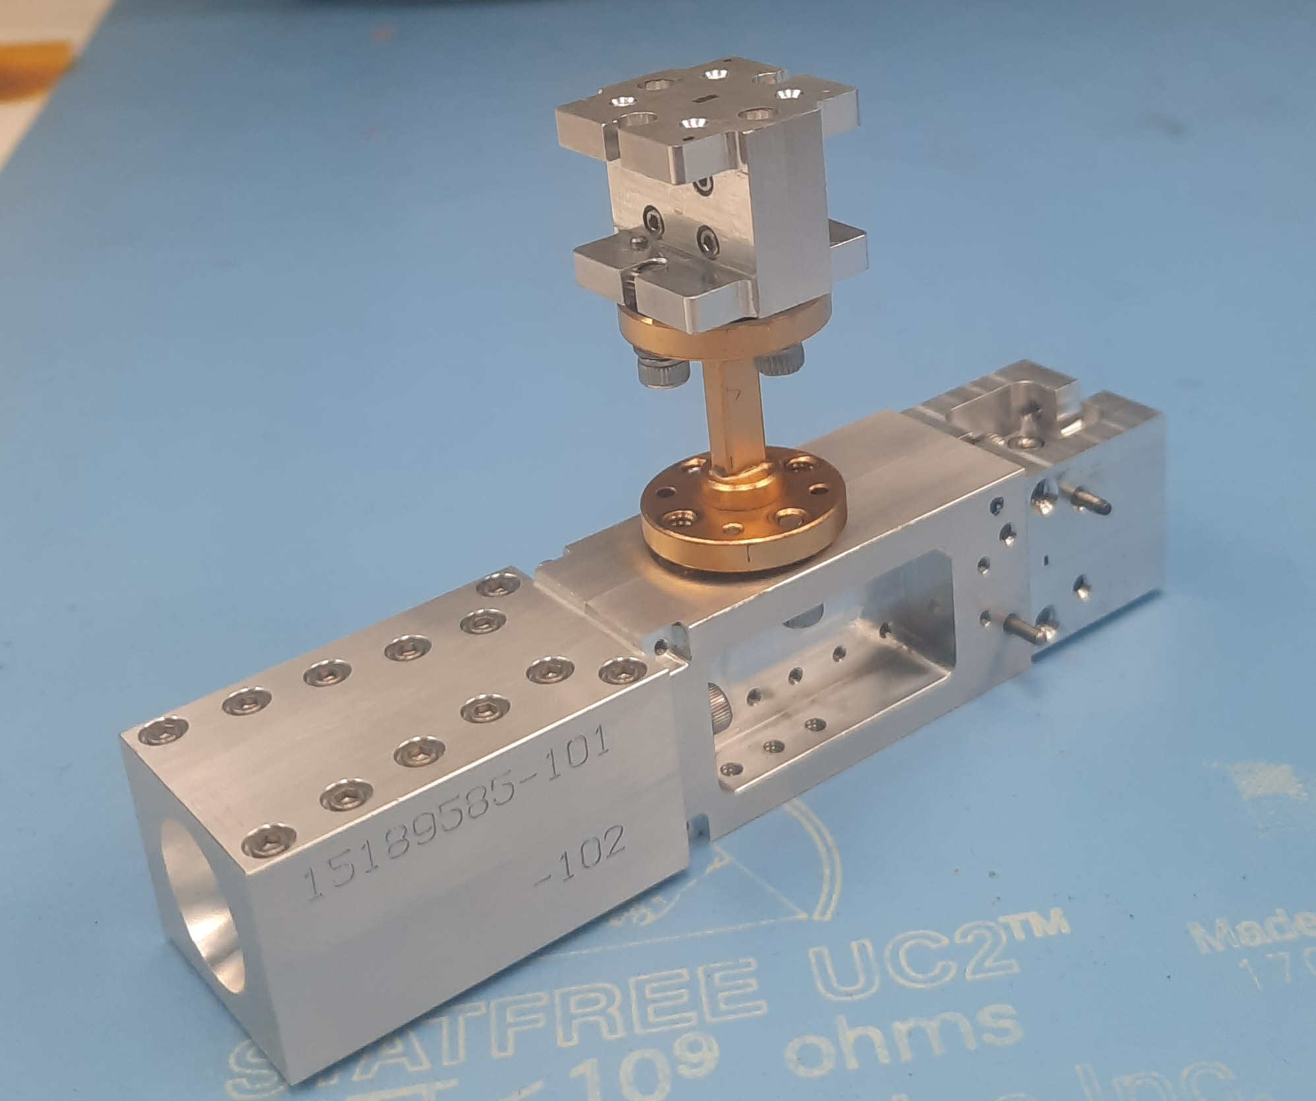
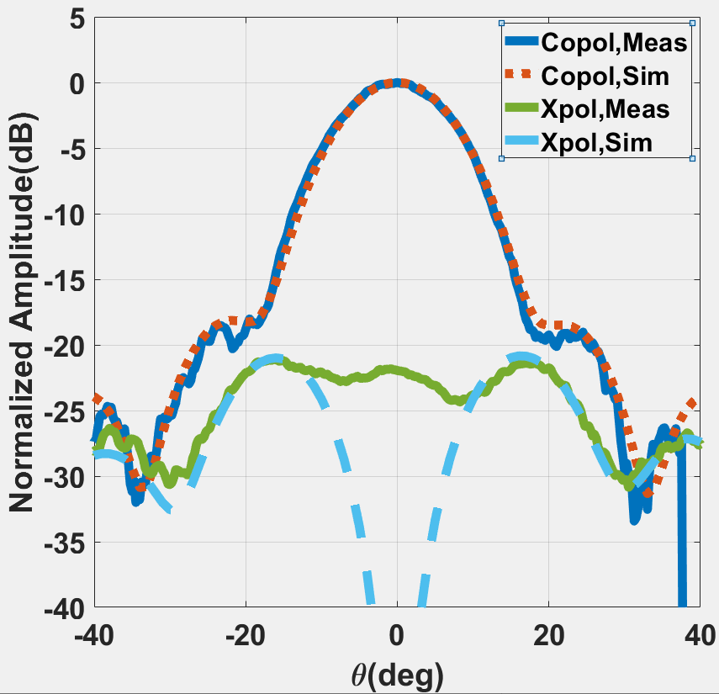
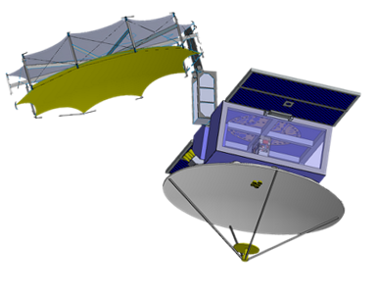
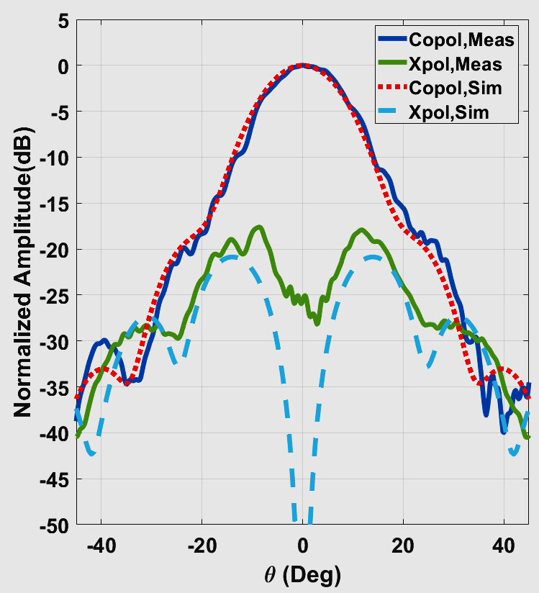
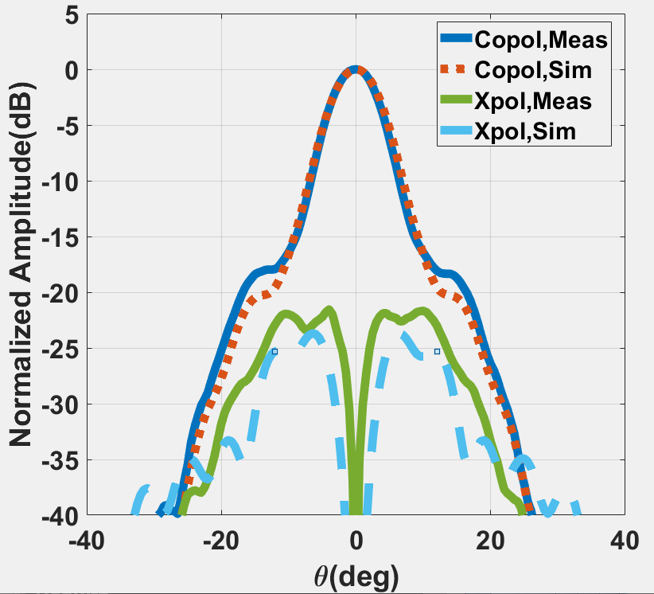
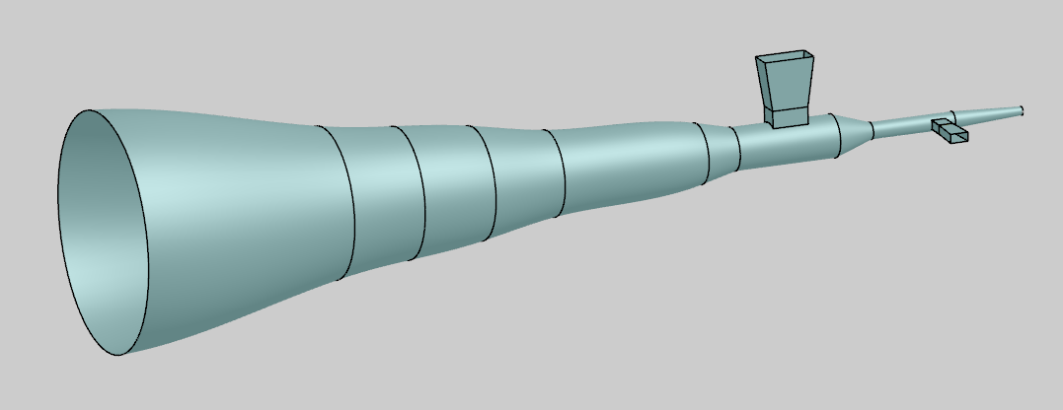
National Aeronautics and Space Administration
Dual Frequency and Multi-Frequency Feed Horns for Atmospheric Radars
Author: Srinivas Nagaraja, JPL Postdoctoral Fellow (334G)
Raquel Rodriguez Monje (334G), Paolo Focardi (337B), Rick Cofield (386G)
Bandpass Filter
  Introduction
Bandpass Filter
  CloudCube is intended to be the first, compact low-cost, pulsed compression radar that combines three frequency channels, Ka-, W- and G-band (35.75/94.92/238 GHz) in a SmallSat form factor.
  Dual frequency and multi-frequency feed horns working at widely separated frequencies are being designed to reduce mass and volume requirements.
Diplexer
OMT
Spline profile
Horn
Diplexer
Spline profile
Horn
Ka/W dual frequency feed horn
Designed and tested at JPL
W/G dual frequency feed horn
Designed and being tested at JPL
35.75 GHz
94.92 GHz
CloudCube Mission Concept
  Methodology
  The dual frequency feed horn consists of:
  Spline profile horn optimized for each frequency of operation.
  A bandpass filter provides isolation between ports.
  Diplexer with orthogonal ports for each frequency.
94.92 GHz
Simulated and Measured Elevation Patterns
W/G-Dual Frequency Horn
  Conclusion
Ka-band port
G-band
port
  The presented approach provides a novel and compact solution that can be used in upcoming multifrequency radars’ feed design, to reduce substantially the total mass and volume of the instrument.
W-band
port
Simulated and Measured Elevation Patterns
Ka/W-Dual Frequency Horn
Spline profile Horn
Ka/W/G band three frequency horn
Design in progress
National Aeronautics and Space Administration
Jet Propulsion Laboratory
California Institute of Technology
Pasadena, California
www.nasa.gov
Publications: 1. S. Nagaraja, R. Monje, R. Cofield, "Dual Frequency Feed Horn Design for a Compact Cloud and Precipitation Radar Operating at Ka- and W-band,“ 2021 International Conference on Electromagnetics in Advanced Applications. (ICEAA IEEE-APWC 2021 Best Paper Award)
2. S. P. M. Nagaraja, R. R. Monje, R. Cofield and P. Focardi, "Design of 94/238 GHz Dual-Frequency Feed Horn for Atmospheric Radar Applications," 2021 IEEE Conference on Antenna Measurements & Applications (CAMA), 2021.
3. S. Nagaraja, P. Focardi, R. R. Monje and R. Cofield, "Compact Dual Band Feed System for a Multifrequency Atmospheric Radar," in IEEE Open Journal of Antennas and Propagation, vol. 3, pp. 762-767, 2022.
Author Contact Information: snagaraj@jpl.nasa.gov
Poster Number: PRD-T#002
Copyright 2022. All rights reserved.

