Slide 1
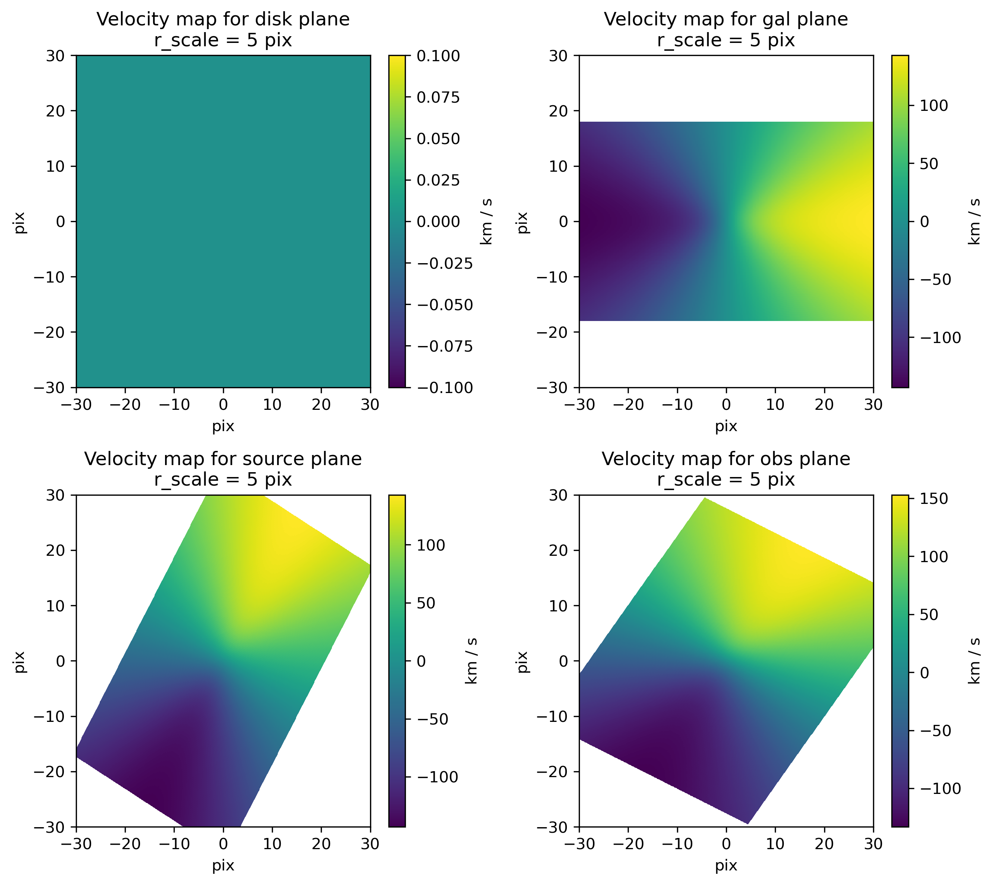
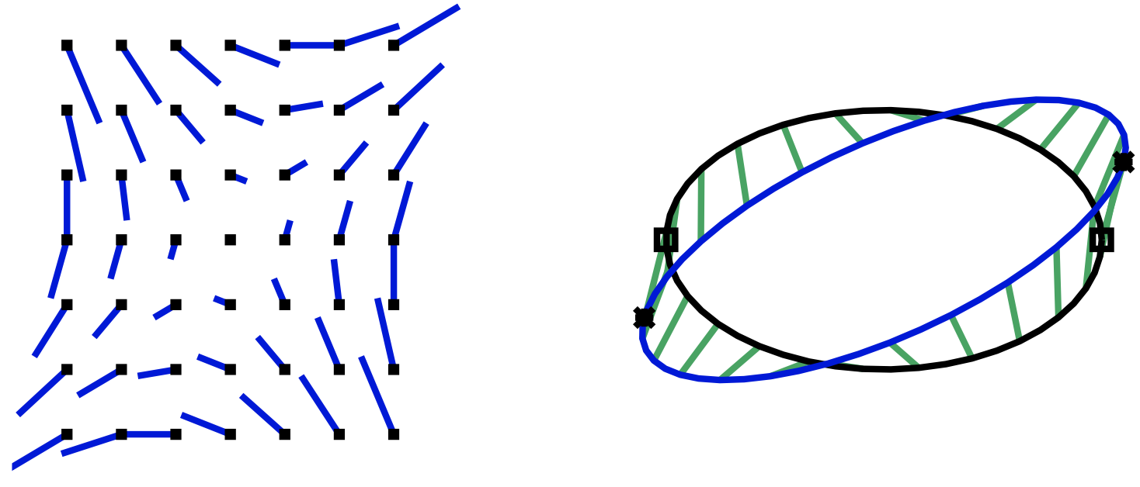
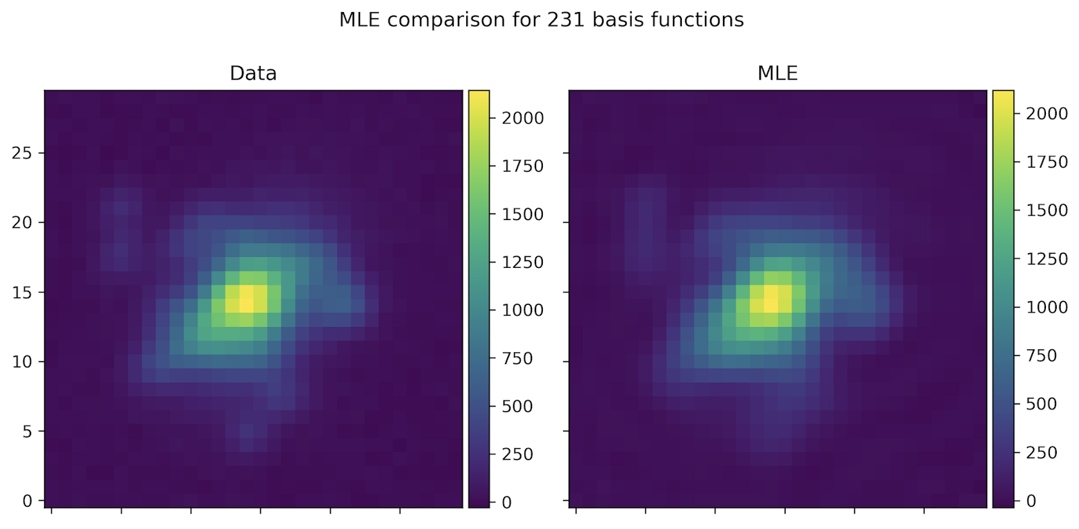
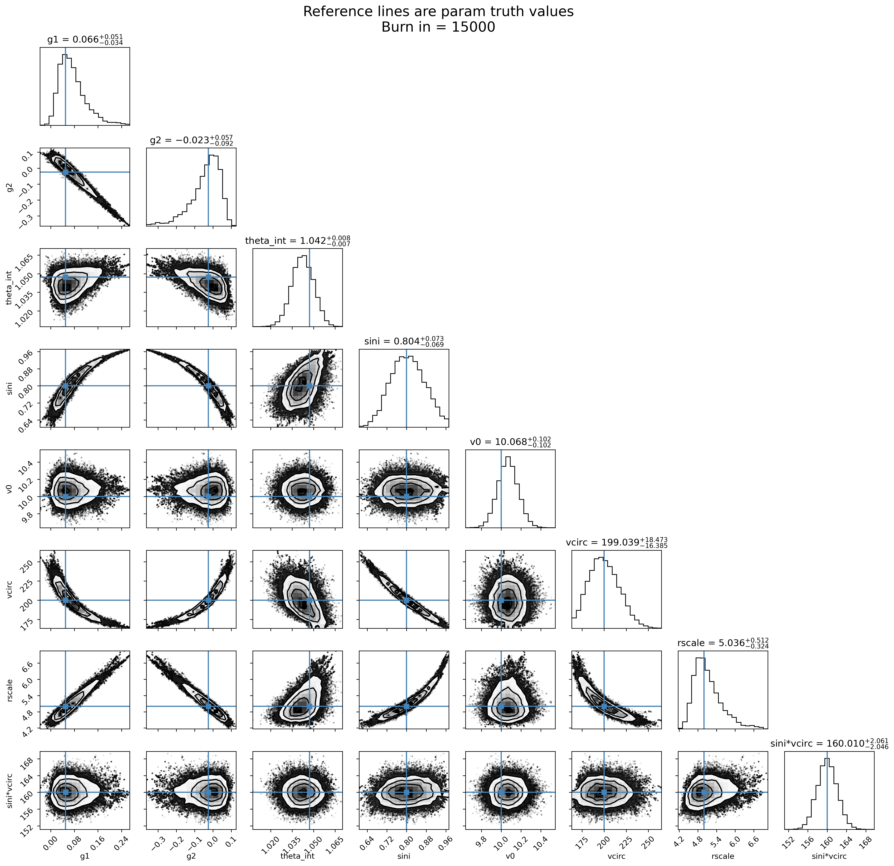
Kinematic Lensing: Cosmic Shear from Individual Galaxies
Author: Spencer Everett (3268)
Collaborators: Eric Huff (3268), Elisabeth Krause (University of Arizona; UA), Tim Eifler (UA), Pranjal Rajendra Singh (UA), Hung-Jin Huang (UA), Jiachuan Xu (UA), Maggie Smith (UA), Yu-Hsiu Huang (UA), Xiao Fang (UA)
Category: Astrophysics and Space Science
Motivation
Weak gravitational lensing (WL) is one of the most powerful tools for constraining the growth of cosmic structures, the evolution of dark energy, and modified gravity.
Problem: The distortion in galaxy shapes from cosmic shear is typically ~0.1%; the measurement is dominated by the intrinsic shape noise
Current & planned surveys overcome this by measuring ~10⁸ to 10⁹ galaxies!
Stage IV experiments will require shear measurement calibration < 0.1%
Solution: Use the difference between a galaxy’s measured velocity field and the one inferred from it’s observed, lensed image to measure the shear of individual galaxies:
Requires spatially-resolved spectroscopy & estimate of the inclination of a disk galaxy
Methodology
We select rotationally-supported disk galaxies that may be well approximated as infinitely-thin disks, along with a simple 2D velocity field model:
Use the Tully-Fisher relation [2] to set a prior on vmax and thus break the degeneracy between it and
The velocity field causes spatially-varying doppler shifts across the image detectable with either 1D slit spectrum or grism data on major / minor axes [3,4], or ideally 2D spectrum from integral field unit (IFU) data
Account for more realistic galaxy intensity profiles by using combination of basis functions (such as Shapelets [5], Sersiclets [6], etc.) that have been transformed in the same way as the velocity field:
systematic
velocity
asymptotic
velocity
scale
radius
galaxy
inclination
angle from
kinematic axis
Face-on,
galaxy
inclination
intrinsic
orientation
shear (𝛾₊, 𝛾_{x})
(a) The distortion field due to a shear of 𝛾⨉ = 0.2. Longer lines correspond to larger point-wise shear
(b) The mapping of the original galaxy shape (black) to the sheared shape (blue). The extremal velocities on the unsheared ellipse lie on the major axis but are moved off-axis by WL. Figure from [1]
(a)
(b)
MLE fit
Fast, flexible intensity profile modeling without cost of marginalizing directly in sampler
Using transformed basis functions:
  Efficiently represent profile with less functions
  Up-weights profiles that are fluctuations on top of inclined, disk-like galaxies
Results
Project is still in the the early stages. However, we have demonstrated that we can recover unbiased estimates of the shear from simulated sources for correctly modeled galaxy continuum and PSF:
Final methodology will be validated on realistic mock observations using simulated IllustrisTNG galaxies [7]
Will measure shear and resulting shape noise as a function of galaxy properties on archival KROSS [8] and MUSE [9] data, along with recently taken IFU observations from the Cosmic Web Imager [10] at Palomar.
Stacked observations
MLE using transformed Shapelets
Truth: 0.05
Truth: -0.025
Truth: 0.8
Truth: 200 km/s
Bias = ?.?𝜎
Summary & Outlook
Kinematic lensing is a new tool to make novel, high-S2N WL measurements able to answer important questions in cosmology, galaxy evolution, the galaxy-halo connection, and more
JPL is uniquely situated to be a leader in kinematic lensing measurements
  IFU observations from Palomar + grism spectra from Roman Space Telescope
  Design of new, dedicated missions that are competitive with Stage IV surveys at a fraction of the cost
0.0
0.24
-0.3
0.1
0.64
0.96
175
250
Publications:
[1] Huff, E. et al., 2013, arxiv:1311.1489; [2] Tully, R.B. Fisher, J.R., 1977, A&A, 54, 661; [3] Pranjal, R. S. et al., 2022, arxiv2209.11811; [4] Xu, J. et al., 2022, arXiv:2201.00739; [5] Refregier, A. et al., 2003, MNRAS, 338, 35; [6] Ngan, W. et al., 2009, MNRAS, 396, 1211; [7] Pillepich, A., et al., 2018, MNRAS, 473, 4077; [8] Harrision, C. M., 2017, MNRAS, 467, 1965; [9] Bacon, R. et al., 2006, SPIE 6265, [10] Rahman, S. et al., 2006, SPIE 6269; [11] Everett, S. et al., 2022 (in prep)
Author Contact Information:
spencer.w.everett@jpl.nasa.gov, +1 (626)-318-8354
PRD-A#012
© 2022. All rights reserved.

