Slide 1

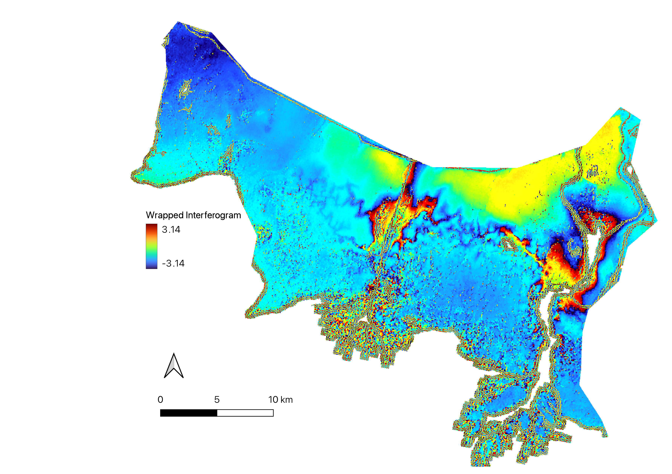
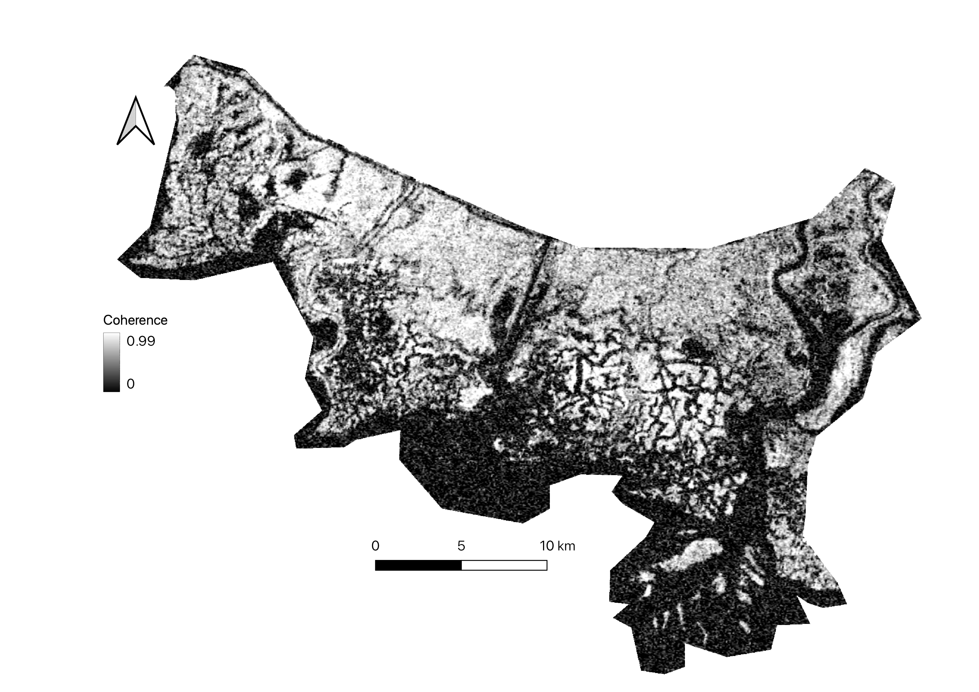
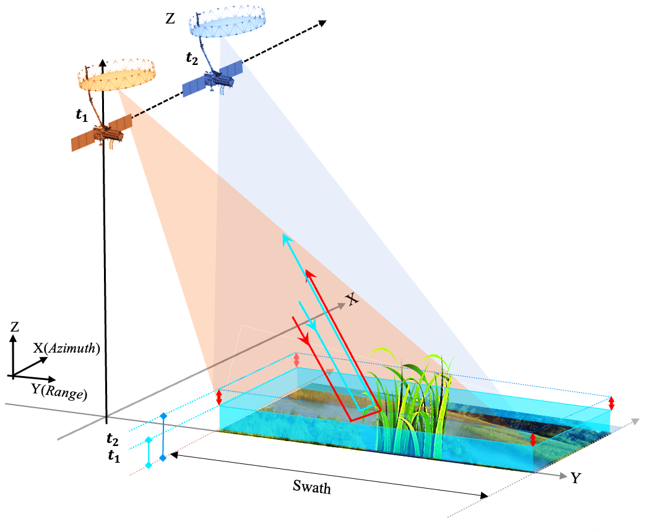
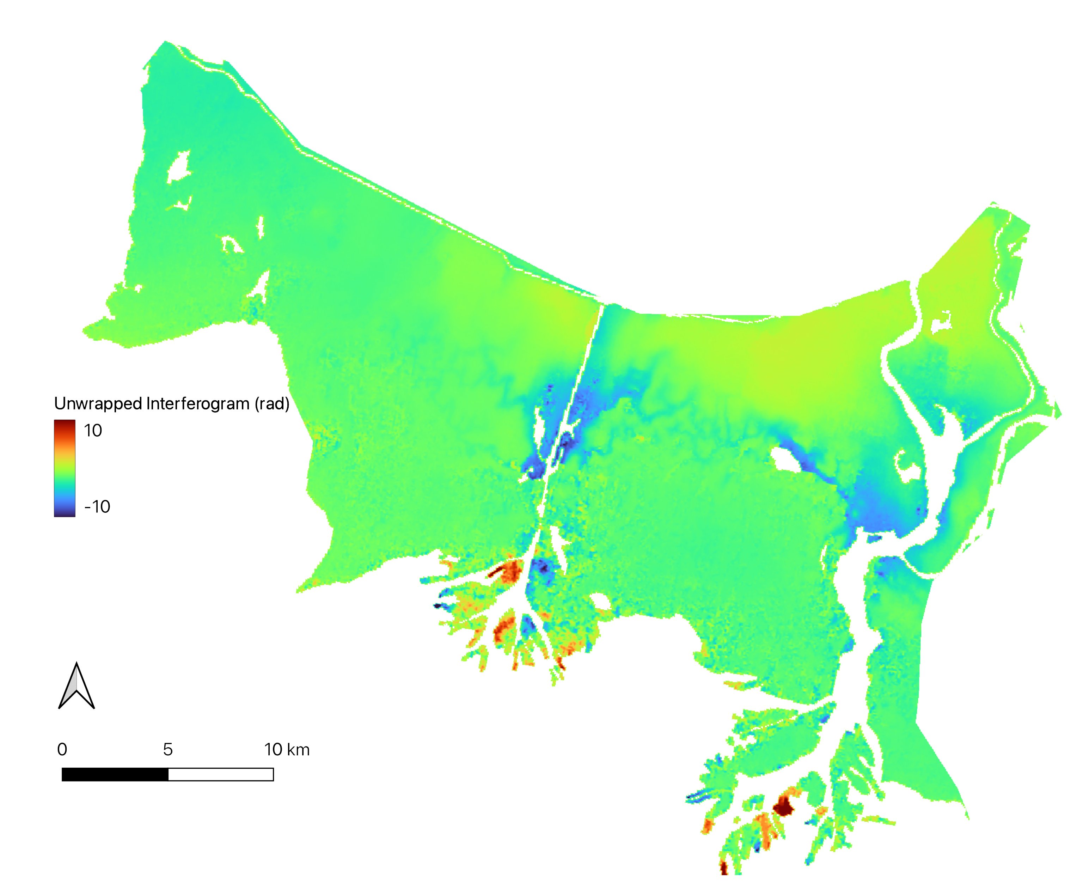
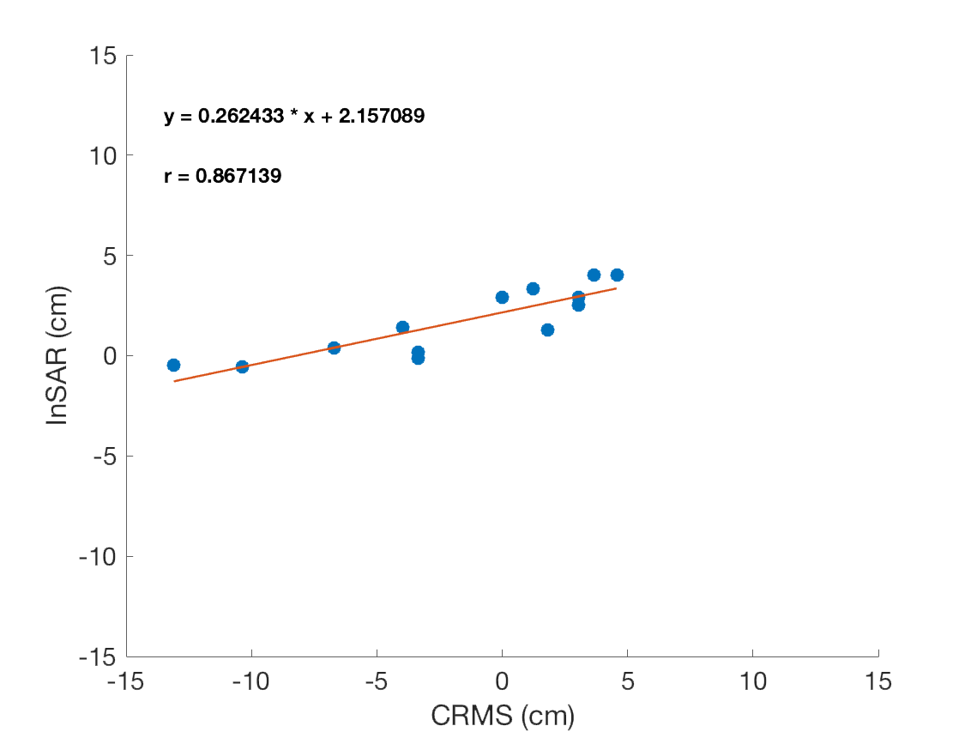
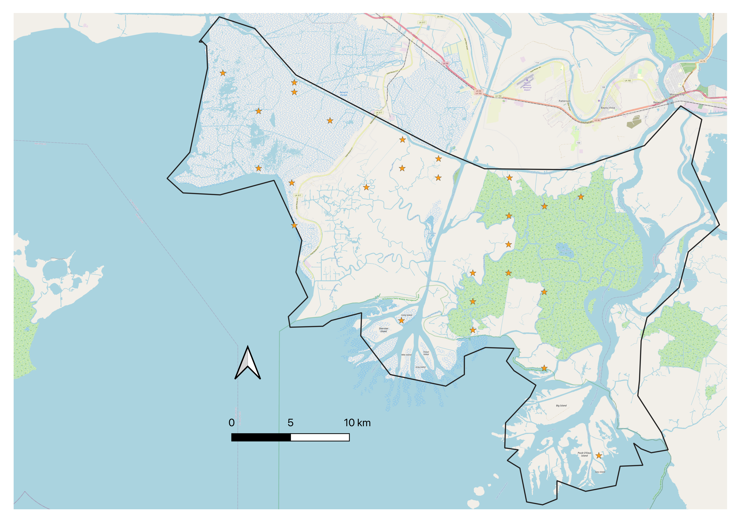
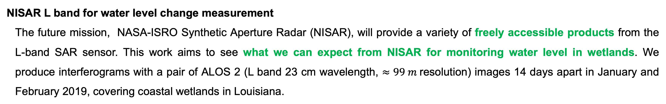
National Aeronautics and Space Administration
Monitoring Water Level Change In Wetlands With NISAR
Author: Saoussen Belhadj aissa, JPL Postdoctoral Fellow 334F
Alexandra Christensen JPL Postdoctoral Fellow 334F
Marc Simard Principal Senior Research Scientist 334F
InSAR for Wetlands Hydrological Monitoring
Wetlands are extremely important habitats of rich biodiversity for many species of plants. They deliver an important range of services such as: water supply, water purification and carbon sequestration. Therefore, wetland hydrological monitoring is increasingly important. Using advanced remote sensing techniques such as Synthetic Aperture Radar Interferometry (InSAR ) , we are able to characterize spatial and temporal water level changes in this habitat.
NISAR L band for water level change measurement
The future mission, NASA-ISRO Synthetic Aperture Radar (NISAR), will provide a variety of freely accessible products from the L-band SAR sensor. This work aims to see what we can expect from NISAR for monitoring water level in wetlands. We produce interferograms with a pair of ALOS 2 (L band 23 cm wavelength, $≈99 m$resolution) images 14 days apart in January and February 2019, covering coastal wetlands in Louisiana.
Fig 1: InSAR Geometry
Fig 2: Differential phase
Fig 3: Coherence
LOS
Fig 4: Unwrapped phase
Fig 6: InSAR derived water level change vs water gauges
Fig 5: Coastwide Reference Monitoring System (CRMS ) Stations
Takeaway:
Applying InSAR in wetland environments is challenging. Due to vegetation, it is hard to have good coherence. HOWEVER, depending on the season and type of wetland it is possible to retrieve reliable water level change with L-band InSAR.
National Aeronautics and Space Administration
Jet Propulsion Laboratory
California Institute of Technology
Pasadena, California
www.nasa.gov
Acknowledgment:
Coastal Protection and Restoration Authority (CPRA) of Louisiana. 2022. Coastwide Reference Monitoring System. Coastal Information Management System (CIMS) database. https://cims.coastal.louisiana.gov. Accessed 01 12 2021.
Author Contact Information:
(818) 354-2564
saoussen.belhadj.aissa@jpl.nasa.gov
Poster Number: PRD-EB#016
Copyright 2022. All rights reserved.

