Slide 1

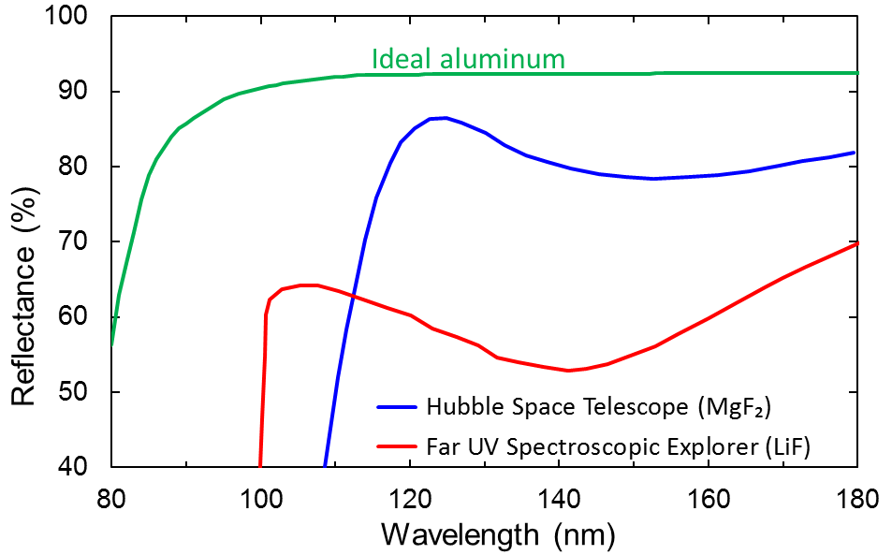
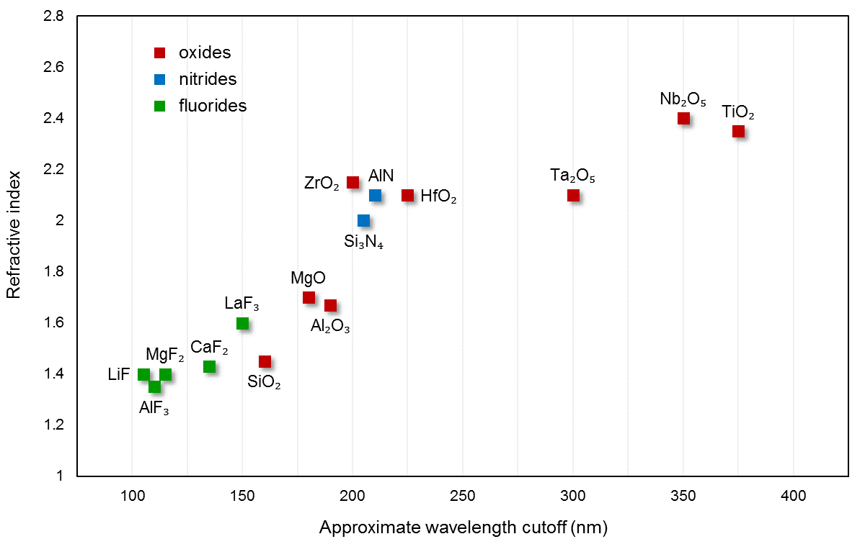
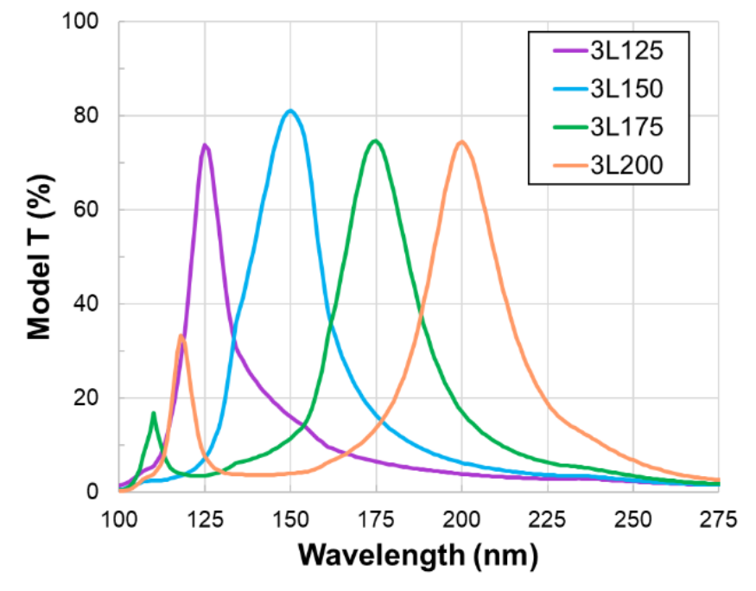
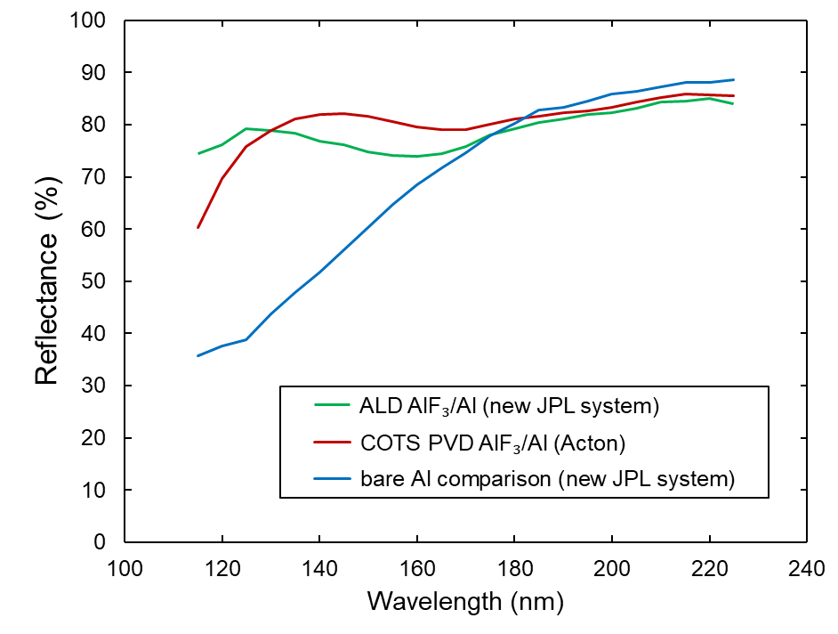
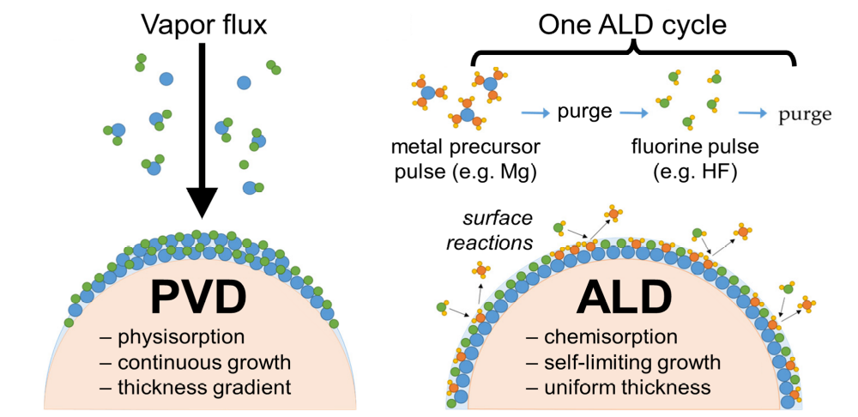
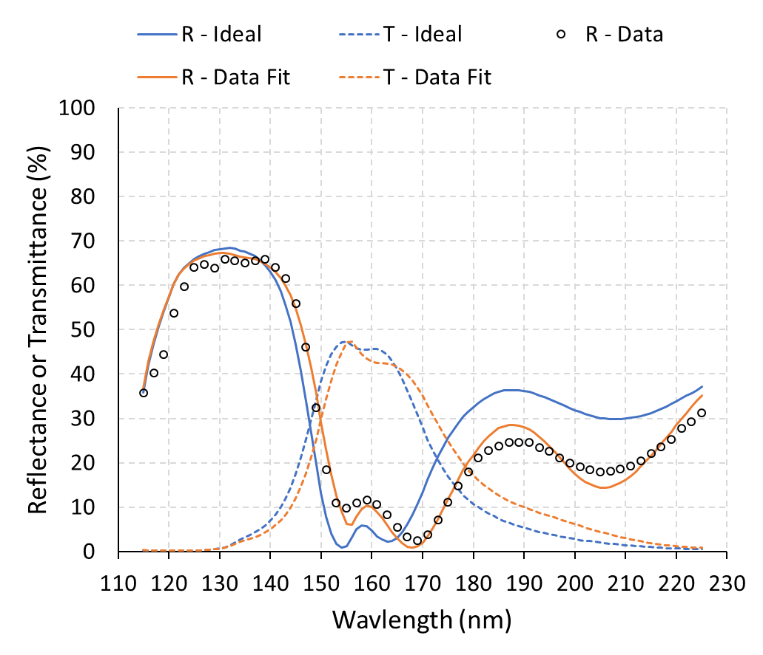
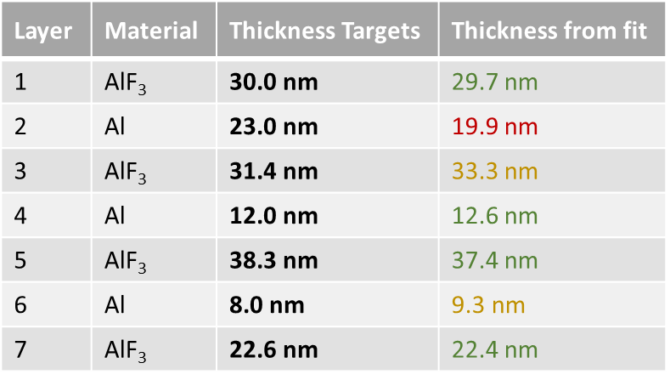
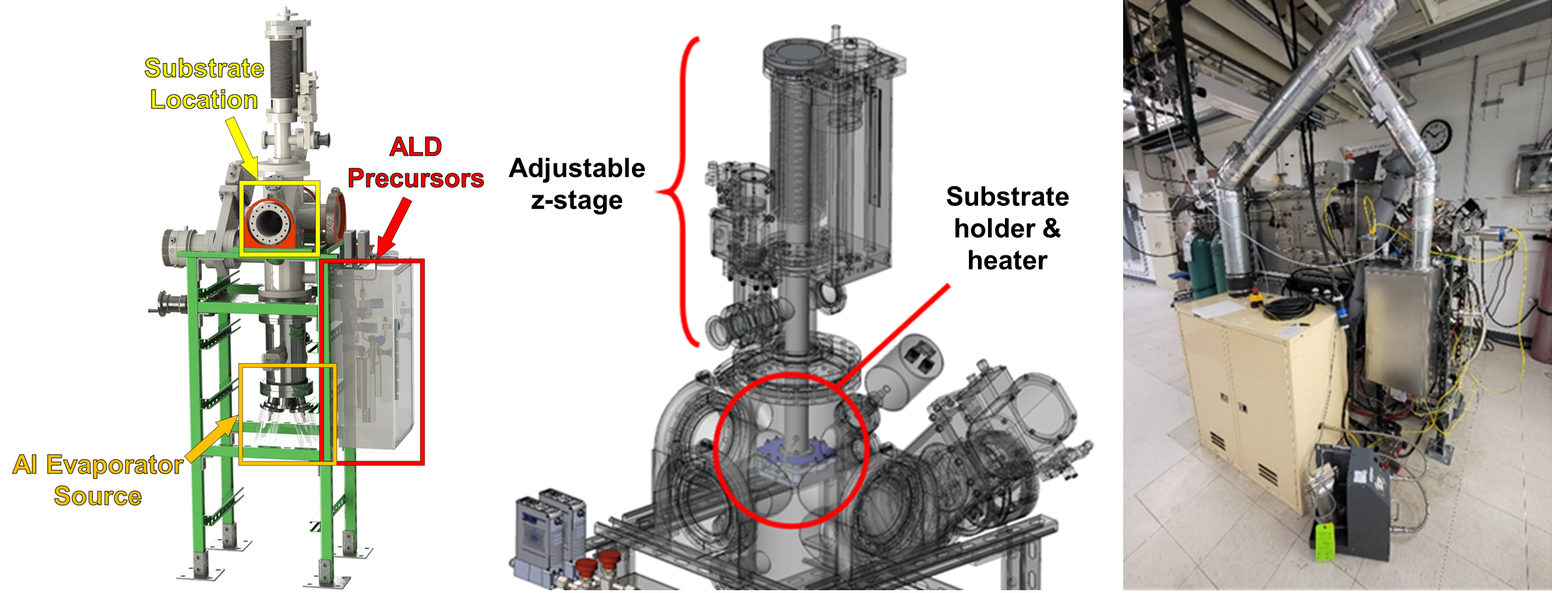
National Aeronautics and Space Administration
Thermal Evaporation Enhanced Atomic Layer Deposition for Far Ultraviolet Mirror Coatings and Bandpass Filters
Author: Robin E. Rodríguez, JPL Postdoctoral Fellow (389E)
Co-Authors: John Hennessy (389E), April D. Jewell (389E), Shouleh Nikzad (3200), Michael Hoenk (389E)
Protective Coatings for UV Aluminum Mirrors
Motivation and Challenges
Al is offers broad ultraviolet/visible/near-infrared spectral reflectivity
However, Al is very reactive and susceptible to oxidation, resulting in reduced ultraviolet (UV) reflectance due to optical absorption in the native oxide layer
Suppressing oxidation and protecting the Al surface is key to maintaining high UV reflectance
Thin, dense fluoride coatings offer protection against oxidation and are optically transparent in the UV, which could greatly improve Al mirror performance at shorter wavelengths
Metal-Dielectric Bandpass Filters for FUV Si Devices
Ultraviolet (UV) imaging and spectroscopy performance is limited by the strong out-of-bound (e.g. visible) background
Therefore, it is necessary to suppress the longer out-of-band signal to isolate and maintain high sensitivity in the far ultraviolet (FUV)
Metal-dielectric filters (MDFs) are multi-layered structures, composed of reflective metal layers separated by transparent dielectric layers, that resonantly maximize transmission of in-band light while strongly reflecting out-of-band light
Optimizing transmission/rejection performance and peak transmission wavelength requires precise control of thickness and composition of the individual layers
AlF₃ (transparent spacer)
Aluminum
7-layer metal-dielectric
FUV bandpass filter
AlF₃ (transparent spacer)
Aluminum
AlF₃ (transparent spacer)
Aluminum
AlF₃ (transparent spacer)
Substrate (Detector)
Model transmission of 3-layer MDFs with varying dielectric layer (AlF₃) thickness
Adapted from Keski-Kuha, R.A.M., Larruquert, J.I., Gum, J.S. and Fleetwood, C.M., 1999. In Ultraviolet-Optical Space Astronomy Beyond HST (Vol. 164, p. 406).
THRUST 2: FUV BANDPASS FILTERS
Optimize metal-dielectric filters that maximize FUV transmission within the band of 150 nm – 170 nm while strongly rejecting out-of-band light
THRUST 1: FUV MIRROR COATINGS
Perfect the process to produce mirrors (with protective wide-bandpass (100–2500 nm), fluoride-based, mirror coatings) emphasizing high reflectance in the far ultraviolet (FUV)
New Processes
Jewell et al, Proc. SPIE 12181
Results: FUV Mirror Coatings
Ultra-Thin Fluoride coatings by Atomic Layer Deposition
First combination of evaporated Al and ALD fluorides in the same vacuum chamber
Thermal evaporation of Al ~80-100 nm
ALD coating: 250 cycles of protective AlF₃ (~20-25 nm)
Physical Vapor Deposition (PVD)
Missions have historically used PVD to coat Al mirrors with fluorides
However, this process requires relatively thick coatings to ensure pinhole-free films
Thickness gradients are likely to be present when coating shaped optics such as curved mirrors or diffraction gratings
Atomic Layer Deposition (ALD)
The self-limiting behavior of the precursors ensure high-quality, ultra-thin, pinhole free coatings with sub-nanometer control
High conformality and low temperature processing are ideal for coating shaped optics such as curved mirrors and diffraction gratings
Initial tests are promising, showing comparable results to commercial off-the-shelf (COTS) mirrors
Further optimization of thermal evaporation and ALD processes could enable the next generation of UV mirrors
Adapted from Pfeiffer, K., Schulz, U., Tünnermann, A. and Szeghalmi, A., 2017. Coatings, 7(8), 118. https://doi.org/10.3390/coatings7080118
Results: FUV Metal-Dielectric Bandpass Filters for Astrophysics Missions (SPARCS & UVEX)
Thermal Evaporation Enhanced Atomic Layer Deposition (TE-ALD)
SPARCS CubeSat FUV Filter:
  Ideal peak transmission: 47% at 155 nm
  Ideal FWHM: 25 nm
  Attained peak transmission: 47% at 156 nm
  Attained FWHM: 27 nm
New in-lab built custom equipment combines thermal evaporation with ALD in the same reactor
Thermal evaporation of Al:
  Al evaporated by heating tungsten filament
  Operating pressure: 7 × 10⁻⁸ Torr – 20 × 10⁻⁸ Torr
  Operating Temperature: Room temperature
Atomic Layer Deposition of AlF₃:
  Precursors: trimethyl aluminum (TMA) and HF-pyridine
  Carrier gas and purging: Argon gas (flowrate: 100 sccm)
  Base pressure: ~0.2 Torr
  Substrate Temperature: 100 °C
TECHNOLOGICAL INNOVATION:
Reflective Al and fluorides can be deposited in the same system without breaking vacuum, protecting the Al from oxidation.
Note: Results shown were done using separate systems
This study was an important validation of the 7-layer MDF using thermal evaporation and ALD processes
Yet, the oxide on the Al can limit overall performance, particularly for shorter wavelength MDFs
Future work has the potential to leverage the benefits of TE-ALD by minimizing oxidation of the Al layer
Potential Impact of Current and Future Work
ALD is a promising approach to deposit ultra-thin metal fluoride coatings for FUV-reflective Al mirrors and metal-dielectric filters (MDFs)
Thermal evaporation enhanced atomic layer deposition (TE-ALD) provides a powerful platform to extend the performance of FUV systems and devices by allowing thermal evaporation of Al and ALD of fluorides to occur within the same reactor, minimizing oxidation of the Al
MDF structures directly integrated onto the Si sensor surface can result in significant performance gains over stand-alone optical filters
  MDF fabrication work presented was used for the Star-Planet Activity Research CubeSat (SPARCS)
  Similar filters are baselined for the Ultraviolet Explorer (UVEX) MIDEX mission currently conducting a Phase A concept study
Lastly, understanding the long-term stability of all UV coatings is key to maximizing the throughput of the next generation IR/O/UV flagship mission.
  Accelerated aging tests are currently being conducted to evaluate the long-term stability of UV mirror coatings deposited by ALD, which include AlF₃, LiF, MgF₂, and CaF₂
National Aeronautics and Space Administration
Jet Propulsion Laboratory
California Institute of Technology
Pasadena, California
www.nasa.gov
Author Contact Information:
e-mail: robin.e.rodriguez@jpl.nasa.gov
mobile: (787) 519-2210
Poster Number: PRD-T#003
Copyright 2022. All rights reserved.

