Slide 1

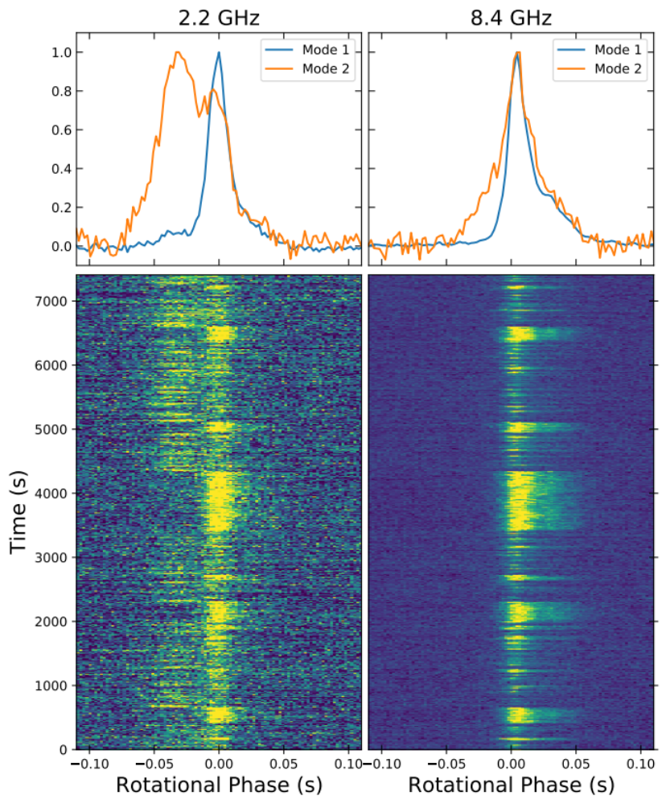
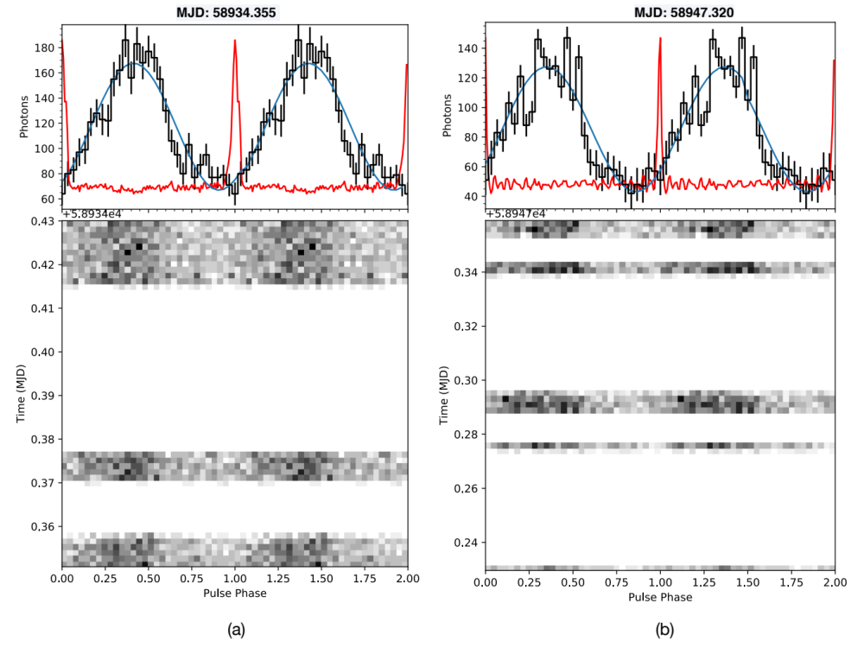
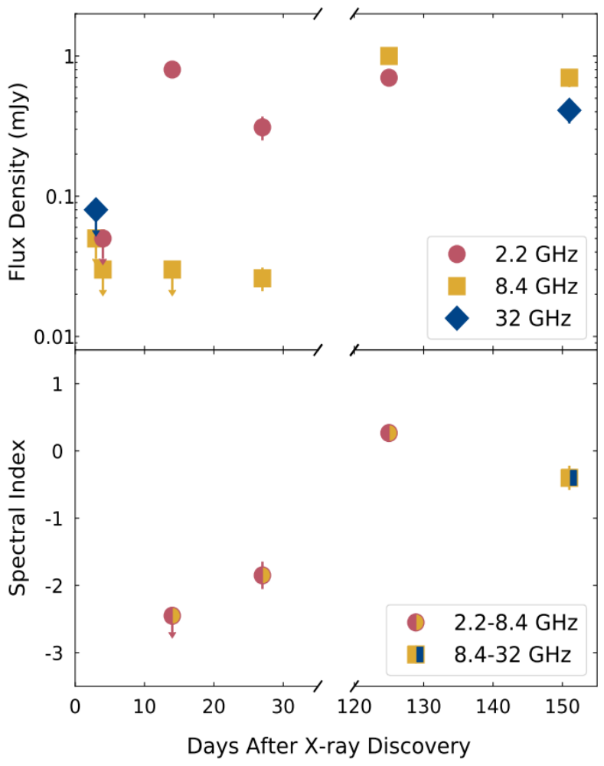
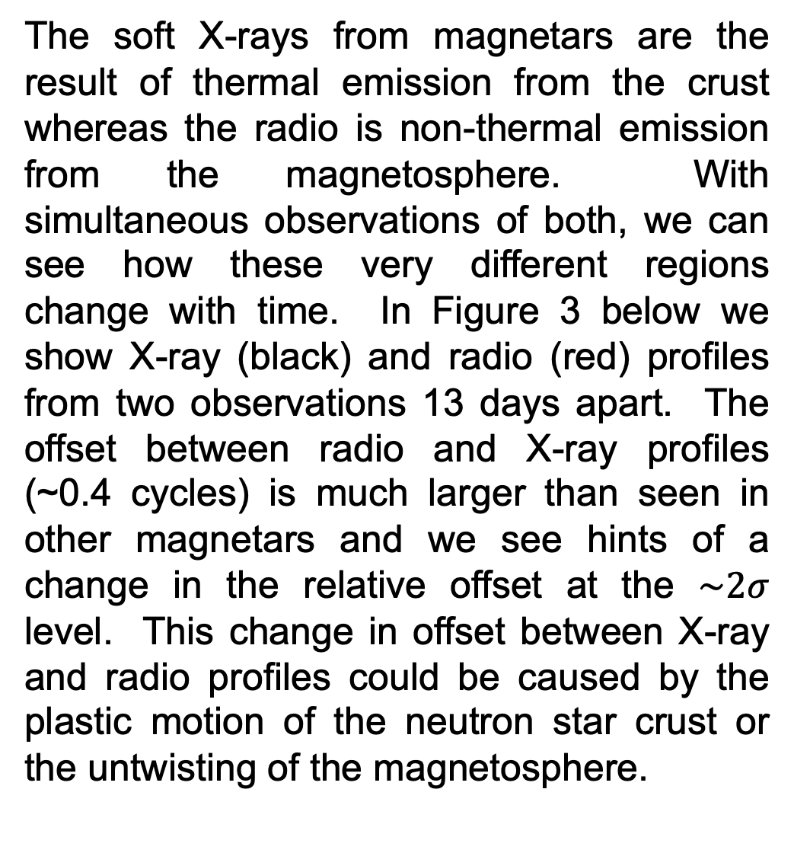
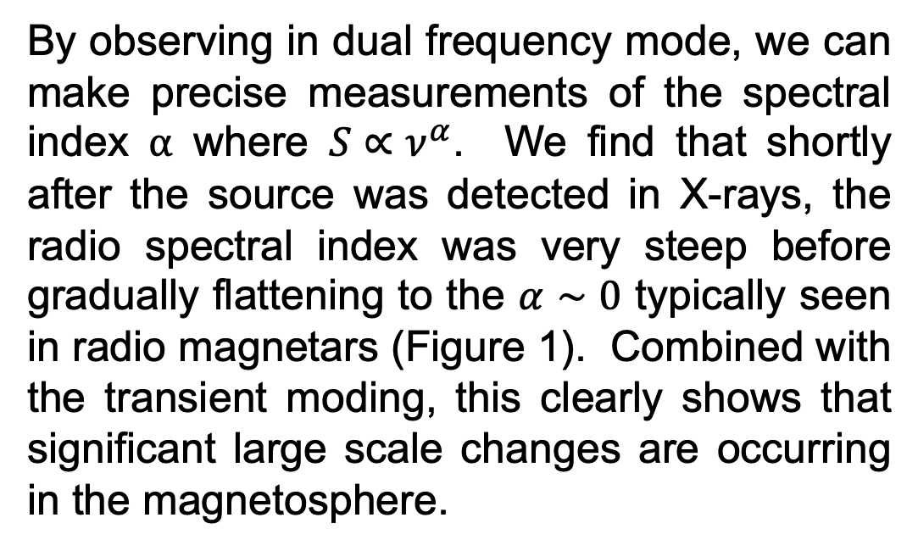
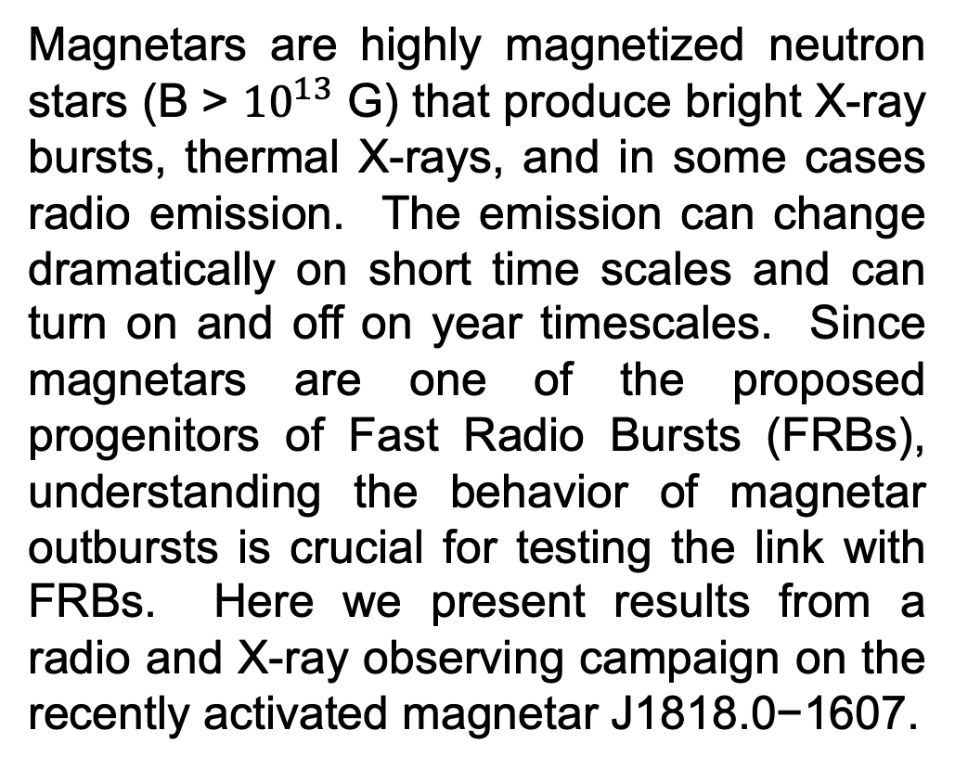
National Aeronautics and Space Administration
Radio and X-ray Monitoring of
Active Magnetars
Robert Wharton, NASA Postdoctoral Fellow (332K)
Karishma Bansal (NASA Ames), Aaron Pearlman (McGill University), Walid Majid (332K),
Thomas Prince (Caltech), George Younes (NASA Goddard), Chin-Ping Hu (Changhua University),
Teruaki Enoto (RIKEN), Jonathon Kocz (Berkeley), Shinji Horiuchi (CSIRO)
Magnetars
X-Ray / Radio Profiles
Magnetars are highly magnetized neutron stars (B > ${10}^{13}$ G) that produce bright X-ray bursts, thermal X-rays, and in some cases radio emission. The emission can change dramatically on short time scales and can turn on and off on year timescales. Since magnetars are one of the proposed progenitors of Fast Radio Bursts (FRBs), understanding the behavior of magnetar outbursts is crucial for testing the link with FRBs. Here we present results from a radio and X-ray observing campaign on the recently activated magnetar J1818.0−1607.
The soft X-rays from magnetars are the result of thermal emission from the crust whereas the radio is non-thermal emission from the magnetosphere. With simultaneous observations of both, we can see how these very different regions change with time. In Figure 3 below we show X-ray (black) and radio (red) profiles from two observations 13 days apart. The offset between radio and X-ray profiles (~0.4 cycles) is much larger than seen in other magnetars and we see hints of a change in the relative offset at the $\sim 2σ$ level. This change in offset between X-ray and radio profiles could be caused by the plastic motion of the neutron star crust or the untwisting of the magnetosphere.
Observations
We observed the magnetar J1818.0−1607 in both radio and X-rays shortly after it became active. The radio observations were done with several Deep Space Network (DSN) dishes in dual frequency mode at 2.2/8.4 GHz and 8.4/32 GHz. The X-ray observations were done with the NICER instrument aboard the International Space Station. The NICER observations were coordinated so that they would be contemporaneous with radio.
Figure 2: Mode switching seen over a ~2hr observation at 2.2 GHz (left) and 8.4 GHz (right). The time averaged profiles for each mode are shown in the top panels, normalized to the same amplitude.
Mode Switching
In one of our epochs, we see mode switching at both 2.2 and 8.4 GHz (Figure 2). Mode switching is a behavior seen in some pulsars where the pulse profile switches between two or more different shapes. It is thought to be caused by large scale changes to the currents in the magnetosphere and is generally broadband. Indeed, we see the switches occurring simultaneously at 2.2 and 8.4 GHz, but with different profile shapes in each frequency. This is the only epoch where the magnetar shows mode-switching.
Figure 3: NICER X-ray (black) and 2.2 GHz radio (red) profiles for the magnetar at two epochs separated by 13 days. The peaks of the X-ray profiles are ~0.4 cycles offset from the radio and there is some indication the offset is changing.
Conclusions
Spectral Index Evolution
By conducting multifrequency observations over the course of a few months after the initial X-ray discovery of the magnetar J1818.0−1607, we were able to see the evolution of its flux density, spectral index, and profile shape. Simultaneous NICER X-ray observations showed an offset between radio and X-ray profiles that may also be changing. All of these behaviors are consistent with large scale changes in the magnetosphere likely caused by the initial activation event.
By observing in dual frequency mode, we can make precise measurements of the spectral index ⍺ where $S∝ν^{α}$. We find that shortly after the source was detected in X-rays, the radio spectral index was very steep before gradually flattening to the $α∼0$ typically seen in radio magnetars (Figure 1). Combined with the transient moding, this clearly shows that significant large scale changes are occurring in the magnetosphere.
Figure 1: Flux density (top) and spectral index (bottom) measurements at 2.2/8.4 GHz and 8.4/32 GHz of J1818.0−1607 shortly after X-ray discovery.
National Aeronautics and Space Administration
Jet Propulsion Laboratory
California Institute of Technology
Pasadena, California
www.nasa.gov
Publications:
Bansal K., Wharton R. S., Pearlman A. B., Majid W. A., Prince T. A., Younes G., Hu C., Enoto T., Kocz J., Horiuchi S., 2022, MNRAS, submitted
Author Contact Information:
robert.s.wharton@jpl.nasa.gov
This research was carried out at the Jet Propulsion Laboratory, California Institute of Technology, under a contract with the National Aeronautics and Space Administration. © 2022. California Institute of Technology. Government sponsorship acknowledged.
Poster Number: PRD-A#001
Copyright 2022. All rights reserved.

