Slide 1

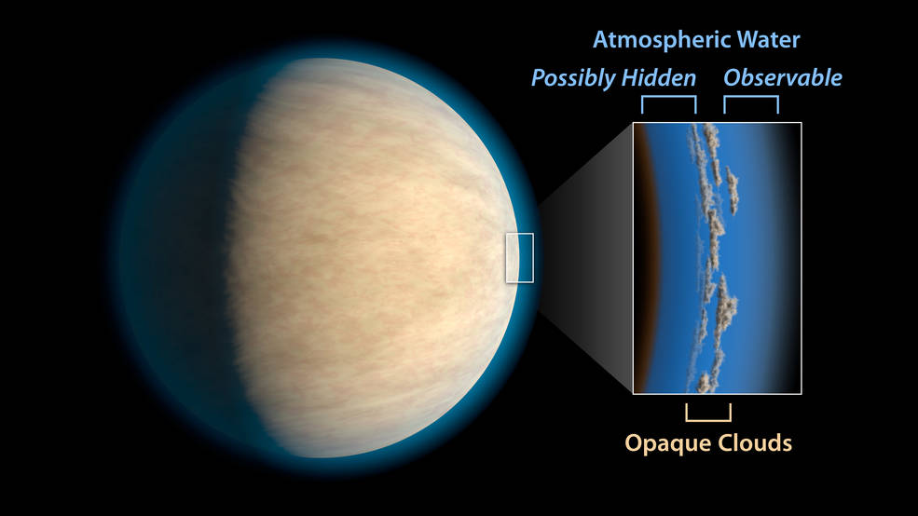
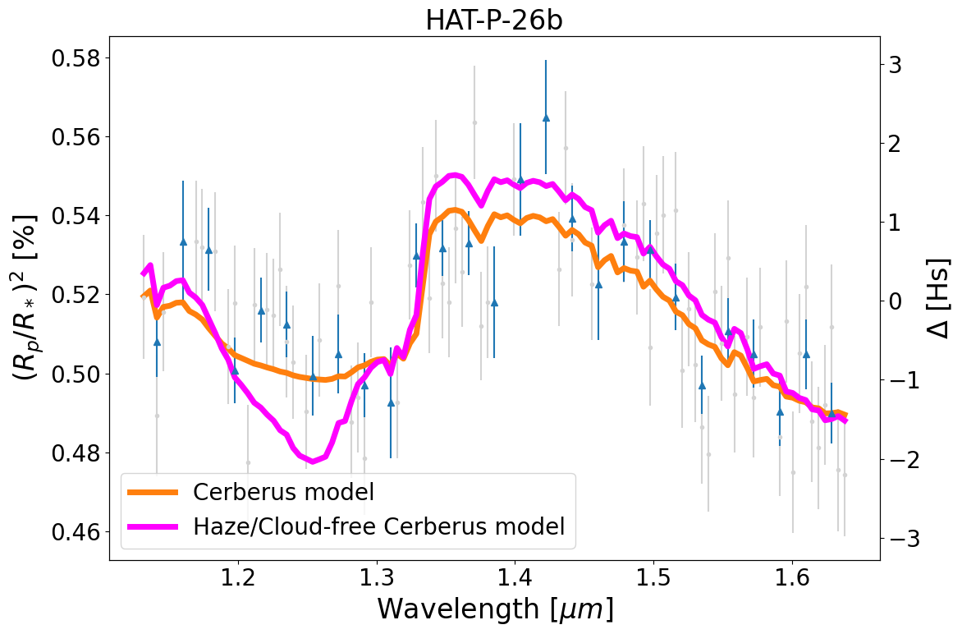
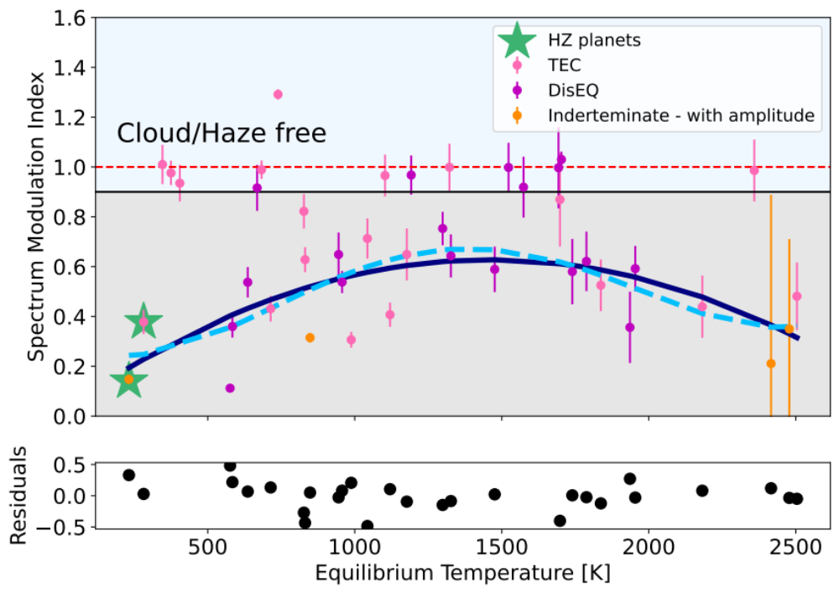
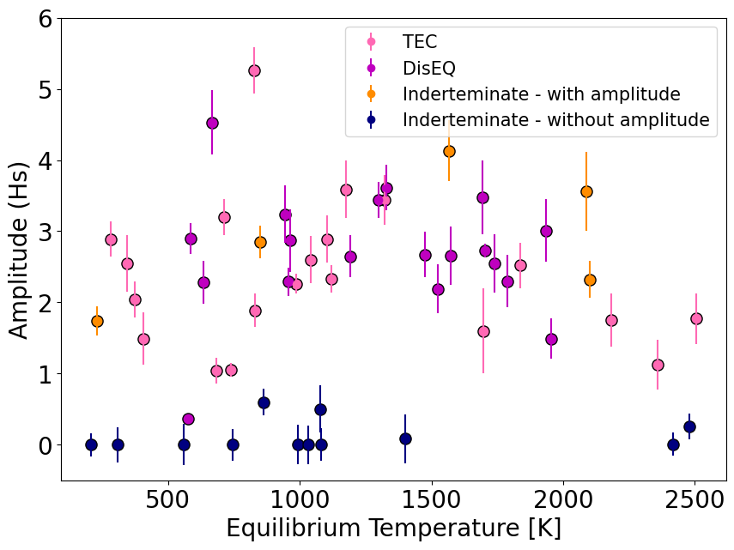

National Aeronautics and Space Administration
A Temperature Trend for Clouds and Hazes in Exoplanets Atmospheres
Author: Raissa Estrela, JPL Postdoc (3262)
Mark Swain, Gael Roudier (3262)
Introduction
Jet Propulsion Laboratory, California Institute of Technology
Clouds are present in exoplanets atmospheres and their possible composition range from various condensed species to photochemically produced hazes. They can lead to a weaker absorption feature in the near-infrared portion of the transmission spectrum of the planet or a featureless spectra. While in the optical spectra they can cause Rayleigh-scattering-like opacity seen in several planets.
Here we report on an analysis of clouds and hazes using the largest uniformly processed exoplanet transmission spectra catalog available from Roudier et al. (2021).
Fig. 1: Clouds may prevent space telescopes from detecting what lies beneath. Credits: NASA/JPL-Caltech
Exoplanet Catalog: Here we perform these analysis using the catalog from [1] that consists in 62 planets observed with the instrument Wide Field Camera 3 (WFC3) aboard of HST using the G141 IR grism (1.1–1.6μm) spatial scan observations.
Methods
Estimating the Spectral Amplitude and Spectral Modulation Index
Spectral Amplitude: difference between the maximum and minimum of the CERBERUS preferred model (CMM) in the NIR range.
Spectral Modulation index:
Innovative aspects of this work: This exoplanet catalog has three important advantages for the study of clouds compared with previous works:
Data have been processed though the same pipeline and analysed with the same spectral retrieval code
2) HST/WFC3-G141 data at the full spectral resolution of the instrument
3) Atmospheric spectral retrieval is capable of modeling atmospheres assuming both thermal equilibrium chemistry (TEC) and disequilibrium chemistry (DisEQ).
The DisEQ atmosphere assumed does not fully exclude water, but includes water as subdominant feature and brings the possibility of other dominant signatures such as CH₄, C₂H₂, HCN and CO₂.
Index $=\frac{CMMCloudy}{CMMCloudy−free}$
amplitude
Fig. 2 Exoplanet Catalog from EXCALIBUR
Fig. 3 Comparison between the atmospheric retrieval model and the same model setting cloud/haze to zero (cloud/haze free)
Main findings:
Planets normally have some level of cloudiness/haziness: Planets can be on a wide range of values from clear to cloudy but they are frequently somewhere in between.
Minimum level of clouds/hazes: trend from mostly cloudy/hazy around 500 K to mostly clear around 1460 K.
Hazes widely distributed: typically vertically distributed throughout the atmospheric column.
Spectral Modulation Index
0 = cloudy/hazy
1 = clear atmospheres
Spectral Modulation Amplitude
Atmospheres vary from cloudy to clear
Results
Fig. 4 Amplitude of the spectral modulation of TEC, DisEQ and Indeterminate targets in terms of scale height
Cloud/Hazy planets or high molecular weight atmospheres
Fig. 5 Spectral modulation index of the TEC and DisEQ targets from the EXCALIBUR catalog
Exoplanets atmospheres follow a trend in temperature where they vary from completely to partially cloudy/hazy or clear.
We observe that atmospheres trend from cloudy/hazy to clear from 500-1460K.
Muting factors in the spectral features is being enhanced at temperatures below 1500K.
Hazes are partially transparent and are widely vertically extended throughout the atmospheric column.
Conclusions
Implications of Clouds/Hazes for Habitability
Hazes | Clouds
Protected Early Earth from harmful UV | Reflect the stellar heat and cooler the surface (Earth’s case)
Source of organic substances | Cooling effect depends on cloud coverage and altitude
Cooling effect
National Aeronautics and Space Administration
Jet Propulsion Laboratory
California Institute of Technology
Pasadena, California
www.nasa.gov
Access this work on arXiv: 2206.09934
Publications:
[1] Estrela, Swain and Roudier, submitted to ApjL
[2] Roudier et al. (2021)
[3] Estrela et al. (2021)
[4] Swain, Estrela, Roudier et al. (2021)
Author Contact Information:
restrela@jpl.nasa.gov
Poster Number:
Copyright 2022. All rights reserved.

