Slide 1

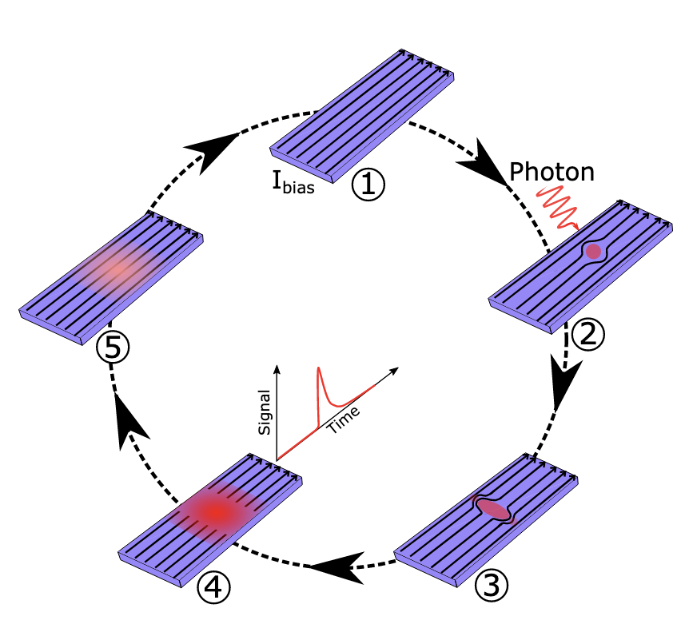
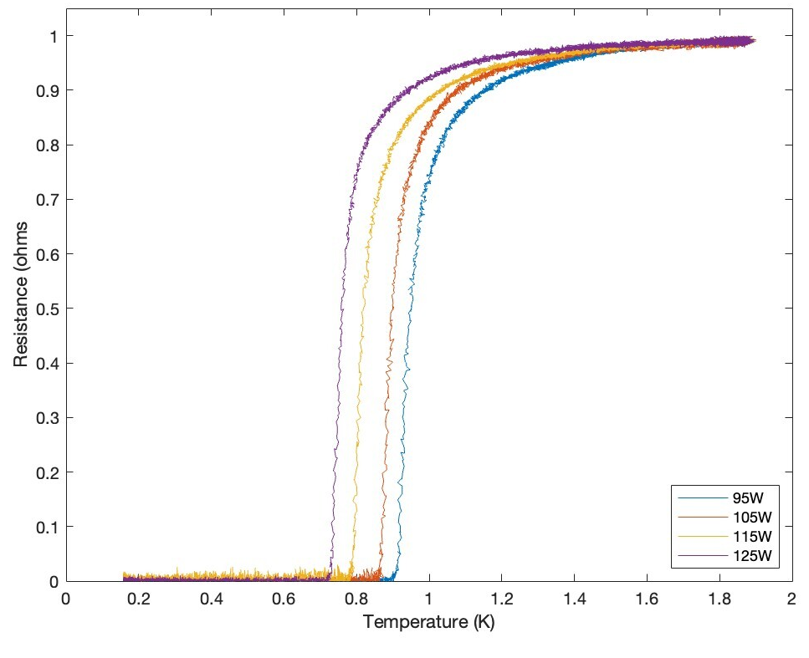
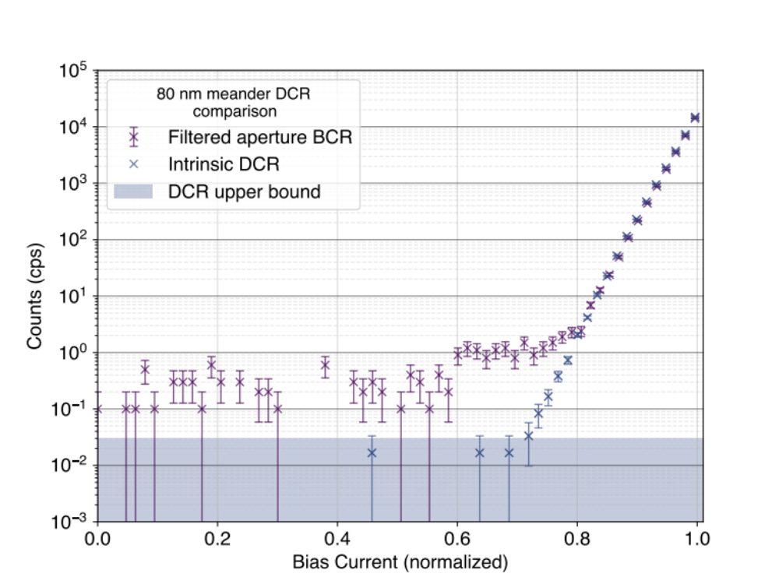
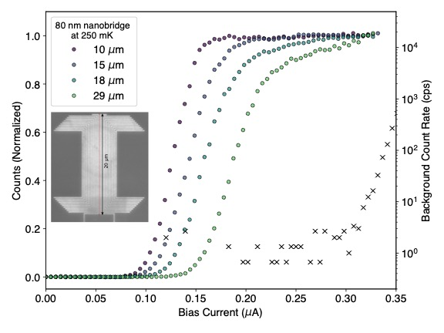
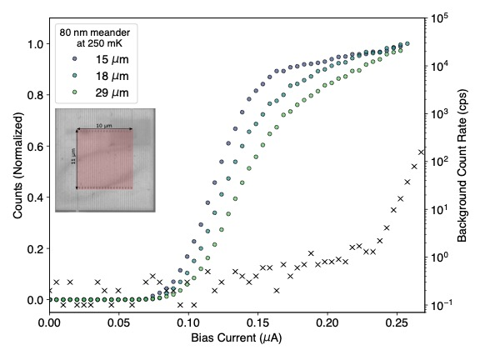

National Aeronautics and Space Administration
Postdoc Research
Superconducting nanowire single-photon detectors for mid/far-infrared wavelengths
Gregor G. Taylor, 389 JPL Postdoctoral Fellow
Alexander B. Walter (383), Boris Korzh (389), Bruce Bumble (389), Sahil R. Patel (389), Jason P. Allmaras (337), Andrew D. Beyer (389), Emma E. Wollman (389) and Matthew D. Shaw (389)
Background
Superconducting nanowire single-photon detectors (SNSPDs) are the gold standard for near-infrared photon-counting applications, offering near 100% system detection efficiency[1], low dark-count rates[2], low timing jitter[3] and high maximum count rates[4]. They also have potential to extend these metrics into the mid/far-infrared, where there is a lack of high-performance photon-counting detector technology. Demonstration of such detectors at these long wavelengths would be highly beneficial to fields such as exoplanet science, molecular science and direct dark-matter detection experiments.
Objectives
The objectives of this research were to:
Demonstrate saturated internal detection efficiency – that is, every photon that is absorbed by the detector results in an output pulse – for wavelengths in the 10 to 30 µm range.
Show that low dark-count rates are still achievable for such sensitive detectors.
SNSPD working principle
Results
Co-sputtering Si with WSi results in a Si-rich WSi. By varying the sputtering power of the Si target we can reduce the T_{c} and increase the resistivity – this results in a lowering of the characteristic energy associated with photon detection, and hence the ability to detect lower energy photons.
Through careful package design we achieve DCR’s on the order of 1 cps with an aperture, and 10⁻² cps with a shielded detector, on the saturated plateau, for a meander design.
Significance & Outlook
The demonstration of SNSPDs at these wavelengths represents a new class of photo-detector for the mid/far-infrared. As SNSPDs are true photon-counting detectors they offer precise timing and are immune to many of the common instability issues encountered with alternative technologies. This makes them an excellent candidate for future large-scale infrared space telescopes. In addition, alternative fields of science such as direct-dark matter detection experiments will benefit from the reduced energy threshold and low dark-counts, allowing the exploration of new parameter space.
Photon-count rate vs bias for two detector geometries at a variety of wavelengths. Unity internal detection efficiency is achieved up to 29 µm
[1] Reddy, Dileep V., et al. "Superconducting nanowire single-photon detectors with 98% system detection efficiency at 1550 nm." Optica 7.12 (2020): 1649-1653.
[2] Chiles, Jeff, et al. "New constraints on dark photon dark matter with superconducting nanowire detectors in an optical haloscope." Physical Review Letters 128.23 (2022): 231802.
[3] Korzh, Boris, et al. "Demonstration of sub-3 ps temporal resolution with a superconducting nanowire single-photon detector." Nature Photonics 14.4 (2020): 250-255.
[4] Craiciu, Ioana, et al. "High-speed detection of 1550 nm single photons with superconducting nanowire detectors." Optica 10.2 (2023): 183-190.
National Aeronautics and Space Administration
Jet Propulsion Laboratory
California Institute of Technology
Pasadena, California
www.nasa.gov
Publications:
G. G. Taylor, A. B. Walter, B. Korzh, B. Bumble, S. Patel, J. P. Allmaras, A. D. Beyer, R. O'Brient, M. D. Shaw, & E. E. Wollman. “Low-noise single-photon counting superconducting nanowire detectors at infrared wavelengths up to 29 μm,” arXiv preprint
arXiv:2308.15631. (2023).
Author Contact Information:
gregor.g.taylor@jpl.nasa.gov – email me, this poster is too small.
Read it here
Clearance Number: CL#00-0000
Poster Number: PRD-T-008
Copyright 2023. All rights reserved.

