Slide 1


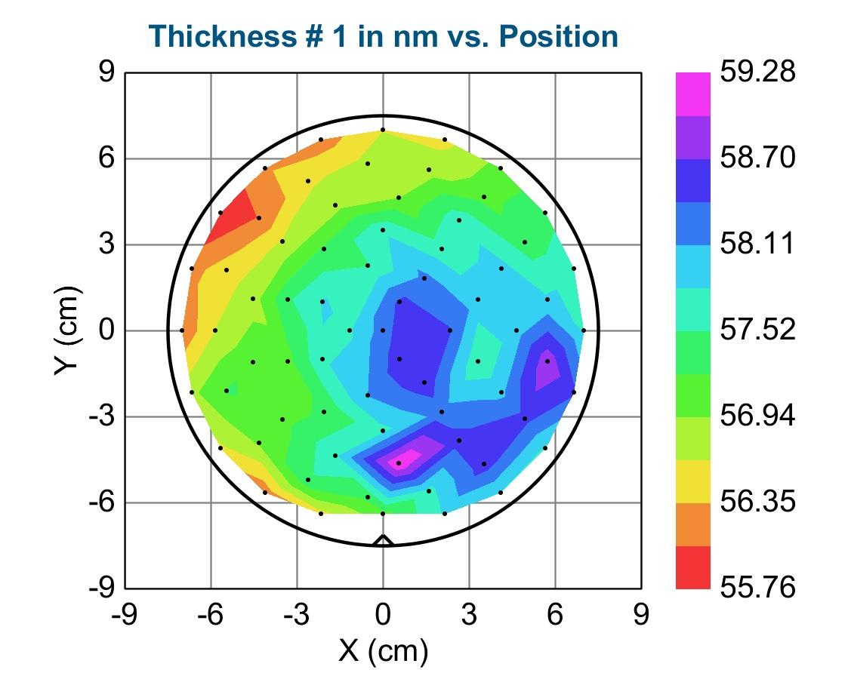
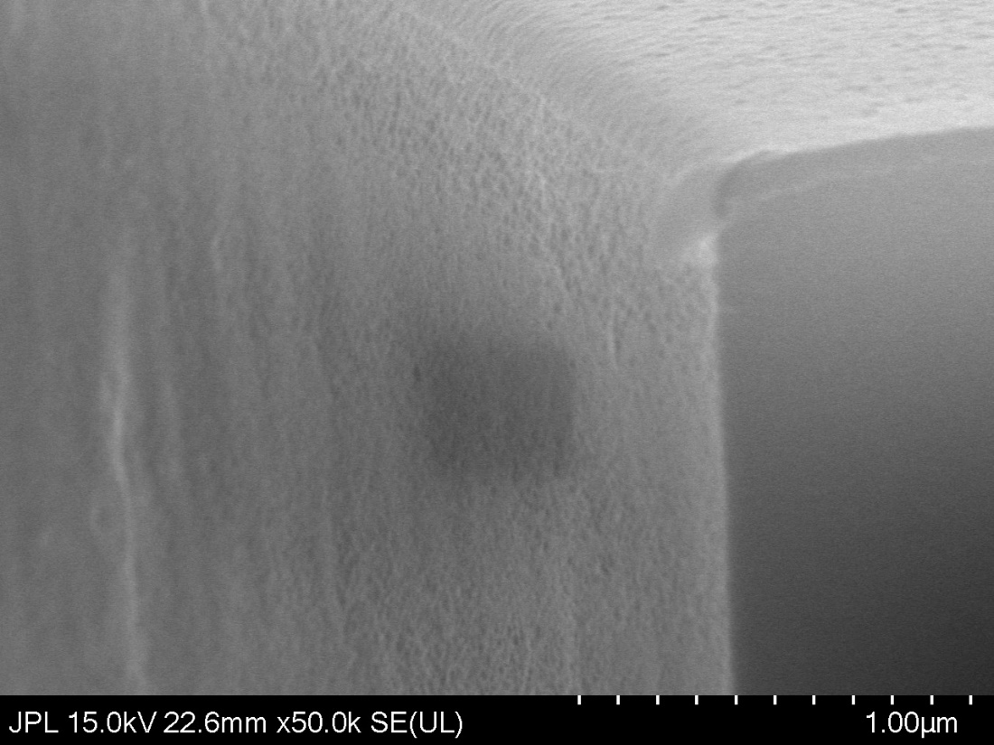
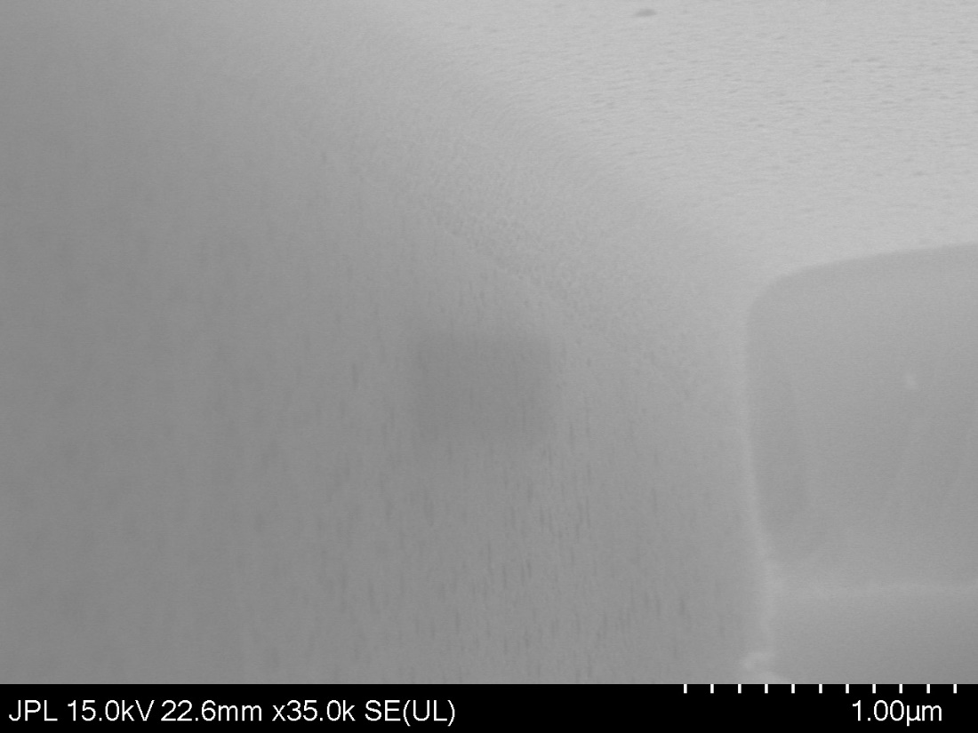
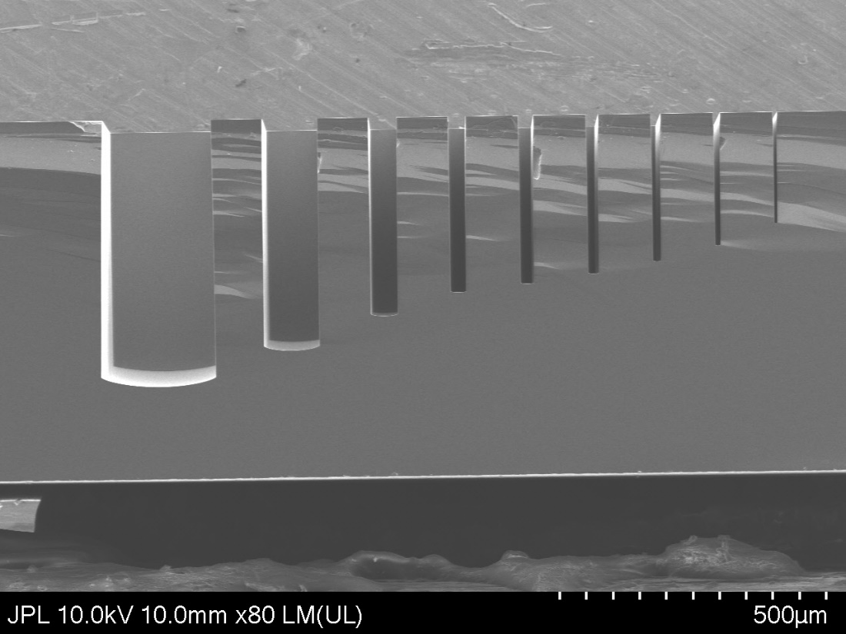
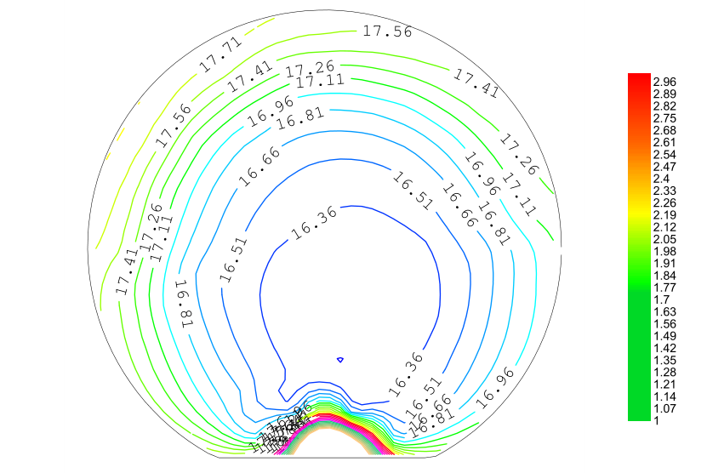
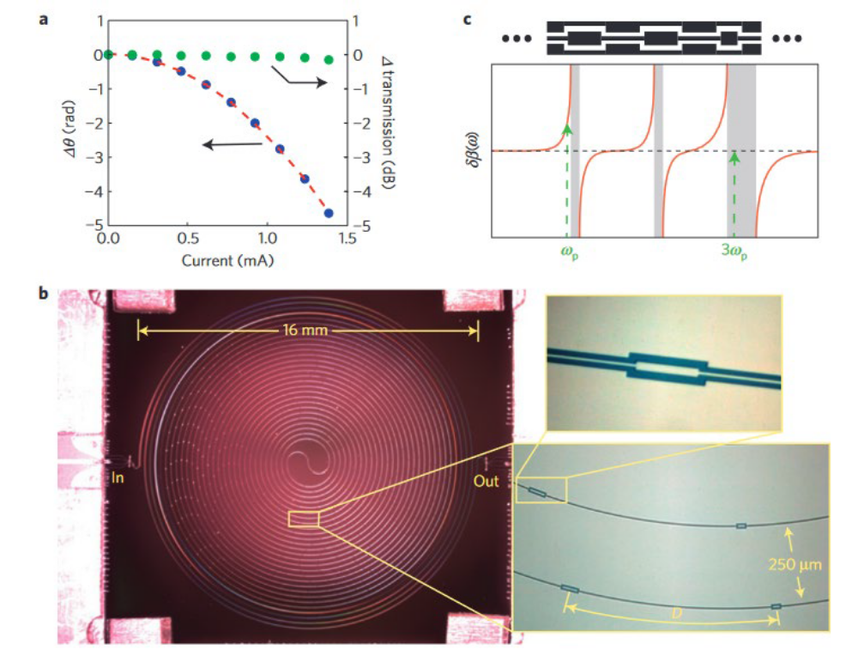
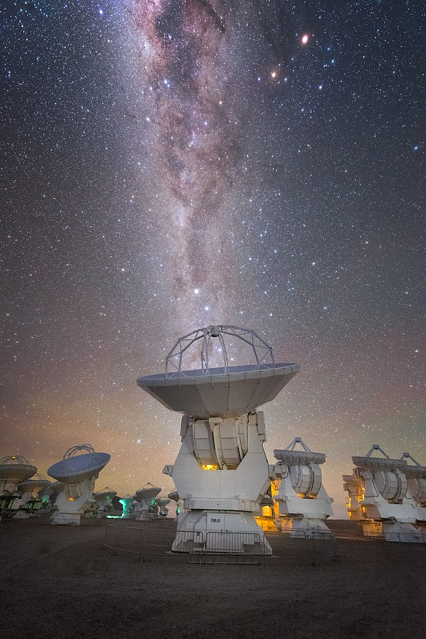
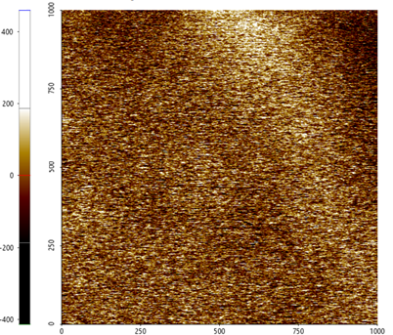
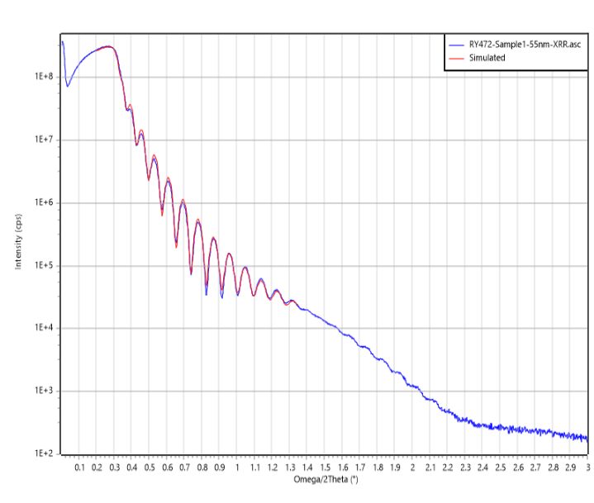
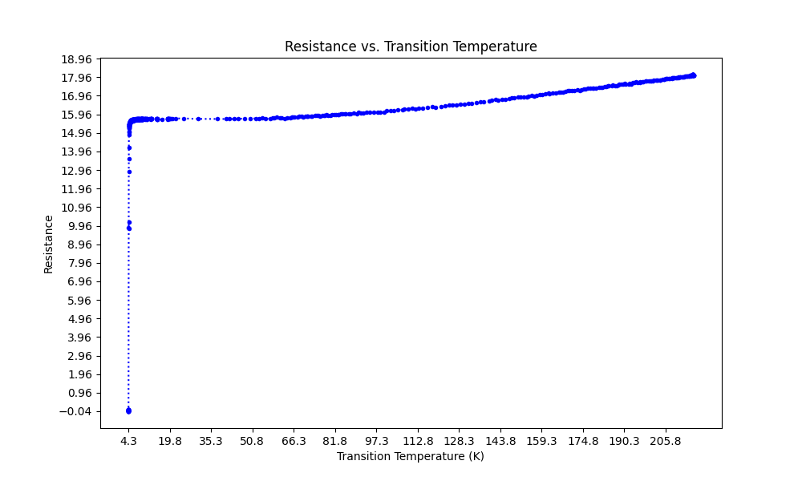
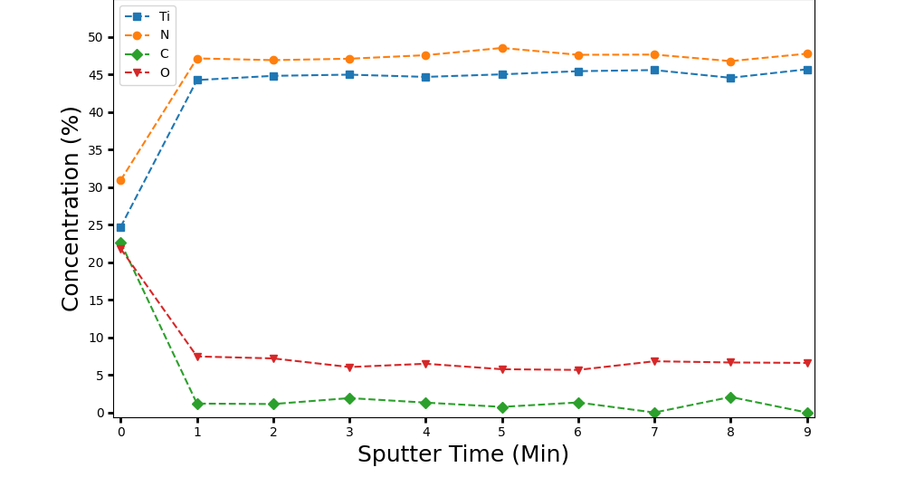
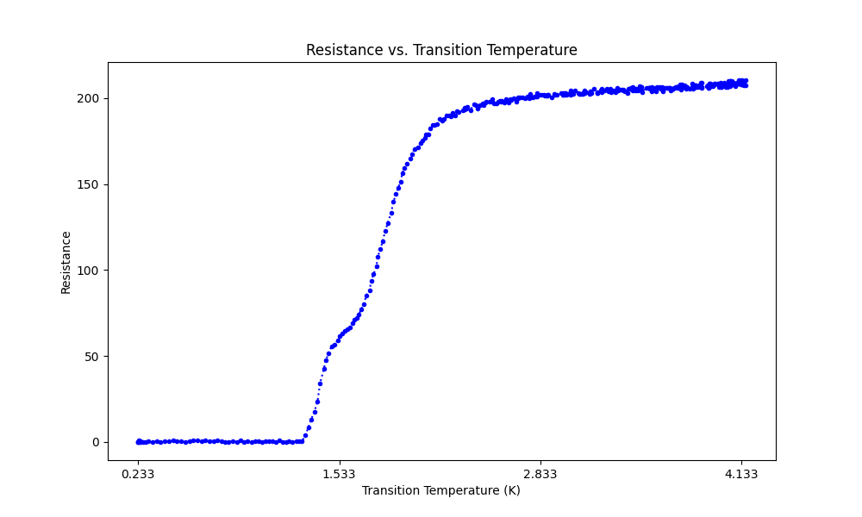
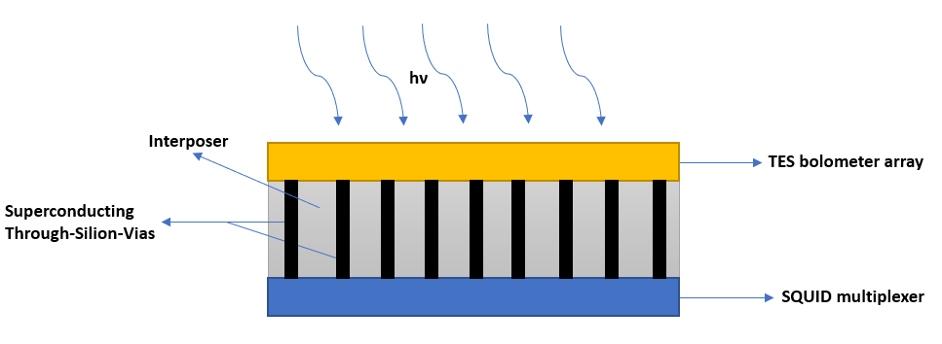
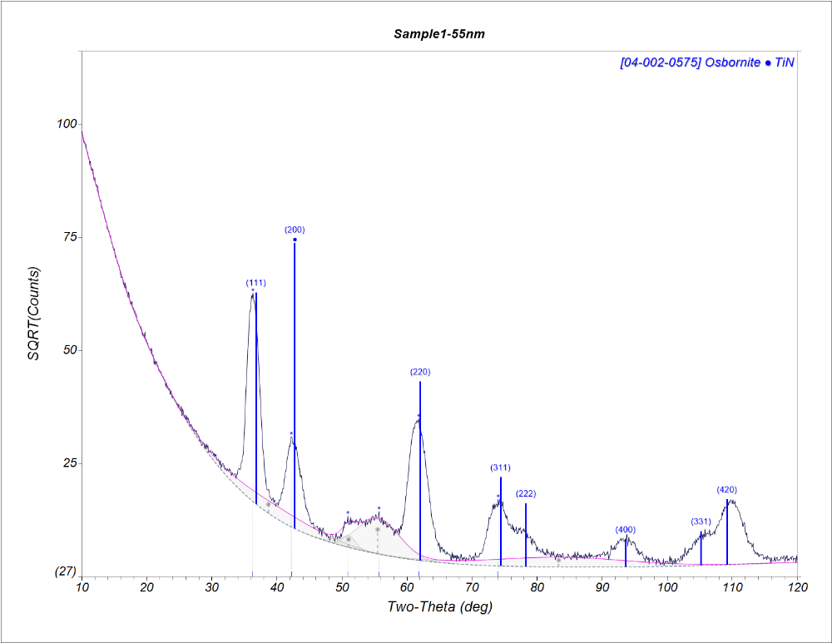
National Aeronautics and Space Administration
Wafer-Scale Atomic Layer Deposition of Superconducting Titanium Nitride for Through-Silicon-Via Structures and Photon Detectors
John Femi-Oyetoro (389W)* , JPL Postdoctoral Fellow
Henry LeDuc (389I)*, Matthew Dickie*, Peter Day (389I)* and Frank Greer (389L)*
*Microdevices Laboratory
Jet Propulsion Laboratory, California Institute of Technology
Abstract
Wafer-scale Properties
Conformality
Transition metal nitrides, such as TiN, NbN, and NbTiN, exhibit a significant intrinsic kinetic inductance (KI) owing to their remarkable London penetration depth. This characteristic assumes paramount importance in a wide array of superconducting devices (SDs) employed across diverse research domains, spanning quantum computing, transduction, photon detection, and parametric amplification. Furthermore, this property has been leveraged in astrophysics for early universe detection and in upcoming scientific observations. These SDs have been practically deployed at the South Pole, exemplified by the Background Imaging of Cosmic Extragalactic Polarization (BICEP) telescopes and the Keck Array, which demonstrate exceptional sensitivity to early universe signatures. In this study, we showcase the precise atomic layer deposition of superconducting TiN films, offering outstanding thickness control and uniformity. We incorporated techniques that tackles impurities which helps in achieving high-quality and outstanding film densification. These films are ideally suited for large-scale SDs, detector arrays, and 3D integration, potentially increasing device yield per wafer. In a broader context, the obtained superconducting parameters significantly outperform the majority of existing ALD techniques and favorably compare to conventionally sputtered TiN films for SD applications. Additionally, they provide the advantage of conformal coverage over intricate 3D structures. These films hold substantial promise in the fabrication of microresonators and parametric amplifiers for photon detection, and other quantum-based devices.
Background
Complex 3D structures, characterized by aspect ratios ranging from 2 to 40, exhibit conformal coverage along the edges and top corners.
A 6-inch wafer exhibits an average film thickness of 57 nm along with a sheet resistance of 16.23 Ω/sq. The average resistivity is approximately 92 µΩcm.
Cryogenic DC Charaterization of Planar and 3D Structures
Structural and Compositional Charaterization
Superconducting films fabricated from transition metal nitrides have found application in cosmic microwave background (CMB) experiments conducted at the Atacama Large Millimeter Array. These films are employed in the fabrication of parametric amplifiers, which offer quantum-limited sensitivity approximately 1/2 hν better than HEMT amplifiers [1, 2 ].
Position (nm)
Height (pm)
Position (nm)
Potential Concept
A three-tier superconducting device system designed for low Size, Weight, and Power (SWaP) consumption consists of a TES bolometer array and a SQUID multiplexer, integrated utilizing superconducting Through-Silicon Vias (TSVs). The TSVs will undergo a TiN coating process using ALD (Not to scale).
Superconductivity tests were conducted on (a) planar and (b) complex 3D structures. The results indicate critical temperature (T_{c}) variations across the trenches.
Future Work
Materials Development
Fabricate and evaluate parametric amplifiers using the recently developed superconducting TiN films.
Utilize Transmission Electron Microscopy (TEM) and Electron Energy Loss Spectroscopy (EELS) to comprehensively analyze the composition and uniformity of TiN films across diverse aspect ratios.
The objective is to gain an exhaustive and rigorous understanding of the films' high-quality characteristics and device performance.
To improve the film's quality, we utilized Tetrakis(dimethylamido)titanium (TDMAT) as the precursor and introduced nitrogen during the plasma step using the Oxford Flex II PEALD system. The utilization of TDMAT presents several noteworthy advantages. These encompass safety through the prevention of hazardous or corrosive byproduct formation, heightened reactivity resulting in an increased growth per cycle (GPC), and lowered process temperatures.
Surface roughness measures at 1 nm, with a material density of 5.12 g/cm³. The Ti:N stoichiometry ratio stands at 0.95, consisting of 78.3% crystalline and 21.7% amorphous phases.
National Aeronautics and Space Administration
Jet Propulsion Laboratory
California Institute of Technology
Pasadena, California
www.nasa.gov
References:
Ho Eom, B., Day, P.K., LeDuc, H.G. and Zmuidzinas, J., 2012. A wideband, low-noise superconducting amplifier with high dynamic range. Nature Physics, 8(8), pp.623-627.
File:Atacama Large Millimeter-submillimeter Array, Milky Way.jpg - Wikimedia Commons. 1 June 2020, commons.wikimedia.org/wiki/File:Atacama_Large_Millimeter-submillimeter_Array,_Milky_Way.jpg.
Femi-Oyetoro, J., and Greer, F. (2023). Atomic Layer Deposition of Superconducting Transition Metal Nitrides for Quantum Circuits and Detectors. Provisional Patent Appliaction #: CIT 9052-P
Contact Information:
Phone:(626) 314-4229, Email: john.femi-oyetoro@jpl.nasa.gov
Poster Number:
Copyright 2023. All rights reserved.

