Slide 1

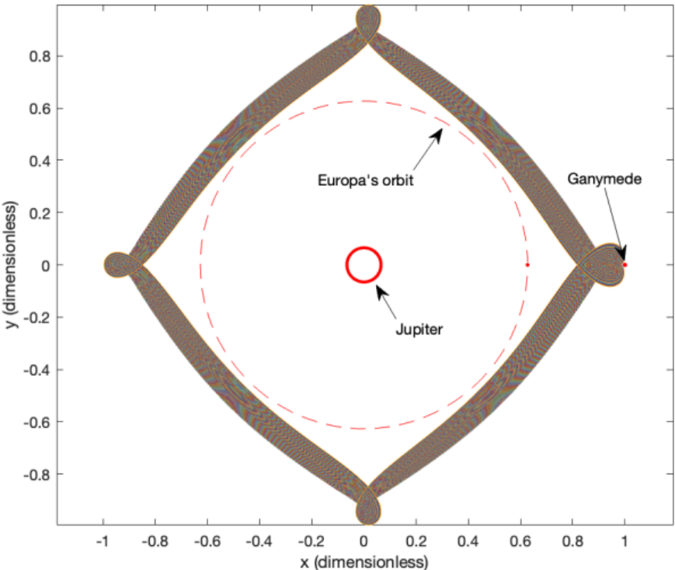
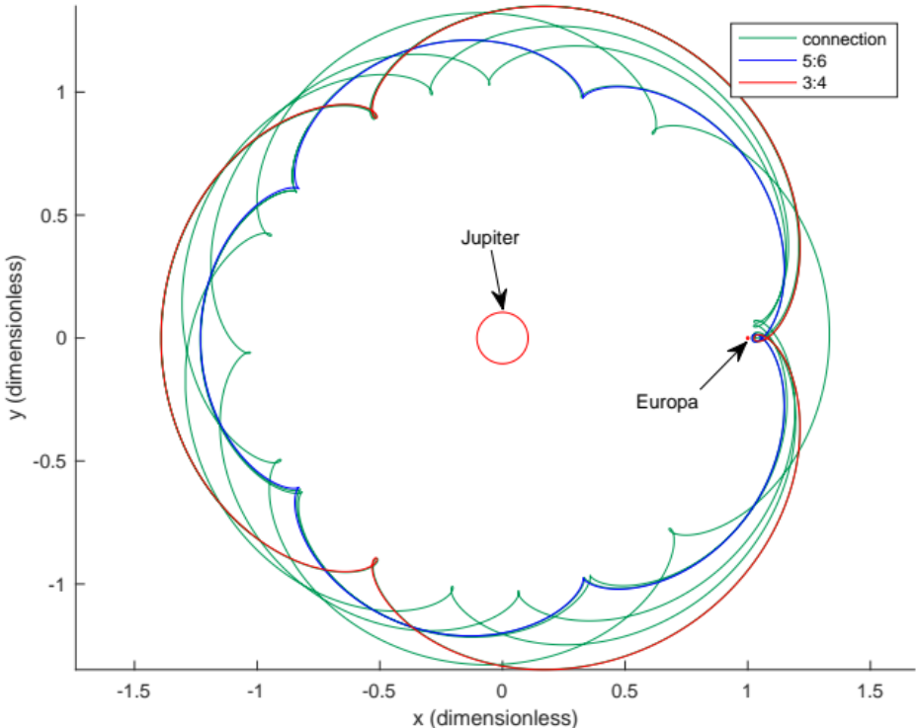
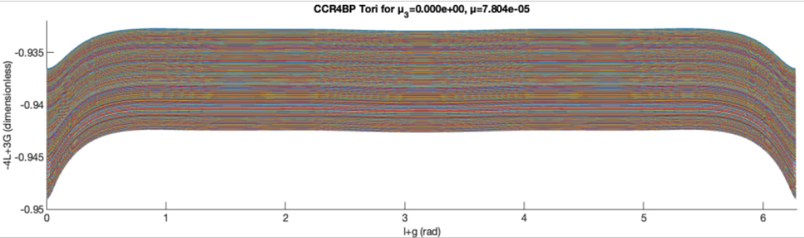
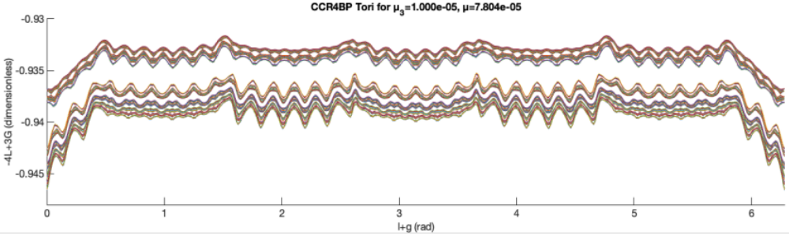
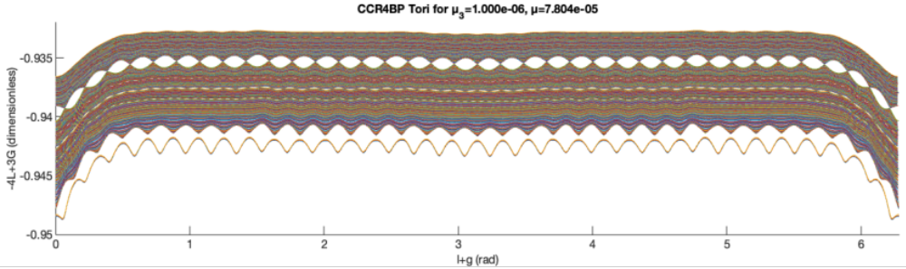
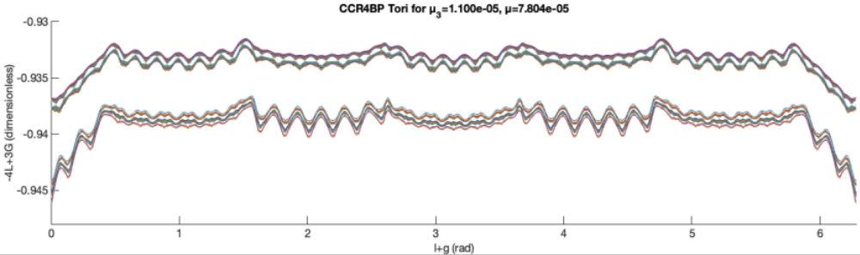
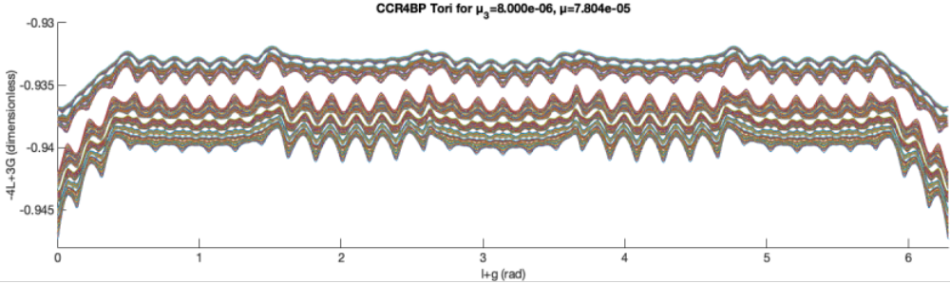
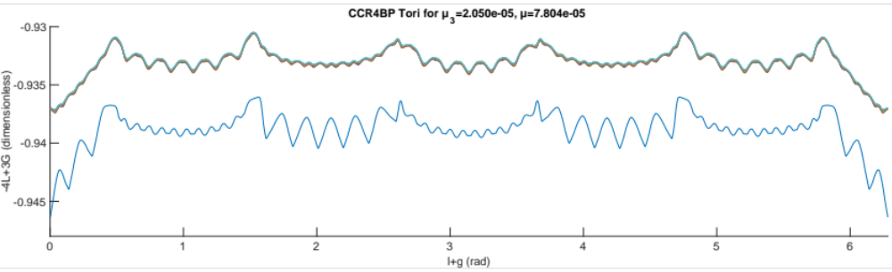
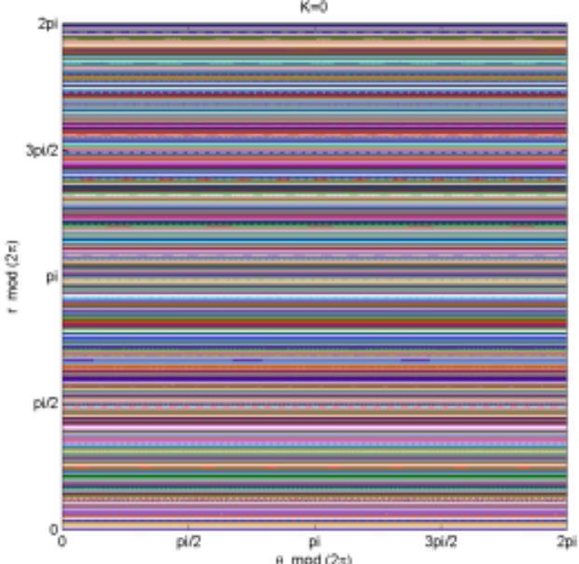
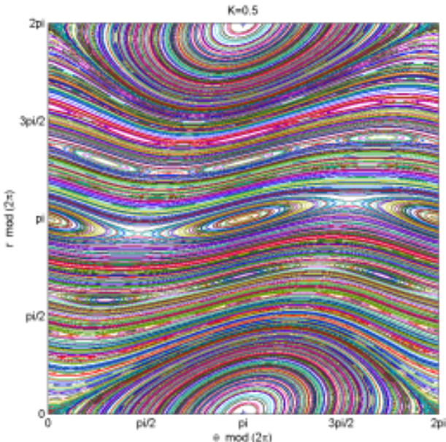
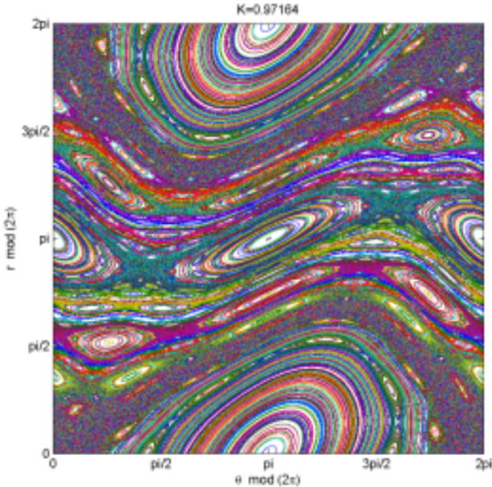
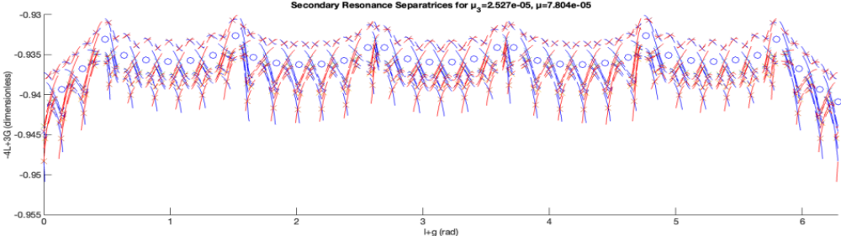
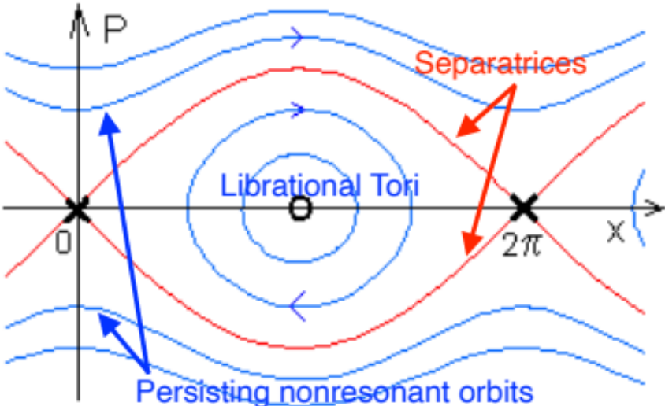
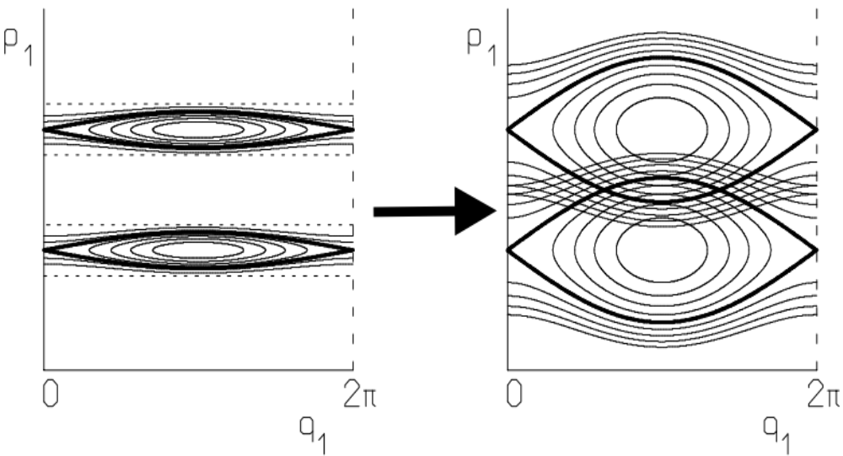
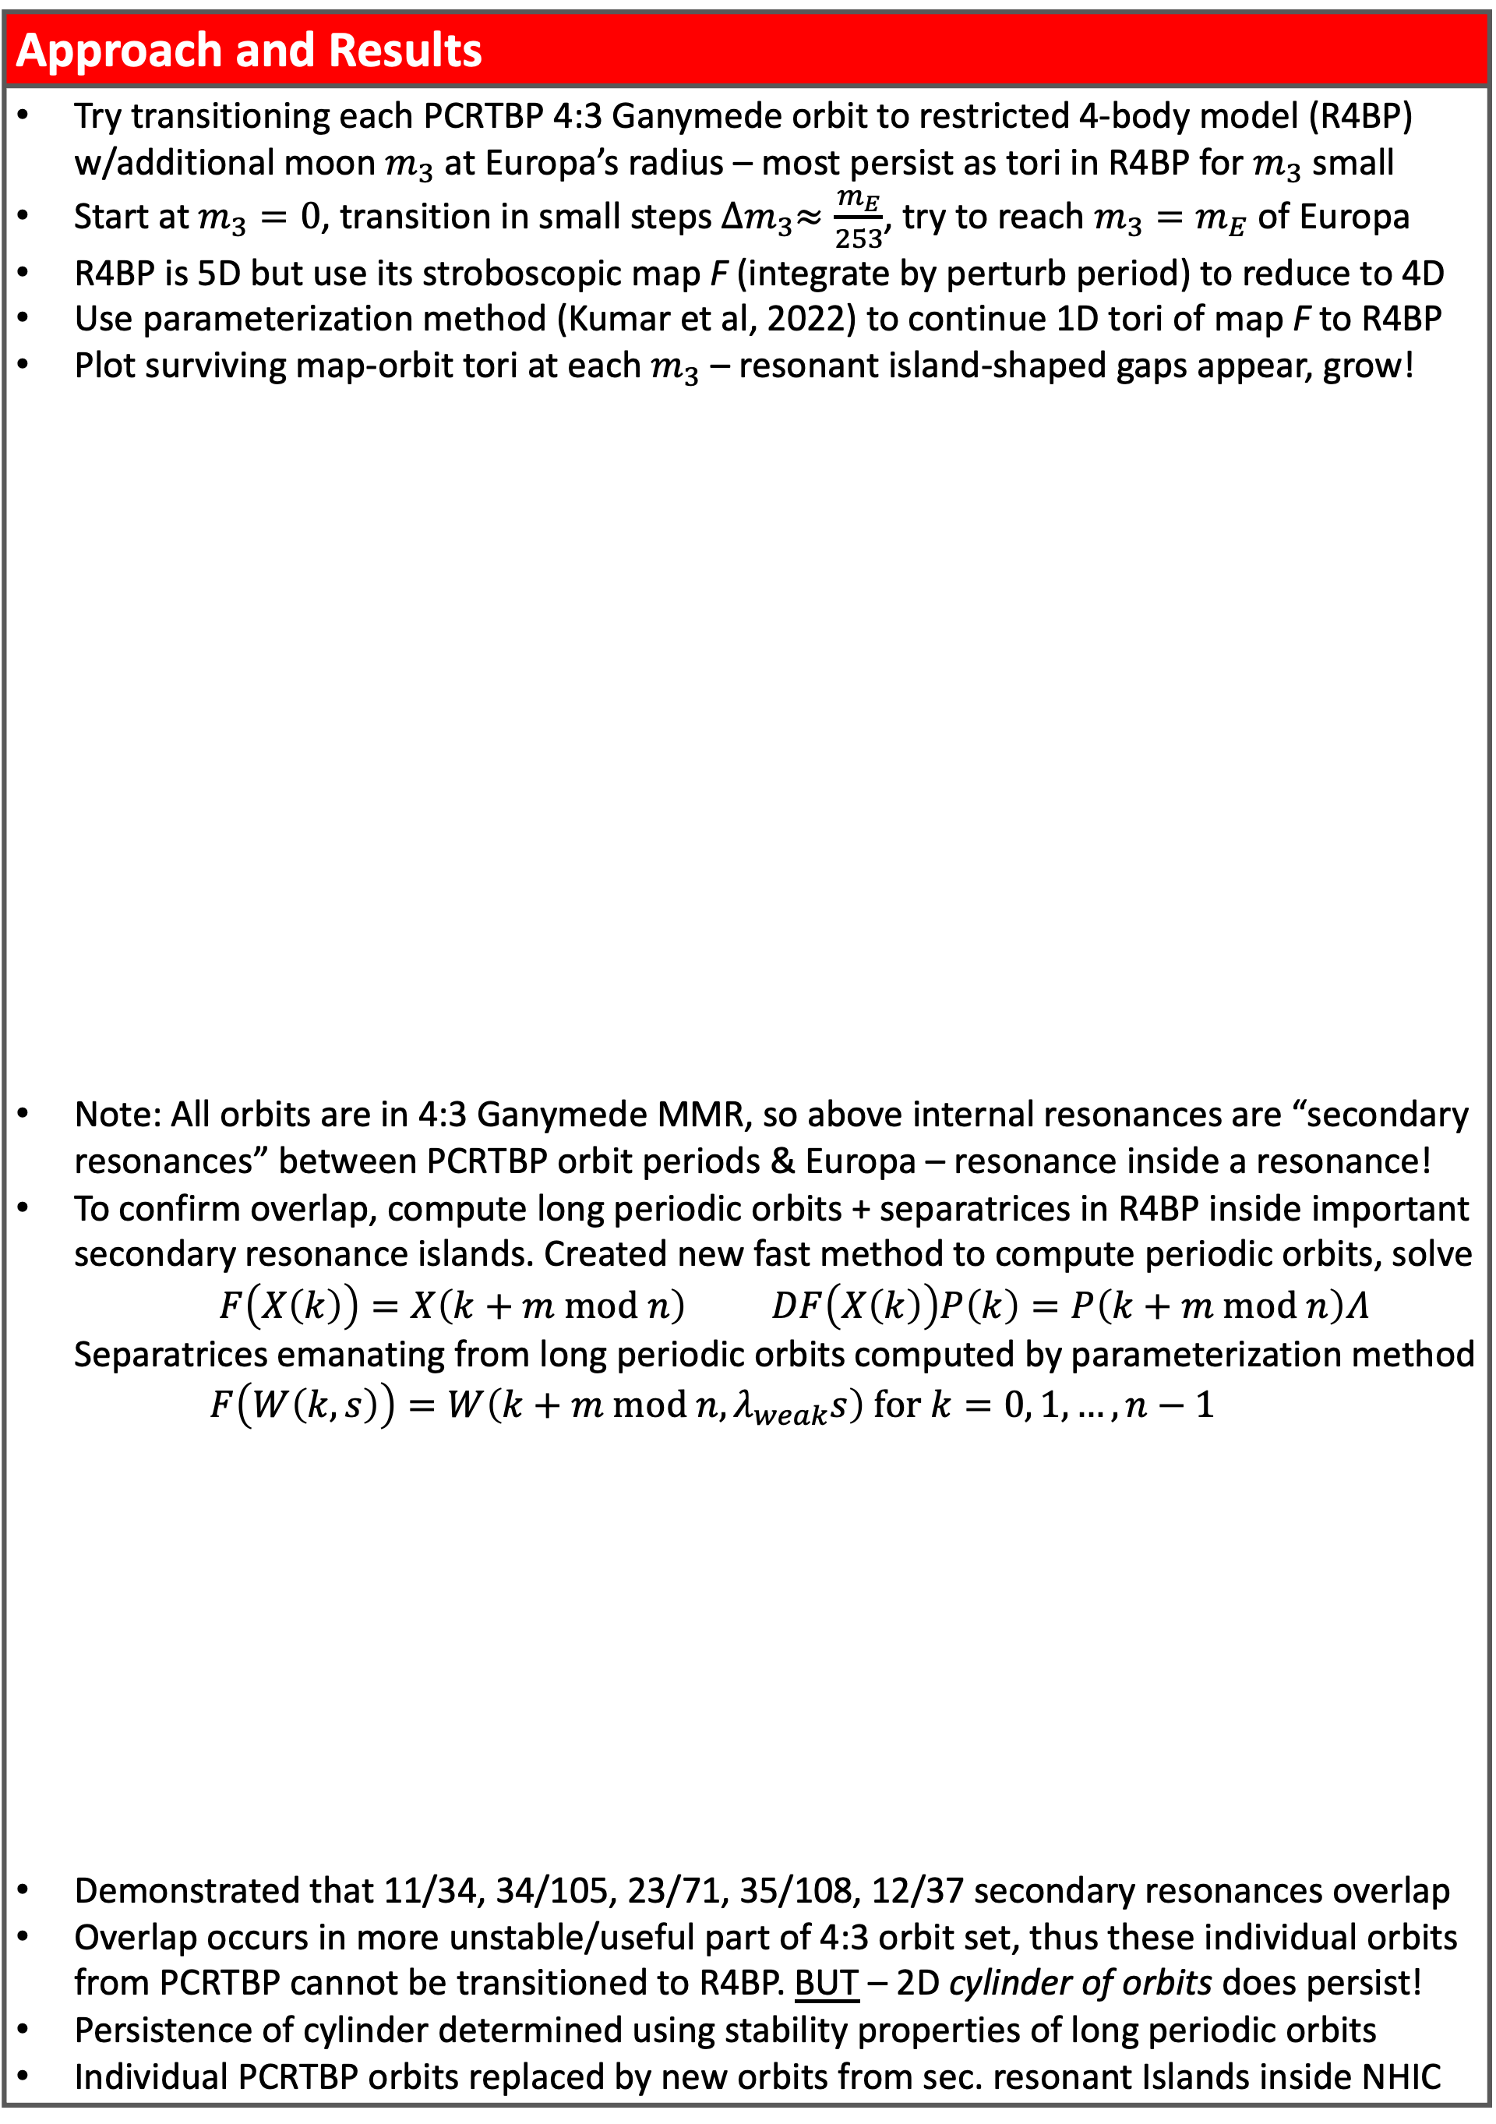
National Aeronautics and Space Administration
Postdoc Research
4th body-induced secondary resonance overlap inside unstable resonant orbit families: a Ganymede 4:3 + Europa case study
Author: Bhanu Kumar (392K), NSF MSPRF Visiting Postdoctoral Scholar
Rodney L. Anderson (392K), Rafael de la Llave (Georgia Tech)
Objectives: | Do unstable resonant orbits computed in a simple PCR3BP planet + 1 moon model have analogues when other moons’ influence is accounted for? If so, what are the dynamical properties/structure of these analogues, and how can we compute them in a higher-accuracy model?
Motivation
Mean motion resonance (MMR): state space region where s/c does m revolutions around planet in same time a moon makes n revs Natural connections between unstable MMR orbits enable fuel-free changes of s/c orbit semimajor axis: useful for multi-moon tours Prior research: MMRs studied in PCR3BP model (planet+moon+s/c) But need to use MMRs affected by 2 moons when going from one moon to another – how does moon #2 affect their unstable orbits? Anecdotal: trajectory designed using resonances in PCR3BP fails transition to ephemeris due to large second moon perturbation
Approach and Results
Try transitioning each PCRTBP 4:3 Ganymede orbit to restricted 4-body model (R4BP) w/additional moon $m_{3}$ at Europa’s radius – most persist as tori in R4BP for $m_{3}$ small Start at $m_{3}=0$, transition in small steps ${∆m}_{3}≈\frac{m_{E}}{253}$, try to reach ${m_{3}=m}_{E}$ of Europa R4BP is 5D but use its stroboscopic map F (integrate by perturb period) to reduce to 4D Use parameterization method (Kumar et al, 2022) to continue 1D tori of map F to R4BP Plot surviving map-orbit tori at each $m_{3}$ – resonant island-shaped gaps appear, grow! Note: All orbits are in 4:3 Ganymede MMR, so above internal resonances are “secondary resonances” between PCRTBP orbit periods & Europa – resonance inside a resonance! To confirm overlap, compute long periodic orbits + separatrices in R4BP inside important secondary resonance islands. Created new fast method to compute periodic orbits, solve $F\left(X\left(k\right)\right)=X\left(k+m mod n\right) DF\left(X\left(k\right)\right)P\left(k\right)=P\left(k+m mod n\right)Λ$ Separatrices emanating from long periodic orbits computed by parameterization method $F\left(W\left(k,s\right)\right)=W\left(k+m mod n,λ_{weak}s\right) for k=0, 1, …,n−1$ Demonstrated that 11/34, 34/105, 23/71, 35/108, 12/37 secondary resonances overlap Overlap occurs in more unstable/useful part of 4:3 orbit set, thus these individual orbits from PCRTBP cannot be transitioned to R4BP. BUT – 2D cylinder of orbits does persist! Persistence of cylinder determined using stability properties of long periodic orbits Individual PCRTBP orbits replaced by new orbits from sec. resonant Islands inside NHIC
Figure 1: (L) Ganymede PCRTBP 4:3 unstable orbits, (R) Europa PCRTBP 3:4 to 5:6 connection
Mathematical Background
PCRTBP unstable MMR orbit = periodic orbit, topologically = circle Set of such orbits at each MMR = 2D normally hyperbolic invariant cylinder (NHIC) – invariant means you start on it, you stay on it… NHIC will deform but persist as NHIC for “small” perturb, can study dynamics in cylinder! Orbits inside it also persist for “small” perturb How do larger perturbations break orbits? Resonance overlapping! Orbits of a map on 2D cylinder can get “squeezed out” by growth of surrounding resonance “islands”, which create new types of orbits Resonance overlap = separatrices from neighboring islands intersect
Figure 4: Plots of surviving 4:3 orbits for $m_{3}≈0, 0.04, 0.32, 0.40, 0.44, 0.81m_{E}$ in 4:3 MMR-adapted coordinates
Figure 2: Resonance island growth in a toy dynamical model on 2D cylinder (“Standard map”)
Figure 5: Plot of secondary resonance long periodic orbit points and separatrices for $m_{3}=m_{E}$ R4BP
Figure 3: (L) Dynamical phase portrait inside island, (R) resonance overlap schematic
Future Work
It happens in one MMR, likely happens in other MMRs, moons, etc…study them in R4BP! Secondary resonant orbits replace the most useful PCRTBP orbits, use them to find fuel-free transfers between different moons’ MMRs in R4BP and then ephemeris model
Significance of Results/Benefits to NASA/JPL
This new understanding of possible dynamics inside MMRs will be useful for tour design in multi-moon systems of interest to JPL, including Jupiter, Saturn, and Uranus. The result indicates that MMR use for mission design in some regions of space requires an R4BP model and secondary resonant orbits, as they replace the most useful PCR3BP orbits in certain MMRs. We expect the resulting trajectories to be much easier and less costly in fuel to transition to the ephemeris model for real missions.
National Aeronautics and Space Administration
Jet Propulsion Laboratory
California Institute of Technology
Pasadena, California
www.nasa.gov
Publications and Acknowledgements:
1. Kumar, B, Anderson, RL, and de la Llave, R. “4th body-induced secondary resonance overlapping inside unstable resonant orbit families: a Jupiter-Ganymede 4:3 + Europa case study”, AAS/AIAA Astrodynamics Specialist Conference, Aug 2023. arXiv:2309.06073
2. Kumar, B. “A multiple-shooting method for computing periodic orbits in symplectic maps without solving large linear systems”, in preparation
This work was supported by the NSF under award no. DMS-2202994.
Author Contact Information:
Phone: (678) 735-0350 | Email: Bhanu.S.Kumar@jpl.nasa.gov
Clearance Number: CL#00-0000
Poster Number: PRD-T-005
Copyright 2023. All rights reserved.

