Slide 1

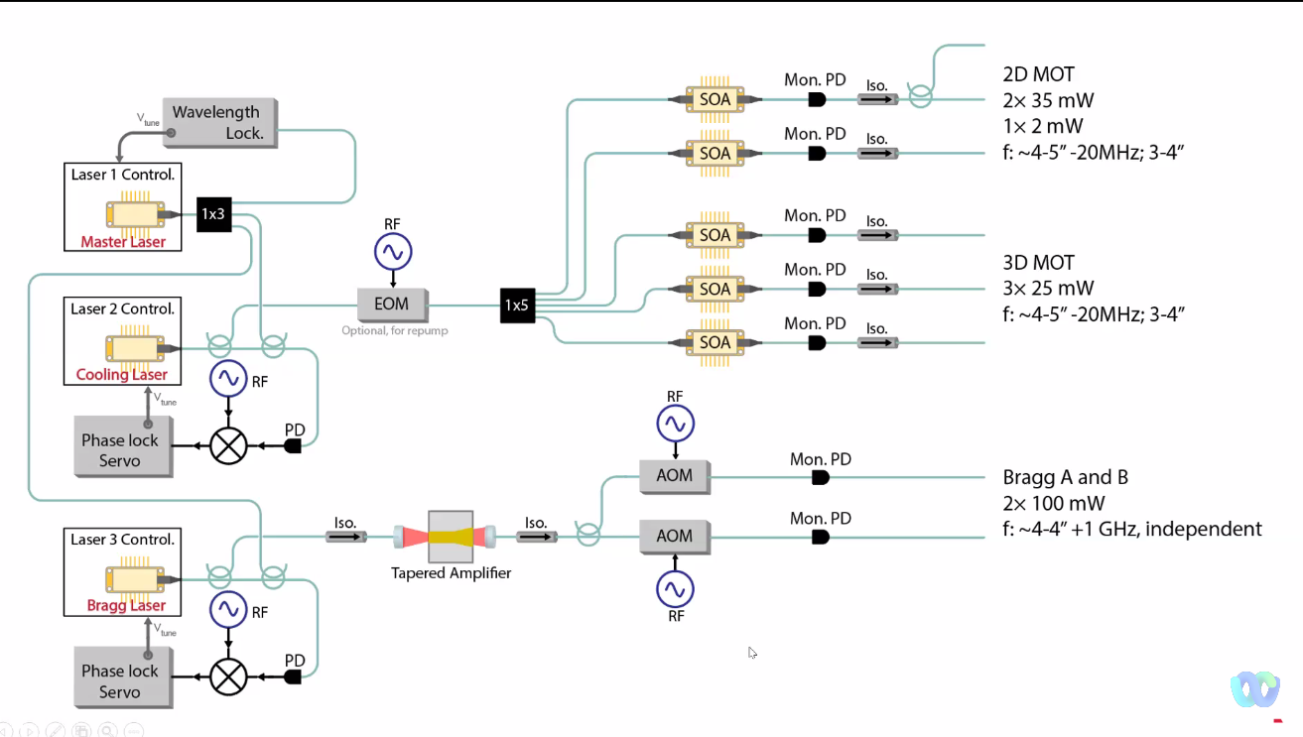
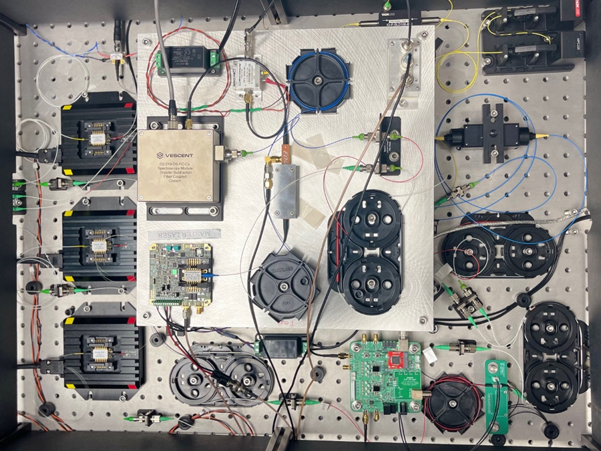
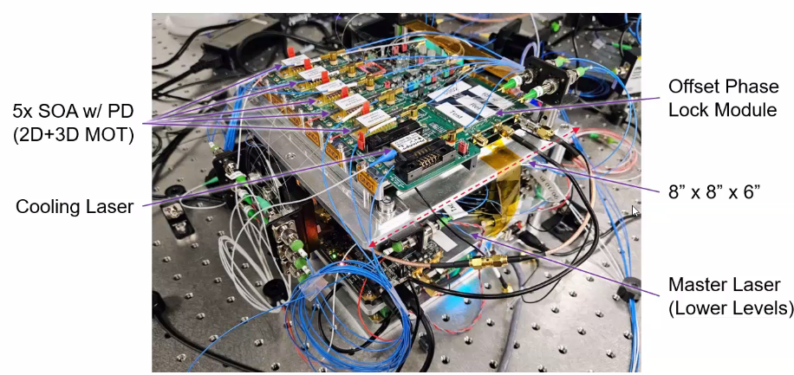
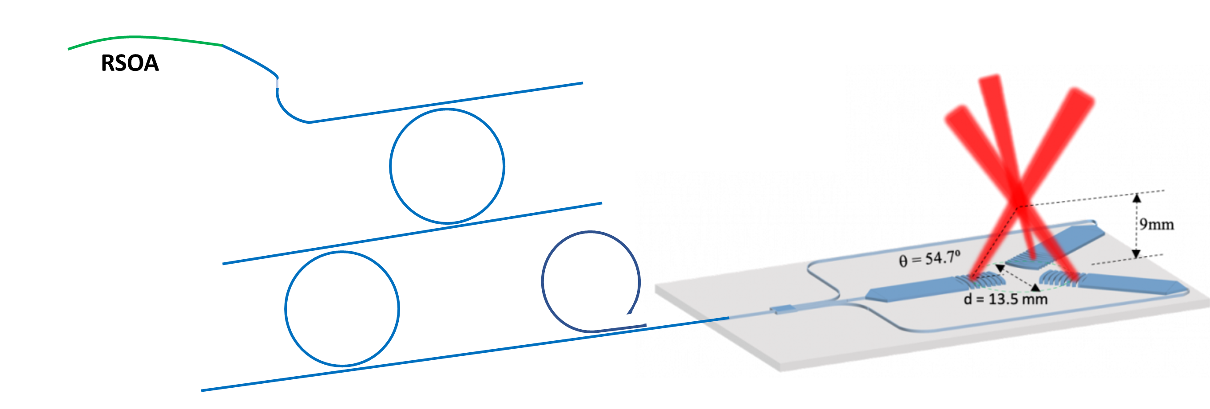
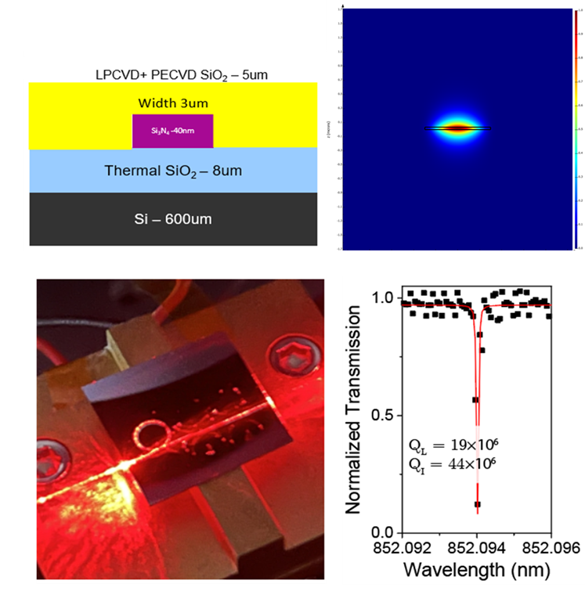
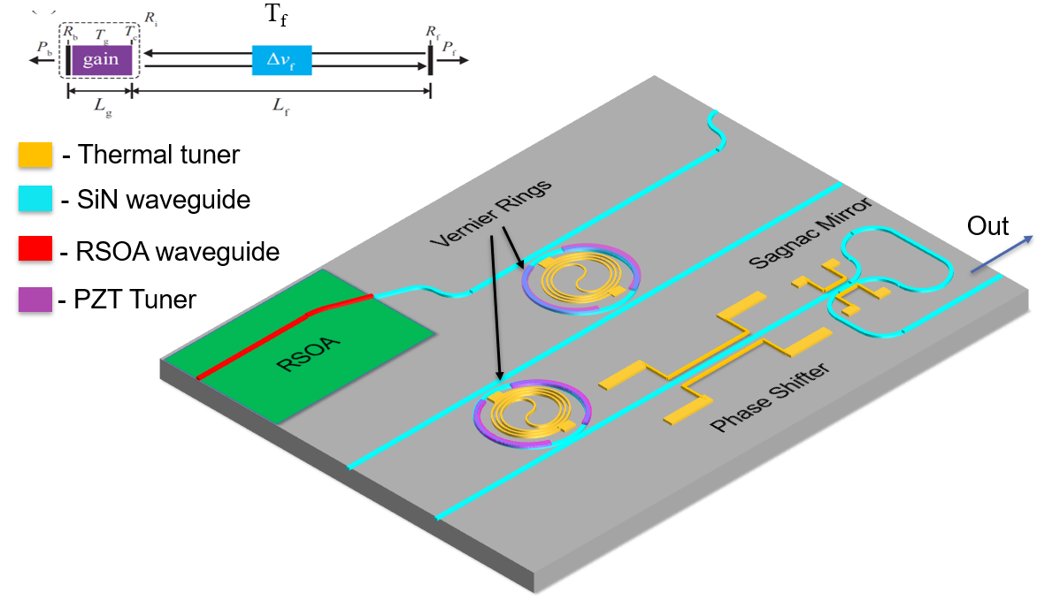
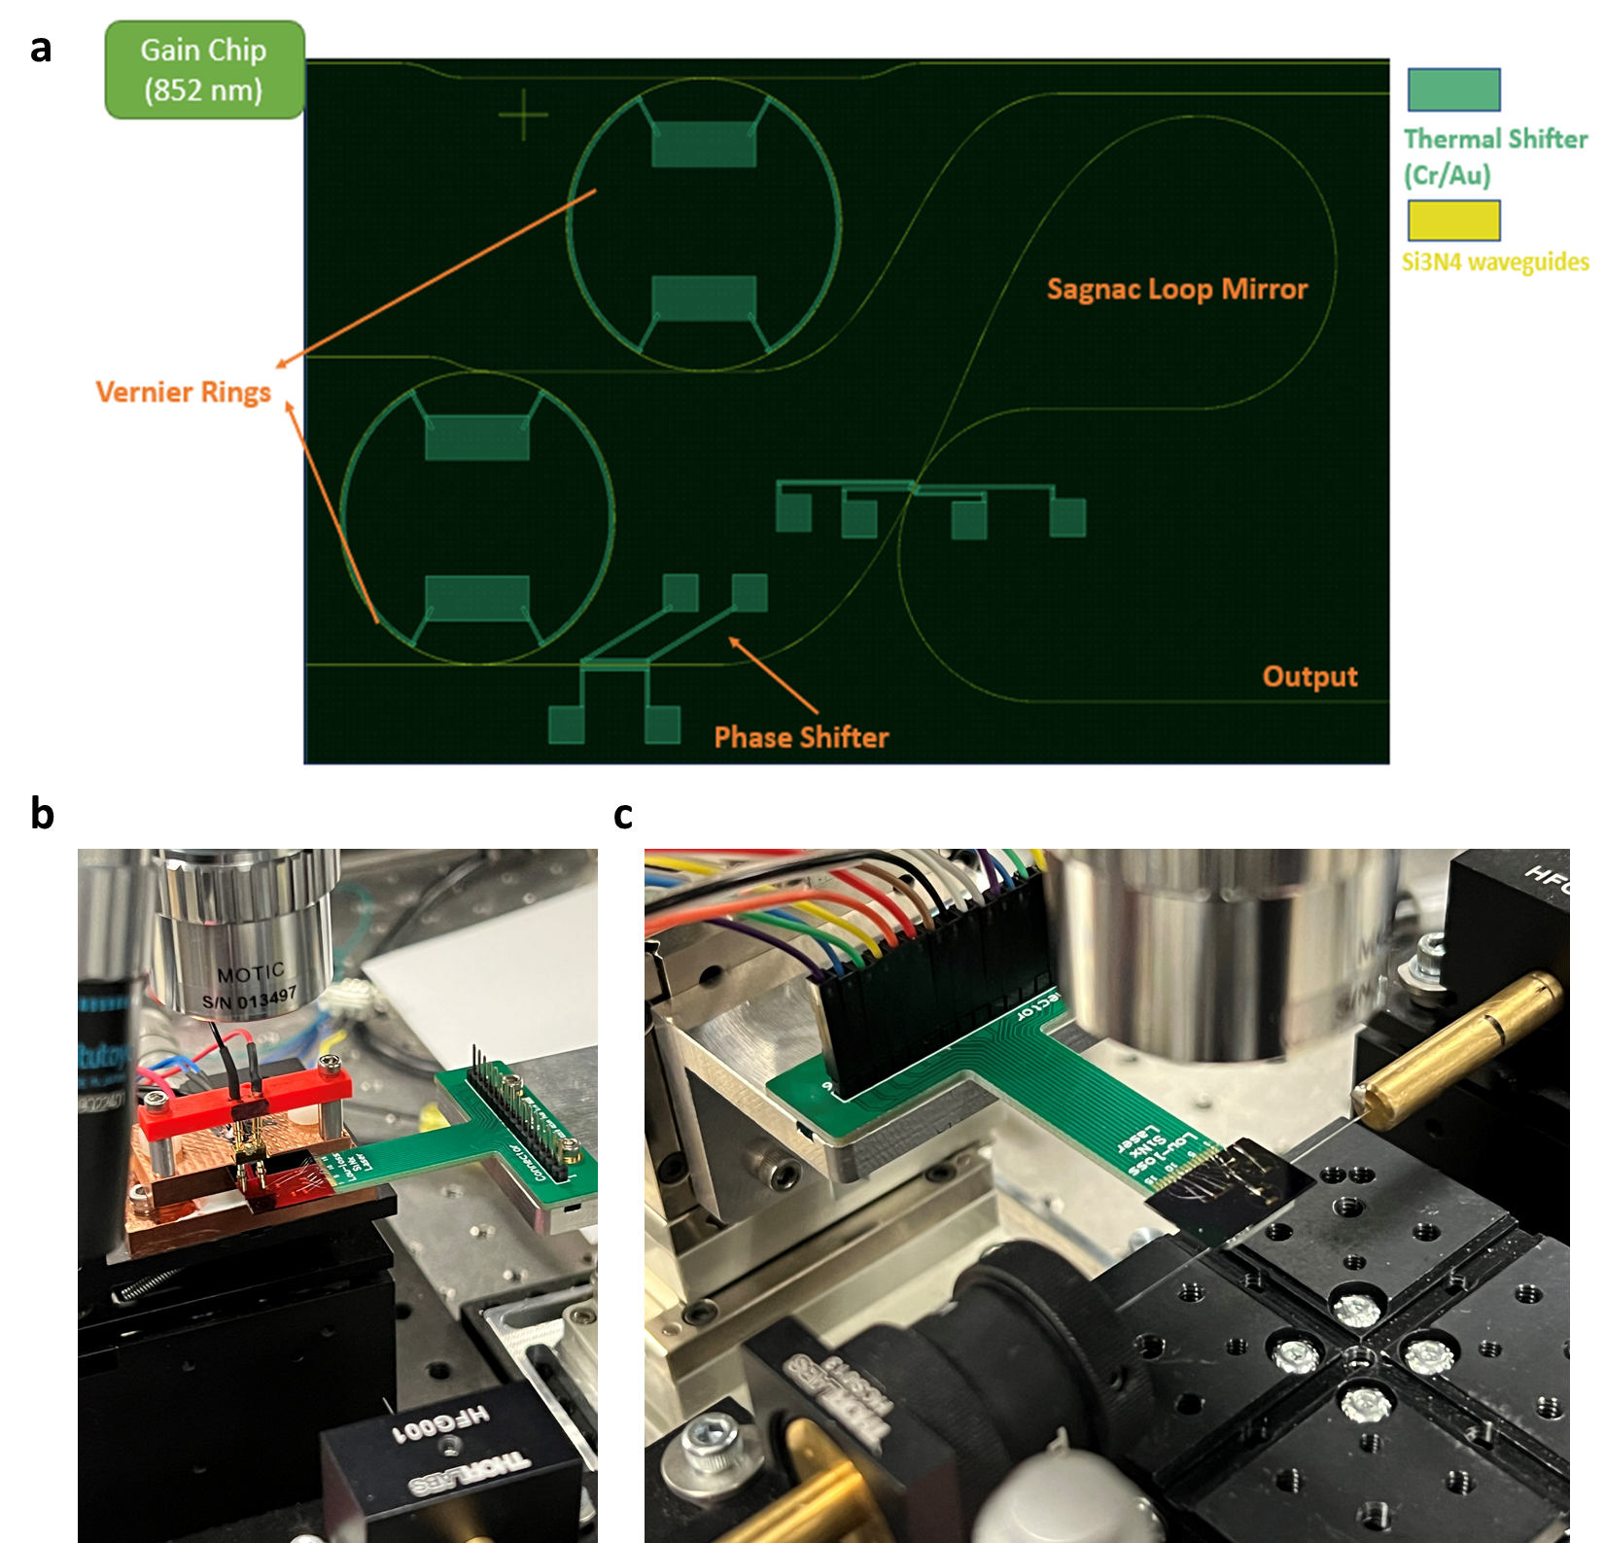
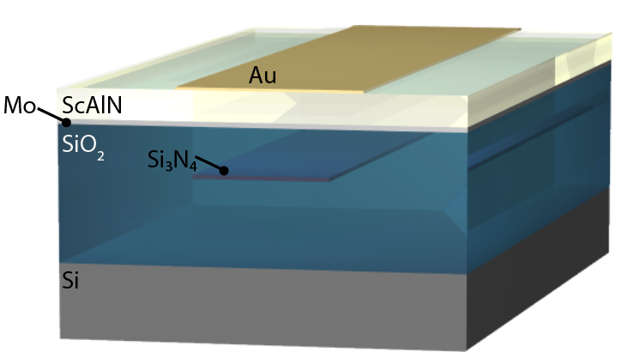
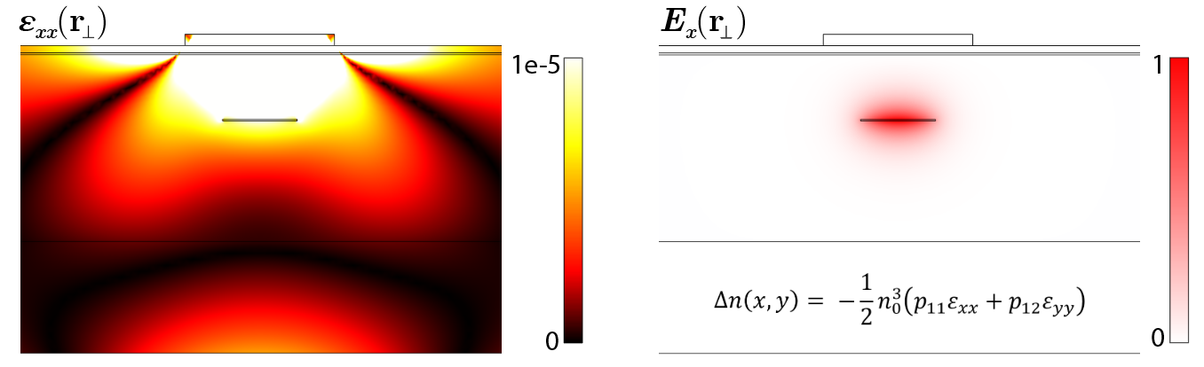
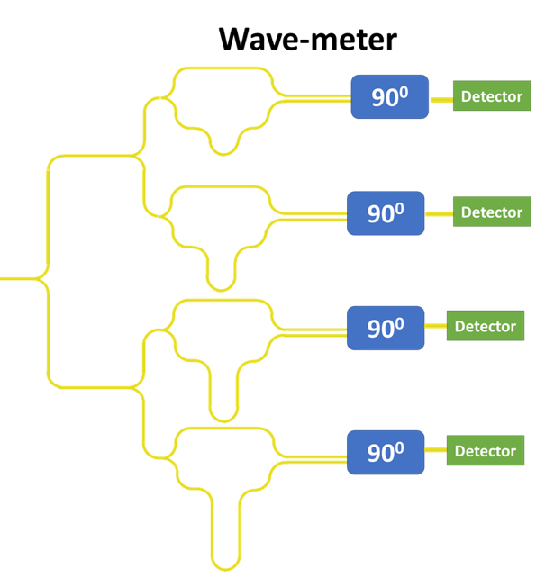
National Aeronautics and Space Administration
Postdoc Research
Low Loss Integrated Silicon Nitride Platform for Earth Science & Astrophysics applications
Author: Hani Nejadriahi (389 W)
Eric Kittlaus (389 W), Siamak Forouhar (389)
Objectives
Development of an ultra-low loss stoichiometric silicon nitride platform aimed at a range of wavelengths for miniaturization of atomic systems such as clocks, atom interferometers, and cold atom sensors including narrow-linewidth (≤ 10 kHz) external cavity lasers, piezoelectric phase shifters, and wavelength meter.
Background
Leveraging decades of experience in lasers, photonic components, and integrated photonics, JPL’s Microdevices Laboratory is developing a compact laser system based on semiconductor laser and amplifier components and custom path-to-flight control electronics.
This same approach is adaptable to a wide array of cold-atom quantum sensors, e.g. gravity gradiometers, Rydberg radar, optical atomic clocks, etc.
Significance/Benefits to JPL and NASA:
Systems based on cold atoms provide unique opportunities for an array of metrology and sensing applications. To date, these have primarily been demonstrated with bench-scale experiments in controlled laboratory environments. All of these systems require sophisticated laser systems to prepare, control, and interrogate the atomic ensemble, representing a major contribution to overall instrument footprint and power consumption.
Developing low loss silicon nitride (Si₃N₄) and leveraging this reliable platform especially in the shorter wavelengths (780-852 nm) to realize actives such as a high power and narrow-linewidth external cavity laser (ECL) and passives such as mode size couplers and interferometers positions JPL at the forefront of low SWaP and robust components for quantum-based sensors and systems. Integrated photonics technology brings a lot of funding opportunities to NASA/JPL especially in the areas of quantum sensing and systems by addressing the challenges of a laser optic system that satisfies the demanding requirements of space-qualified quantum sensor.
Approach & Results
Material Development: Our device design leverages low loss stoichiometric silicon nitride (Si₃N₄) waveguides by addressing the sources of loss through optimized waveguide designs, high quality thin films, low loss etching and cladding processes.
  Ring resonators with Q_{intrinsic} = 44 million and Q_{loaded} = 19 million were fabricated to measure the loss of 1.1 dB/m at 852 nm.
External Cavity Laser: Existing 850 nm sources are not optimal to meet the stringent requirements in quant. Conventional external cavity lasers rely on bulk optical elements that introduce fragility and hamper scalability.
The extended cavity was designed and fabricated based on a tunable pair of Vernier ring filters (Q > 40E6) for spectral filtering and single mode operation with radii~ 2 mm and an extended free spectral range (FSR) of 16 nm & 55 nm ( > Gain BW) for laser noise suppression.
Alignment and measurement of the linewidth and power are on the way.
Phase Shifter (nonreciprocal devices): Current state-of-the-art is to use thermo-optic phase shifters based on local heaters. However these are power hungry (~0.1 W/channel) and hence not cryostat compatible, can experience thermal crosstalk and hysteresis, and are relatively slow (ms).
To design and fabricate integrated optical phase shifters on-chip utilizing surface-patterned piezo-electric transducers in ScAlN.
Future Work
Fully packaging the external cavity laser along with other components i.e. isolators, wavemeters.
Improving the insertion losses for full integration of integrated photonics components in a larger system for flight compatible instruments.
Wavemeter: Determining the precise wavelength of a laser especially in atomic systems where stability of the laser is extremely important (monitoring current and temperature fluctuations), a highly precise wavemeter is being implemented in silicon nitride for high precision and spectral range.
Current integrated wavemeters are in 1550 nm only and need to have their precision improved
Our aim is to do so for 852 and short wavelengths
  Low SWaP
  Precision < 10 pm
  Given the low loss platform our imbalance lengths can be large which lead to improved accuracy
Clearance Number: CL#00-0000
Poster Number: PRD-003
Copyright 2023. All rights reserved.
National Aeronautics and Space Administration
Jet Propulsion Laboratory
California Institute of Technology
Pasadena, California
www.nasa.gov
Publications and Acknowledgements:
Daniel Blumenthal, UCSB
Author Contact Information:
(626)298-5046: hani.Nejadriahi@jpl.nasa.gov

