Slide 1



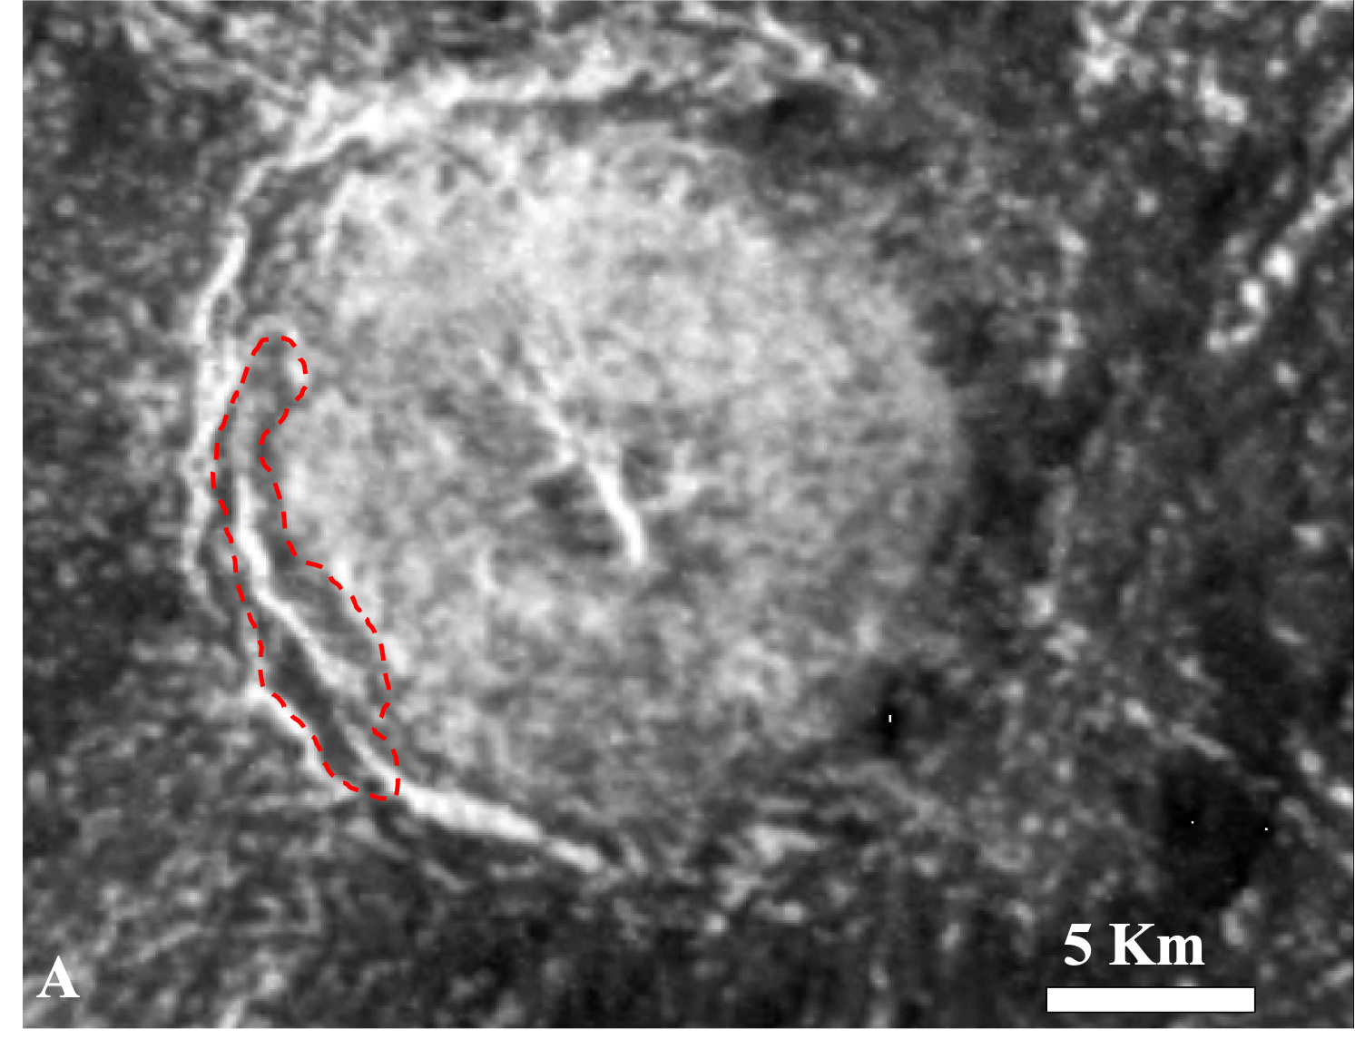
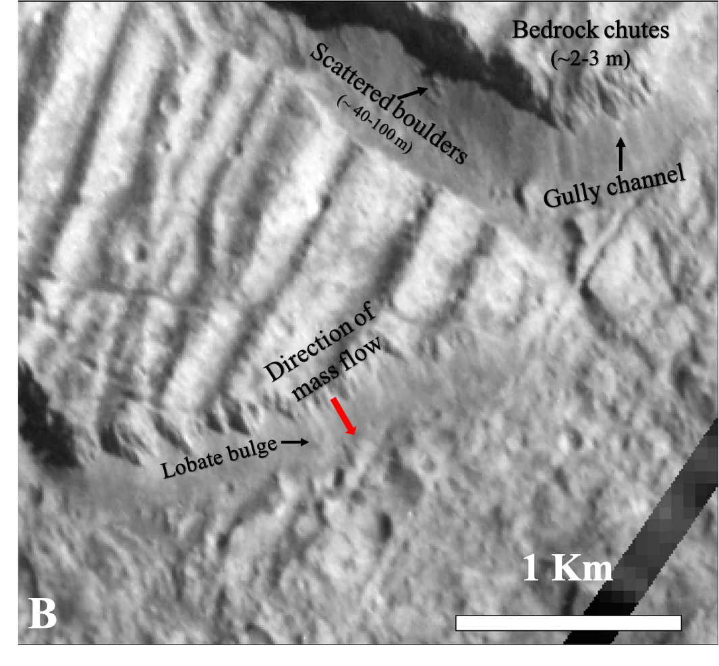
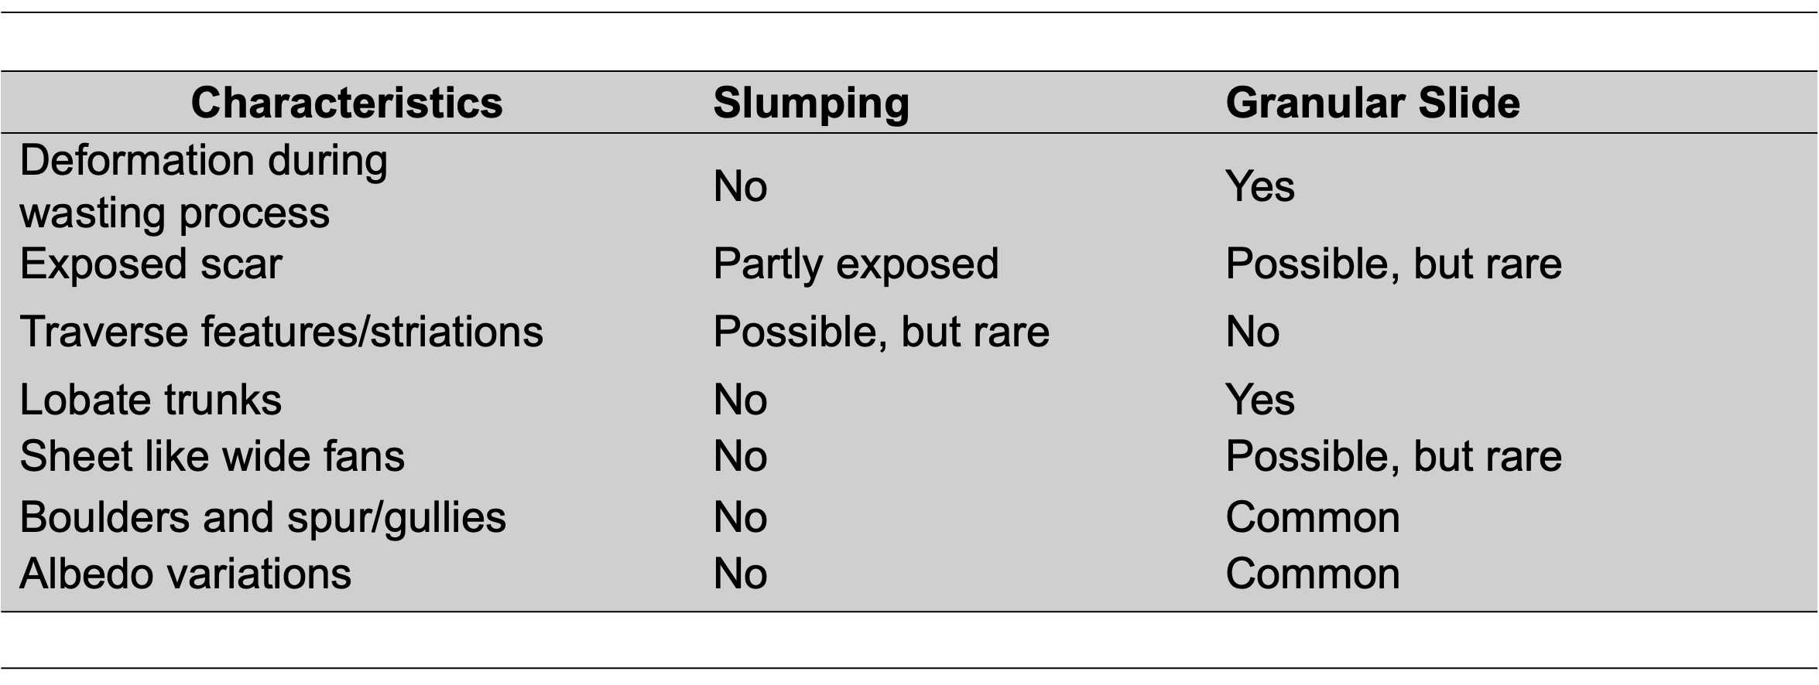
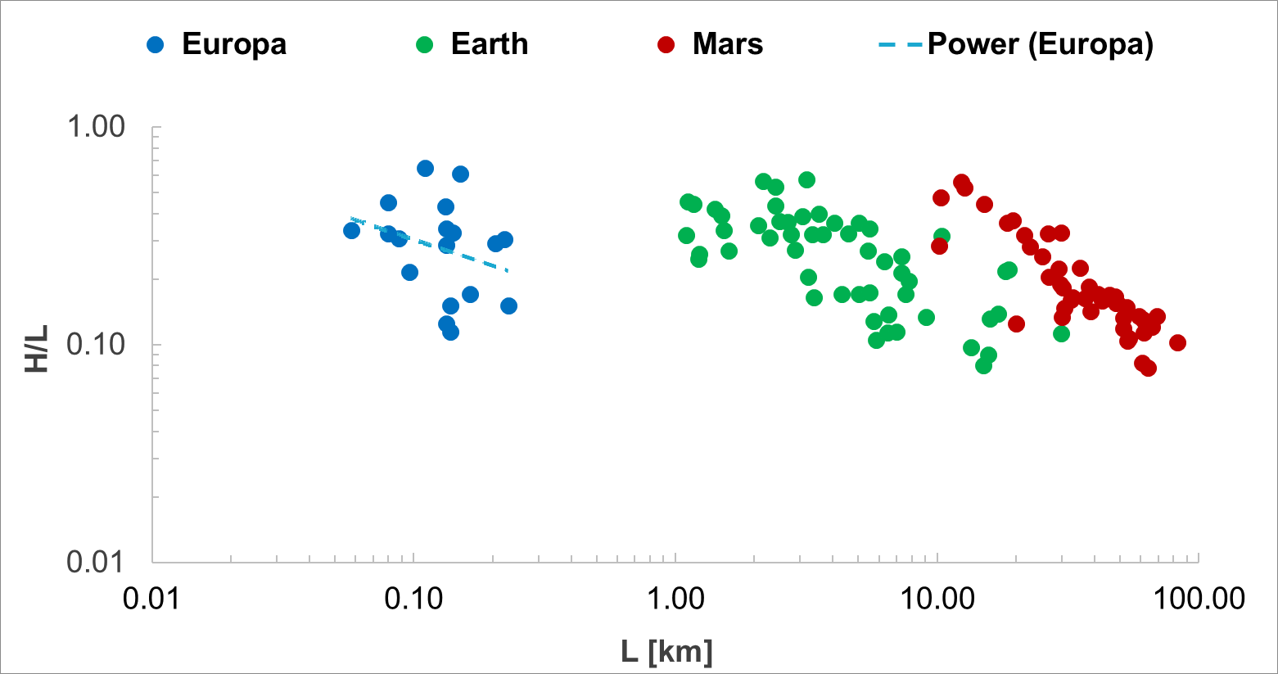
National Aeronautics and Space Administration
Postdoc Research
Mass-wasting surface degradation process on Europa
Author: Rutu Parekh¹, JPL Postdoctoral Research Fellow (3223)
Co-Author: R. Pappalardo (3200)¹, Jennifer Scully (3224)¹, Marissa Cameron¹ (398P), P. Schenk²
¹Jet Propulsion Laboratory,California Institute of Technology, ²Lunar and Planetary Science Institute, Houston
Synopsis:
Mass wasting analysis is an area of interest in the field of planetary science and the astrobiology community due to its potential influence on planetary habitability. Especially, on the surface of low-temperature bodies such as Europa where the subsurface ice-rich salty ocean is proposed to exit.
Multiple lines of evidence suggest that Europa has a thin layer of unconsolidated icy regolith material [1] however, limited knowledge is available related to the development of regolith features, mobility, and distribution at a global scale.
Analyze deposit features developed by icy regolith and estimate the effective coefficient of friction to quantify the mobility.
Methods:
Our mass wasting classification is adopted from [3] which categorizes 6 different classes namely: fall, topple, slides, lateral spread, flows, and complex mechanisms.
Each category reveals various modes of morphological features, material properties, and surface conditions.
On Europa, based on indicators (Table 1), two common morphological types were noted: slump (rotational slides) exhibiting no spreading at lateral margins, but a large cohesive block of deposit material is observed and slides associated with granular-like behavior.
The mobility of mass wasting deposits is measured by estimating the effective coefficient of friction, known as Heim’s ratio
(µ) = Drop height (h)/ Run-out length (L)
Observation & Results:
(A) Slumping block: Within Cilix (dia.: ~19 km) a ruptured slump block (~11.8 Km² area highlighted in red dashed line) in the SW region of the crater was observed. Cohesion within the detached mass prevents extensive spreading, causing a step-like topographic profile with one or multiple scarps (an overall elevation difference of ~0.02 Km).
(B) Granular slides: Within Conamara Chaos, we observed a narrow deformation zone along the steep slope of plates. The upper section of the plate is dissected by the bedrock chutes serving as an alley for weathered gullies, typically forming straight channels. From the foot of the chute, the detached deposit is
accumulated at the bottom, forming a thick bulge-like morphology at the terminal nearby to the base of the slope.
(C) On Europa there is a trend of decreasing H/L with increasing deposit L and a slope of
Conclusion:
The surface of Europa is populated with slide features (at a given resolution) involving the disintegration and spreading of the deposited material.
Slump characteristics are generally associated with craters on Europa (i.e. Cilix, Niamh) covering relatively larger deposited areas in comparison to slide.
Based on the H/L estimation, we show that displaced slide material becomes immobile on shorter distances and does not advance beyond the plate slopes whereas, similar features on Earth and Mars travel longer distances.
C
-0.40±0.3. The H/L scatter is between 0.1- 0.6, and for similar H/L a range of deposit L is observed.
Future work:
The next step is to study regolith mobility by conducting laboratory analog experiments and MARSSIM landform evolution model [4] in order to understand the rate of surface erosion on Europa.
Implications for Europa Clipper and JUICE mission:
This study identifies and maps the sites of icy regolith transposition which can be used as a recommendation for E-THEMIS and REASON instruments on board the Clipper to map the erosional process on the surface of Europa.
Next, mass-wasting surface features on Europa are well–preserved. Therefore, their observation is of a high area of interest for potential sites of active surface in the recent past, an overlapping the science goal of the ESA’s JUICE mission and NASA’s Europa Clipper mission.
National Aeronautics and Space Administration
Jet Propulsion Laboratory
California Institute of Technology
Pasadena, California
www.nasa.gov
Publications and Acknowledgements:
[1] Moore, Jeffrey M., et al. Surface properties, regolith, and landscape degradation. Tucson: University of Arizona Press, 2009. [2] Parekh, Rutu, et al. "Influence of volatiles on mass wasting processes on Vesta and Ceres." Journal of Geophysical Research: Planets 126.3 (2021): e2020JE006573. [3] Dikau, R., Brunsden, D., Schrott, L., & Ibsen, M.-L. (1996). Book review: Landslide recognition: Identification, movement, and causes (21). New York, NY: Wiley and Sons.
[4] White, O. L., O. M. Umurhan, J. M. Moore, and A. D. Howard (2016), Modeling of ice pinnacle formation on Callisto,
J. Geophys. Res. Planets, 121, 21–45, doi:10.1002/2015JE004846.
Rutu Parekh: (626)-379-0536, rutu.a.parekh@jpl.nasa.gov
Clearance Number: CL#00-0000
Poster Number: PRD-P-034
Copyright 2023. All rights reserved.

