Slide 1

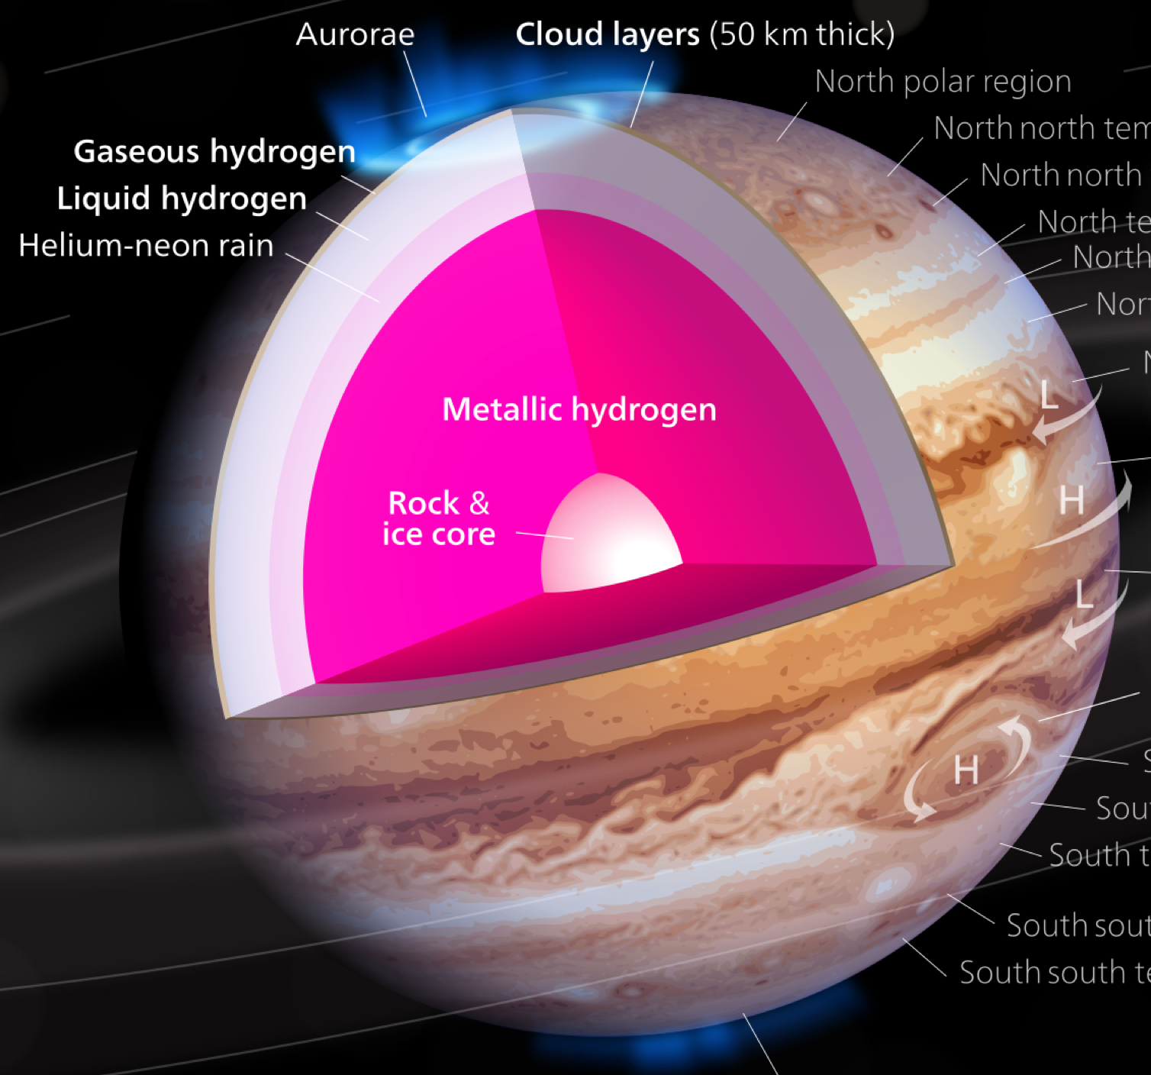
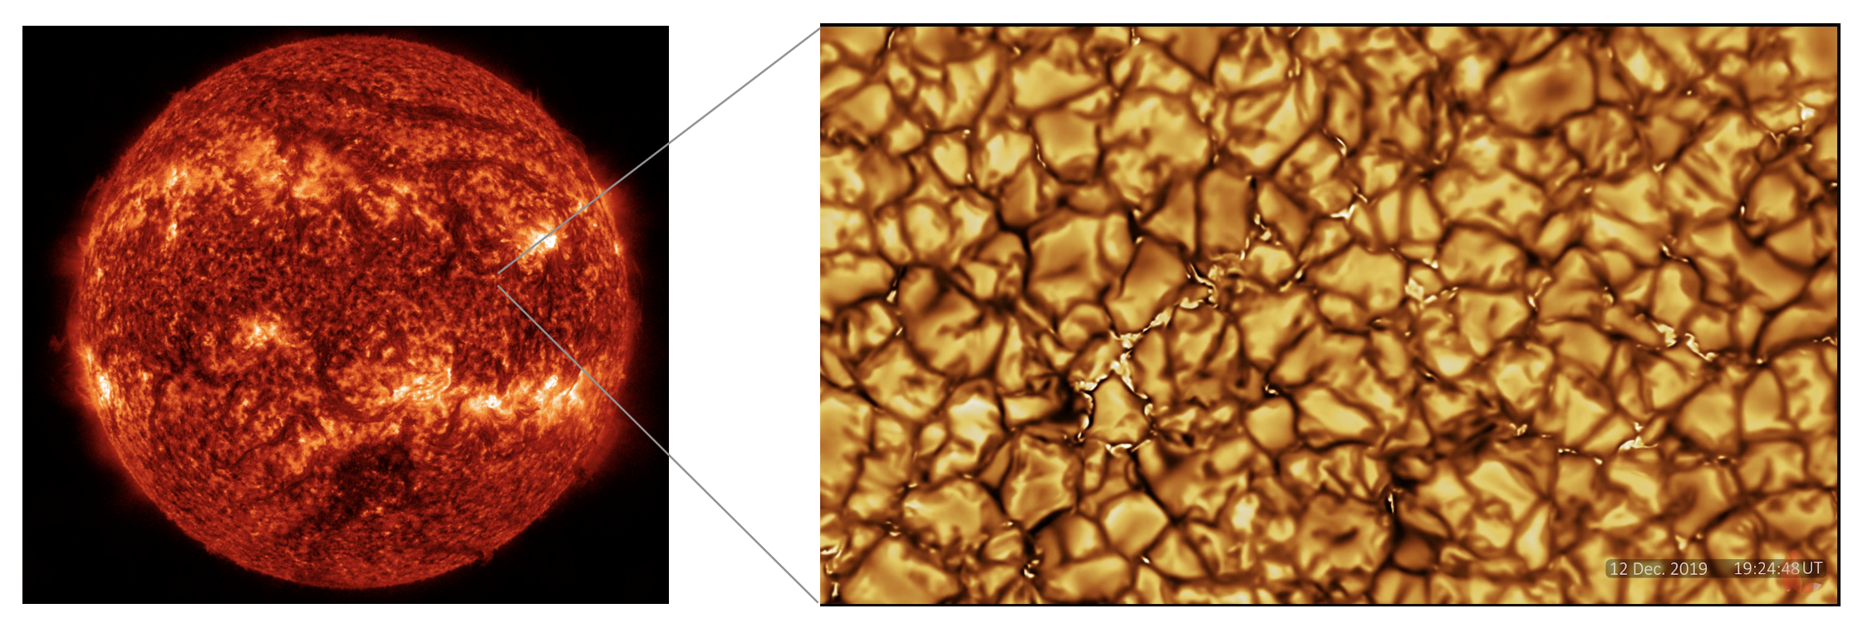
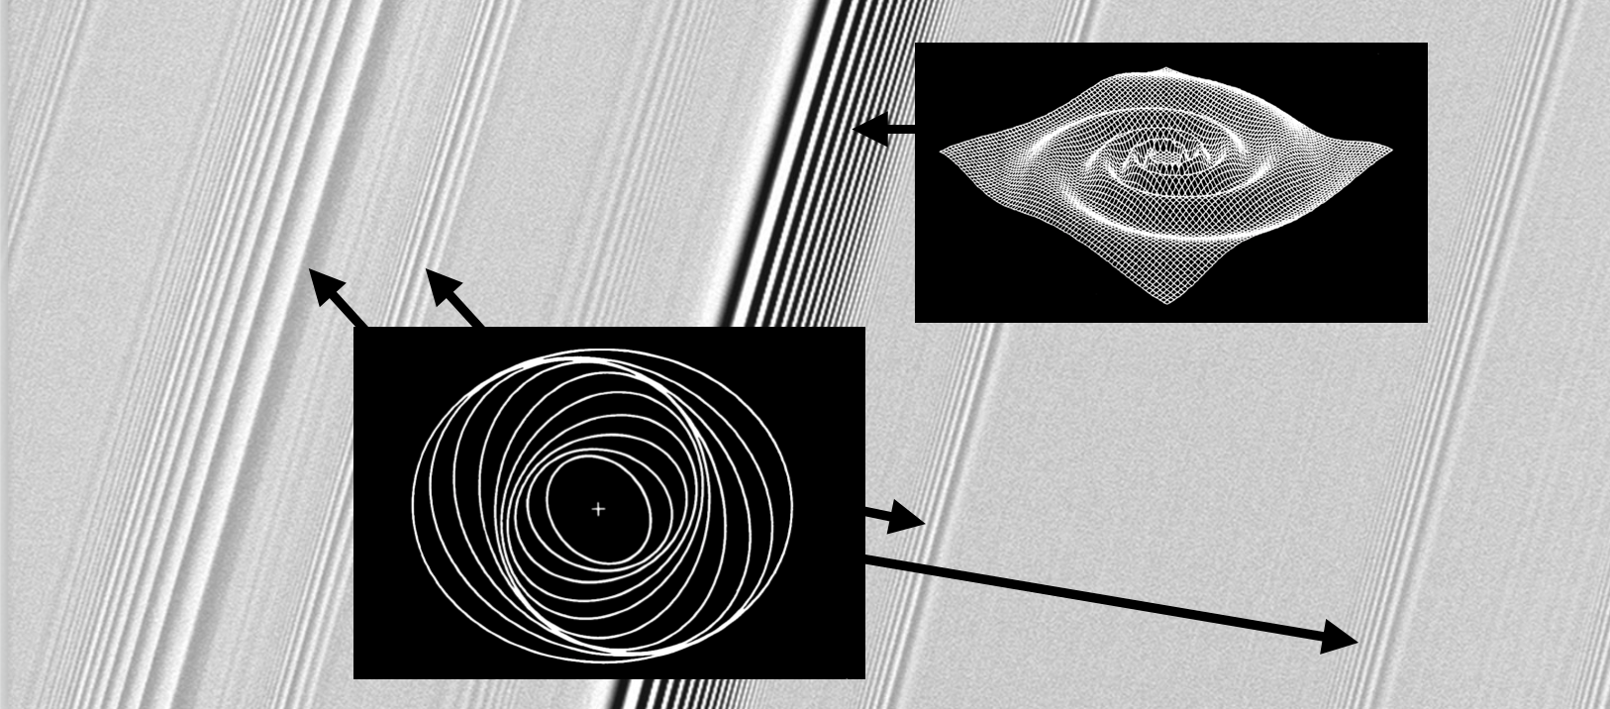
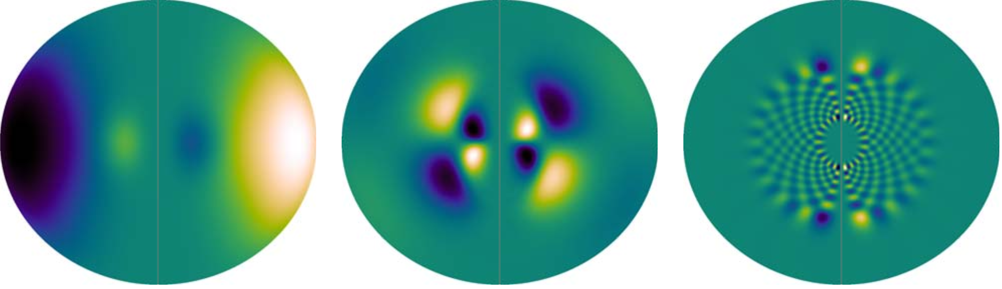

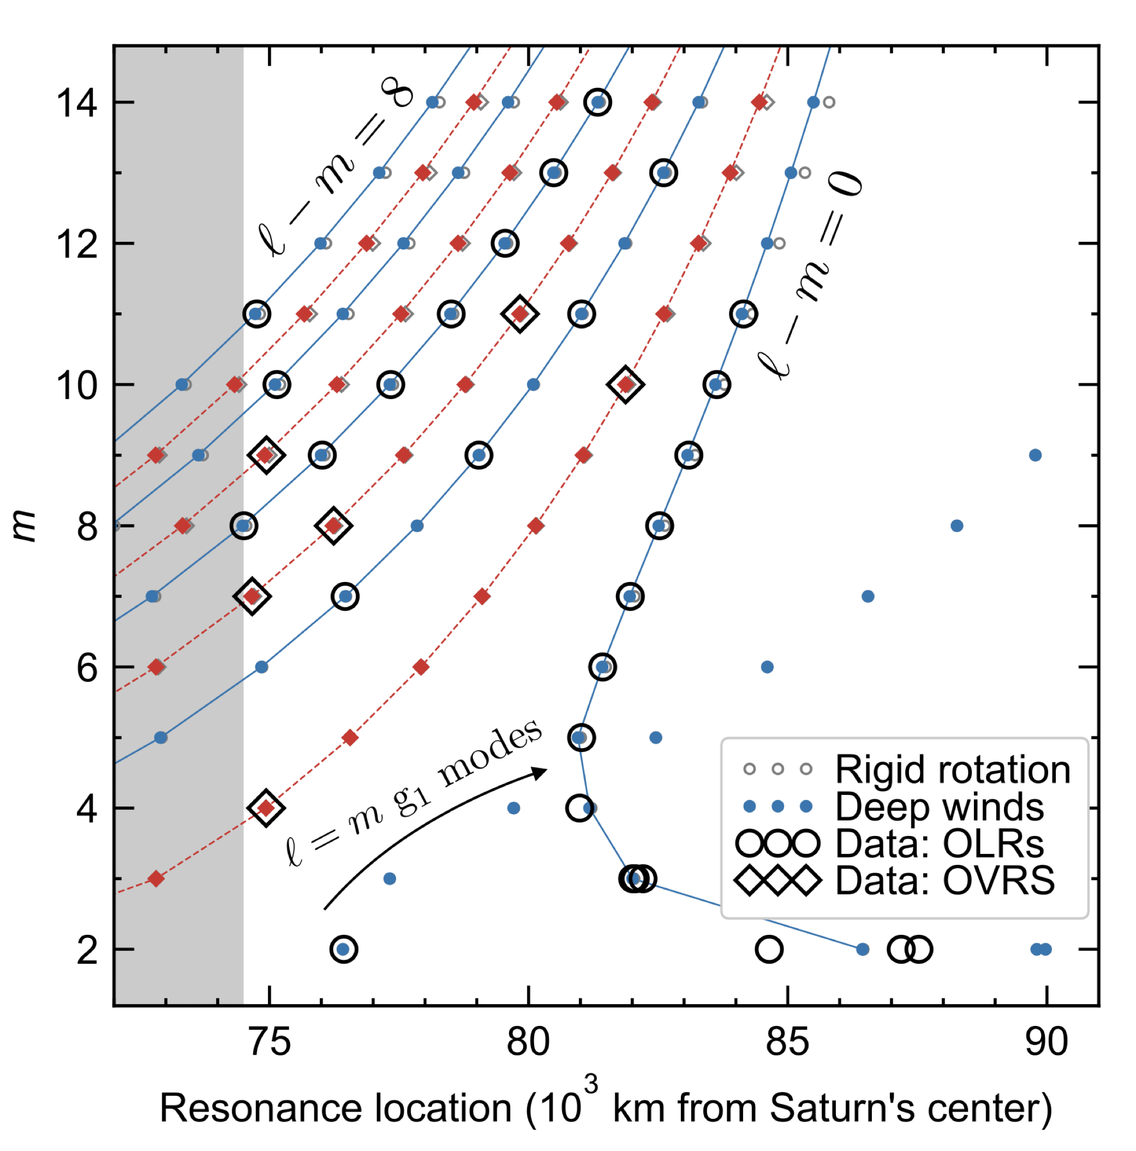
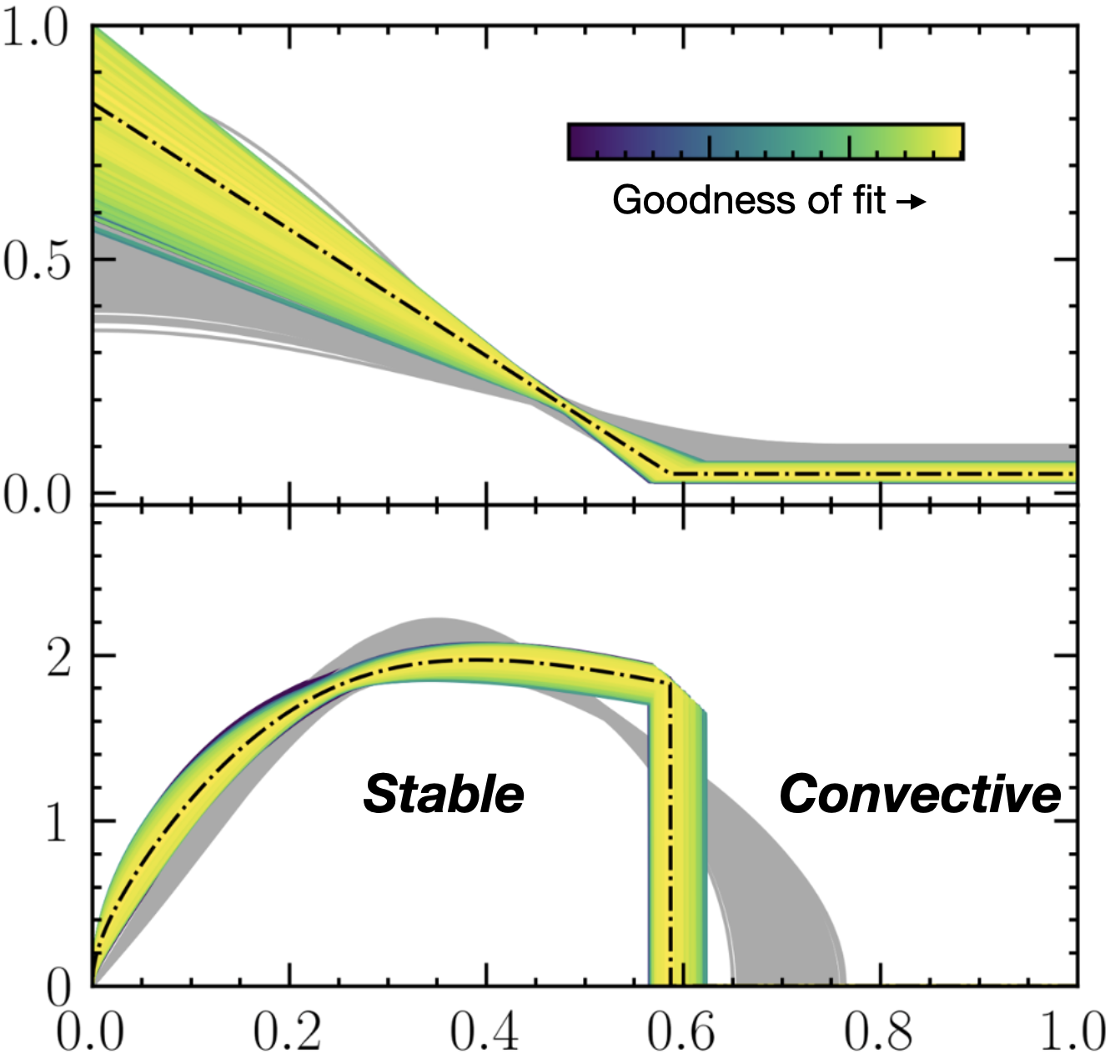
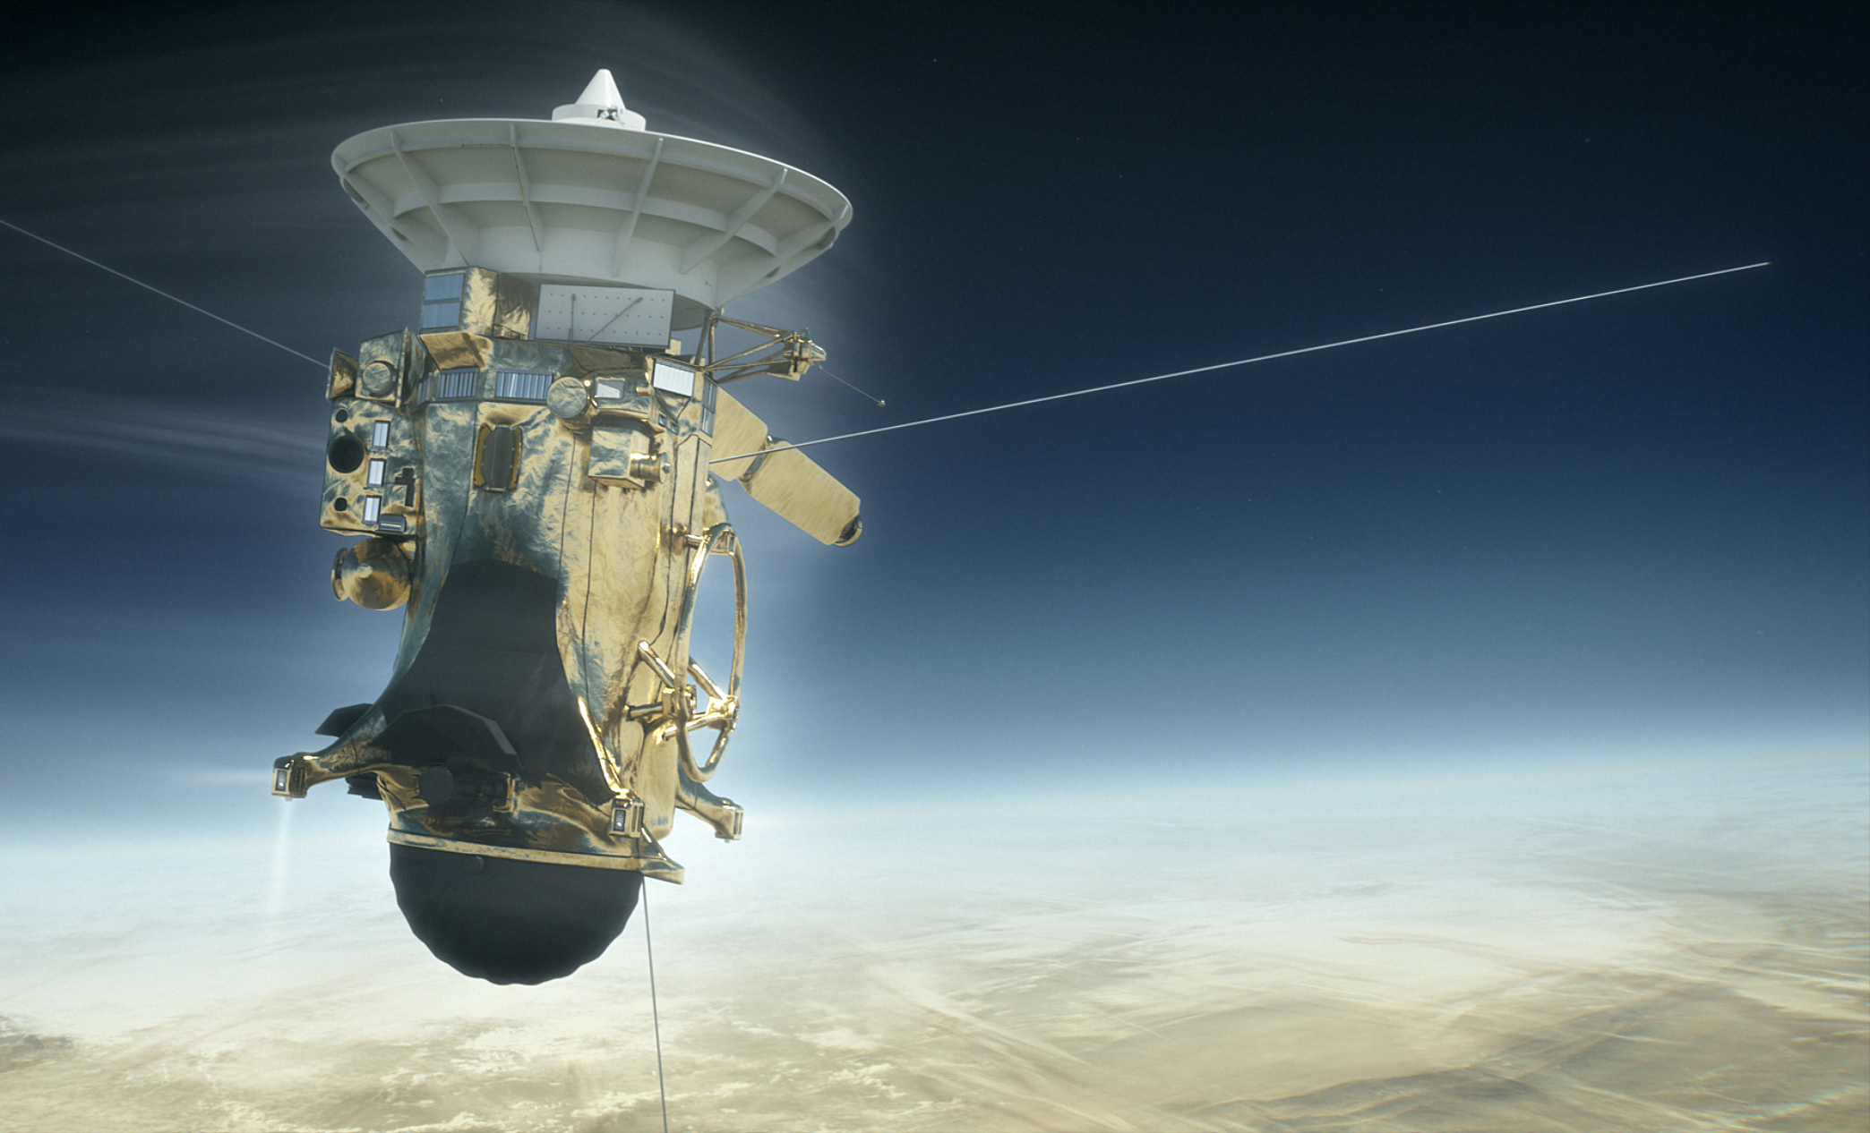
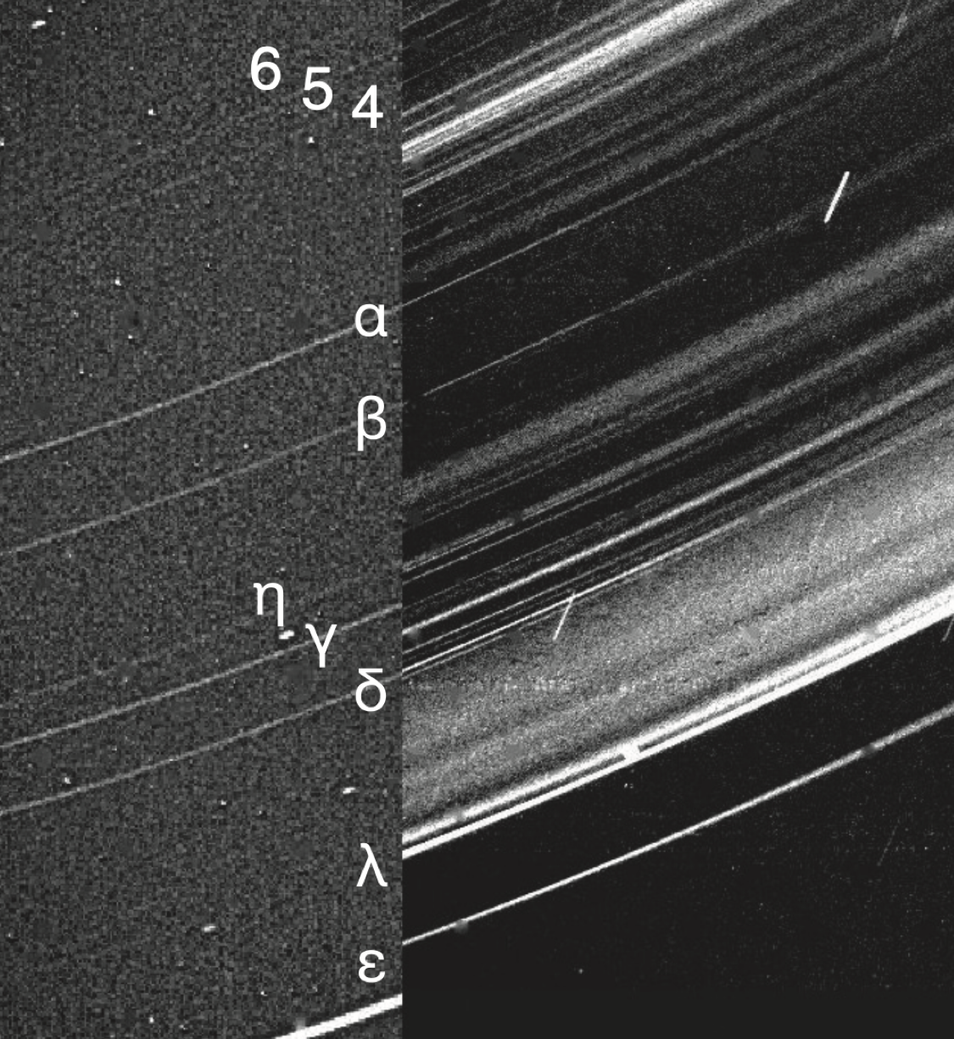
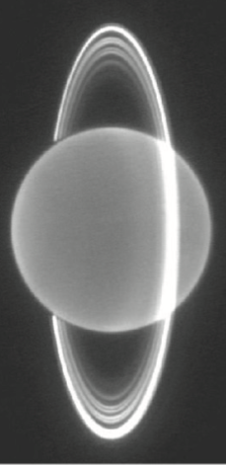
National Aeronautics and Space Administration
Postdoc Research
Using Saturn’s Rings as a Seismograph for Planetary Oscillations
Author: Chris Mankovich, NASA Postdoctoral Fellow (3222)
Supervisor: Mark D. Hofstadter (3222)
Background
Are gas giants fully convective, like the outer layers of the Sun?
Do gas giants have solid cores?
Wikipedia version of Jupiter’s internal structure
Big picture: How do giant planets cool over time? What is the origin of planetary magnetism?
Big picture: How do planets form? What were conditions like in the young solar system?
How does matter behave at extreme pressure?
Objectives and Approach
Saturn’s rings are a natural laboratory for planetary seismology.
Nonspherical oscillations in Saturn’s interior force waves in Saturn’s rings¹ that were measured by NASA’s Cassini spacecraft²⁻⁶.
I use these waves’ frequencies and pattern numbers (number of spiral arms) to provide novel constraints on my models for Saturn’s internal structure.
The seismic fingerprints of Saturn’s core show that it lacks any sharply defined boundary⁷⁻⁸.
Mass fraction of ices + silicates
(remainder is hydrogen and helium)
This composition gradient renders a huge part of Saturn’s interior stable to convection⁸⁻⁹.
Azimuthal pattern number m
Buoyancy frequency
In units of Saturn’s dynamical frequency (GM/R³)^{1/2}
The >30 known modes also constrain Saturn’s uncertain rotation¹⁰⁻¹¹ and confirm the gravity science result that strong zonal winds penetrate >7,000 km into the planet¹²⁻¹³.
Model (rigid rot.)
Model (winds)
Detections in Cassini VIMS
Fractional radius within Saturn
Location of resonances in Saturn’s rings
(thousands of km from Saturn’s center)
Significance of Results and Benefits to NASA/JPL
Honing our theoretical tools to enhance scientific return from Cassini even now, 6 years after the Grand Finale and 19 years after Saturn Orbit Insertion.
Augmenting traditional gravity science with a new, powerful tool that breaks degeneracies concerning composition, since oscillation modes probe fluid stability directly.
Setting the stage for exploring frontiers in the outer solar system…
Future Work
Uranus’s narrow dusty rings
The confinement of Uranus’s narrow rings is largely unexplained, and “shepherding” by Uranian normal modes might be responsible for several of these features¹⁴. In preparation for NASA’s Flagship mission to Uranus, I am now using the same methods we have applied to Saturn to quantify how the detection by a Uranus orbiter of resonant signatures in the rings would empower us to rule out some models for Uranus’s interior. This work also advocates for a Doppler imager that would be sensitive to higher frequency (acoustic) oscillation modes.
National Aeronautics and Space Administration
Jet Propulsion Laboratory
California Institute of Technology
Pasadena, California
www.nasa.gov
References
[1] Marley & Porco 1993 (Icarus)
[2] Hedman & Nicholson 2013 (AJ)
[3] Hedman & Nicholson 2014 (MNRAS)
[4] French et al. 2016 (Icarus)
[5] French et al. 2021 (Icarus)
[6] Hedman et al. 2022 (PSJ)
[7] Fuller 2014 (Icarus)
[8] Mankovich and Fuller 2021 (Nat. Astron.)
[9] Friedson, Parisi et al. 2023 (Icarus)
[10] Mankovich, Marley et al. 2019 (ApJ)
[11] Dewberry, Mankovich et al. 2021 (PSJ)
[12] Dewberry, Mankovich, Fuller 2022 (MNRAS)
[13] Mankovich, Dewberry, Fuller 2023 (PSJ)
[14] A’Hearn, Hedman, Mankovich et al. 2023 (PSJ)
Some of this research was carried out at the Jet Propulsion Laboratory, California Institute of Technology, under a contract with the National Aeronautics and Space Administration (80NM0018D0004).
Clearance Number: CL#00-0000
Poster Number: PRD-P-033
Copyright 2023. All rights reserved.
Contact: mankovich@jpl.nasa.gov

