Slide 1

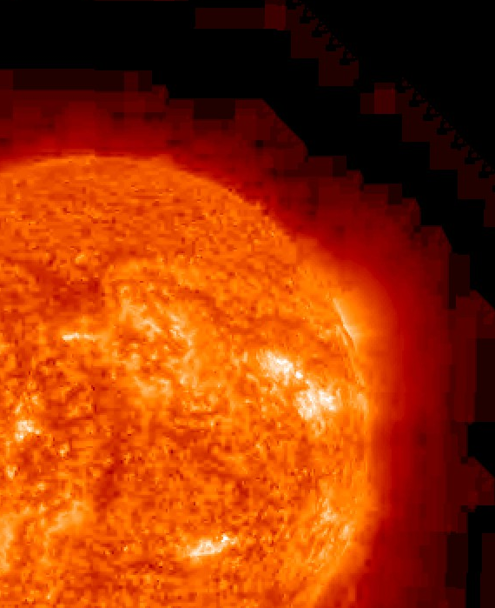


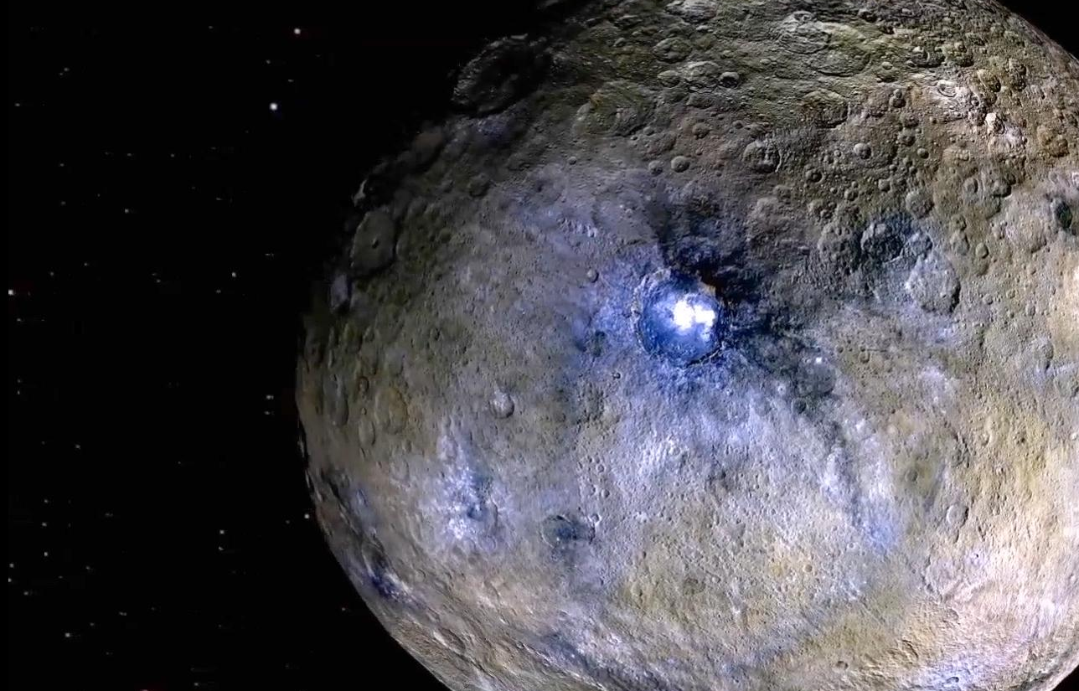
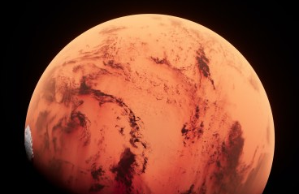
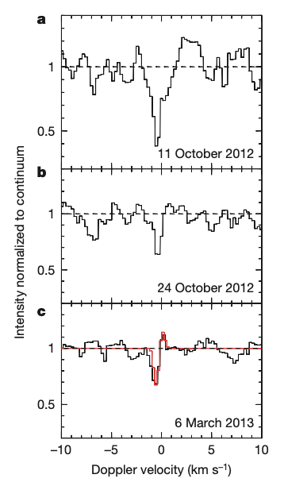
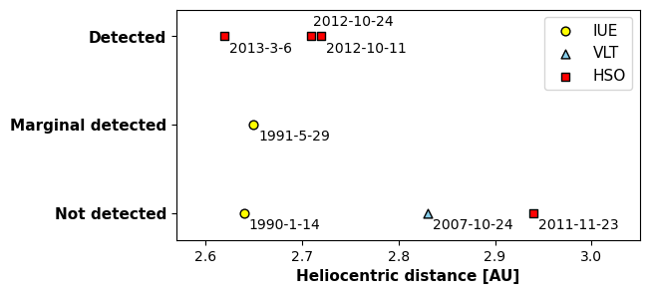
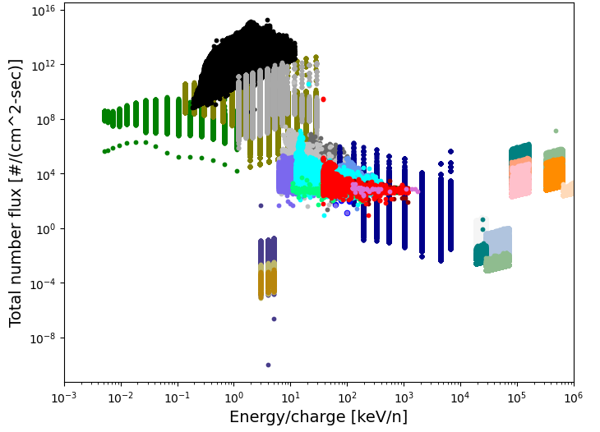
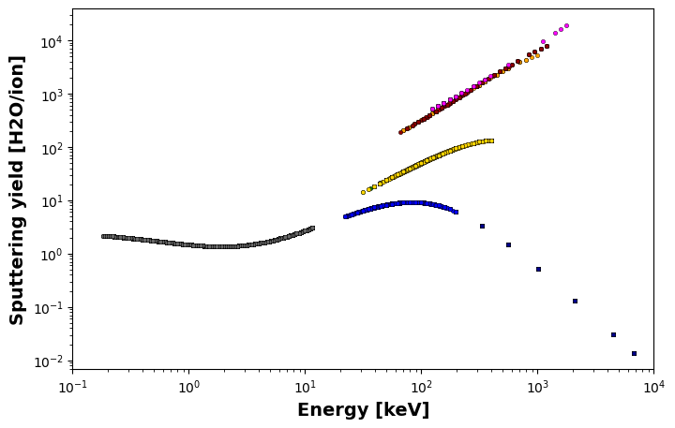
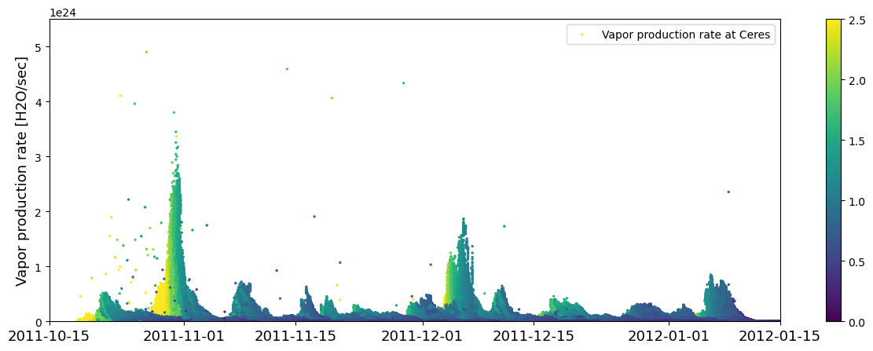
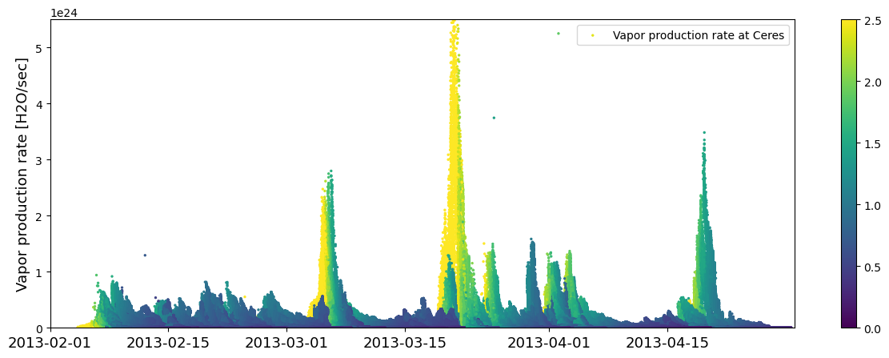
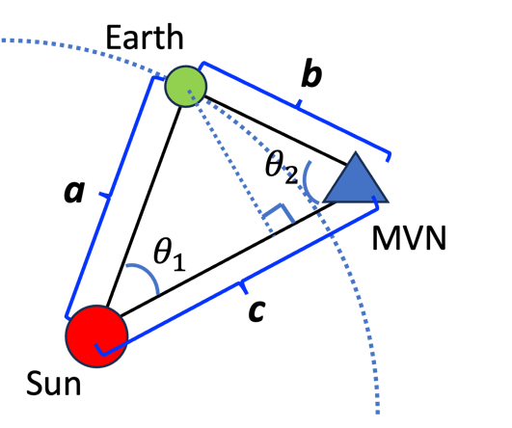
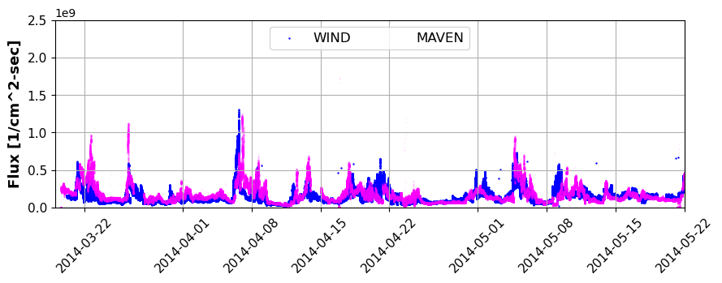
National Aeronautics and Space Administration
Postdoc Research
Ice to water vapor on Ceres: solar sputtering
Kyoungwon (Mary) Park, JPL Postdoctoral Fellow (398)
Paul von Allmen (398)
H+
v
Earth
H+
H₂O
Ceres
Sun
H+
Mars
H+
Background
Discovering the presence of water beyond our planet is consistently captivating, as water constitutes the fundamental element for sustaining life and habitability. The Herschel Space Observatory (HSO) achieved the milestone of directly detecting water vapor in the exosphere of Ceres, a dwarf planet renowned for harboring a substantial water content (17 to 27 wt.%) as shown in Figure 1. The comprehensive analysis of these observations allows us to estimate the rate of water vapor production at ~ 10²⁶ H₂O/s ( ~ 6 kg/s). The water vapor production rate at this level was not consistently detected but rather observed intermittently, without a clear dependence on Ceres' proximity to the Sun (Figure 2). This suggests that the primary mechanism for
water vapor production, which is linked to surface temperature (i.e., sublimation), does not fully account for the origin of the observed water vapor in the telescopic observations of Ceres. Indeed, sublimation from Ceres is projected to be two orders of magnitude lower than what we observe through telescopes [2]. Consequently, it becomes imperative to identify additional mechanisms that bridge the gap between our telescopic observations and the predicted values, helping us comprehend the sources and processes responsible for the presence of water vapor.
Fig. 2 Heliocentric distance of Ceres from the Sun when IUE, VLT and HSO attempted to detect water in Ceres
Objectives
We investigate the rate at which ionized particles from the solar wind (SW) interact with the water ice present on the surface of Ceres, leading to water vapor formation through a process known as sputtering. Our study utilizes real data, specifically the number flux and energy information of various ionized particles measured by spacecraft in space.
Approach and Results
We employed real data collected by the WIND spacecraft (located at the L1 point) in space. This data includes comprehensive information on time-dependent solar activity, along with the corresponding differential flux and energy data for charged particles. Figure 3 illustrates
Fig. 1 Spectra of the ground-state transition line 1₁₀-1₀₁ of ortho-water at 556.939 GHz colleced by HIFI Wide-band spectrometer of HSO [1]
the relationship between the total number flux and the energy of particles in the SW collected from WIND. Among the various particles present in the solar wind, protons (H⁺) in the energy range of 1－10 keV exhibit the highest flux. The sputtering yield of water by different charged particles at varying energy levels is depicted in Figure 4. Notably, heavy ions with energies in the MeV range, such as Fe, O, and C ions, possess sputtering capabilities for water that are 4－5 orders of magnitude greater than lighter He ions and protons. However, it is important to highlight that protons with energies in the 1－10 keV range exhibit significantly higher flux levels, by more than 10⁶. Consequently, the primary contributors to the sputtering of water ice are protons within the energy range of 1－10 keV.
H⁺
WIND Data:
03/01/2014 – 07/20/2014
T=140K
Fe¹⁰⁺
H₂O was not detected on 11/23/2011
At Oxo crater
e-
H⁺
He
O⁺, O⁶⁺
C⁵⁺
Energy [keV]
e-
H+
H⁺
He
He⁺, He²⁺
(a)
He+
He²⁺
CNO
CNO
O⁺
O⁶⁺
Fe
Fe
H⁺
H₂O was detected on 3/6/2013
At Oxo crater
He
H⁺
H⁺
H⁺
O
He
He
Energy [keV]
Fe
[1]
(b)
Fig. 3 Plot of total number flux derived from differential number flux of various charged particles as measured by WIND, versus the energy of the particles.
Fig. 4 Sputtering yield of water by various charged particles in a wide range of energy. Sputtering yield of water is estimated based on the energy of particles measured by WIND and an empirical formula [3, 4], at 140 K.
Fig. 5 Vapor production rate on Ceres during the times when HSO attempted to detect water vapor. These rates are predicted by combining the total number flux of protons with E < 10 keV (Fig. 3) propagated to the location of Ceres with the sputtering yield (Fig. 4) under the assumption that water vapor originates from Oxo crater (exposed ice area ≃ 6.8 km² (estimated from DAWN mission), at 140 K)
Water vapor production resulting from the sputtering of protons of 1－10 keV energy aligns with the telescopic observation. Specifically, a notable peak in the vapor rate coincided with the day when HSO detected water vapor (Figure 5(b)). Conversely, there was no discernible increase in the vapor production activity when HSO did not detect water vapor as shown in Figure 5(a). The highest vapor production rate originating from the SW sputtering reaches ~10²⁵ H₂O/s.
Significance of Results/Benefits to NASA/JPL
This study yields significant insights in several key areas:
SW sputtering’s Role: SW sputtering is a significant factor influencing water vapor production on Ceres
Utilization of Real Data: This study utilizes physical data collected by spacecrafts, propagating them to to Ceres’
location after validation with MAVEN in Figure 6. This approaches successfully interprets the transient water vapor
observation on Ceres. This methodology can be applied to estimate the impact of SW sputtering on water vapor or
exosphere formation in other icy moons, without the need for additional spacecrafts near the target planet.
3) Future Prospects: This research can be expanded upon in future work to explore the SW sputtering effect on the
water vapor formation from the water-rich regolith (phyllosilicate) in Ceres or other celestial bodies like Europa.
This expansion aims to enhance our understanding of the mechanism responsible for the substantial water vapor
presence observed in the exosphere of Ceres.
Fig. 6 Flux propagated from WIND to the location of MAVEN spacecraft. Flux measured by MAVEN was superimposed on the propagated WIND data.
Future Work
This research opens up several promising avenues for future investigations:
Improved solar wind propagation models : utilizing more advanced models such as
the Parker spiral model or implementing machine learning-based prediction.
Prediction of water vapor production rate from water-rich regolith in Ceres
References
[1] M. Küppers et al. Nature, 505 (2014), 525-527.
[2] F. P. Fanale & J. R. Salvail, Icarus, 82 (1989) 97-110.
[3] Fama et al., Surface Science, 602 (2008) 156-161
[4] R. E. Johnson et al., Composition and detection of Europa’s sputter-induced atmosphere, Europa (pp. 507-527). Tuscon, Arizona, USA: The University of Arizona Press.
Clearance Number: CL#00-0000
Poster Number: PRD-P-032
Copyright 2023. All rights reserved.
National Aeronautics and Space Administration
Jet Propulsion Laboratory
California Institute of Technology
Pasadena, California www.nasa.gov
Publications and Acknowledgements:
Manuscript is in preparation.This research is supported by ROSES DDAP project Author Contact Information: (626) 319-4381, mary.park@jpl.nasa.gov

