Slide 1

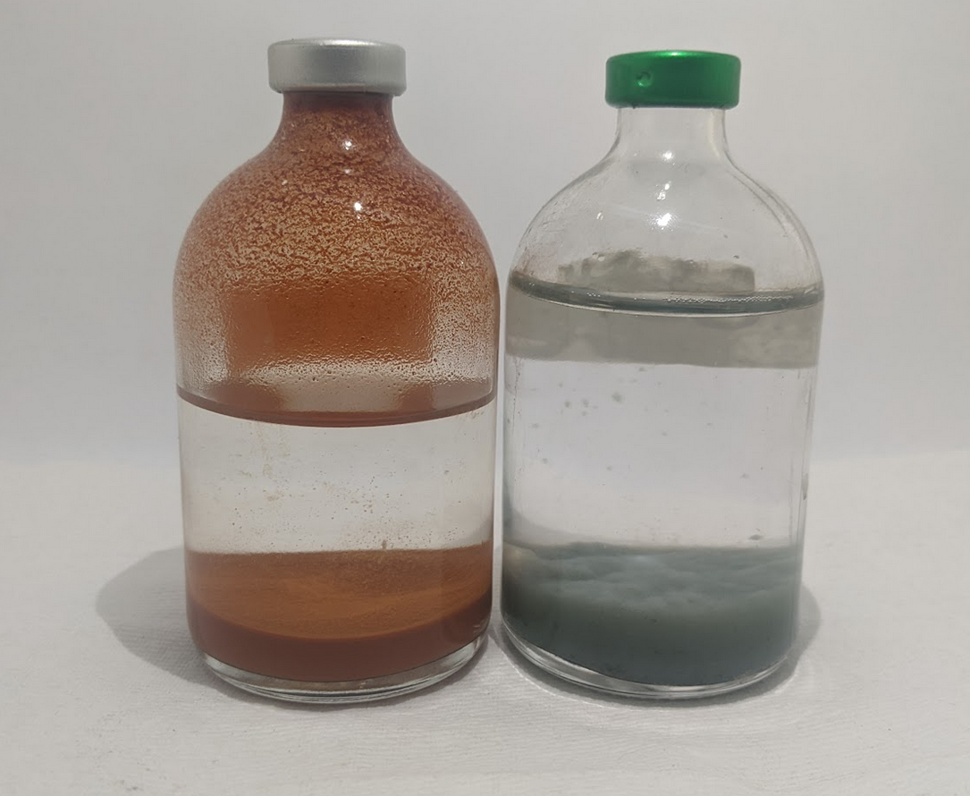
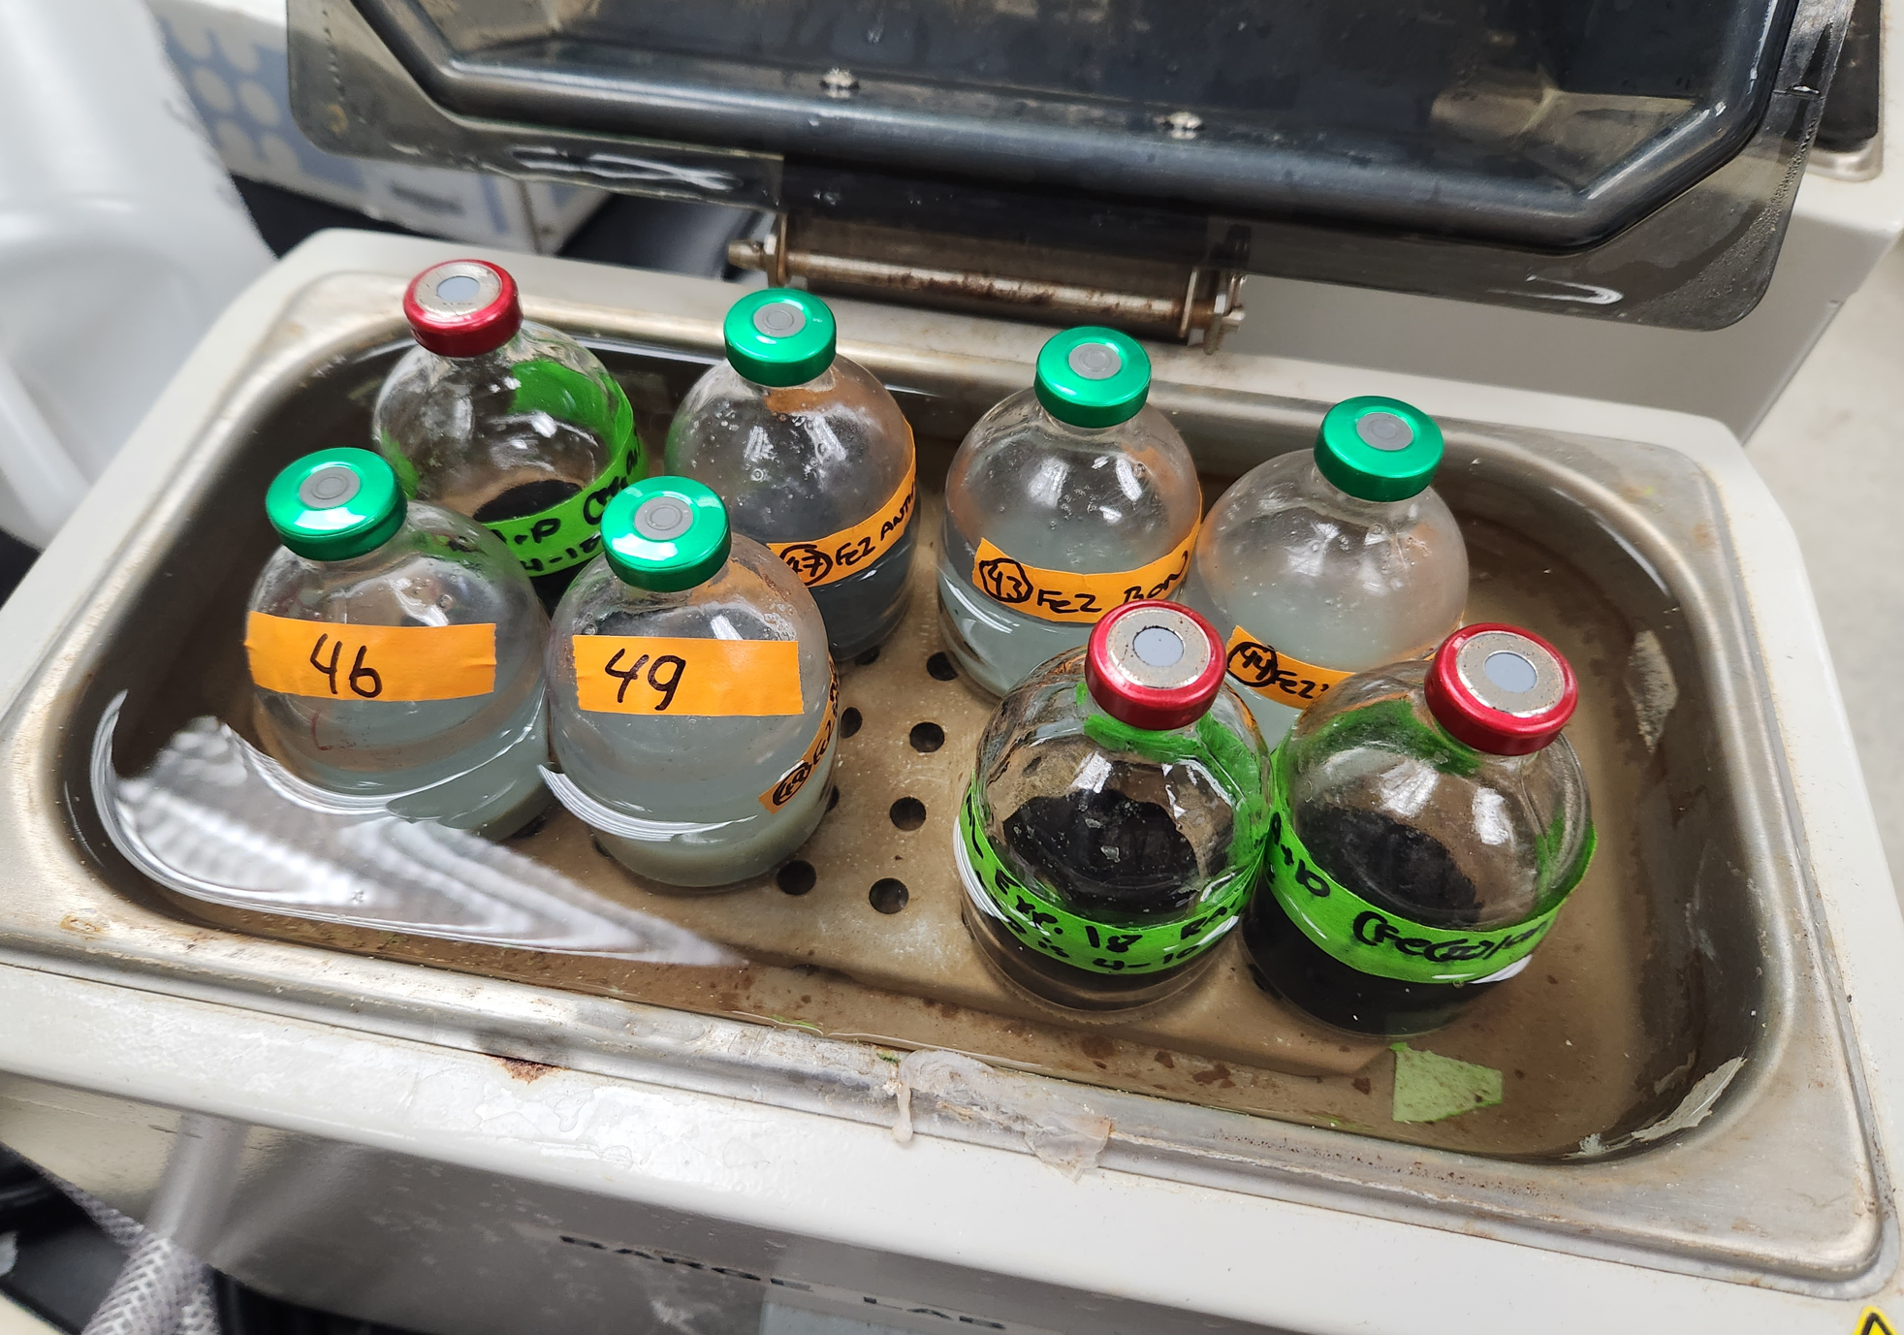
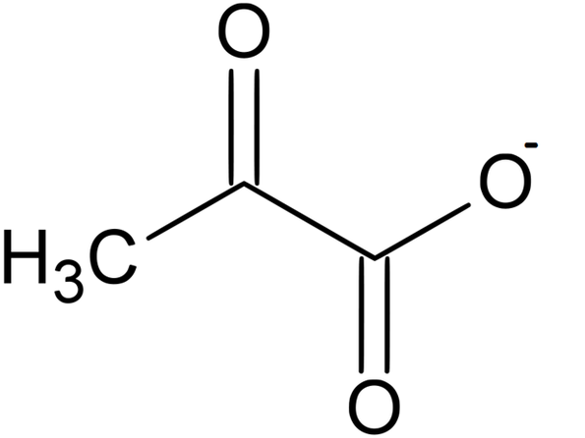
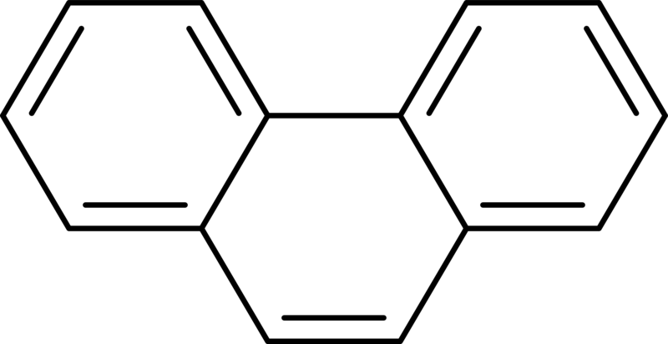
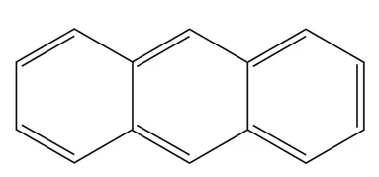
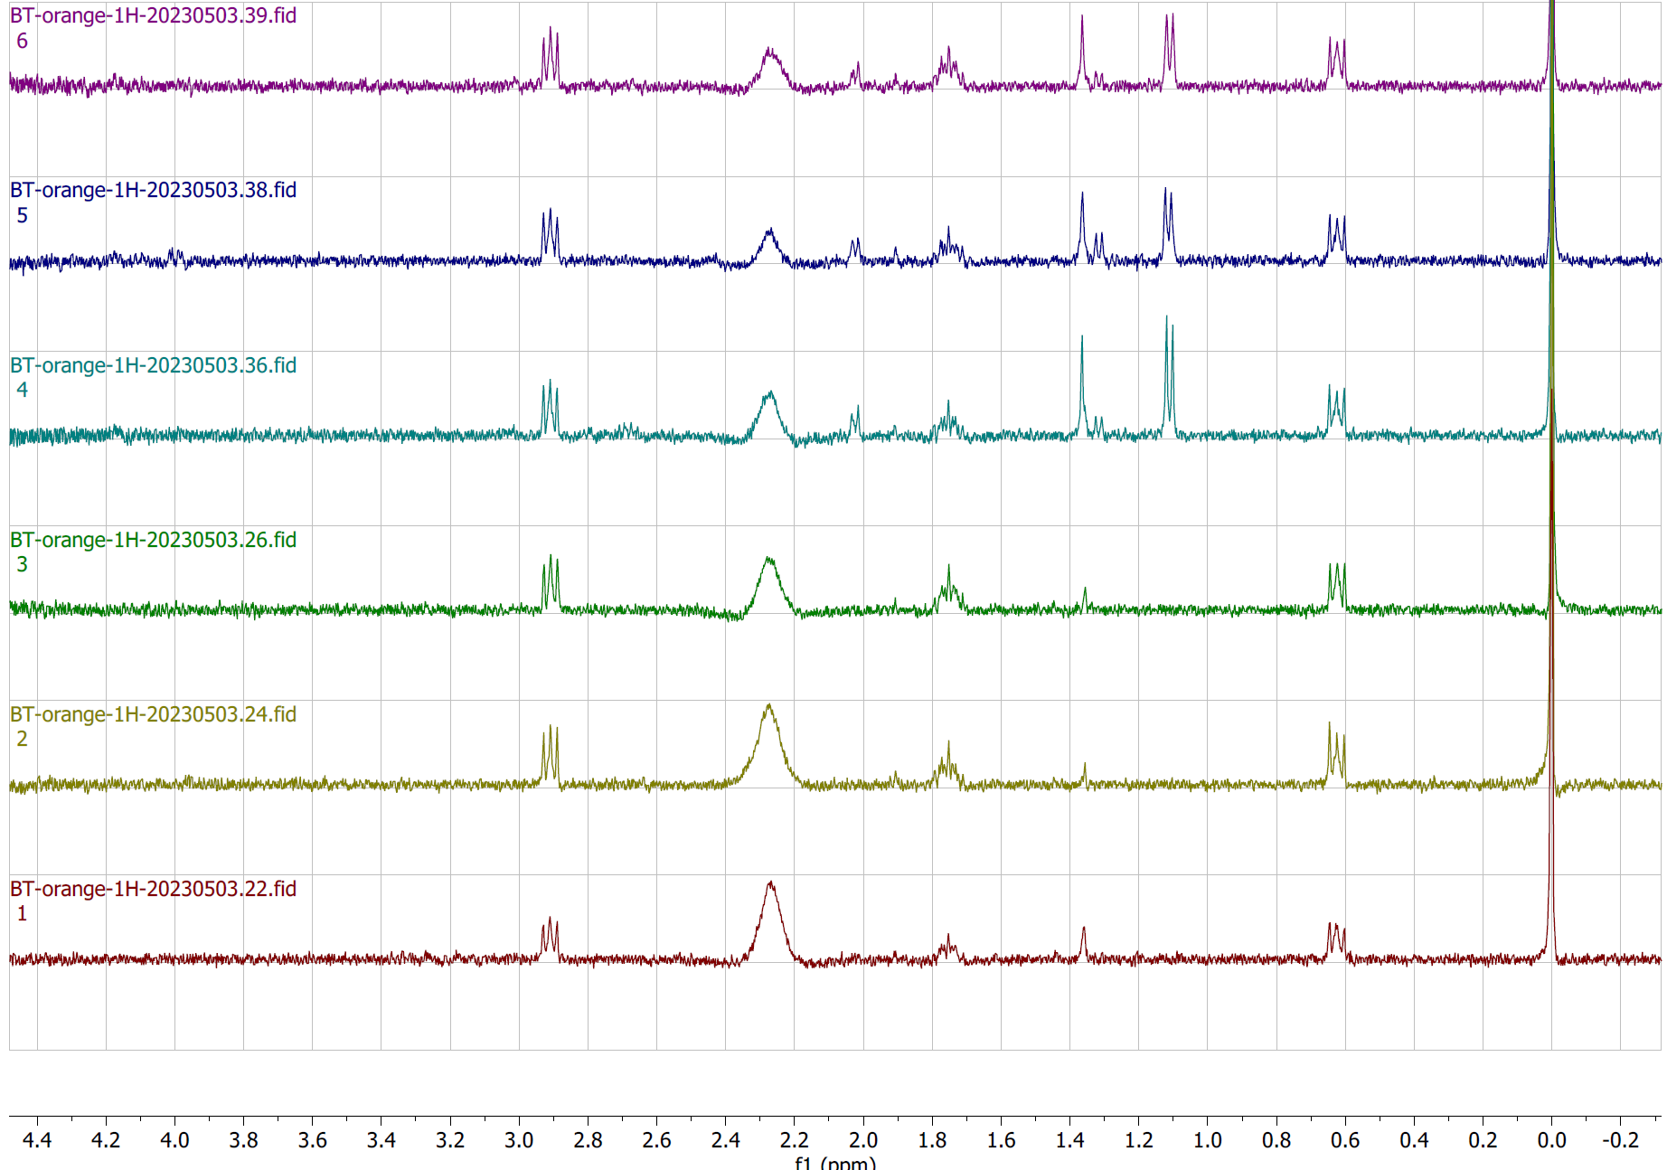

National Aeronautics and Space Administration
Postdoc Research
Interaction of polyaromatic hydrocarbons with pyruvate under hydrothermal early Earth conditions
Author: Bronwyn L. Teece, JPL Postdoctoral Fellow (3227)
Katherine Dzurilla (3227), Jessica M. Weber (3227), Laura M. Barge (3227)
Background
The early Earth likely contained iron oxide rich seawater, sediments, and hydrothermal systems (MacLeod et al., 1991). An example of these environments in the geological record of the early Earth can be seen in the >3.2 Ga Barberton iron stone pods which were thought to form in the iron rich hydrothermal sea floor (De Ronge, et al., 1994). The Hadean and early Archean oceans would have been anoxic and Fe(II)-rich (e.g., Canfield, 2005; Johnson et al., 2022). In these settings, iron oxyhydroxide rich minerals would have been only partially oxidized and had different redox states (Jolivet et al., 2004). Pyruvate, a simple organic molecule known to form in hydrothermal environments (Cody et al., 2000) can undergo reductive amination when reacted in warm alkaline fluids containing Fe(II) and Fe(III) iron oxyhydroxides forming acetate an amino acid alanine, or reducing to lactate (Barge et al., 2019).
Polycyclic aromatic hydrocarbons (PAHs), are one of the most abundant groups of compounds on Earth and in the solar system. On modern Earth they can form from the incomplete combustion of carbonaceous materials, and are found in hydrothermal environments and in hydrothermal oils (e.g., Kawka and Simmoneit, 1987).
Objectives
In our study we decided to test what happens to pyruvate and PAHs when heated in the presence of Fe(II) or Fe(III) oxyhydroxides, under different pHs as would have occurred in hydrothermal seafloors in the Early Earth (Russell and Hall, 2006). We also wanted to see if the redox state of the mineral was altered during these reactions. The PAHs we chose, phenanthrene and anthracene, have the same molecular weight but different structures and are often used as model PAHs in chemistry studies.
Approach and Results
Fe(II)Cl₂ or
Fe(III)Cl₃
NaOH
Combinations of organics
Exp at pH 3, 7, 10 at 70°C, for 72 h
These samples are created and synthesized in the laboratory in an anaerobic glove box. The samples are sampled for colorimetry and NMR at the beginning and end of the experiments to measure changes in redox state of minerals and reactions of organics.
50 mM
5 mM
5 mM each
Pyruvate
Phenanthrene
Anthracene
72 h Pyruvate + Phenanthrene
Pyruvate
Alkane?
Lactate?
Significance of Results/Benefits to NASA/JPL
The NMR spectra pictured to the right in our preliminary work shows that these molecules are stable without oxidants being applied to the system. We hope that later work will tell us more about abiotic chemical synthesis, and dynamic habitability as identified as priority areas in the last Decadal Survey (NASEM, 2022). The use of oxidants to break down PAHs has direct relation to organics in the Martian regolith with similar structures and oxidant alteration.
72 h
72 h Pyruvate + Anthracene
Acetate
72 h Pyruvate
0 h Pyruvate + Phenanthrene
0 h Pyruvate + Anthracene
DSS/D₂O
PAH
Pyruvate
Fe (II/III)
0 h Pyruvate
Future Work
Chemical oxidation, using Fenton reagents produces hydroxyl radicals are produced when hydrogen peroxide and ferrous iron react together. In chemical engineering this reaction is often used for cleaning up soil contamination of PAHs (e.g., Rivas, 2006) to break them down. We will apply hydrogen peroxide to these systems to see what abiotic recombinations can occur in these conditions
National Aeronautics and Space Administration
Jet Propulsion Laboratory
California Institute of Technology
Pasadena, California
www.nasa.gov
Publications and Acknowledgements:
Teece, B. L., Dzurilla, K, Weber, J. M., Barge, L. M. 2023 Interaction of polyaromatic hydrocarbons with pyruvate under hydrothermal early Earth conditions, AbGradCon, San Diego, May 22-25
This work was conducted at the Jet Propulsion Laboratory, California Institute of Technology under a contract with the National Aeronautics and Space Administration (80NM0018D0004).
Author Contact Information:
626-375-5754 bronwyn.teece@jpl.nasa.gov
Clearance Number: CL#00-0000
Poster Number: PRD-P-025
Copyright 2023. All rights reserved.

