Slide 1

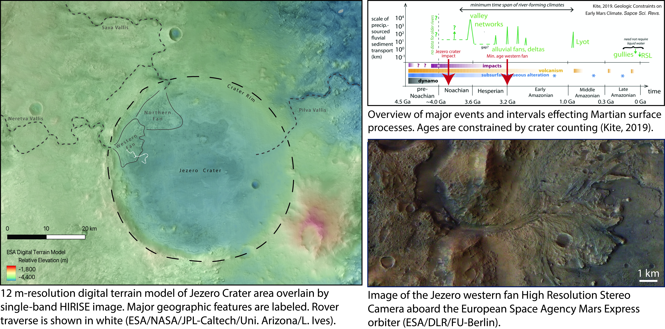
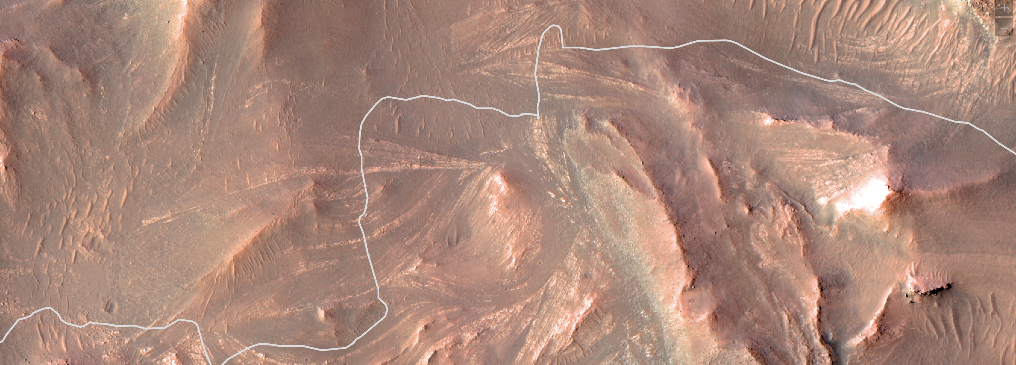
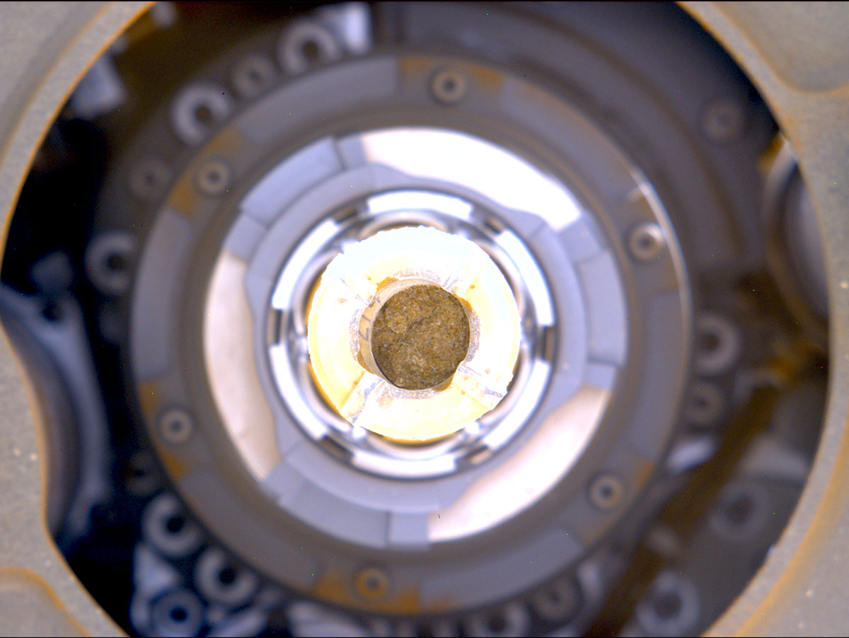
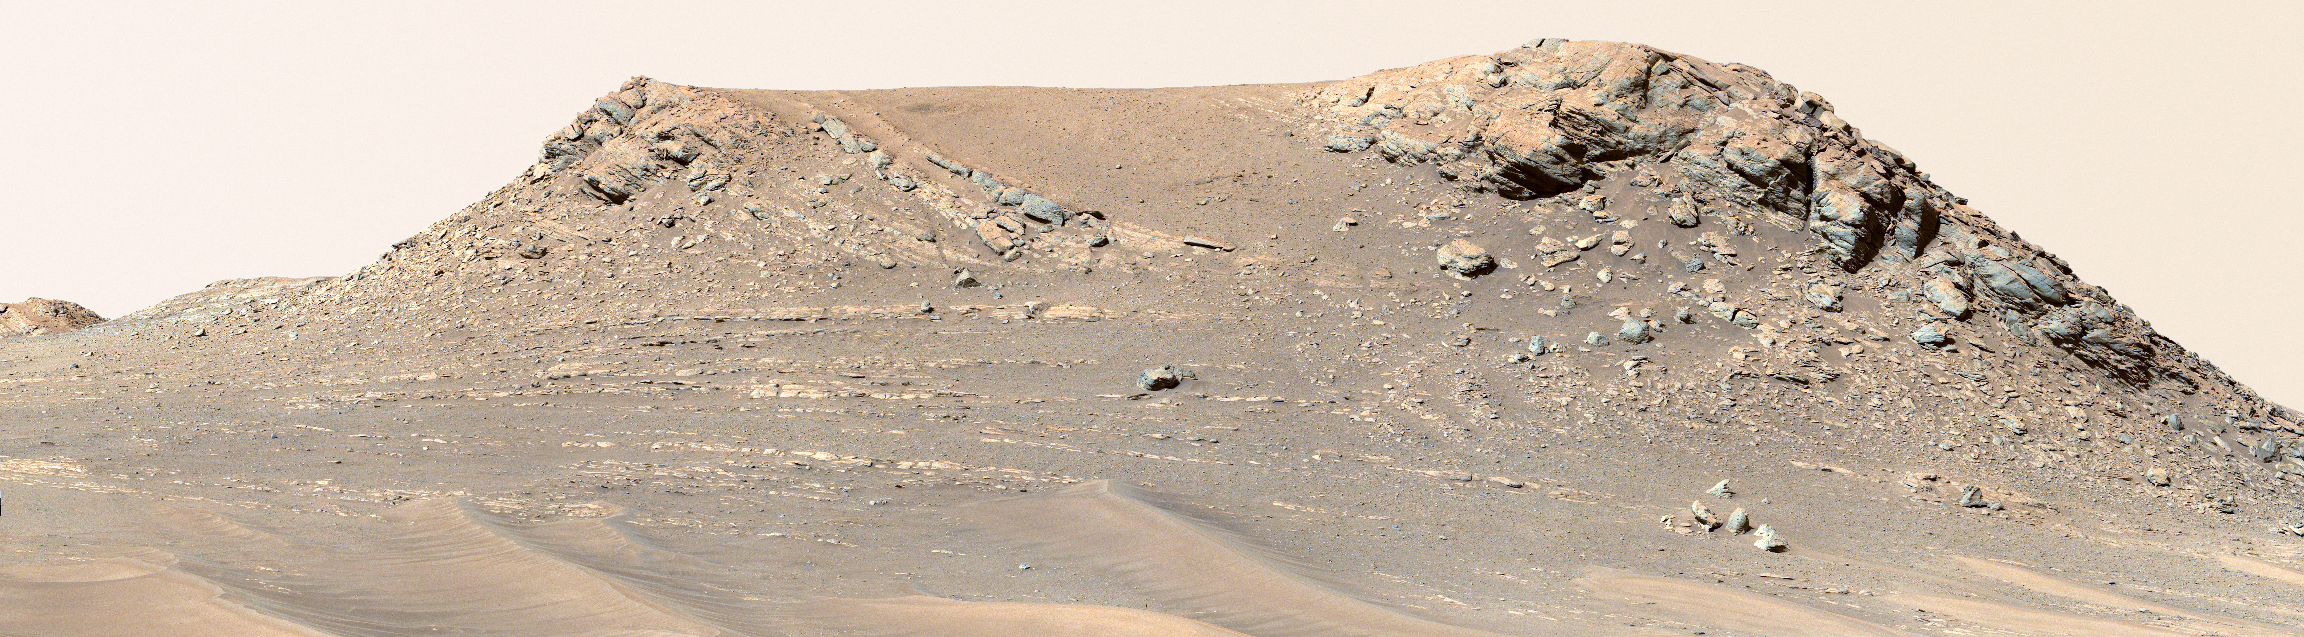
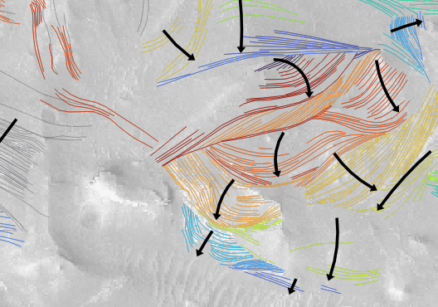
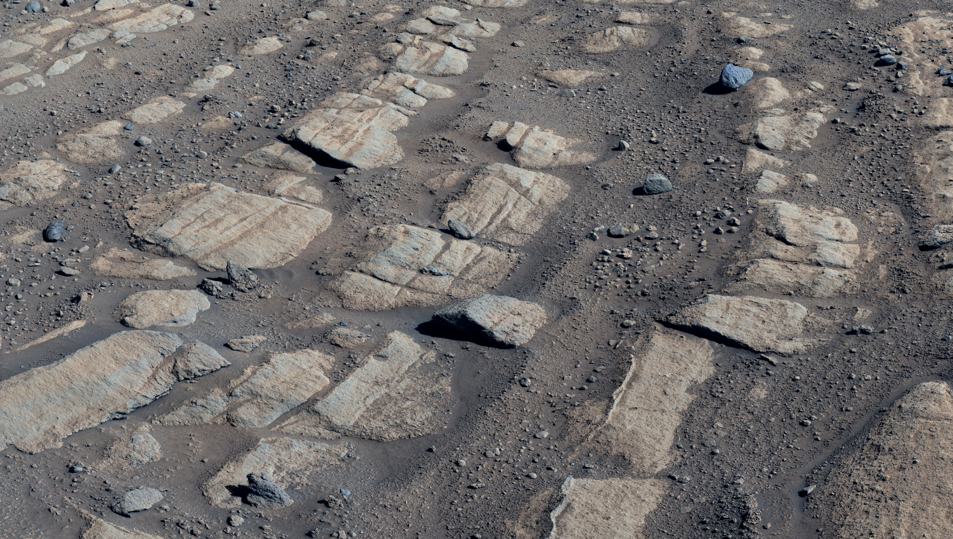
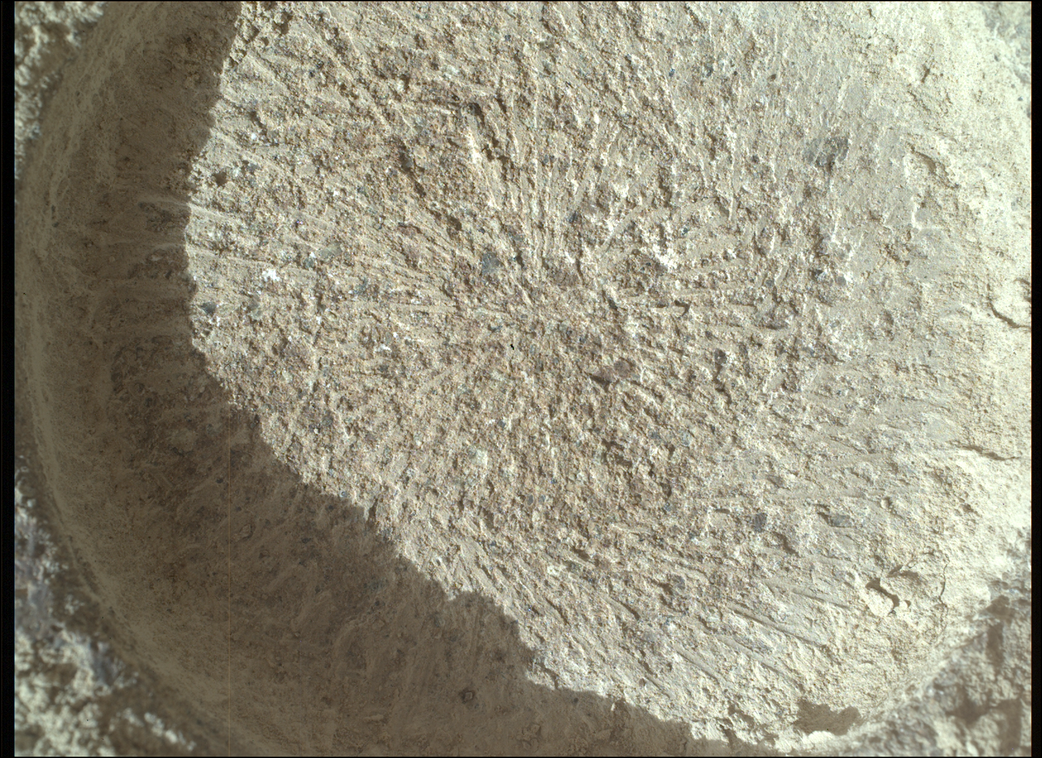


National Aeronautics and Space Administration
Postdoc Research
Deposition of the “Curvilinear Unit”
(Jezero crater, Mars) & its Implications for
Ancient Martian Surface Environments
Libby R.W. Ives, JPL Postdoctoral Fellow (3223)
Kathryn M. Stack(3223), Samantha J. Gwizd (3223), and the Mars 2020 Operations and Science Teams
Mars 2020, Jezero Crater, and the Jezero Western Fan
The Perseverance rover and Ingenuity helicopter are currently exploring and collecting observations on the < 3.8-billion-year-old sedimentary rocks of the ”western fan” in Jezero crater
By studying the geologic properties of these sedimentary rocks, we can infer which planetary surface processes worked to create them.
This work expands our knowledge of Mars’s geologic history and past surface habitability and gives meaningful context to Mars Sample Return samples.
100 m
Rover traverse
Importance of the “Curvilinear Unit”
The “curvilinear unit” is a sedimentary rock unit in the Jezero western fan whose physical characteristics as observed from orbit led to many authors to propose it was deposited by a meandering fluvial system.
The Melyn Mars Sample Return core was collected from this unit
This work aims to test the hypothesis that the “curvilinear unit” was deposited by a meandering fluvial system using observations from the Perseverance rover.
The Curvilinear Unit
younger rock units
High-resolution HIRISE color image of the western fan top at Jezero crater with the Perseverance rover traverse superimposed [NASA/JPL-Caltech/University of Arizona/USGS/JHU-APL]. The curvilinear unit is in the center of the image. The white areas are different, younger sediments that sit on top of Curvilinear unit.
Image of the Melyn core in its sample tube prior to sealing. The core is 13 mm diameter [NASA/JPL-Caltech/ASU/MSSS]
Approach
Revisiting Orbital Data:
The steep bedding dips were not expected based on original assessments of the orbital imagery and elevation data. With the Mastcam-Z outcrop photos for reference, we can reassess bedding dips and other stratigraphic relationships between curvilinear sets with more certainty. Different colors of lines show different curvilinear sets. Black arrows indicate accretion directions during curvilinear deposition.
Outcrop image analysis:
False-color image mosaic of images collected on mission sol 718 by the Mastcam-Z instrument on the Perseverance Rover. This collection of images shows the curvilinear unit feature, Pinestand Mountain, which stands up to 33 m above the surrounding terrane. This image shows that the curvilinear features have variable dips – including very high dips (yellow) that can only form in slopes when gravity controls deposition. The blue and green lines highlight curvilinear features with low dips that are more likely formed through current deposition. [NASA/JPL-Caltech/ASU/MSSS]
Proximal outcrop analysis:
False-color image mosaic of images collected on mission sol 721 - 729 by the Mastcam-Z instrument on the Perseverance Rover. This proximal outcrop mosaic showed that the stripped appearance of the curvilinear unit from orbit is due to laterally extensive beds that consist of structureless, decimeter-thick beds of alternating sandstone and pebble conglomerate with sharp upper and lower contacts.
Grain size and distribution:
SHERLOC WATSON image collected on sol 750 of an abrasion patch on the light-toned sandstone of the curvilinear unit. The size, shape, and composition of individual sand grains can all be used to help infer depositional environment
Results
Rover observations of the “curvilinear unit” show that these rocks are made up of steeply dipping beds of alternating lithologies between 4 - ~30 m tall and 50 – 500 m across.
Geologic observations made using Perseverance-collected images of outcrops and abrasion patches are not wholly consistent with the river hypothesis but may be consistent with some sort of fluvial-deltaic depositional system
Future Work
Ongoing work on the deposition of the “curvilinear unit” involves delving more deeply into the remote sensing and rover image datasets to make additional observations that will help us develop hypotheses for how these rocks were deposited and what implications those processes have for ancient surface processes on Mars.
Significance of Results & Benefits to NASA/JPL
The ”curvilinear unit” is the sedimentary rock unit that the Melyn (#19) Mars Sample Return rock core was collected from. Through this work, we will provide a detailed understanding of how these rocks were created. This knowledge would guide the science conducted on the Melyn core upon its return*.
National Aeronautics and Space Administration
Jet Propulsion Laboratory
California Institute of Technology
Pasadena, California
www.nasa.gov
Related Abstracts:
Ives, L.R.W.* (and 17 others) (2023). Reassessing the sedimentary depositional origin of the Jezero crater western fan’s curvilinear unit: reconciling orbital and rover observations. American Geophysical Union Annual Meeting, December 11 – 15, San Francisco, USA.
Author Contact Information:
elizabeth.r.ives@jpl.nasa.gov
Clearance Number: CL#00-0000
Poster Number: PRD-P-015
Copyright 2023. All rights reserved.
* The decision to implement Mars Sample Return will not be finalized until NASA’s completion of the National Environmental Policy Act (NEPA) process. This document is being made available for information purposes only.

