Slide 1

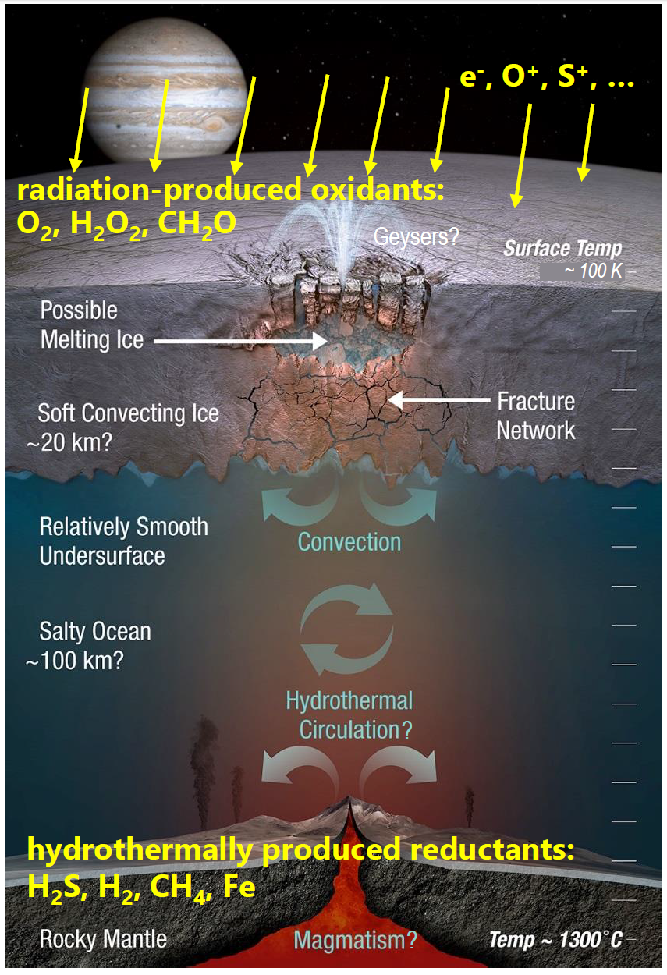
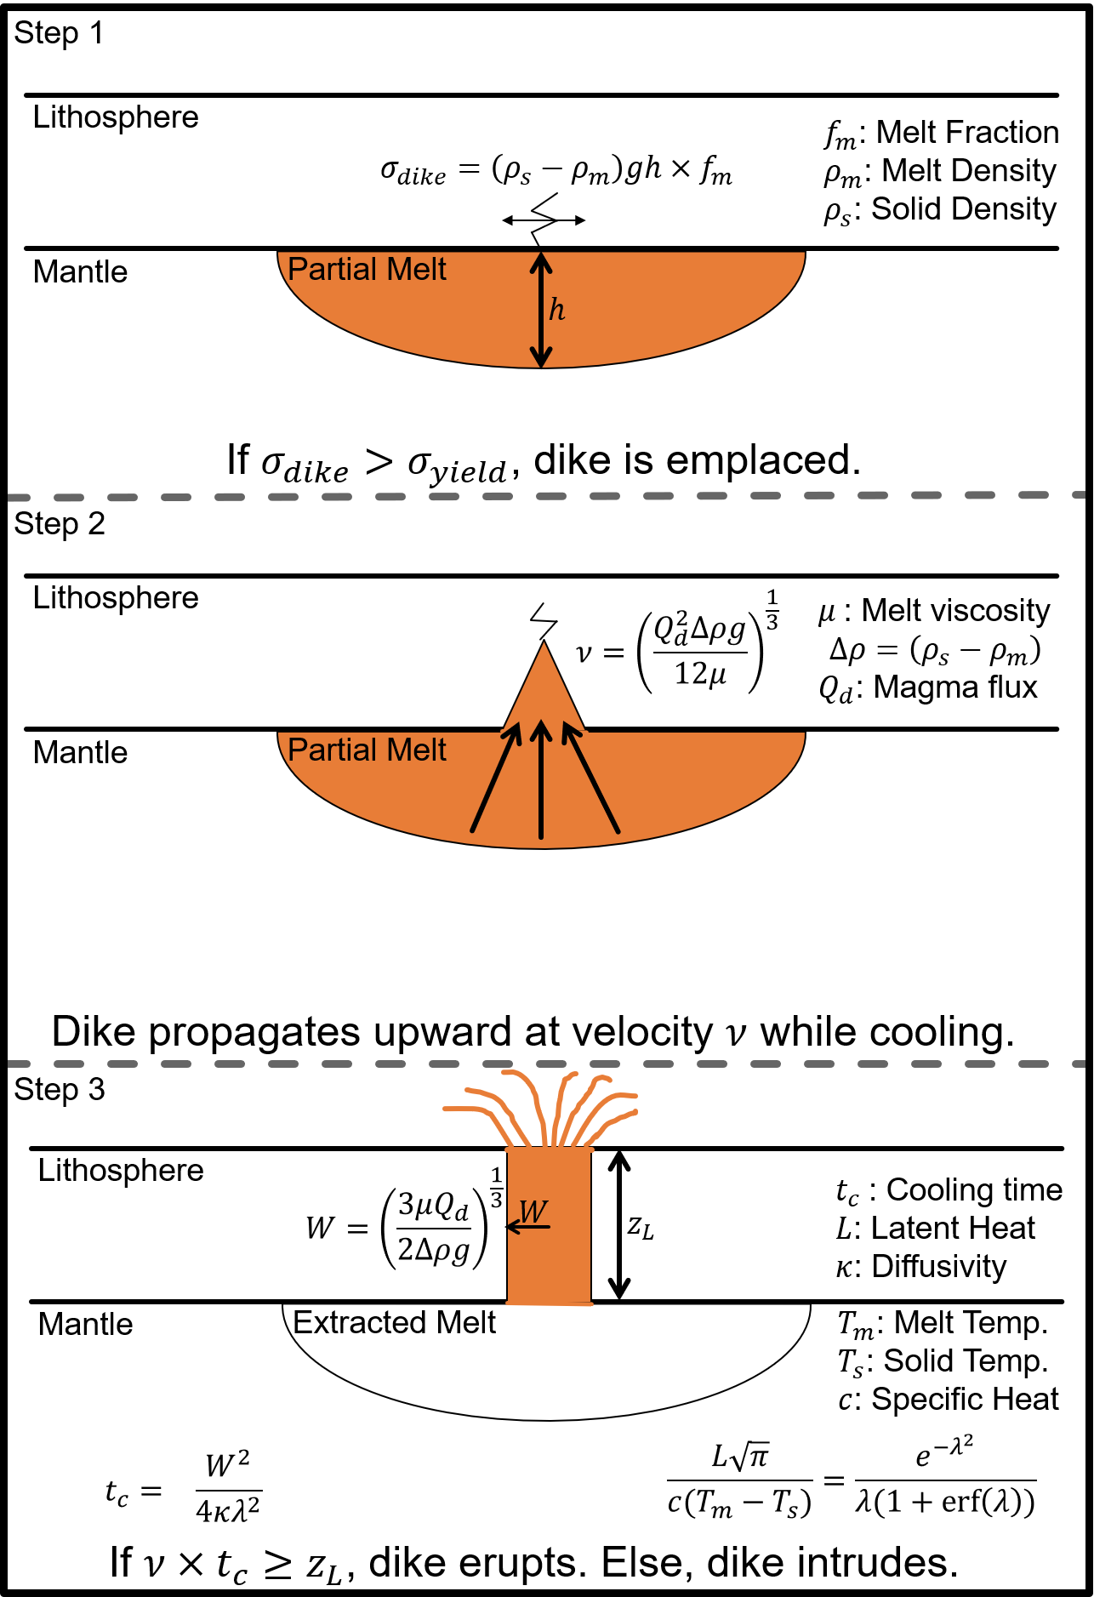
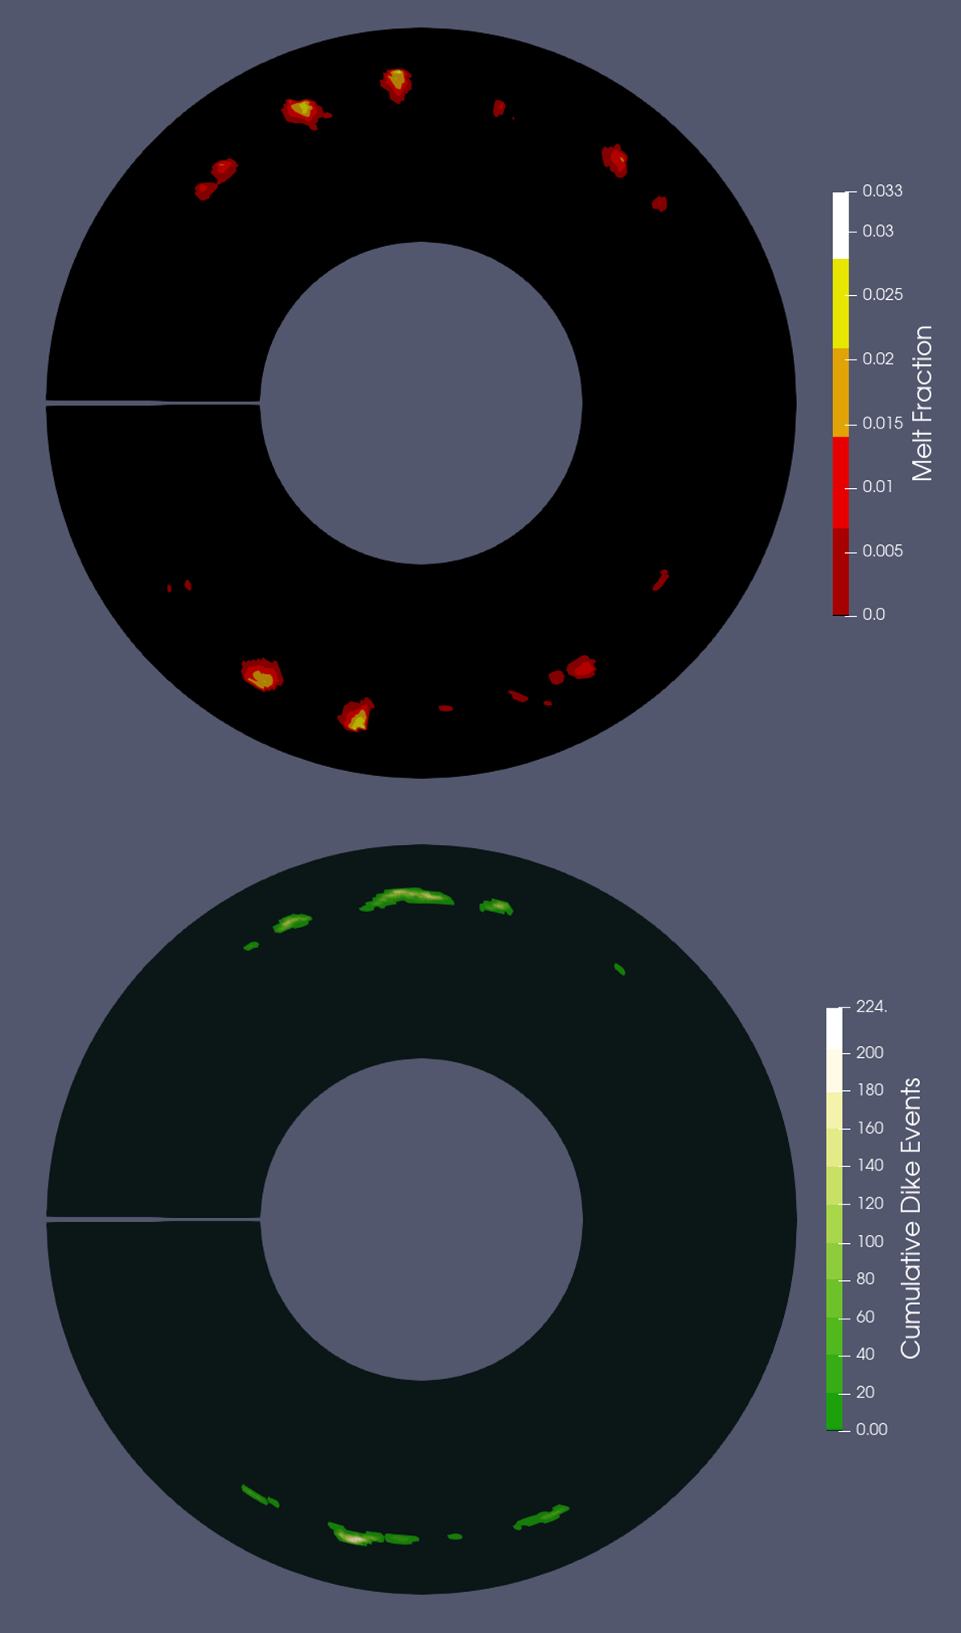
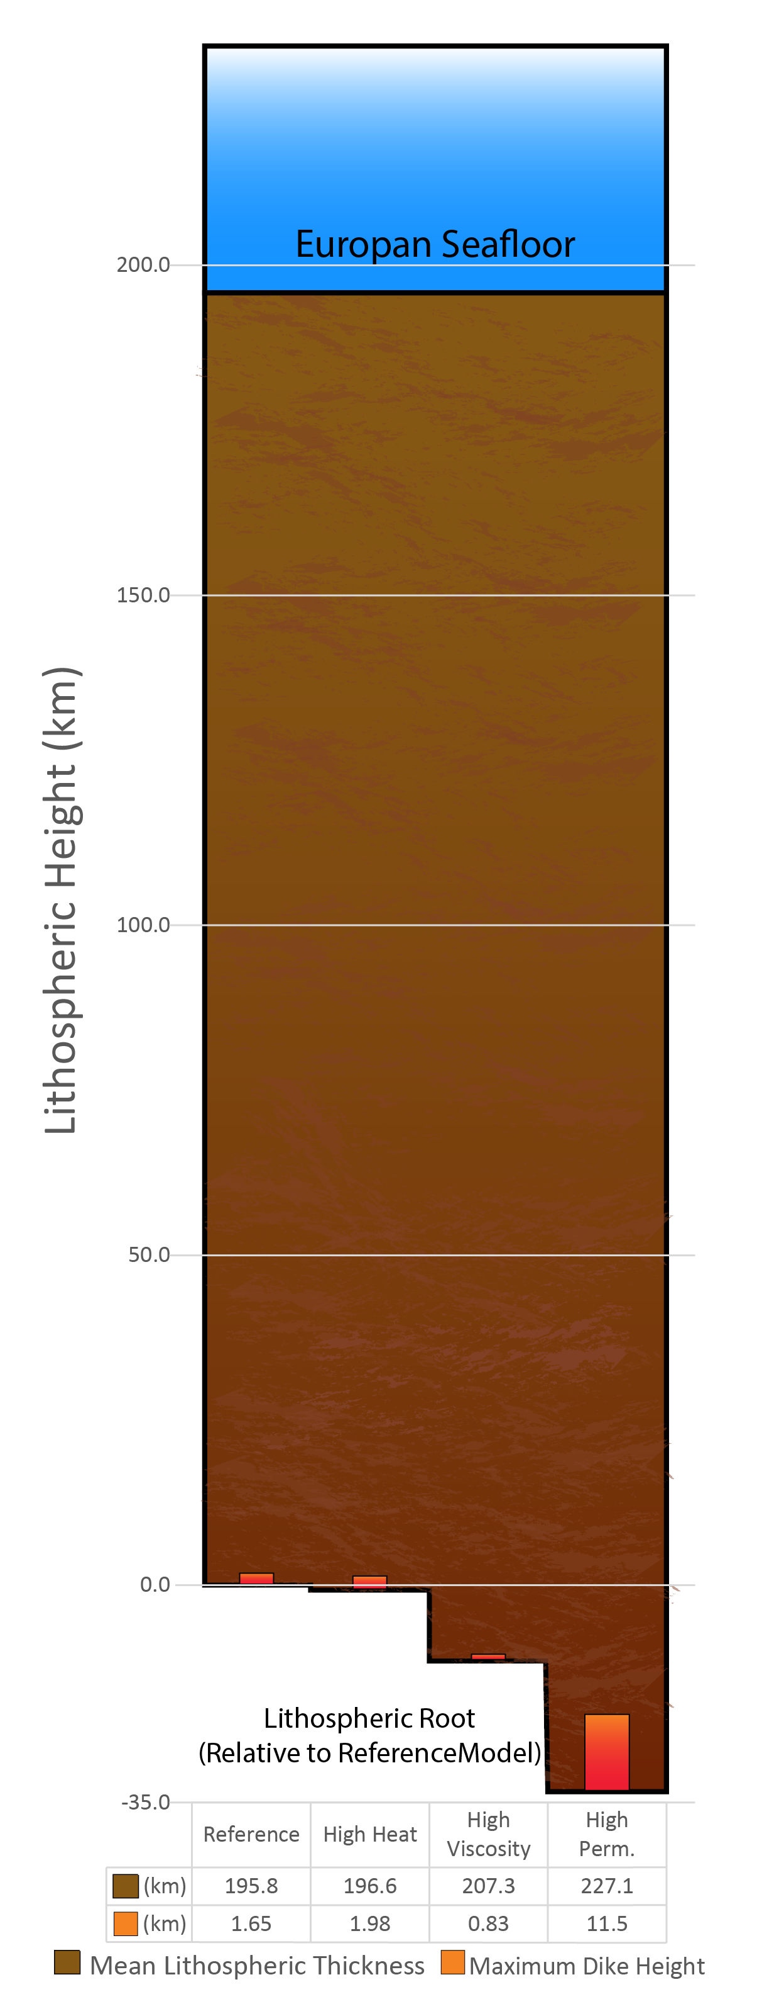
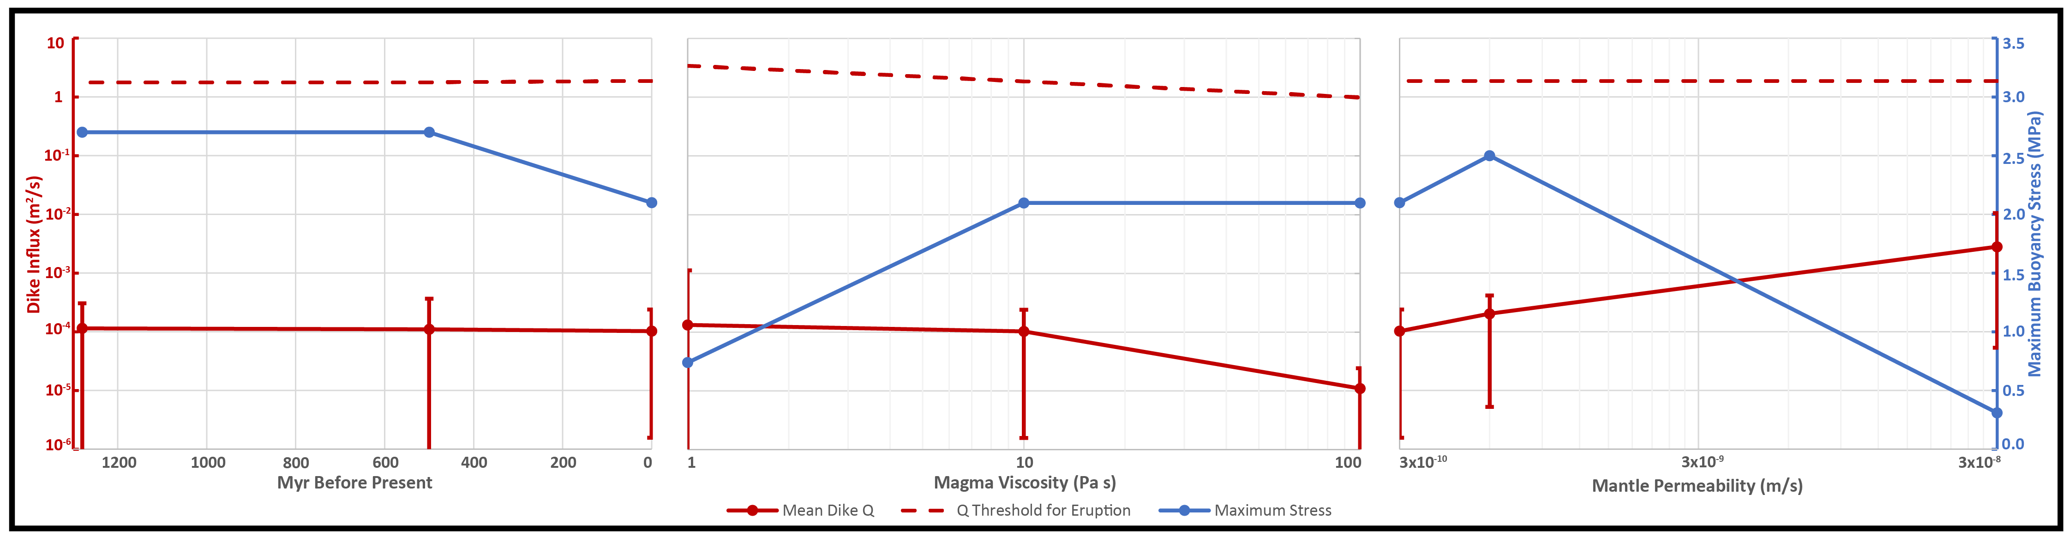
National Aeronautics and Space Administration
Postdoc Research
Strong Lithospheric Resistance Limits Potential for Europan Seafloor Volcanism
Author: Austin Green, JPL Postdoctoral Fellow (Section 3226)
Catherine Elder (Section 3226)
Michael Bland (U.S. Geological Survey, Flagstaff, AZ)
Paul Tackley (Department of Earth Sciences, ETH Zurich, Switzerland)
Background
The overarching goal of the Europa Clipper mission is to assess the habitability of the ocean underneath Europa’s icy shell. In the absence of sunlight, chemical input from seafloor volcanism is thought to be necessary for a healthy Europan oceanic biosphere (top-left figure). However, whether Europa’s rocky mantle is capable of driving this volcanism remains an open question. Europa’s 200 km thick lithosphere is likely to be the largest obstacle for any volcanic processes. We conceptualize this volcanism as occurring through the emplacement of large, lithospheric-scale dikes (right).
Objectives
In this work, I aim to combine mantle-scale geodynamic modeling with local-scale dike propagation and cooling calculation for the first time. This allows me to dynamically determine how much magma is produced at depth within Europa’s mantle (middle-left figure) and evaluate if crustal scale volcanic processes are physically capable of transporting that magma upward to the seafloor.
Source: NASA/Europa Clipper
Approach and Results
I implemented a model of Europa’s mantle in the geodynamic simulation code StagYY, designing within StagYY an entirely new melt extraction routine that assesses the ability of Europan magma to penetrate and travel through the lithosphere (described at top-right). Two criteria must be met for eruption: 1) Magma must exert sufficient buoyancy stress at the base of the lithosphere to break it and initiate a dike. 2) The dike must propagate upward through the lithosphere faster than conductive cooling solidifies the dike, halting it.
I was unable to find Europan mantle conditions capable of satisfying these criteria. Magmatic buoyancy stress is low in all cases considered, making it difficult to initiate a dike event (bottom figure). When a dike event is initiated, Magma influx is extremely low (~0.0001 m²/s), four orders of magnitude smaller than the influx necessary for eruption (bottom figure). These fluxes result in dike heights of 1-10 km penetrating only the lowermost portions of a ~200 km thick lithosphere (bottom-right figure).
Significance of Results/Benefits to NASA/JPL
Our primary discovery is that Europa’s rocky lithosphere is far too thick to accommodate seafloor volcanism. Therefore, if this volcanism is the sole source of life-sustaining oceanic reactants, Europa’s ocean is uninhabitable. This conclusion will have a significant impacts on the science of Europan habitability assessment and the Europa Clipper flagship mission managed by JPL. Alternative habitability models that do not rely on seafloor volcanism must be considered in Clipper’s habitability assessment, as well as within the broader Europa community.
Future Work
Modeling for this project is now complete. We are in the process of sharing this work with the wider community via conference talks at GSA and AGU, as well as smaller meetings and seminars. We plan to submit a manuscript of these results to Nature.
National Aeronautics and Space Administration
Jet Propulsion Laboratory
California Institute of Technology
Pasadena, California
www.nasa.gov
Publications and Acknowledgements:
Conference Presentations:
LPSC LIV (2023): Poster Presentation. “Modeling Present-Day Melting and Eruption in Europa’s Silicate Mantle”. March 2023.
GSA Connects 2023: Invited Oral Presentation. “Strong Lithospheric Resistance Limits Potential for Europan Seafloor Volcanism”. October 2023.
AGU 2023: Submitted Abstract. “Stong Lithospheric Resistance Limits Potential for Europan Seafloor Volcanism”. December 2023.
Journal Publications:
Nature: Manuscript in Preparation. “Strong Lithospheric Resistance Limits Potential for Europan Seafloor Volcanism”. Submitting October/November 2023.
Author Contact Information:
Phone: 626-491-5382 Email: Austin.green@jpl.nasa.gov
Clearance Number: CL#00-0000
Poster Number: PRD-P-011
Copyright 2023. All rights reserved.

