Slide 1

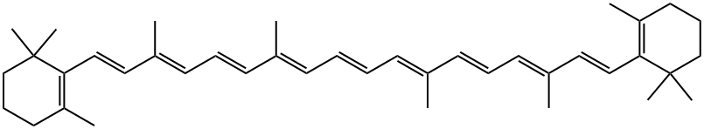
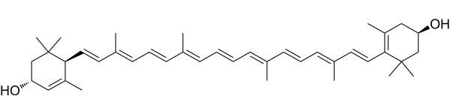
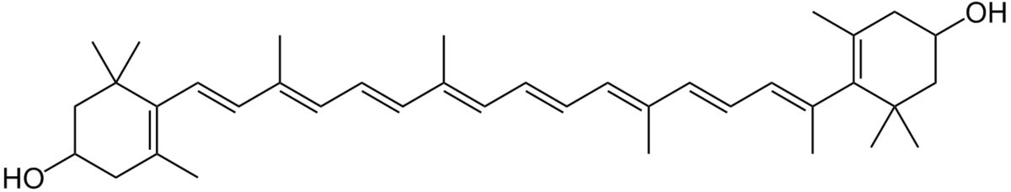
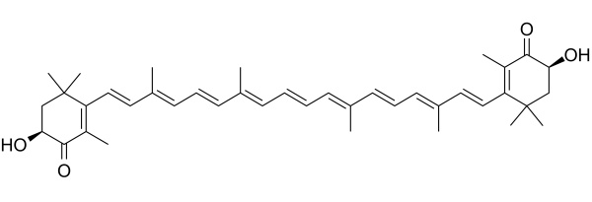
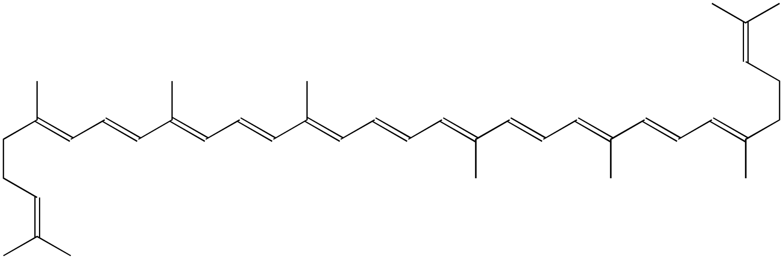
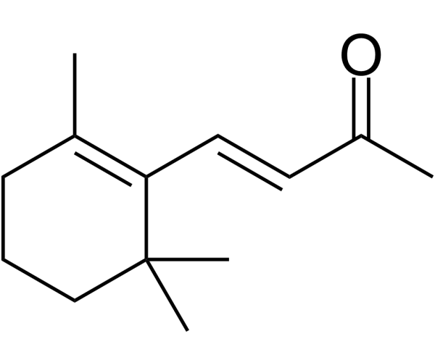
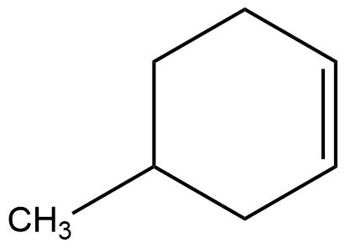
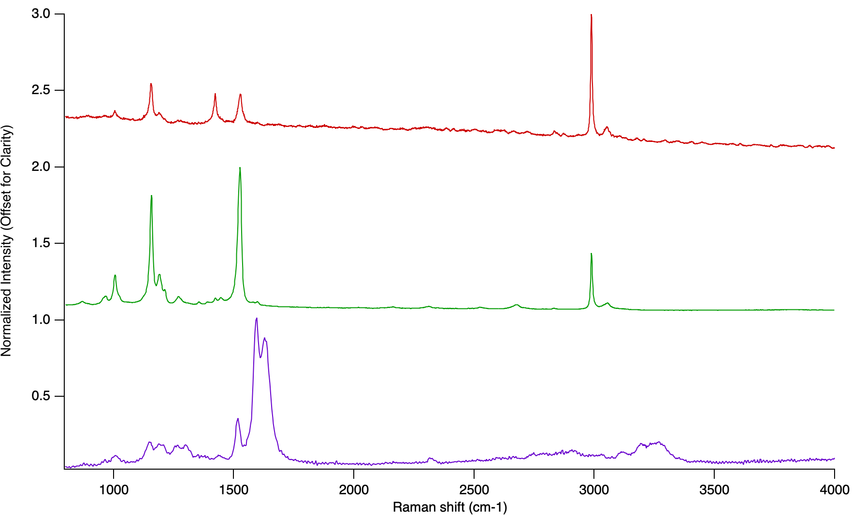
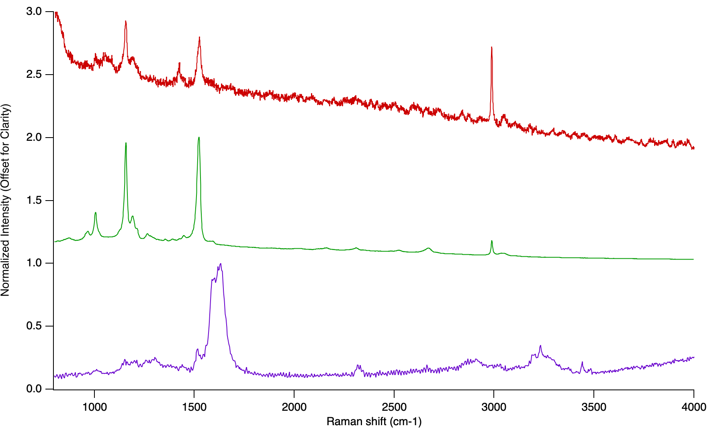
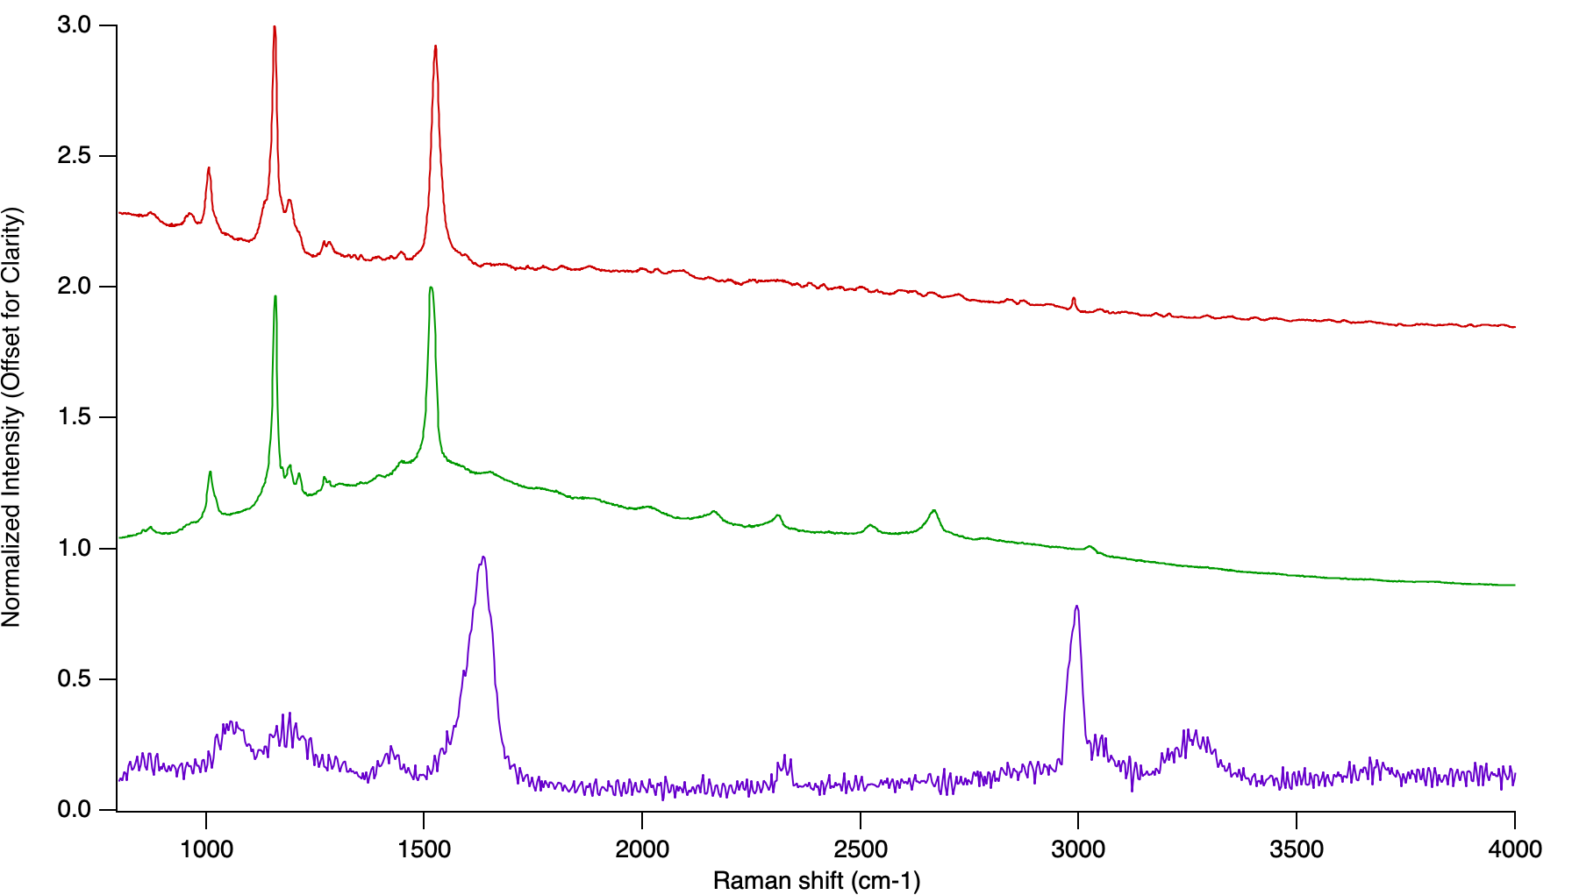
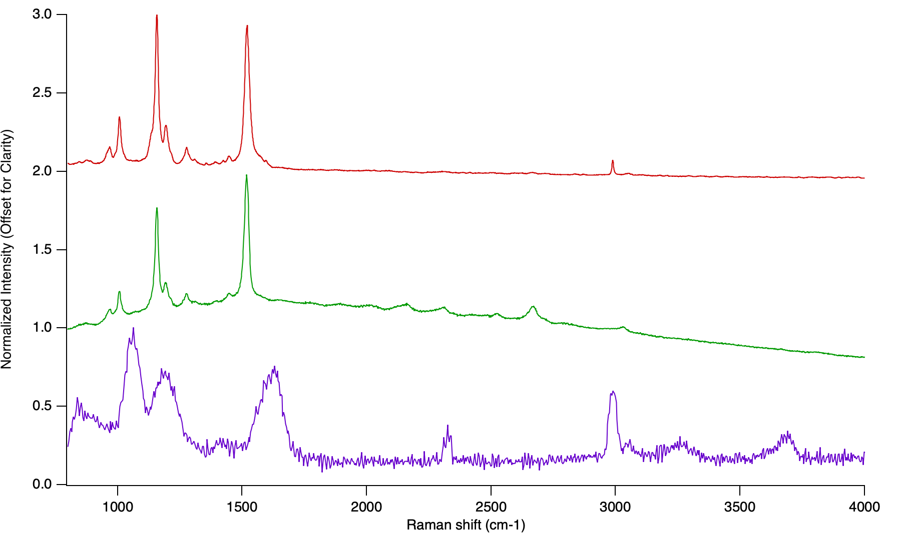
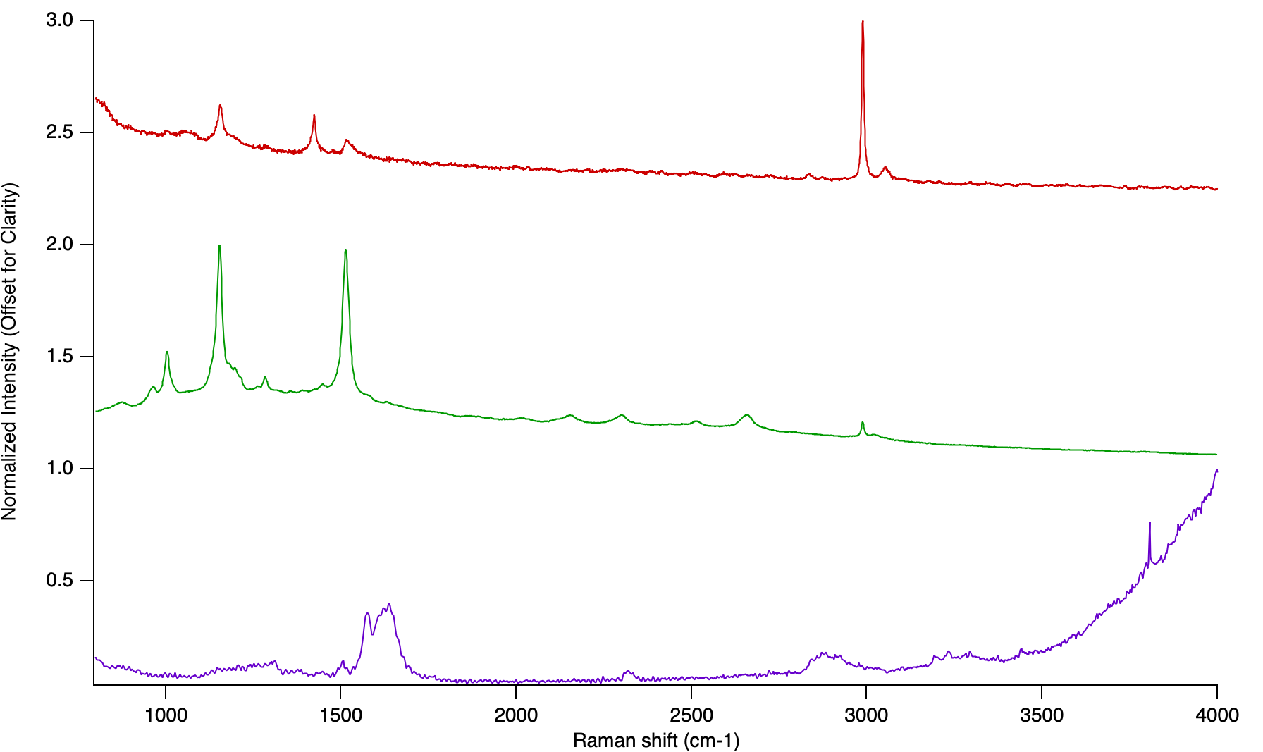
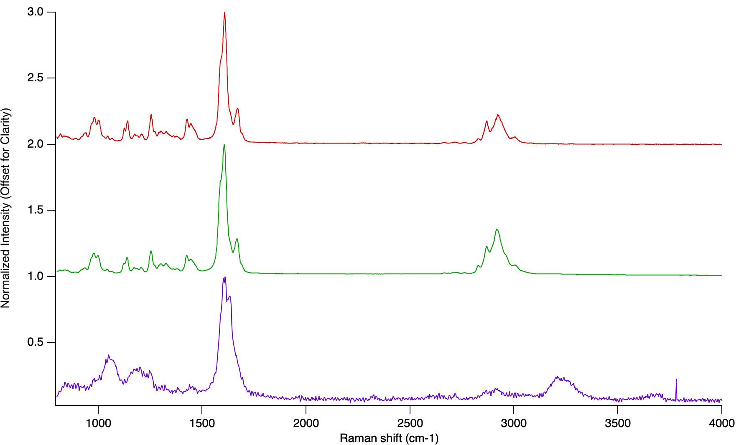
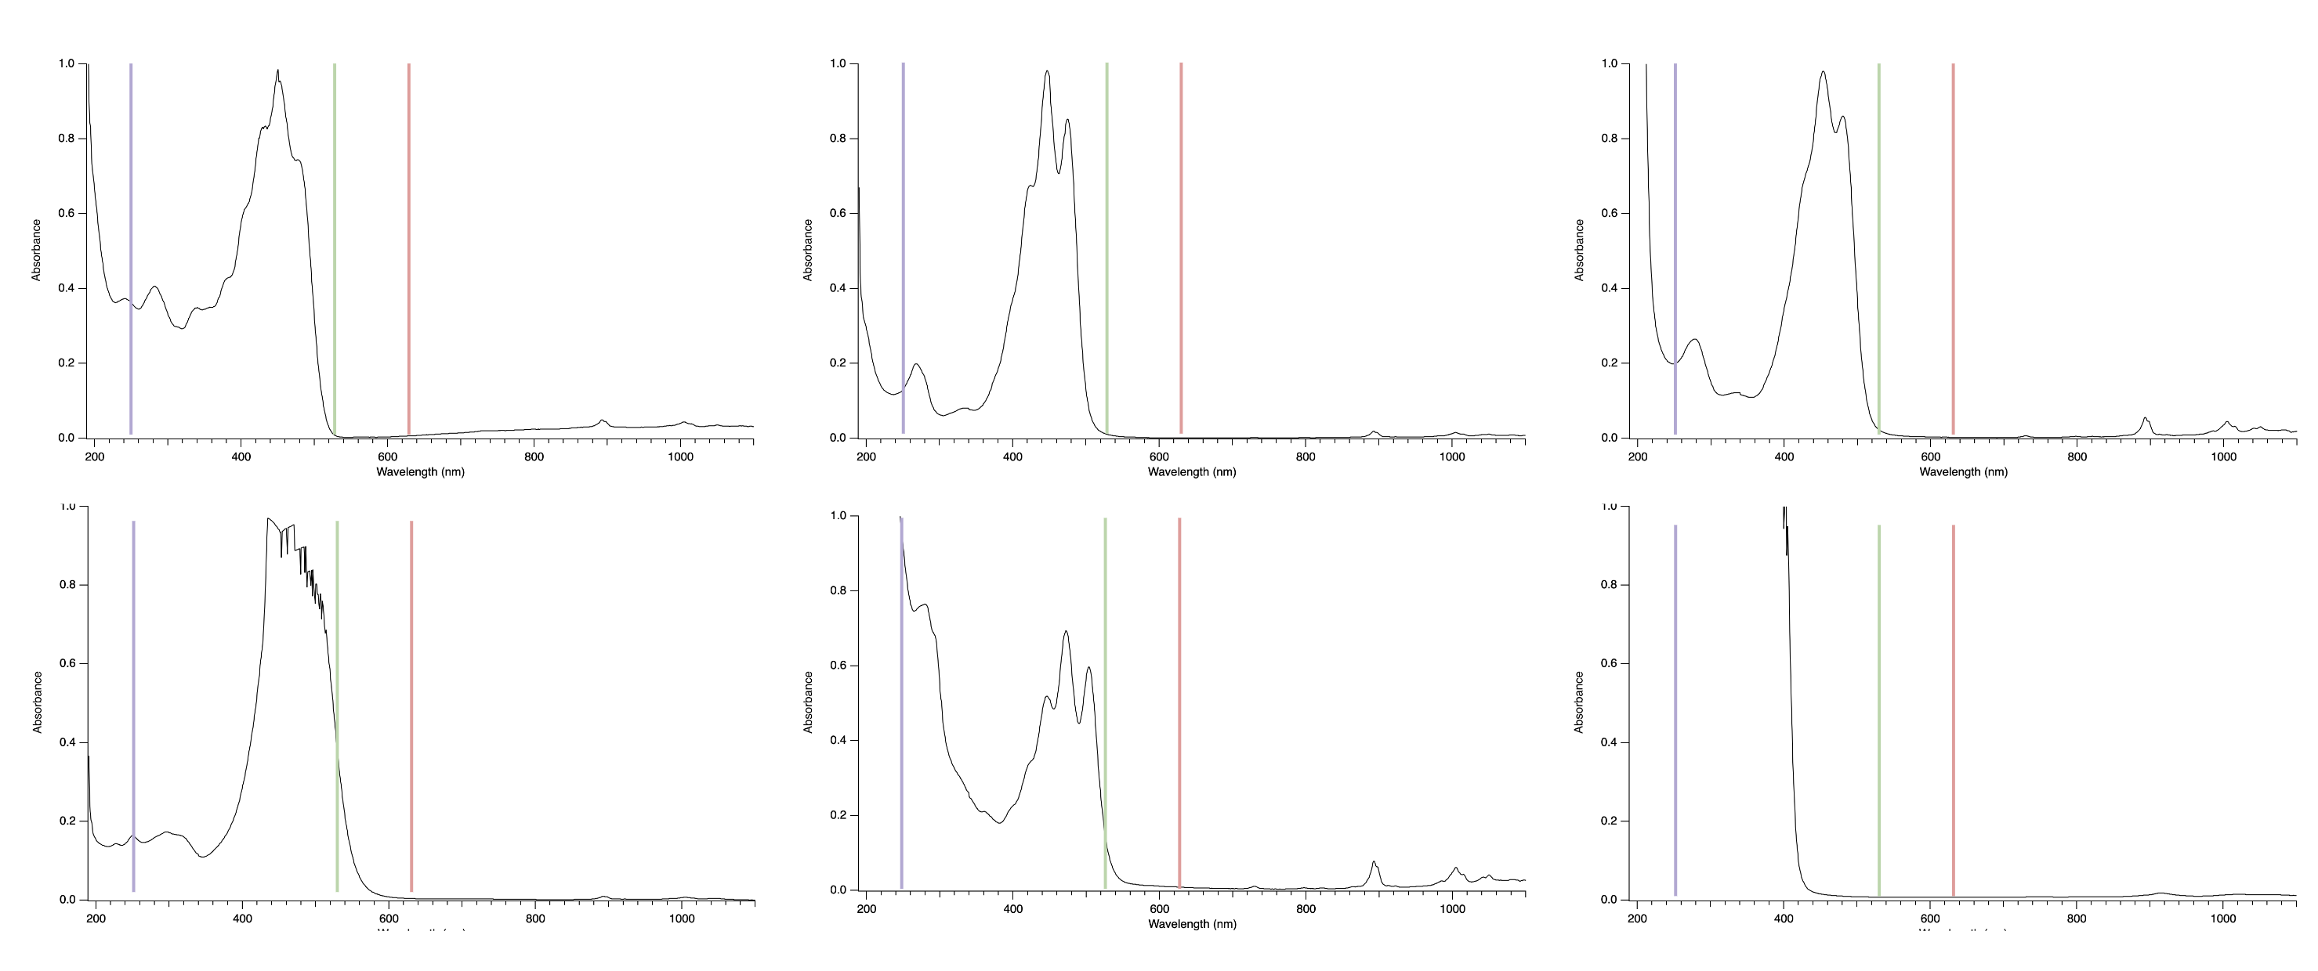
National Aeronautics and Space Administration
Postdoc Research
Deep Ultraviolet Raman Spectroscopy of Carotenoid Pigments
Sunanda Sharma, JPL Postdoctoral Fellow (3223)
Tuan Vu (3227), Edith Fayolle (3227), Carina Lee (Jacobs, JSC), Jessica Weber (3227), Mike Malaska (3227)
Background
Carotenoids are a class of vibrant biological pigments that have a characteristic chemical structure centered around a polyene. Carotenoids and their derivatives are candidate biosignatures because they can persist in the terrestrial geologic record for up to 1.73 billion years, have specific structures that are likely the result of complex pathways, mediate the survival of many microorganisms in Mars and Ocean Worlds analog environments, and are detectable with multiple techniques, including Raman spectroscopy and MS.
β-carotene
Lutein
Zeaxanthin
Most previous Raman studies on carotenoids utilize visible excitation wavelengths to take advantage of the resonance due to polyene absorption at 400-500 nm. However, there is evidence that there is a carotenoid absorption band deeper in the UV region (<300 nm), suggesting there is another enhancement effect that can be utilized.
Astaxanthin
Lycopene
β-ionone
Methylcyclohexene
β-carotene
Lutein
Zeaxanthin
Figure 1. Samples used in this study, including carotenoids and model compounds.
Objectives
Here, we compare Deep UV (DUV) and Visible Raman spectra of a range of carotenoids. Our objectives are:
To collect novel DUV Raman spectra for a range of carotenoids and a carotenoid-forming organism.
To compare the DUV and visible Raman spectra to investigate possible resonance effects.
To identify instrument parameters that avoid alteration.
This study is the first step of an ongoing project (see Topical Poster RPC#175, science PI: Sharma) and provides necessary baseline data and protocol development.
Astaxanthin
Lycopene
β-ionone
Figure 2. Comparison of normalized Deep UV and visible Raman spectra for carotenoids. In all cases, top spectrum is 633 nm excitation; middle is 532 nm; bottom is 248 nm.
Instruments and Methods
DUV Raman: MOBIUS SHERLOC Analog (248.6 nm)
Visible Raman: HORIBA LabRam (532 nm, 633 nm)
UV-Vis: VWR UV 6300 PC
Sample Prep: All chemicals and solvents were acquired from Sigma Aldrich or TCI chemicals. Pigments were analyzed in different preps (in organic solvent, dried solution, as solid). Halobacterium salinarum NRC-1 was acquired from Carlina Biological and grown in Halobacterium liquid or on solid media, then placed at 4°C for stronger pigment expression.
Data Analysis: Igor Pro 9 (Wavemetrics)
β-carotene
Lutein
Zeaxanthin
Astaxanthin
Lycopene
β-ionone
Figure 3. UV-Vis absorption spectra for carotenoids. The Raman laser lines are marked.
Results and Future Work
We found that the DUV and visible spectra of all carotenoids were significantly different due to pre-resonant enhancement effects. We aim to publish these novel spectra (additional spectra not shown) in an upcoming publication to contribute to the body of literature of DUV Raman of biotic organics relevant to biosignature detection. We successfully identified parameters that allow for clear signals to be detected with DUV Raman with minimal, if any, sample alteration. The results from model compounds suggests that the end groups, rather than only the polyene, may have an impact for UV absorption, but further modeling efforts would be required to thoroughly investigate these results. The next step of this study, part of a Topical project, is to expose samples to planet relevant conditions and evaluate changes in samples and resulting derivatives with DUV, Visible Raman and GC-MS.
Significance of Results
DUV and visible Raman have flight heritage from two Mars 2020 Perseverance Rover instruments (SHERLOC, SuperCam) and has development heritage at JPL. These results highlight that the excitation wavelength selected for Raman spectroscopy is critically important to sample identification and that accurate reference libraries need to be created to mirror the enhancement effects. These results further JPL’s expertise in Raman for biosignature detection.
National Aeronautics and Space Administration
Jet Propulsion Laboratory
California Institute of Technology
Pasadena, California
www.nasa.gov
Publications and Acknowledgements:
[A] Sunanda Sharma, Tuan Vu, Edith Fayolle, Carina H. Lee, Michael Malaska, Jessica Weber. “Deep Ultraviolet Raman Spectroscopy of Carotenoid Pigments: Implications for Biosignature Detection,” In preparation, 2023.
[B] Sunanda Sharma, Carina Lee, Michael Malaska, Edith Fayolle, Tuan Vu, Rohit Bhartia, “Detecting Pigments As Potential Biosignatures With Deep UV Raman Spectroscopy,” Lunar and Planetary Science Conference, #2666.
[C] Sunanda Sharma, Carina Lee, Michael Malaska, Rohit Bhartia, “Detecting Pigments with Deep UV Raman and Fluorescence Spectroscopy,” Gordon Research Conference Geobiology. Ventura, CA 2022.
Author Contact Information:
Sunanda Sharma (sunanda.sharma@jpl.nasa.gov)
Clearance Number: CL#00-0000
Poster Number: PRD-
Copyright 2023. All rights reserved.

