Slide 1


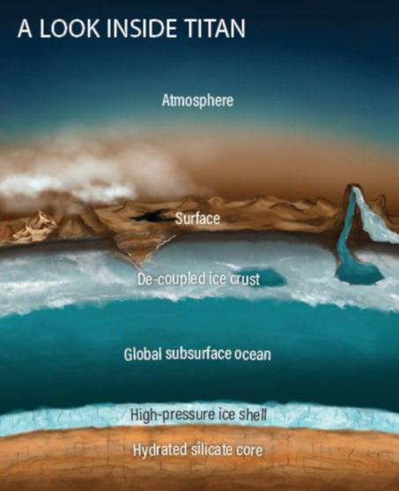
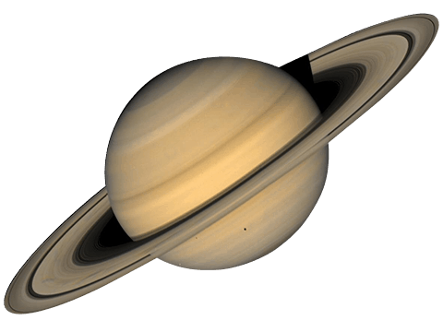
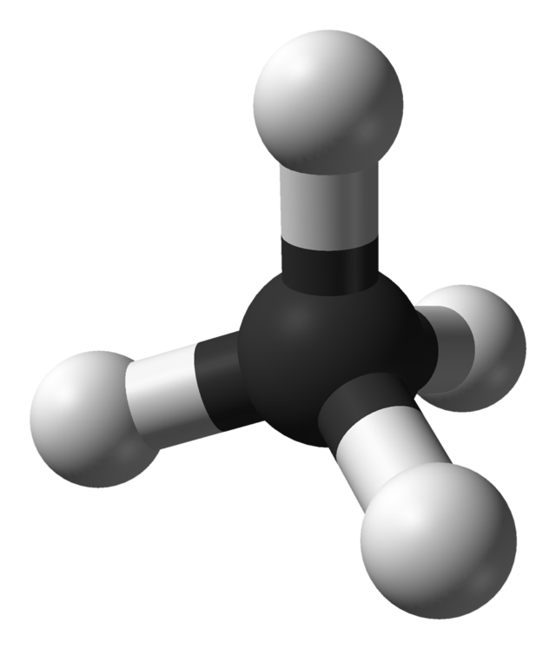
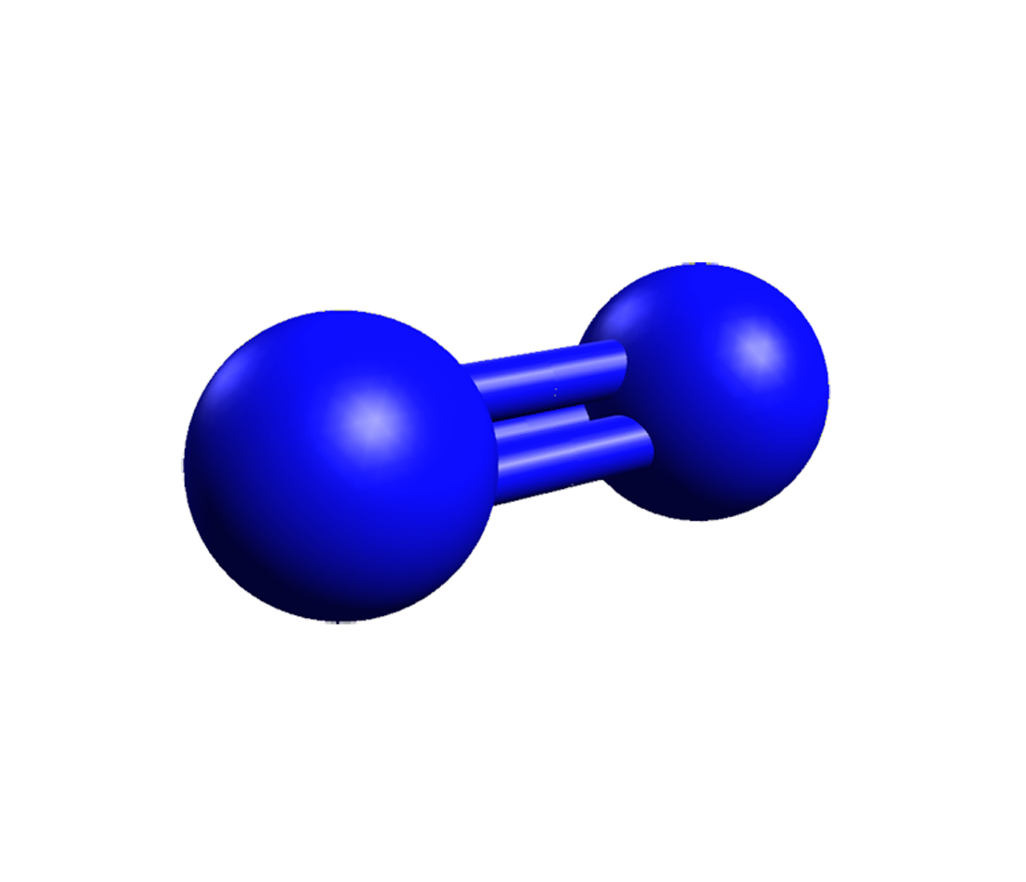
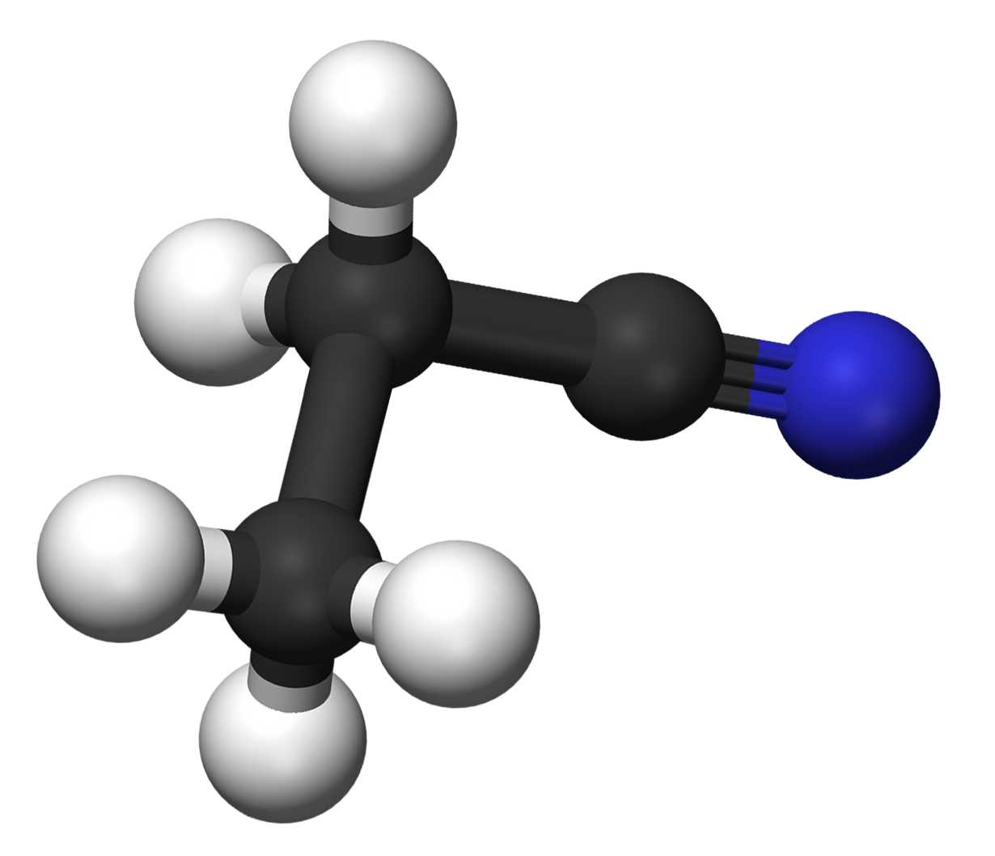
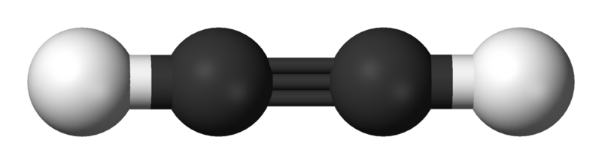
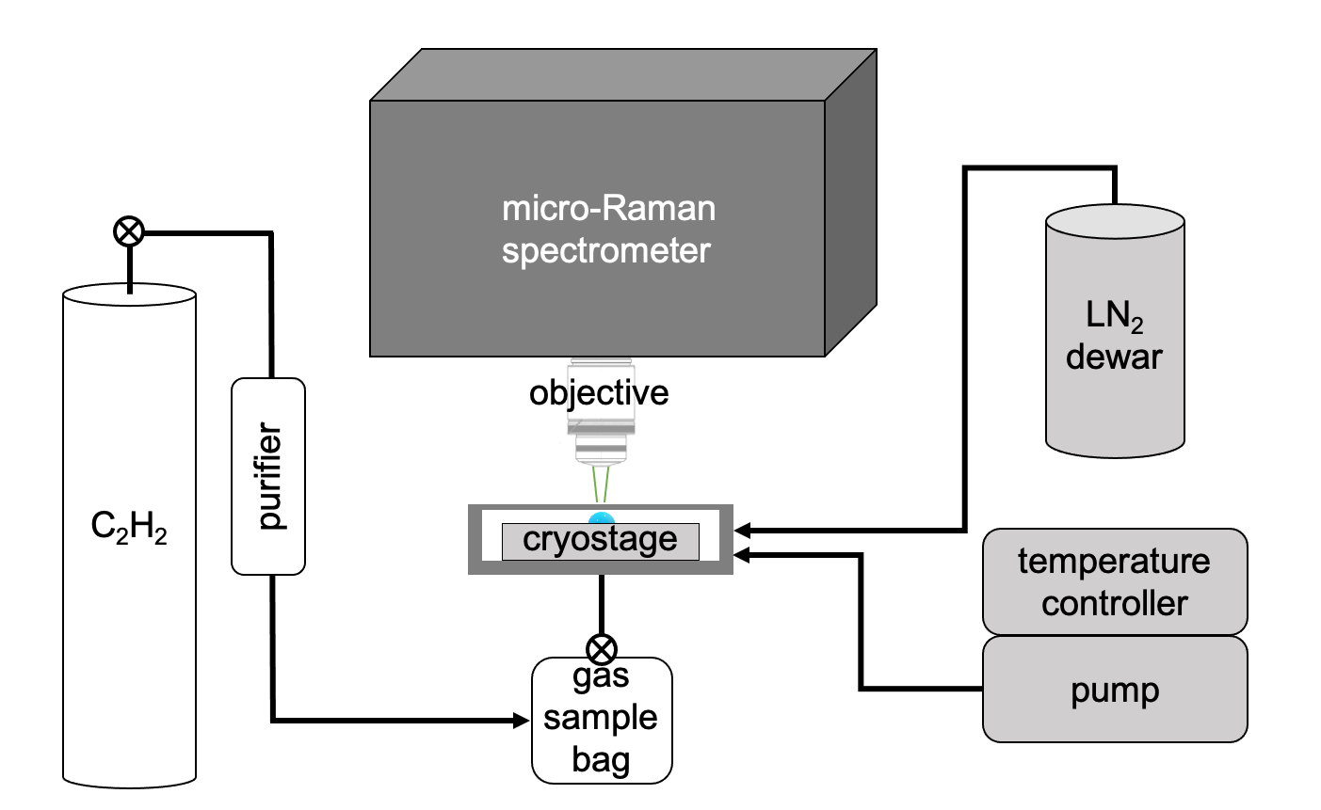
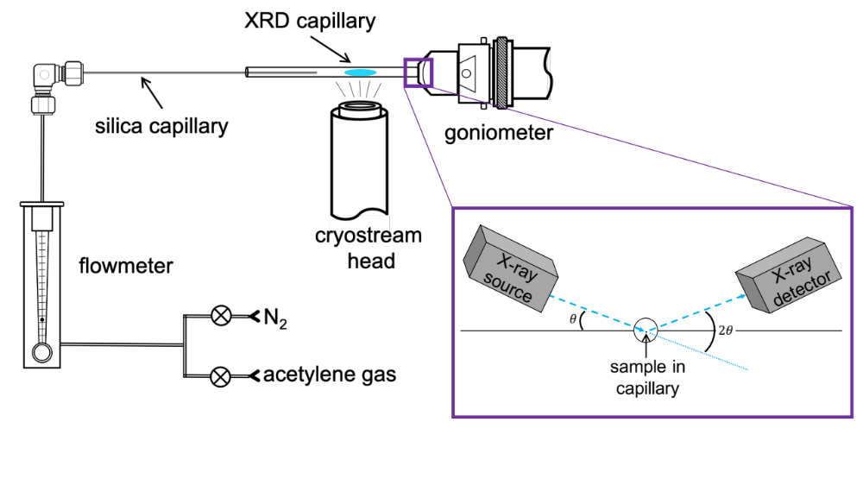
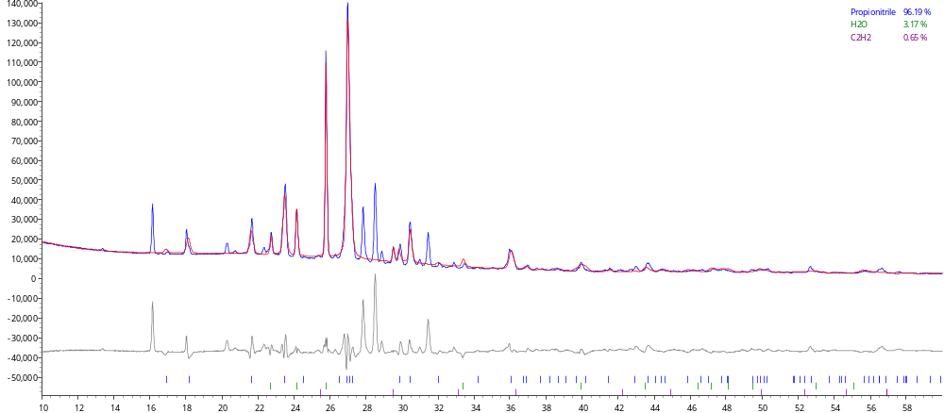
National Aeronautics and Space Administration
Postdoc Research
Titan-Relevant Molecular Minerals: A Co-Crystal between Propionitrile and Acetylene
Authors: Ellen Czaplinski, NASA Postdoctoral Fellow (322)
Robert Hodyss (322), Tuan Vu (322), Morgan Cable (322)
Background
A chemical cascade of organic molecules are created in Titan’s atmosphere, including acetylene (C₂H₂) and propionitrile (CH₃CH₂CN). These molecules are known to interact with each other to create a co-crystal, a molecular mineral. Co-crystals may have important astrobiological and geological implications regarding Titan’s surface and subsurface evolution³.
Here, we tested the formation conditions and stability of the propionitrile:acetylene co-crystal under Titan conditions for the first time using micro Raman & infrared spectroscopy and X-Ray Diffraction (XRD).
energetic particles
methane
nitrogen
solar radiation
a
b
propionitrile
acetylene
Research Objectives
Examine the formation conditions of the co-crystal
Measure the stability of the co-crystal with temperature
Determine atomic-scale structure of the co-crystal
co-crystal
Co-crystals are secondary compounds (“cryominerals”) with a unique crystalline structure. They are stabilized by weak interactions and can form in the atmosphere, surface, or subsurface.
Approach/Methods
- Deposit CH₃CH₂CN (l) in cryostage at room temp., cool sample to 90 K
- Deposit C₂H₂ gas into cryostage (s) at 90 K
- Collect Raman spectra in 10 K increments from 90-160 K
- Deposit CH₃CH₂CN (l) in capillary at room temp.
- Cool sample to 90 K while depositing C₂H₂
CH₂/CH₃ sym./asym. stretches
ν₁ C–H stretch
Benefit to JPL
JPL is a leader in experimental co-crystal studies, and this work highlights our unique approach to determining which Titan-relevant compounds form co-crystals.
Even after the Cassini mission, there are many unanswered questions about the composition of Titan’s surface. This study, provides fundamental compositional information about the surface - critical for planning a future Titan orbiter mission (i.e., for New Frontiers concepts).
This project is also tied to the NASA Astrobiology Institute (NAI) grant, “Habitability of Hydrocarbon Worlds: Titan and Beyond” (PI Rosaly Lopes) [REF]. Specifically, Objective 1.2. Molecular Transport Across the Surface and 1.3. Molecular path: Surface to ocean.
new band
12 cm⁻¹ shift
Figure 1. Raman spectra of the propionitrile + acetylene experiment shows frequency shifts of the CH₂/CH₃ and C-H stretches, new peaks, and splitting/merging of bands, indicative of co-crystal formation. The co-crystal is stable from 90-160 K.
experimental
calculated
residual
Future Work
Publish this work in ACS Earth & Space Chemistry
Continue to present work at relevant conferences
Continue investigating co-crystal combinations in our lab
Collaborating with our co-crystal colleagues around the world to submit ROSES proposals and continue new projects
  e.g., co-crystal material properties database
*
*
Significance
These results provide formation conditions and stability of the propionitrile:acetylene co-crystal for the first time. Acetylene and propionitrile are relatively abundant in Titan’s atmosphere; they may preferentially exist as a co-crystal at 90 K on the surface. This co-crystal is astrobiologically relevant, and may be a way for prebiotic compounds to be concentrated on Titan.
*
*
*
*
*
Figure 2. XRD pattern of the propionitrile + acetylene co-crystal (blue), the best calculated fit (red), and residual pattern (gray). All major peaks in the residual pattern are the co-crystal phase. Pawley fit and indexing of XRD patterns from 90 to 160 K indicate a monoclinic structure and anisotropic expansion as temperature increases, common of previously reported co-crystals. Monoclinic crystals have unit cell vectors of unequal lengths.
National Aeronautics and Space Administration
Jet Propulsion Laboratory
California Institute of Technology
Pasadena, California
www.nasa.gov
Publications and Acknowledgements:
- Czaplinski, E. C., Vu, T., Hodyss, R. The Propionitrile:Acetylene Co-crystal under Titan Conditions. In Prep. ACS Earth and Space Chem.
- Czaplinski, E. C., Vu, T., Cable, M. L., Choukroun, M., Malaska, M. J., and Hodyss R. 2023. Experimental Characterization of the Pyridine:Acetylene Co-crystal.
and Implications for Titan’s Surface. ACS Earth and Space Chem., 7 (3), 597-608.
- Czaplinski, E. C., Vu, T., Cable, M. L., Choukroun, M., Malaska, M. J., and Hodyss R. 2023. An Update on Titan-Relevant Co-Crystals Formed Experimentally: Implications for Titan’s Atmosphere, Surface, and Subsurface. Titan Through Time VI Workshop, Paris, FR.
Author Contact Information:
Ellen.C.Czaplinski@jpl.nasa.gov
Clearance Number: CL#00-0000
Poster Number: PRD-P-002
Copyright 2023. All rights reserved.
Notes:
Raman spectroscopy: 50-4000 cm⁻¹
Optical microscopy: 10×, 50×
90 K solid-solid sequential deposition
FTIR spectroscopy [range]
XRD: 10-45 2θº
co-deposition as sample is cooled to solid phase

