Slide 1


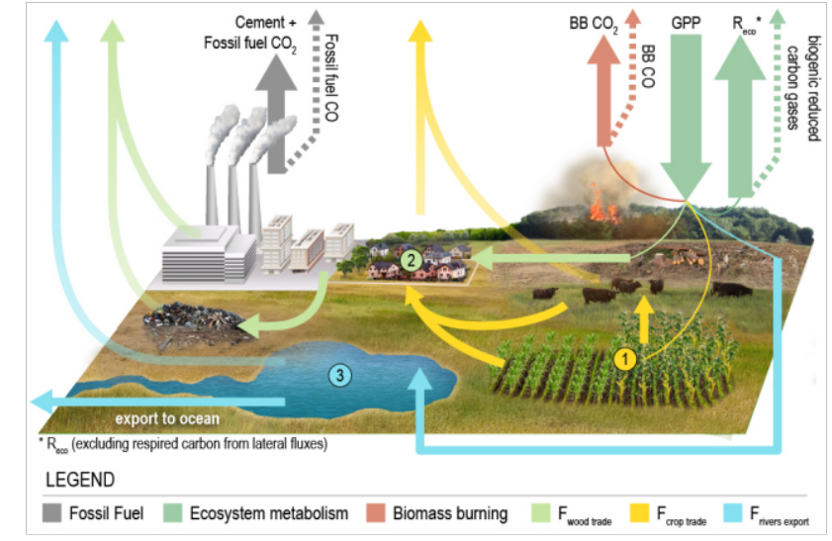
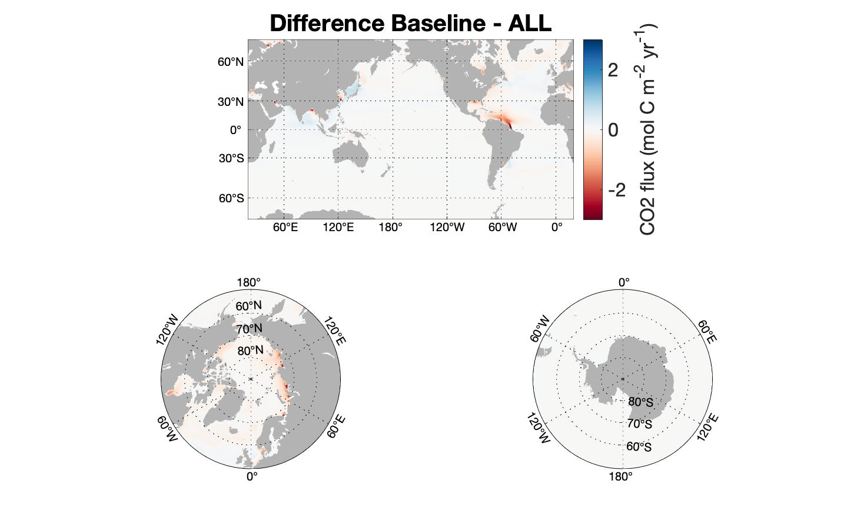
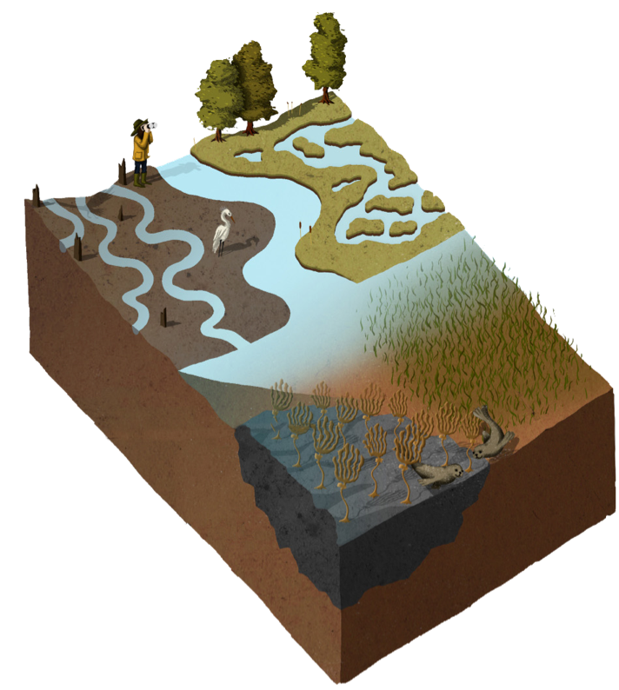
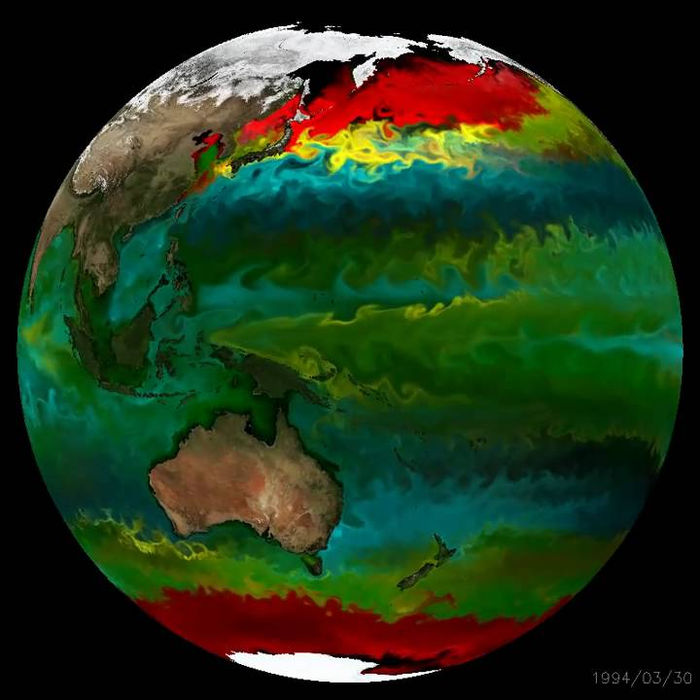
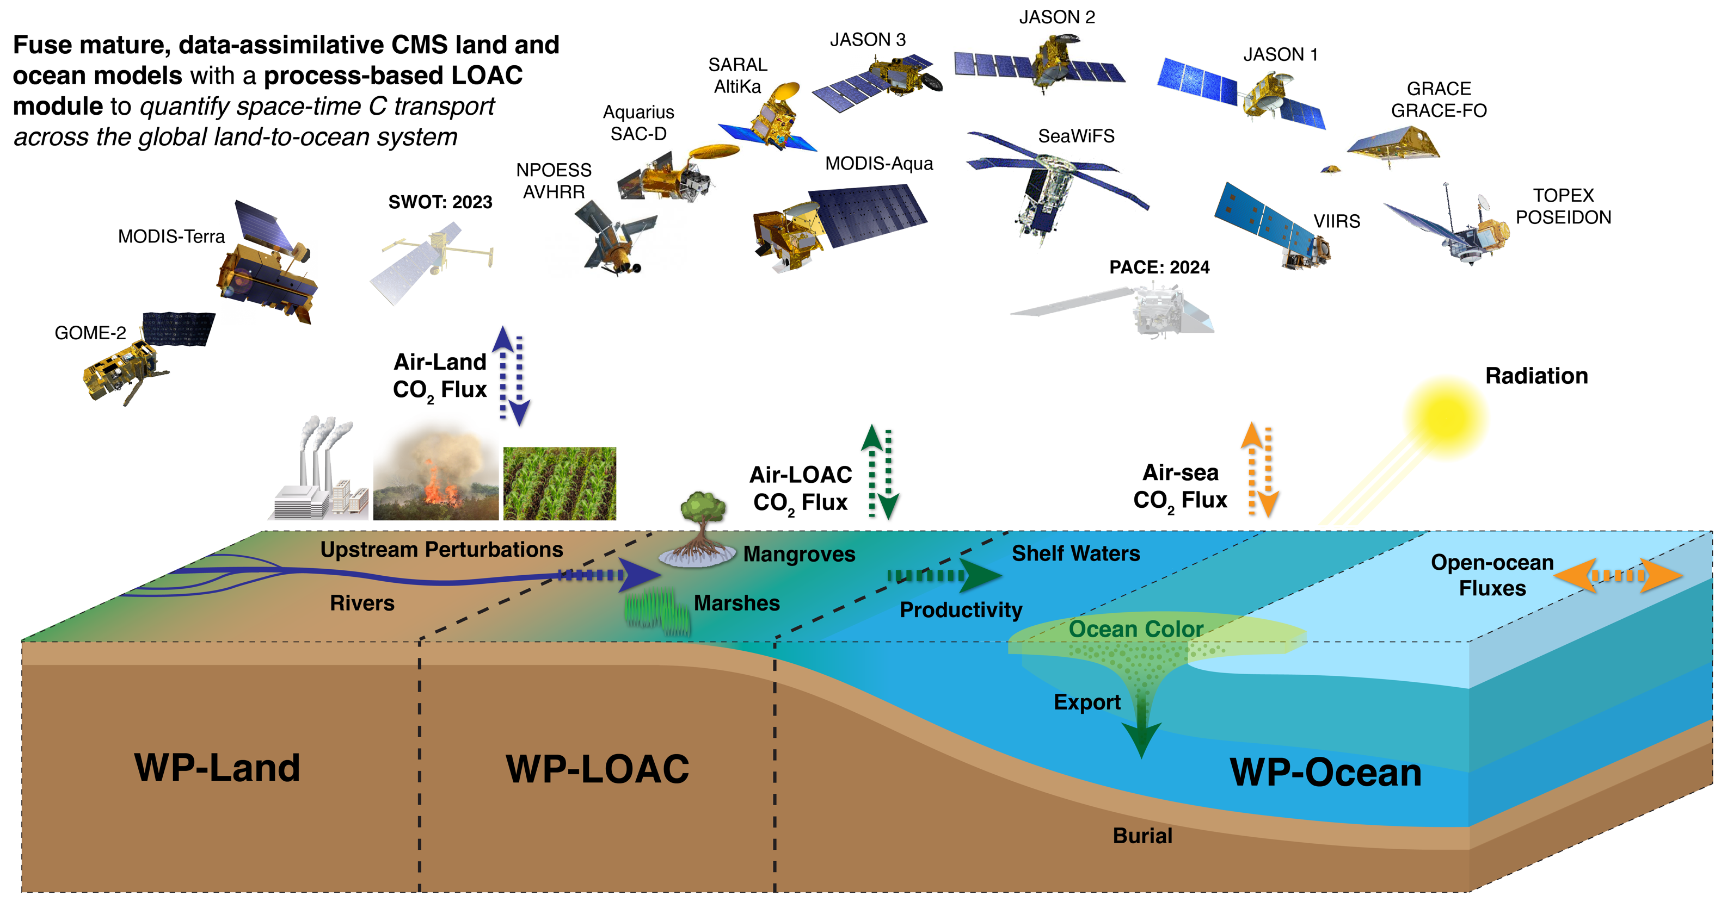
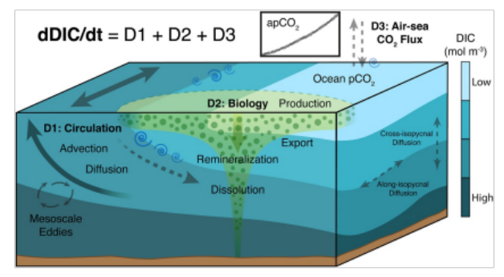
National Aeronautics and Space Administration
Postdoc Research
Building bridges between land and ocean carbon budgets
Raphaël Savelli, JPL Postdoctoral Fellow (329B)
Dimitris Menemenlis (329B), Marc Simard (334F), Dustin Carroll (MLML, SJSU)
This is the ”state of the art”!
… by improving estimates of lateral exports of carbon from coastal wetlands …
Can you be more precise on your lateral exports of carbon…
???
Large amounts of carbon and nutrients transit from land to the ocean.
Two main pathways of lateral exports of carbon:
Rivers: ~ 1 Pg C yr⁻¹ (Li et al., 2017)
Coastal wetlands: ~ 2 Pg C yr⁻¹ (Duarte et al., 2005)
= the Land-to-Ocean Aquatic Continuum (LOAC)
The LOAC contribution to the ocean carbon cycle is underrepresented in Earth System Models and global ocean biogeochemistry models (Ward et al., 2020)
Ocean
Land
Coastal watersheds
Image Credit: Yale Program on Climate Change Communication
POC
DOC
C
DIC
C
ALK
C
How land and ocean carbon currently communicate in models.
²
C
¹
Florida Everglades (US)
¹ Simard et al., 2019
² Sanderman et al., 2018
We aim to unify land and ocean carbon into an ocean biochemistry model …
Land carbon budget
… and quantifying ocean carbon sensitivity to lateral exports of carbon from rivers.
Image Credit: Byrne et al., 2022
Key development:
First spatial inter- and intra-annual variability of lateral exports of carbon and nutrients from rivers, globally.
FLUX: Red = more outgassing / blue = more uptake in experiments compared to baseline (daily point-source)
CONCENTRATION: Red = higher / blue = lower in experiments compared to baseline (daily point-source)
PRODUCTION: Red = higher / blue = lower in experiments compared to baseline (daily point-source)
The Land-to-Ocean Aquatic Continuum
C runoff drives more outgassing through physical/dissolution pump
N runoff drives more ingassing through biological pump
O₂ production due to biological activity enhanced by N addition
Stronger effect in the coastal ocean, close to river mouths
Regions of interest:
Blue carbon ecosystems (mangroves, marshes, seagrass…)
Coastal waters
Modified from Legge et al. 2020
Key development:
First globally-resolved diffuse lateral exports of carbon from coastal wetlands.
Future perspectives
Ocean model
Image Credit: ECCO-Darwin
Key development:
First non-adhoc estimate of the sensitivity of the ocean carbon cycle to time and spatially-resolved exports from land.
Carbon Monitoring System 2022, PI D. Carroll: Closing the Carbon Cycle Loop: Quantifying Land-to-Sea Carbon Fluxes
Image Credit: Carroll et al., 2022
ECCO-Darwin ocean biogeochemistry model
National Aeronautics and Space Administration
Jet Propulsion Laboratory
California Institute of Technology
Pasadena, California
www.nasa.gov
Publications:
Savelli, R., Menemenlis, D., Simard, M., Carroll, D., Bloom, A., Manizza, M., Dutkiewicz, S., Zang, H., (in prep), Global ocean carbon sensitivity to time and spatially-resolved carbon and nutrient exports from rivers.
Author Contact Information:
818-354-4768 | raphael.savelli@jpl.nasa.gov
Poster Number: PRD-E-038
Clearance Number:
Copyright 2023. All rights reserved.

