Slide 1

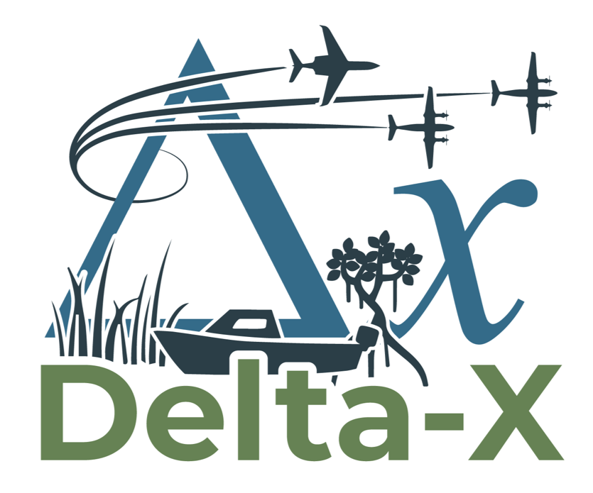
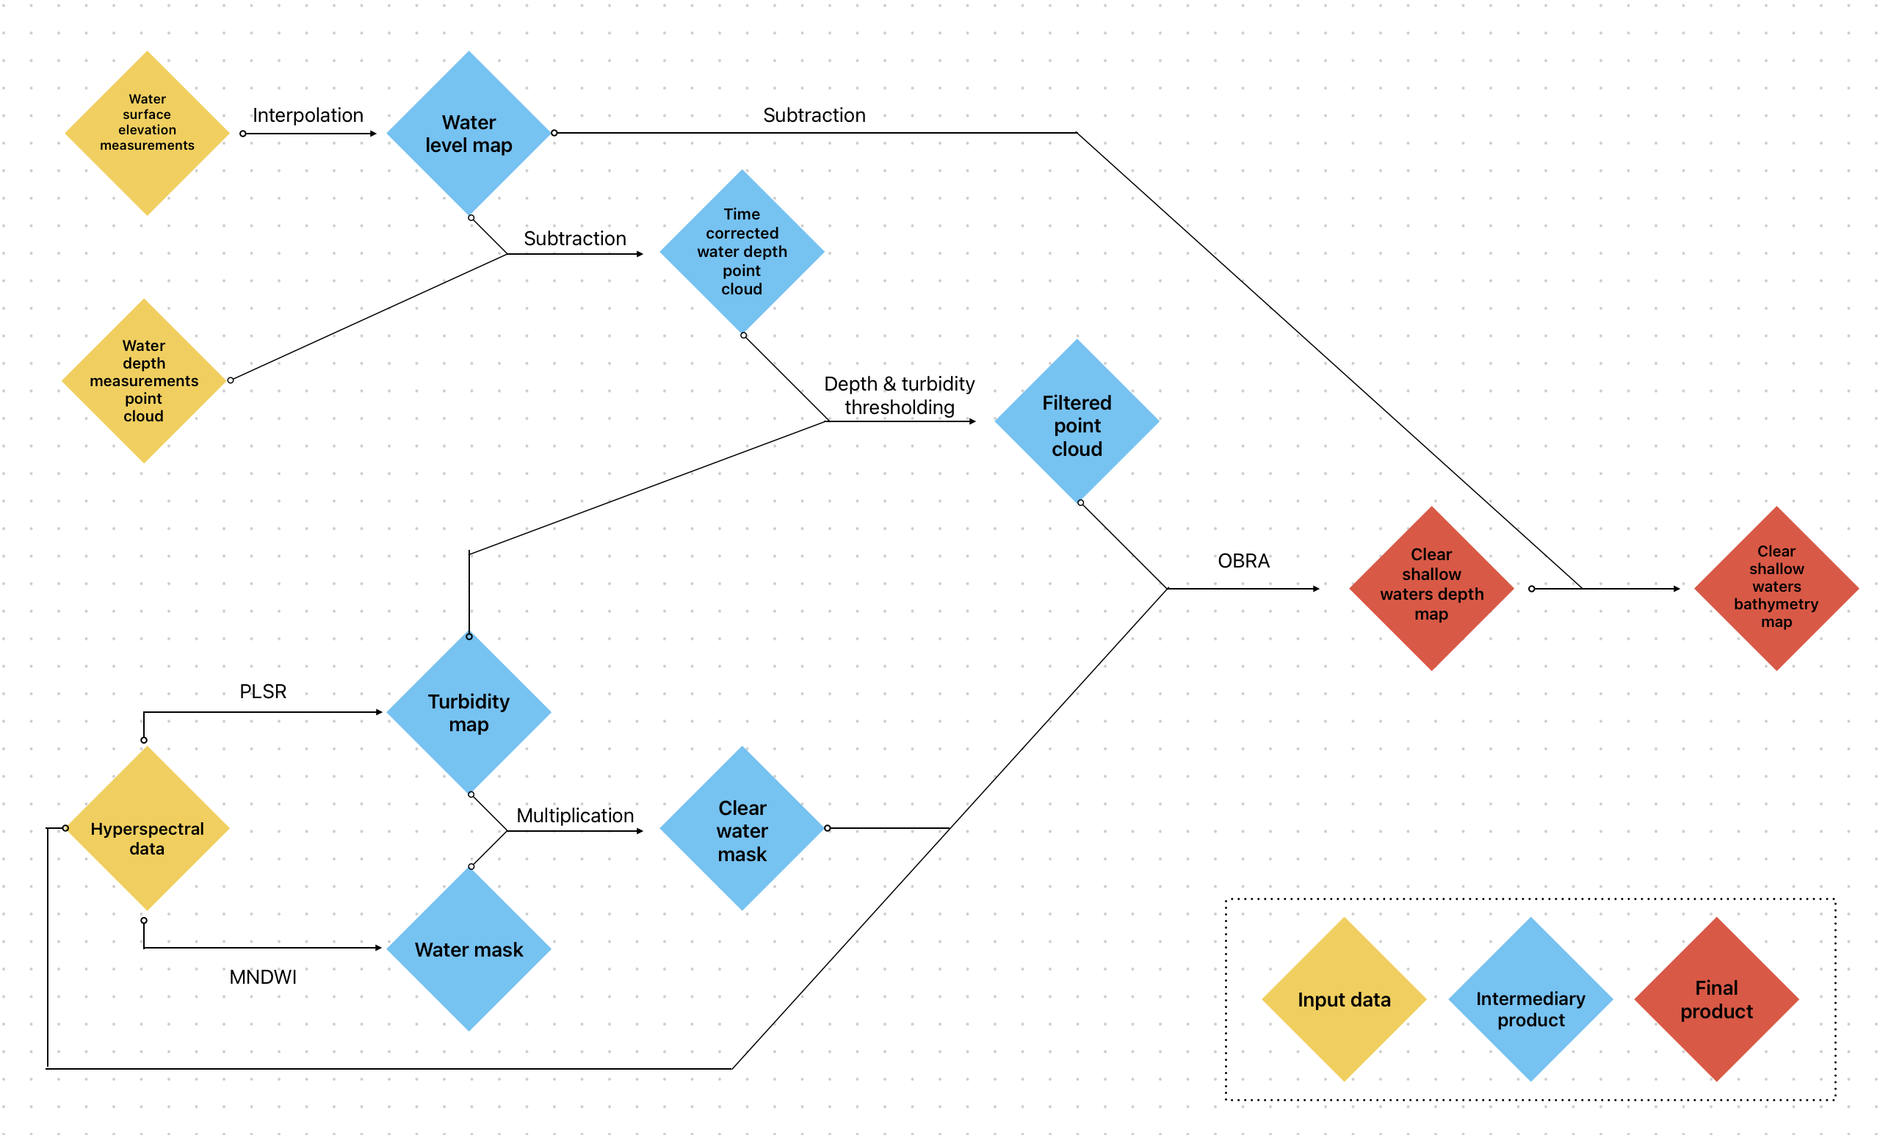
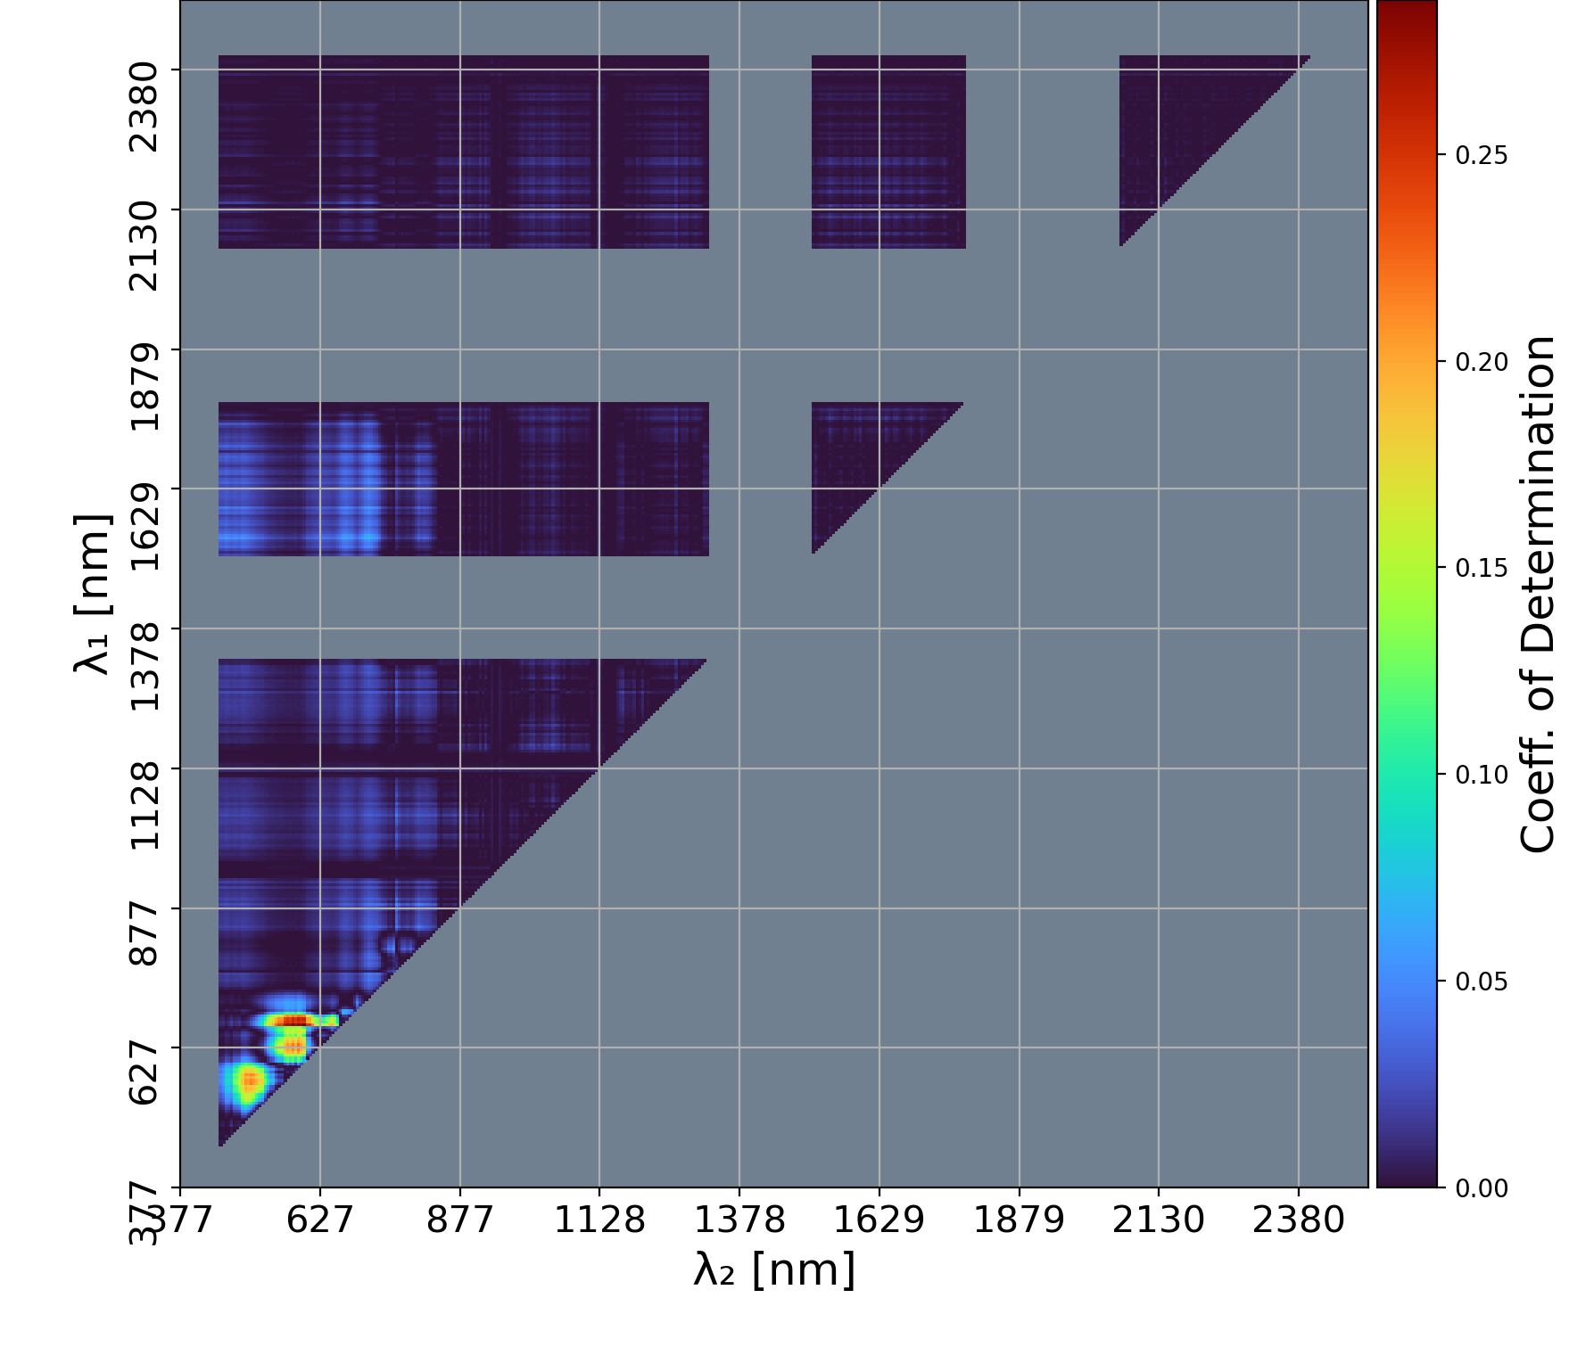
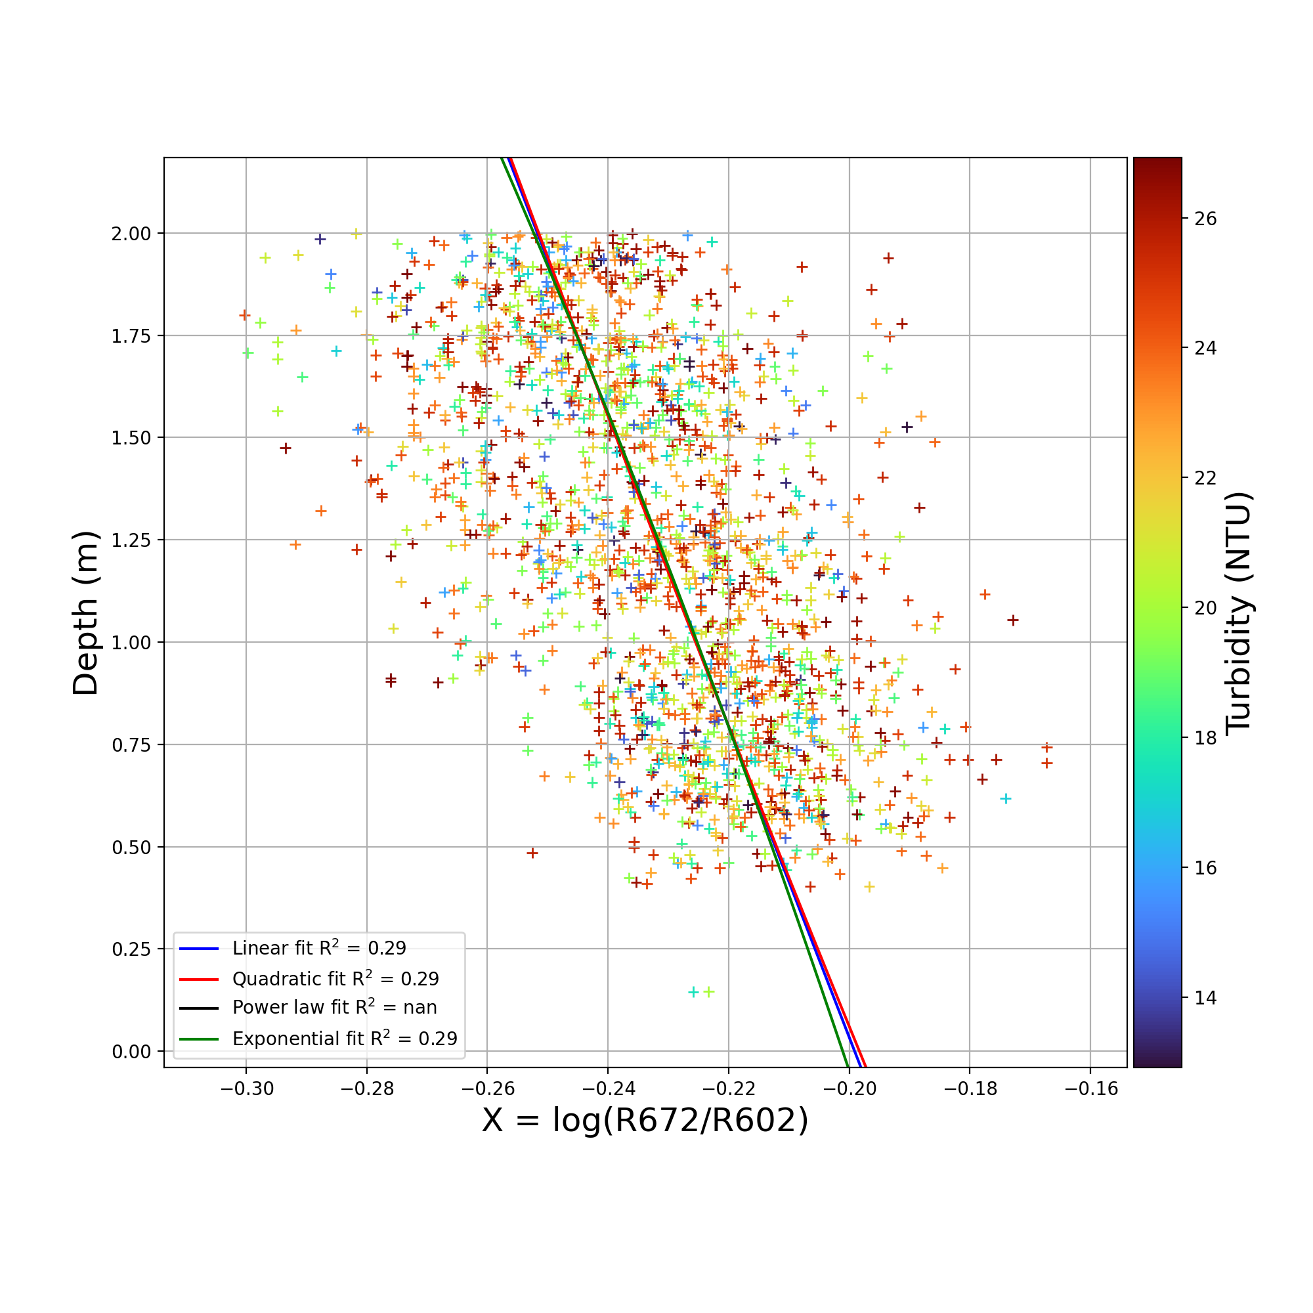
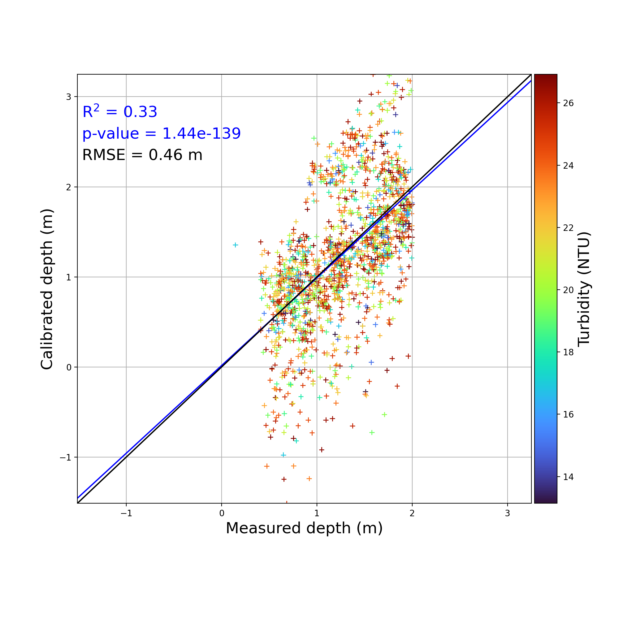
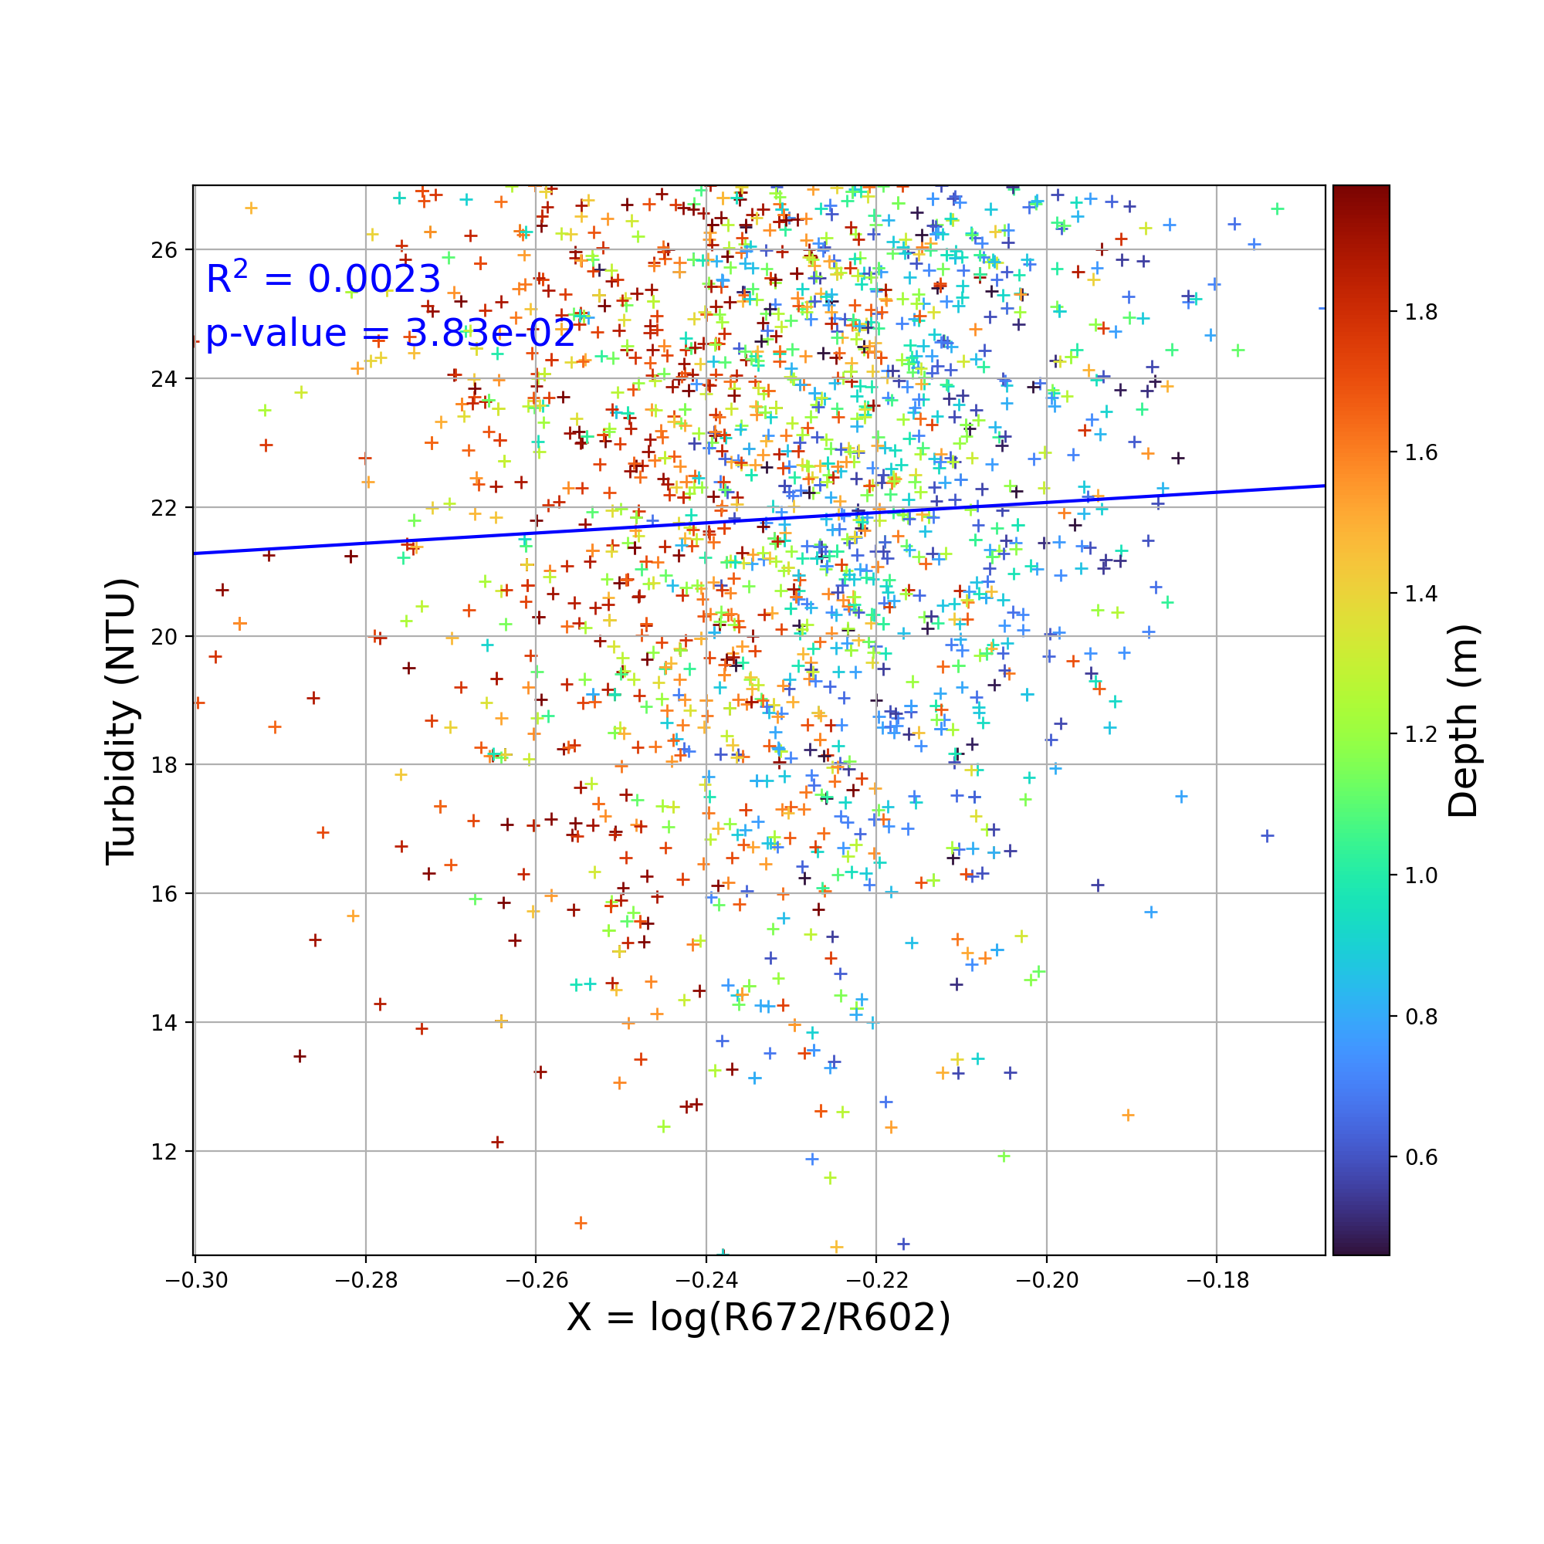
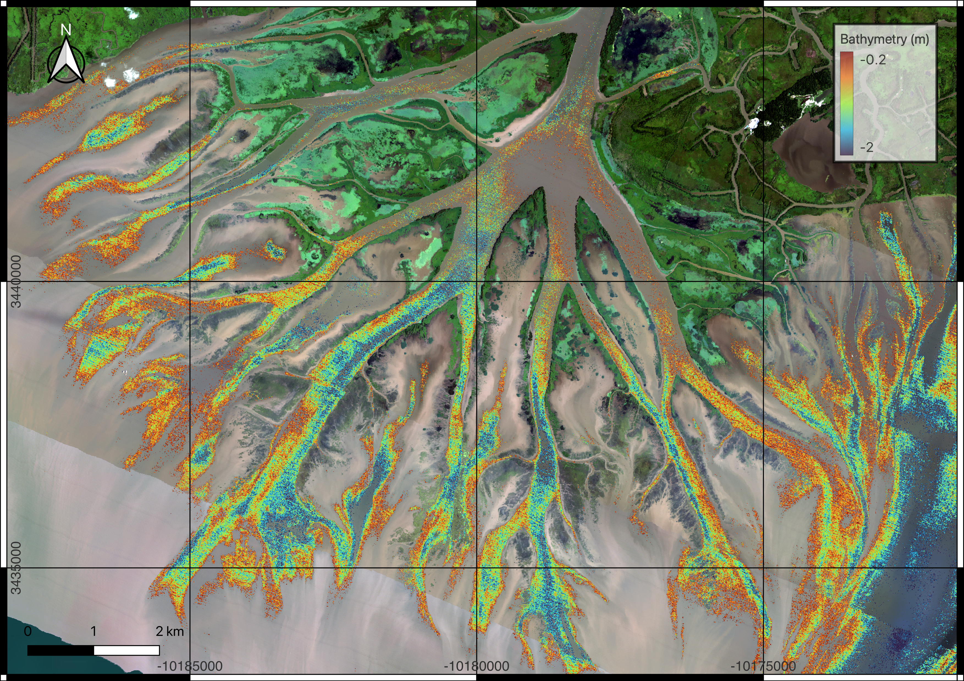
National Aeronautics and Space Administration
Postdoc Research
Shallow Bathymetry Estimation in Turbid Environments: Leveraging AVIRIS-NG Hyperspectral Data
Antoine Soloy, JPL Postdoctoral Fellow (334F)
Daniel Jensen, Signal Analysis Engineer (382F)
Marc Simard, Senior Research Scientist (334F)
Background
Accurate estimation of shallow bathymetry is vital for applications like maritime navigation and hydrodynamic modeling. However, traditional underwater sensors face challenges in non-navigable waters. This poster presents the innovative use of the Optimal Band Ratio Analysis (OBRA) applied to hyperspectral data from Aviris-NG.
While OBRA is conventionally used in clear water, our study successfully adapts it to the turbid conditions of the Wax Lake Delta (Louisiana, USA). The exceptional spectral resolution of Aviris-NG previously enabled the precise estimation and mapping of total suspended sediment (TSS) by Fichot and Harringmeyer (2023), allowing identification of subregions of clear water. This breakthrough facilitates the effective application of OBRA in challengingly turbid environments.
Methodology
Optimal Band Ratio Analysis
Fig 1: Algorithm description
Step 1:
Optimal Band Ratio identification
Step 2:
Depth calibration
Step 3:
Validation
Step 4:
Independence from turbidity
Fig 2: Confusion matrix of all band ratios
Fig 3: Optimal band ratio fit to training data
Fig 4: Calibrated values vs ground truth testing dataset
Fig 5: Calibrated values vs turbidity
Step 5:
Water depth to bathymetry conversion
Takeaway message
The best performing band ratio is found between 672nm (red) and 602nm (orange).
Calibrated water depths exhibit a significant correlation with ground truth measurements while remaining independent from turbidity.
AVIRIS-NG’s 5nm resolution enables the precise identification of an optimal pair of wavelengths, despite high levels of turbidity.
Output bathymetry fills the lack of data in existing Digital Elevation Models, especially where in-situ measurements are challenging to collect.
Repeated measurements can help monitoring shallow morphodynamics.
References
Fichot, C.G., and J. Harringmeyer. 2023. Delta-X: AVIRIS-NG L3-derived Water Quality, TSS, and Turbidity, MRD, V3. ORNL DAAC, Oak Ridge, Tennessee, USA. https://doi.org/10.3334/ORNLDAAC/2152
Fig 5: Map of calibrated bathymetry
National Aeronautics and Space Administration
Jet Propulsion Laboratory
California Institute of Technology
Pasadena, California
www.nasa.gov
Publications and Acknowledgements:
This work was funded by the NASA Delta-X project. Delta-X is funded by the Science Mission Directorate's Earth Science Division through the Earth Venture Suborbital-3 Program NNH17ZDA001N-EVS3
Author Contact Information:
(818) 354 1463
antoine.soloy@jpl.nasa.gov
Clearance Number: CL#00-0000
Poster Number: PRD-E-032
Copyright 2023. All rights reserved.

