Slide 1


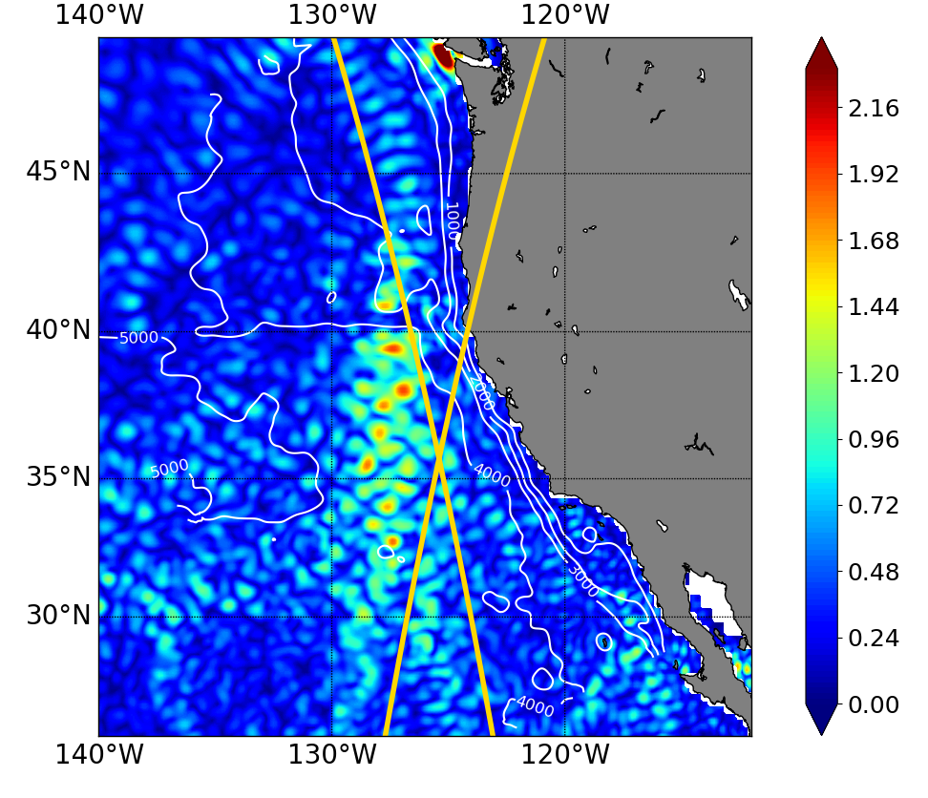
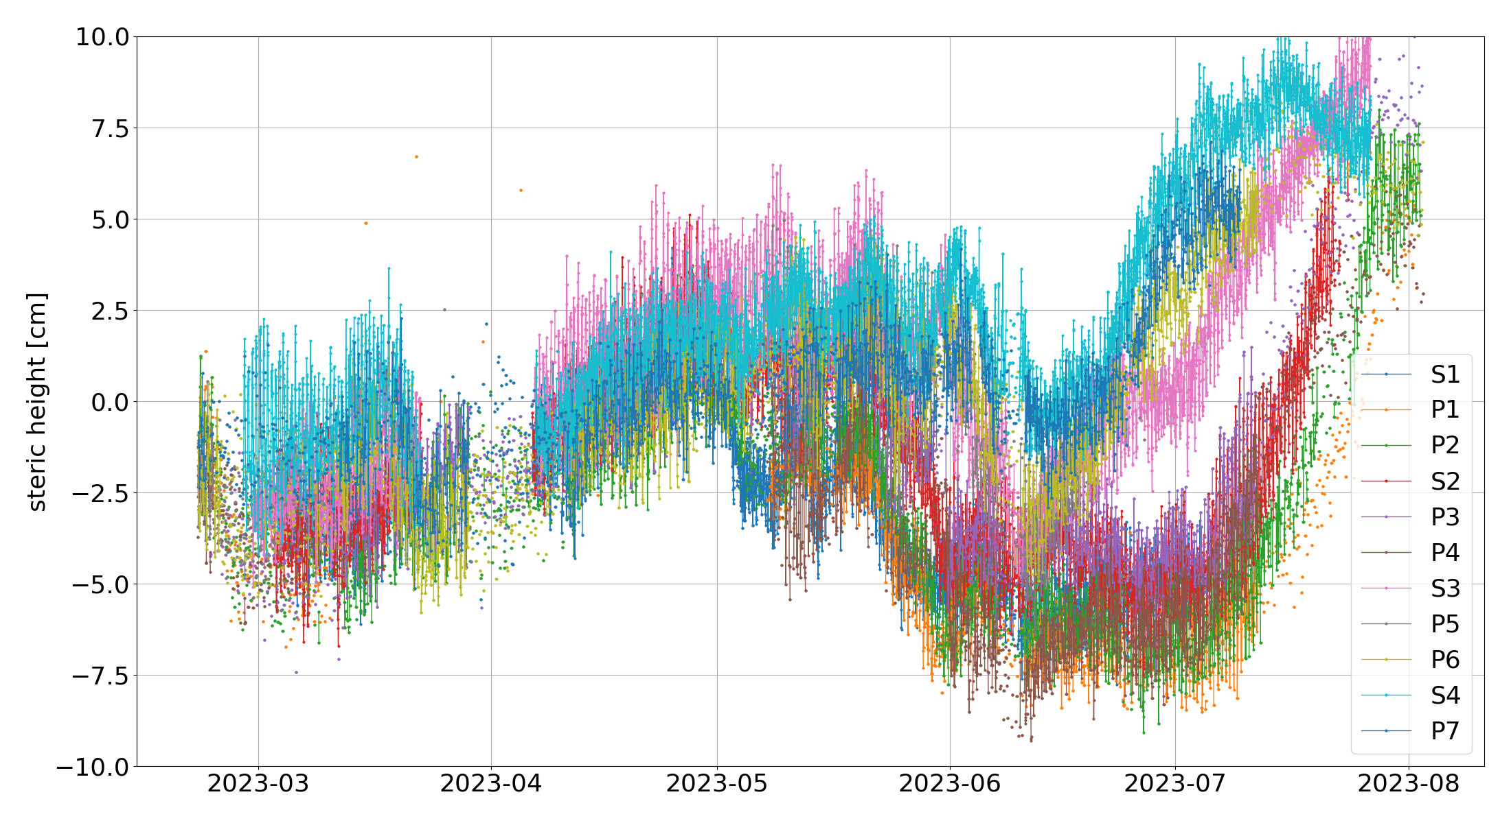
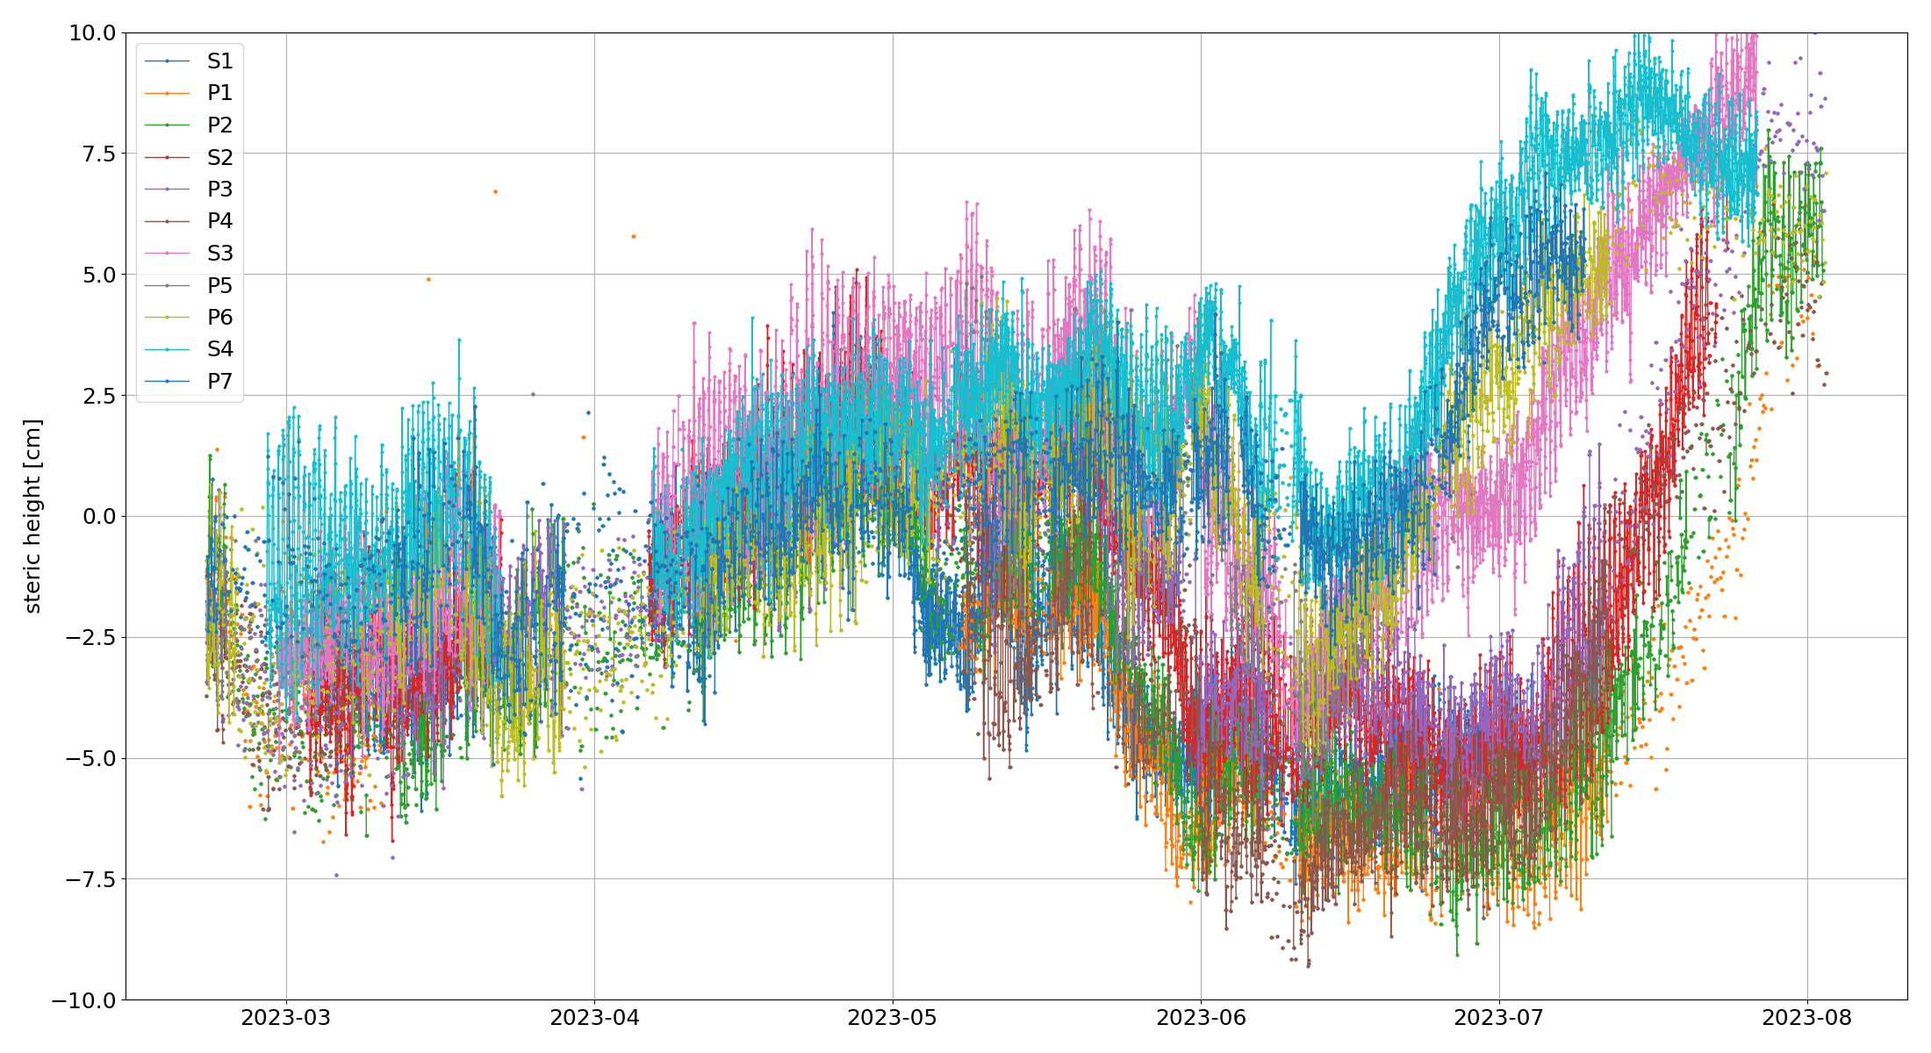
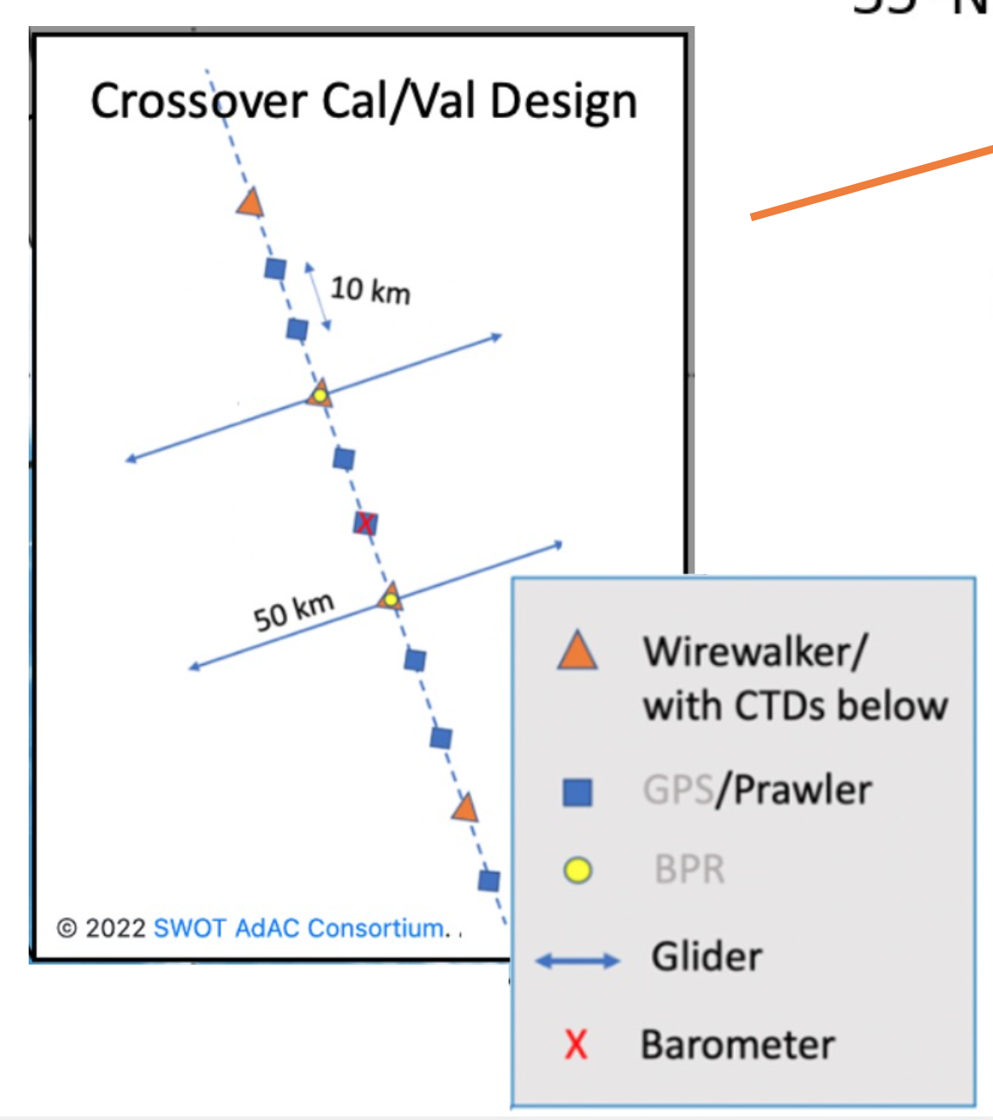
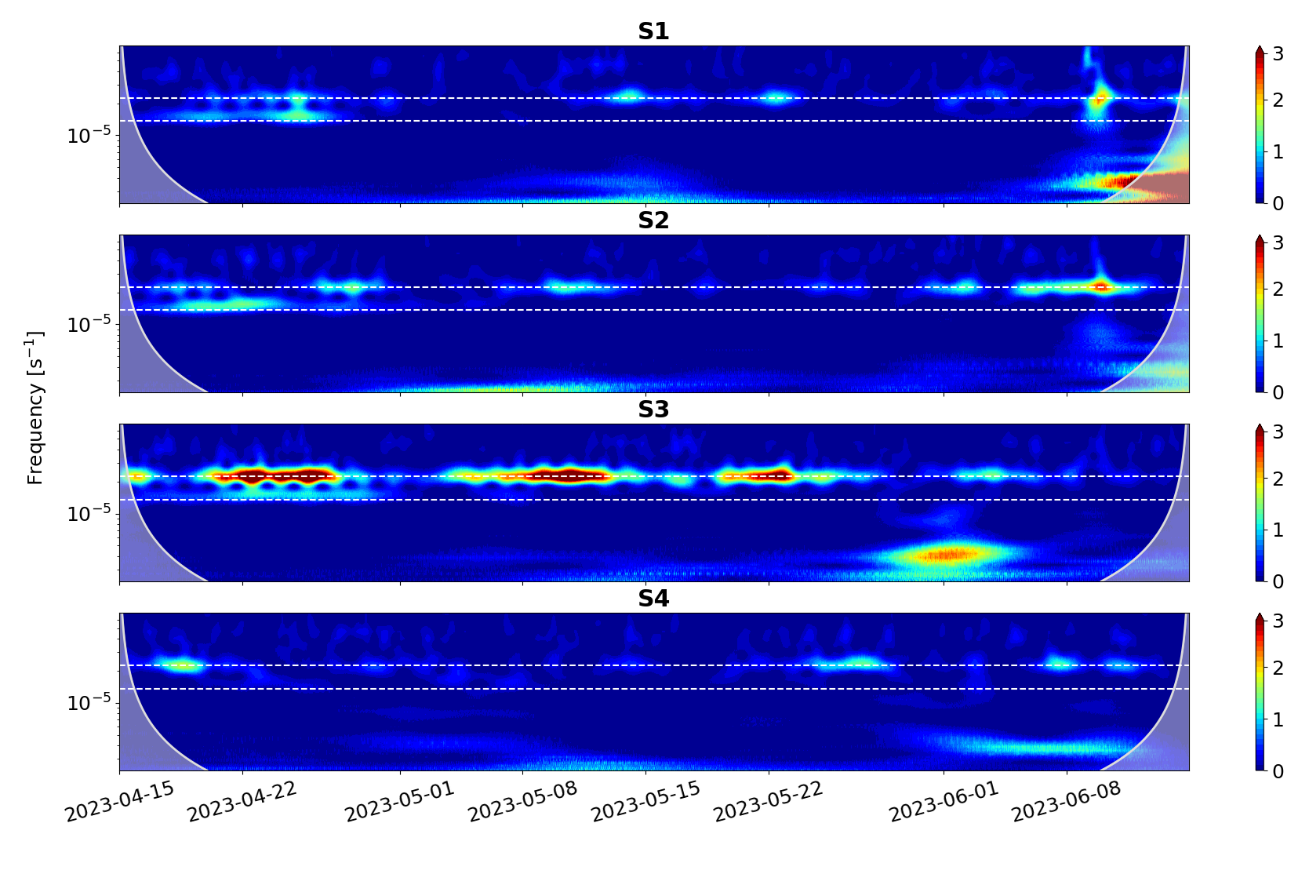
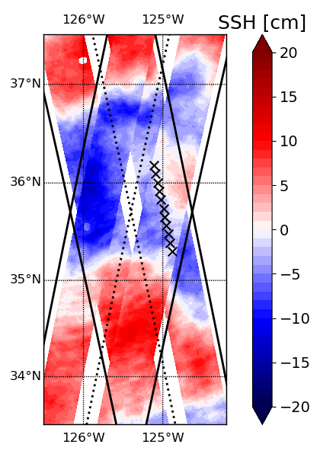
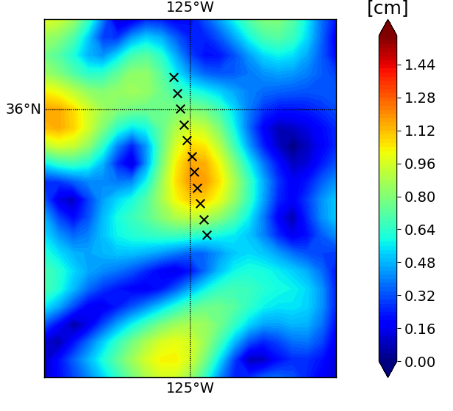
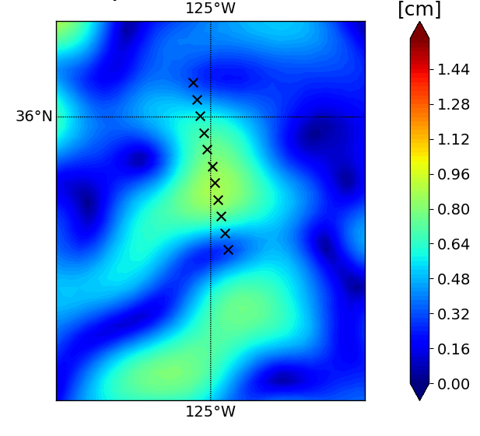
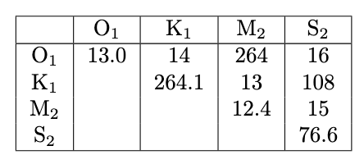
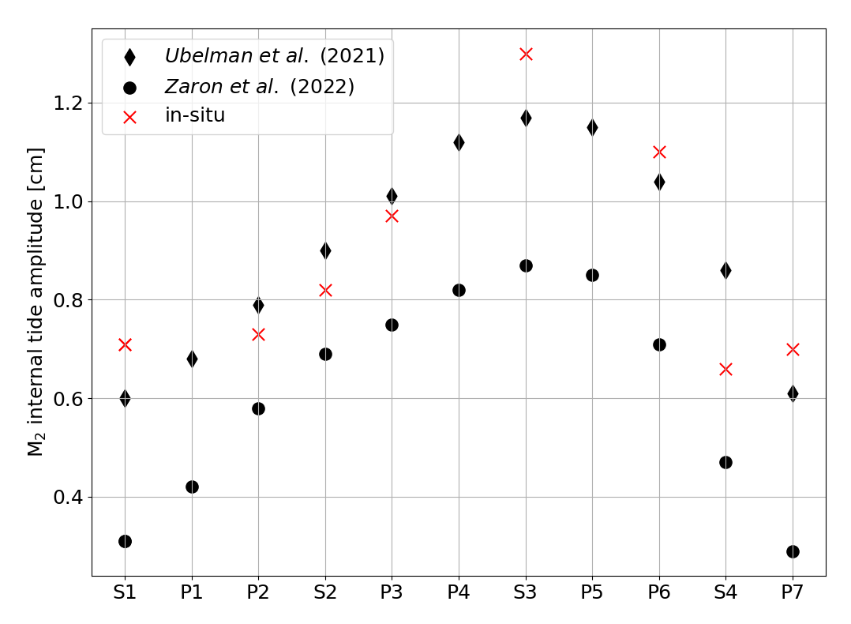
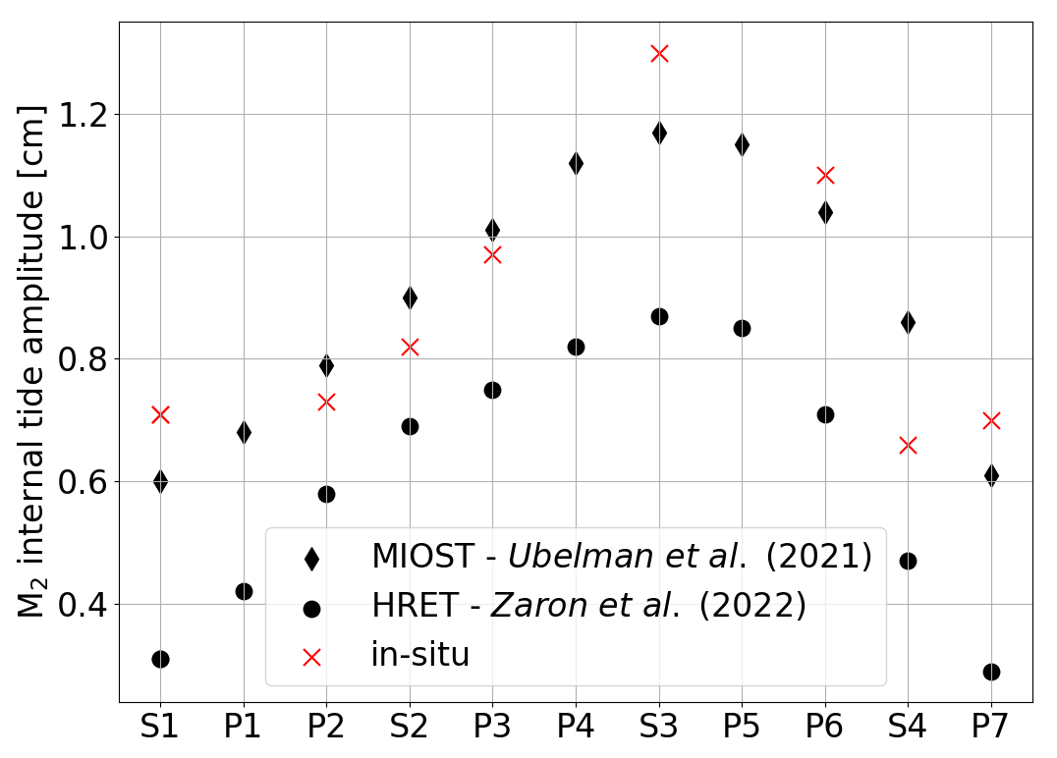
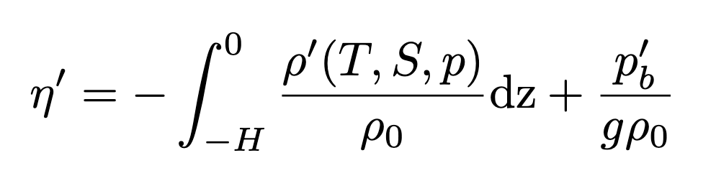
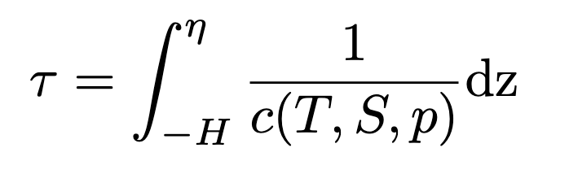
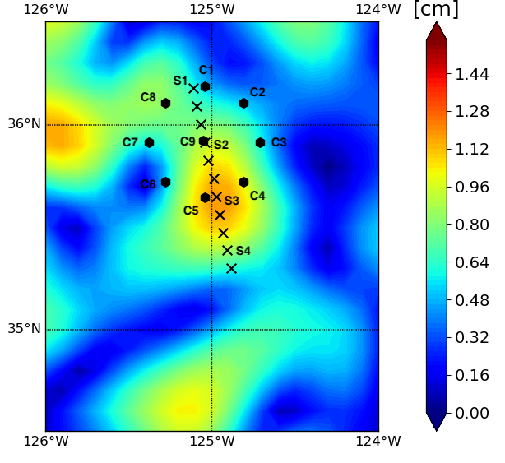
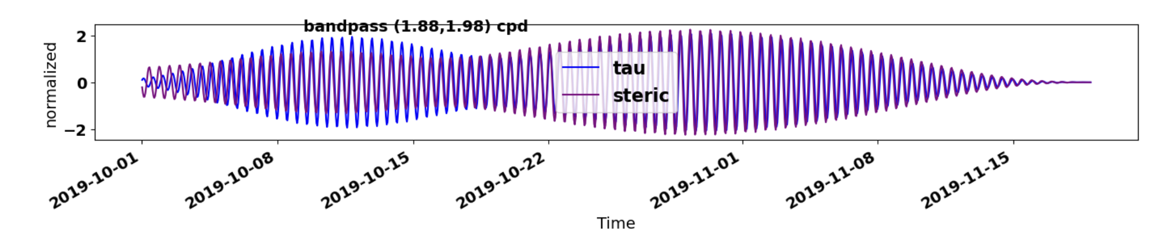

Internal tide characterization at the Californian SWOT Cal/Val site
Audrey Delpech (329B), Jinbo Wang (329B), Luke Kachelein (329B), Amy Waterhouse (SIO), Drew Lucas (SIO), J. Tom Farrar (WHOI), Magdalena Andres (WHOI), Uwe Send (SIO), Matthias Lankhorst (SIO)
MOTIVATION
IN SITU CAL/VAL SITE
Internal tides are one of the most energetic features at depth in the ocean, through enhanced forward cascade and breaking, it is the main source of diapycnal mixing that is key to maintaining the global overturning circulation and vertical fluxes of heat, CO₂ and nutrients that controls our climate.
Understanding the characteristics of internal waves is also key for the interpretation of high-resolution sea surface height observations from SWOT.
How well do the internal waves characteristics inferred from new instruments compare to the ones observed with in-situ moorings ?
Sea Surface Height [cm]
11 moorings with temperature and salinity measurements [1]
SWOT
Objectives
Characterize internal tides at the SWOT Cal/Val site in terms of amplitude, horizontal and vertical structures and propagation
Understand how accurately SWOT can measure both the coherent and incoherent components of the internal tides.
Understand how accurately internal tides can be observed by PIES (Pressure sensor equipped Inverted Echo Sounder).
M₂ internal tide amplitude in SSH from 25 years of altimetry [2].
Cal/Val
begins
Cal/Val
ends
Steric height (0-500m) from the 11 moorings
INTERNAL TIDES FROM ALTIMETERS
INTERNAL TIDES FROM IN SITU
NEXT: INTERNAL TIDES FROM SWOT
MIOST [2]
HRET [3]
Wavelet analysis at the moorings location
M₂
[cm²]
Plane wave fit at the aliased tidal periods
Requires several months of data to be able to separate between tidal constituents.
S1
f
S1
P1
P1
P2
P2
P3
S2
S2
P3
P4
S3
P4
S3
P5
P5
S4
P6
S4
P6
P7
P7
[days]. Alias (diagonal) and synodic periods (upper diagonal) of the main tidal constituent (O₁, K₁, M₂, S₂) for the SWOT Cal/Val orbit (δt = 0.9935815 day).
Comparison of M2 internal tide amplitude from altimetry products and in situ steric height
SWOT pass and SSH snapshot over the Californian Cal/Val Site
M₂ internal tide dominates at S3 location
No evidence of energy propagation across the mooring array.
NEXT: INTERNAL TIDES FROM PIES
CONCLUSION & PERSPECTIVES
PIES: Pressure Inverted Echo Sounders are instruments that measure the round trip travel time of an acoustic waves between the bottom and the surface of the ocean and give an approximation for sea surface height.
The in situ SWOT Cal/Val dataset is a promising tools to investigate internal wave dynamics
Future efforts will focus on decomposing the signal onto baroclinic modes and inferring horizontal propagation.
Steric Height
Acoustic Time
b
Sound speed
Global Internal Waves Project
Density anomaly
Steric bottom pressure
Good agreement between the amplitude of M₂ internal tide from satellite and in-situ measurements.
In all cases, the amplitude maximum is found at the location of S3 mooring.
Ongoing deployment of an array of PIES to answer specific questions:
What is the dominant source of internal waves on the shelf?
What is the fate of the remotely generated low-mode internal waves?
Comparison between steric height and ‘steric’ acoustic travel time band-passed around the M₂ frequency
- Different methods are used to compute these amplitudes for altimetry data (plane wave fit) or in-situ data (complex demodulation).
- Sensitivity to the M2 amplitude calculation method remains to be investigated.
Good agreement between the steric height and acoustic travel time in a narrow band around M₂ frequency
Can the acoustic travel time be uniquely related to a temperature and salinity profile structure associated with internal tides ?
REFERENCES
National Aeronautics and Space Administration
Jet Propulsion Laboratory
California Institute of Technology
Pasadena, California
www.nasa.gov
Copyright 2023. All rights reserved.
[1] Wang, J., Fu, L. L., Haines, B., Lankhorst, M., Lucas, A. J., Farrar, J. T., Send, U., Meing, C., ... & Stalin, S. (2022). On the development of SWOT in situ calibration/validation for short-wavelength ocean topography. Journal of Atmospheric and Oceanic Technology, 39(5), 595-617.
[2] Ubelmann, C., Carrere, L., Durand, C., Dibarboure, G., Faugère, Y., Ballarotta, M., ... & Lyard, F. (2022). Simultaneous estimation of ocean mesoscale and coherent internal tide sea surface height signatures from the global altimetry record. Ocean Science, 18(2), 469-481.
[3] Zaron, E. D. (2019). Baroclinic tidal sea level from exact-repeat mission altimetry. Journal of Physical Oceanography, 49(1), 193-210.

