Slide 1

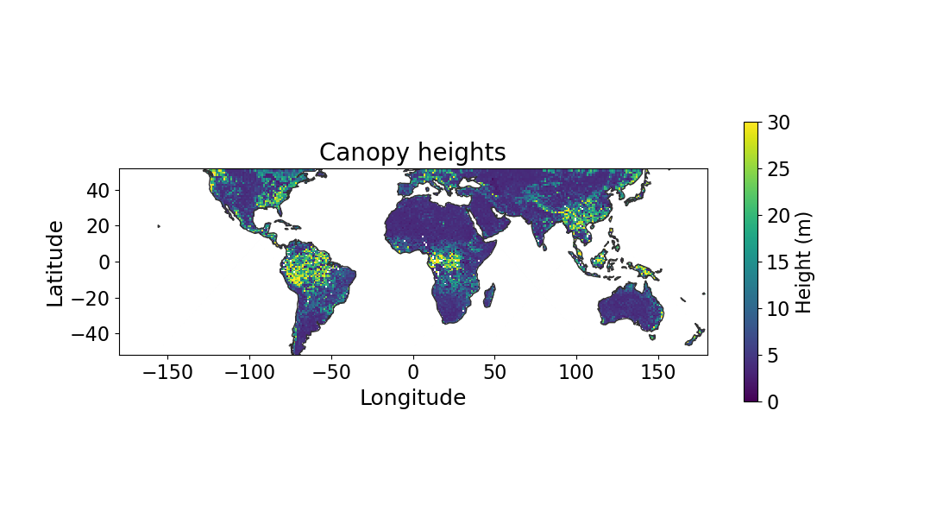
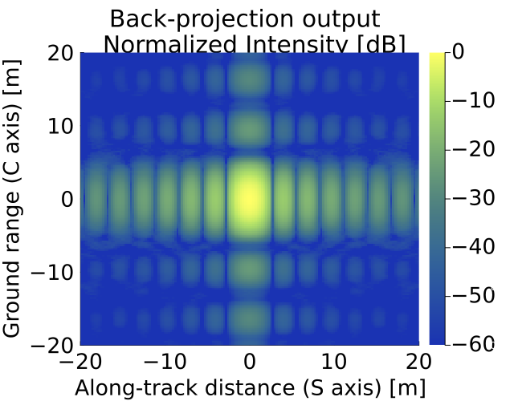
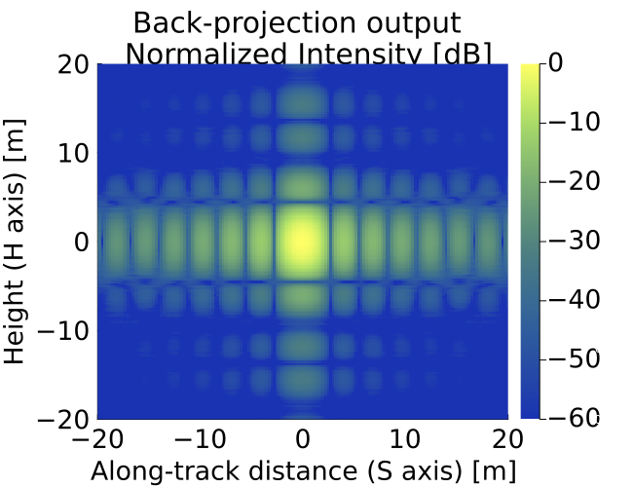
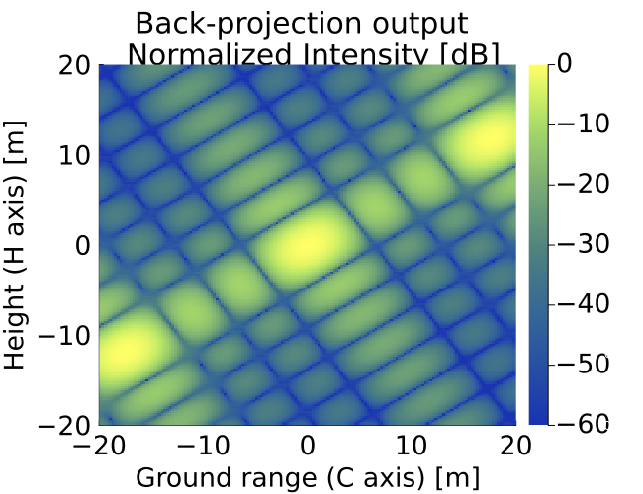

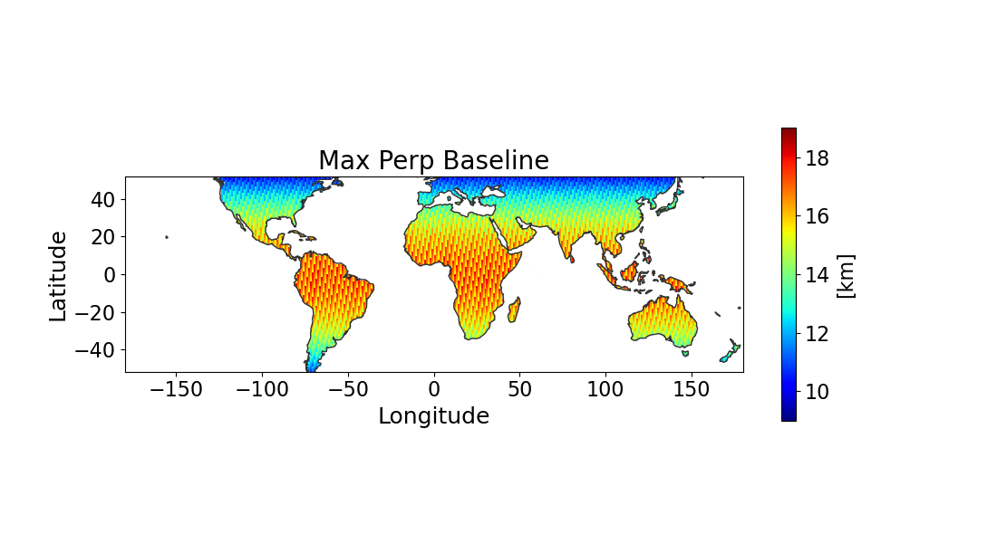
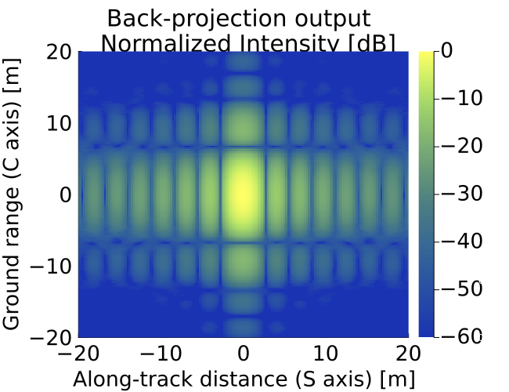
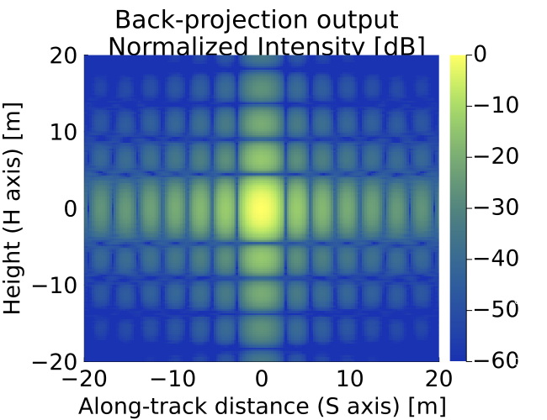
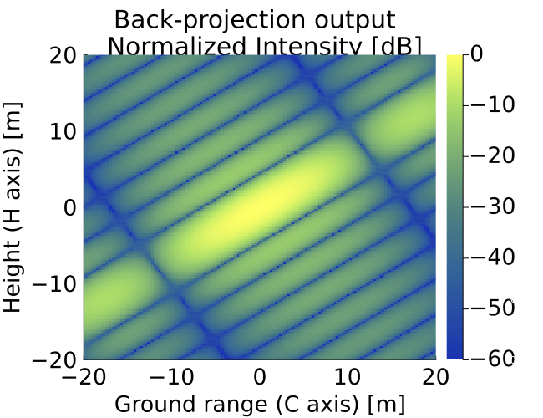
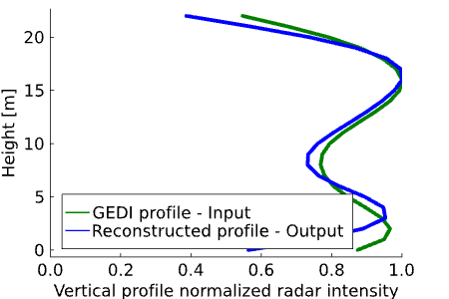

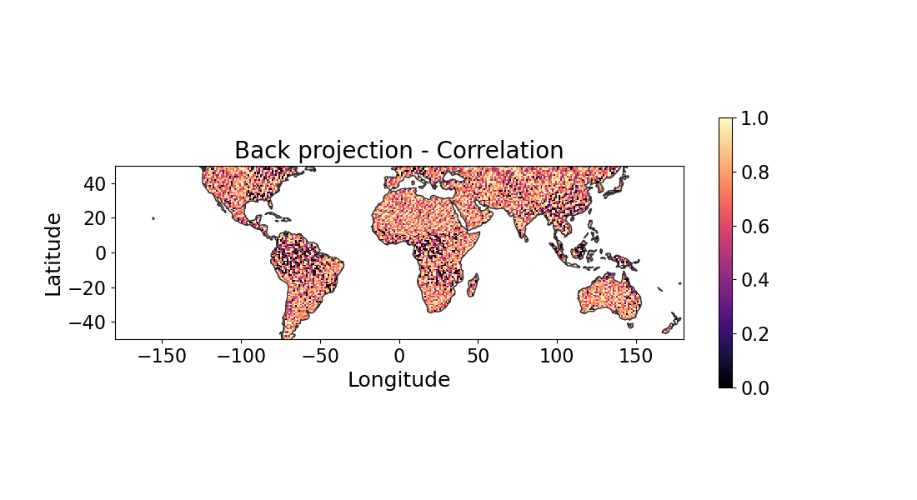

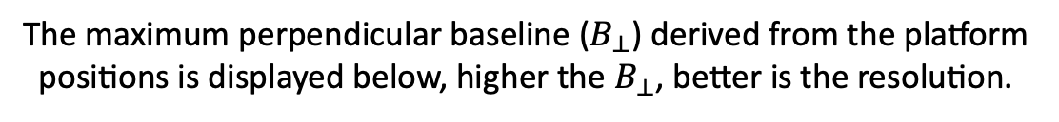
National Aeronautics and Space Administration
Postdoc Research
Mapping 3D Global Vegetation using Radar Tomography:
Simulation Tool Supporting STV and SDC Studies
Author: Shashank Srinivas Joshil, JPL Postdoctoral Fellow (334K)
Marco Lavalle (334K), Ilgin Seker (334C), Razi Ahmed (334C),
Brian P. Hawkins (334F) and Eric Loria (334H)
Background
Decadal Survey 2018 recommended global mapping of 3D vegetation structure and surface topography, which will aid researchers in addressing key scientific questions.
Mission concept formulation for science observables that have been recommended by the Decadal Survey based on advanced SAR concepts that have never flown before and are expected to reduce costs and provide new measurements.
Synthetic Aperture Radar (SAR) tomography/Tomo-SAR [1] is the acquisition and processing of signals received from multiple radar platforms from different look angles that lead to 3D imaging of natural and human-made media. This research explores its application in mapping 3D global vegetation.
Objectives
Multistatic radar simulator does not currently exist at JPL, so this research is paving the path for new type of missions. The contribution of this postdoctoral research has been:
Support the development of a simulation trade study tool using Julia programming language which carries out spaceborne Tomo-SAR simulations.
Extend the simulation framework to carry-out simulation studies at the global scale.
Explore existing technology to generate realistic orbits for the spaceborne platforms and to use actual canopy profiles from NASA GEDI platform.
Validate the simulation framework for various Tomo-SAR configurations and improve the code performance.
Significance of Results and Benefits to NASA/JPL
Support for Surface Topography and Vegetation (STV) and NASA Surface Deformation and Change (SDC) study programs.
The research that is conducted will inform the next Decadal Survey RFI (request for inputs) in 2025 by providing valuable insights into the most viable architecture for STV and SDC.
Enhanced insight into sensors (DARTS) IIP project [2] by providing support for technology demonstrations related to Tomo-SAR mission.
Contribution to mission formulation: Planning, performance assessments, system design, and instrument software advancements.
Orbits: Generated from NISAR/Rose-L orbital parameters
Simulation parameters: Configured based on the simulation study
Approach
GEDI data:
Canopy heights and
Canopy profiles
Modules: Core computation and supporting code blocks for the main code
The developed Tomo-SAR simulation framework is displayed in this section.
Distributed
code architecture
The figures depicting 3D Tomo-SAR reconstruction performance for a point target are displayed below, accompanied by a table presenting performance metrics. These results provide valuable insights for assessing the reconstruction algorithm.
Include
error
sources
Global scale results
The canopy heights from GEDI L2 data is displayed below, the corresponding canopy profiles are considered for simulations.
SISO mode (All platforms transmit and receive)
Main Simulation Code
Plot
data
Estimate performance metrics
Geo location:
36.53 N, 82.99 W
The maximum perpendicular baseline ($B_{⊥}$) derived from the platform positions is displayed below, higher the $B_{⊥}$, better is the resolution.
SIMO mode (Master platform transmits and all platforms receive)
Results
Effects of oscillator phase error and synchronization translates to location errors, the results shown here are for ideal case with no oscillator or synchronization errors.
The correlation between the input and output profiles constructed using back projection algorithm is displayed below.
 | Mode | Theoretical resolution [m] | Measured resolution [m]
Along-track (S) | SISO | 2.8 | 2.8
 | SIMO | 2.8 | 2.8
Ground range (C) | SISO | 6.7 | 4.9
 | SIMO | 6.7 | 6.4
Tomo-axis (n) | SISO | 5.3 | 5.5
 | SIMO | 10.6 | 10.9
Spaceborne Tomo-SAR simulation results considering four platforms is displayed in this section
Future
Work
Detailed study of various Tomo-SAR configurations (including SISO, SIMO and MIMO modes) to achieve best results with realistic parameters.
Conversion of tomograms into bio- physical quantities such as biomass, then comparing them with existing biomass maps derived from other sensors.
Conduct simulation studies to investigate the trade-offs among different parameters in the context of future mission formulation.
Publish the findings for benefit to the worldwide Tomo-SAR community.
National Aeronautics and Space Administration
Jet Propulsion Laboratory
California Institute of Technology
Pasadena, California
www.nasa.gov
Publications:
[1] Joshil S.S., Lavalle M., Seker I., Ahmed R., Hawkins B., Loria E., “Simulation Studies of Sar Tomography at the Global Scale in Support Of Three-dimensional Vegetation Structure Retrieval”, IEEE TGRS/JSTARS, In preparation.
References:
[1] I. Seker, and M. Lavalle, “Tomographic performance of multi-static radar formations: Theory and simulations,” Remote Sensing, 13(4), p.737, 2021.
[2] M. Lavalle, I. Seker, J. Ragan, E. Loria, R. Ahmed, B. P. Hawkins, S. Prager, D. Clark, R. Beauchamp, M. Haynes and P. Focardi, “Distributed aperture radar tomographic sensors (DARTS) to map surface topography and vegetation structure”, In 2021 IEEE IGARSS (pp. 1090-1093). IEEE, July, 2021.
Author Contact Information:
✉️ joshil@jpl.nasa.gov
📞 818-354-4398
Clearance Number: CL#00-0000
Poster Number: PRD-E-020
Copyright 2023. All rights reserved.

