Slide 1

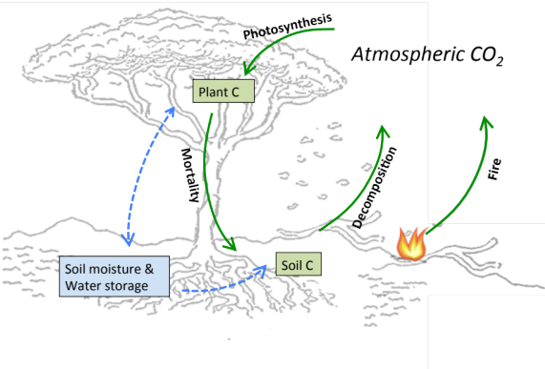
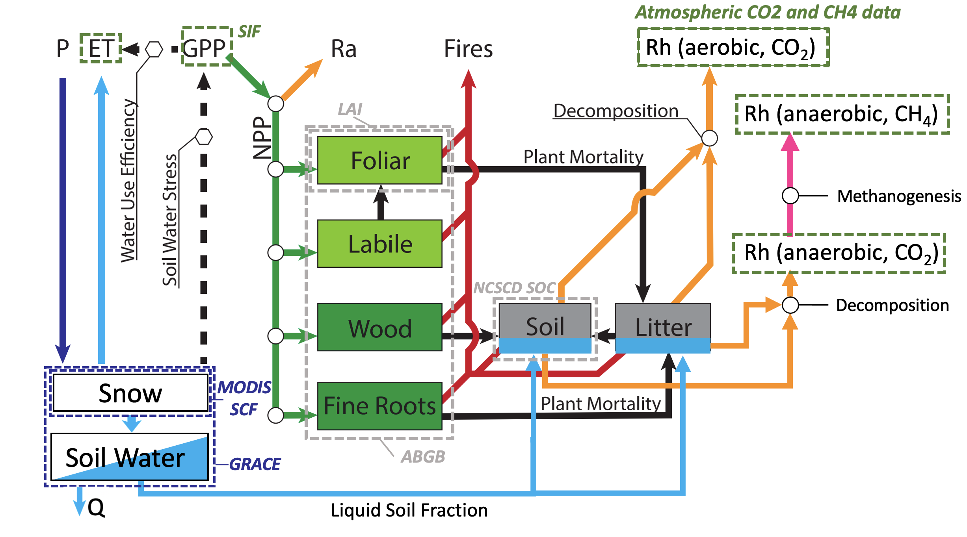
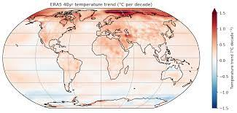
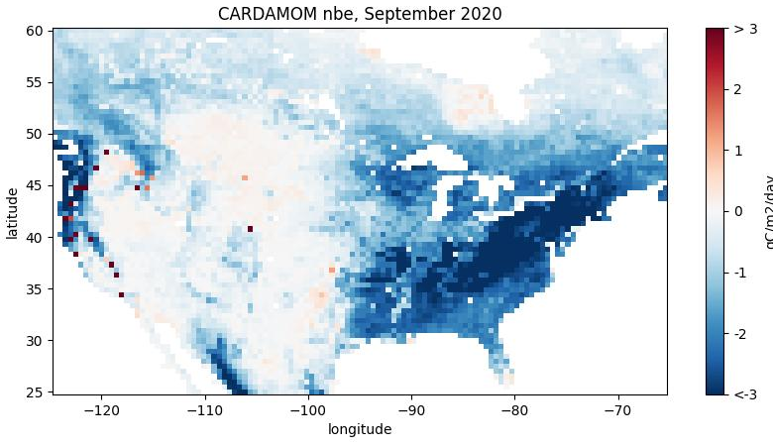
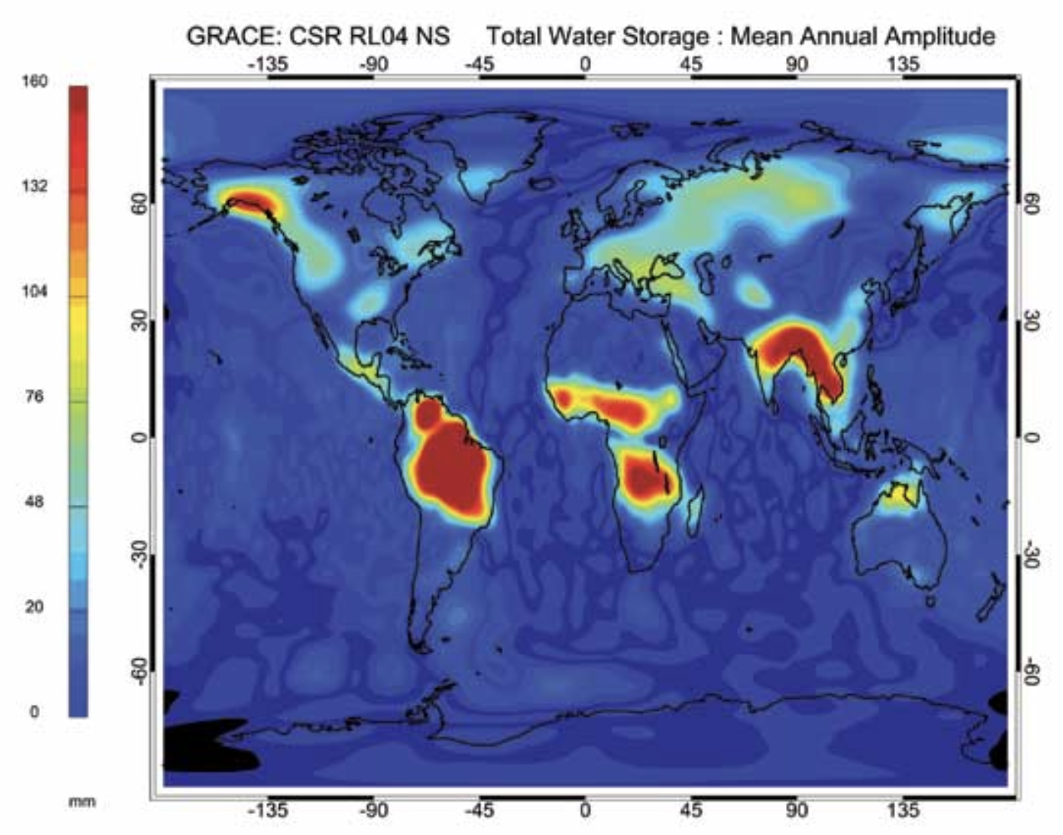

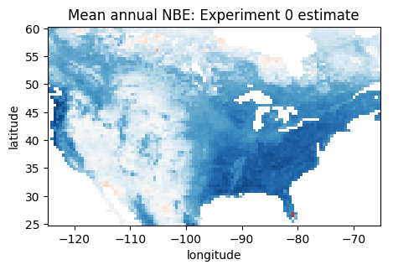
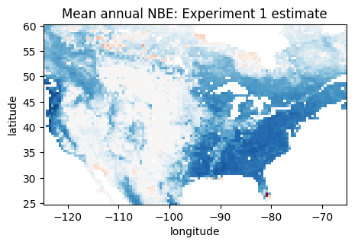
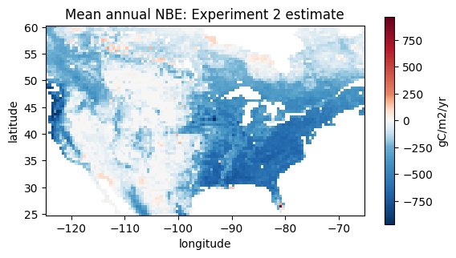
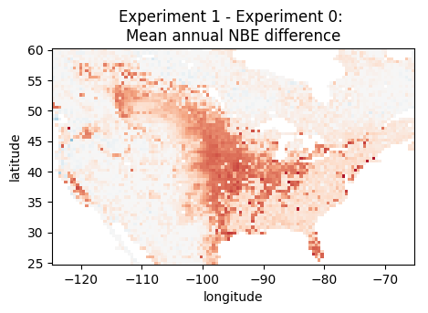
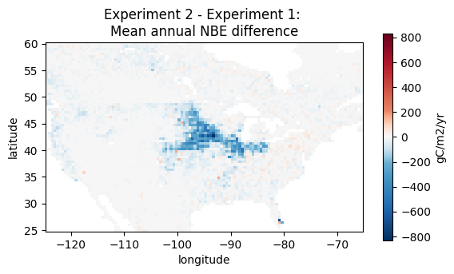
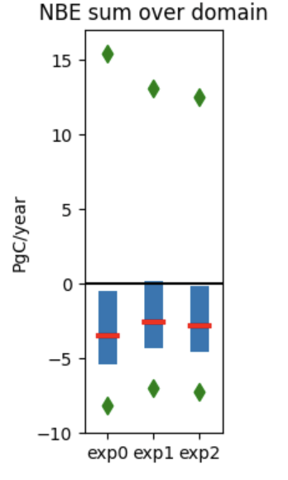
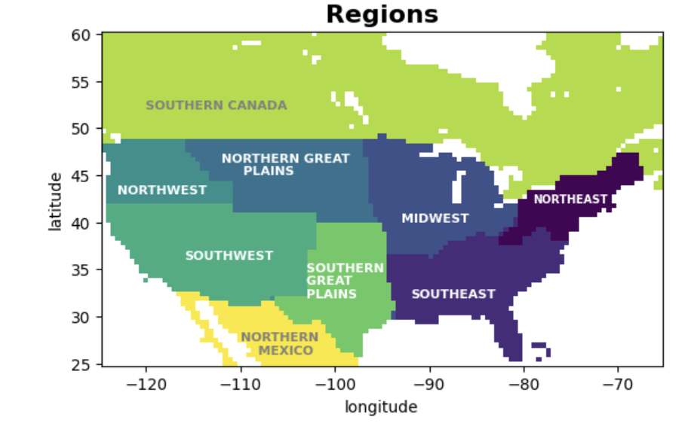
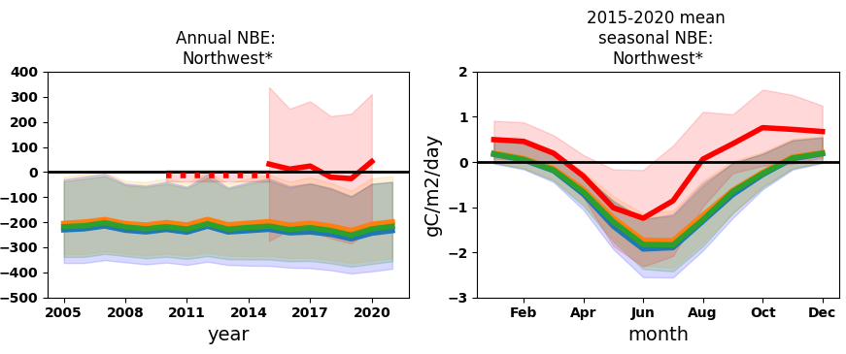
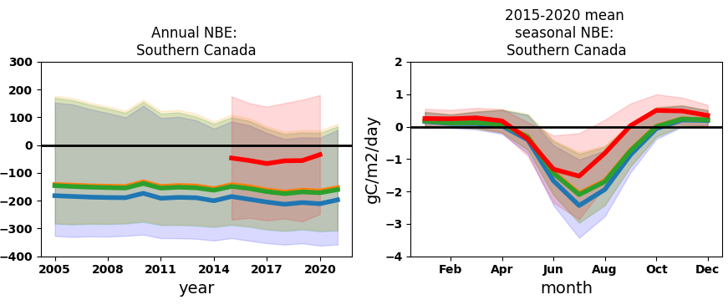
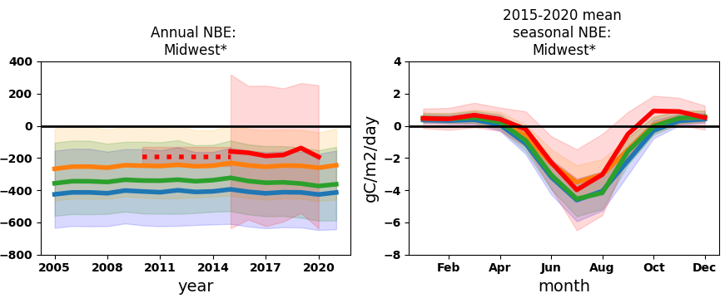
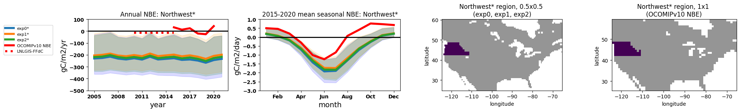
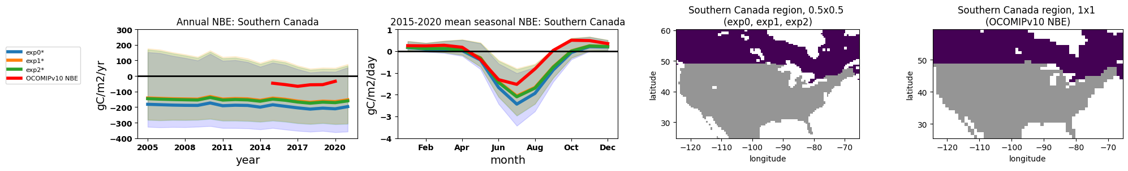
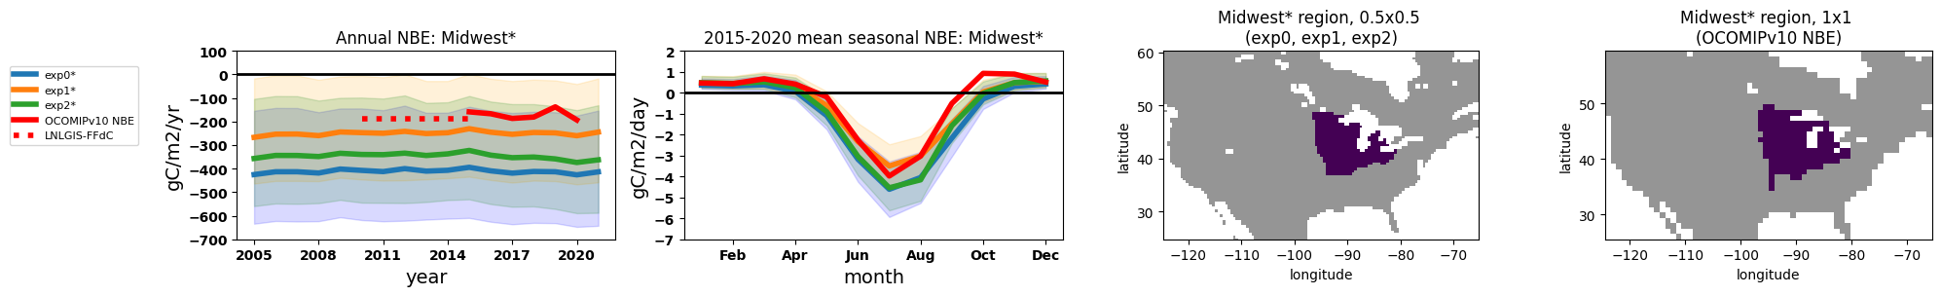
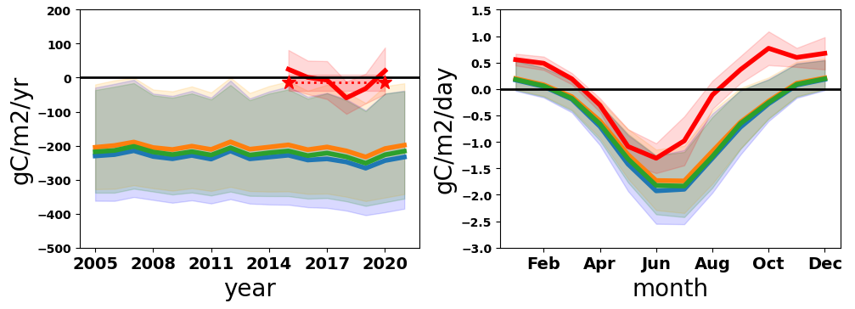
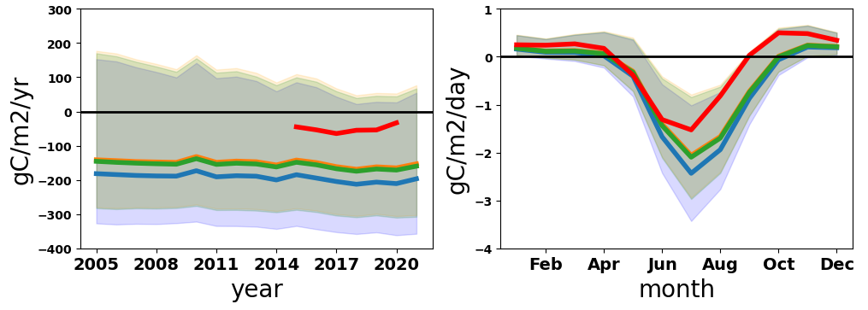
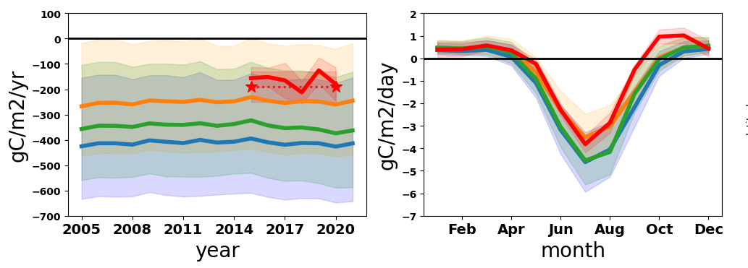
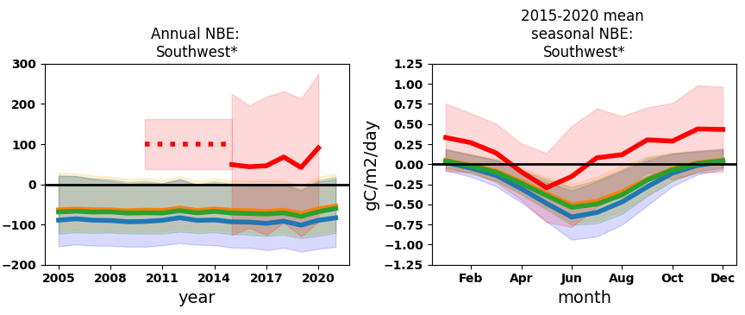
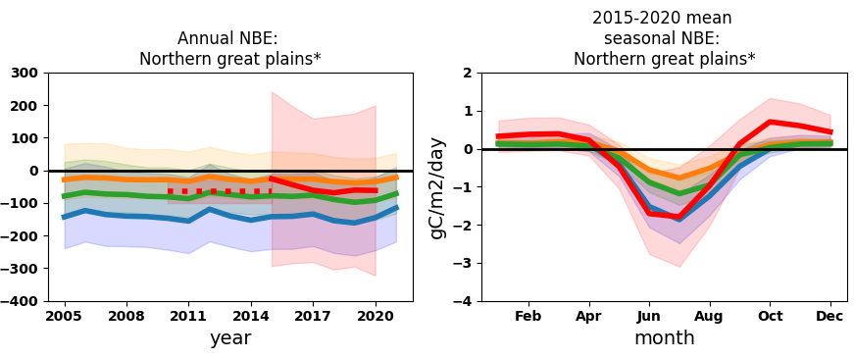
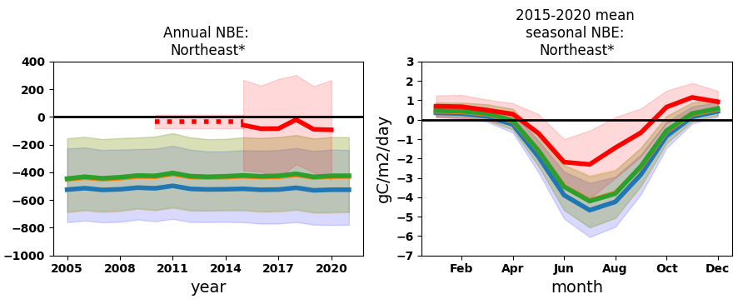
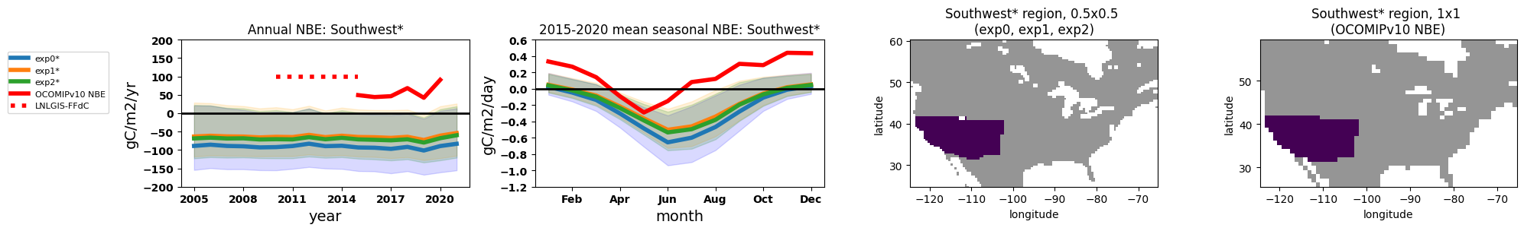
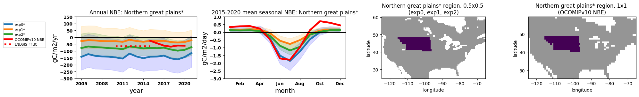
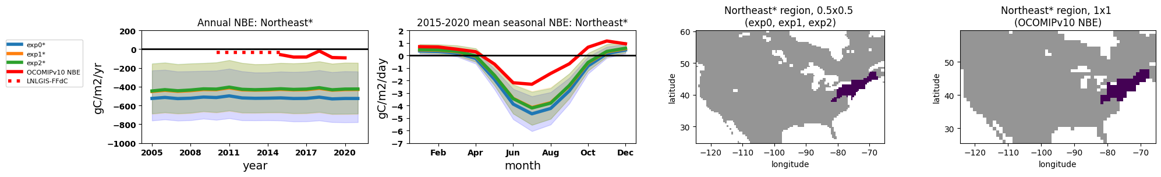
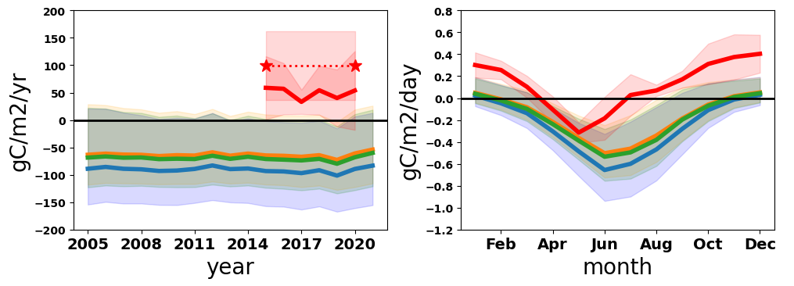
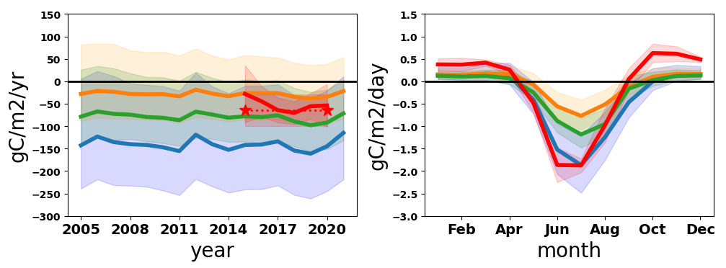
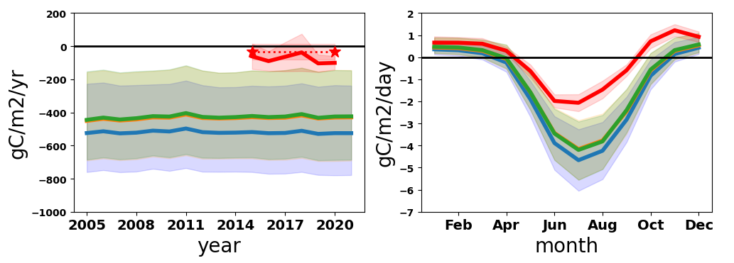
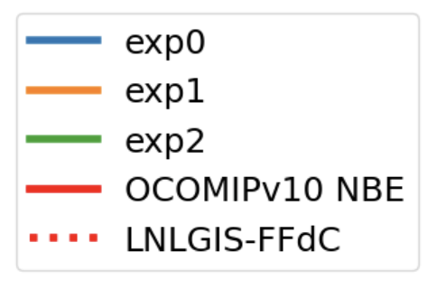
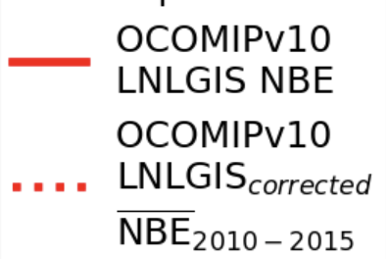
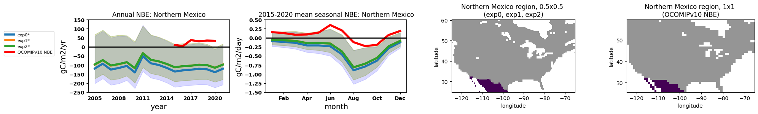
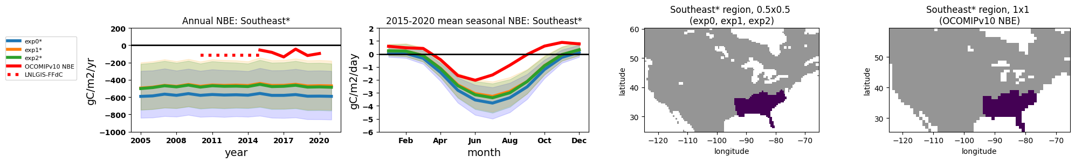
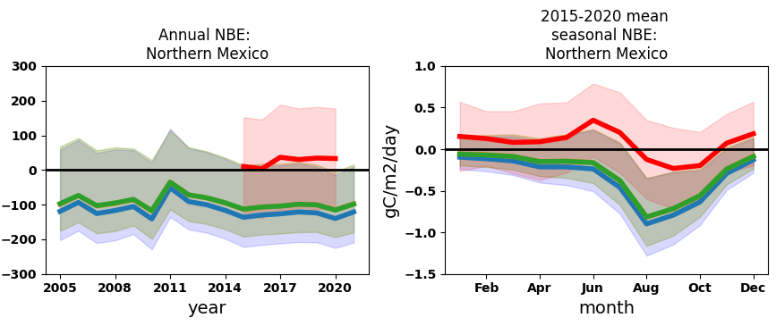
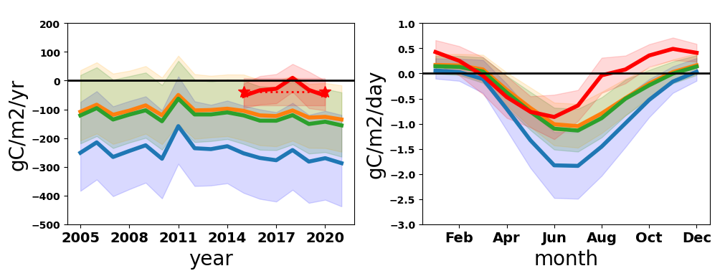
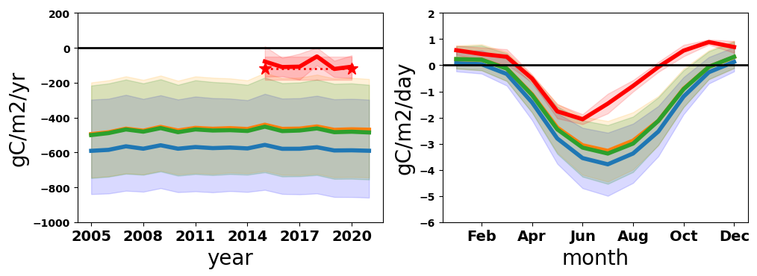
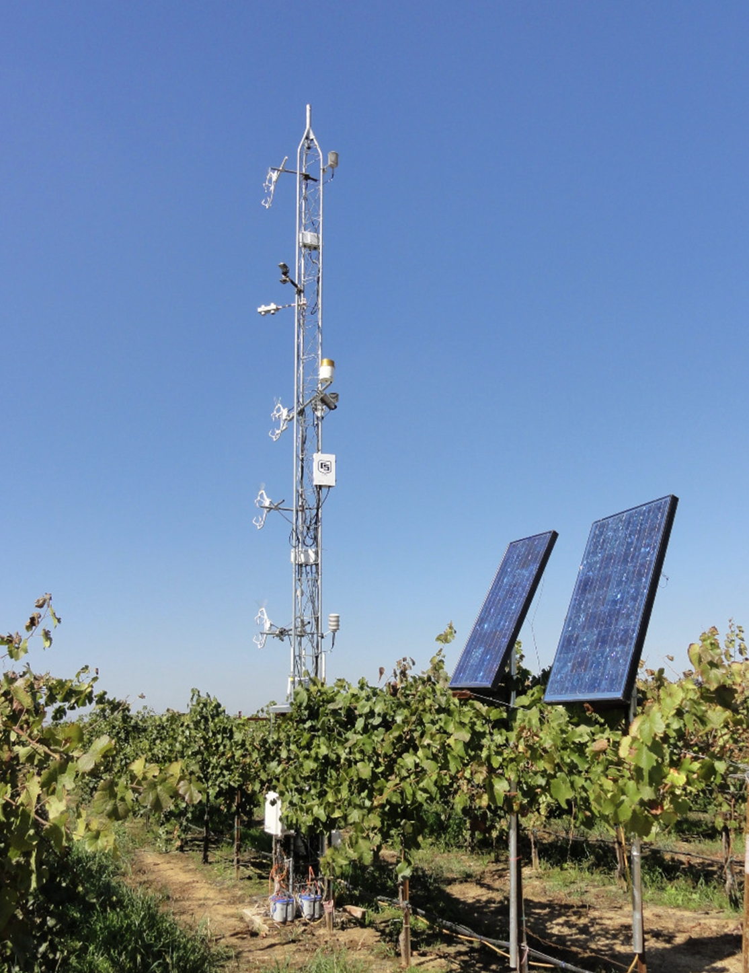

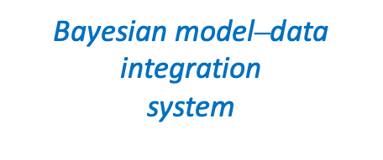
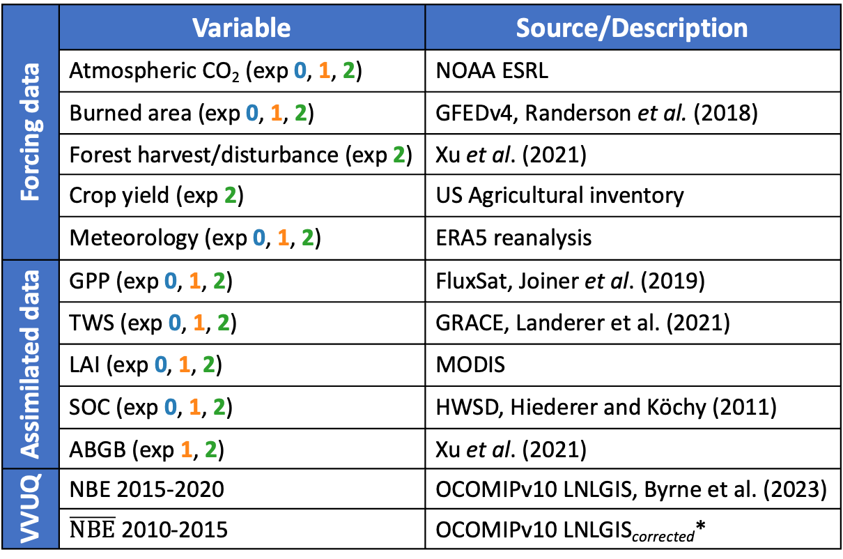
National Aeronautics and Space Administration
Agricultural and Forest Carbon Inventories Improve
Estimates of North American Carbon Fluxes
Author: Eren Bilir (329F) JPL Postdoctoral Fellow
Anthony Bloom (329F), Brendan Byrne (329G), Ken Davis (Pennsylvania State University), Gabriel Dias Ferreira (Colorado State University), Grant Domke (USFS), Junjie Liu (329G), Stephen Ogle (Colorado State University)
1. Background & Motivation
CARDAMOM at JPL
Improvements in resolution and uncertainty in land-atmosphere carbon (C) flux estimates enable higher-quality carbon management policies. Here, we show how a Bayesian model-data fusion (MDF) framework (CARDAMOM, fig. 1) combines diverse satellite and in situ observations to generate C fluxes that can serve as prior estimates for a nested inversion system (CMS-Flux-NA).
Question: How do forest and crop inventory datasets impact the magnitude, spatiotemporal distribution and uncertainty of estimated C fluxes over North America?
Biosphere model
Prior parameter & ecophysiology knowledge
Environmental forcing (Meteorology, fire, CO2)
Bayesian model$⎼$data
integration
system
Observation-informed biosphere C-cycle model
2. Approach & Results
Intercomparison of three CARDAMOM configurations with increasing levels of data were used to quantify the impact
of forest and agricultural inventory datasets
2020 Fire emissions
Experiment 0: Standard CARDAMOM forcing configuration with assimilated Gross Primary Productivity (GPP), Terrestrial Water Storage (TWS), Leaf Area Index (LAI), and Soil Organic Carbon (SOC)
Experiment 1: Experiment 0 + assimilated Above and Below Ground Biomass (ABGB)
Experiment 2: Experiment 1 + direct removals of carbon due to crop yield and forest harvest/disturbance
Satellite & in situ data constraints:
Terrestrial water storage (GRACE)
LAI (MODIS)
GPP & Fluorescence (Multi-mission)
Biomass (Multi-mission)
Forest Inventory (ingested into Biomass)
Soil Carbon
Figure 1: CARDAMOM (CARbon DAta MOdel fraMework) is a Bayesian model–data fusion platform that uses observations of terrestrial carbon and water cycling to inform estimates of C pools and fluxes in a biosphere model.
Table 1: Datasets used
Experiment 0
Experiment 1
Experiment 2
Forcing data | Variable | Source/Description
 | Atmospheric CO₂ (exp 0, 1, 2) | NOAA ESRL
 | Burned area (exp 0, 1, 2) | GFEDv4, Randerson et al. (2018)
 | Forest harvest/disturbance (exp 2) | Xu et al. (2021)
 | Crop yield (exp 2) | US Agricultural inventory
 | Meteorology (exp 0, 1, 2) | ERA5 reanalysis
Assimilated data | GPP (exp 0, 1, 2) | FluxSat, Joiner et al. (2019)
 | TWS (exp 0, 1, 2) | GRACE, Landerer et al. (2021)
 | LAI (exp 0, 1, 2) | MODIS
 | SOC (exp 0, 1, 2) | HWSD, Hiederer and Köchy (2011)
 | ABGB (exp 1, 2) | Xu et al. (2021)
VVUQ | NBE 2015-2020 | OCOMIPv10 LNLGIS, Byrne et al. (2023)
 | $\overline{NBE}$ 2010-2015 | OCOMIPv10 LNLGIS_{corrected}*
Experiment 1
Experiment 0
Experiment 2
Experiment 1
CARDAMOM’s simulations with inventory datasets show:
Figure 2: CARDAMOM’s estimates of Net Biosphere Exchange (NBE) magnitude, seasonality, spatial distribution, and uncertainty are sensitive to which data are included in each experiment (top panels). ABGB constraint reduces estimated biomass, and hence the estimated carbon sink, in the Midwest and Great Plains (bottom left), while prescribing crop inventory and forest disturbance C fluxes increases the estimated carbon sink over the domain, particularly in the Northern Great Plains and Midwest (corn belt) regions. NBE uncertainty (bottom right; red line: median NBE, blue rectangle: 25th-75th percentile, green diamonds: 2.5th-97.5th percentile) is reduced with the addition of both ABGB constraint and crop inventory and forest disturbance C fluxes.
Shifts in spatial distribution of fluxes (fig. 2)
Reduction of NBE uncertainty (fig. 2)
Regionally varying shifts in the NBE seasonal cycle (fig. 3)
Regionally varying impacts to agreement with independent top-down observations of NBE (OCOMIP v10 LNLGIS fig. 3)
3. Significance to NASA/JPL
Annual NBE:
Northwest*
2015-2020 mean seasonal NBE:
Northwest*
Annual NBE:
Southern Canada
2015-2020 mean seasonal NBE:
Southern Canada
Annual NBE:
Midwest*
2015-2020 mean seasonal NBE:
Midwest*
This work supports NASA/JPL’s production of next-generation C-flux datasets by providing an improved ensemble of prior NBE fluxes for the CMS-Flux-NA inversion. Our methodology relies on datasets produced by NASA/JPL (Table 1) and showcases a NASA/JPL-developed Bayesian model–data fusion platform. The long-term aim of this work is to apply NASA’s observations, inversion modeling systems, and other science products to support national carbon accounting efforts and high-quality carbon management policy.
Annual NBE:
Southwest*
2015-2020 mean seasonal NBE:
Southwest*
Annual NBE:
Northern Great Plains*
2015-2020 mean seasonal NBE:
Northern Great Plains*
Annual NBE:
Northeast*
2015-2020 mean seasonal NBE:
Northeast*
Annual NBE:
Northern Mexico
2015-2020 mean seasonal NBE:
Northern Mexico
Annual NBE:
Southern Great Plains*
2015-2020 mean seasonal NBE:
Southern Great Plains*
Annual NBE:
Southeast*
2015-2020 mean seasonal NBE:
Southeast*
4. Future Work
Figure 3: Comparison of annual NBE and mean seasonal NBE cycle across all three experiments with two inversion estimates shows that in many regions CARDAMOM estimates greater land carbon uptake than is consistent with top-down observations. We hypothesize this stems primarily from underestimation of respiration fluxes, as agreement between model and assimilated GPP is strong. Where possible, in this comparison we incorporate C flux estimates of processes missing in CARDAMOM’s simulations (biofuel/incinerator combustion, livestock/human respiration, and landfill emissions) into exp totals (indicated by * where included), to better match the inversion products.
VALIDATION: Future work will further evaluate CARDAMOM C fluxes using:
Eddy-covariance towers to evaluate cross-ecosystem variability
ACT-America aircraft observations to assess consistency of simulated C fluxes with observed vertical profiles of CO₂
Alternative uncertainty quantification methods
Acknowledgements:
This research was supported by NASA project number 80NSSC21K1060: ”Preparing the global CMS Flux system for application to carbon flux inventories via regional-scale, observation-based evaluations”
Author Contact Information:
teresa.e.bilir@jpl.nasa.gov
National Aeronautics and
Space Administration
Jet Propulsion Laboratory
California Institute of Technology
Pasadena, California
www.nasa.gov
Image descriptions & credits: GRAPEX Flux Tower (ars.usda.gov); NASA’s B-200 research aircraft (actamerica.ornl.gov)
Copyright 2023. All rights reserved.

