Slide 1

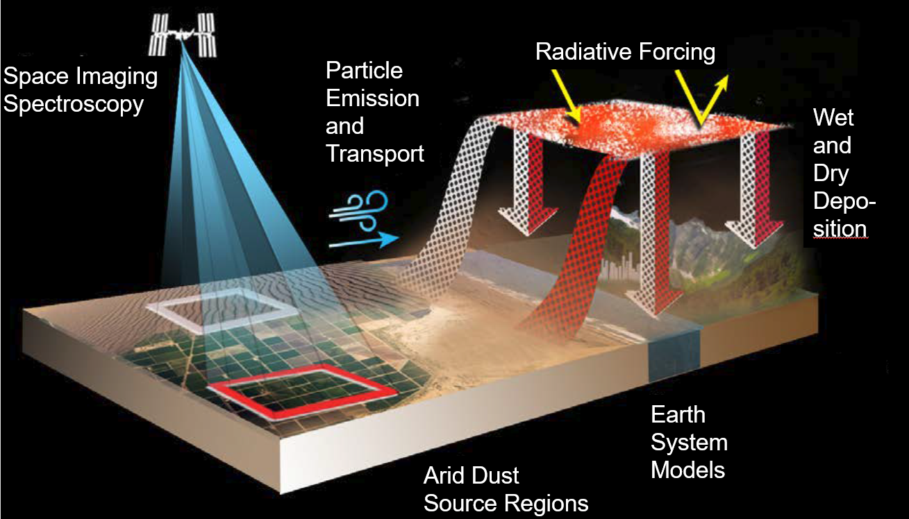
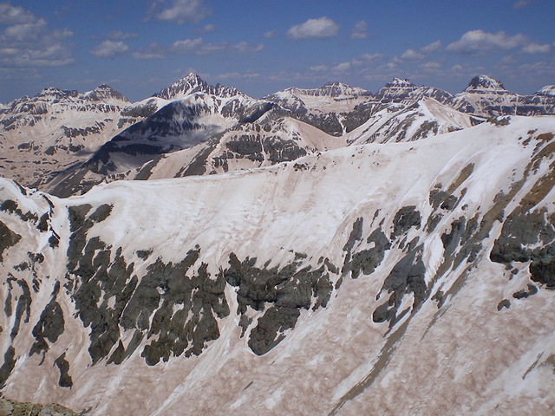
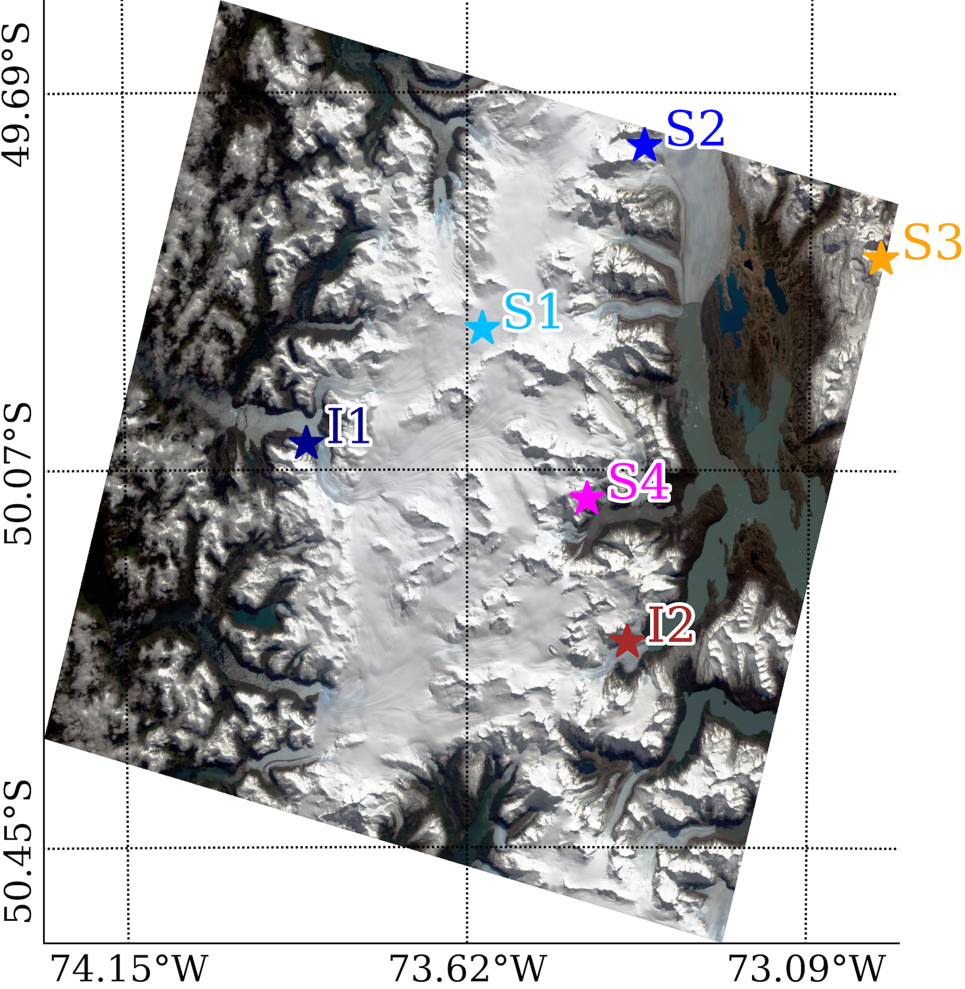
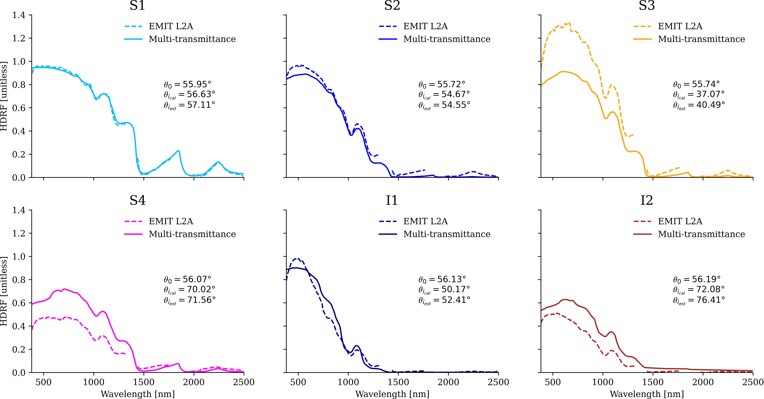
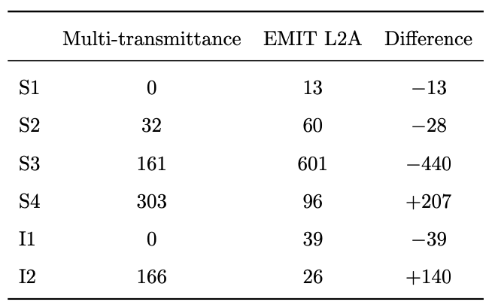
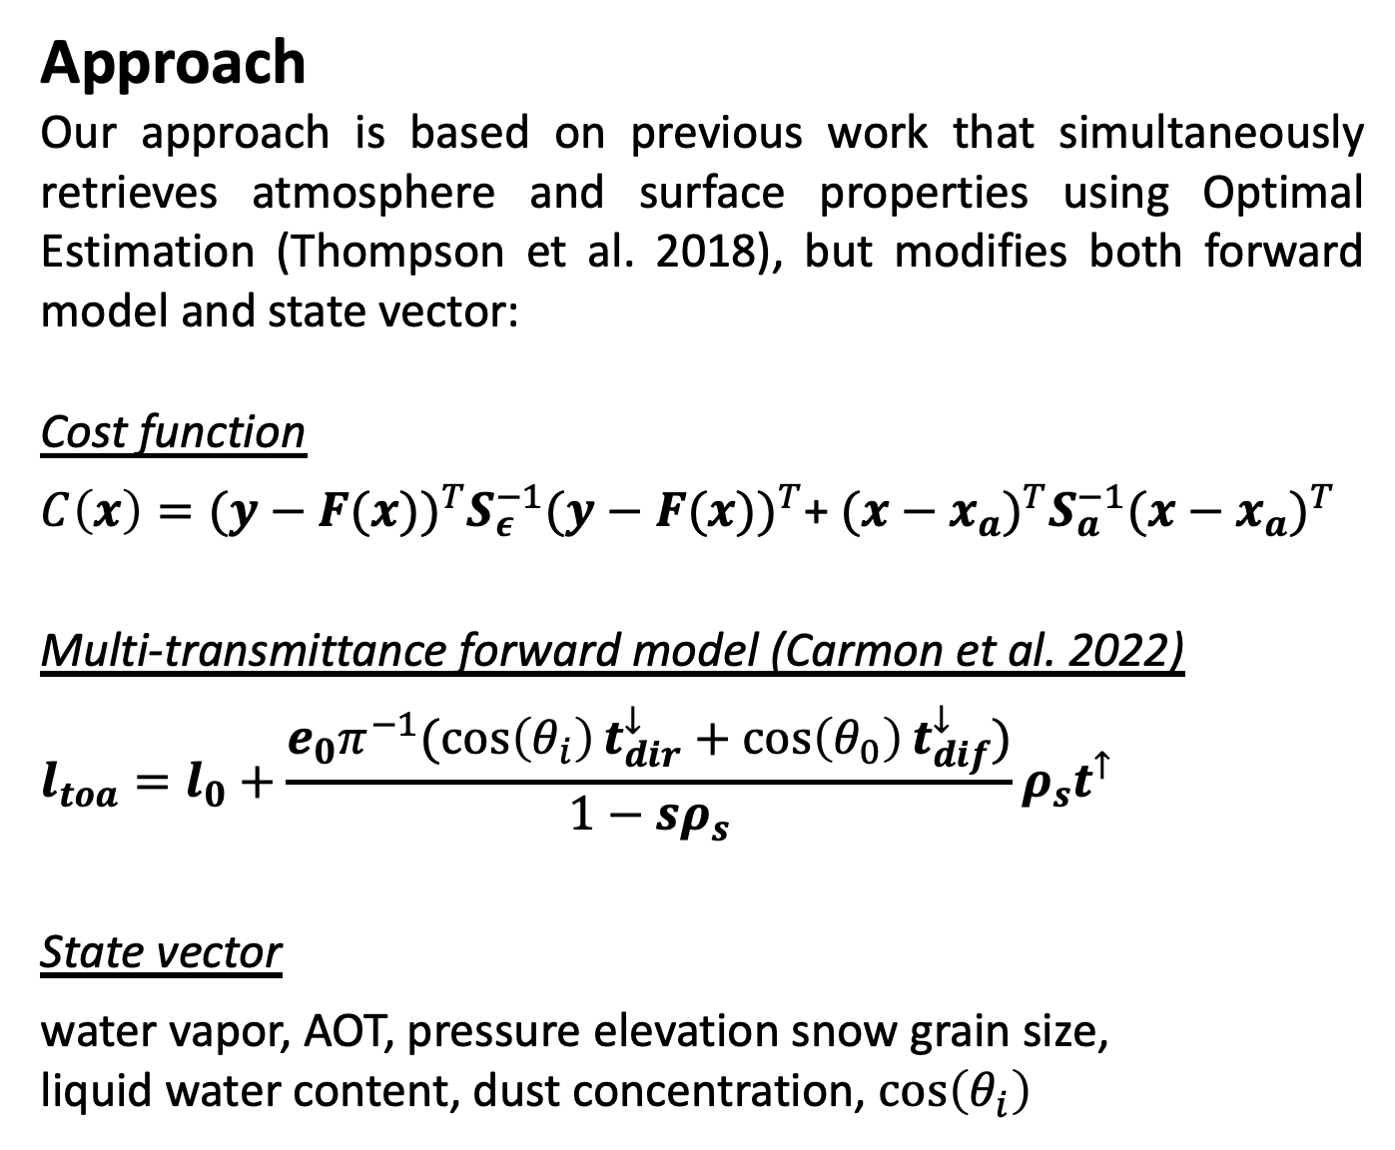
National Aeronautics and Space Administration
Postdoc Research
The Pitfalls of Ignoring Topography in Snow Retrievals: A Case Study with EMIT
Author: Niklas Bohn, JPL Postdoctoral Fellow (382B)
Philip Brodrick (398J), David R. Thompson (382B), Robert O. Green (382B), Nimrod Carmon (398L)
Background
NASA’s Earth Surface Mineral Dust Source Investigation (EMIT), launched in July 2022 and installed on the International Space Station (ISS), aims to improve our understanding of the Earth’s mineral dust sources and their climate impacts. These impacts include dust deposition on snow surfaces in mountainous regions, such as the Western US and the Andes in South America. Small dust particles reduce the snow albedo and increase the radiative forcing, leading to enforced melting dynamics, which play a key role in climate change. EMIT provides the prerequisites needed to quantify the concentration of these particles in the upper layer of the snow pack by featuring narrow spectral channels and a ground
sampling distance of
60 m. Current retrieval
approaches neglect the
effects of topography,
which could lead to
significant biases in
estimated dust
concentration, and
propagate through to
erroneous calculations
of radiative forcing.
Objective
Emphasize the importance of surface topography for remote imaging spectroscopy snow retrievals by highlighting the pitfalls when ignoring it.
Approach
Our approach is based on previous work that simultaneously retrieves atmosphere and surface properties using Optimal Estimation (Thompson et al. 2018), but modifies both forward model and state vector:
Cost function
$C\left(x\right)={(y−F(x))}^{T}S_{ε}^{−1}{(y−F(x))}^{T}$+ ${(x−x_{a})}^{T}S_{a}^{−1}{(x−x_{a})}^{T}$
Multi-transmittance forward model (Carmon et al. 2022)
$$l_{toa}=l_{0}+\frac{e_{0}π^{−1}(\cos\left(θ_{i}\right)t_{dir}^{↓}+\cos\left(θ_{0}\right)t_{dif}^{↓})}{1−sρ_{s}}ρ_{s}t^{↑}$$
State vector
water vapor, AOT, pressure elevation snow grain size,
liquid water content, dust concentration, $\cos\left(θ_{i}\right)$
Results
Radiative forcing [W/m²]
Conclusion
Our topography-aware forward model couples atmosphere and snow radiative transfer to improve retrievals of surface properties in mountainous regions. This leads to a dimensionality reduction of the optimized state by several orders of magnitude and associated decreasing computational cost. It also facilitates a more physics-based model parameterization, as the inversion only optimizes a few atmospheric parameters and geobiophysical properties of the snow surface. We highlight significantly increased retrieval errors of mineral dust concentration and radiative forcing when topographic characteristics are not accounted for. These findings will be essential for the development of global retrieval algorithms for upcoming spaceborne imaging spectroscopy missions such as NASA’s Surface Biology and Geology (SBG). In this context, future efforts also need to consider the mixed pixel problem, as well as a more variable representation of snow and ice surface layers in terms of their optical properties.
National Aeronautics and Space Administration
Jet Propulsion Laboratory
California Institute of Technology
Pasadena, California
www.nasa.gov
Publications and Acknowledgements:
N. Bohn, E. H. Bair, P. G. Brodrick, N. Carmon, R. O. Green, T. H. Painter, D. R. Thompson (2023). Estimating dust on snow - Application of a coupled atmosphere-surface model to spaceborne EMIT imaging spectrometer data. IGARSS Proceedings, Pasadena, CA, USA.
N. Bohn, E. H. Bair, P. G. Brodrick, N. Carmon, R. O. Green, T. H. Painter, D. R. Thompson (2023). The pitfalls of ignoring topography in snow retrievals: a case study with EMIT. In prep.
Author Contact Information:
Phone: (626) 319-9194, Email: urs.n.bohn@jpl.nasa.gov
Clearance Number: CL#00-0000
Poster Number: PRD-
Copyright 2023. All rights reserved.

