Slide 1


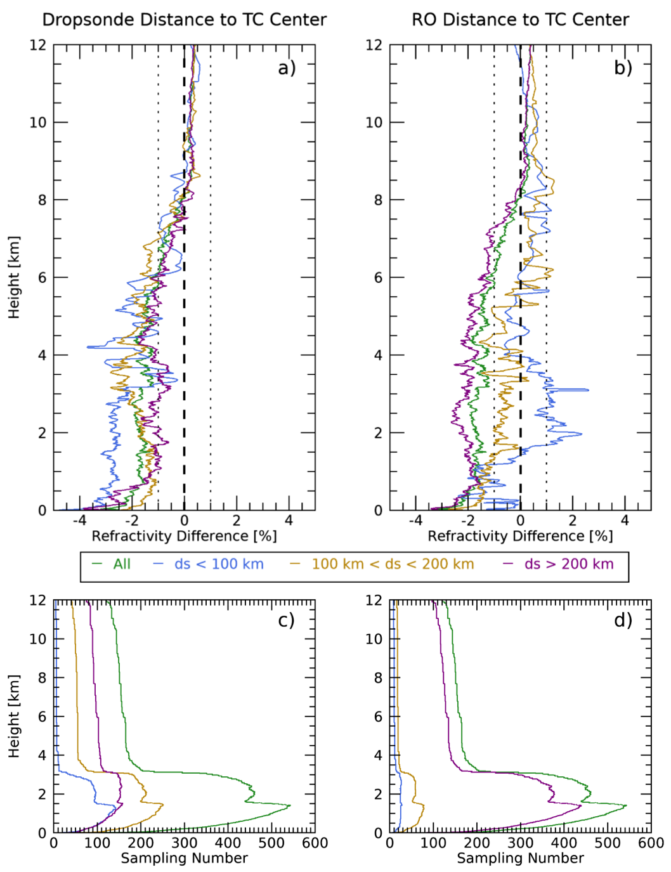
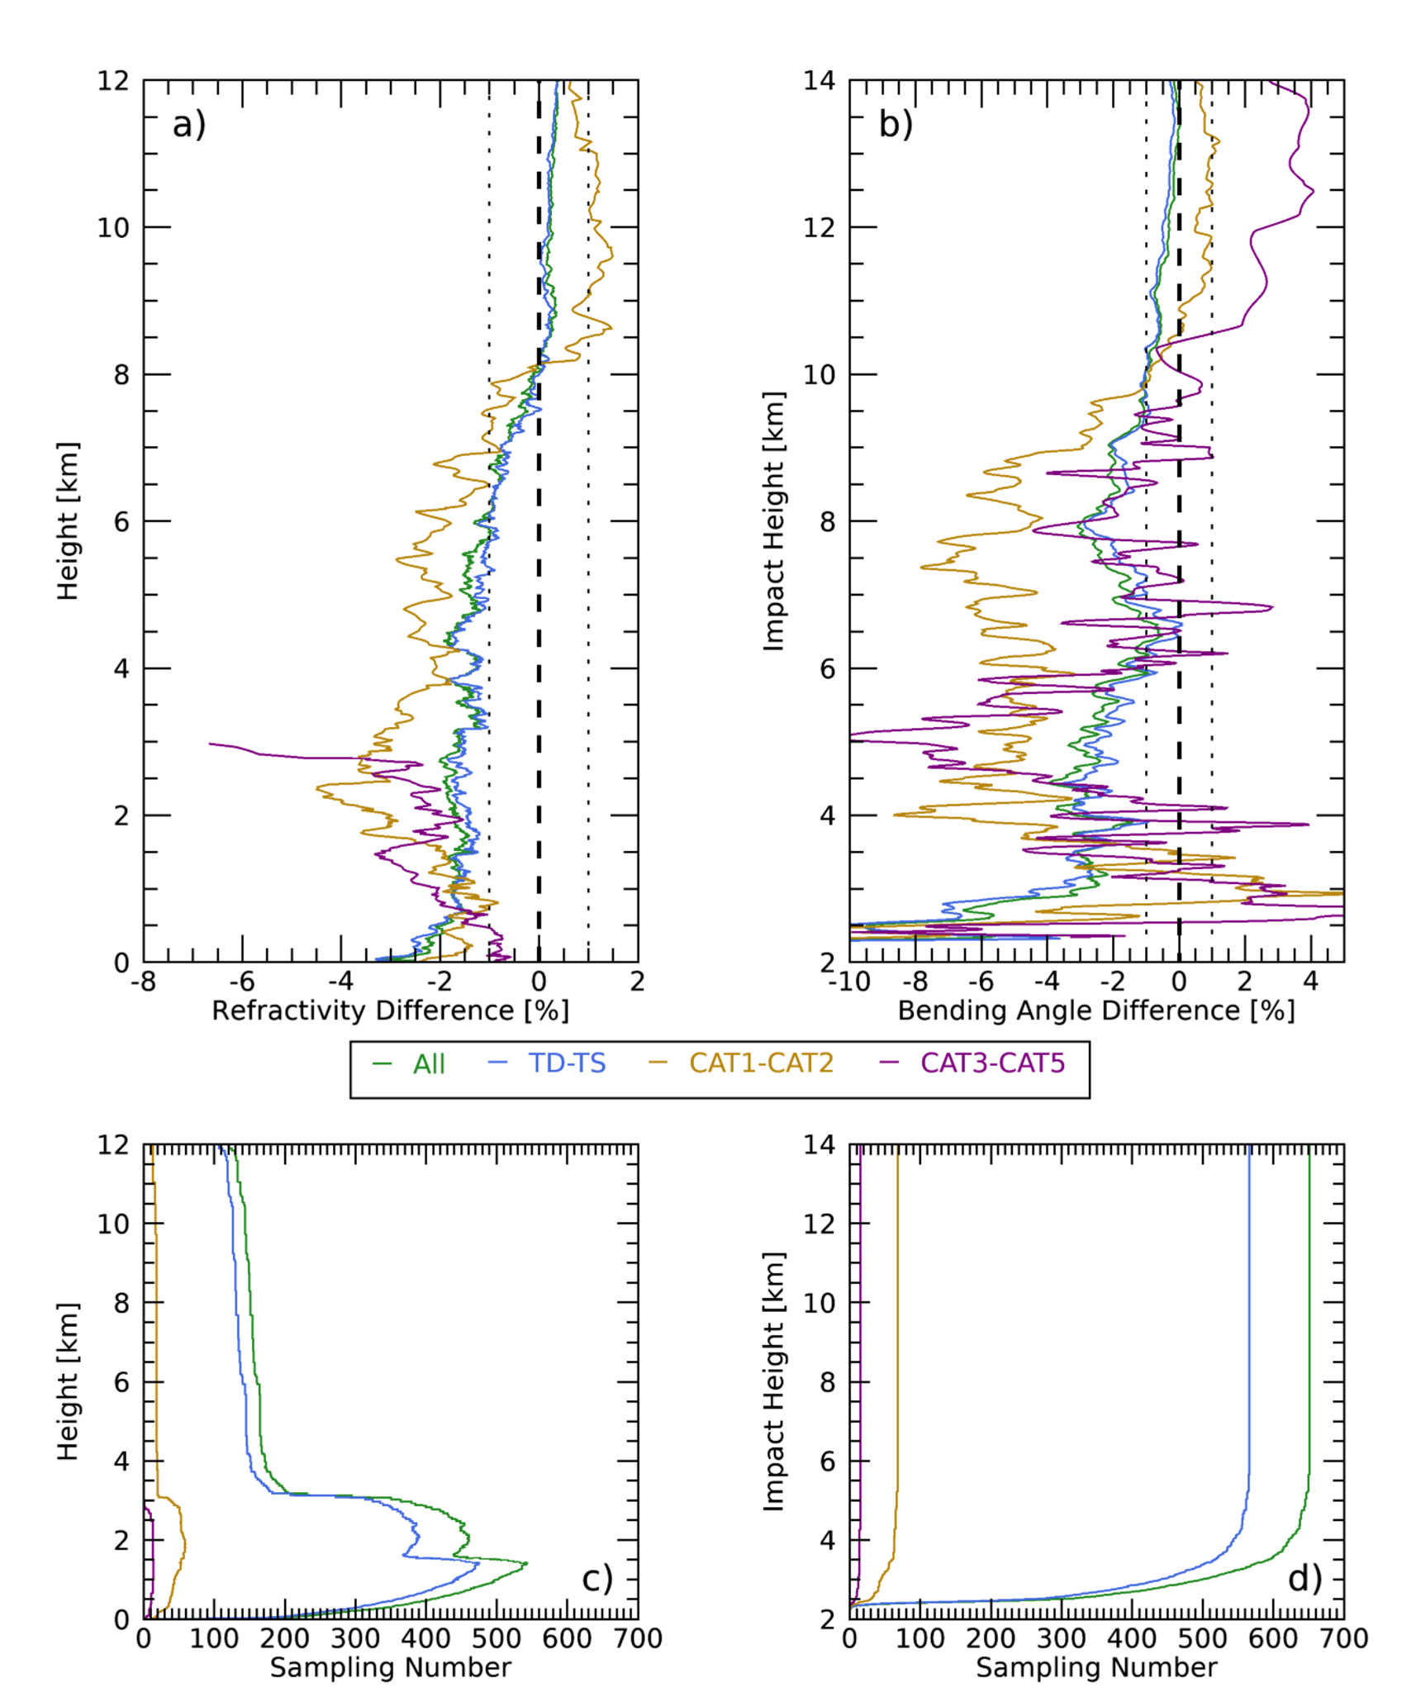
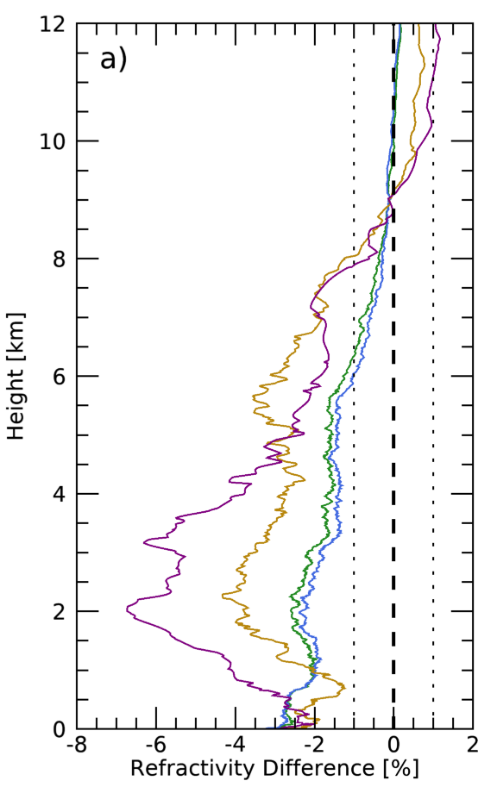
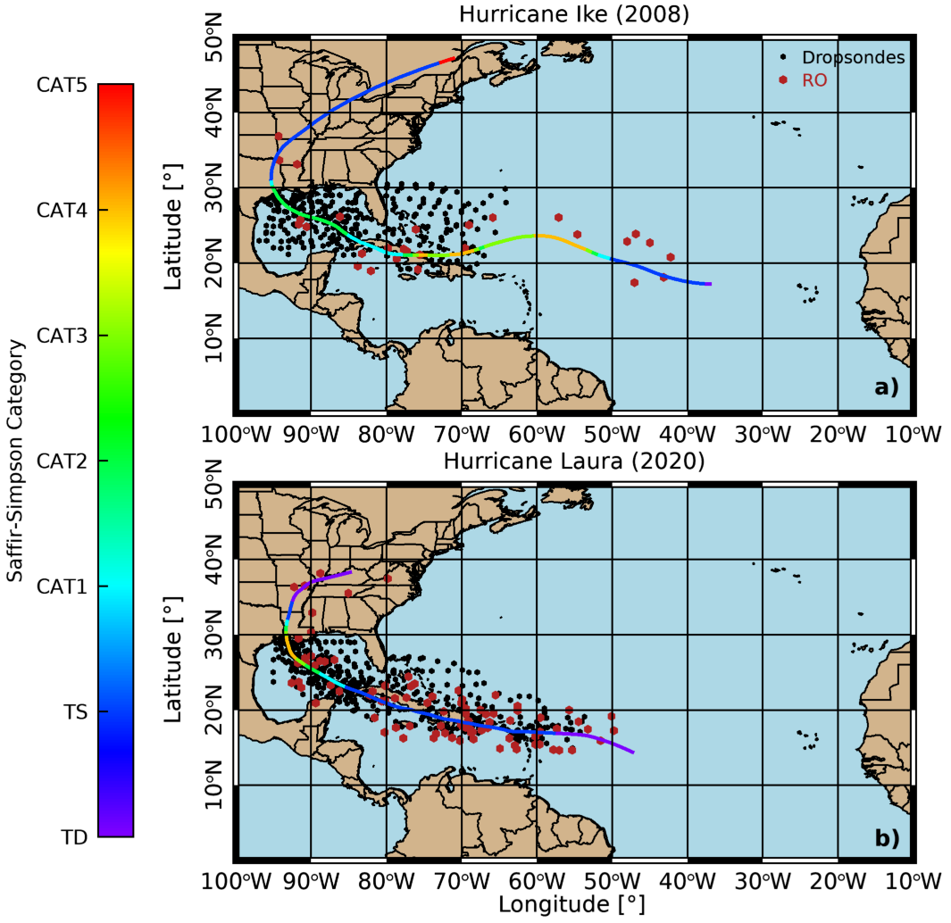
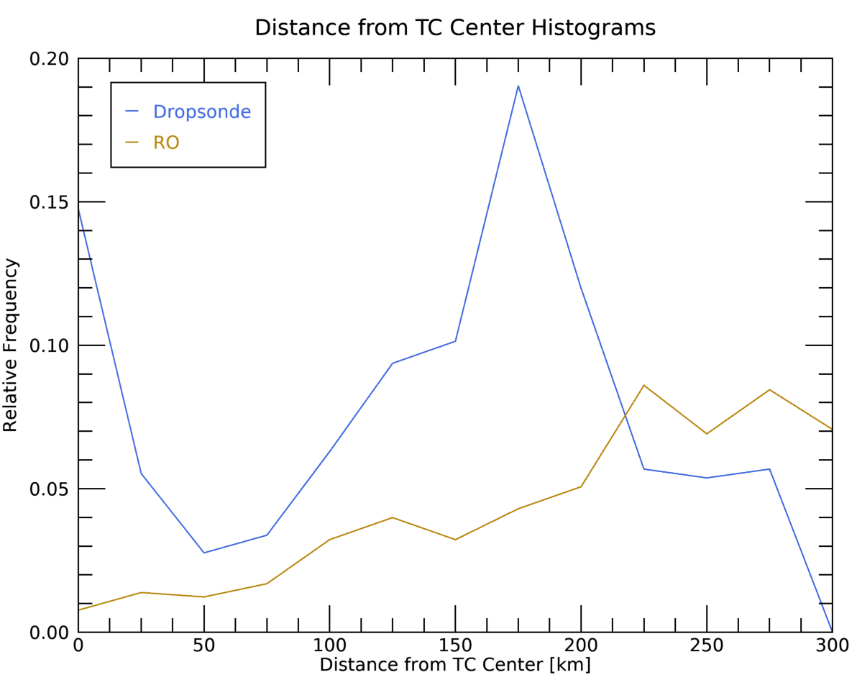
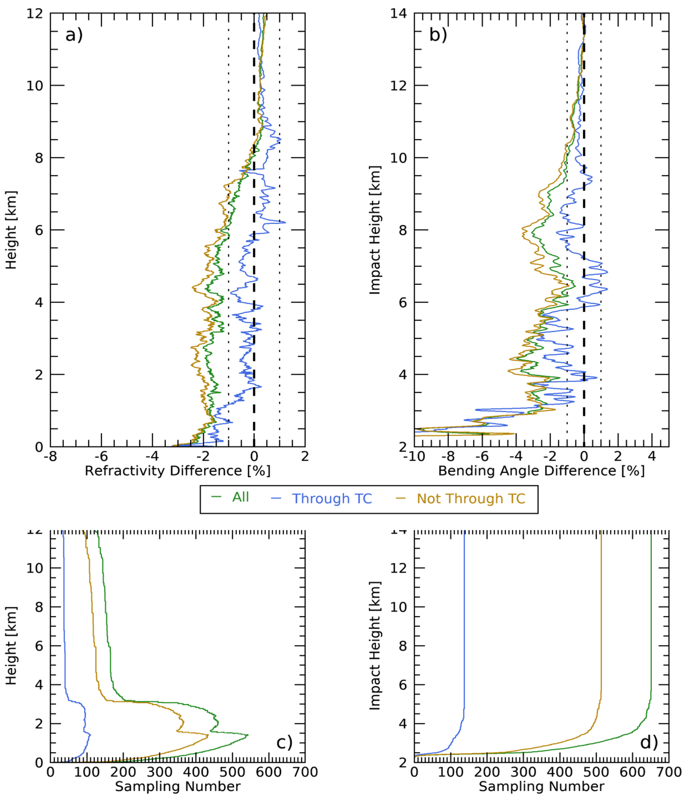
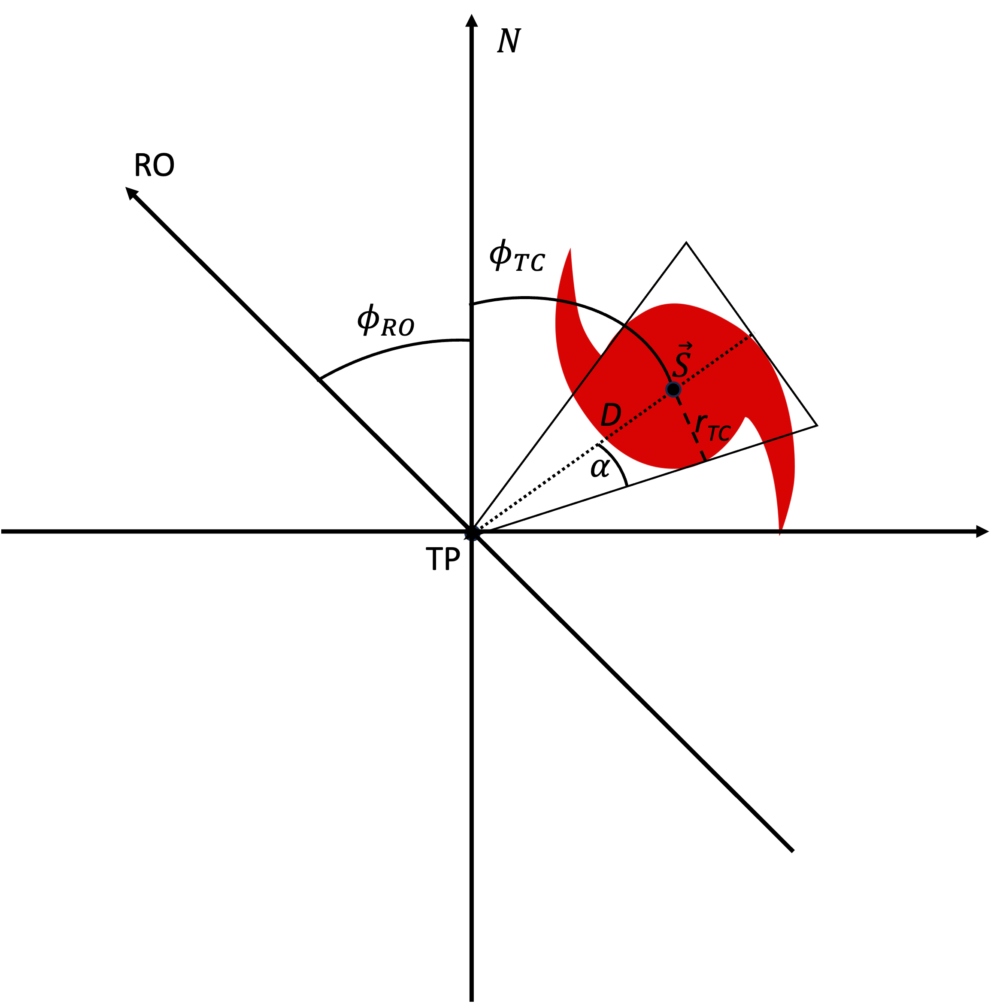
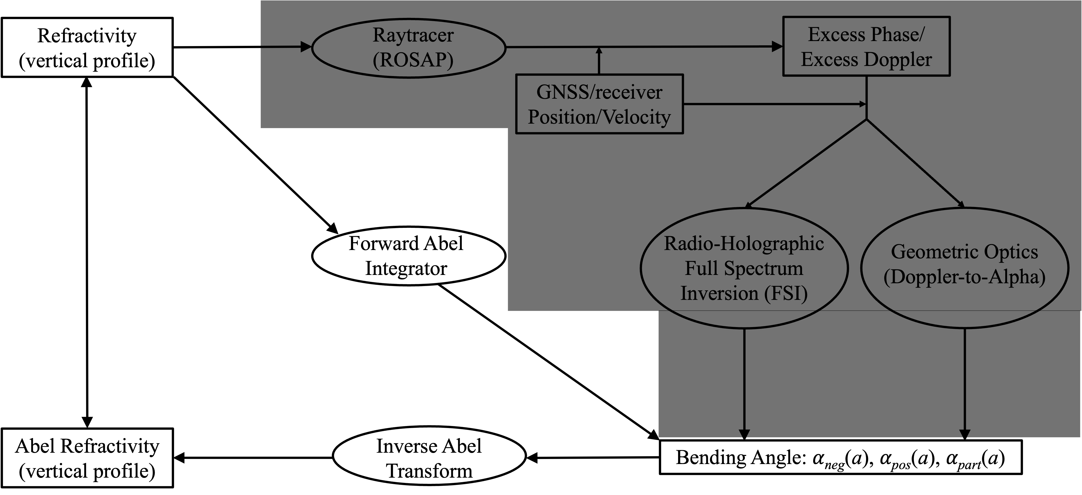
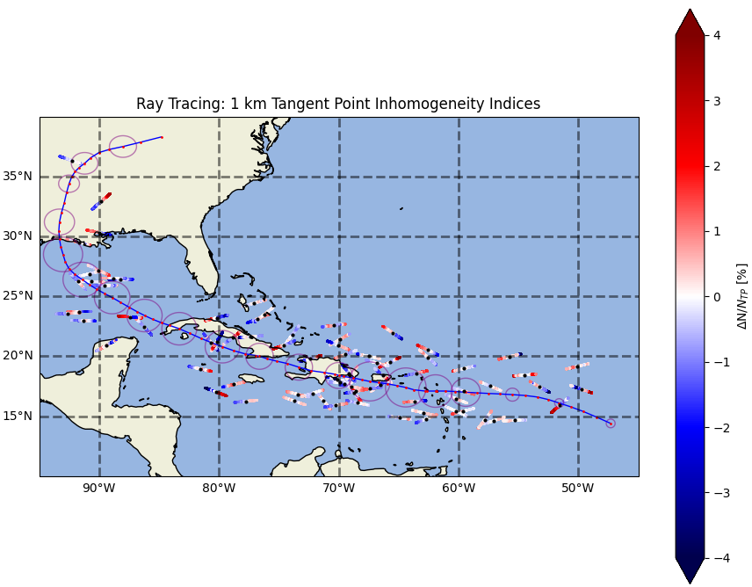
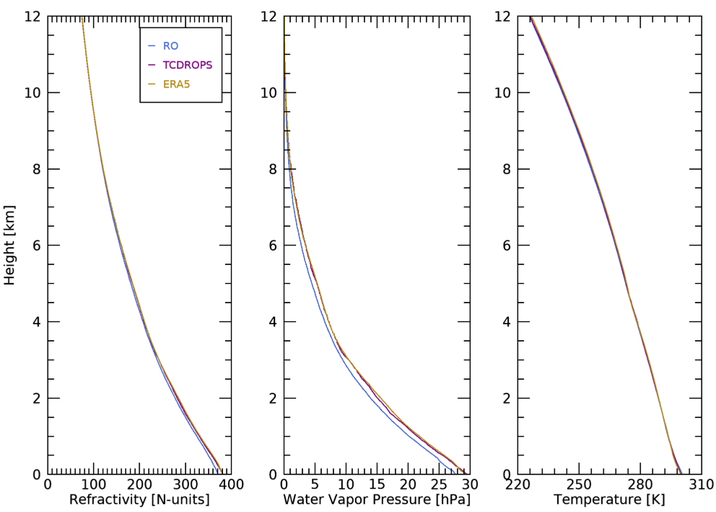
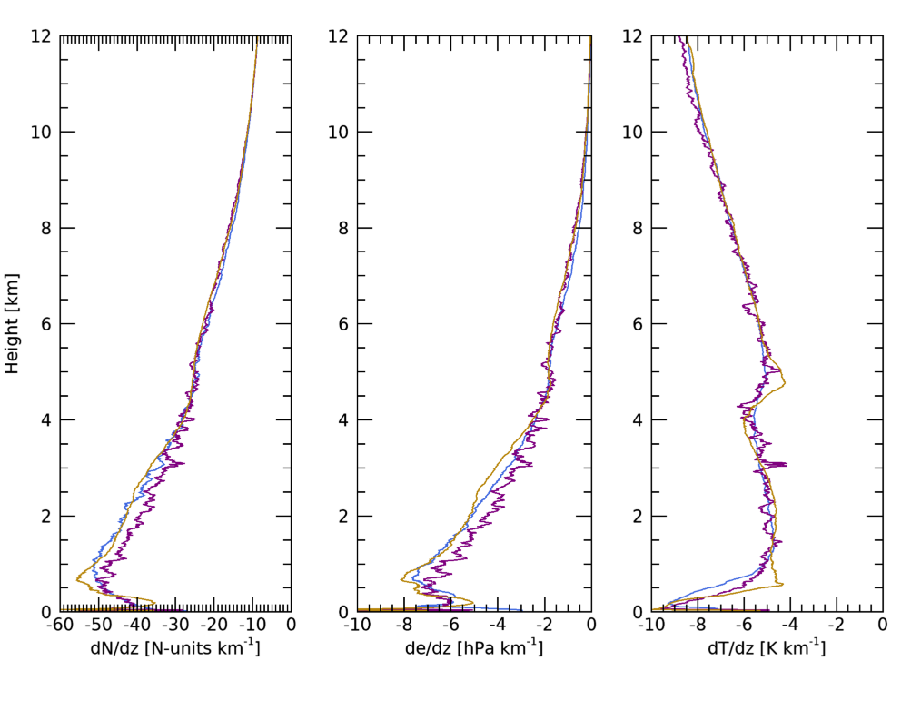
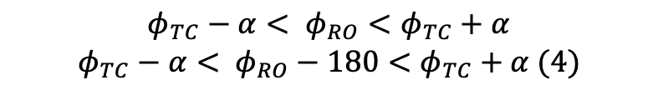
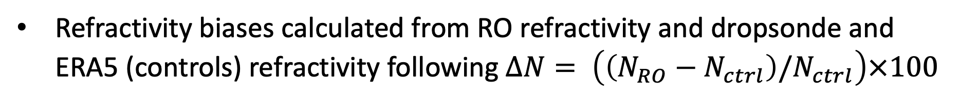

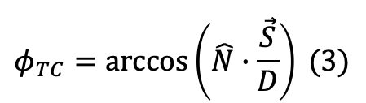

National Aeronautics and Space Administration
Jet Propulsion Laboratory
California Institute of Technology
Pasadena, California
www.nasa.gov
Assessing the Quality of GNSS Radio Occultation Observations in Tropical Cyclones and Implications for Future Observations
Author: Kevin J. Nelson, NASA Postdoctoral Fellow, 335G
Chi O. Ao and Kuo-Nung Wang, 335G
Feiqin Xie, Texas A&M University - Corpus Christi, Corpus Christi, TX, USA
Jonathan Zawislak, NOAA Flight Operations Center, Lakeland, FL, USA
Author Contact Information:
JPL Phone #: (818) 354-2347
JPL Email: kevin.j.nelson@jpl.nasa.gov
Clearance Number: CL#00-0000
Poster Number: PRD-E-007
Copyright 2023. All rights reserved.
Background
Long-range tropical cyclone (TC) forecasts remain one of the biggest numerical weather prediction challenges
Vertical profiles of middle-troposphere in TCs limited to in-situ dropsondes passing through from higher altitudes
  Important thermodynamic and dynamic processes thought to occur here
GNSS radio occultation (RO) is insensitive to clouds and precipitation, providing a unique opportunity for observing TC vertical structure
  COSMIC-2 launched in 2019, tropical samples increase
Previous studies use GNSS RO to study TCs, but do not consider observation quality relative to ground-truth
GNSS RO profiles can be assimilated into TC forecast ensembles to provide longer lead times for civilians and improve TC intensity estimates
Refractivity biases calculated from RO refractivity and dropsonde and ERA5 (controls) refractivity following $ΔN= \left(\left(N_{RO}−N_{ctrl}\right)/N_{ctrl}\right)×100$
Dropsonde
b)
ERA5
Objectives
Determine the biases of radio occultation (and potentially dropsondes) in tropical cyclones to provide context for future observations of tropical cyclones.
Approach and Results
Utilize COSMIC-1 and COSMIC-2 level 2a and 2b profile data; datasets are combined for analysis
RO profiles are colocated to dropsonde dataset (beta) TC-DROPS
Fig. 4 (left two columns): Refractivity differences between RO and dropsonde subset by dropsonde distance to TC center (a) and RO distance to TC center (b). Sampling profiles for refractivity difference for the same subsets provided in (c) and (d). Fig. 5 (right two columns): Refractivity differences between RO and dropsonde (a) and RO and ERA5 (b) subset by intensity (dropsonde 1 km wind speed). Sampling profiles for refractivity difference for intensity subsets shown in (c) and (d).
N bias is nearly constant at -2% for dropsonde distance to TC center subsets in lower and middle troposphere for all subsets
Opposite N bias patterns for RO distance to TC center profile subset
Distance to TC Center alone does not control RO N biases in TCs
TC intensity subsets indicate that RO N biases increase with higher intensity TCs from both dropsondes and ERA5
Fig. 1 (left): Map showing tracks of Hurricane Ike (2008, top) and Hurricane Laura (2020, bottom) colored by Saffir-Simpson TC intensity with colocated dropsondes (black) and colocated radio occultation (red) profiles. Fig. 2 (right): Histograms of 1 km location of dropsondes (blue) and RO (blue) profiles relative to TC center.
$\vec{S}=\left(λ_{TC},φ_{TC}\right)$ (1)
$α= \arcsin\left(\frac{r_{TC}}{D}\right)$ (2)
RO limb-sounding retrievals provide bending angle and refractivity profiles (level 2a), profiles of temperature and water vapor pressure disentangled from RO refractivity using 1D-VAR method using model data.
Bending angle profiles for dropsondes calculated using end-to-end simulation system (Xie et al., 2006; Nelson et al., 2023)
$$φ_{TC}=\arccos\left(\hat{N}∙\frac{\vec{S}}{D}\right) (3)$$
Fig. 6 (above): Conceptual diagram showing RO and TC geometry, as well as the azimuth calculation method for passthrough subsets. Fig. 7 (left): Refractivity (a) and bending angle (b) difference profiles for subsets of colocations that pass through the storm vs. pass near the storm satisfying to equation 4.
Fig. 3: End-to-end simulation system pathway (modified from Nelson et al., 2023). Black polygon covers spaceborne RO retrieval process, where bending angles for dropsondes simulated using Forward Abel integrator.
$$φ_{TC}−α< φ_{RO}<φ_{TC}+α$$
$$φ_{TC}−α< φ_{RO}−180<φ_{TC}+α (4)$$
Fig. 8 (below): ERA5 horizontal inhomogeneity estimates based on linear ray tracing for 89 cases colocated with Hurricane Laura (2020).
RO passthrough subsets show distance colocation of RO and TC is not sufficient, RO azimuth
must be considered outside of points closest to TC center
Horizontal inhomogeneities present at 1 km but do not contribute more than ±0.5% N bias
RO is able to observe the overall structure of the tropical cyclone thermodynamics and the thermodynamic vertical gradients
Significance of Results/Benefits to NASA/JPL
This work is the first to quantify RO biases in TCs and provides recommendations for minimizing bias when using RO to study TCs, benefitting multiple facets of both NASA and JPL research.
Future Work
The next steps for this work entail further study of biases due to radio wave critical refraction in TCs and horizontal inhomogeneities, as well as using RO to observe TC thermodynamic vertical structure for the purposes of increasing our understanding and improving model intensity forecasts.
Fig. 3: Median profiles of TC refractivity, temperature, and water vapor
pressure from RO (blue), dropsonde (purple), and ERA5 model reanalysis (gold)
Publications and Acknowledgements:
Nelson, K. J., F. Xie, C. O. Ao, J. Zawislak, and K.-N. Wang, 2023: Assessing the Quality of GNSS Radio Occultation Observations in Tropical Cyclones and Implications for Future Observations. Atmos. Meas. Tech., In review.

