Slide 1

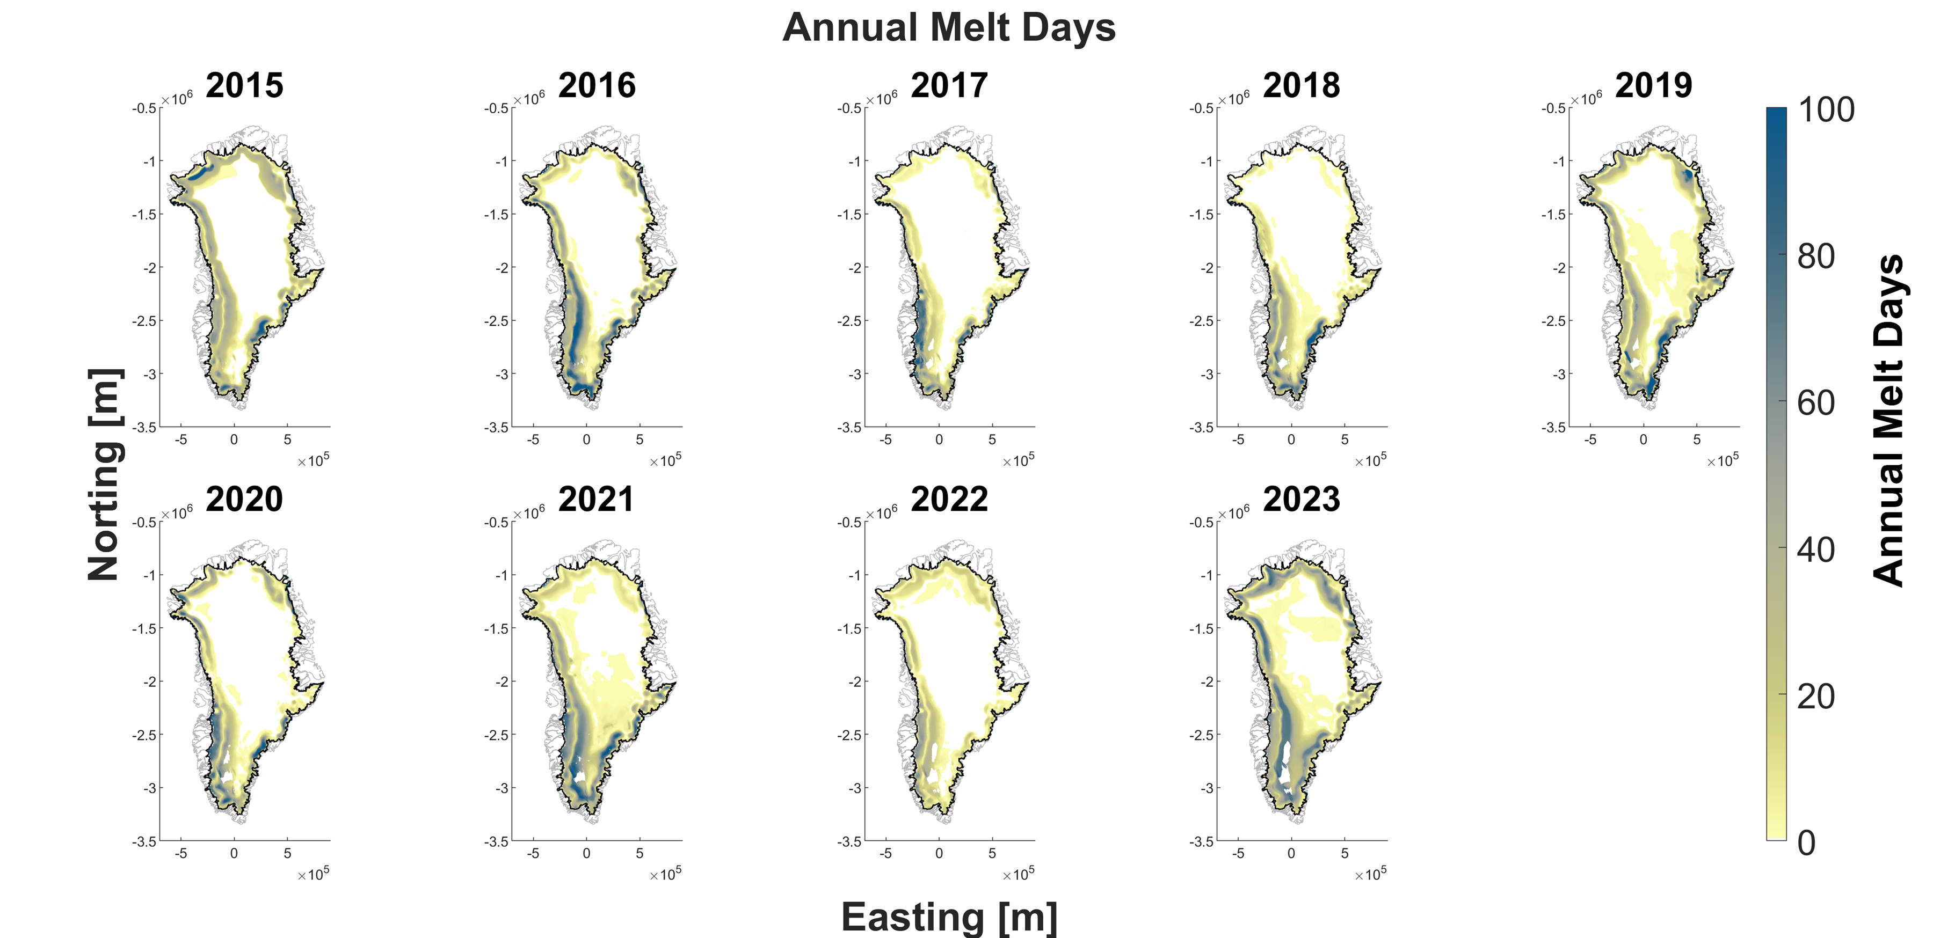
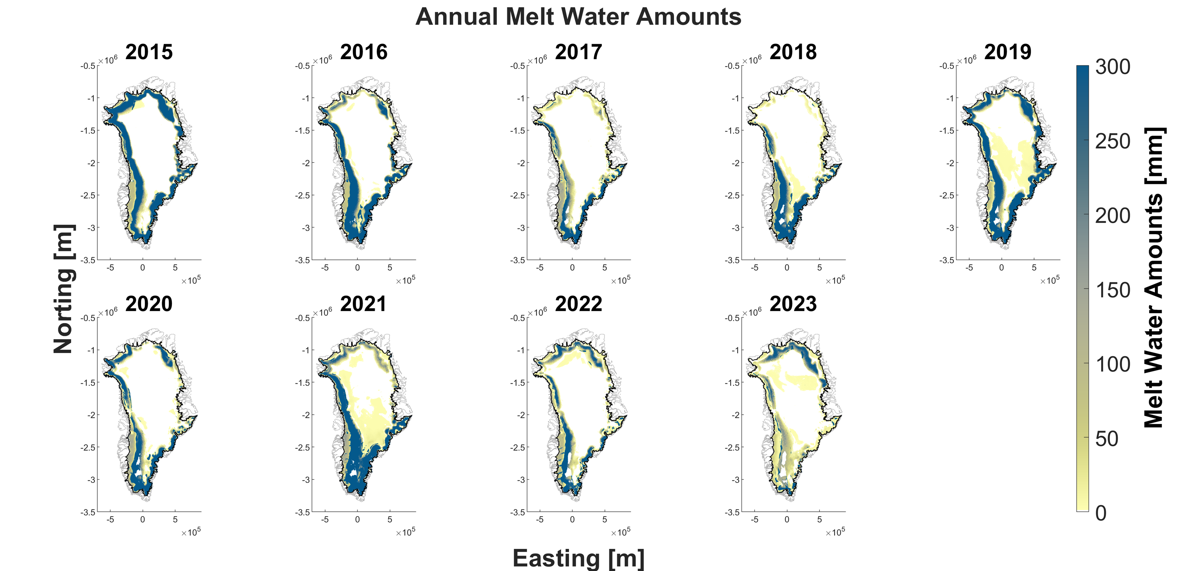
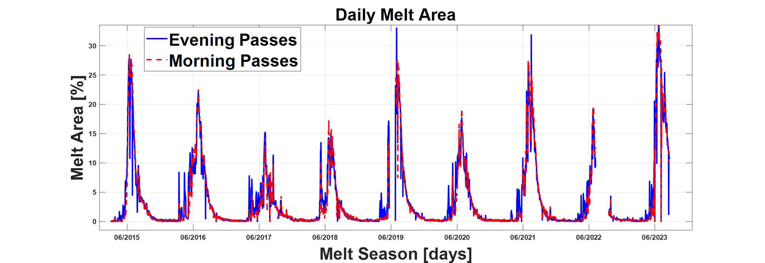
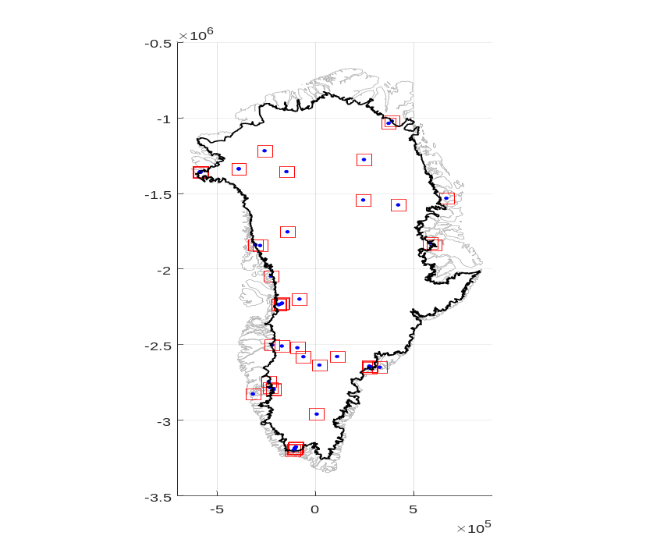
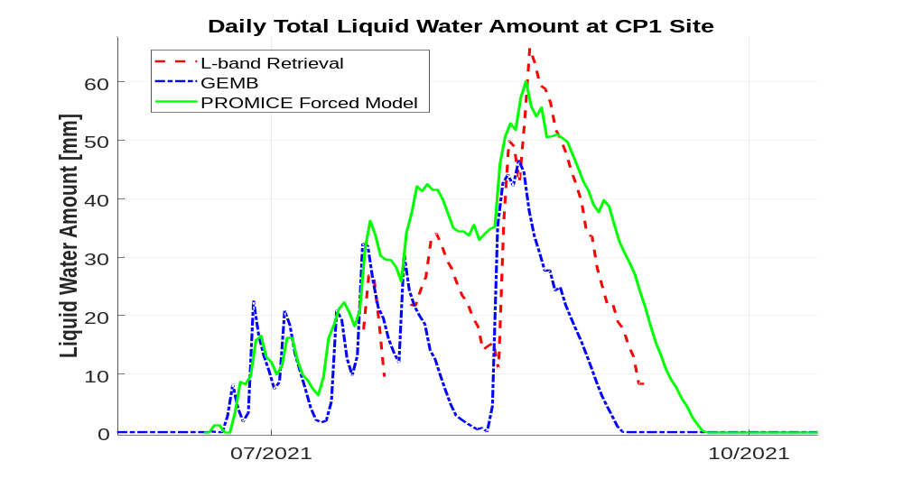
National Aeronautics and Space Administration
Postdoc Research
Retrieval of Liquid Water Content over the Greenland Ice Sheet Using Enhanced Resolution L-band Brightness Temperature
Alamgir Hossan, JPL Postdoctoral Fellow (386G)
Advisor: Andreas Colliander (386G)
Background
Greenland ice sheet continues to experience an accelerated melting due to climate warming [1,2,3].
The meltwater not only contributes to the sea level rise by direct runoff, but it also changes the overall internal structure and dynamics of the ice sheet altering its capability to retain meltwater and buffer sea level rise [2].
Current ice and climate models lack in agreements in estimating meltwater [4]. In-situ observational networks are consistent but limited [5].
Space-based microwave radiometers provide a reliable way of monitoring ice sheet melting across Greenland; however conventional high frequency bands (i.e., 18 or/and 36 GHz), can only track the surface and near-surface binary melt status because of their limited penetration [6].
Here, we use multi-year L-band observations from the NASA Soil Moisture Active Passive (SMAP) mission, to examine ice sheet meltwater amounts and analyze their variabilities.
L-band signals can penetrate to tens of meters deep and provide a more accurate estimate of sub-surface meltwater concealed from higher frequency signals [6-7].
Objectives
To quantify the amounts of surface and sub-surface meltwater on the Greenland ice sheet and examine their spatial and temporal variability.
Approach and Results
We use recently developed SMAP enhanced-resolution (3.125 km) multi-year (2015 - present) L-band brightness temperature (TB) data products [7].
First, a physics-based empirical algorithm is used to detect surface and subsurface melt events. See melt freq. and extent in Fig. 1 and 2, respectively.
Then, a geophysical retrieval algorithm is used to estimate the intensity (as shown in Fig. 3) and physical properties of the melt events.
Finally, the retrieval is validated by comparing with in-situ measurements obtained from the PROMICE (the Programme for Monitoring the Greenland Ice Sheet [5]) automatic weather station (AWS) network. A sample validation results is presented in Fig. 4.
Fig. 1: Annual Melt Days over Greenland for 2015-2023
Fig. 3: Total Annual Meltwater Amounts for 2015-2023
PROMICE AWS
CP1
Fig. 2: Percentage of daily melt area over Greenland tracked by SMAP
Fig. 4: Comparison with in-situ observations and GEMB model
Significance of Results/Benefits to NASA/JPL
NASA satellite (SMAP) tracks meltwater across the ice sheet down to tens of meters.
The results demonstrate the potential for advancing our understanding of ice sheet properties and melt processes.
It helps to better project Greenland’s contribution to global sea level rise in response to climate change and variability.
Future Work
To determine the precise location and distribution of the melt water, a multifrequency algorithm is required; its development is underway.
For better understanding the science of ice sheet physical processes, interdisciplinary efforts are essential; collaboration with the researchers from University of Colorado Boulder, University of Calgary, University of Montana, Geological Survey of Denmark and Greenland, and NOAA is ongoing.
Publications:
Hossan, A., Colliander, A., Miller, J., Marshall, S., Harper, J., Vandecrux, B., "Investigation of Greenland Ice Sheet Melt Processes Using Multi-Year Low-Frequency Passive Microwave Observations,”- abstract accepted in AGU Fall Meeting 2023, 11-15 December 2023 in San Francisco, CA.
Hossan, A., Colliander, A., Miller, J., Marshall, S., Harper, J., Vandecrux, B., "Examination of Melt Water Amounts and their Variability in Greenland Ice Sheet using L-band Radiometry,”- abstract accepted in AGU Chapman Conference 2024, 13-16 February 2024, Honolulu, HI.
Hossan, A., Colliander, A., “SnowR V2: A Microwave Retrieval Algorithm for Estimating Ice Sheet Meltwater Amounts and other Physical Properties“, submitted in IEEE 17th Specialist Meeting on Microwave Radiometry and Remote Sensing of the Environment (MicroRad 2024), to be held on 8-11 April 2024, Alexandria, Virginia, USA.
References:
Mousavi, Mohammad, et al. "Evaluation of surface melt on the Greenland ice sheet using SMAP L-band microwave radiometry." IEEE Journal of Selected Topics in Applied Earth Observations and Remote Sensing 14 (2021): 11439-11449.
Samimi, Samira, et al. "Time‐domain reflectometry measurements and modeling of firn meltwater infiltration at DYE‐2, Greenland." Journal of Geophysical Research: Earth Surface 126.10 (2021).
Vandecrux, B., et al. "Drivers of firn density on the Greenland ice sheet revealed by weather station observations and modeling." Journal of Geophysical Research: Earth Surface 123.10 (2018): 2563-2576.
Vandecrux, Baptiste, et al. "The firn meltwater Retention Model Intercomparison Project (RetMIP): evaluation of nine firn models at four weather station sites on the Greenland ice sheet." The Cryosphere Discussions 2020 (2020): 1-32.
Fausto, Robert S., et al. "Programme for Monitoring of the Greenland Ice Sheet (PROMICE) automatic weather station data." Earth System Science Data 13.8 (2021): 3819-3845.
Colliander, Andreas, et al., "Spatial and temporal differences in surface and subsurface meltwater distribution over Greenland ice sheet using multi-frequency passive microwave observations." Remote Sensing of Environment 295 (2023): 113705.
Long, David G., et al., "Enhanced-resolution SMAP brightness temperature image products." IEEE Transactions on Geoscience and Remote Sensing 57.7 (2019): 4151-4163.
Contact:
Email: Alamgir.Hossan@jpl.nasa.gov Phone: +1 818-354-2888
National Aeronautics and Space Administration
Jet Propulsion Laboratory
California Institute of Technology
Pasadena, California
www.nasa.gov
Clearance Number: CL#00-0000
Poster Number: PRD-E-005
Copyright 2023. All rights reserved.

