Slide 1

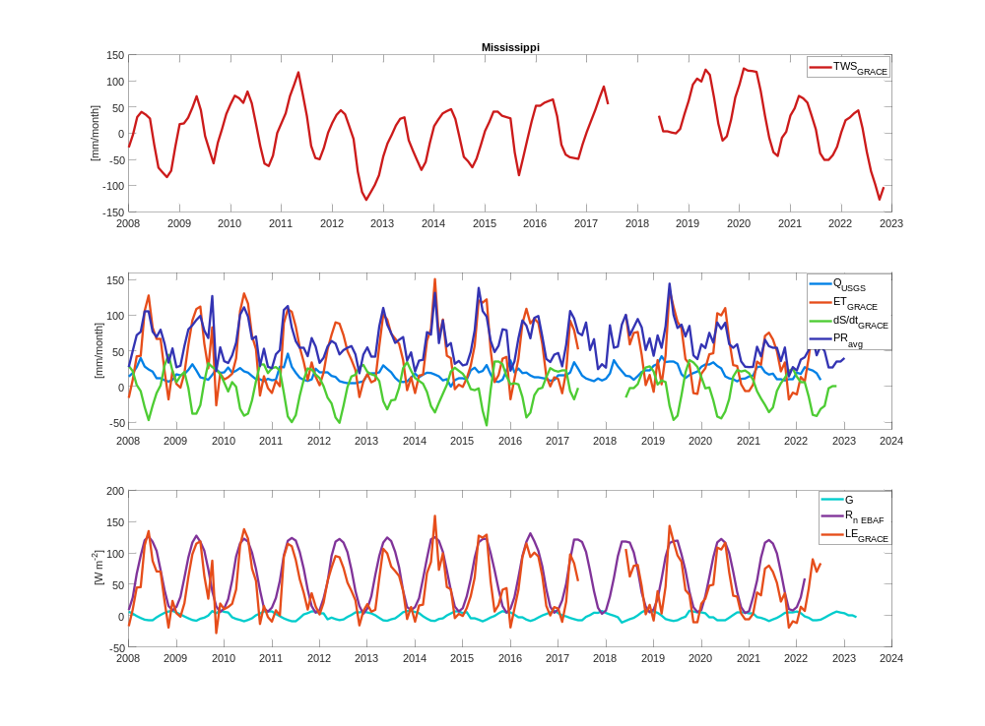
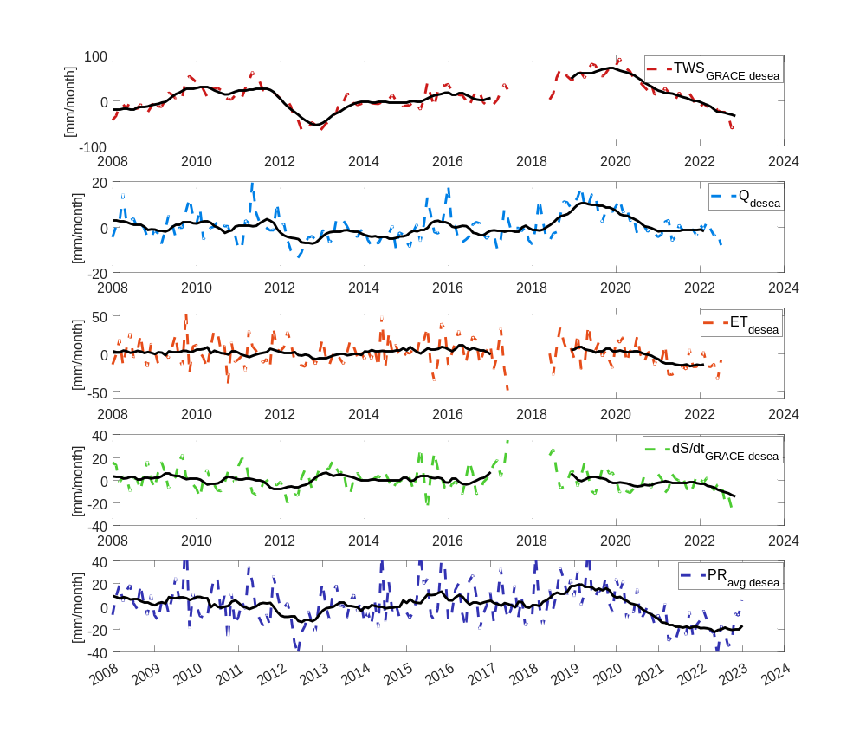
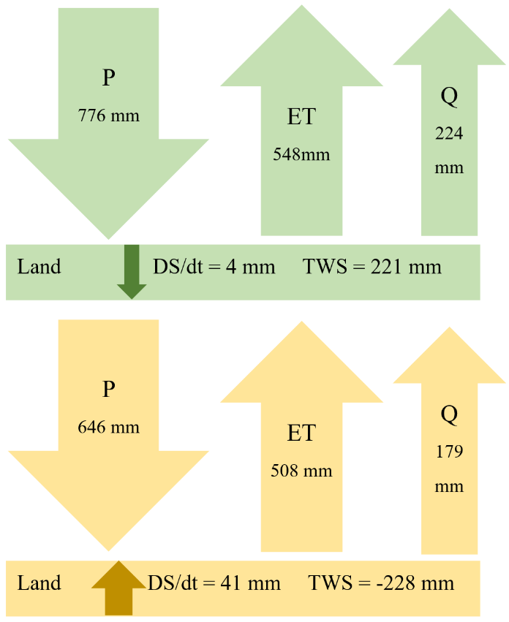
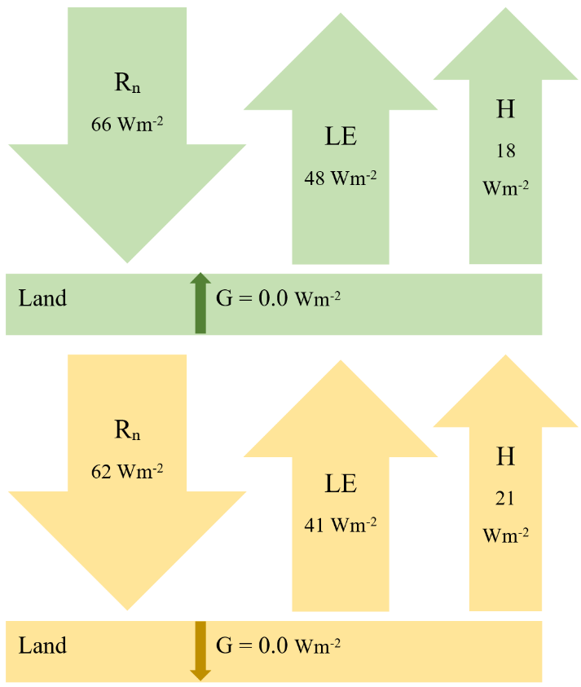
National Aeronautics and Space Administration
Postdoc Research
Energy-Water Dynamics in the U.S. Largest River Basin: Satellite Observations during Drought Conditions
Elahe Tajfar (329) JPL Postdoctoral Fellow,
Madeleine Pascolini-Campbell (329), Maria Hakuba (329),
John Reager (329), Cedric David (329)
Background
The Water & Ecosystems Group at NASA's Jet Propulsion Laboratory (JPL) builds on its legacy of excellence in advancing hydrology missions, focusing on the dynamic interplay between water and energy fluxes in the largest basin in the U.S., the Mississippi River Basin (MRB), spanning both drought and non-drought years. The main research question answered is how do surface water and energy balance components change under drought conditions in the MRB? We anticipate significant changes in the surface energy partitioning and water budget during drought periods.
Objectives
The goal of this study is to strengthen JPL’s capabilities for scientific discovery in hydrology and water resources in the upcoming era of satellite remote sensing.
Approach and Results
This research involves a multi-mission exploration of variability between water and energy cycles using hydrology missions (GRACE, GRACE/FO), energy missions (CERES), and vegetation information (MODIS) for the U.S. largest basin. Our approach integrates the water balance equation into the surface energy balance equation, allowing for a comprehensive analysis of the impact of drought on the interplay between water and energy fluxes. Results indicate increased ratio of evapotranspiration to precipitation (ET/P) and runoff (ET/Q), and greater sensible heat flux during the severe droughts of 2012, 2013 and 2022.
Significance of Results/Benefits to NASA/JPL
This work will pave the way for future studies possible with the Earth System Observatory (ESO) including the upcoming Mass Change, Surface Biology and Geology missions, as well as Libera. This work also addresses Decadal survey key science questions, by investigating how water and energy fluxes are changing. Other activities address the time scales of hydrologic extreme events, needed for designing mission requirements.
Figure 1. Basin-averaged water and energy components at the Mississippi River Basin using GRACE/GRACE-FO, CERES and satellite-based precipitation data sets.
Figure 2. Water and energy fluxes interannual variability highlighting key drought years in 2012, 2013 and 2019.
Figure 3. Partitioning of water and energy fluxes using a multi-sensor approach (GRACE, GRACE-FO, CERES, GPM) to characterize drought/non-drought conditions (2008-2022).
Table 1. Ratios of water and energy balance components in non-drought vs drought years at the MRB
Future Work
1. Spatial Variation: Exploring how water and
energy dynamics vary spatially within the MRB,
potentially focusing on sub-basins or specific land cover types. 2. Integration with Additional Satellite Missions: we extend our analysis to incorporate independent ET data from missions such as ECOSTRESS and MODIS, diversifying our analytical toolkit. 3. Model Validation: Validating my findings with numerical models to ensure the observed trends align with the expected behavior.
Ratio | ET/P | Q/P | ET/Q | ΔS/P | H/LE | H/Rn | LE/Rn | G/Rn
Non-drought | 0.71 | 0.41 | 2.4 | 0.01↓ | 0.38 | 0.27 | 0.73 | 0.00↑
Drought | 0.79 | 0.35 | 2.8 | 0.06↑ | 0.51 | 0.34 | 0.66 | 0.00↓
National Aeronautics and Space AdministrationJet Propulsion Laboratory
California Institute of Technology
Pasadena, California
www.nasa.gov
Publications and Acknowledgements:
Tajfar, E. et al. Satellite-based approach towards understanding energy-water-vegetation coupling in the Mississippi River Basin, AGU Fall Meeting 2023.
Tajfar, E. et al. Characterizing water-energy-carbon cycle changes during droughts for the Mississippi River Basin, Manuscript in prep.
Author Contact Information:
elahe.tajfar@jpl.nasa.gov; (808) 589-8939
Clearance Number: CL#00-0000
Poster Number: PRD-E-002
Copyright 2023. All rights reserved.

