Slide 1

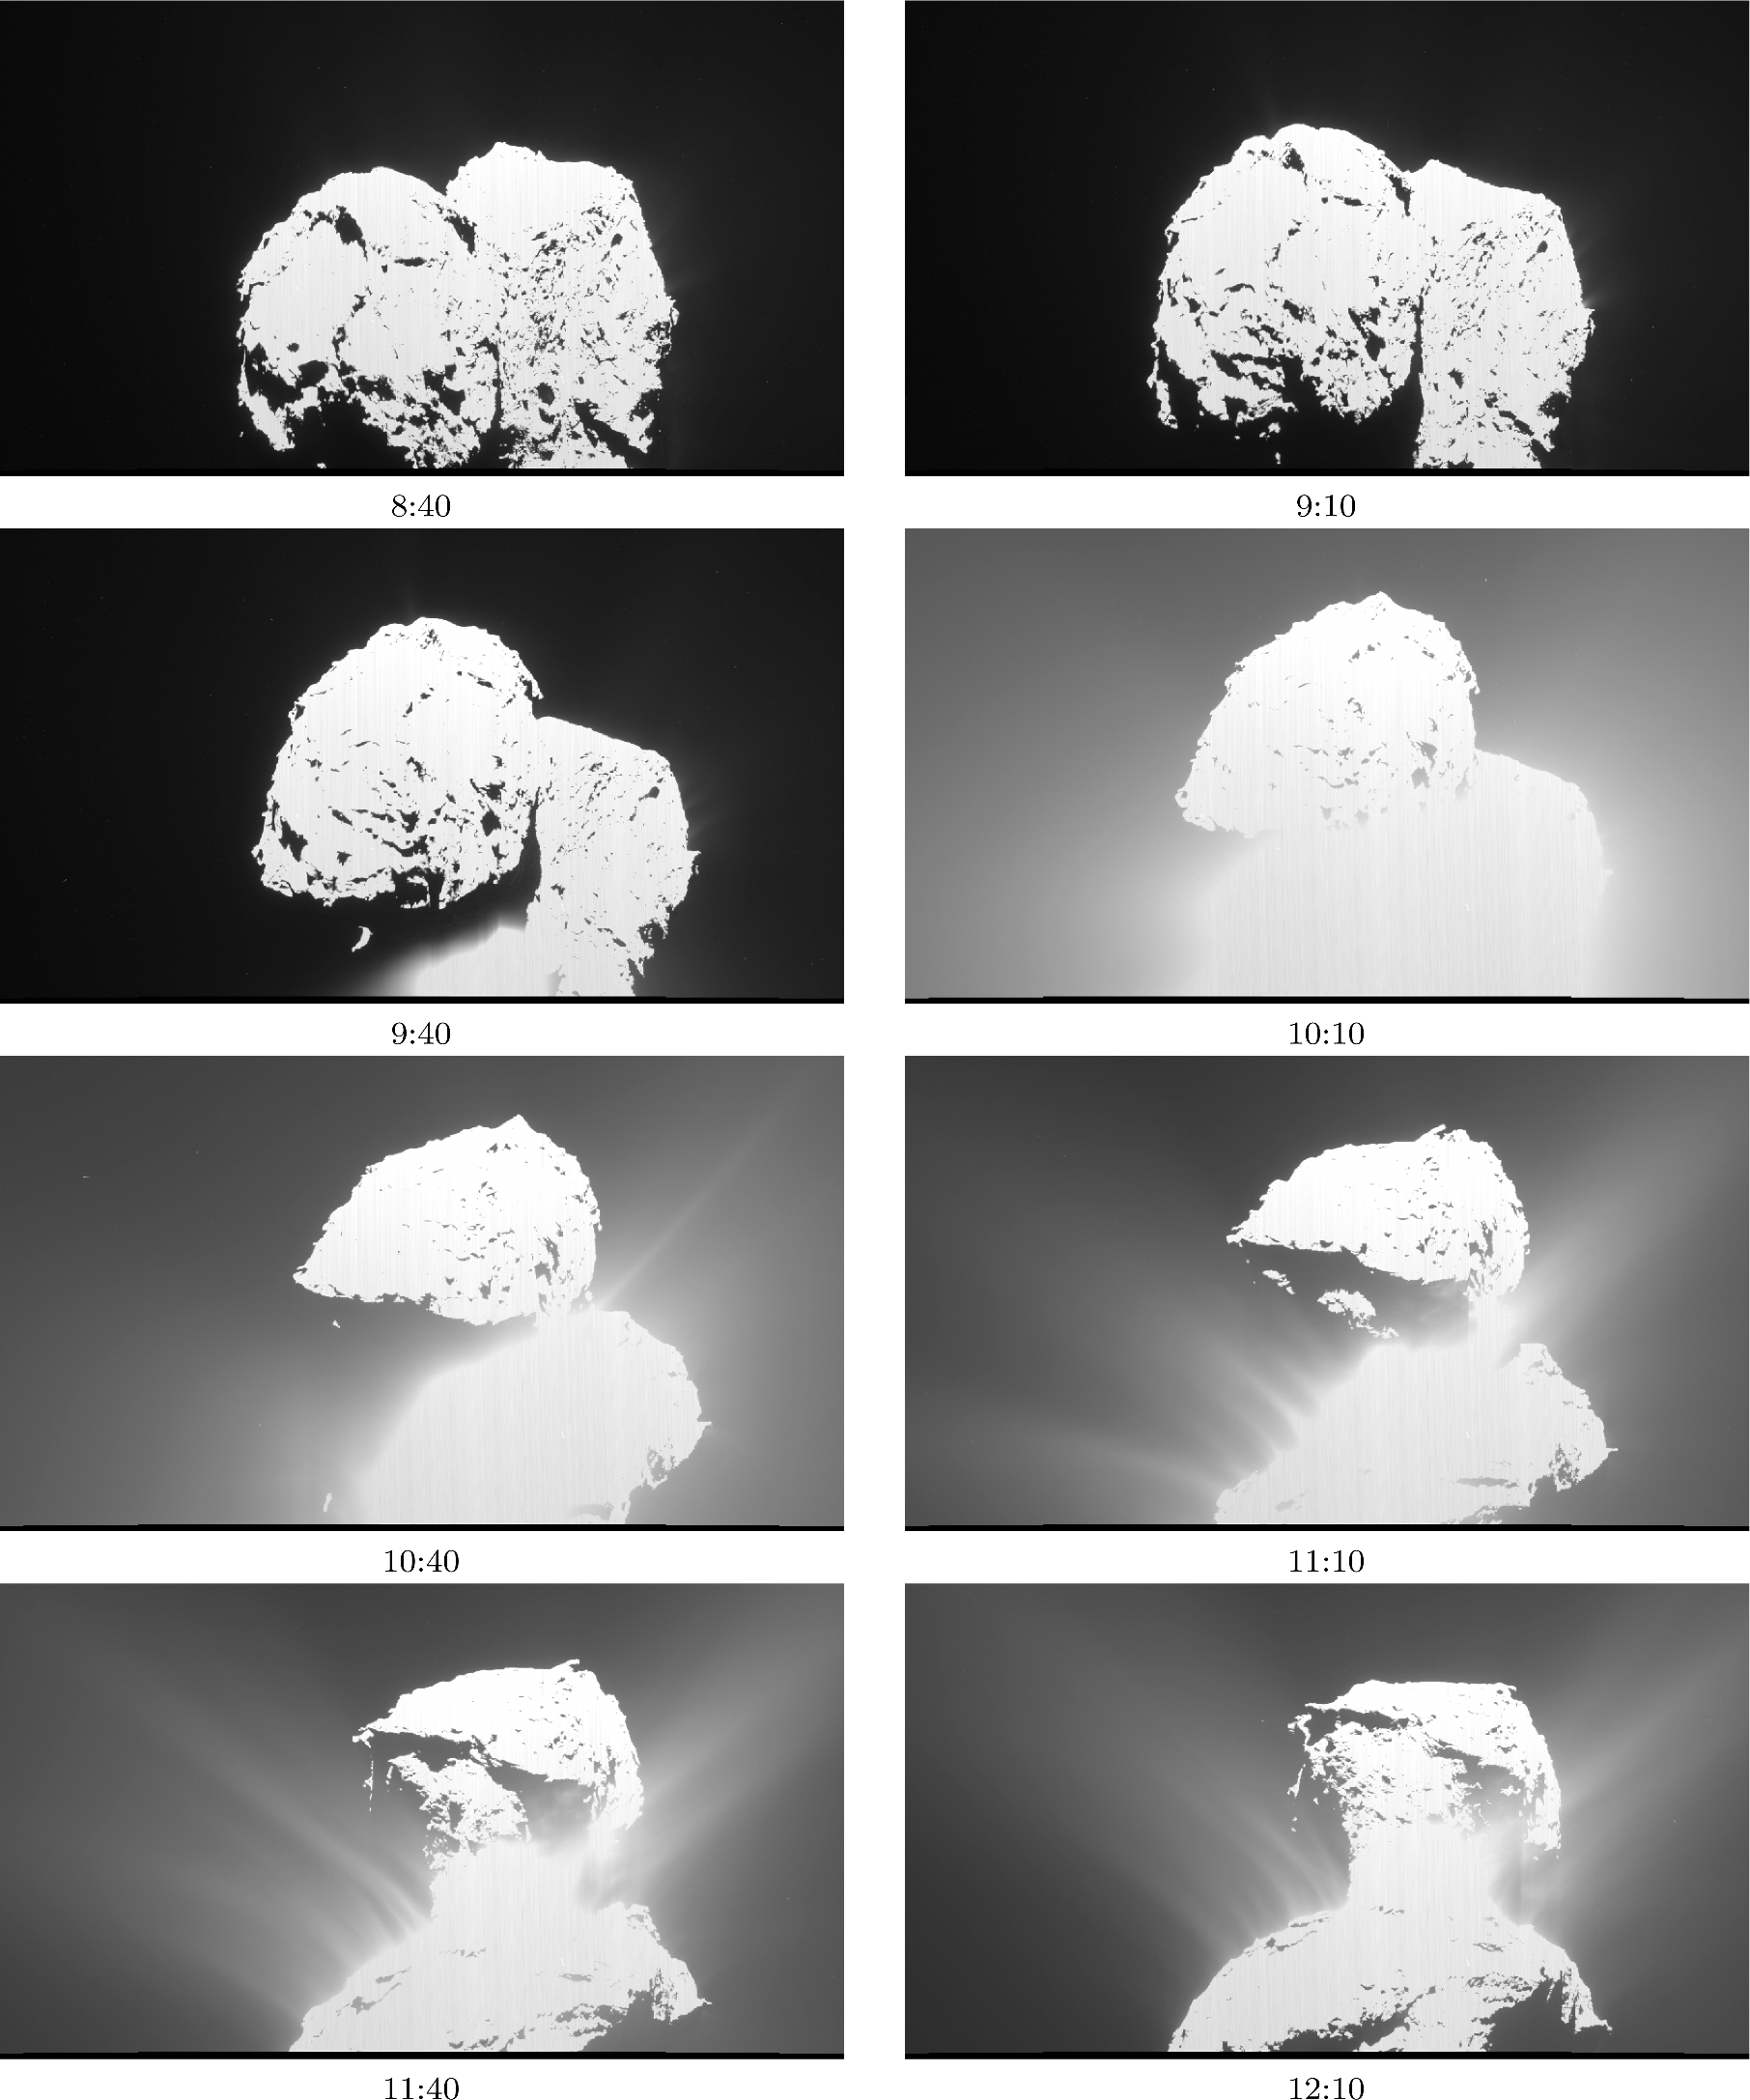
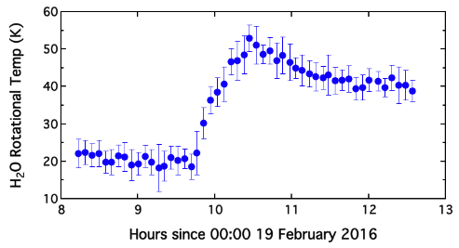
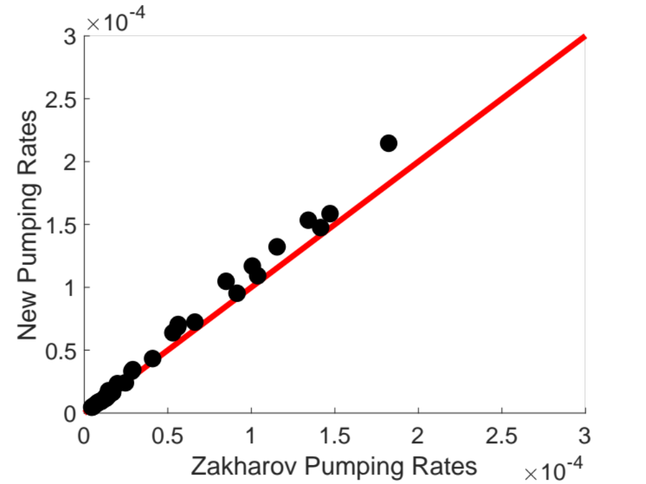
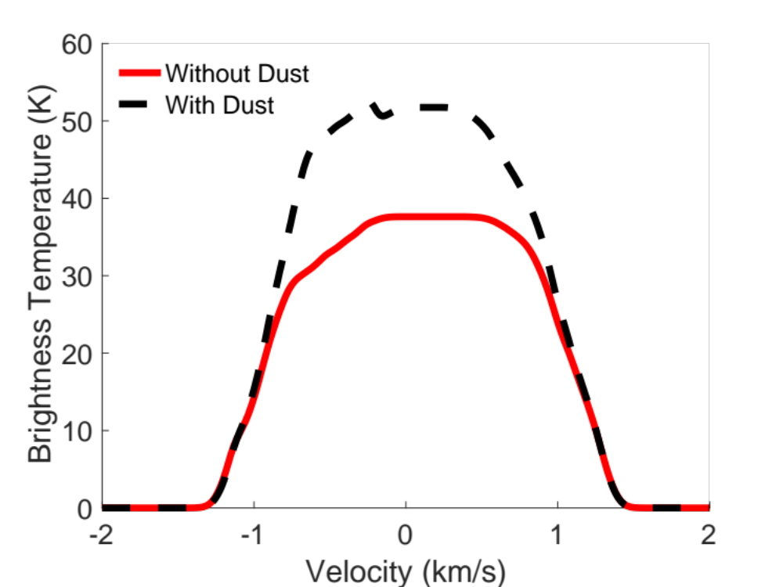
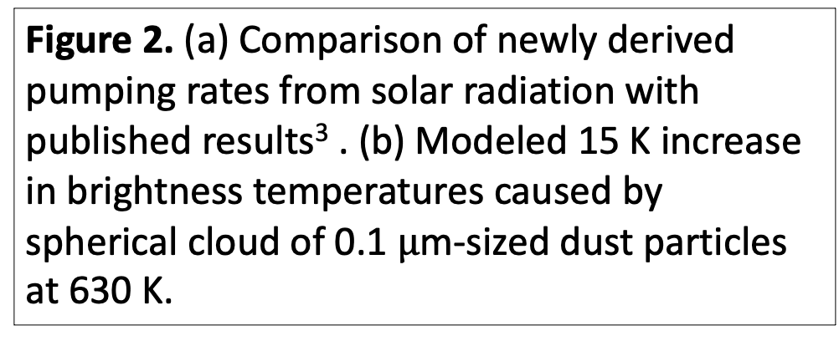
National Aeronautics and Space Administration
The Radiative Effects of Dust on Water Vapor in a Cometary Coma
Aditya Khuller, JPL Postdoctoral Fellow (3980)
Paul von Allmen (3980) & Mark Hofstadter (3222)
I. Background
Comet 67P, before outburst
c
Comets are ancient remnants of the planetary formation process
By studying a comet’s dusty atmosphere (coma), we can learn about its volatiles, regolith, and isotopic composition
The Rosetta mission observed dusty outbursts that correlate with an increase in water vapor rotational temperature (Fig. 1)
30 K increase
a
Comet 67P, during outburst
Figure 1. Comet 67P, (a) before, and (b) during a dusty outburst observed by ESA’s Rosetta mission¹. The ~30 K rise in water vapor rotational temperature observed simultaneously by the Microwave Instrument for the Rosetta Orbiter (MIRO) is shown in (c).
b
II. Objectives
a
IV. Significance of Results/Benefits to NASA/JPL
Determine if thermal emission from coma dust radiatively pumps water molecules’ rotational levels
Provide improved estimates of water mass loss and gas properties by accounting for this pumping
Improve estimates of gas-to-dust mass ratios in the coma
Incorporating the thermal radiation from dust in the coma will help us understand cometary evolution better
These results can help JPL design and plan future cometary missions
This dust-gas model can be extended to study processes across the universe (e.g., in the interstellar medium, proto-planetary disks, etc.)
b
III. Approach & Results
Derived and incorporated new analytical expressions to calculate pumping rates from solar radiation and dust into existing coma model²
Validated new solar radiation pumping rates against previous work³
Quantified effect of thermal emission from spherical dust cloud for varying coma properties and observing geometries (Fig. 2)
V. Future Work
Working on adding a distribution of dust particles in the coma based on Rosetta observations
Will simulate jets of dust for quantitative analysis of effect on water molecular line emission
Will submit manuscript on spherical dust distribution case before attempting to replicate actual MIRO observations
Figure 2. (a) Comparison of newly derived pumping rates from solar radiation with published results³ . (b) Modeled 15 K increase in brightness temperatures caused by spherical cloud of 0.1 $μ$m-sized dust particles at 630 K.
National Aeronautics and Space Administration
Jet Propulsion Laboratory
California Institute of Technology
Pasadena, California
www.nasa.gov
References: 1. Grun et al. (2016), MNRAS. 2. Lee et al. (2011), Icarus. 3. Zakharov et al. (2007), AA.
Publications:
Khuller, A.R., von Allmen, P., Hofstadter, M. (in prep.).
The Radiative Effects of Dust on Water Vapor in a Cometary Coma.
Author Contact Information:
akhuller@jpl.nasa.gov; 520-450-7199
Clearance Number: CL#00-0000
Poster Number: PRD--A-020
Copyright 2023. All rights reserved.

