Slide 1

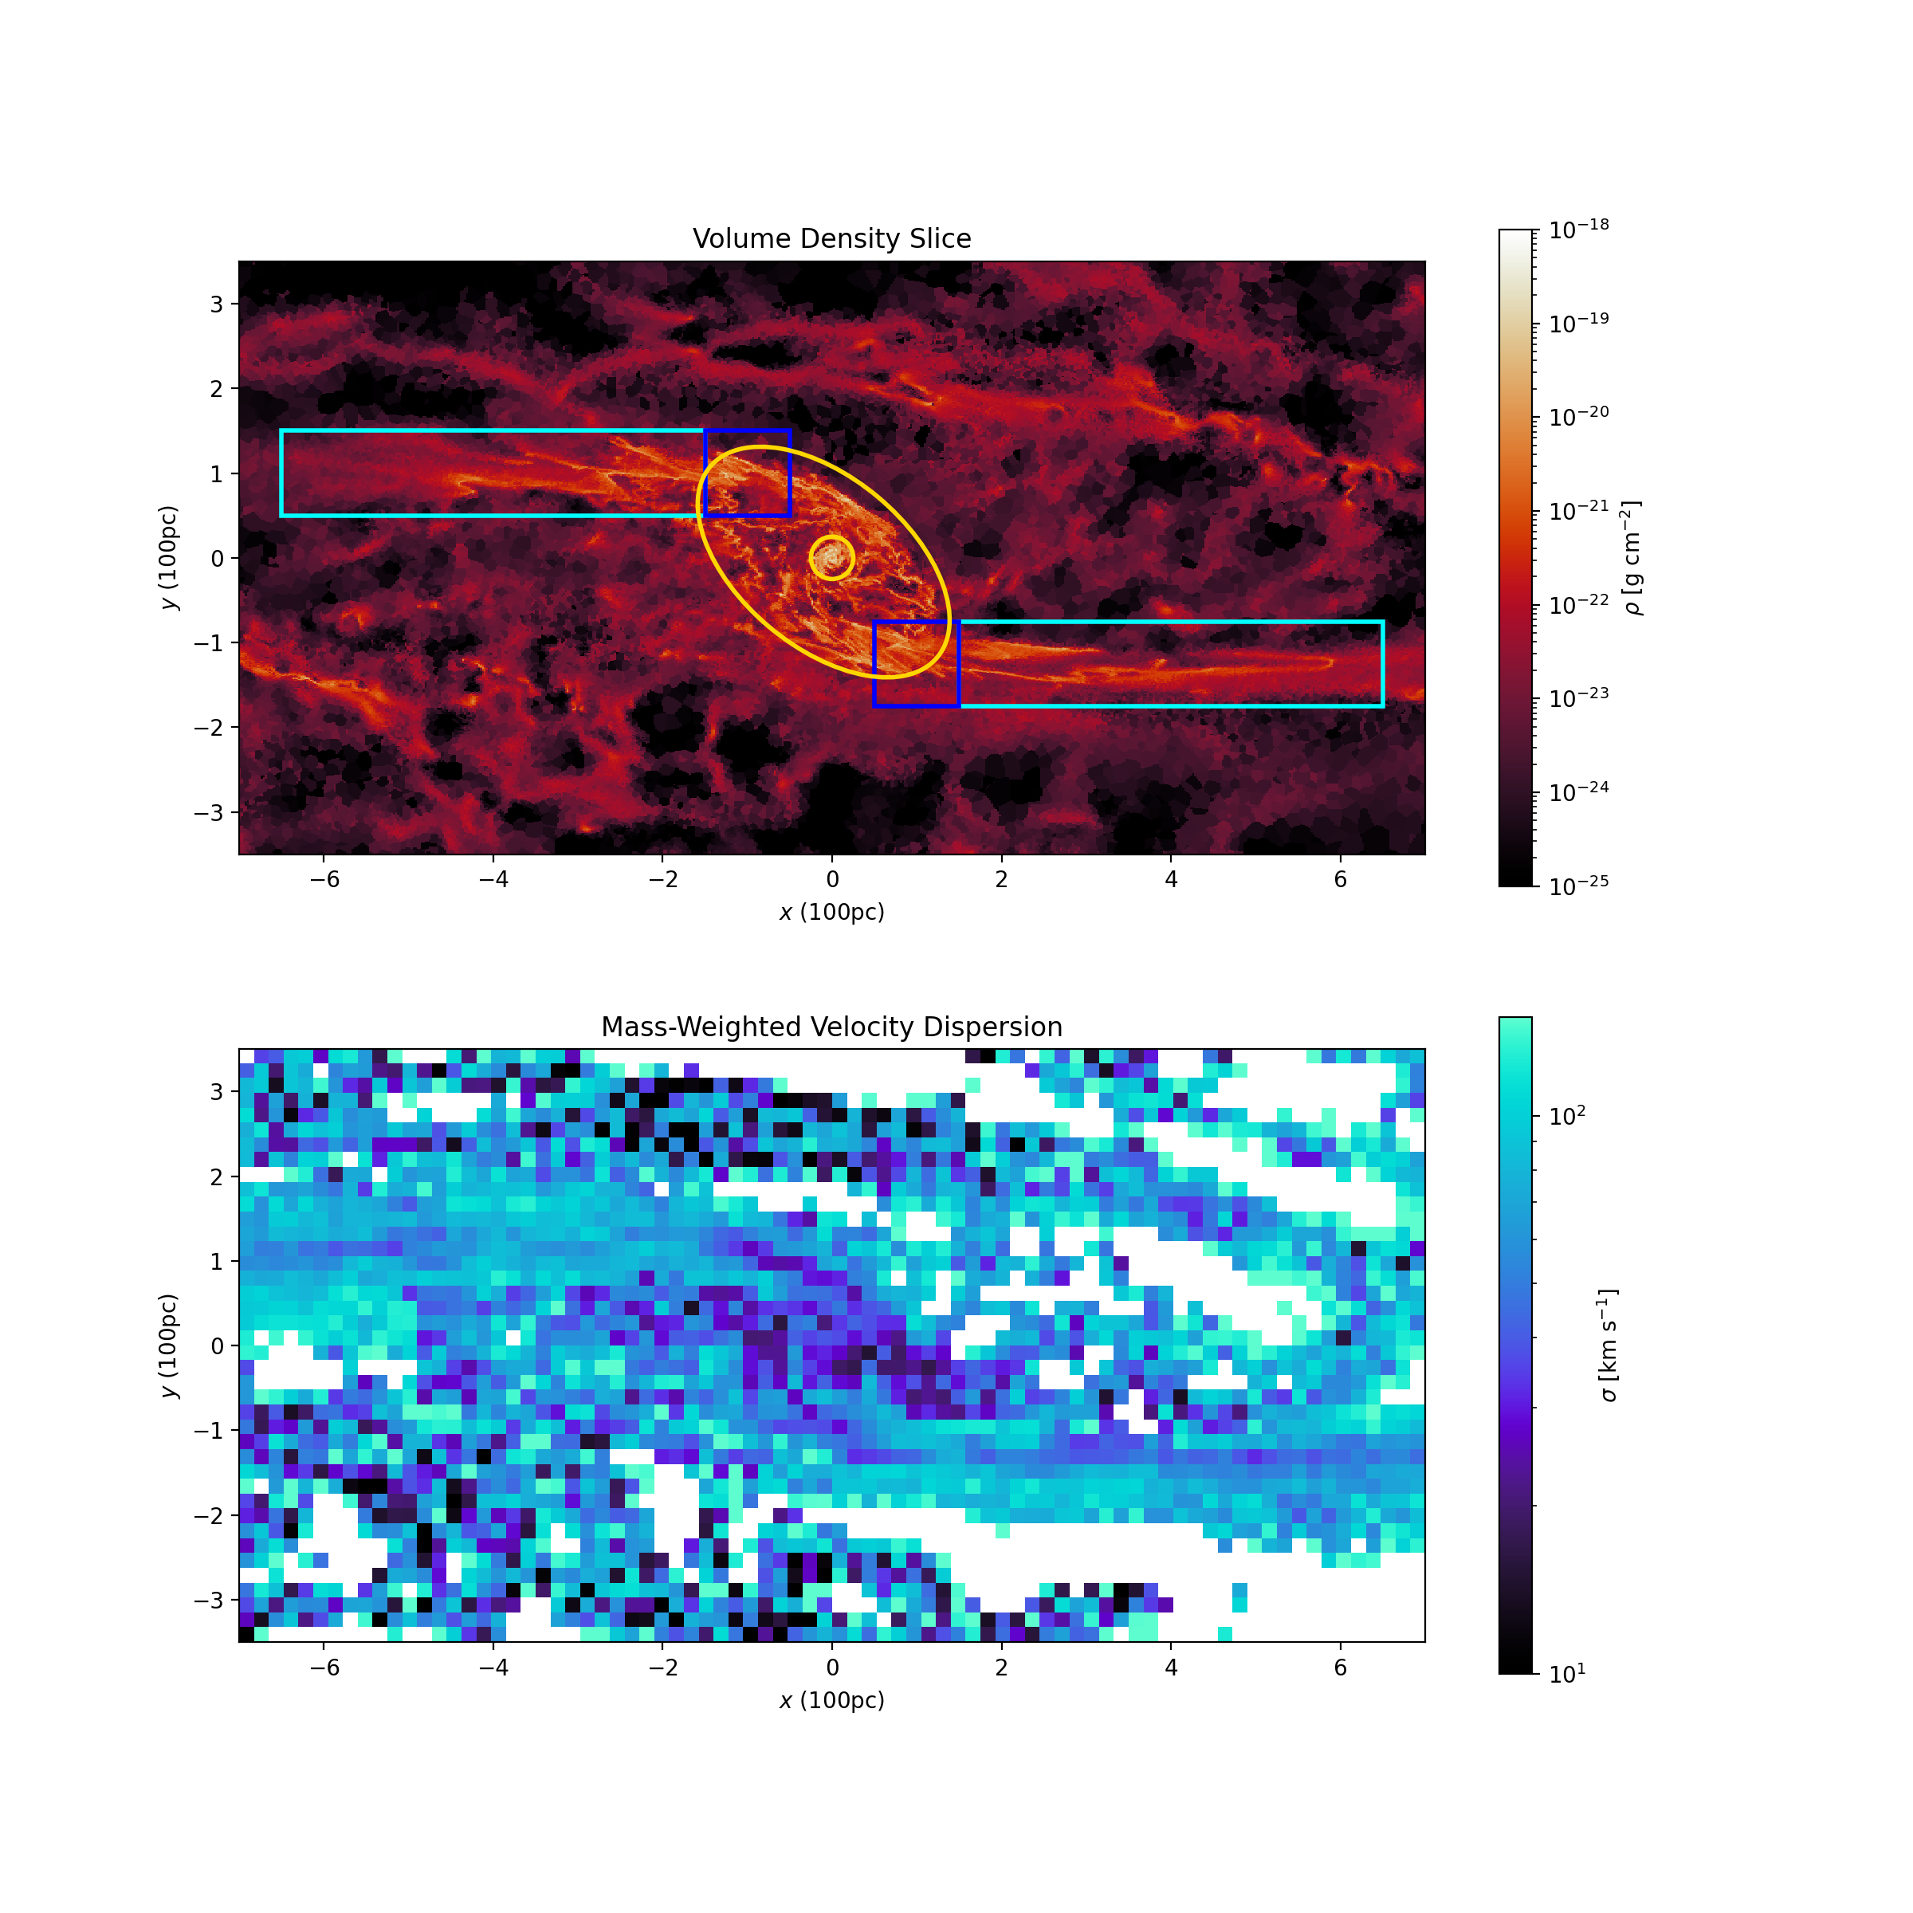
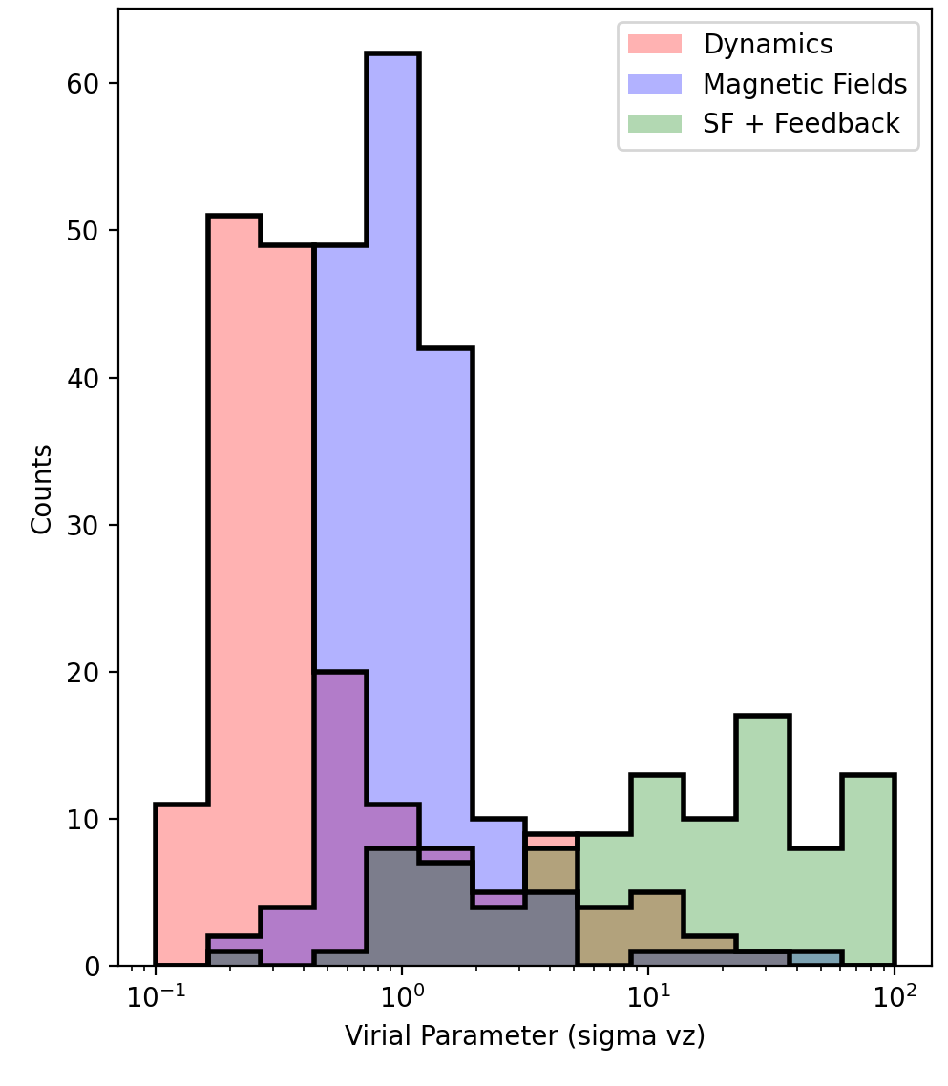
National Aeronautics and Space Administration
Postdoc Research
Chaos in the Core: Turbulence and Star Formation in the Milky Way’s Galactic Center
Authors: H Perry Hatchfield, NASA Postdoctoral Fellow (3266), Paul F. Goldsmith (3266),
Cara Battersby (University of Connecticut), Mattia C. Sormani (University of Surrey),
Robin Tress (École Polytechnique Fédérale de Lausanne)
Background
The process star formation (SF) is a vital component in our understanding of the universe, from governing the evolution of galaxies through high-mass stellar feedback to the formation of protoplanetary disks and eventually planets capable of hosting life. Our theories of SF are calibrated according to observations of the Solar Neighborhood, which is not representative of conditions throughout the cosmos more broadly.
The Milky Way’s Galactic Center is the nearest star-forming environment with properties substantially different from local molecular clouds, more resembling those of higher-redshift (z~2) galaxies (Kruijssen and Longmore 2013). The innermost few hundred parsecs of the Milky Way, known as the Central Molecular Zone (CMZ) contains a reservoir of 3-5×10⁷ M⊙ of gas in dense molecular clouds with large turbulent velocity dispersions. (Henshaw+2023). Despite the substantial reservoir of gas, the star formation rate (SFR) of the CMZ is 1-2 orders of magnitude lower than predicted by its dense gas content (Longmore+2013, Barnes+2017, Battersby+2020, Hatchfield+2023). One plausible explanation for the dearth of SF in the CMZ is the elevated and pervasive supersonic turbulence measured in Galactic Center clouds, however the origin and influence of this turbulence is, as of yet, poorly understood.
Objectives
We aim to use a set of simulations run using AREPO isolate the importance of the three most promising candidate turbulent driving mechanisms at work in the Galactic Center:
Gravitational influence of the Galactic Bar
Large-scale instabilities due to the strong local magnetic field
Clustered supernova feedback from high-mass stars
Understanding more about the source of this turbulence is crucial for designing better simulations of clouds in the Galactic Center on scales comparable to recent surveys with SOFIA and ALMA.
Approach and Results
We use the moving mesh code AREPO to run three simulations, each with a mass resolution of 25 M⦿, non-isothermal chemistry, and dynamics from the barred galactic potential:
1. Dynamics only 2. Dynamics + Magnetic Fields
3. Dynamics + Gas Self-Gravity + Stellar Feedback
Each of our simulations includes a different implementation of physics, but all use the carefully modeled gravitational potential of the Galactic Center from Sormani+2019. The non-axisymmetric component of the potential drives violent collisions in the Galaxy’s Dust Lanes and their intersection with the CMZ. These collisions are present in all three simulations, but their impact is isolated in the dynamics-only run.
Our primary findings are:
Simulations including supernova feedback were significantly more turbulent than those modeling dynamics and magnetic instability alone.
Turbulent properties are more similar in dust lane collision sites of each simulation, suggesting that dynamics might be more important in certain regions.
Figure 1. One of our hydrodynamic simulations of the Milky Way’s Galactic Center, run using AREPO. This run includes star formation and stellar feedback in addition to the influence of the Galactic Center’s gravitational potential The top panel shows a density slice through the midplane and the bottom panel shows a mass weighted velocity dispersion which we use to compare the levels of turbulence generated in our three suites of simulations. In the top panel, the three regions of interest are highlighted (the Dust Lanes in cyan, the collision regions in blue, and the CMZ ellipse in yellow)
Future Work
Our next steps include developing higher-resolution zoom simulations to resolve details about how turbulence affects star formation in the CMZ. These simulations will be a powerful tool for future studies of the CMZ.
Significance of Results/Benefits to NASA/JPL
The Galactic Center is an important target for any current and future missions investigating dust and gas in the Galactic Plane, and a better understanding of turbulence and its environmental effects on SF throughout the universe more broadly. In particular, the CMZ is an excellent target for upcoming and future infrared and submillimeter balloon missions and mission concepts like PRIMA, focused on exploring dust, gas, and early star formation. The CMZ provides a crucial lever arm in constraining the baryon cycle in extragalactic and high-z star forming galaxies which are the focus of many JPL projects and missions.
Figure 2. Three histograms showing the virial parameter calculated for each grid cell in each of the simulations.
National Aeronautics and Space Administration
Jet Propulsion Laboratory
California Institute of Technology
Pasadena, California
www.nasa.gov
Publications and Acknowledgements:
Barnes et al. 2017. MNRAS 469, 2 Henshaw et al. 2023. PPVII ASP 534
Battersby et al. 2020. ApJS 249, 2 Kruijssen et al. 2014. MNRAS 440 4
Hatchfield et al. 2023, accepted by ApJ Longmore et al. 2013. MNRAS 429 2
Hatchfield et al. 2024. in prep. (this work)
Author Contact Information:
Cell: 617 276 2211 email: h.perry.t.Hatchfield@jpl.nasa.gov
Clearance Number: CL#00-0000
Poster Number: PRD-A-019
Copyright 2023. All rights reserved.

