Slide 1

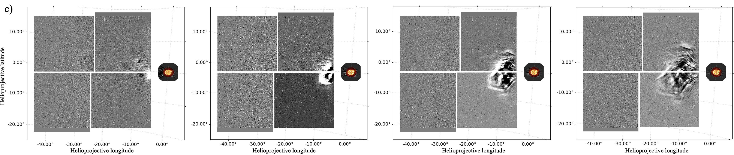
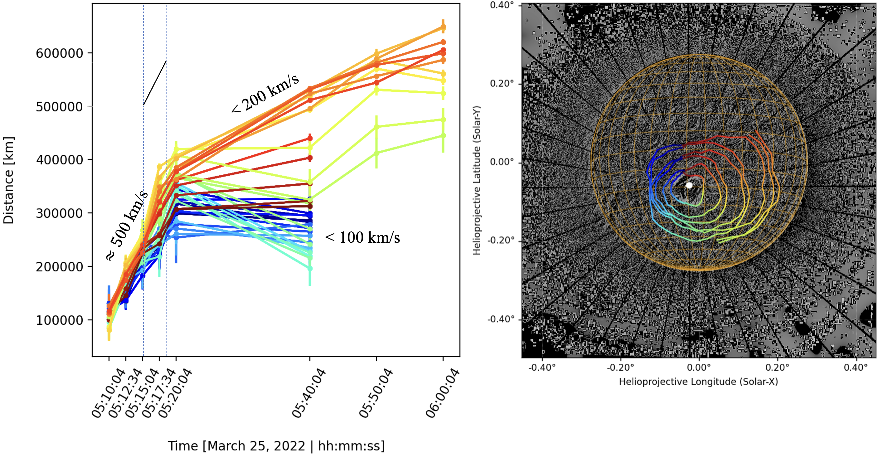
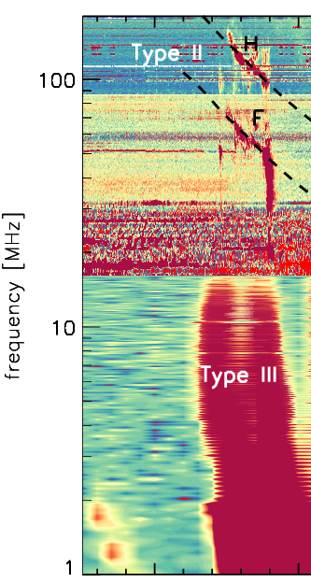
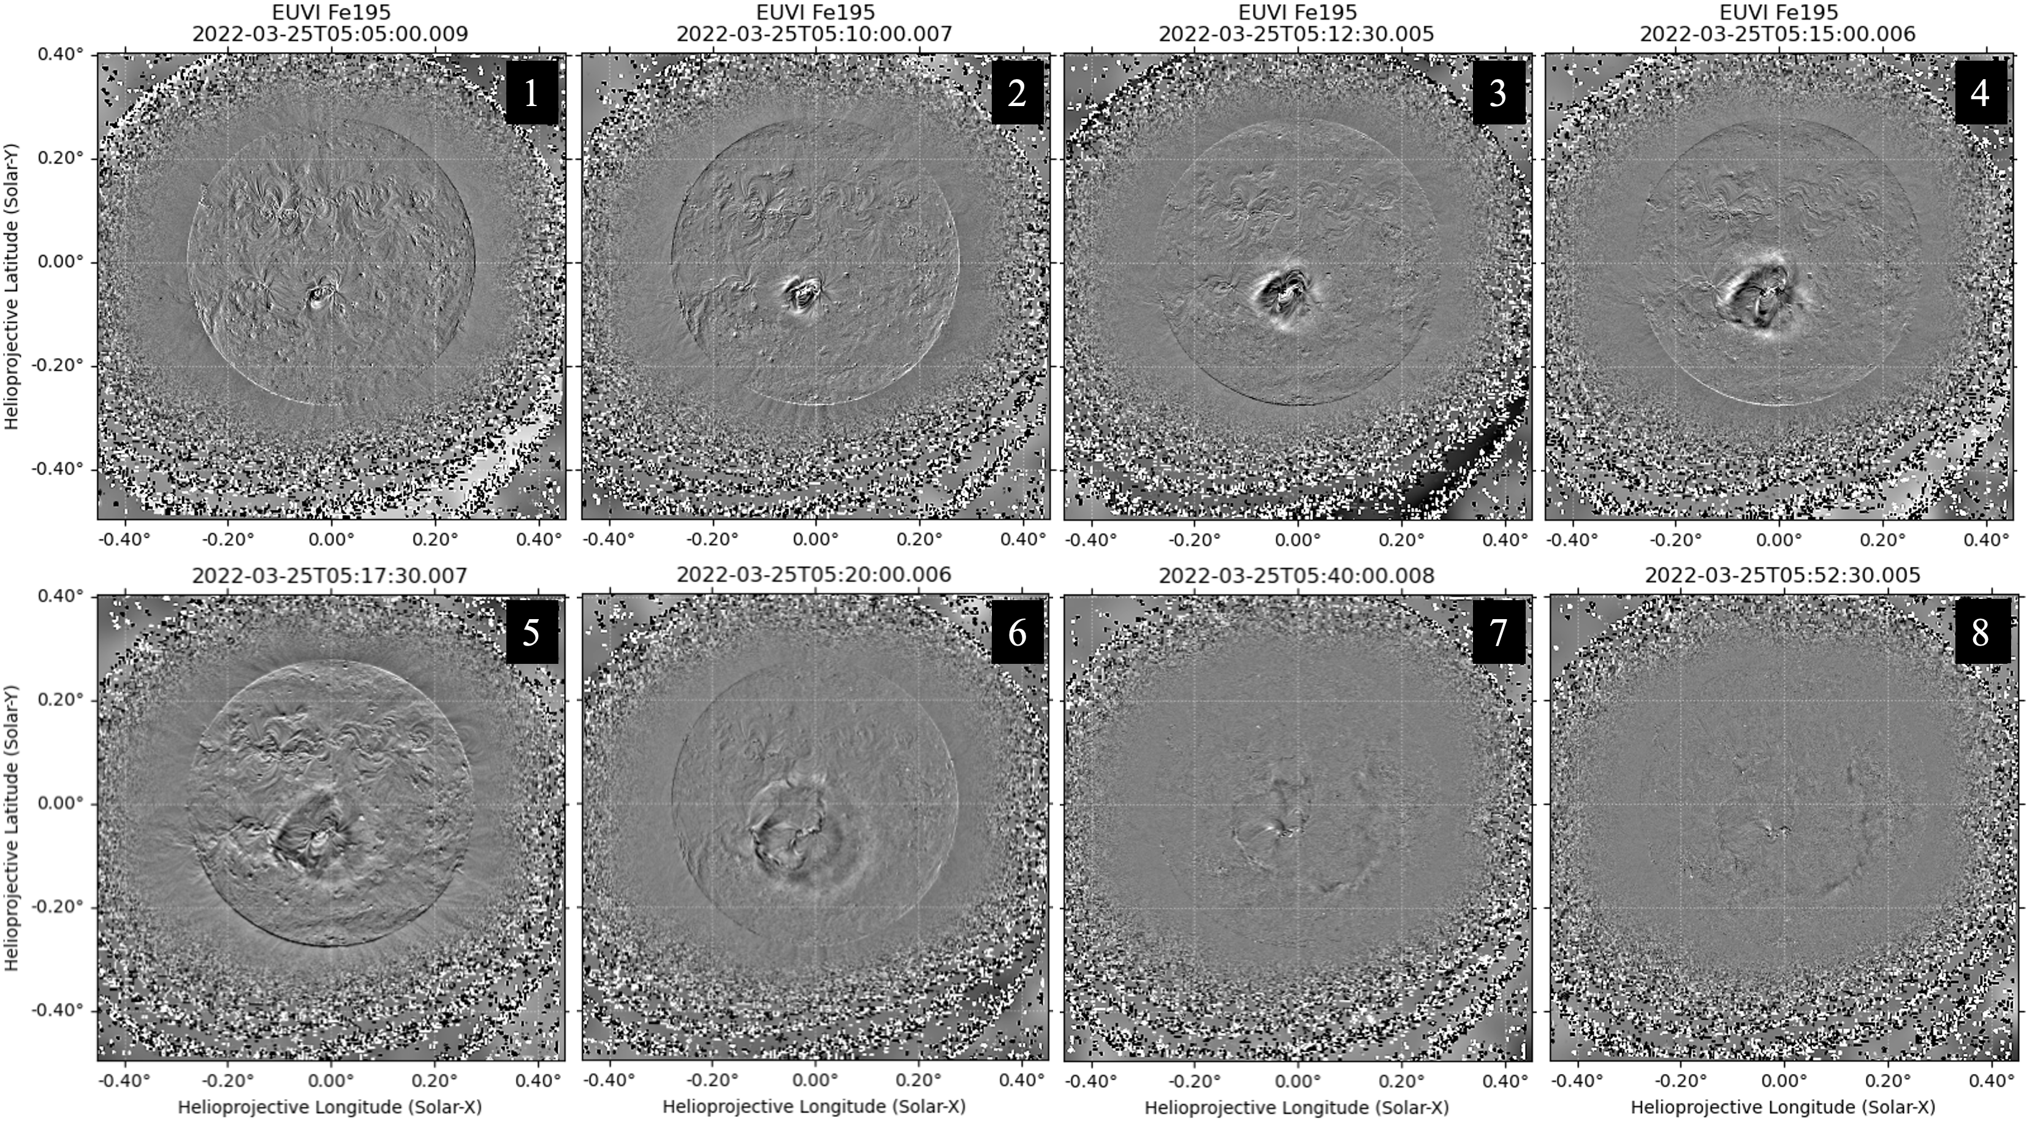
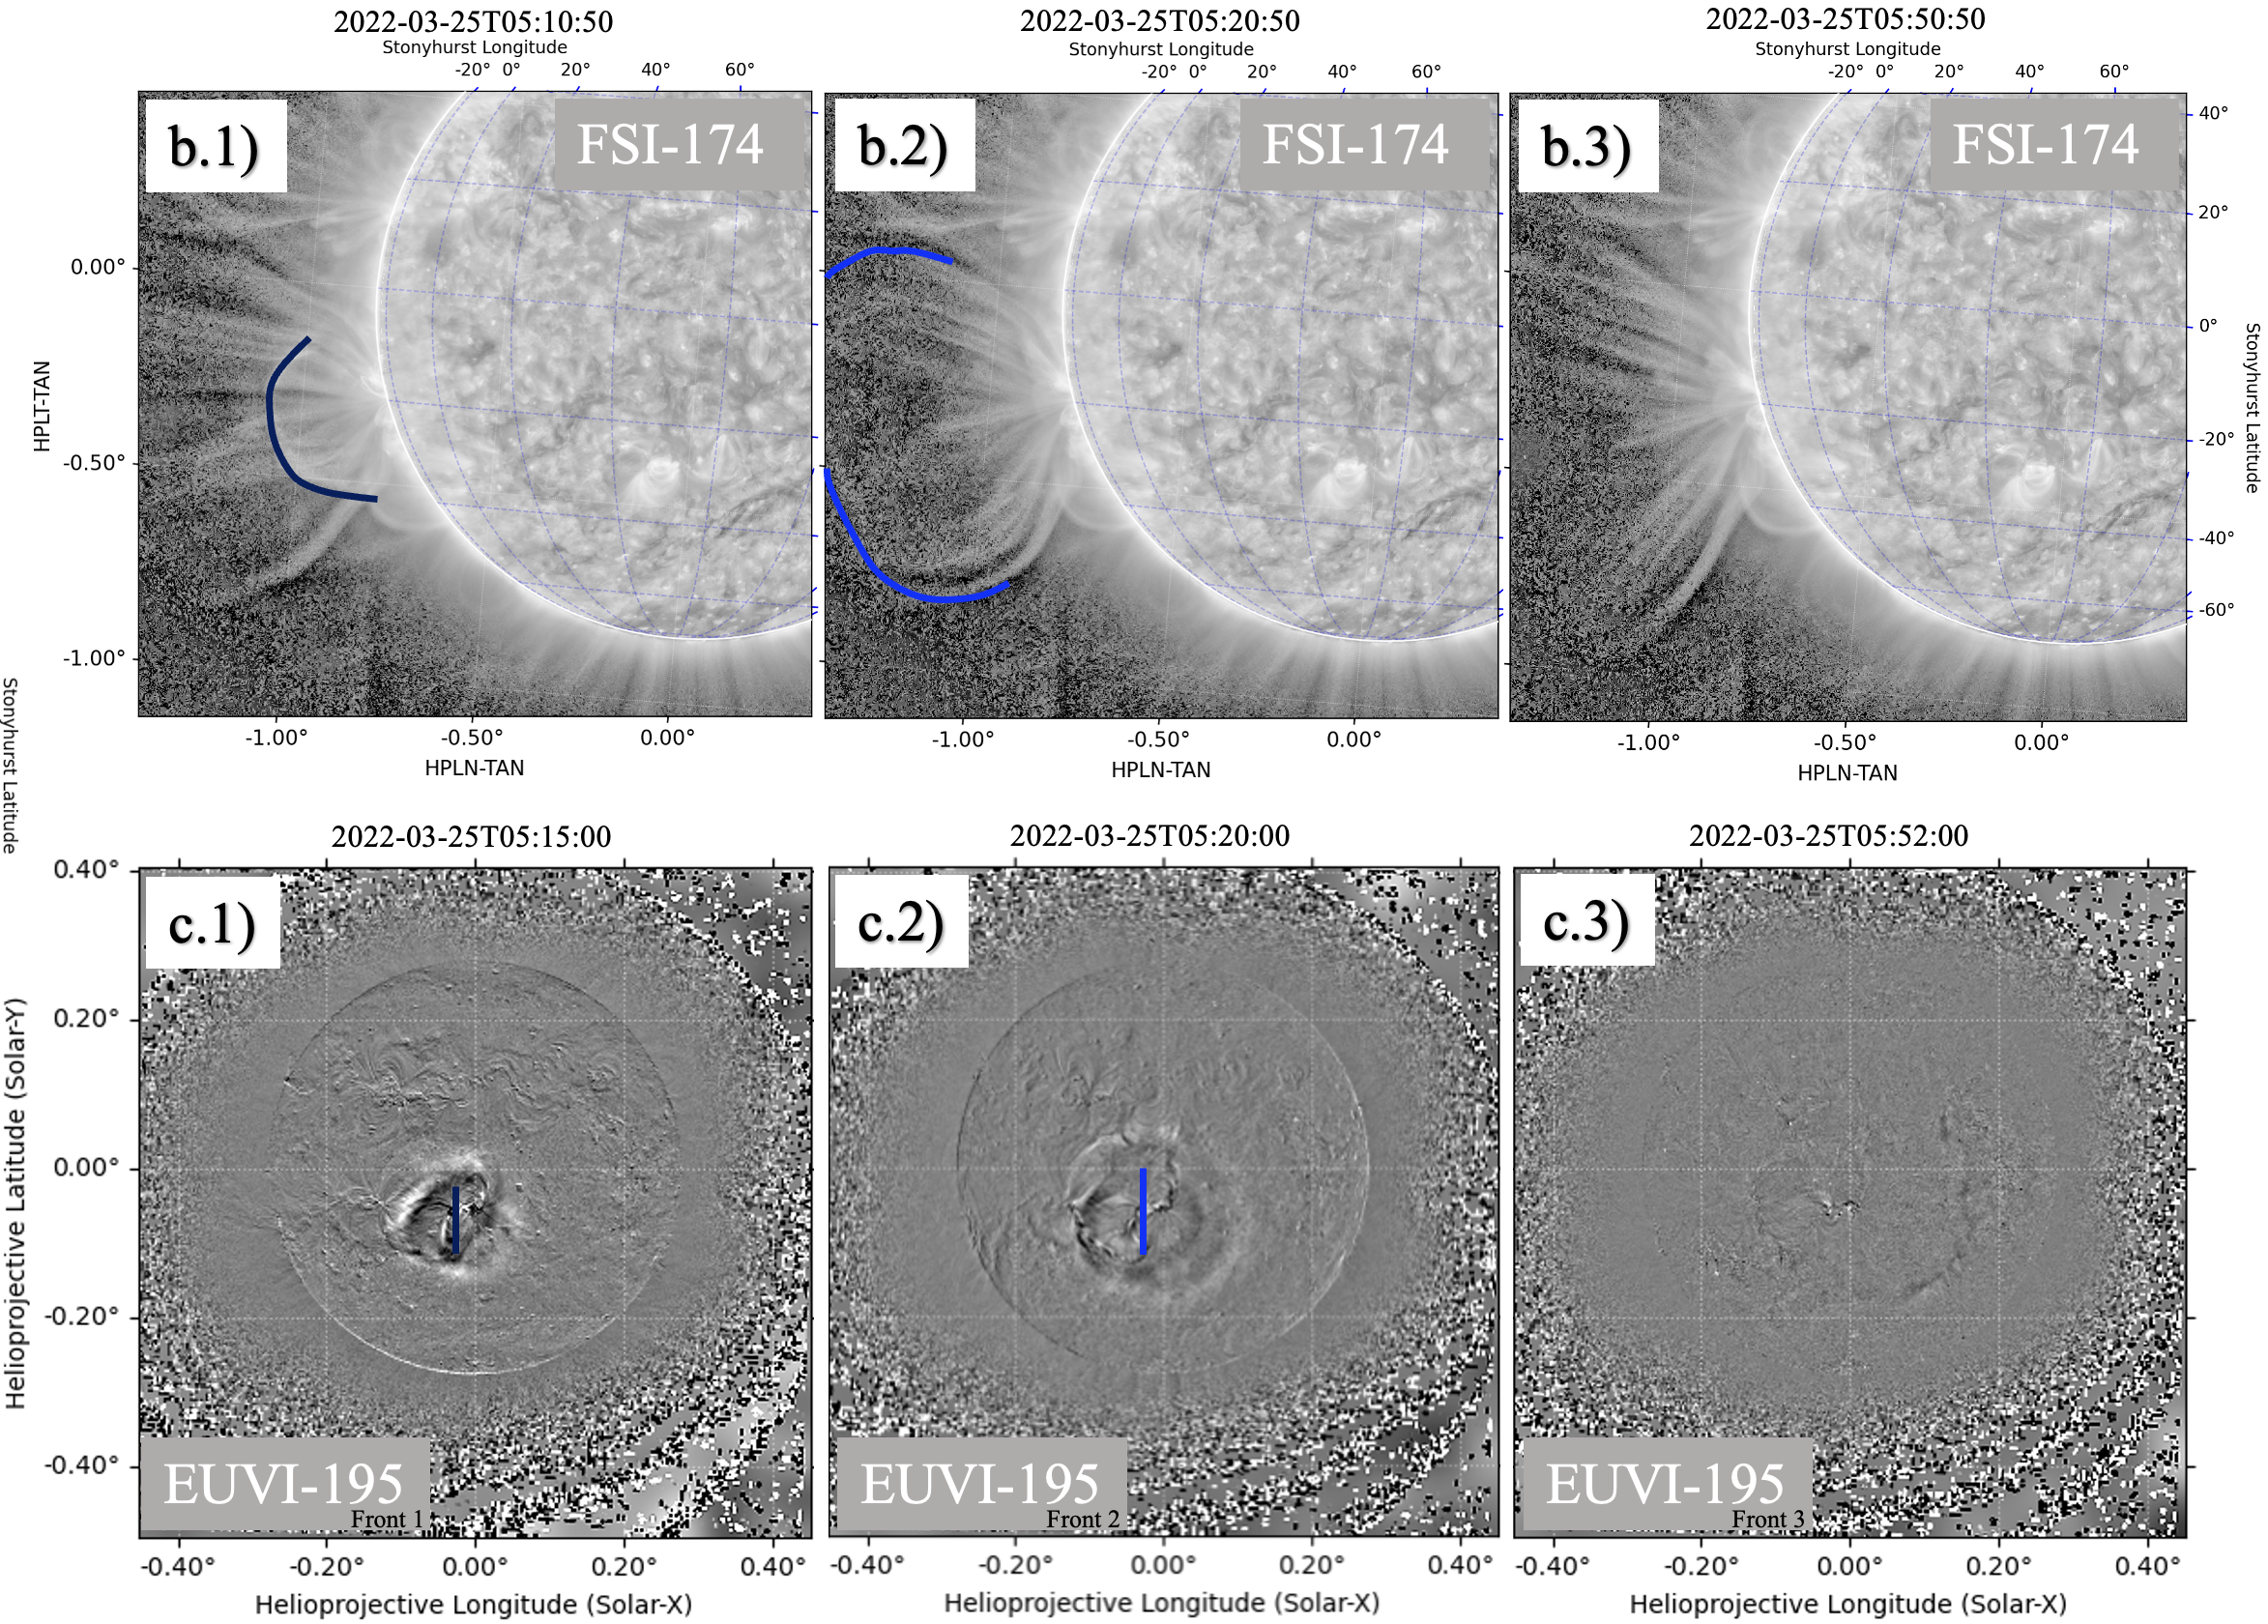
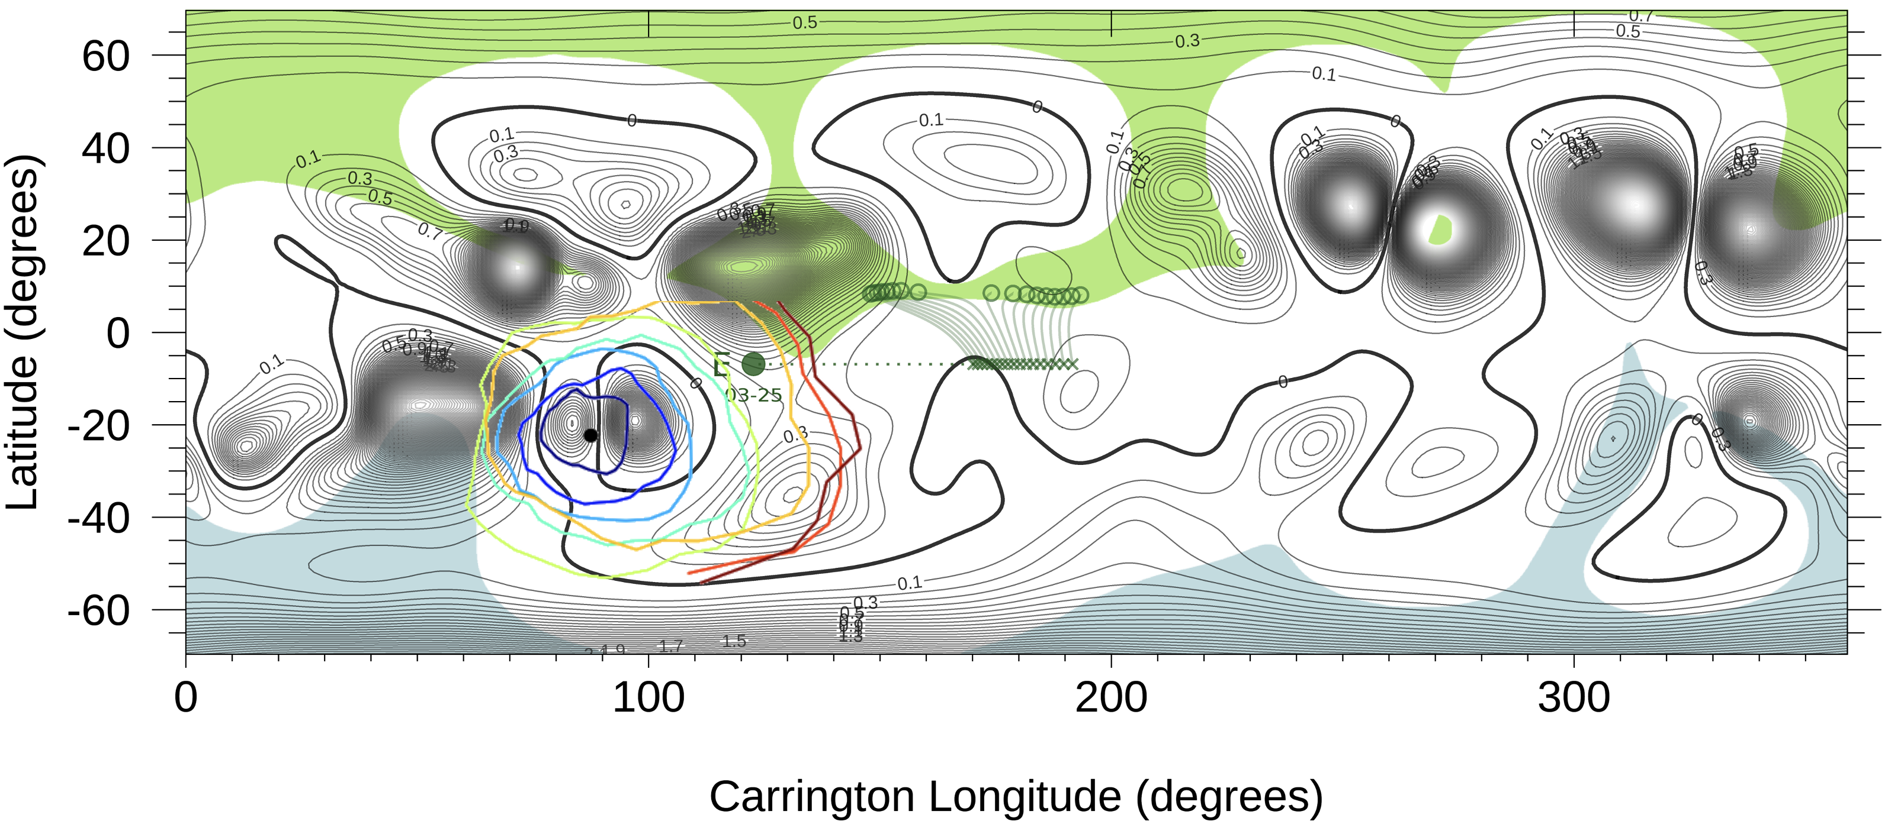
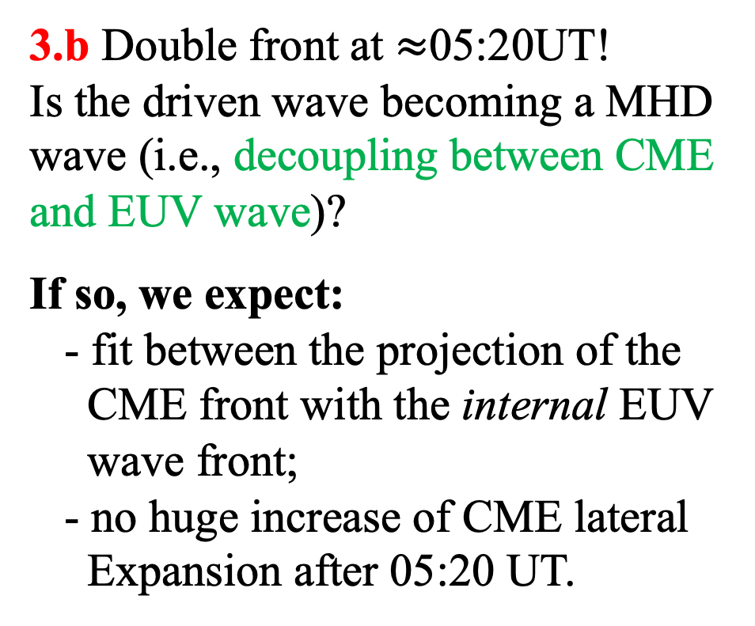
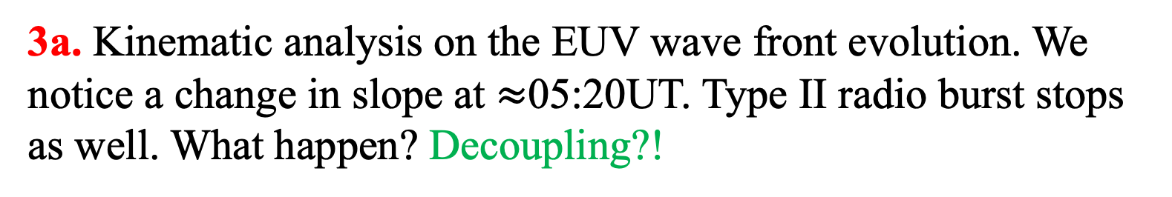
National Aeronautics and Space Administration
Postdoc Research
On the nature of the EUV waves: A Multi-Spacecraft Analysis of a
CME-EUV Waves Propagation and Interrelation
Author: Alessandro Liberatore, JPL Postdoctoral Fellow (JPL-3263)
Co-Authors: Paulett C. Liewer (JPL-3263), Angelos Vourlidas (APL), Carlos R. Braga (APL),
Marco Velli (UCLA), Olga Panasenco (AdvHelio), Daniele Telloni (INAF), Salvatore Mancuso (INAF)
Background
Coronal Mass Ejections (CMEs) are large eruptions of magnetized plasma from the outer layer of the solar atmosphere. The solar community looks with interest at this large eruptions because they drive the space weather activity.
Extreme Ultraviolet (EUV) waves are large-scale wave-like coronal disturbances first reported in 1999. Are observed propagating away from solar eruptive active regions and almost always associated with CMEs.
The nature of EUV waves is still debated. Patsourakos & Vourlidas, 2012 reviews the main interpretations of the nature of EUV waves: pseudo-waves, magneto-hydrodynamic (MHD) waves, or hybrid (i.e., a combination of the previous ones). They suggested a new interpretation of this phenomenon (Patsourakos & Vourlidas, 2009): the wave starts as a driven wave at the flanks of the CME (due to a rapid lateral expansion of the associated CME) and then propagates as a fast-mode MHD wave (once the CME lateral expansion ceases).
Objectives
We investigated the nature of a well-defined EUV wave associated with a CME observed on 2022 March 25. This was possible via a multi-spacecraft analysis of the event and making use of the strategic position of Solar Orbiter (SolO, lunched in 2020) that was in near quadrature with the Solar Terrestrial Relations Observatory (STEREO-A).
Why do that? A thorough understanding of EUV waves has implications beyond the phenomenon itself. It can give more information on the origin and the early phases of the CMEs evolution, establish possible links with the Solar-Energetic-Particles events, and contribute to new research areas such (e.g., global coronal seismology). In addition, a more reliable characterization of coronal parameters (such as magnetic field strengths) can results from these studies.
Approach and Results
Early phase of the CME evolution
Higher distances
3a. Kinematic analysis on the EUV wave front evolution. We notice a change in slope at $≈$05:20UT. Type II radio burst stops as well. What happen? Decoupling?!
1. Multi-instrument observations of the CME (SolO /FSI-174+Metis+SoloHI)
2. Image processing → EUV wave (STEREO-A/EUVI-195) associated to the CME
3.b Double front at $≈$05:20UT!
Is the driven wave becoming a MHD
wave (i.e., decoupling between CME
and EUV wave)?
If so, we expect:
- fit between the projection of the
CME front with the internal EUV
wave front;
- no huge increase of CME lateral
Expansion after 05:20 UT.
Contour of solar magnetic field strength
4. Patsourakos & Vourlidas
interpretation: after the
decoupling, the wave is free to propagate as a fast-mode MHD wave → avoid regions with strong magnetic field (Alfvén velocity).
Conclusion: We performed a multi-spacecraft and multi-instrument study of a well-defined EUV wave and the associated CME. We looked at remote-sensing data, radio data, models, and performed a kinematic study of the event. We also observed, for the first time, the decoupling moment between the EUV wave and the CME exactly when we expect to see it. We consider all these results a very strong robust proof in support of the Patsourakos & Vourlidas interpretation on the nature of the EUV wave. More details can be found at Liberatore et al., 2023 [1].
National Aeronautics and Space Administration
Jet Propulsion Laboratory
California Institute of Technology
Pasadena, California
www.nasa.gov
Publications:
[1] Liberatore et al., 2023; Multi-Spacecraft Observations of the 2022 March 25 CME and EUV Wave:
An Analysis of their Propagation and Interrelation (in press).
[2] Liberatore et al., 2023; Multi-Spacecraft Analysis of a Coronal Mass Ejection Deformation (in prep).
Useful references:
- Patsourakos, S., & Vourlidas, A. 2012, SoPh, 281, 187, 277 doi: 10.1007/s11207-012-9988-6.
Author Contact Information: alessandro.liberatore@jpl.nasa.gov | +1 (626) 318-3969
Clearance Number: CL#00-0000
Poster Number: PRD-A-009
Copyright 2023. All rights reserved.

