Slide 1

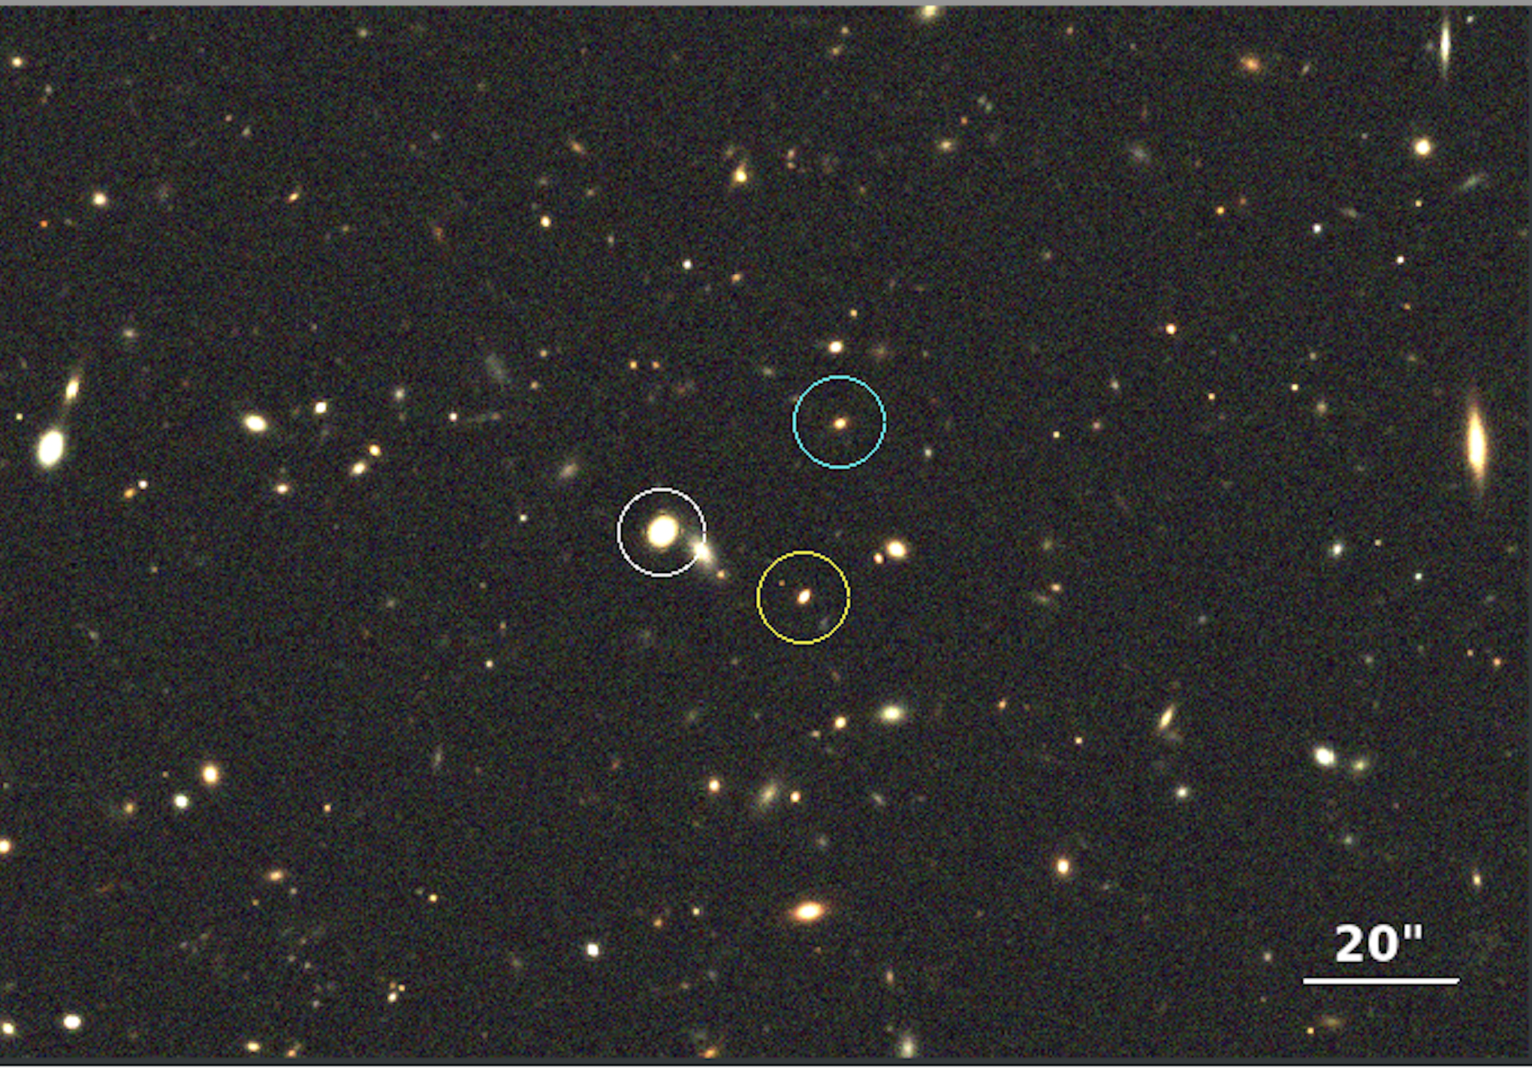
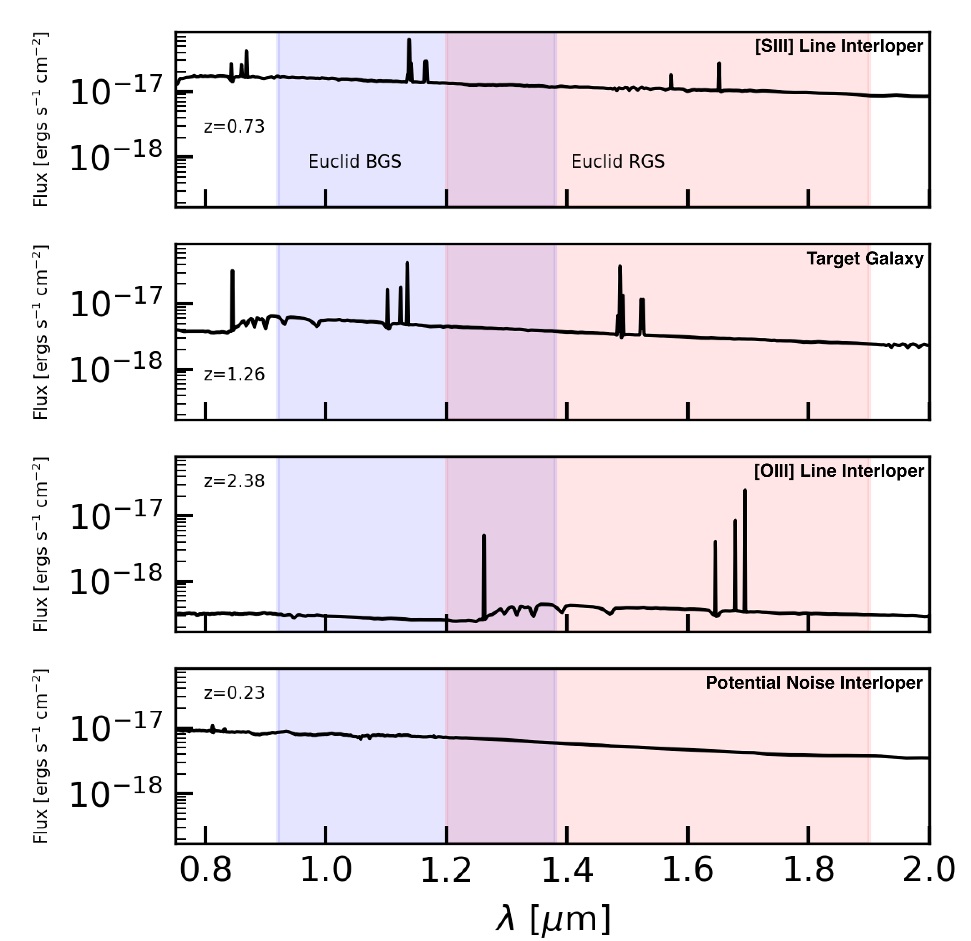
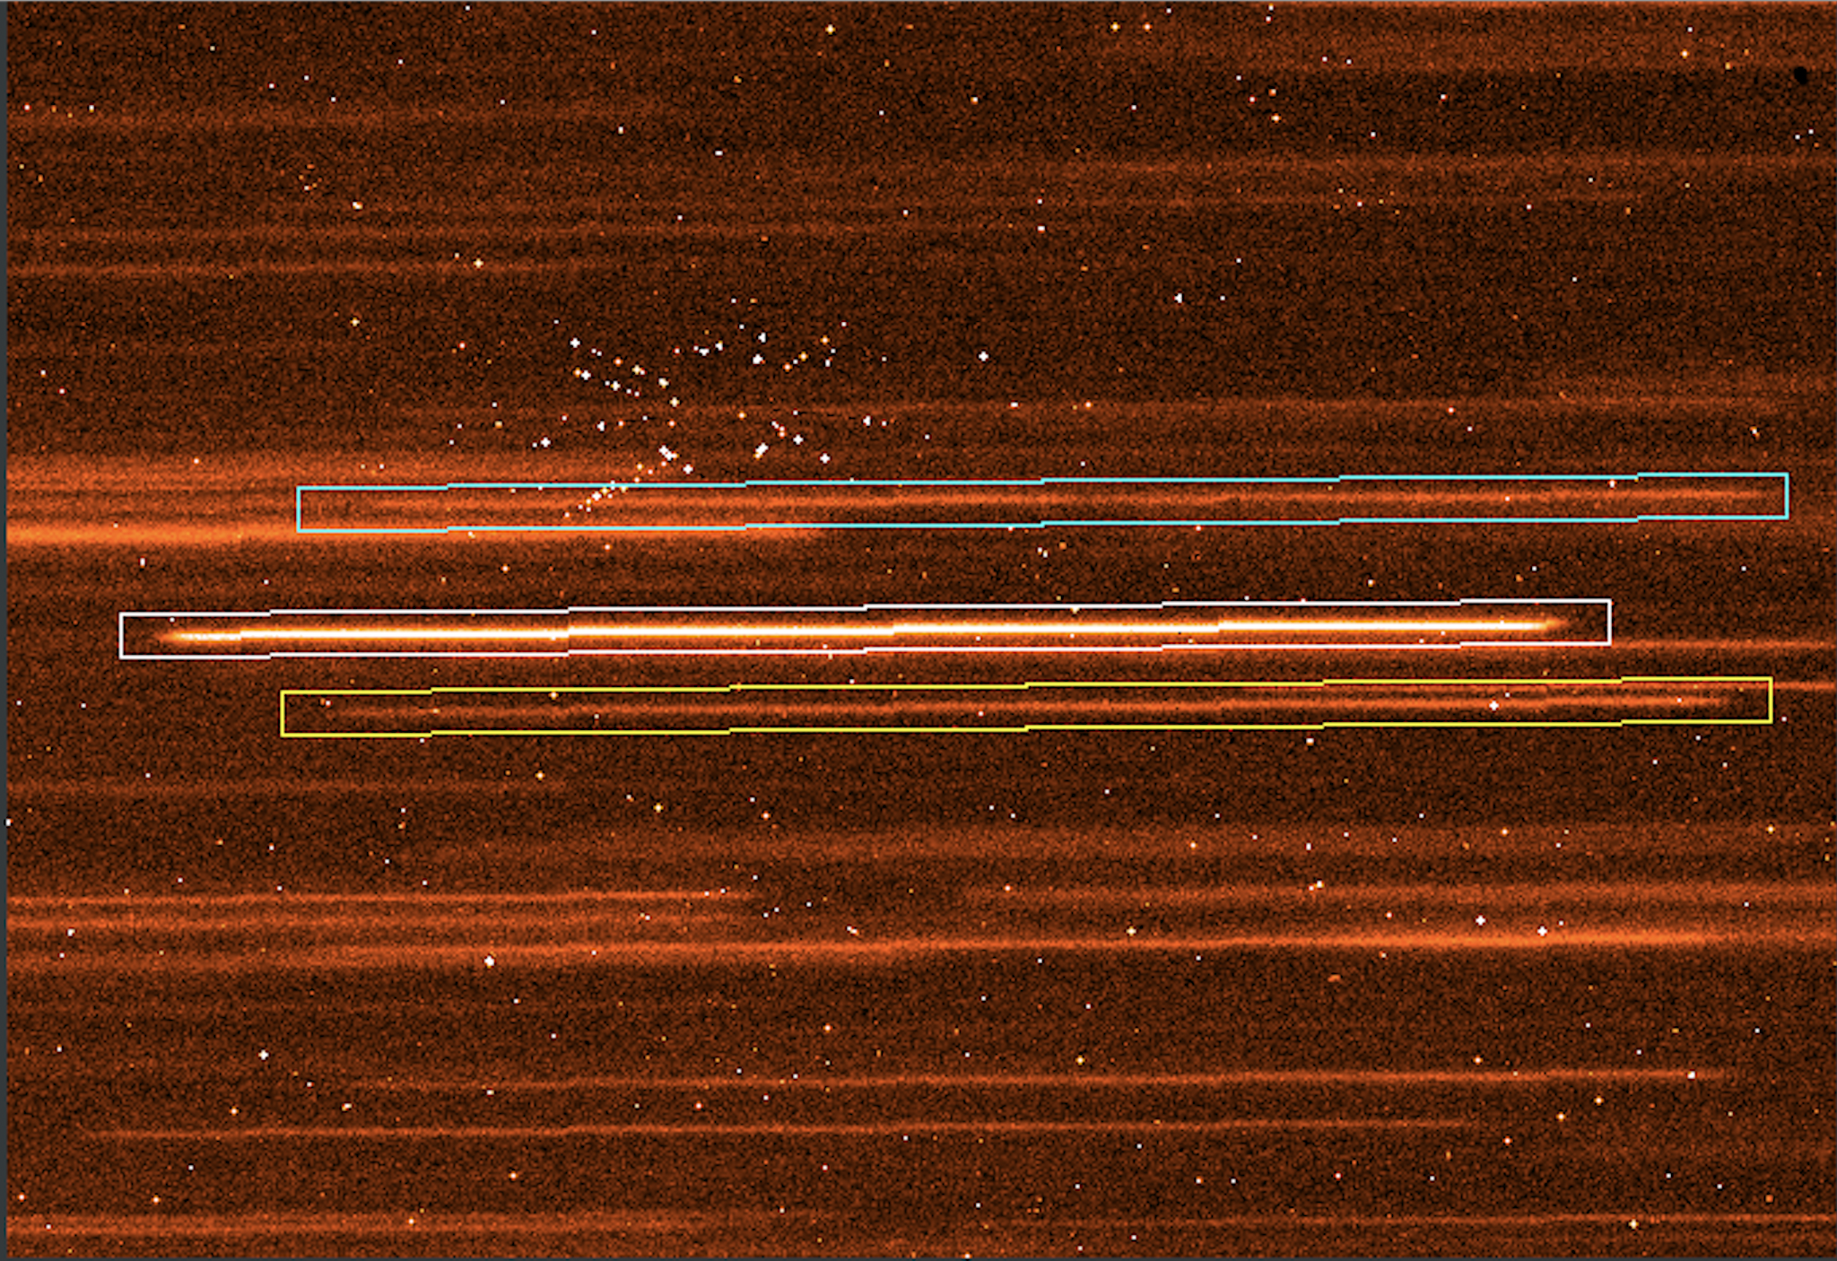
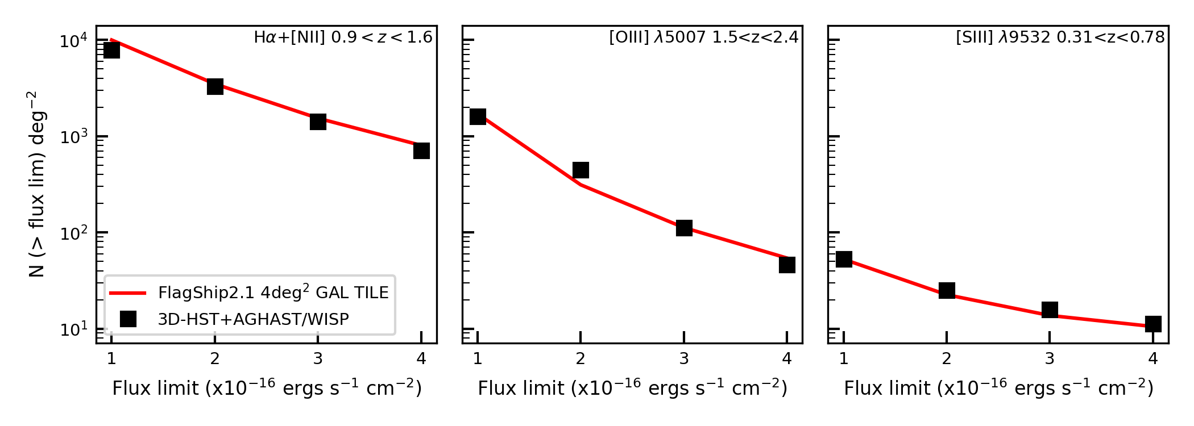
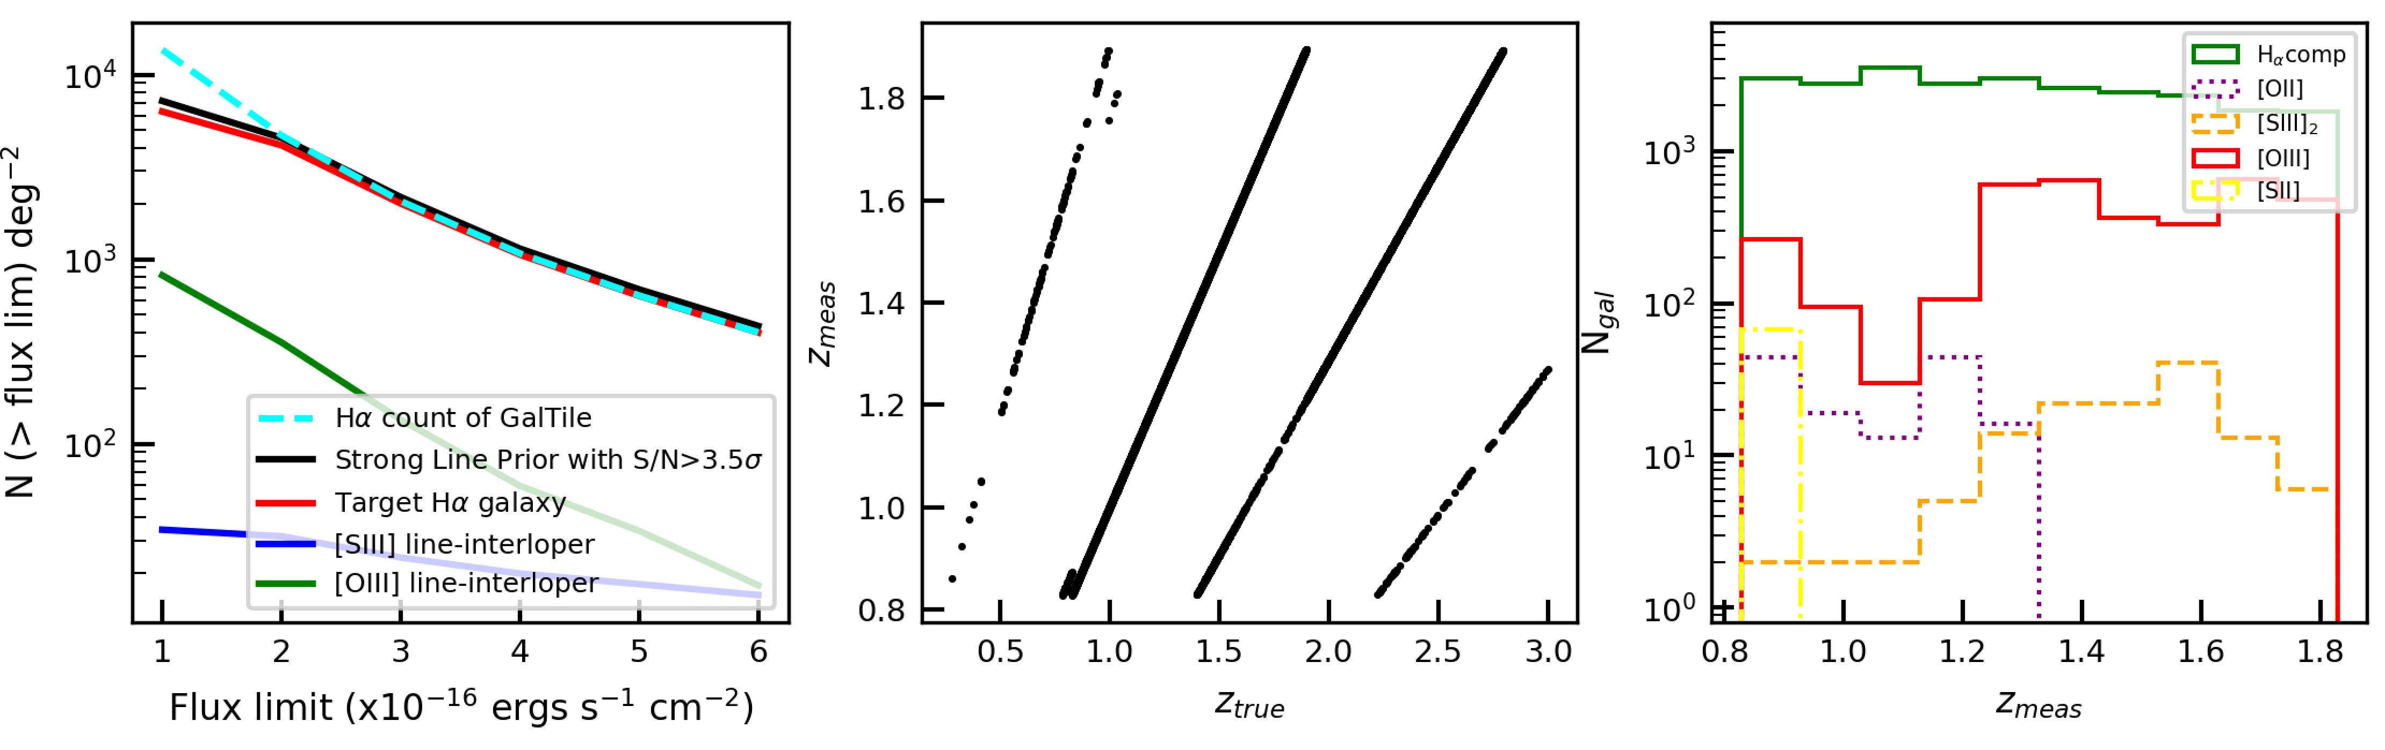
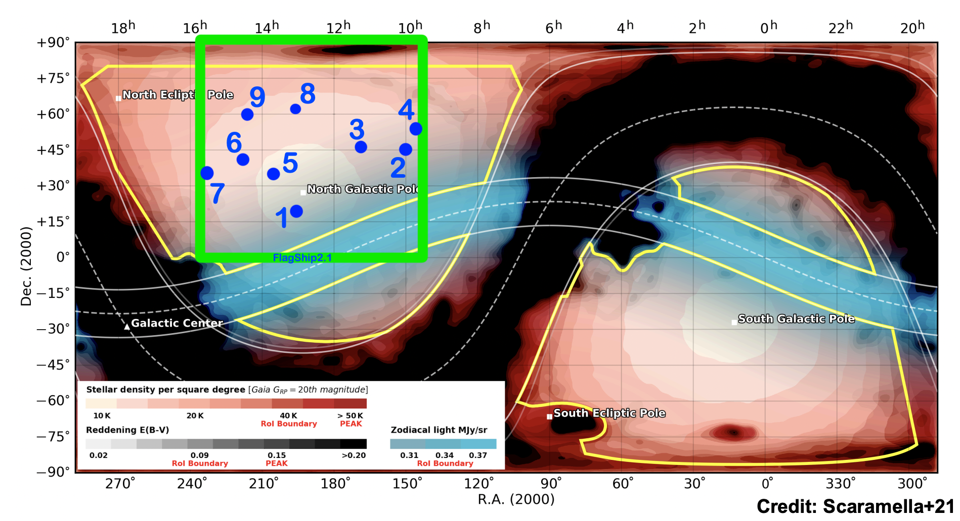
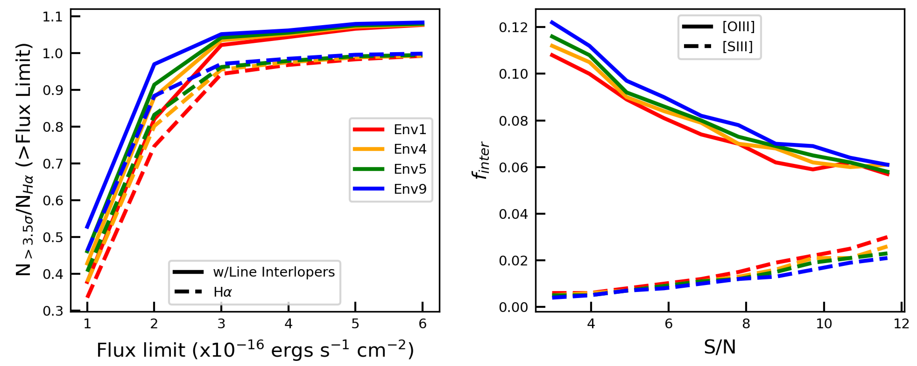
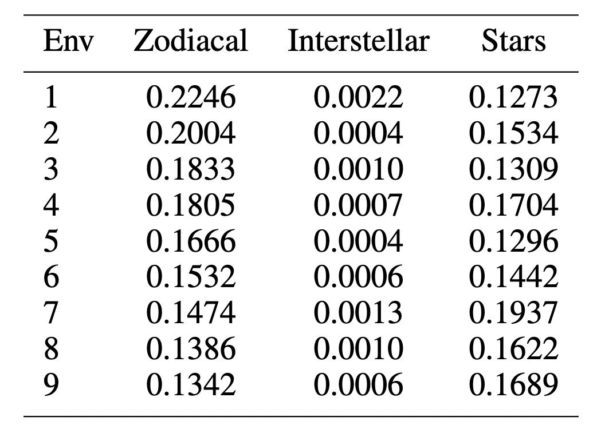
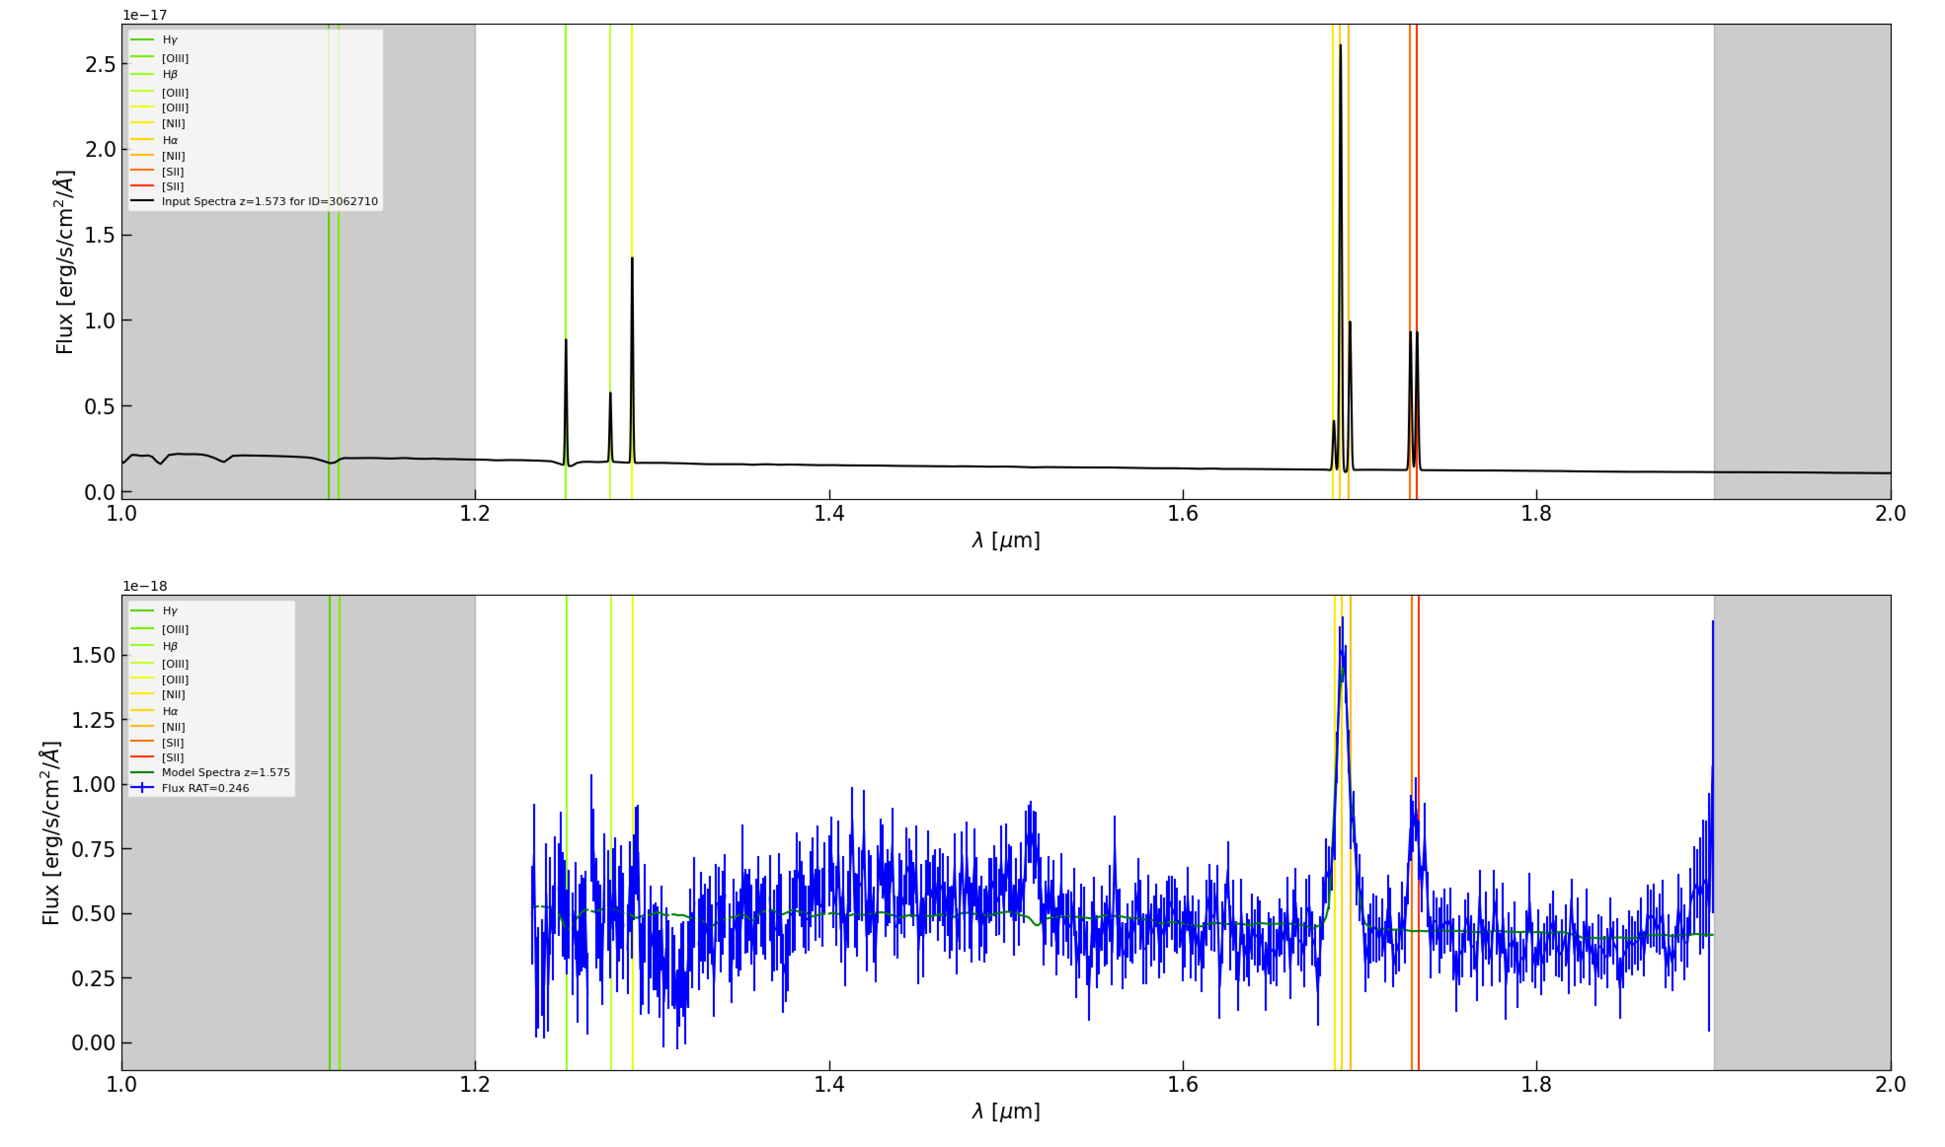
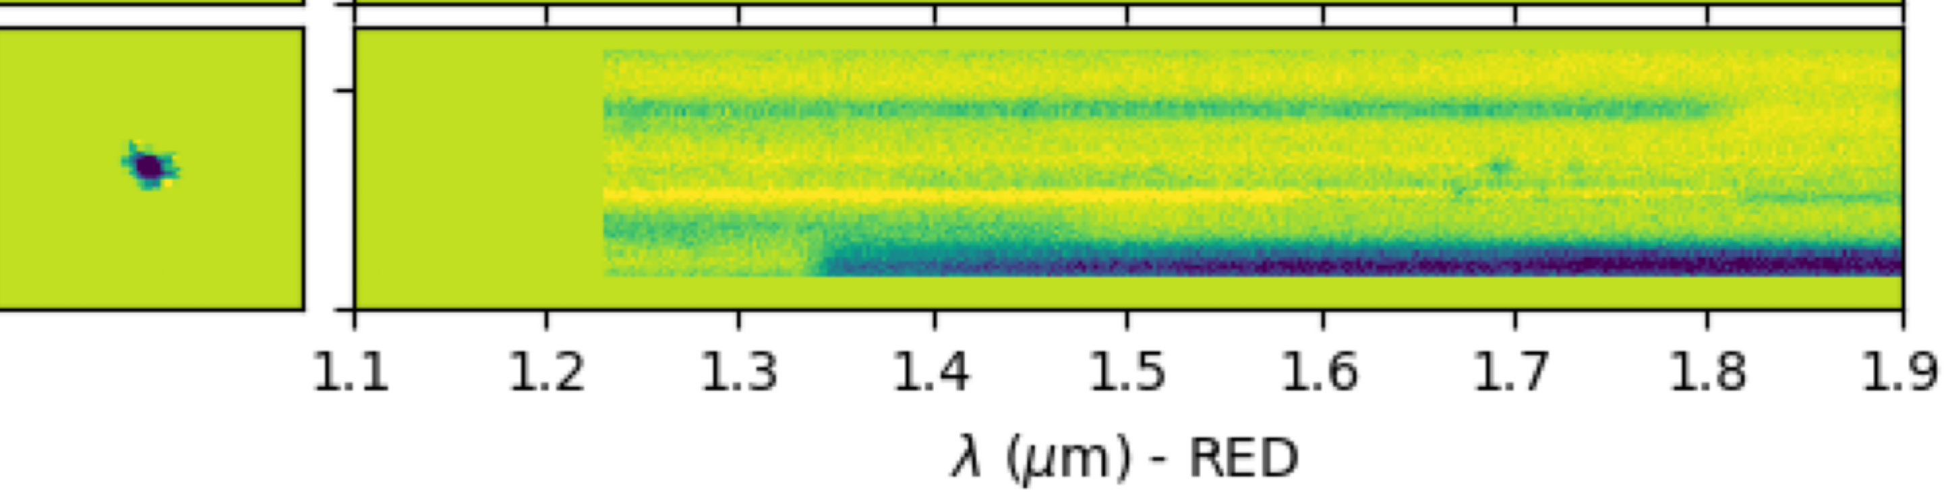
National Aeronautics and Space Administration
Postdoc Research
Characterizing Observational Systematics for the Euclid Wide Spectroscopic Survey
Author: Kevin S. McCarthy, NASA Postdoctoral Fellow, Sec. 3266
Collaborators: Yun Wang and Greg Walth, Caltech/IPAC
Background
Euclid is a space-based survey from the European Space Agency (ESA), a Medium Class mission of the ESA Cosmic Vision 2015-2025 program, designed to understand the origin of the Universe's accelerating expansion. Euclid will measure the time and space potentials to test theories of gravity by carrying out a wide area imaging and spectroscopy survey (EWS) in visible and near infrared bands, covering approx. 15,000 deg² of the extragalactic sky in six years. The Near Infrared Spectrometer and Photometer (NISP) instrument contains an array of 4x4 H-2RGs detectors (2k x 2k pixels each) tested and delivered by JPL. The Euclid NASA Science Center at IPAC (ENSCI), at Caltech, will support U.S.-based investigations using Euclid Data.
NISP Y,J,H
Direct (Simulated)
[SIII]
Hα
[OIII]
NISP Red Grism
Slitless (Simulated)
Objectives
The NISP red grism (RGS) is used in the EWS to perform slitless spectroscopy on the ~0.54 deg² field-of-view and obtain spectra between 1.2 < λ < 1.9 μm where tracers of the matter field, emission line galaxies (ELGs), between redshifts 0.9 < z < 1.8 are expected to have bright Hα emissions. Other bright lines ([OIII] & [SIII]) and noise can contaminate the clustering signal and bias cosmological constraints even when the interloper fraction is small, < 1 % (Pullen+16). We simulate the behavior of NISP in EWS observations across various environments to ensure appropriate modeling of observational systematics to meet mission objectives.
Figure 1: Upper) Simulated NISP Y,J,H direct image and red grism slitless image with examples of input galaxy spectra in the Euclid rest frame; Middle) Line counts for Euclid target Hα+[NII] ELGs and two line-interlopers, [OIII] and [SIII]; Lower) Effect of line-interlopers on Hα-count, the measured redshift verse true redshift, and the histogram of lines per measured redshift bin.
Figure 2: Background map with numbered Env. observations listed in table with noise contributions in units of MJy/sr (left), fraction of objects extracted from GalTile with S/N > 3.5σ relative to total Hα count in GalTile above a flux limit (center), and the fraction of line interlopers for objects extracted from GalTile with S/N above value on x-axis (right).
Approach and Results
Using a 4 deg² sky patch of Euclid FlagShip2.1 galaxies with properties important for grism simulations, such as emission line fluxes, and S/N values for each galaxy computed from exposure time calculators considering zodiacal and straylight maps, we give a redshift to the strongest line in the Euclid RGS assuming it is Hα and find that the fraction of [OIII] interlopers can vary as much as 15%, from f_{int} = .105 to .121, due to systematic noise in the sky.
Future Work
Use the OU-SIM's pixel-level NISP simulation pipeline to produce NISP images and extract the 1D spectra to fit with redshift. This realistic approach will enable modeling of noise interlopers and spectral overlap. These results will be compiled into a key preparation paper for submission to the Euclid consortium board and A&A later this year.
Hα+[ΝΙΙ]
Input Flux
Hβ
[OIII]
[SII]
Extracted Flux
Significance of Results/Benefits to NASA/JPL
These findings suggest that, to achieve the science goal of producing percent-level constraints on DE equation-of-state parameter, we must account for systematic noise in the sky either in our clustering models or through a strategic removal of displaced objects. Our work is part of NASA/JPL's continued effort to advance the field of astrophysics from space.
Wavelength
Figure 3: Effect on 1D spectra from NISP RGS simulation and extraction from contaminated beam.
National Aeronautics and Space Administration
Jet Propulsion Laboratory
California Institute of Technology
Pasadena, California
www.nasa.gov
Publications and Acknowledgements:
Euclid Preparation TBD: Line-of-sight systematic effects 1
Author Contact Information:
(626) 379-5419 kevin.s.mccarthy@jpl.nasa.gov
Clearance Number: CL#00-0000
Poster Number: PRD-A-007
Copyright 2023. All rights reserved.

