Slide 1

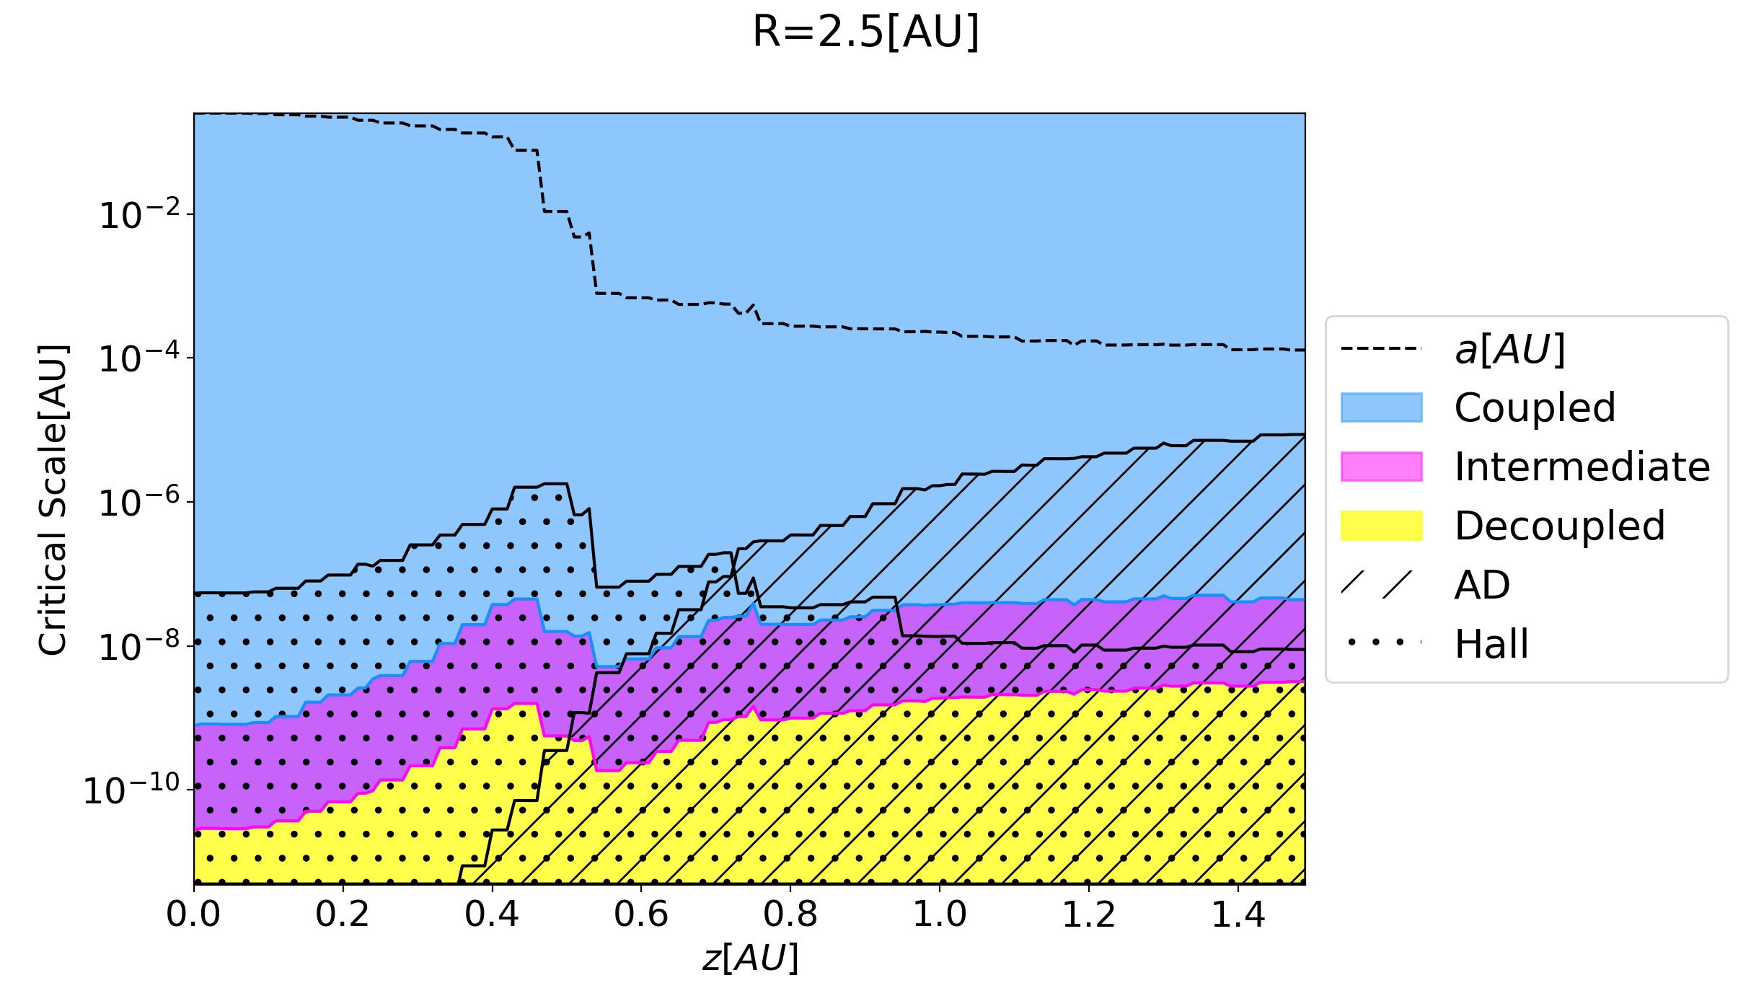
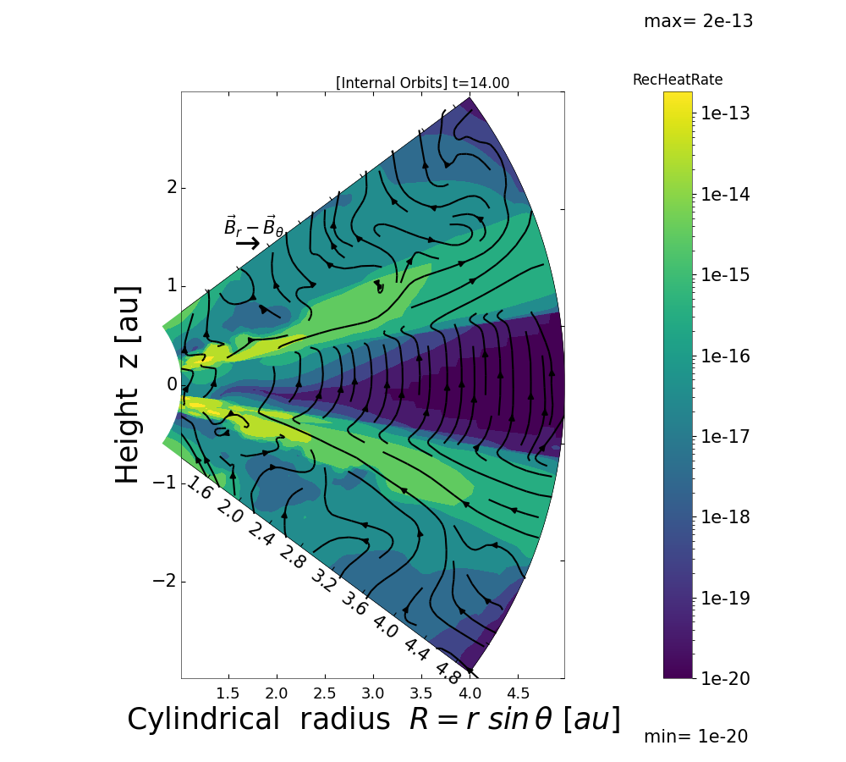
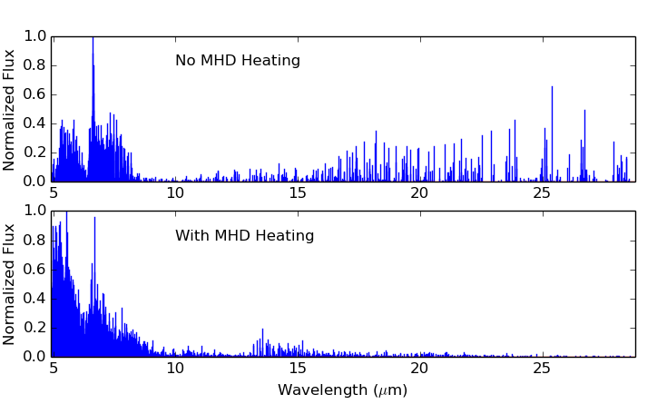



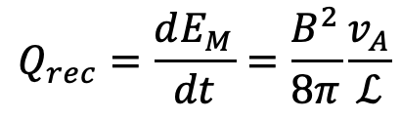

National Aeronautics and Space Administration
Postdoc Research
Protoplanetary disk atmospheres’ fast magnetic energy dissipation and its role in chemistry and line emission
Author: Fulvia Pucci, NASA Postdoctoral Fellow (326)
N. Turner (advisor 326), U. Gorti (Seti Institute), R. Nakatani (Visiting Postdoctoral Scholar)
Background
Protoplanetary disk atmospheres are now the subject of amazing new spectroscopic observations by the JWST. These objects have a very complicated dynamics and thermochemistry which requires appropriate and comprehensive modeling to understand and predict spectral lines. Recently, magnetic fields’ role has been recognized to be a fundamental element for disks’ evolution: for local heating (Hubbard et al 2012) with its effects on the chemistry, for driving accretion (Sano and Inutsuka 2001), for star-disk interaction and jets (Lee et al 2021) and finally as a contributor to forming the rings and gaps observed in ALMA images of the disks (Hu et al 2018, Suriano et al 2018). All these processes affect both the disk’s short- and long-term evolution and the atomic and molecular emission observed by the JWST.
Objectives
Combine MHD modeling of the flows in the disks and their winds with thermal and photochemical modeling of the heating, cooling, and reactions among the constituent species. Use a realistic disk configuration to estimate the role of magnetic field in disk heating and evolution. In particular, in the work presented here we want to provide heating estimates of magnetic reconnection converting magnetic energy into thermal energy in the disk atmosphere. The goal is to estimate if the contribution of this local heating can change emission lines in the mid- and near-infrared spectra, for example observed by the JWST.
Approach and Results
$$Q_{rec}=\frac{dE_{M}}{dt}=\frac{B^{2}}{8π}\frac{v_{A}}{ℒ}$$
Left: preliminary MHD simulation of a disk atmosphere in Athena ++ initially threaded by a vertical uniform magnetic field (black lines). Color coded the heating rate due to magnetic energy conversion into heating, thanks to the reconnection process. Below: synthetic spectral of water with and without magnetic reconnection heating. The spectra are obtained by radiative transfer with an nLTE method using the LAMBDA line database. Reconnection heating drastically changes the emission, shifting the lines towards shorter wavelengths.
$$Q_{rec}$$
$$M_{⊙}$$
No magnetic dissipation
$$H_{2}O$$
Reconnection Heating
$$H_{2}O$$
Above: different regimes of magnetic energy conversion into heat by reconnection in a model disk. Blue means magnetic energy is converted into heat at an Alfvènic rate established by neutrals and charged particles. Reconnection proceeds towards thinner current sheets, moving down towards the yellow region where magnetic dissipation grows faster as neutrals and ions decouple. Dissipation drives new ionization and other chemical reactions and excitations, affecting the disk’s composition and the emitted spectrum.
Synthetic spectra
Significance of Results/Benefits to NASA/JPL
JWST offers powerful new spectroscopic capabilities at wavelengths 1-28 μm covering many transitions of the main molecules, atoms, and ions in protoplanetary disks and their winds. Turning the observed spectra into knowledge of planetary systems' origins requires modeling that treats the main factors determining the lines' strengths: the magnetically-driven flows governing the distribution of gas in the disk atmosphere and wind, the photochemical heating and cooling that set temperatures, the reactions that alter the emitting species' abundances, and the excitation controlling how strongly each species emits. Our MHD modeling of disk winds combined with thermal and photochemical modeling of the disk allow to diagnose the lines and line ratios to reveal disk processes.
Future Work
Our work now focuses on 2D and 3D MHD simulations for an accurate prediction of the magnetically-driven winds' dynamics. This will enable refining the model above while informing study of the disks’ long-term evolution and eventual disk dispersal by photoevaporation, the object of the study of team member Dr. Nakatani.
National Aeronautics and Space Administration
Jet Propulsion Laboratory
California Institute of Technology
Pasadena, California
www.nasa.gov
Publications and Acknowledgements:
Pucci et al ApJL,903,1
Pucci et al ApJ, 907, 1
Pucci et al 2023 submitted.
Pucci et al 2024 in prep.
Author Contact Information:
fulvia.e.pucci@jpl.nasa.gov
(626)-747-3594
Clearance Number: CL#00-0000
Poster Number: PRD-A-005
Copyright 2023. All rights reserved.

