Slide 1

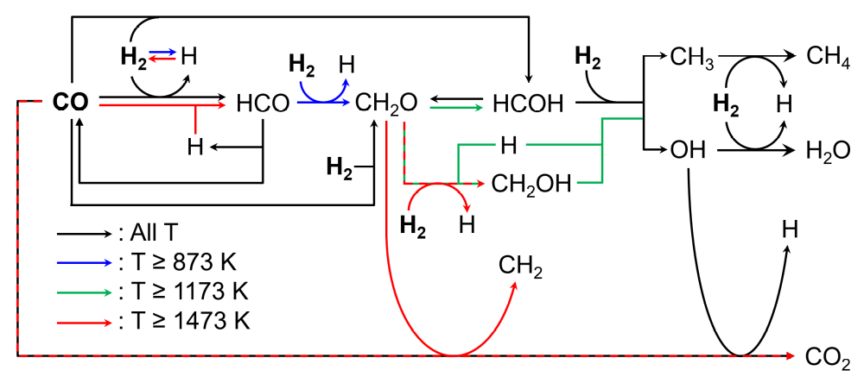
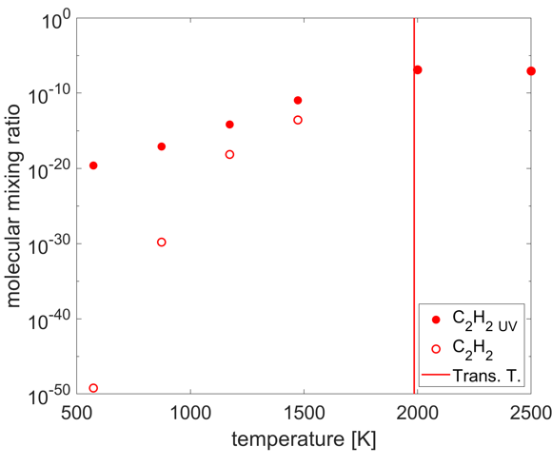
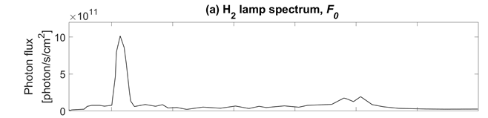
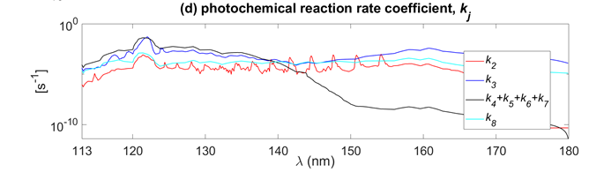
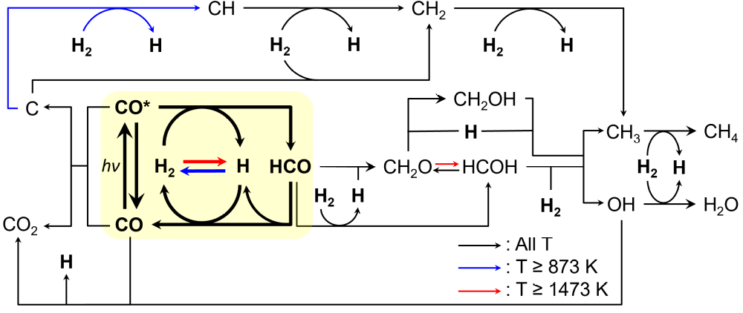
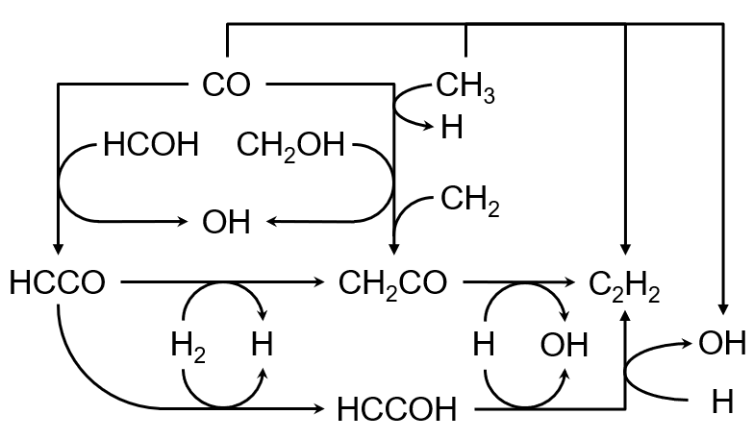
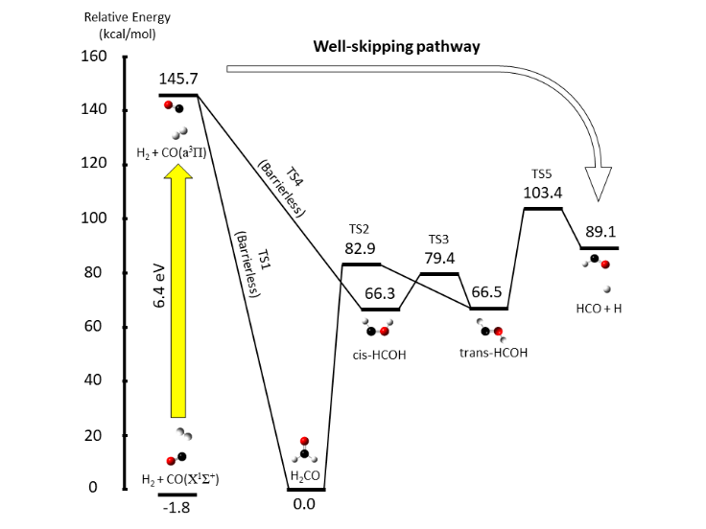
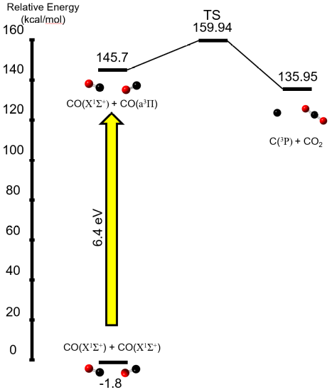
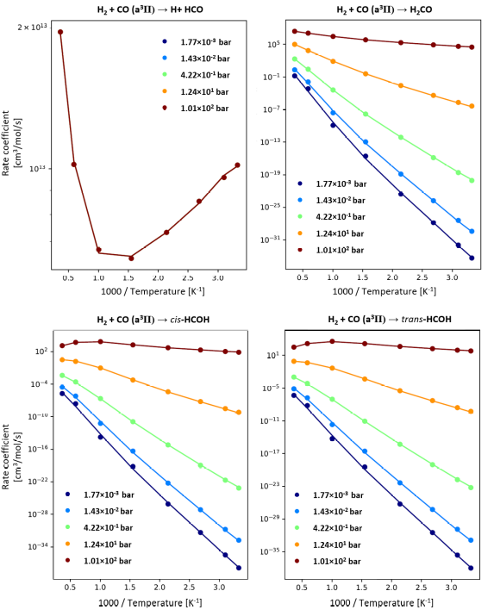
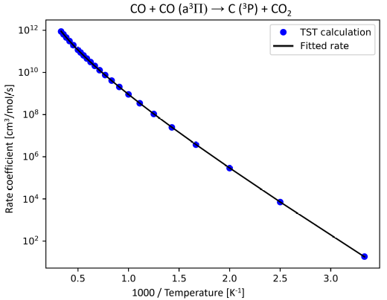
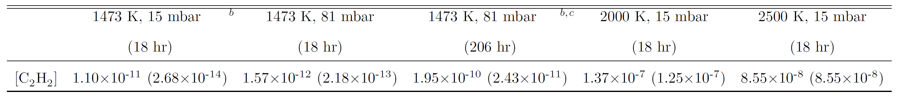
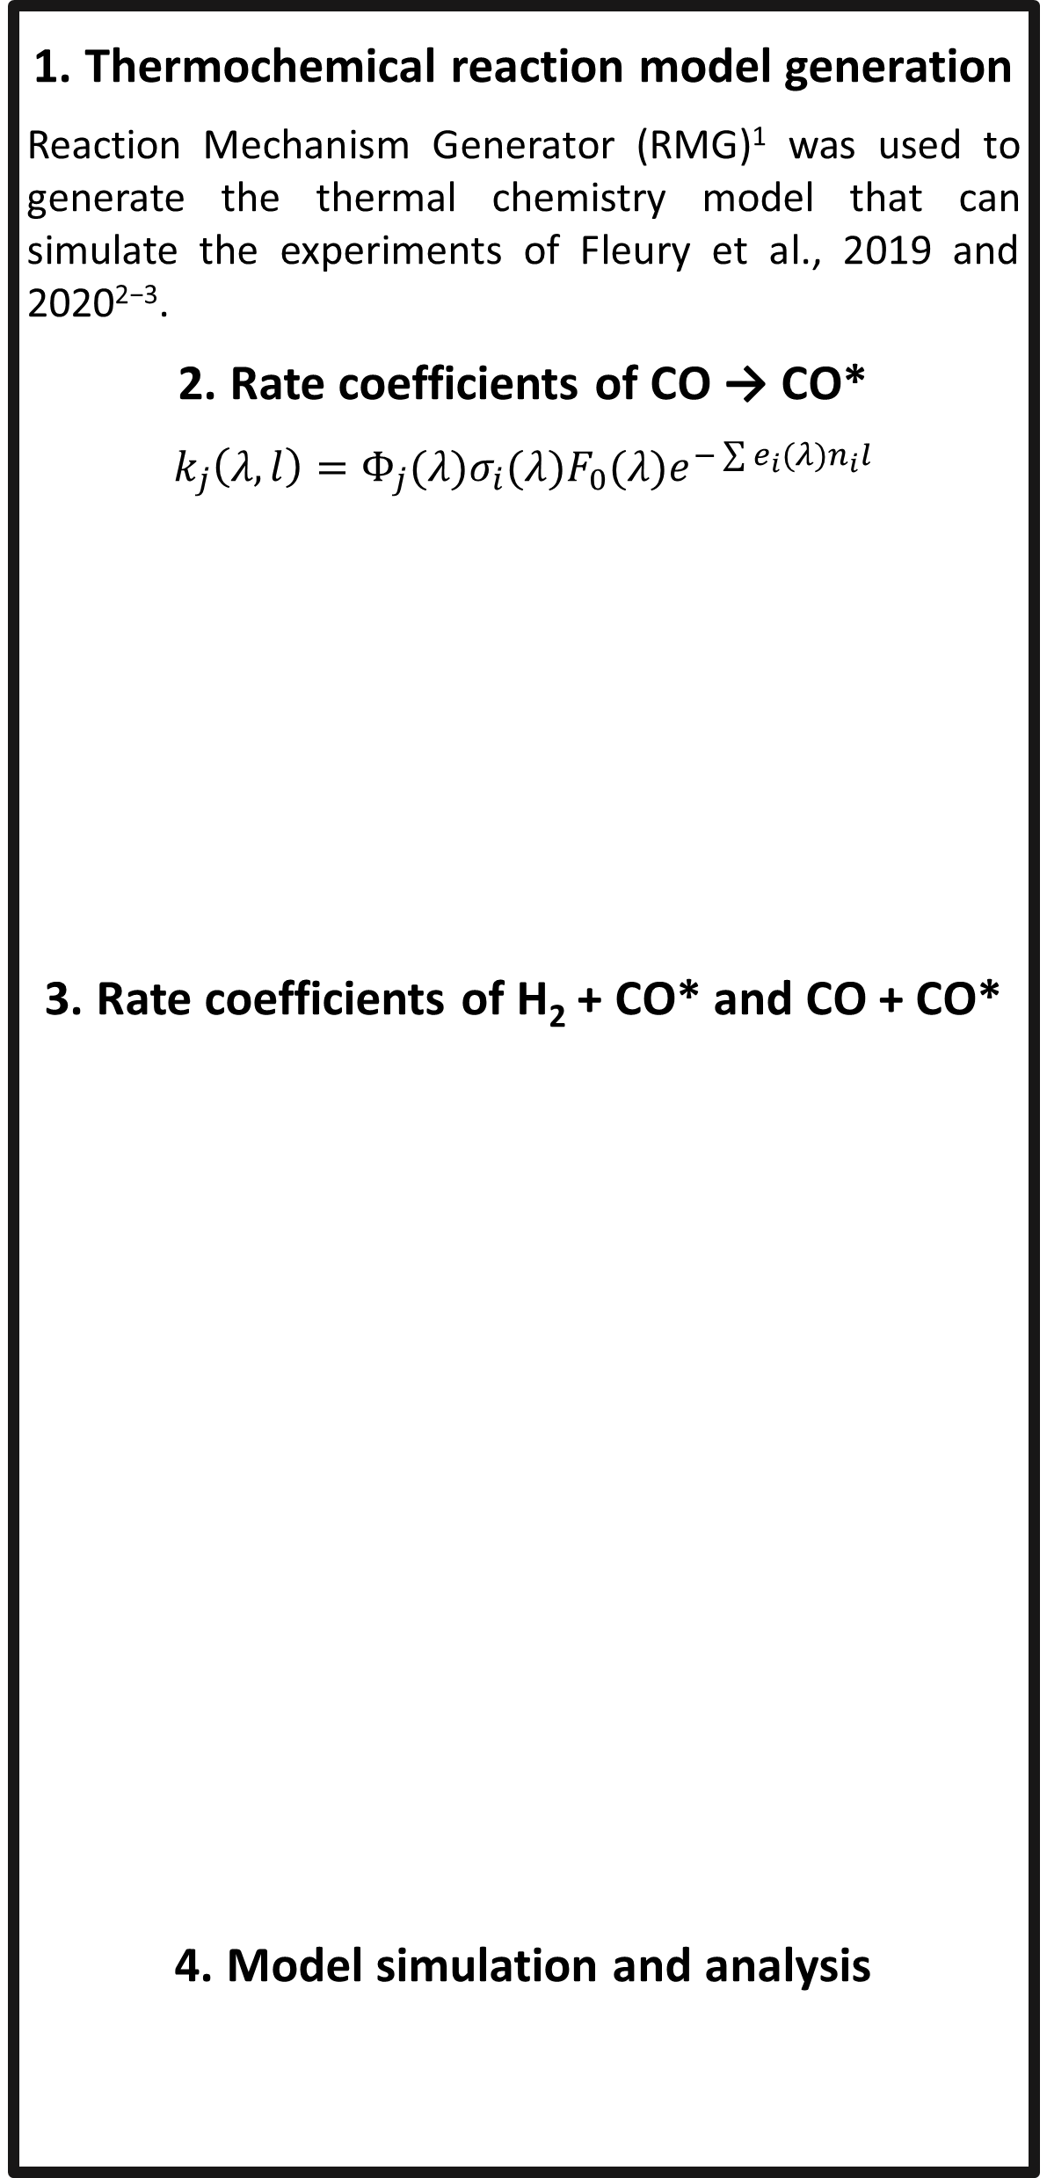
National Aeronautics and Space Administration
High-fidelity reaction kinetic modeling of hot-Jupiter atmospheres incorporating thermal and UV-photochemistry enhanced by metastable CO ⁽a³𝚷)
Author: Jeehyun Yang, JPL Postdoctoral Fellow (322)
Murthy S. Gudipati (322), Bryana Henderson (322), Benjamin Fleury
MOTIVATION
RESULTS AND DISCUSSIONS
A detailed modeling of simultaneous UV-photochemical and thermochemical processes in exoplanet atmosphere-like conditions is essential for the analysis and interpretation of a vast amount of current and fugure spectral data from exoplanets
1. Model predicted-temperature-dependent molecular mixing ratio profiles
2. Model predicted-major reaction pathways based on the rate-of-production analysis
3. Model C₂H₂ mixing ratio comparison among various conditions
15 mbar
H₂: 0.9926, H₂O: 0.0048, CO: 0.0026
METHODS
1. Thermochemical reaction model generation
Reaction Mechanism Generator (RMG)¹ was used to generate the thermal chemistry model that can simulate the experiments of Fleury et al., 2019 and 2020²⁻³.
2. Rate coefficients of CO → CO*
$$k_{j}\left(λ,l\right)=Φ_{j}(λ)σ_{i}(λ)F_{0}(λ)e^{−\sum{e_{i}(λ)n_{i}l}}$$
3. Rate coefficients of H₂ + CO* and CO + CO*
4. Model simulation and analysis
15 mbar
H₂: 0.997, CO: 0.003
15 mbar
H₂: 0.997, CO: 0.003
Thermal
only
15 mbar
H₂: 0.997, CO: 0.003
With UV
Extracting rate coefficients from the potential energy surfaces (quantum mechanical calculation)⁴⁻⁵
CONCLUSIONS
Lyman-α-aided electronically excited carbon monoxide molecules (a³Π) can significantly enhance thermal chemistry in the exoplanet atmosphere-like conditions through two difference reactions which are (i) H₂ + CO(a³Π) → H + HCO and (ii) CO(X¹Σ⁺) + CO(a³Π) → C(³P) + CO₂ at T ˂ 2000 K
At T ≥ 2000 K, thermal chemistry dominates the whole chemistry.
Thermal-only chemistry up to 2500 K cannot push the chemistry to larger species such as PAHs, which indicates that C₂H₂-photochemistry might be the key to explain the experimentally observed hydrocarbon aerosol formations
Reaction Mechanism Simulator (RMS)⁶ was used to solve ordinary differential equations and perform rate-of-production analysis.
REFERENCES
1. Gao et al., 2016, Comput. Phys. Commun., 203, 212
2. Fleury et al., 2019, ApJ, 871, 1
3. Fleury et al., 2020, ApJ, 899, 1
4. Frisch et al., 2009, Gaussian 09 Revision E.01
5. Allen et al., 2012, Phys. Chem. Chem. Phys., 14, 1131
6. Johnson eet al., 2019, Reaction Mechanism Simulator
National Aeronautics and Space Administration
Jet Propulsion Laboratory
California Institute of Technology
Pasadena, California
www.nasa.gov
Publications: Yang et al., 2022, submitted to ApJ
(if any)
Author Contact Information: Jeehyun.yang@jpl.nasa.gov
(Phone and Email address)
Poster Number: PRD-A#006
Copyright 2022. All rights reserved.

