Slide 1

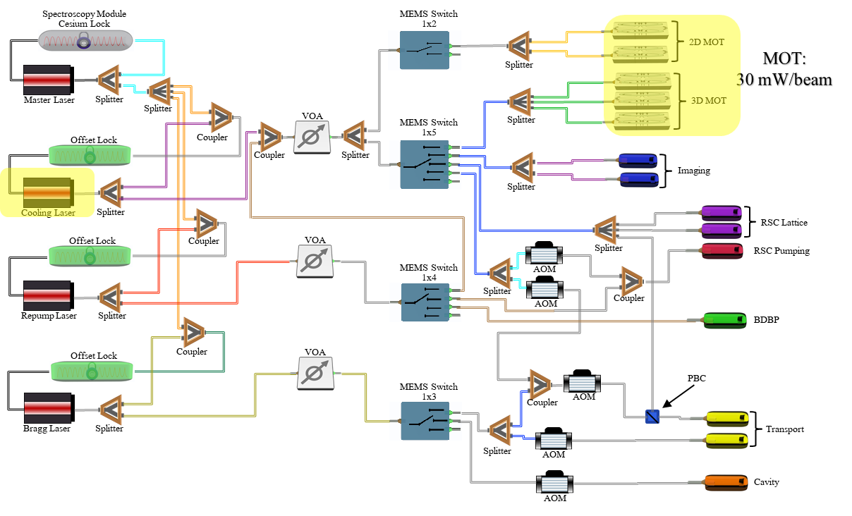
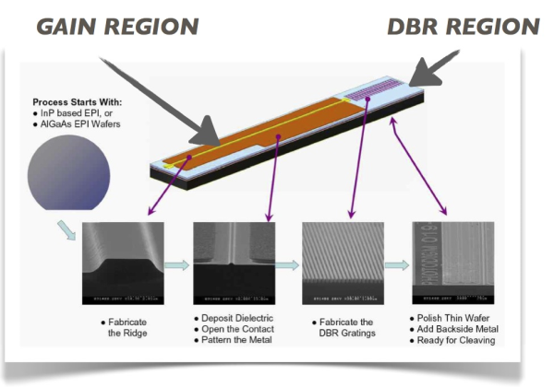
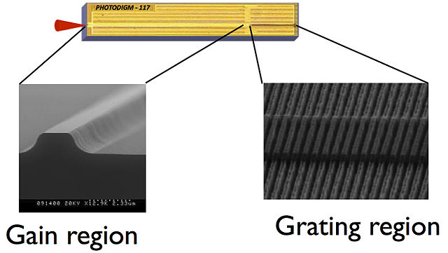
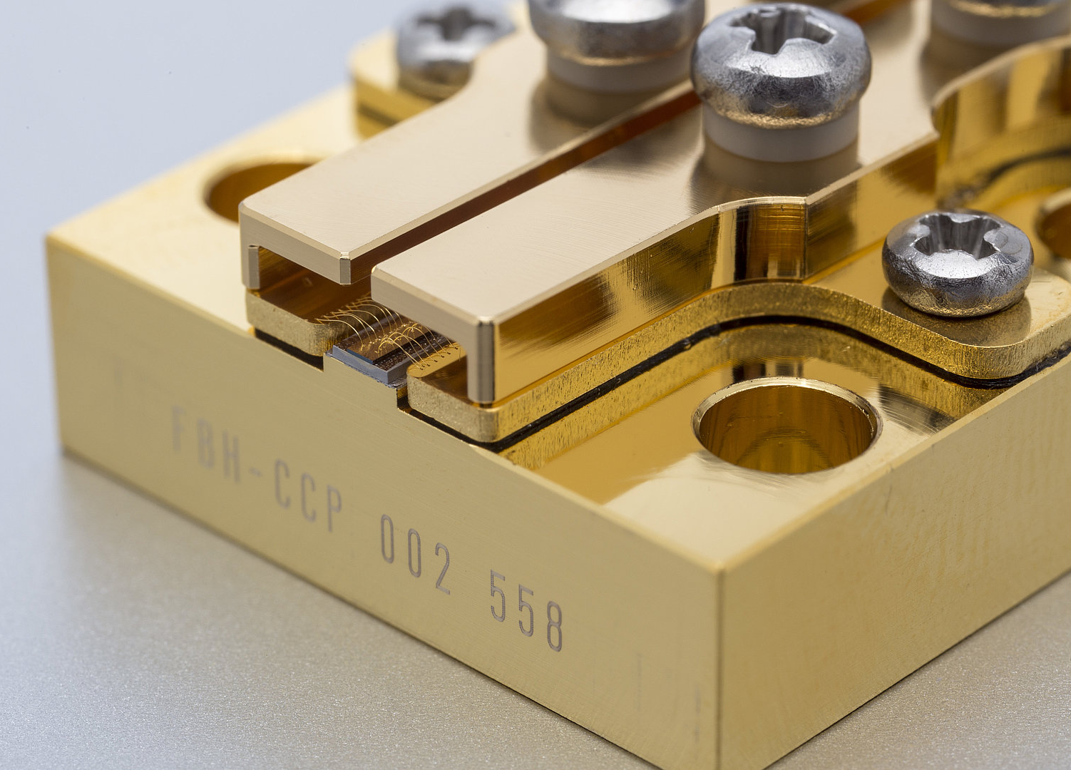
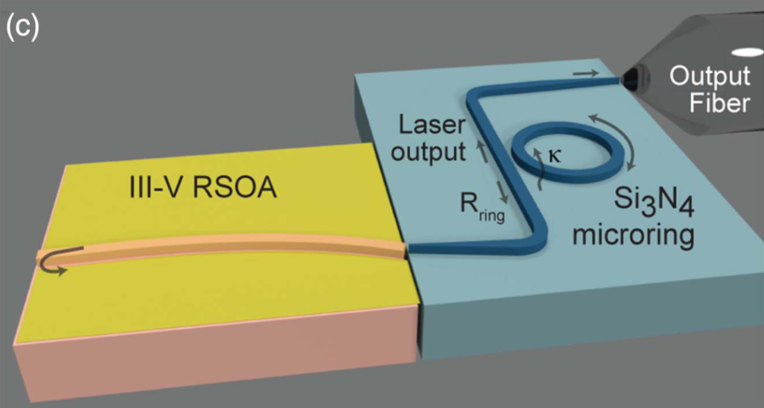
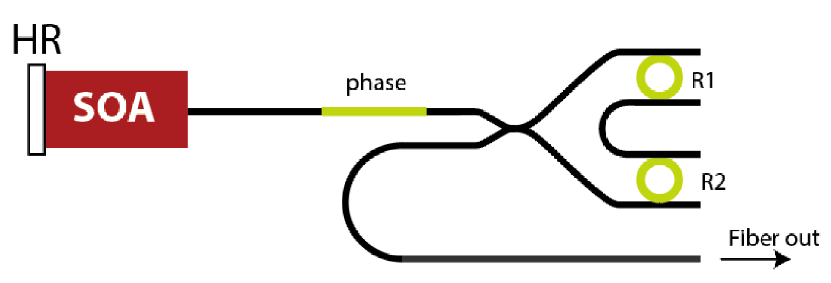
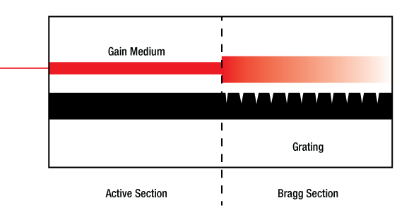
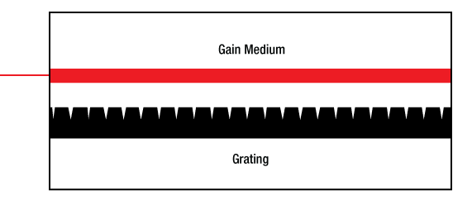
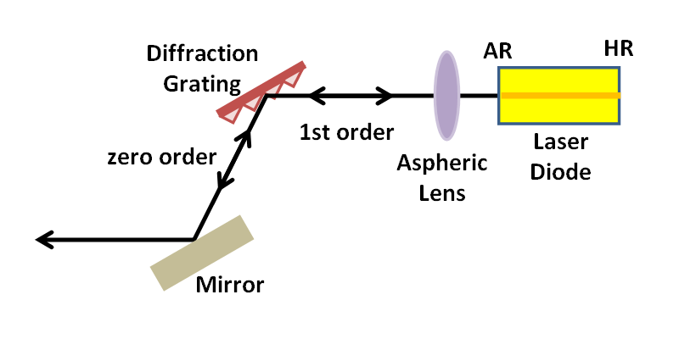
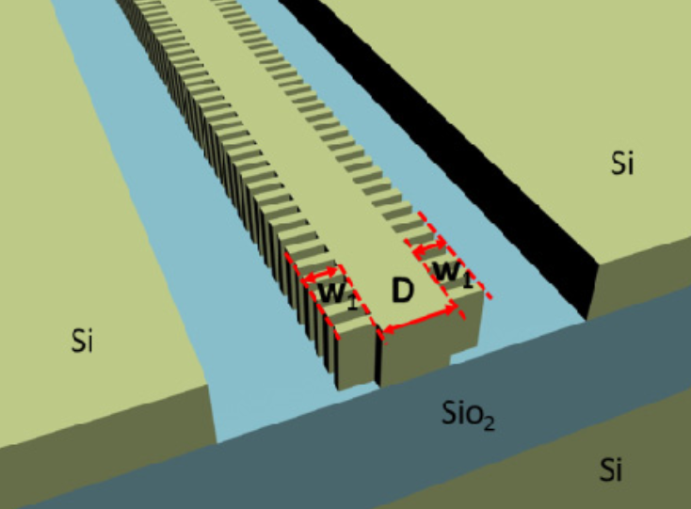
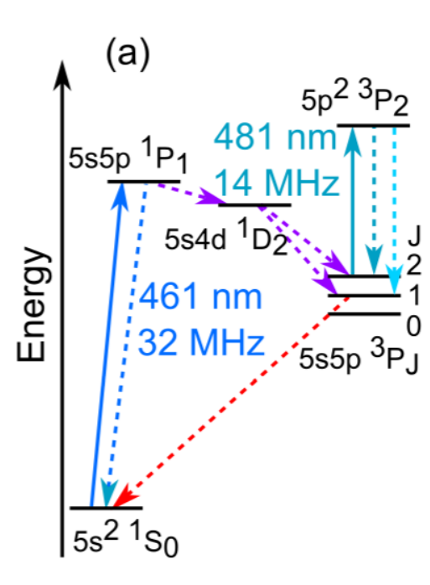
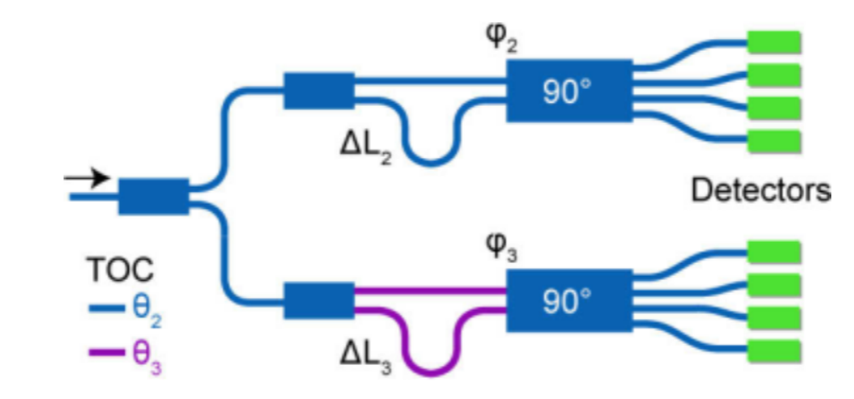
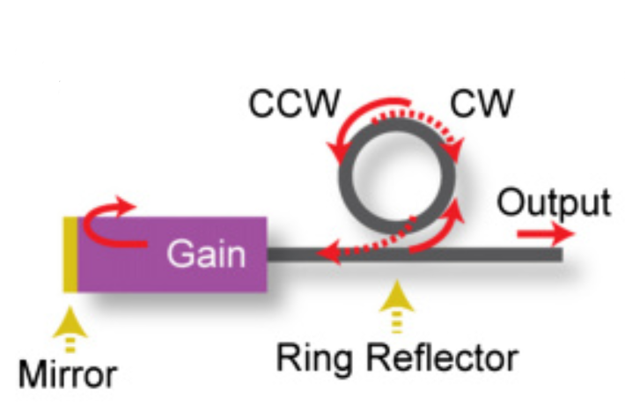
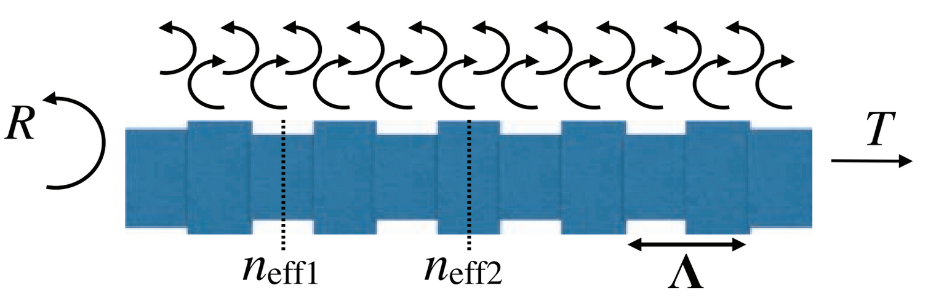
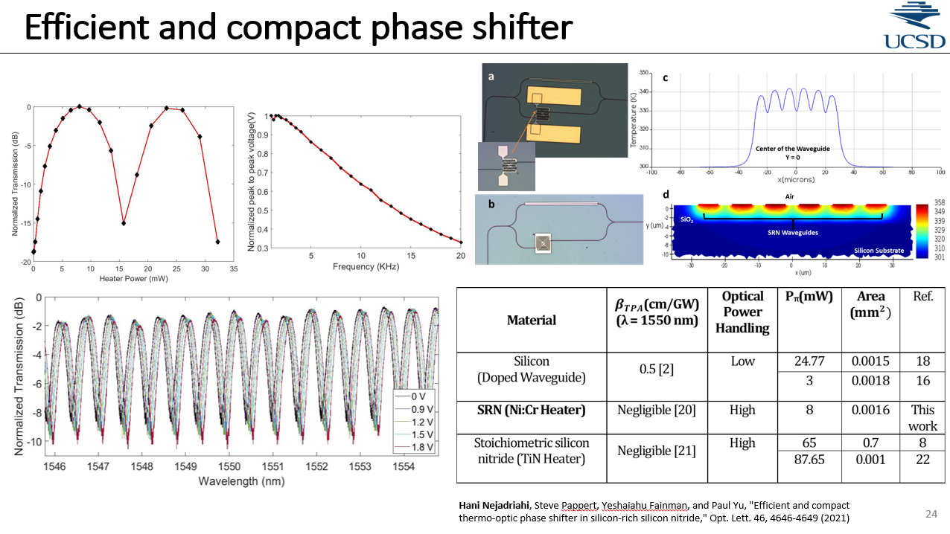
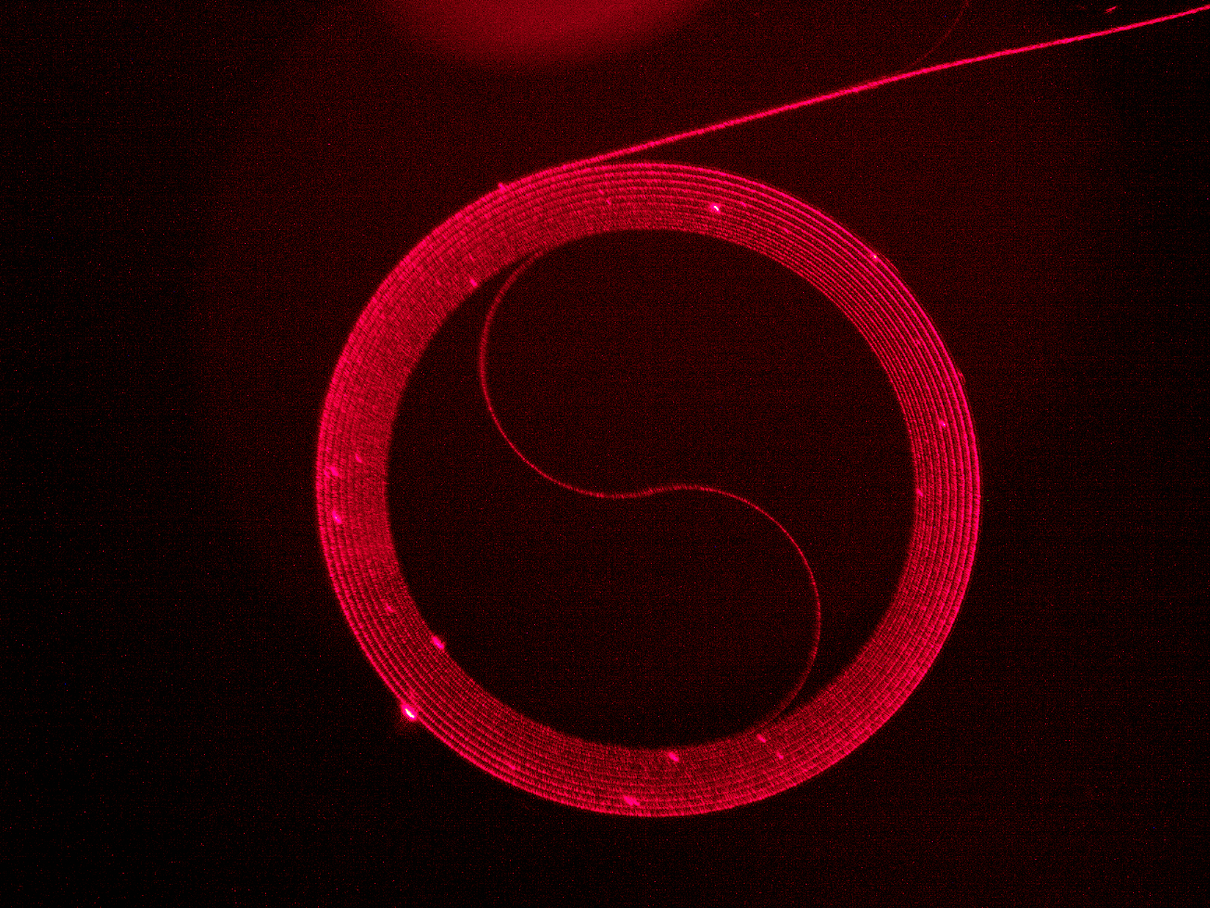
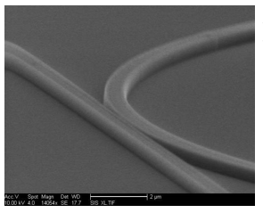
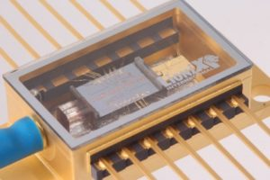
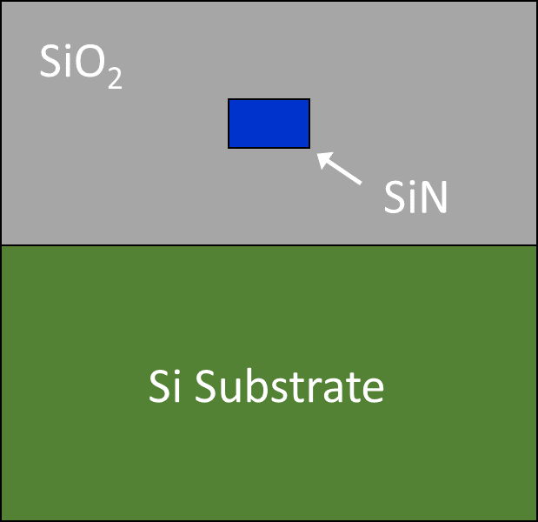
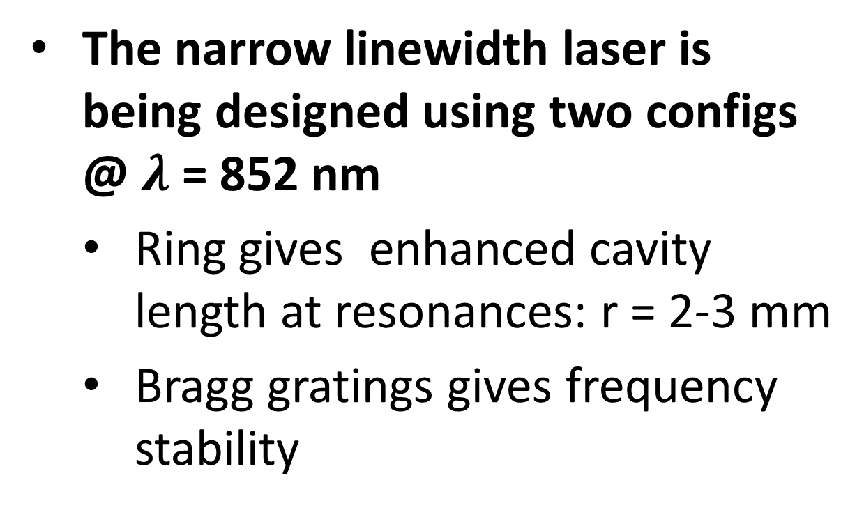
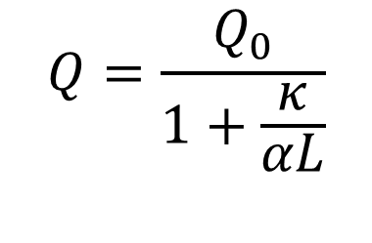
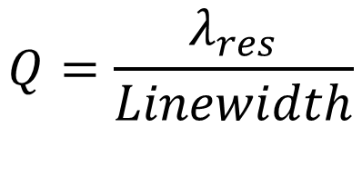
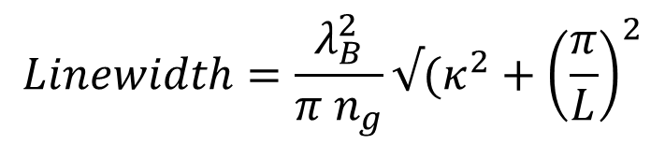
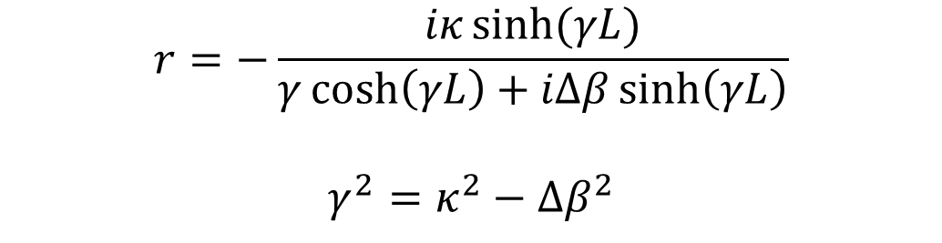
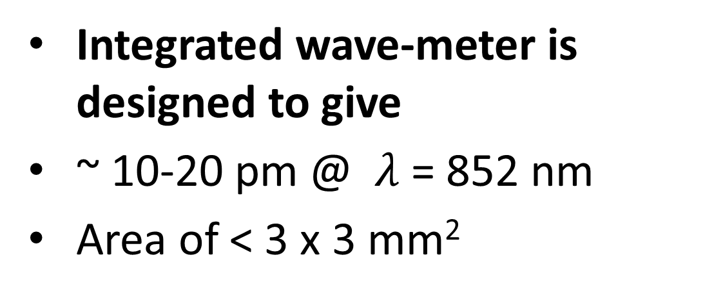
National Aeronautics and Space Administration
Integrated Photonic Devices for Quantum Sensors
Author: Hani Nejadriahi (3890)- JPL Postdoctoral Fellow
Advisor: Dr. Siamak Forouhar (389)
Background
Objective
The design and fabrication of an integrated narrow linewidth external cavity laser (ECL) and a wave-meter
Lasers are essential to cold atom sensors and quantum applications
4-8 Lasers used typically used for cooling process
  Wavelength of operation: 852 nm (Cs)
Integration and compact solutions for optical components:
  i.e., Modulators, attenuators, MEMS switches, splitters
Today, there is a gap between current lasers reliability and specification and what is needed for quantum
The ultra-narrow linewidth ECL
Operating at 780 and 852 nm.
Narrow linewidth < 10 kHz.
High optical power > 10 dBm.
The wave-meter
Operating at 780 and 852 nm.
Precision: 5-10 pm
Both devices are fabricated in stoichiometric silicon nitride platform
Distributed Bragg Laser
Distributed Feedback Laser
JPL wants to study micro-gravity at the atomic scale
Photodigm
Ferdinand Braun Institute
Linewidth: 1-10 kHz
Power: 5-30 mW
Wavelength: 1550 nm
Linewidth: ~10 kHz
Power: 5 mW
Wavelengths: 835-865 nm
External Cavity Laser : Grating
Design and concept of integrated wave-meter
Laterally coupled Bragg Grating architecture
Wavelength: 1550 nm
Limitations of the existing lasers
New Approaches
Design and concept of narrow-linewidth ECL
Precision: ~ 11 pm over 80 nm wavelength range
Wavelength: 1550 nm
Ring Resonator
Bragg Grating
Current and temperature create instability in lasers
Frequency tracking at atomic transitions
Laser stability at those λ
Frequency doubling applications
High Q ring resonator > 10⁷ (minimum)
Waveguide loss < 1-2 dB/m
Large optical path: ring radius
Limited Tunability
Uniformity over large opt. path
Index change between two waveguides
Precision: 5-10 pm
Good for various wavelengths (quantum)
Small in size, reliable for space flights
$$Linewidth=\frac{λ_{B}^{2}}{π n_{g}}√(κ^{2}+{\left(\frac{π}{L}\right)}^{2}$$
$$r=−\frac{iκ\sinh{(γL)}}{γ\cosh\left(γL\right)+iΔβ\sinh\left(γL\right)}$$
$$γ^{2}=κ^{2}−Δβ^{2}$$
Summary
$$Q=\frac{λ_{res}}{Linewidth}$$
The narrow linewidth laser is being designed using two configs @ $λ$ = 852 nm
  Ring gives enhanced cavity length at resonances: r = 2-3 mm
  Bragg gratings gives frequency stability
$$Q=\frac{Q_{0}}{1+\frac{κ}{αL}}$$
Waveguiding Material: Si₃N₄
Wide transparency window (Sr, Rb, Cs)
Low temperature sensitivity
Ultra-low loss waveguides
  (1 dB/m across the visible spectrum)
Packaging
Packaging: coupling efficiency < micron alignment precision
  Isolators
  Low loss waveguiding is being studied in collaboration with UCSB
Integrated wave-meter is designed to give
~ 10-20 pm @ $λ$ = 852 nm
Area of < 3 x 3 mm²
National Aeronautics and Space Administration
Jet Propulsion Laboratory
California Institute of Technology
Pasadena, California
www.nasa.gov
Publications:
Manuscript in preparation
Author Contact Information:
Email: hani.nejadriahi@jpl.nasa.gov
Phone: 626-298-5046
Poster Number: PRD-T#016
Copyright 2022. All rights reserved.

