Slide 1

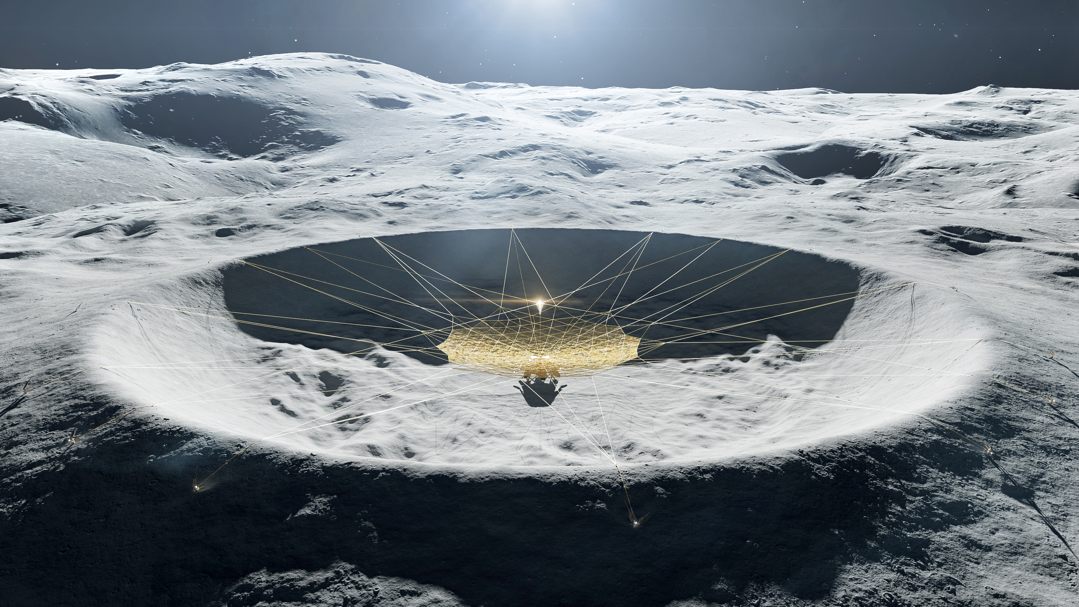
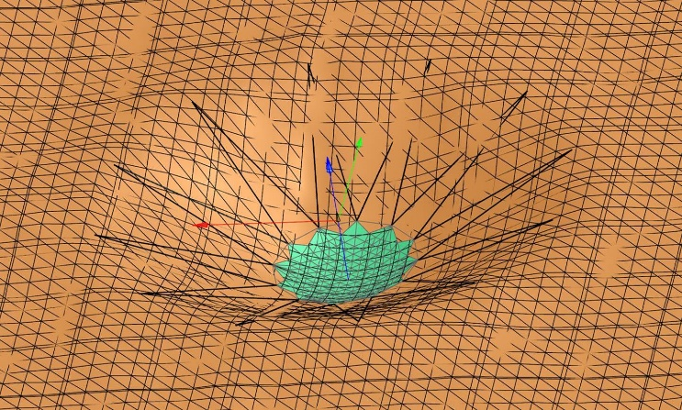
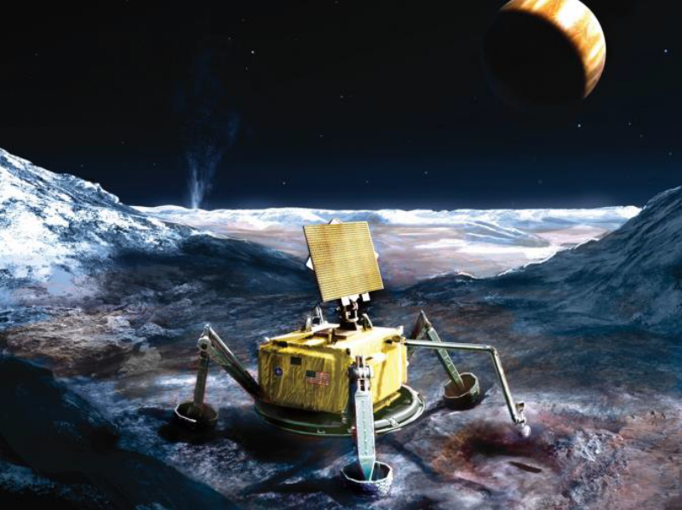
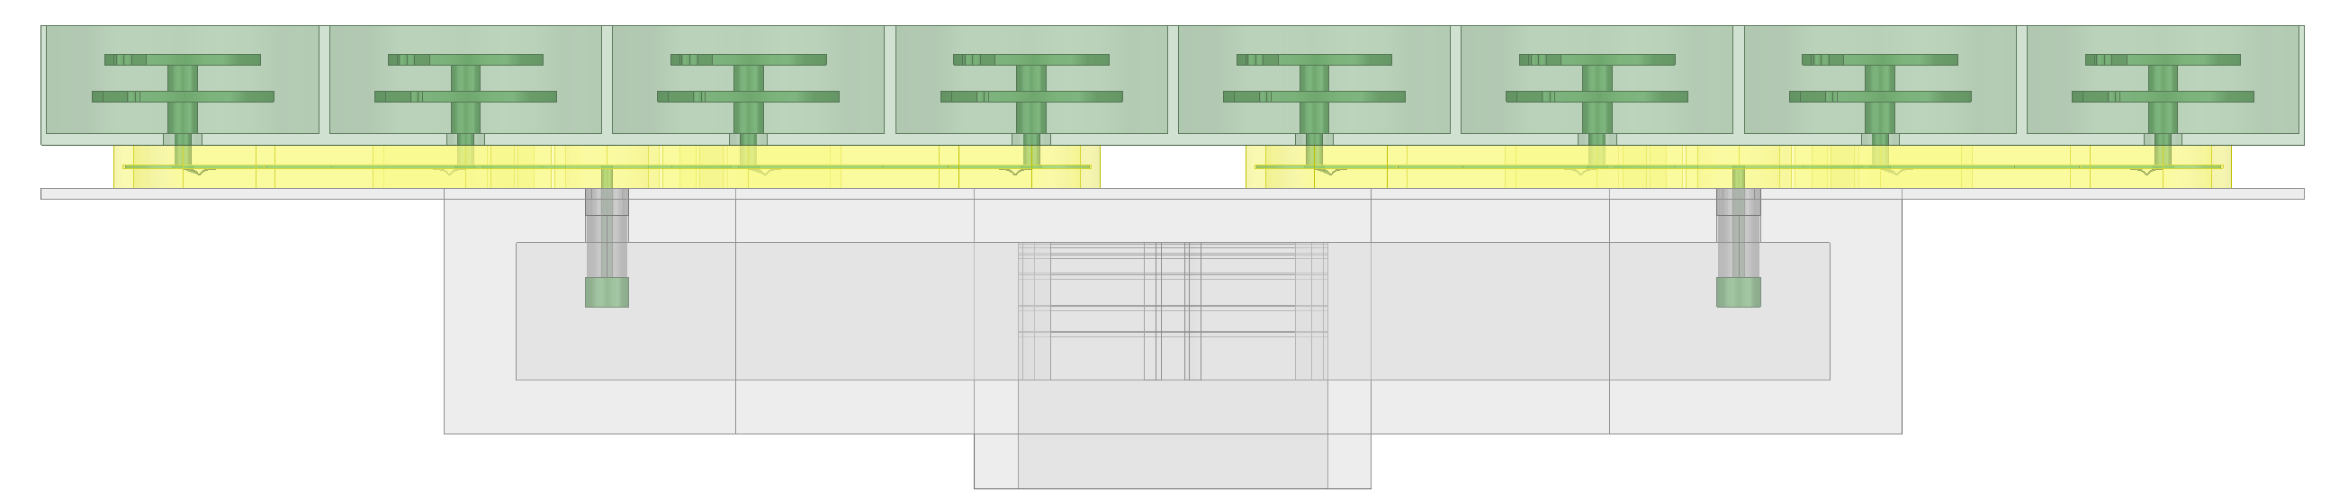
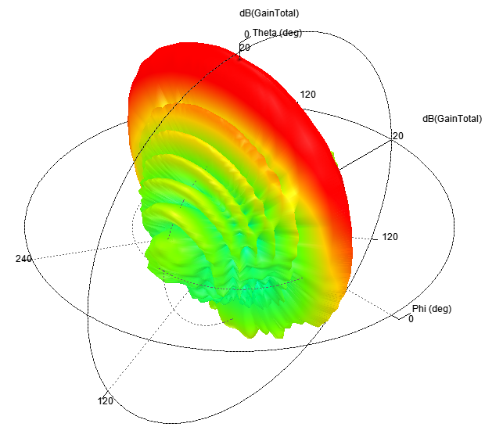
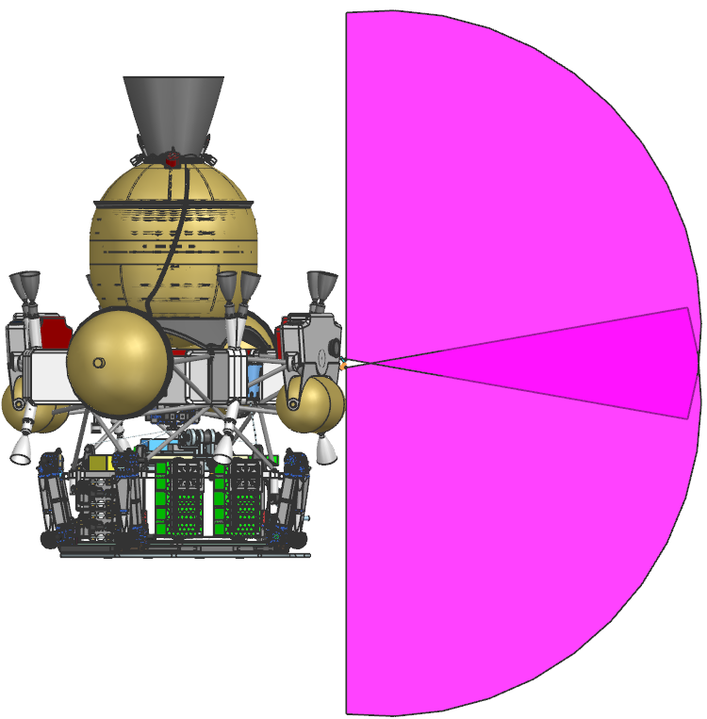
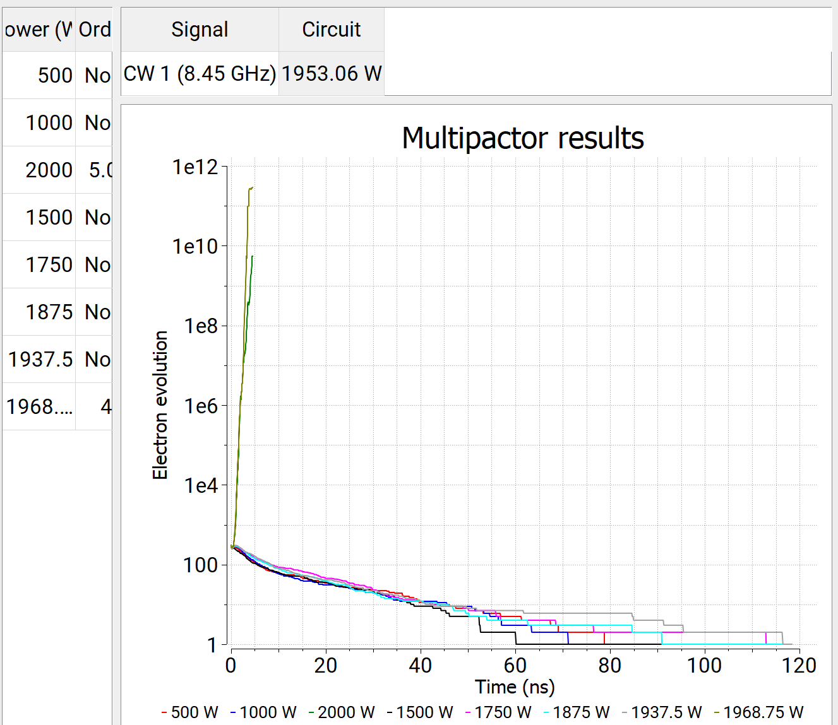
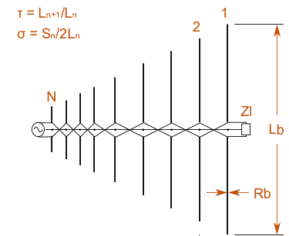
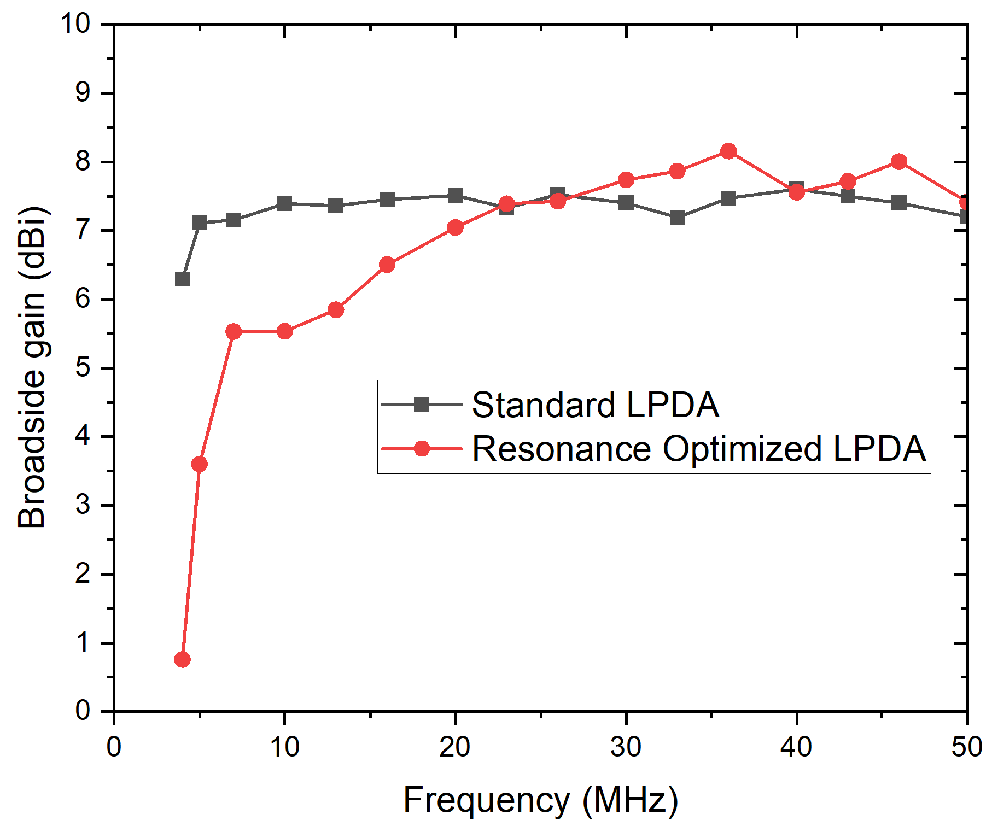
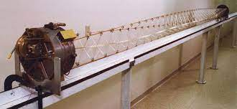
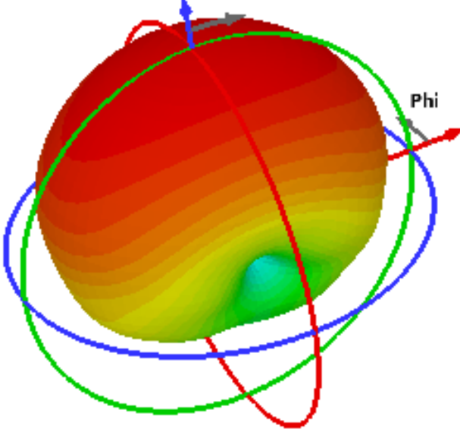
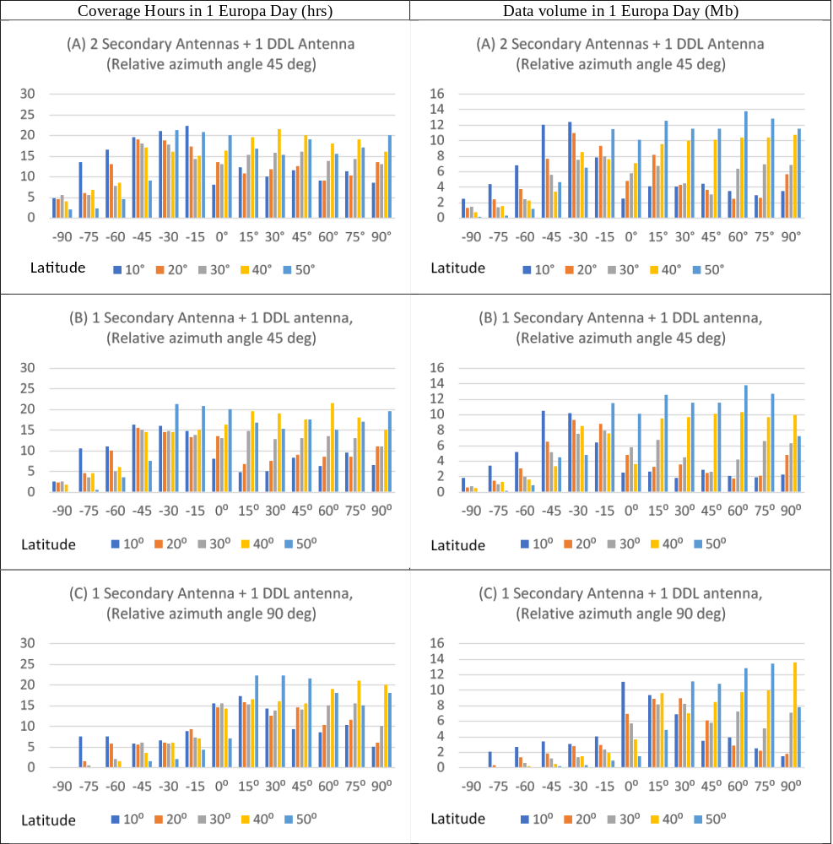
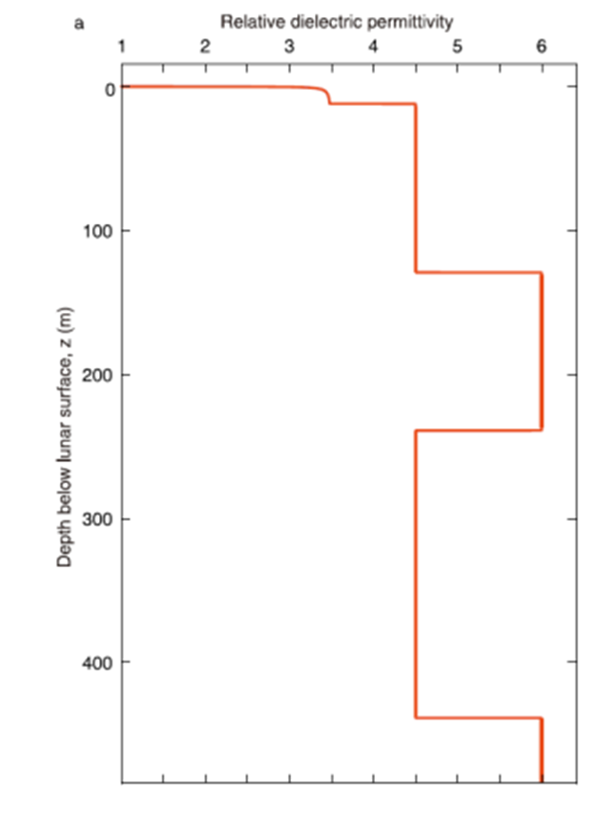
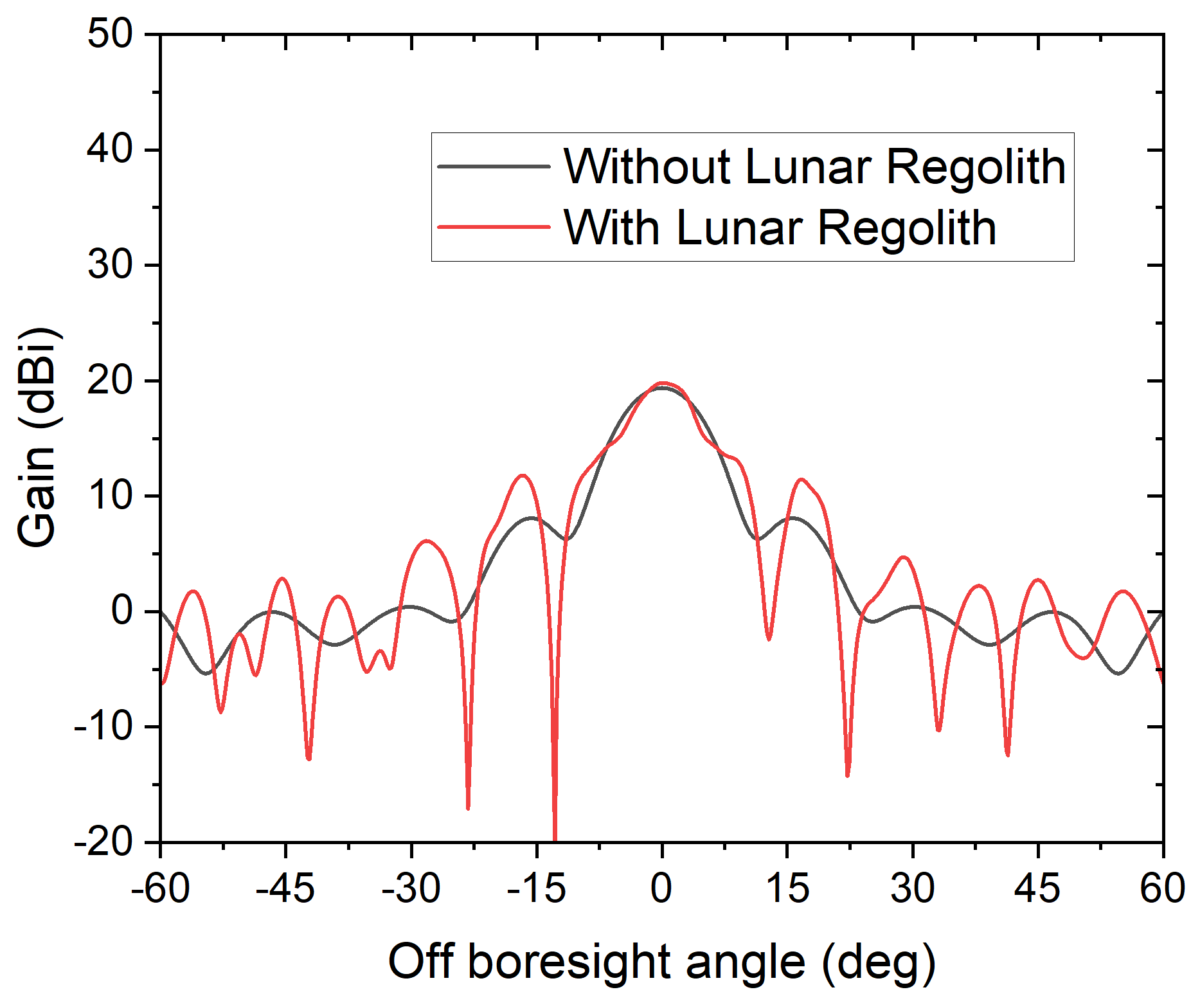
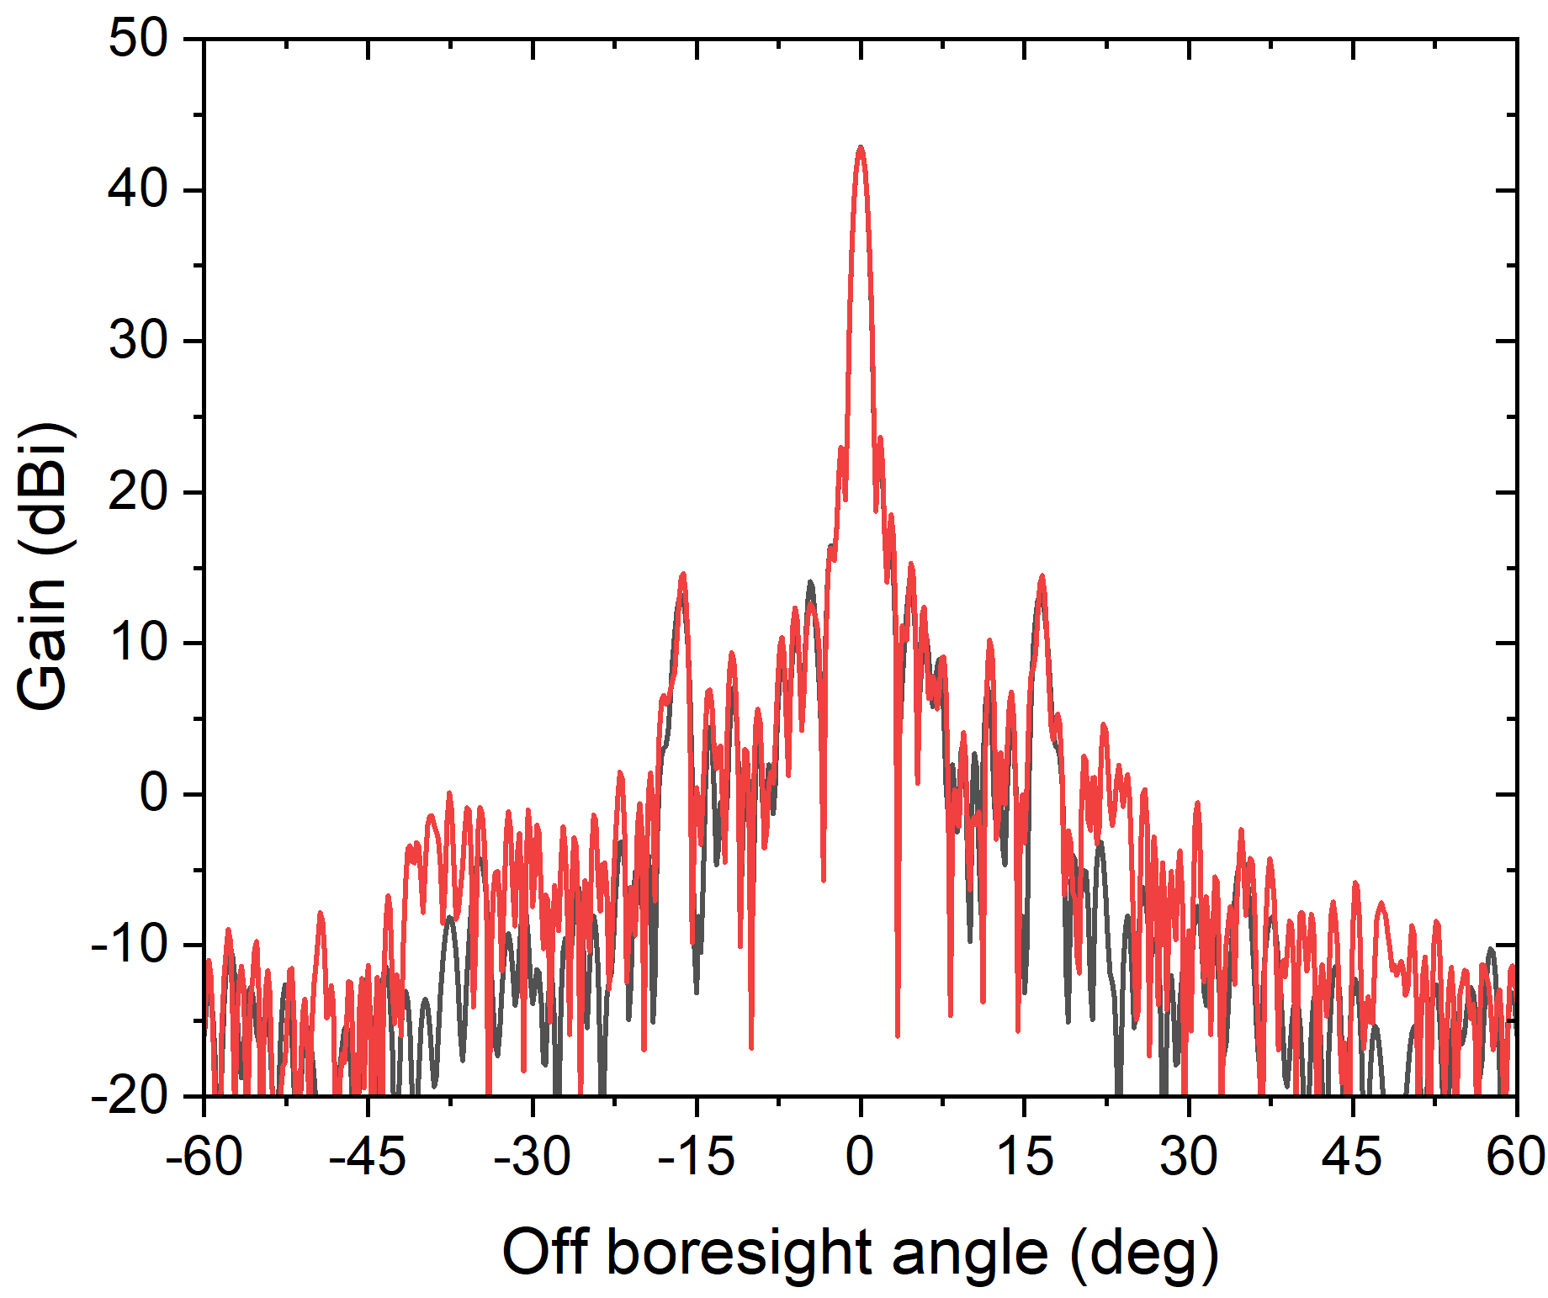
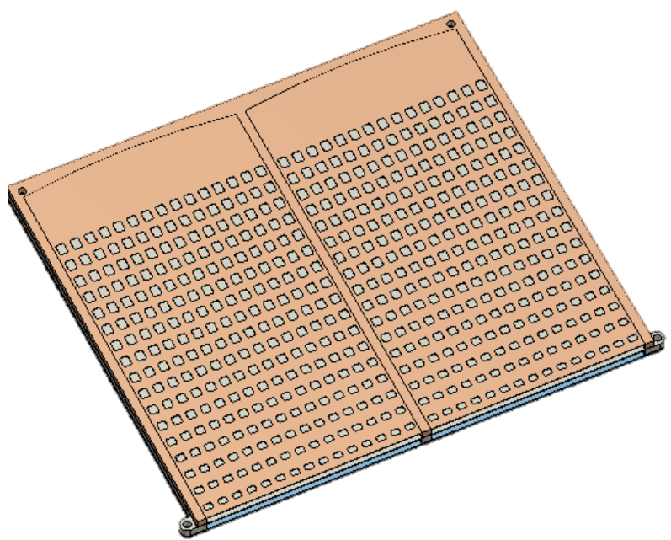
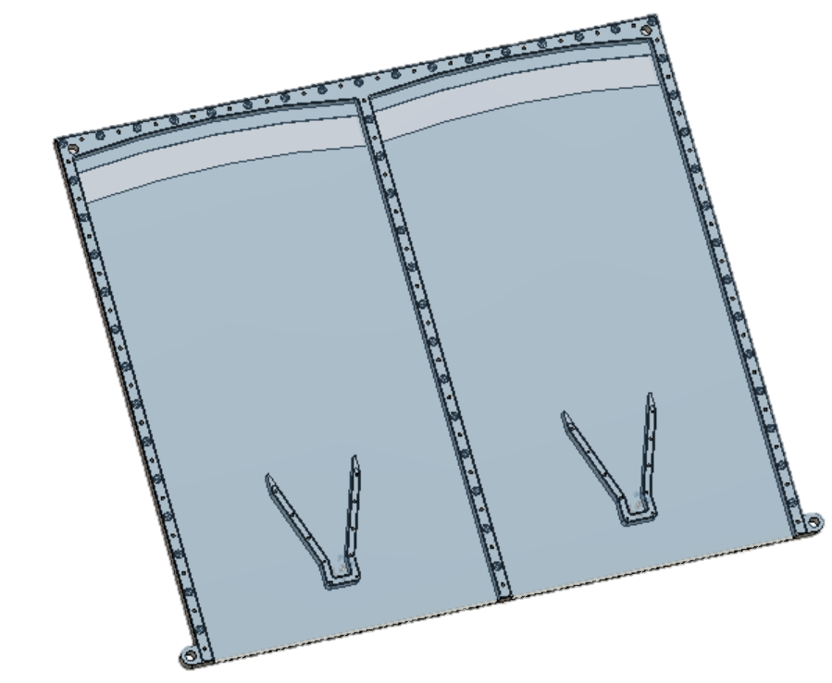
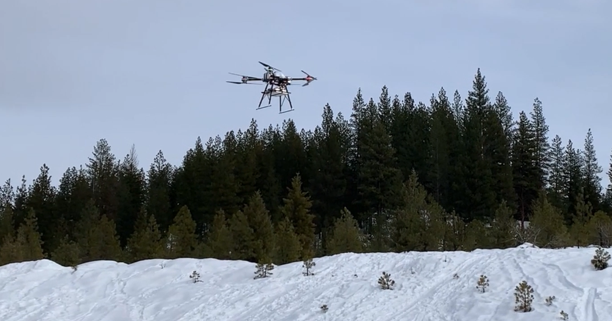
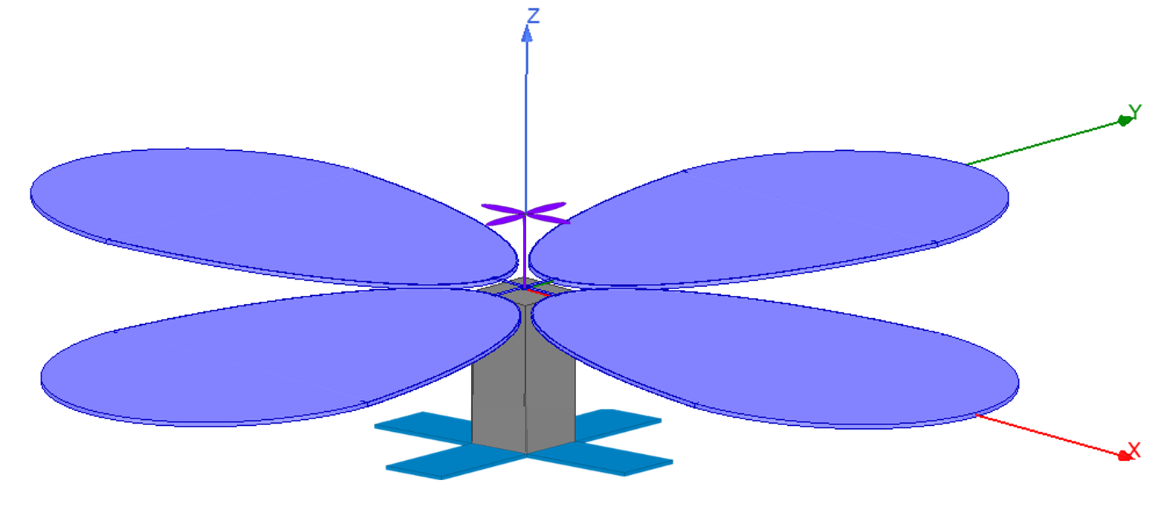

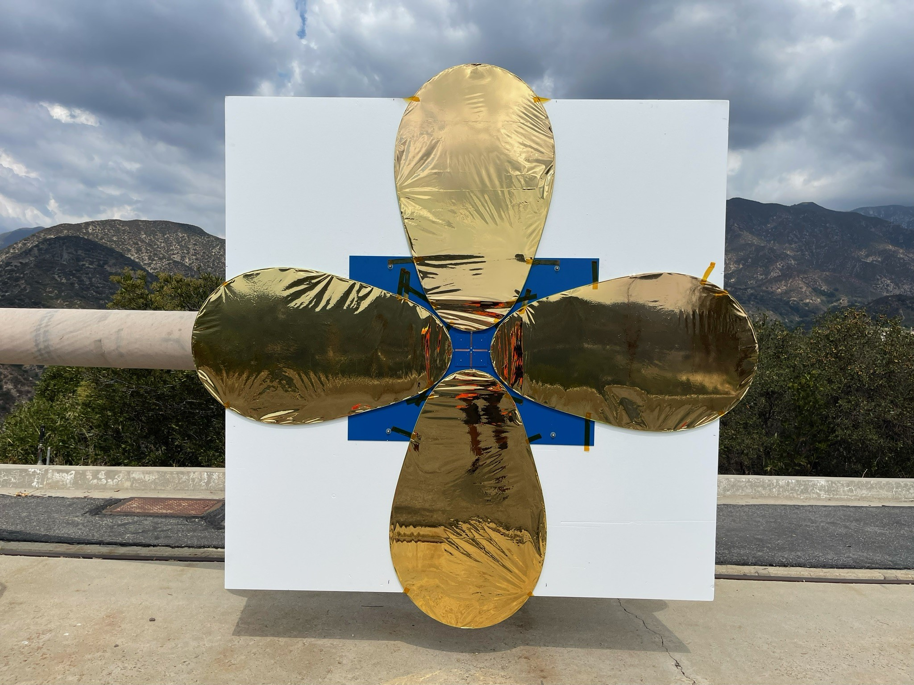
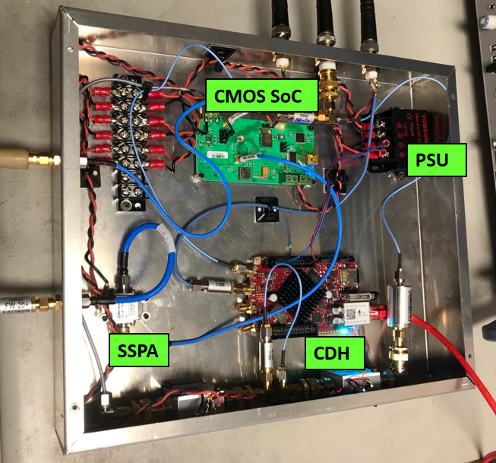
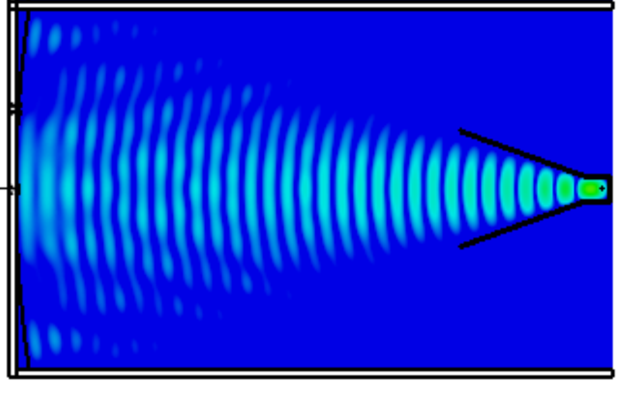
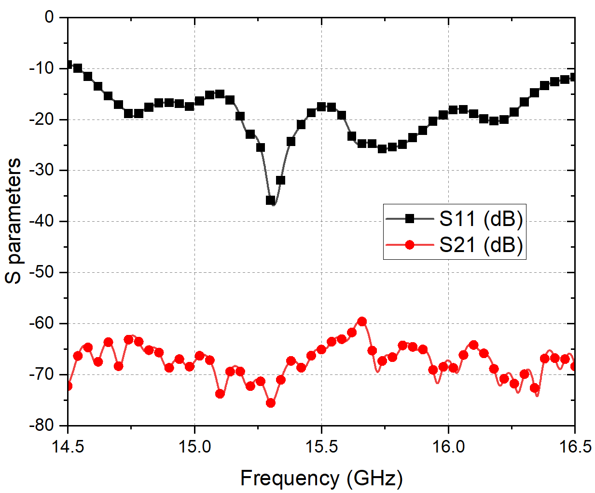
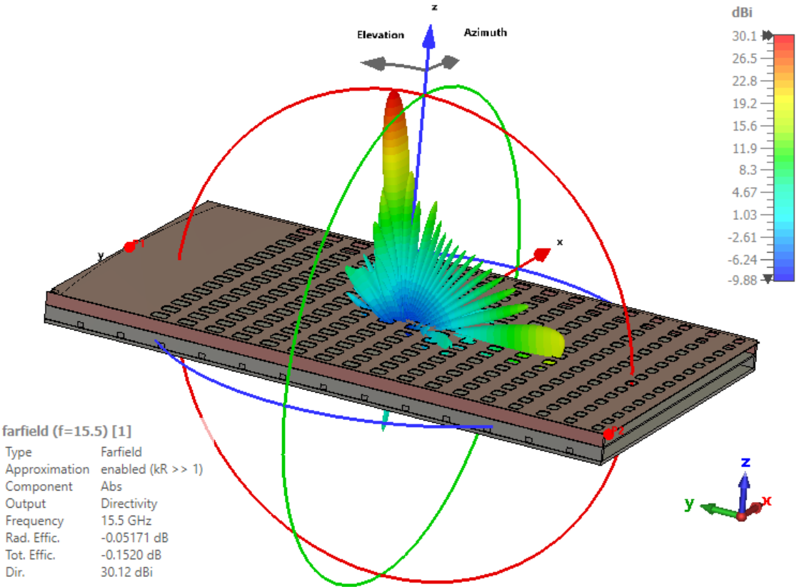
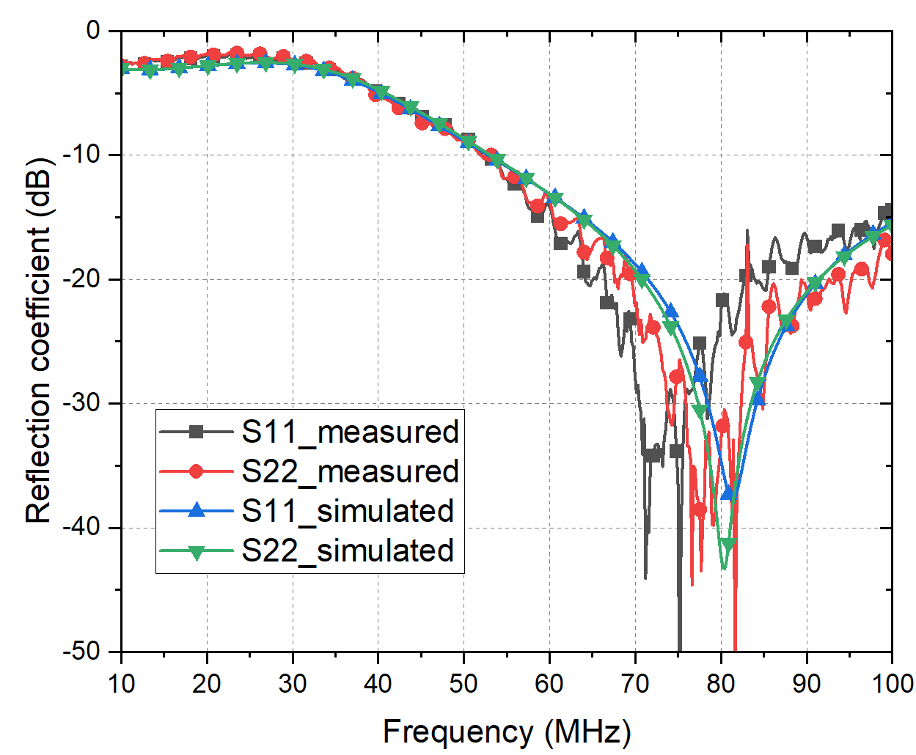
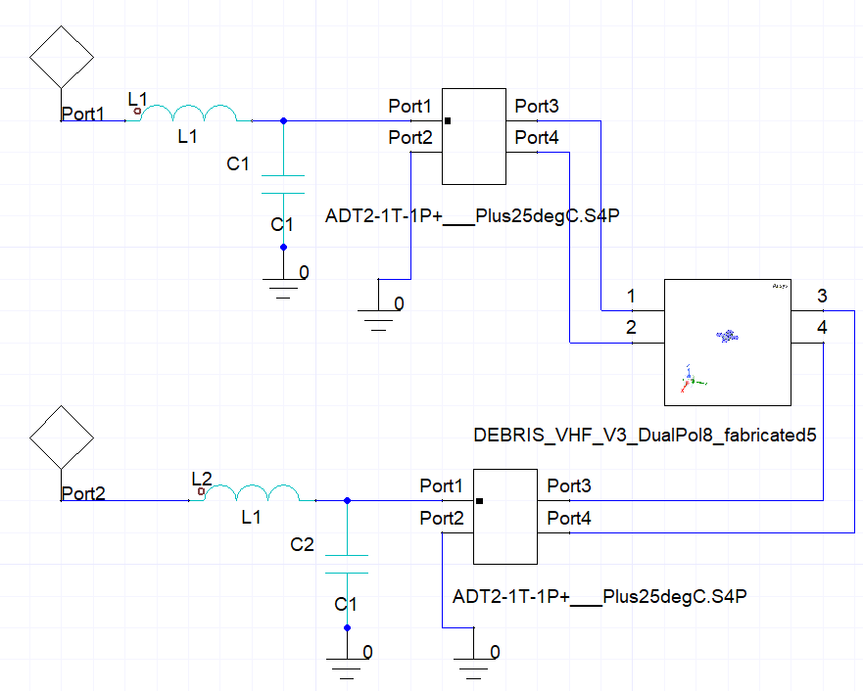
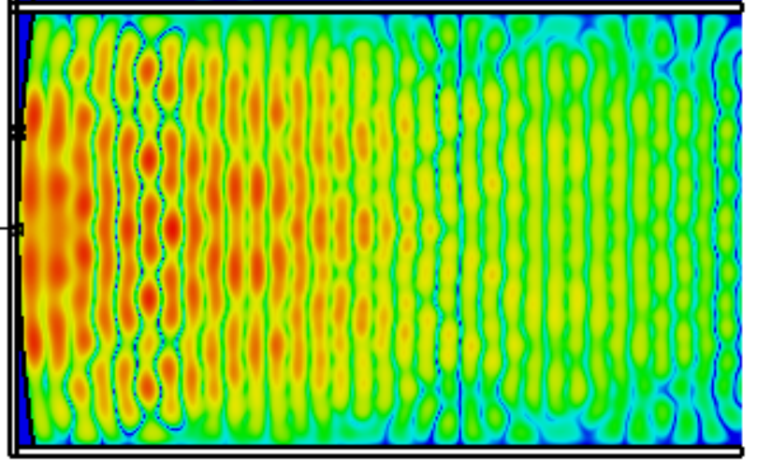
National Aeronautics and Space Administration
Innovative Antennas for Satellite Telecom, Radio Telescope and Radar
Author: Gaurangi Gupta, JPL Postdoctoral Fellow (3370)
Advisor: Dr. Nacer Chahat (3370)
Lunar Crater Radio Telescope
Europa Lander DTE Communication
Team: Saptarshi Bandyopadhyay, Ashish Goel, Nacer Chahat, Manan Arya, Paul Goldsmith, Joseph Lazio, Dario Pisanti, Ben Byron
Team: Nacer Chahat, Polly Estabrook, Mike Meacham, Kevin Barltop, Stephen Aldama
Antenna 1
Antenna 2
8 × 1 Fan beam Array (Patch excited cup antenna)
RHCP, Dual band, 100 W power, -70° ≤ θ ≤ 70°, -5° ≤ φ ≤ 5° beam coverage,
-170 °C to +130 °C temperature variation, Radiation environment
RF Model inside Lunar Crater
Secondary Comm. strategy
Breakdown power
Feed (4.7-47 MHz)
Implementation stages | Gain at 4.7 MHz | Gain at 47 MHz
Ideal Gaussian feed | 23.61 dBi | 43.61 dBi
LPDA feed | 19.09 dBi | 42.94 dBi
Feed blockage | 19.08 dBi | 42.65 dBi
Faceted reflector with support nodes | 19.37 dBi | 42.87 dBi
Meshed reflector (1 OPI) | 19.37 dBi | 42.86 dBi
Reflector shape errors | 19.31 dBi | 36.86 dBi
N = 19
37 m
L = 37.5 m
DDL Strategy
Coverage hours in 1 Europa Day (hrs)
Ref. Astromast deployable structure
Effect of Lunar Crater on Radiation Performance in field of view
10 MHz
47 MHz
Data volume in 1 Europa Day (hrs)
Ref. Permittivity variation on farside of Moon, Chang’E 4 data
Data rates for secondary communication at different latitudes on Europa Surface
Flat Panel Metasurface Antennas for Ice Sounding Radar
VHF Crossed Dipole Antenna for DEBRIS Mission
Team: Nacer Chahat, Adrian Tang, Goutam Chattopadhyay
Team: Paolo Focardi, Robert M. Beauchamp
Measurements
1 Mothership (Smallsat with deployable yagi antenna)
N = 10 Daughterships (Smallsat/Cubesat with deployable UHF and VHF crossed dipole)
Measurement in MESA outdoor range
Metasurface Radiating layer
Feed horn and coupling slot
Aperture efficiency ~ 55-60%
Balun Feed circuit
Balun Measured Performance
Performance Metric | Circuit 1 | Circuit 2
I/P port S11 | -15.8 dB | -16.2 dB
O/P port S22 | -5.86 dB | -5.97 dB
O/P port S33 | -6.1 dB | -6.1 dB
Magnitude Imbalance | 0.18 dB | 0.15 dB
Phase Imbalance | 185° | 184.65°
Electric Field Distribution in lower and upper layer
National Aeronautics and Space Administration
Jet Propulsion Laboratory
California Institute of Technology
Pasadena, California
www.nasa.gov
Publications:
Conferences: IEEE AP-S 2022 (2), IEEE WAMS 2022 (3), AAS Meeting 2022 (1), AIAA Scitech 2023 (1), EMTS URSI 2023 (1 submitted), EuCAP 2023 (1 submitted), White paper (2)
Journals: 2 under preparation
Patents: 1 provisional patent filed
Awards: Best paper award WAMS 2022, JPL Team Award to Mars Helicopter Operations Team
Author Contact Information:
Gaurangi.Gupta@jpl.nasa.gov
Poster Number: PRD-T#006
Copyright 2022. All rights reserved.

