Slide 1

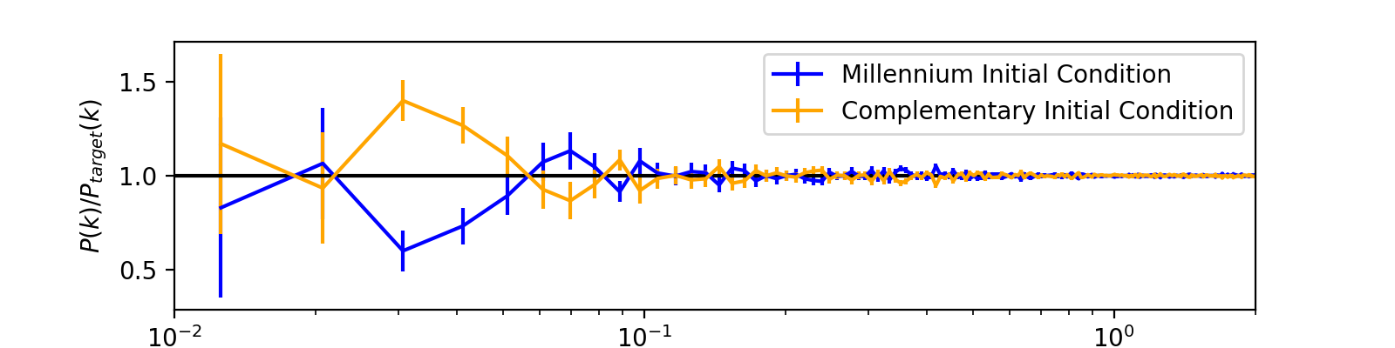
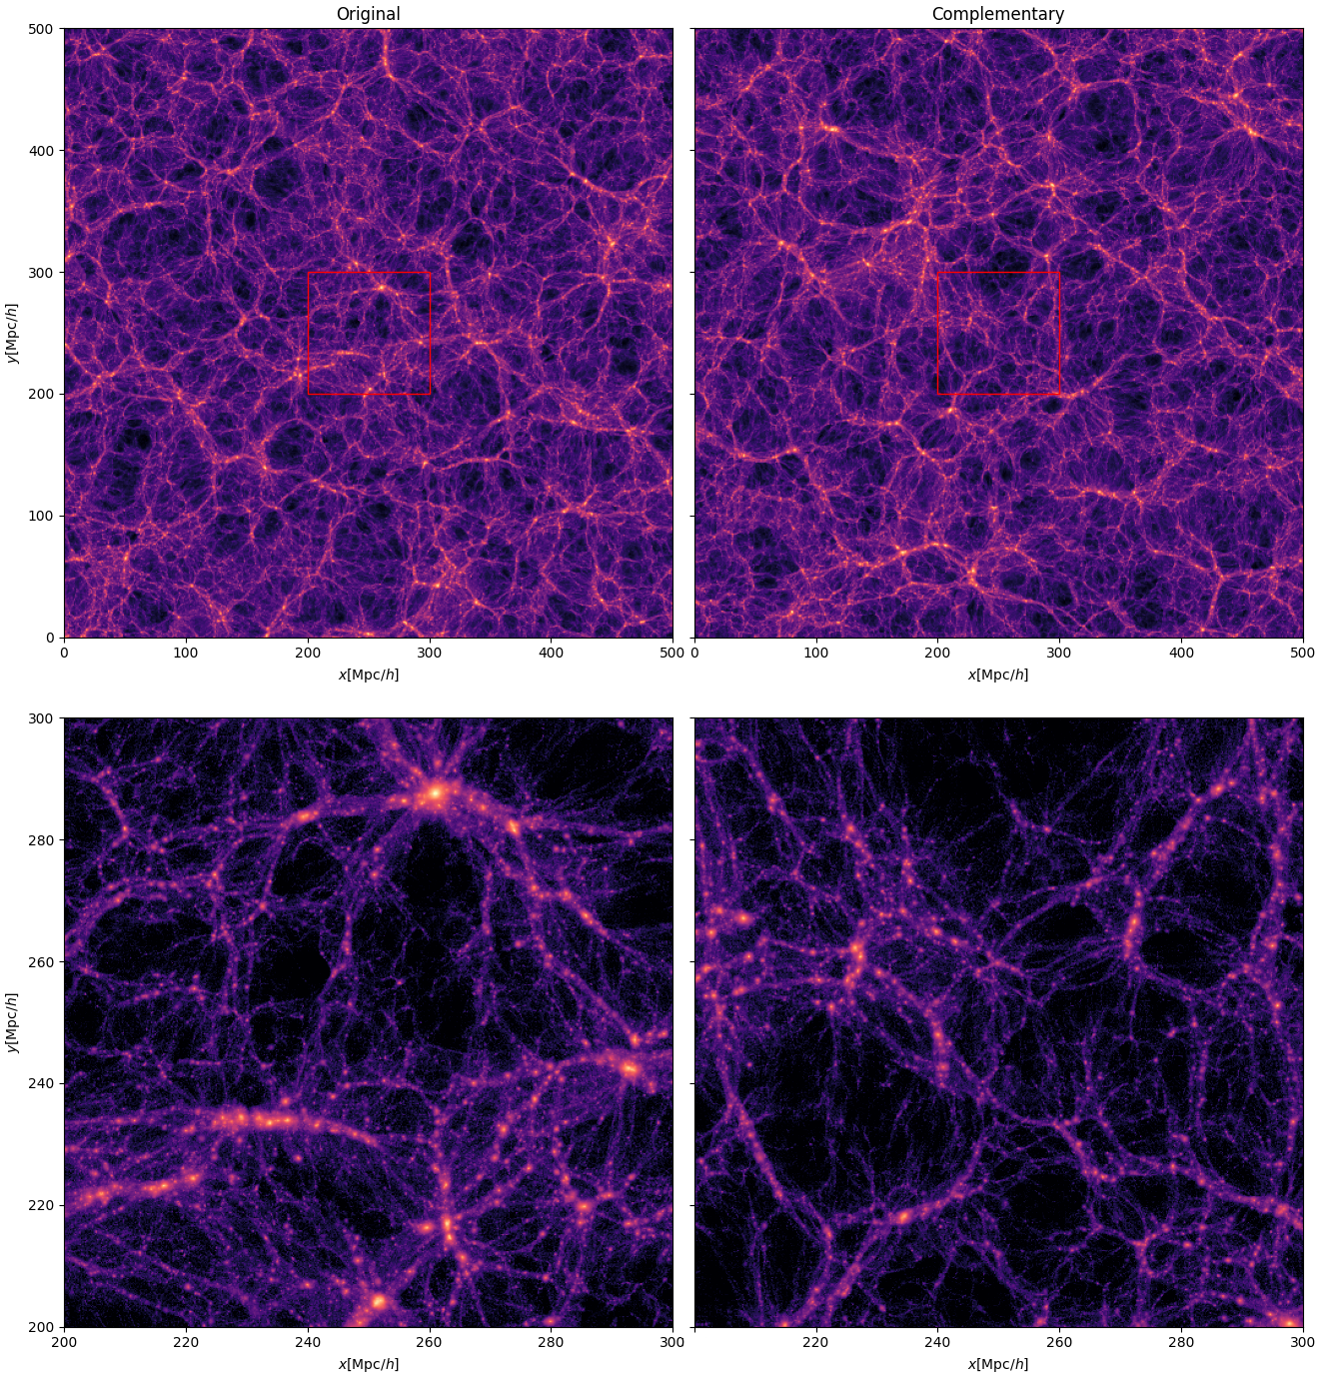
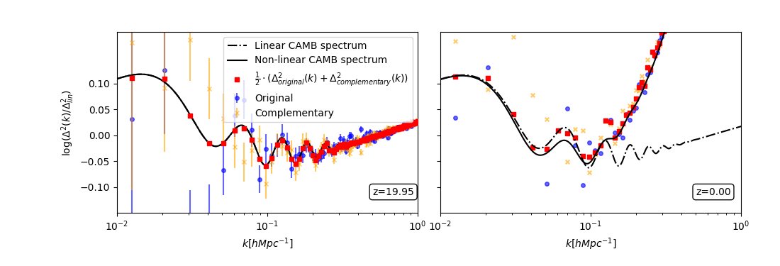
National Aeronautics and Space Administration
Complementary Cosmological Simulations
Author: Gábor Rácz, NPP fellow (3266)
Alina Kiessling (3266), István Csabai (ELTE), István Szapudi (IfA UH)
Introduction
  Large-scale galaxy surveys are important probes to test models of how the Universe is evolving over time.
  The upcoming NASA Roman, SPHEREx, and ESA/NASA Euclid surveys will greatly extend our knowledge of the large-scale structure of the Universe by mapping unprecedented volumes.
  Cosmological N-body simulations use theoretical models to predict the nonlinear evolution of the 3D matter density distribution in the Universe.
  This simulation process is computationally expensive since it follows the motion of billions of particles in very large volumes.
  Simulation sample variance can grow significantly over the evolution of the simulation, and this will introduce bias in important statistics used for comparison to observations.
  Sample variance is typically mitigated by running hundreds of simulations, or by using extremely large volumes which can be prohibitively expensive computationally.
Complementary initial conditions
  Initial conditions for simulations are random gaussian realizations of the linear power spectrum for the matter density field at early times.
  For a given initial condition, a complementary pair can be generated, in which the amplitude values are selected such that the average of the two initial power spectra match the cosmic average power spectra:
  We use inverted initial phases in the pairs, to reduce the effect of phase correlations.
  The average power spectrum of a pair of simulations started from these initial conditions have significantly reduced sample variance, and this spectrum remains consistent with the estimated non-linear spectra of the state-of-the-art methods even at late times.
  To demonstrate the effectiveness of this new method in reducing sample variance, we run the complementary pair of the most widely-used simulation in cosmology (known as Millennium simulation).
P_{IC}/P_{target}(k)
k[h/Mpc]
Results
y[Mpc/h]
log(Δ²/ Δ_{lin}²)(k)
k[h/Mpc]
k[h/Mpc]
y[Mpc/h]
The power spectrum of the original Millennium simulation and its complementary pair.
  These wiggles in the power spectrum are the results of the baryon acoustic oscillation (BAO) that happened in the early Universe, and they are used as standard rulers in the observations.
  While by itself the original simulation was not large enough to resolve the BAO wiggles in the power spectrum due to the sample variance at the large scales (low-k modes), the average with the new complementary simulation was able to effectively follow the evolution of these fine details.
x[Mpc/h]
x[Mpc/h]
Conclusions
  Errors introduced by sample variance in the original simulation can be estimated using the complementary pair, since structure evolution in this is directly inverted.
  Using complementary pairs of simulations greatly reduces the computational cost of cosmological predictions and analyses since the evolution of the Universe can be followed using a significantly smaller volume than with a single simulation.
  As a consequence, we will be able to compare more cosmological scenarios with the observations while using significantly fewer computational resources.
The dark matter density field of the Millennium simulation (left) and its complementary pair (right) today. The bottom row is a zoom in of the region outlined by the red boxes in the figures in the top row. A region that collapses to a galaxy cluster (bright spots) in the original Millennium simulation is a void (black region) in the complementary simulation and vice versa.
National Aeronautics and Space Administration
Jet Propulsion Laboratory
California Institute of Technology
Pasadena, California
www.nasa.gov
Publications:
Complementary Cosmological Simulations, G. Rácz, A. Kiessling, I. Csabai, and I. Szapudi, 2022, in prep.
Author Contact Information:
Phone: +1 (626) 298-4492
Email: gabor.racz@jpl.nasa.gov
Poster Number: PRD-A#008
Copyright 2022. All rights reserved.

