Slide 1


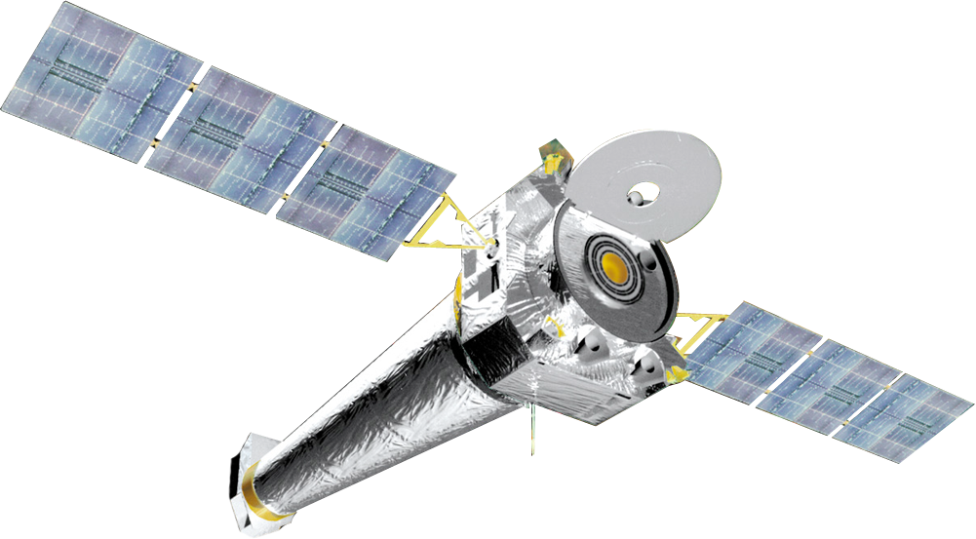

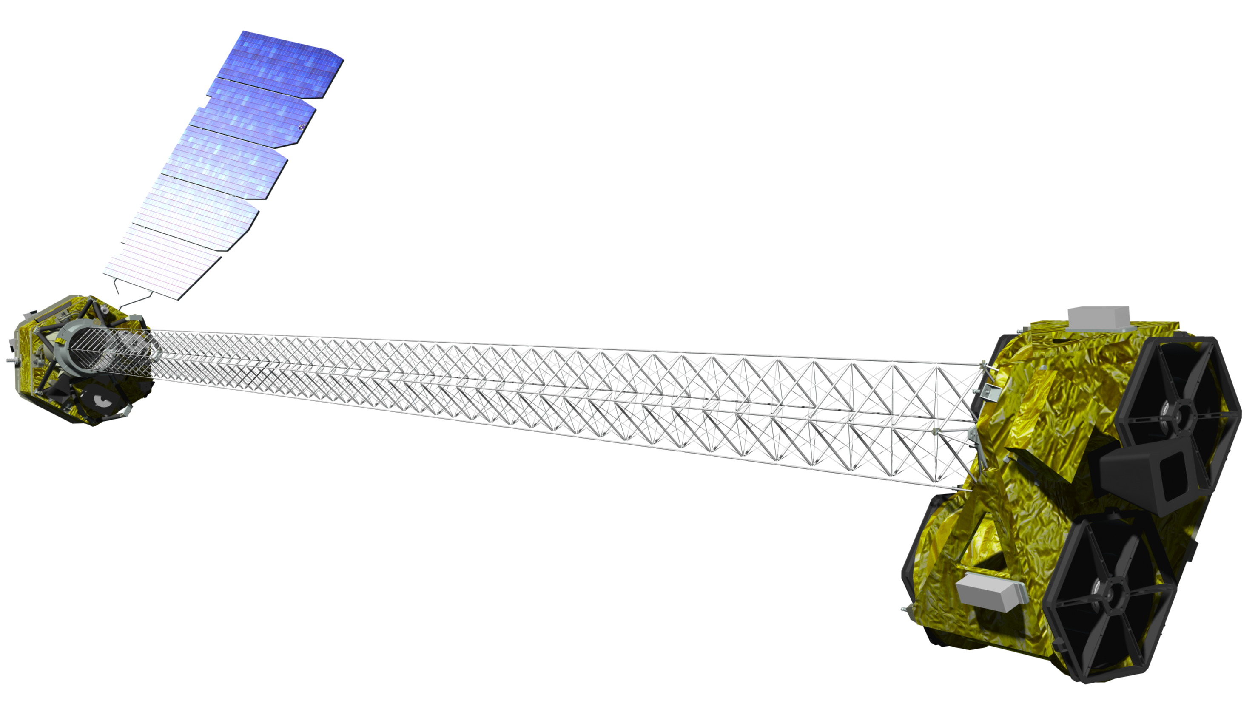
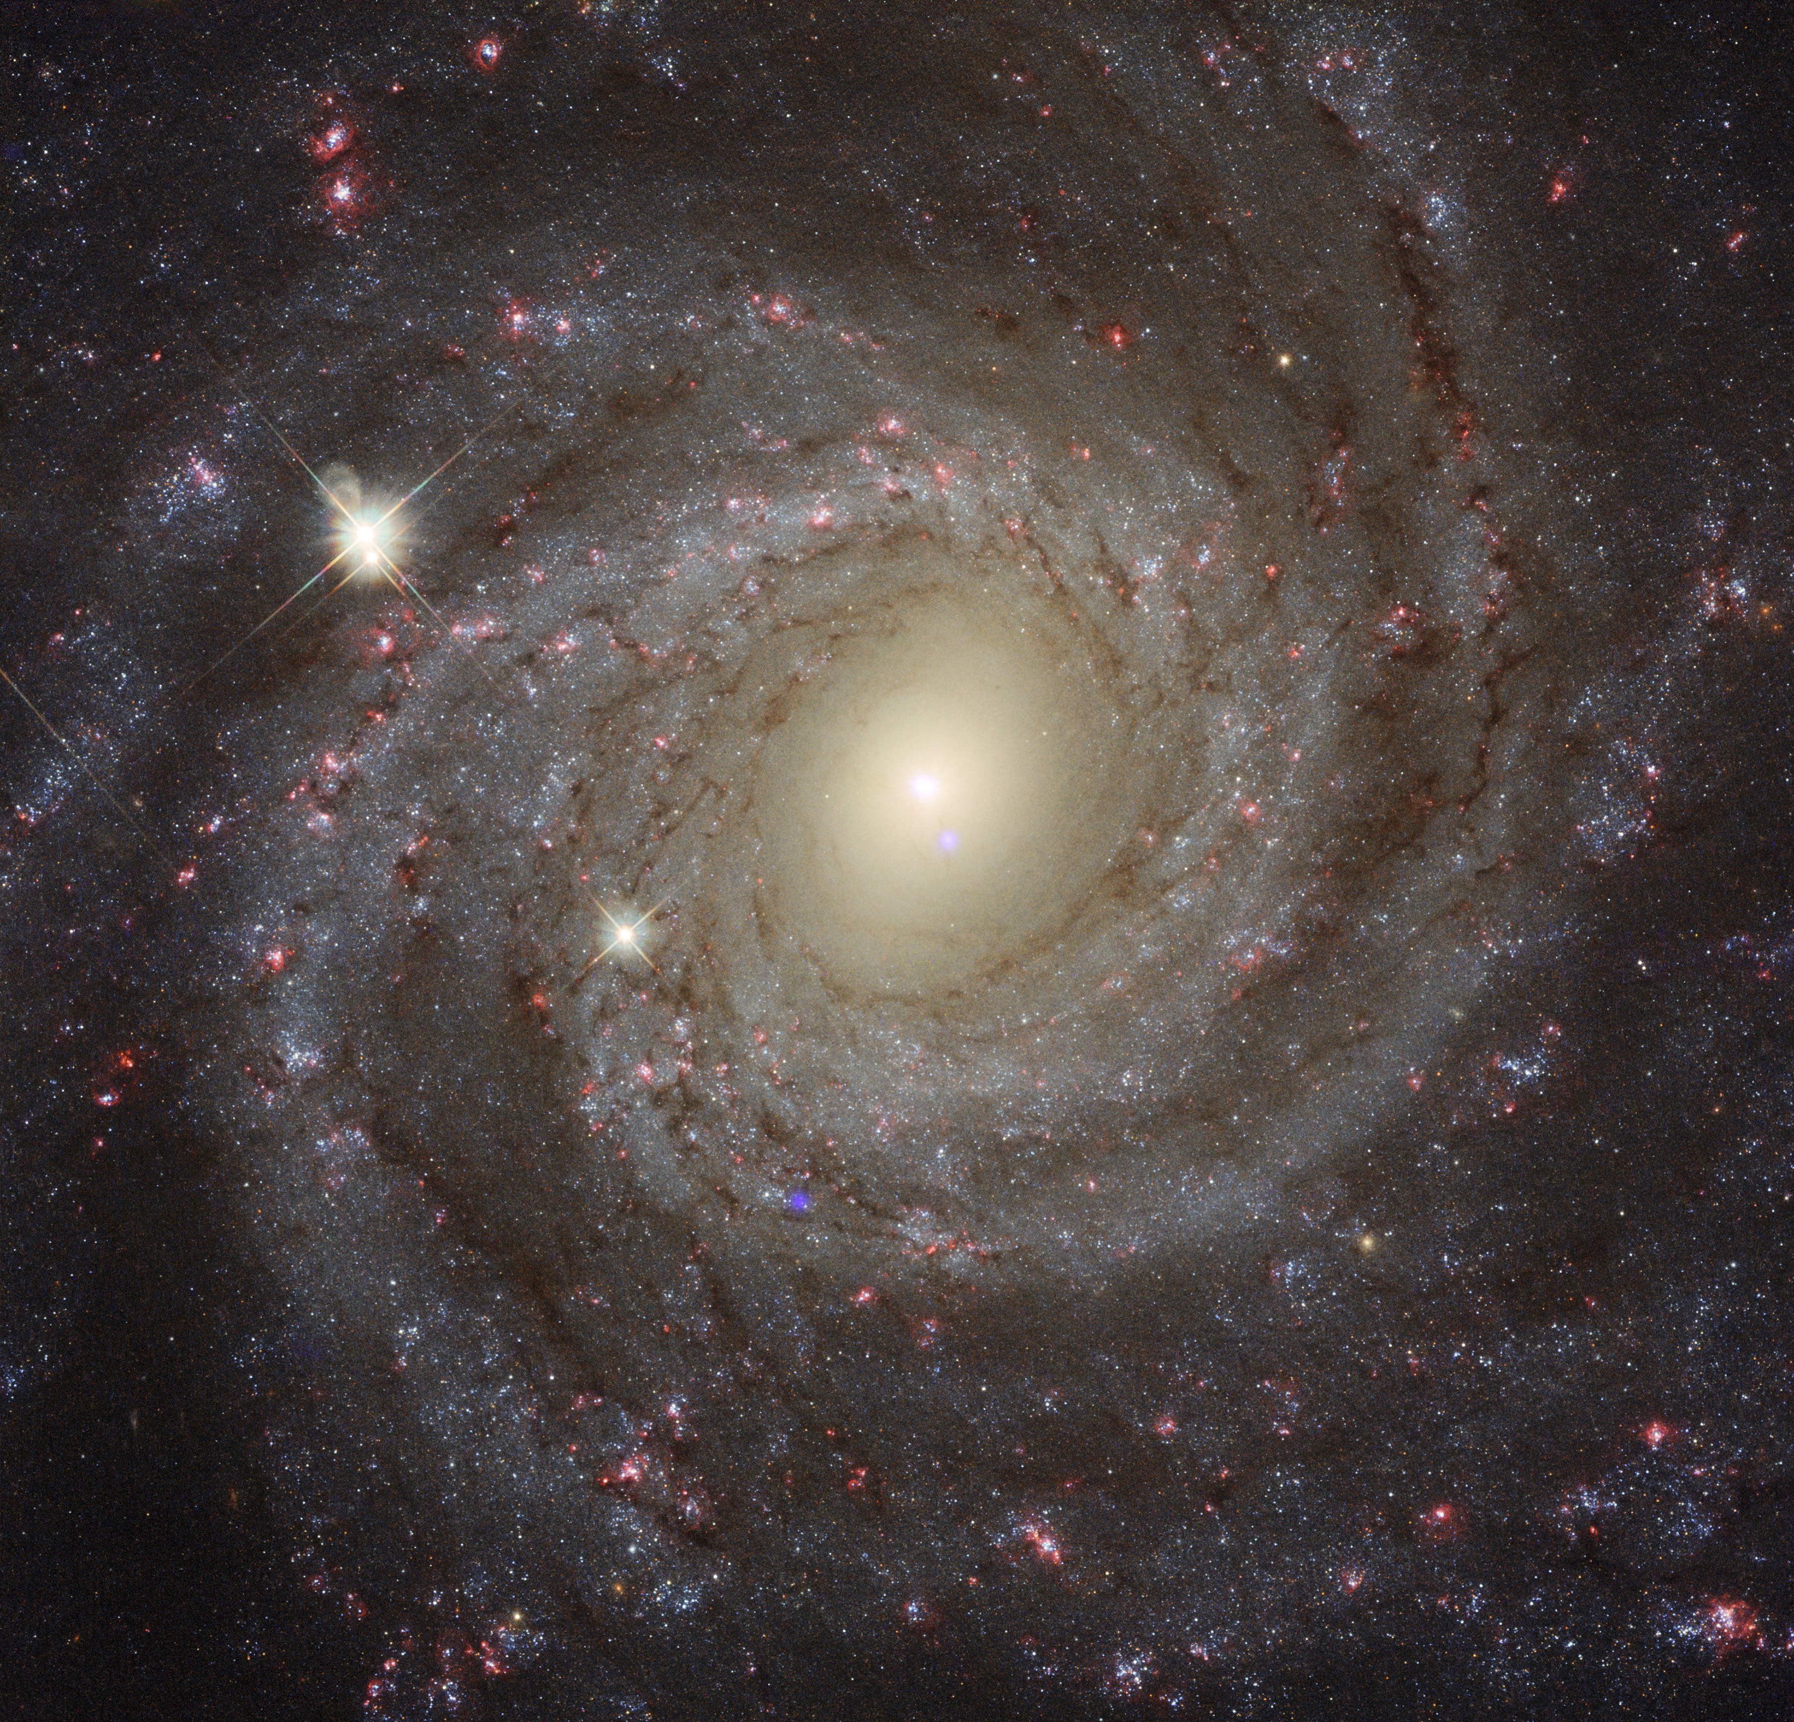
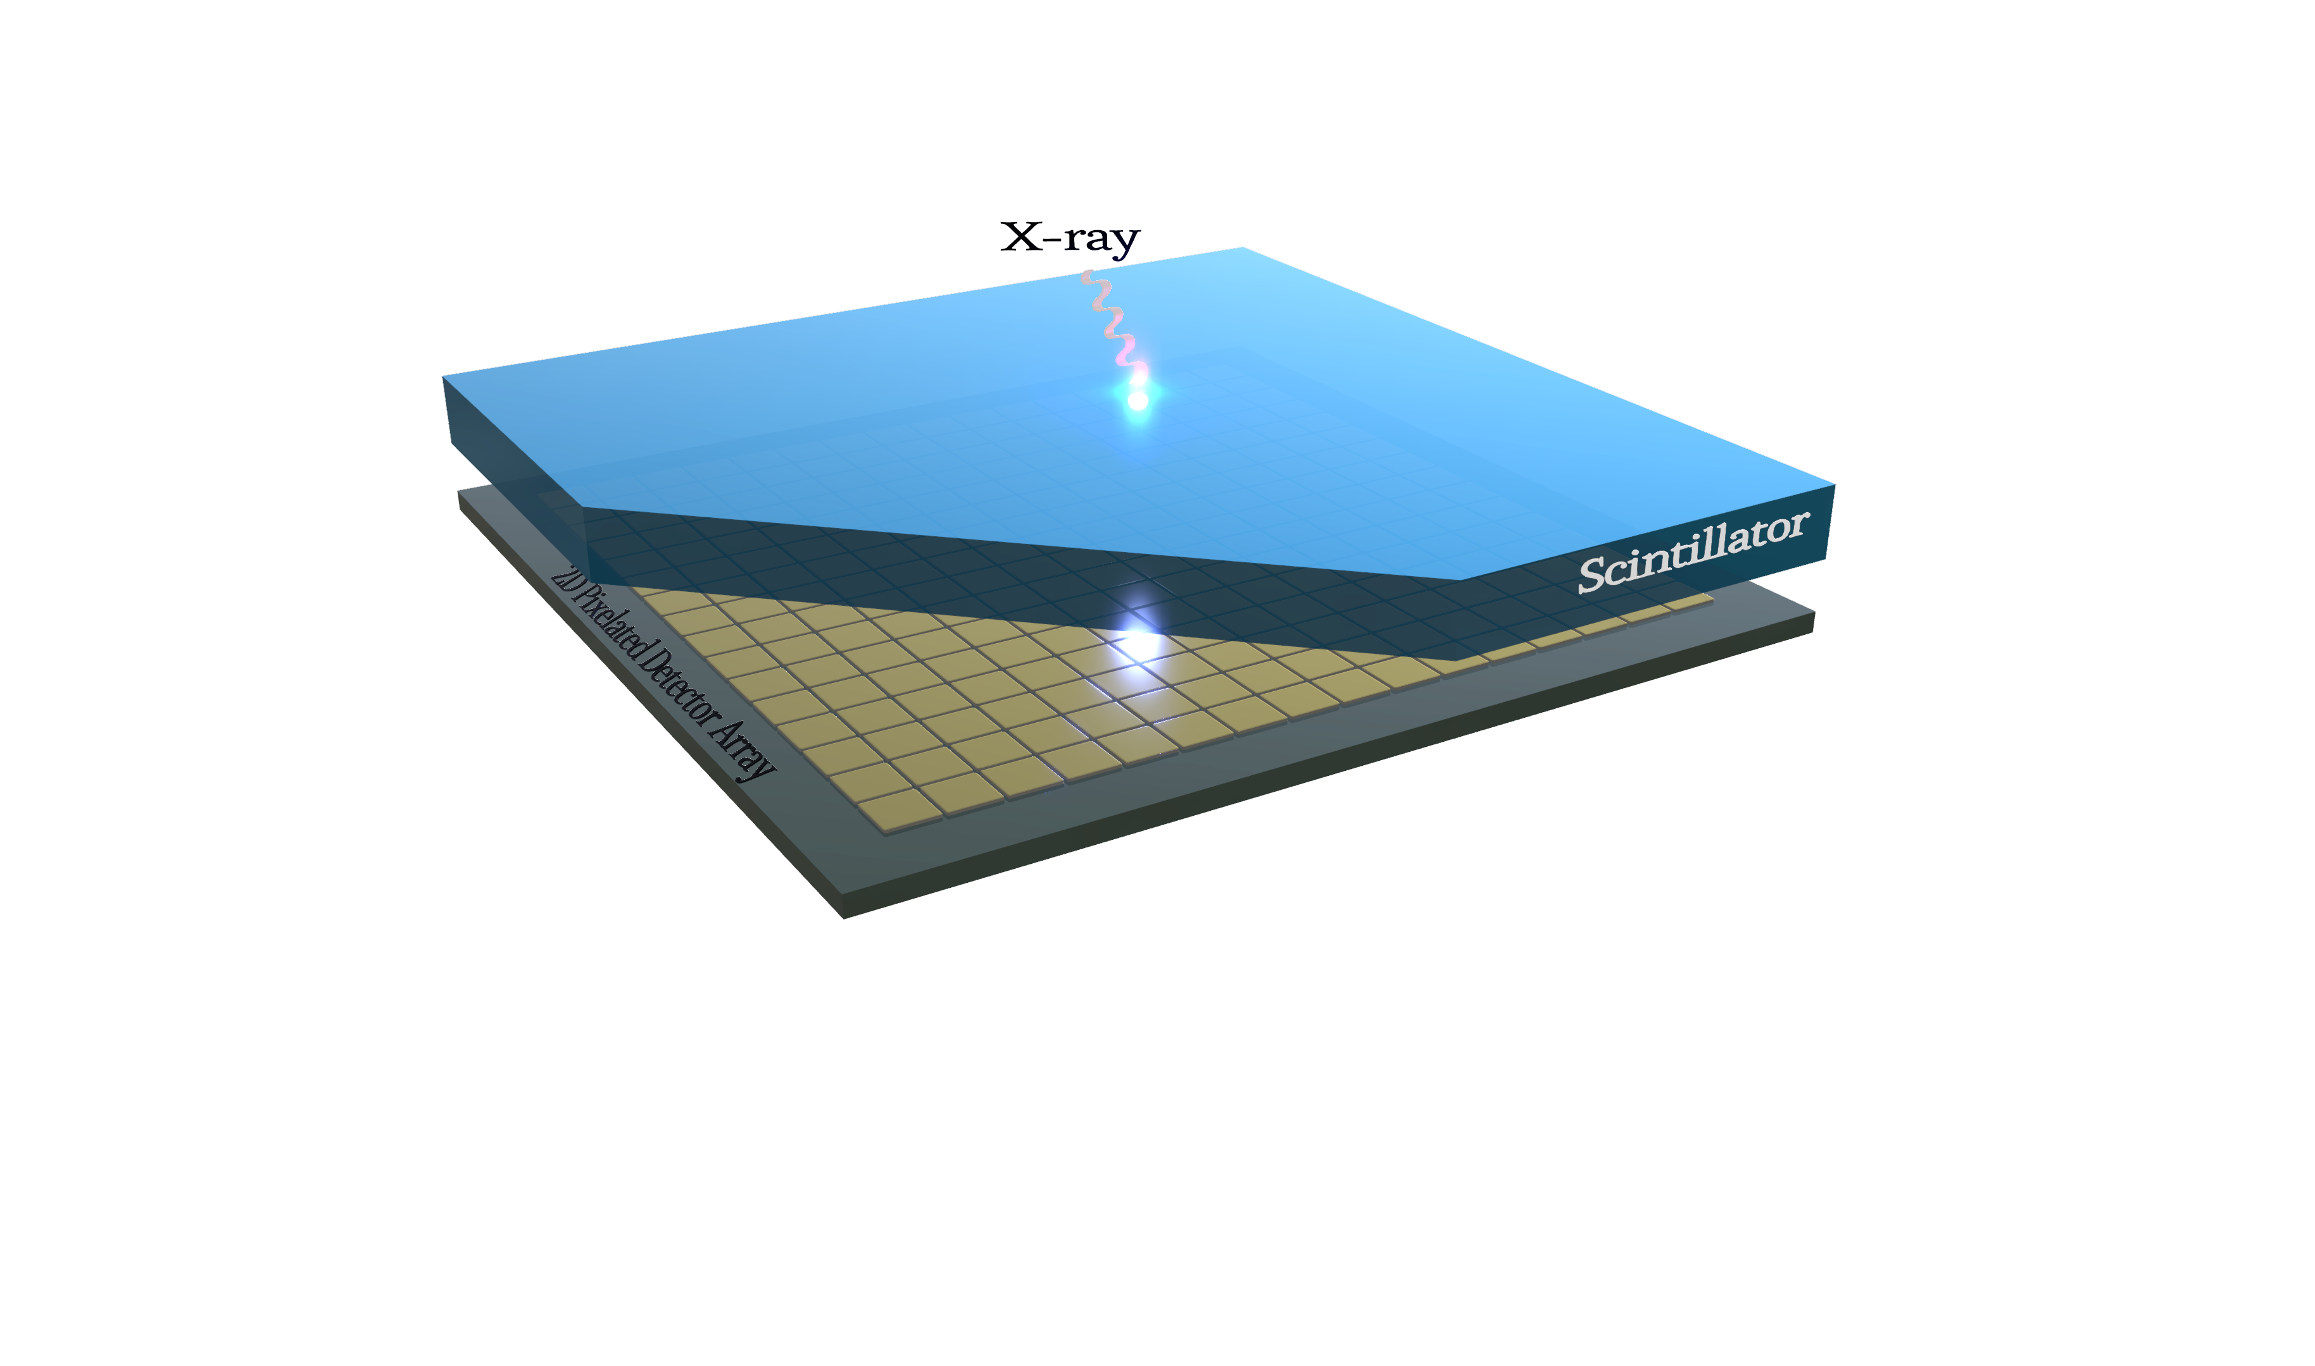
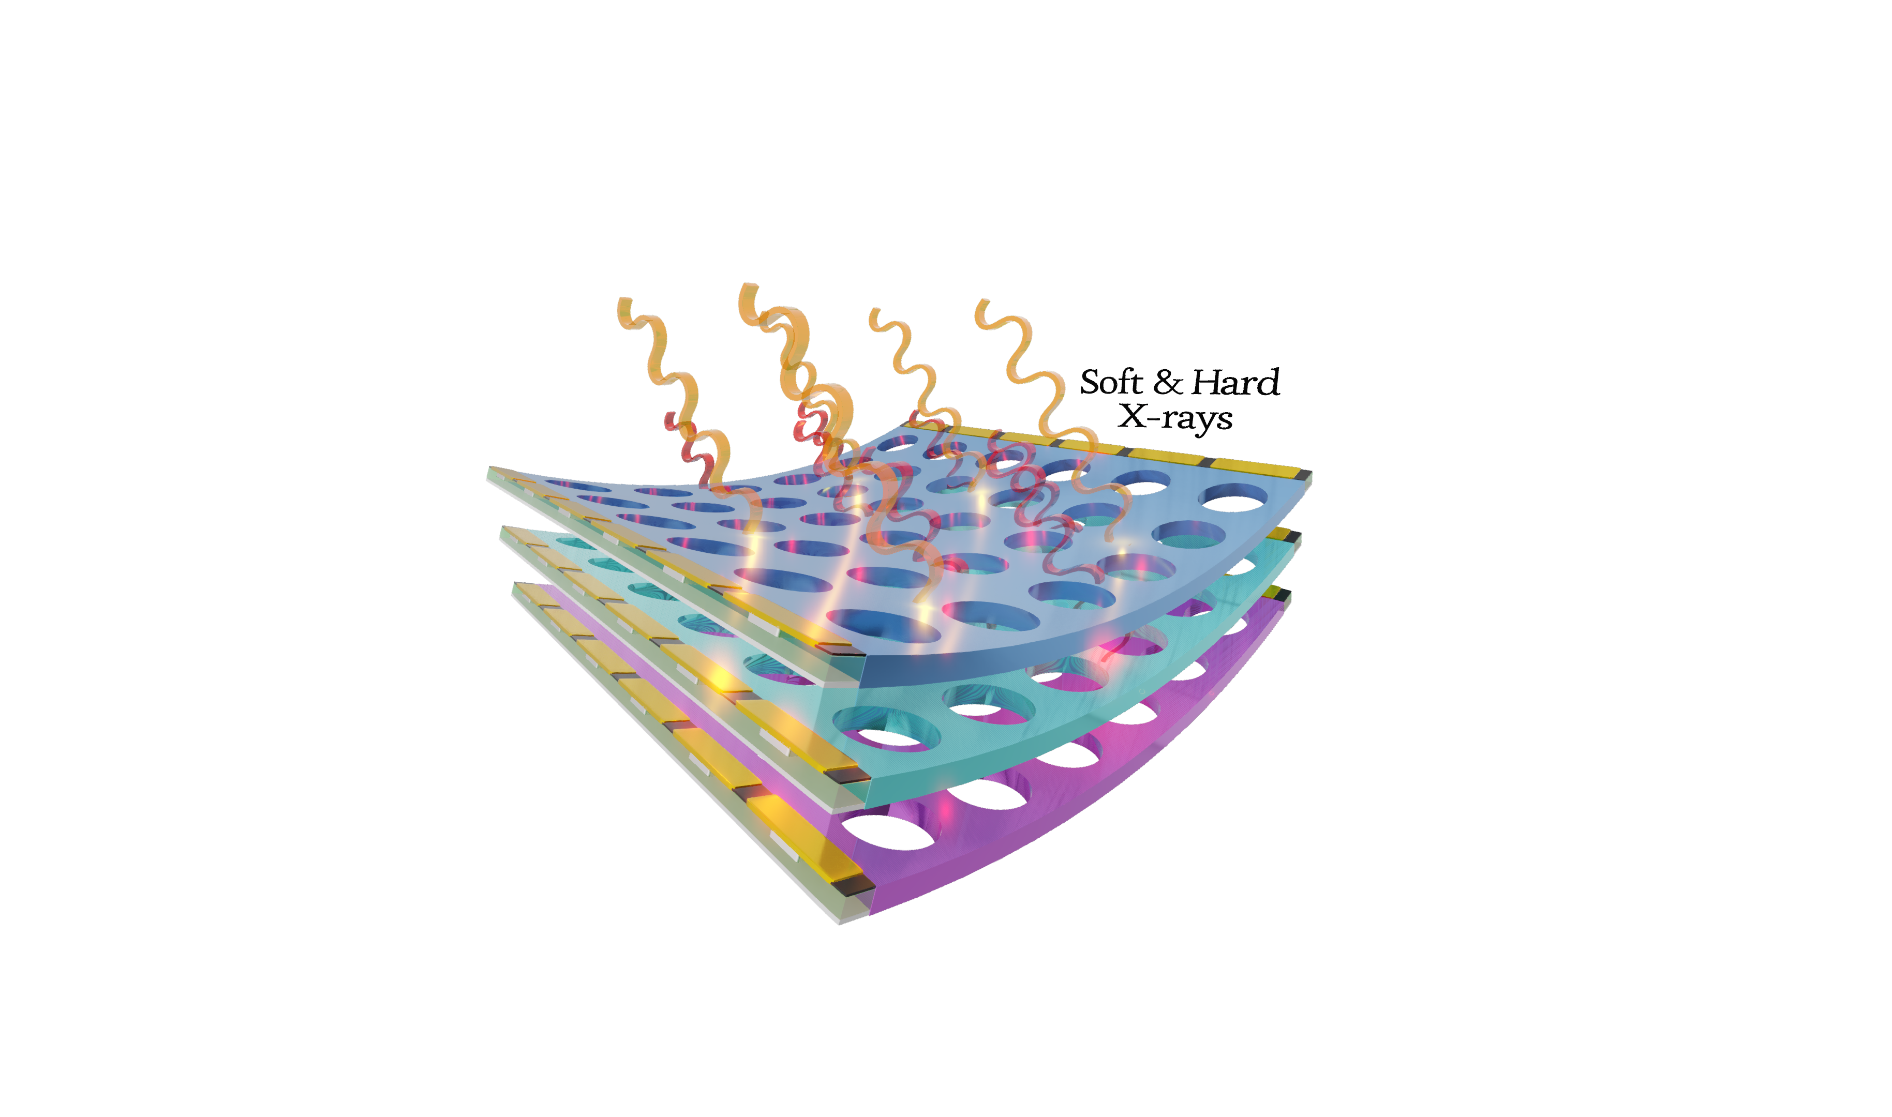
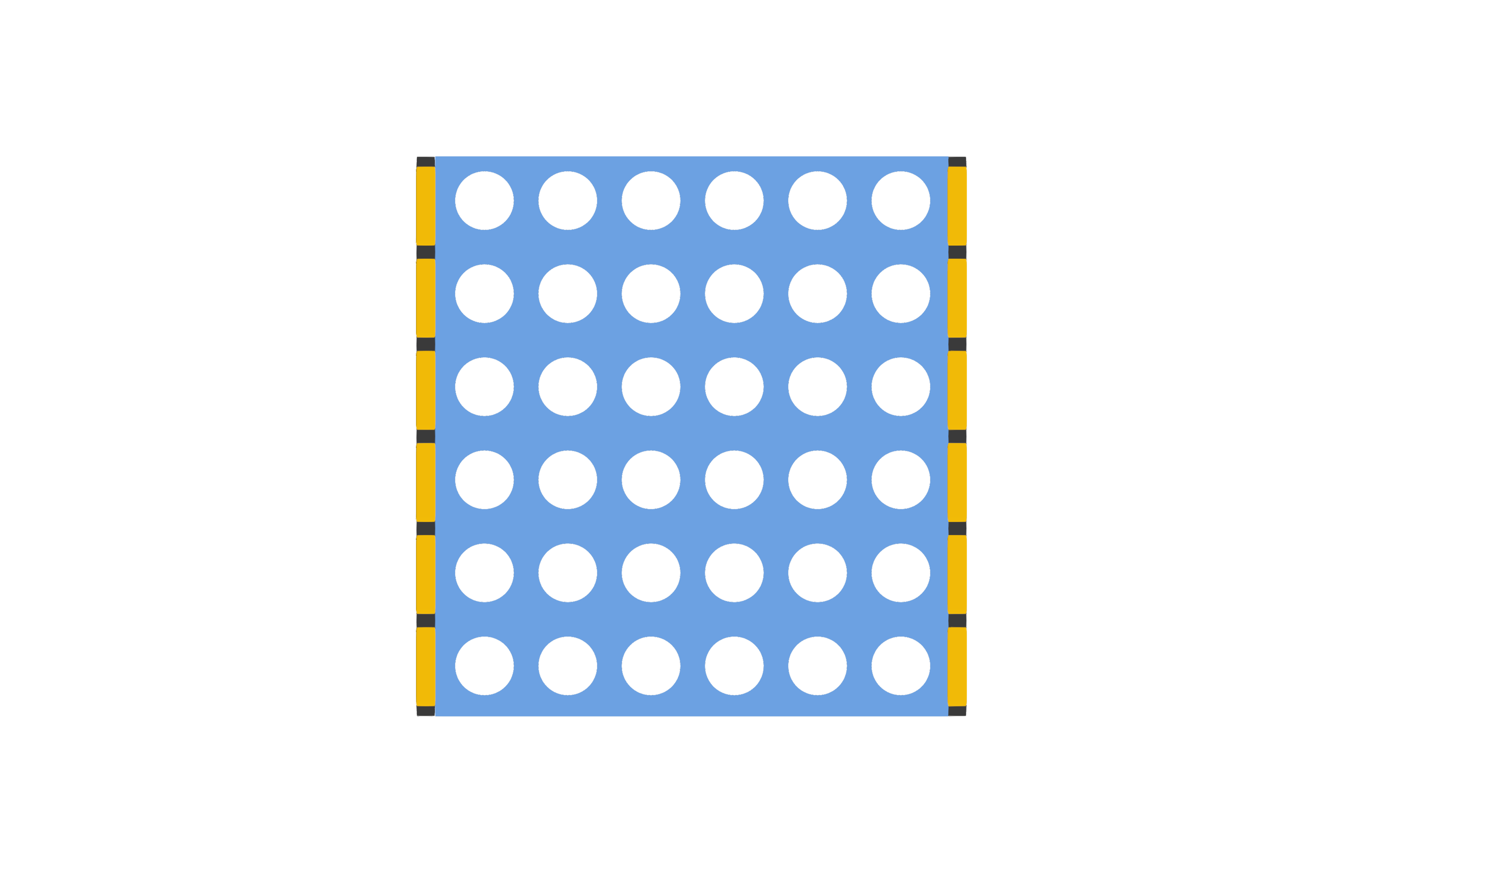
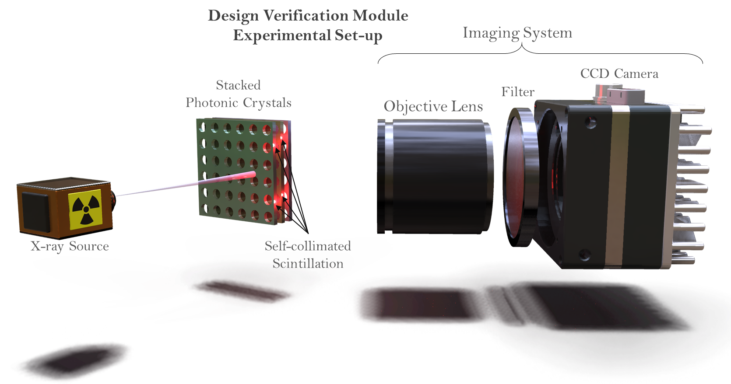


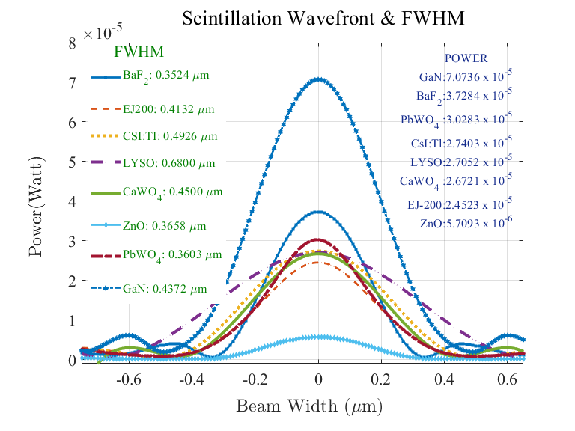
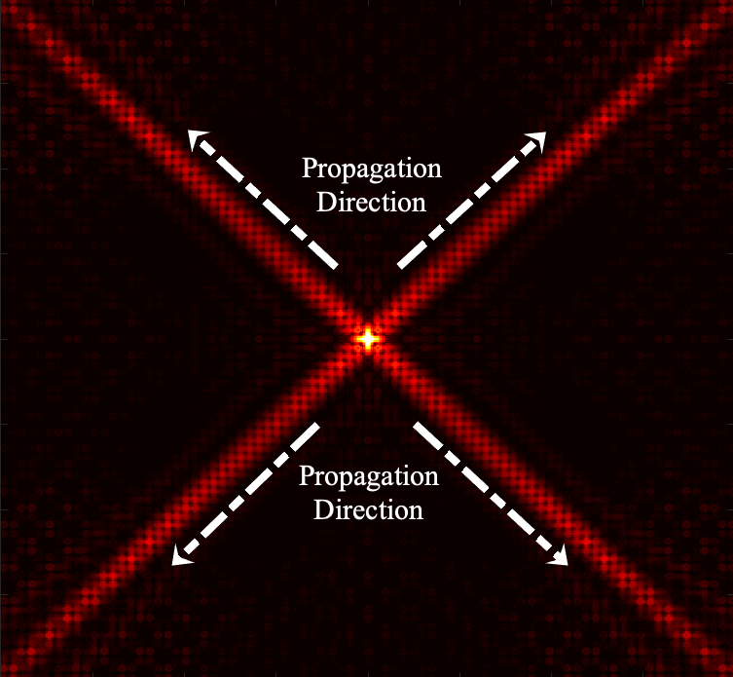

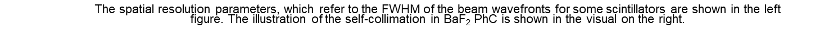
A Novel X-ray Imaging Detector Concept: Multilayer Photonic Crystal Scintillators with Perimetric Pixel Array
Firat Yasar*, Arezou Khoshakhlagh, Sam Keo
Jet Propulsion Laboratory, California Institute of Technology, Pasadena, CA, 91109, USA
*Contact email: firat.yasar@jpl.nasa.gov
OBJECTIVE
Develop a novel X-ray imaging detector architecture, which introduces perimetric charge coupled device arrays as pixels integrated laterally.
Offering a single imaging detector having energy resolving capability with high spatial resolution in broad X-ray energy regimes.
FABRICATION
Two main steps of fabrication;
E-beam lithography for patterning and Inductively Coupled Plasma (ICP) etching to realize photonic crystal structure.
The integration of perimetric CCDs via multi-stage wafer processing; deposition of the hard-mask layer, lithography, etch, regrowth of the CCD architecture, wet-etch for the lift-off of the excess layers.
MOTIVATION
Filling the technology gaps prioritized by the ”Decadal Survey on Astronomy and Astrophysics in 2020s.”
Using a photonic crystal structure collimating and guiding the scintillation in an in-plane geometry^{[1]}.
A novel concept with perimetric pixels, which unnecessiates 2D CCD/CMOS coupled at the back, and enables the stacking of thin film layers of a variety of scintillators.
An opportunity for flexible (polyvinyl-toluene) imaging detector application for better optical-angular-coupling efficiency.
Polarization-sensitive imaging capability.
Si₃N₄
Deposition
Scintillator
on n-type wafer
Lithography
UV Patterning
ICP/RIE
Etch
Si₃N₄
Photoresist
Photoresist
Etch
GaN
PhC Scintillator
GaN
PhC Scintillator
Si₃N₄
Si₃N₄
GaN
PhC Scintillator
GaN
PhC Scint.
GaN
PhC Scint.
n-type semiconductor
n-type semiconductor
n-type semiconductor
n-type semiconductor
Trench
Line
i-layer Deposition
p-layer Deposition
p-layer
Intrinsic
layer
Intrinsic
layer
Si₃N₄
Si₃N₄
Si₃N₄
State of the Art
Our Design
p
GaN
PhC Scint.
GaN
PhC Scint.
PhC Scint.
i-layer
PhC Scint.
PhC Scint.
i-layer
PhC Scint.
n-type semiconductor
n-type semiconductor
n-type semiconductor
Metal Deposition
Si3N4 Selective
Wet-Etch
Edge-on
Si p-i-n
between GaN PhCs
Metal
Metal
p-layer
p-layer
Intrinsic
layer
Intrinsic
layer
Si₃N₄
p
p
p
PhC Scint.
i-layer
PhC Scint.
GaN
PhC Scint.
i-layer
GaN
PhC Scint.
GaN
PhC Scint.
i-layer
GaN
PhC Scint.
Conventional X-ray imaging detector with CCD located at the back of the active layer.
Our design of an X-ray imaging detector with CCD is located at the perimeter of the active layer which can also be curved.
n-type semiconductor
n-type semiconductor
n-type semiconductor
DESIGN
CHARACTERIZATION
X-ray induced scintillation spectroscopy: energy resolution and spatial resolution analysis with required apparatuses for focusing and filtering^{[2]}.
Photoluminescence spectroscopy to characterize scintillation properties such as light yield, scintillation wavelengths and intensity ^{[3]}.
Photonic Crystal Structure
2-dimensional photonic crystal structure, which consists periodic cylindrical air holes.
150nm unit cell size of Photonic crystal media, with ~ 500 nm thick scintillator thin films.
Edge-on detectors integrated laterally to the active scintillation layers.
A simple p-i-n structure for perimetric pixels.
Multilayer architecture of variety of stacked thin film scintillators.
Scintillator
Metal Contact
SiO₂
Edge-on
Detector Array
Edge-on Detector
Photonic Crystal Unit Cell
150nm x 150nm
Photonic Crystal Stack of various scintillators
Multilayer Linear Detector arrays
The figure shows an experimental setup for verification of the self-collimated scintillation. The objective lens with a specific X-ray filter is focused on the sides of the active layer where the self-collimated in-lane scintillation will be observed.
TARGETED RESULTS
200 nm – 500 nm spatial resolution with about or less than 3% ~ energy resolution at 662 keV.
Polarization sensitive imaging with an engineered PhC structure.
Broadband X-ray imaging including soft, tender and hard X-rays (0.1-100keV).
Reduced coupling loss with the X-ray optics of the space telescopes.
Metal Contact
Gold or Aluminum
SiO₂
p-type Strip
Edge-on Detector
n-type Substrate
Large Bandgap Semiconductors (300nm-500nm)
GaN, AlN, ZnS, ZnSe, MgSe, MgTe, …
MPB
MIT-Photonic Bands
SIMULATIONS
For computing the band structures, or dispersion relations, and electromagnetic modes of periodic dielectric structures.
For computing Fourier transforms based finite-difference time and frequency simulations for the validation of the self-collimating PhC structures.
Acknowledgement: We would like to thank Tim Kalman from Goddard Space and Flight Center, Jessica Gaskin from Marshalls Space and Flight Center, and Zhehui Wang from Los Alamos National Laboratory for their support and guidance.
References:
[1] Yasar, F., Kilin, M., Dehdashti, S., Yu, Z., Ma, Z., & Wang, Z. (2021). Spatially resolved x-ray detection with photonic crystal scintillators. Journal of Applied Physics, 130(4), 043101.
[2] Roques-Carmes, Charles, et al. "A framework for scintillation in nanophotonics." Science 375.6583 (2022): eabm9293.
[3] Varney, C. R., et al. "X-ray luminescence based spectrometer for investigation of scintillation properties." Review of Scientific Instruments 83.10 (2012): 103112.
Poster Number: PRD-T#017
© 2022. All rights reserved.

