Slide 1

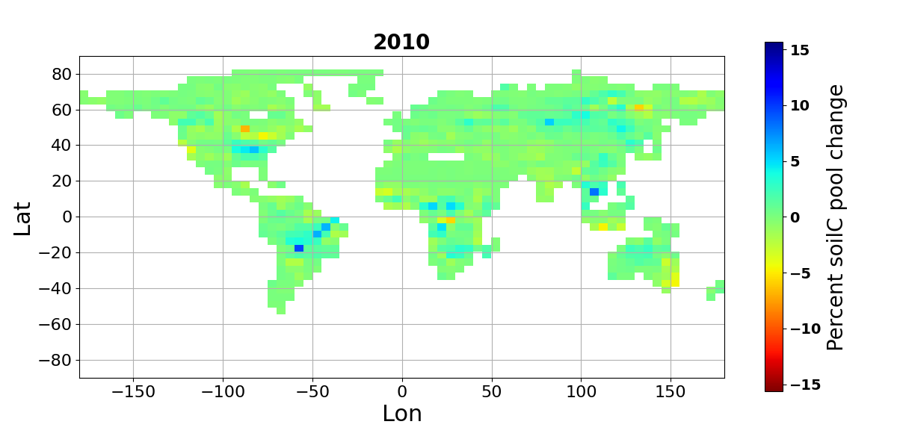
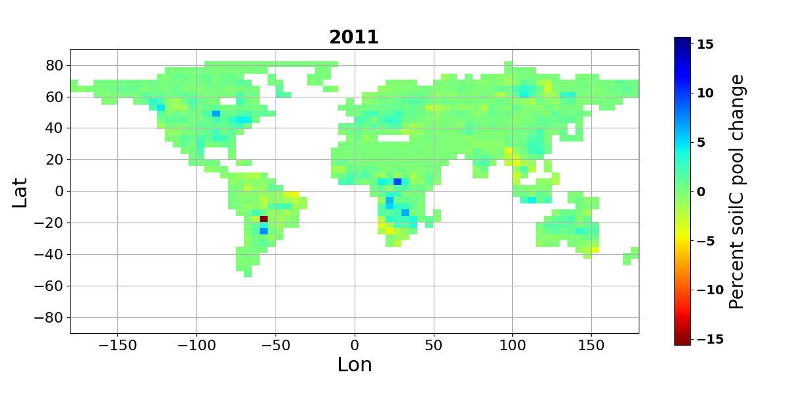

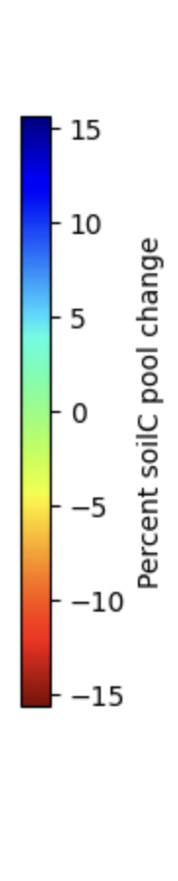
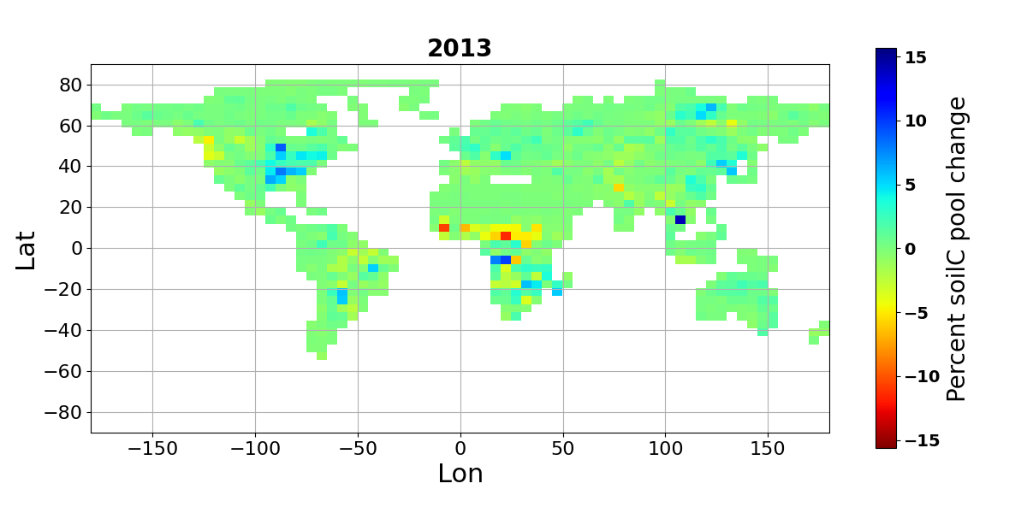
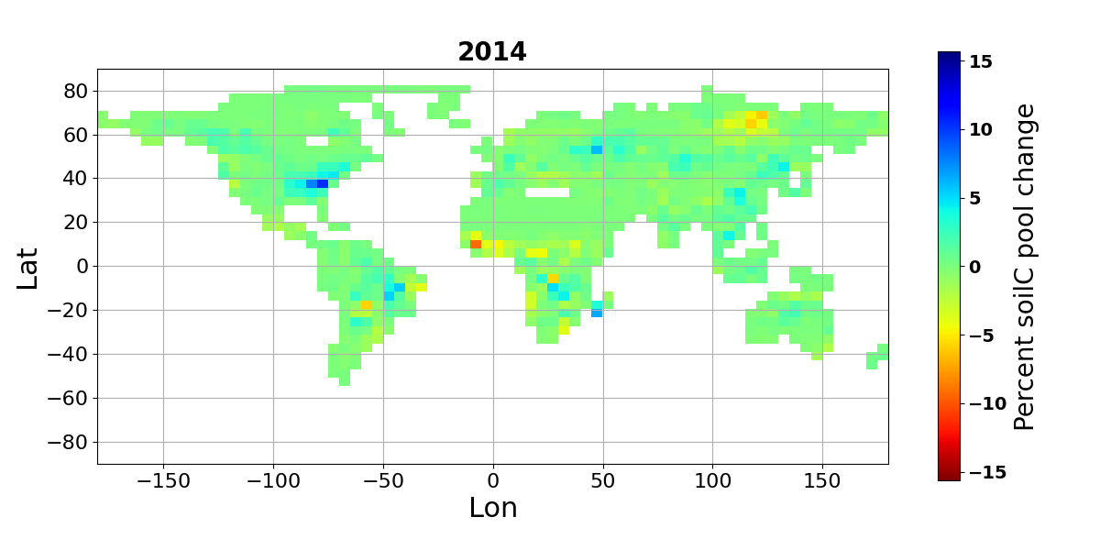



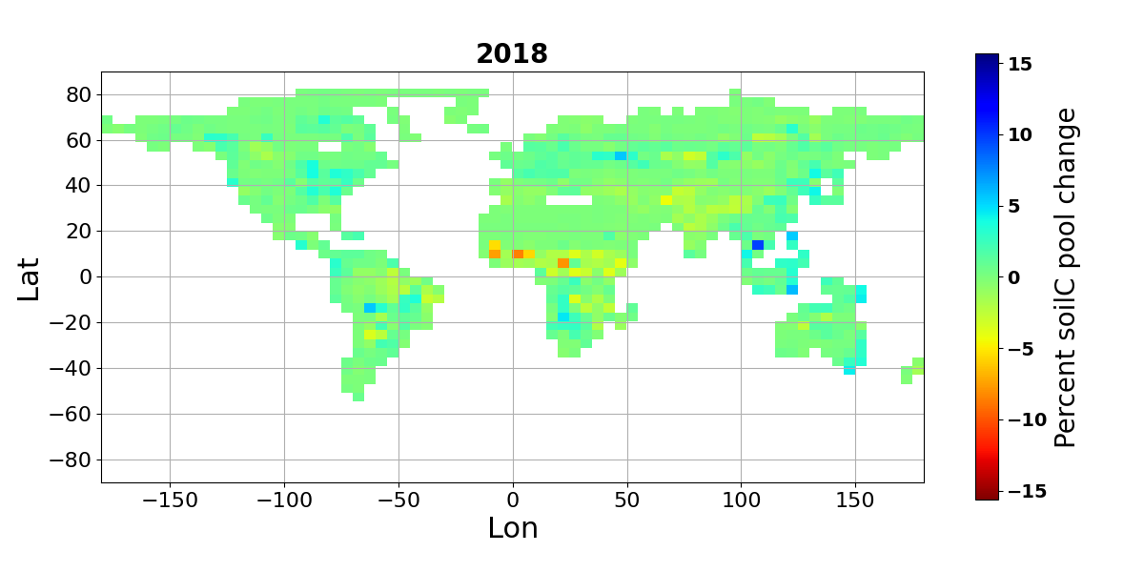
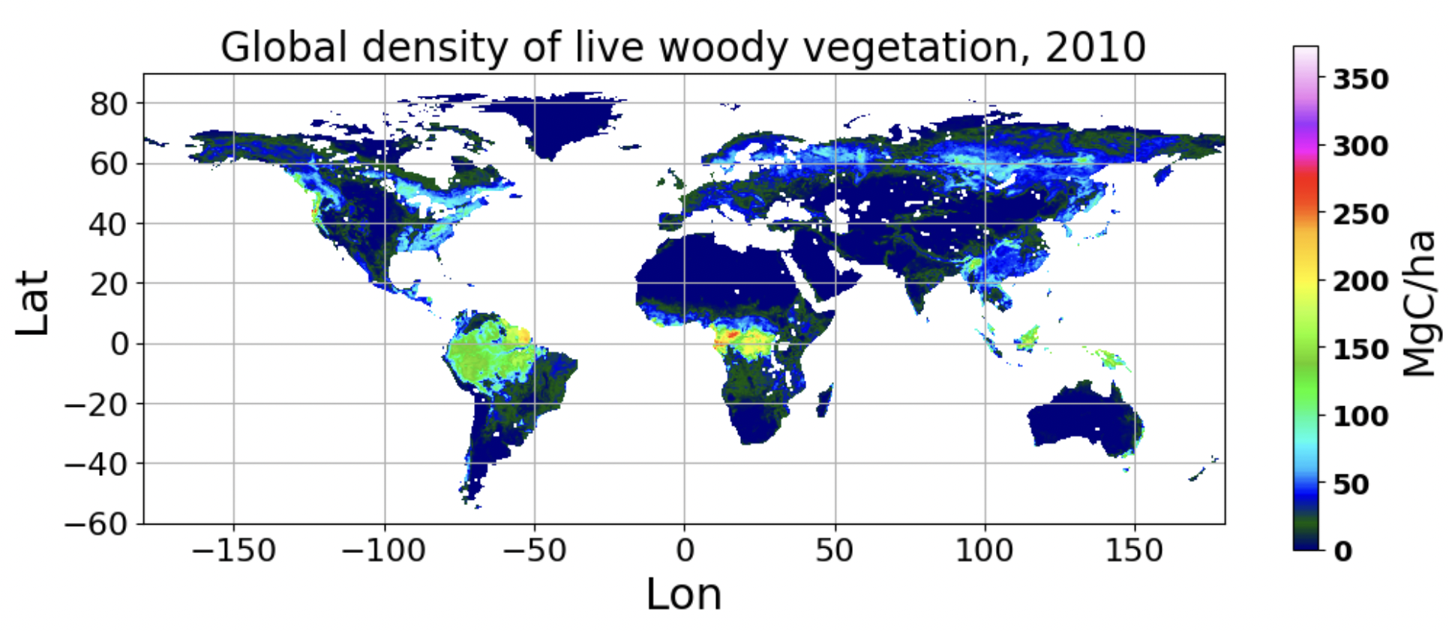
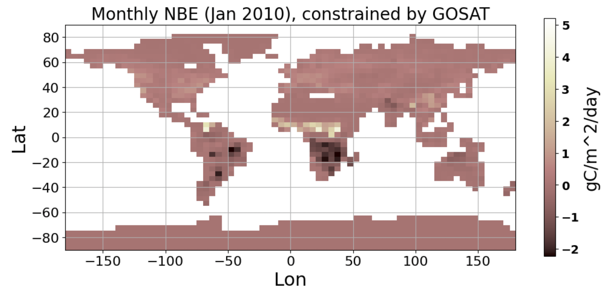
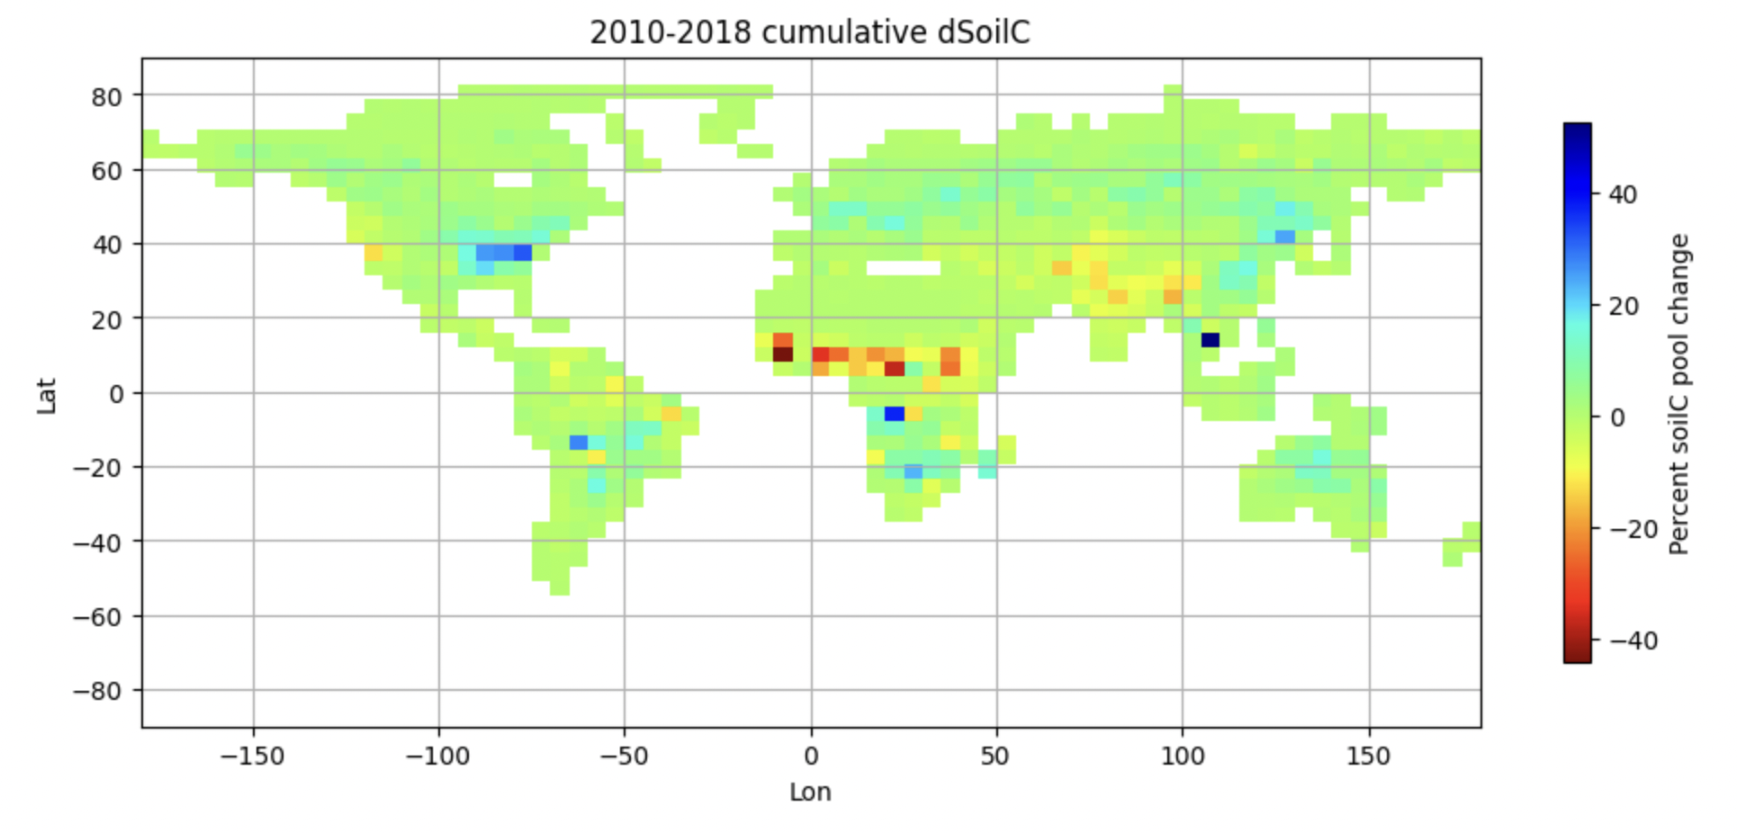
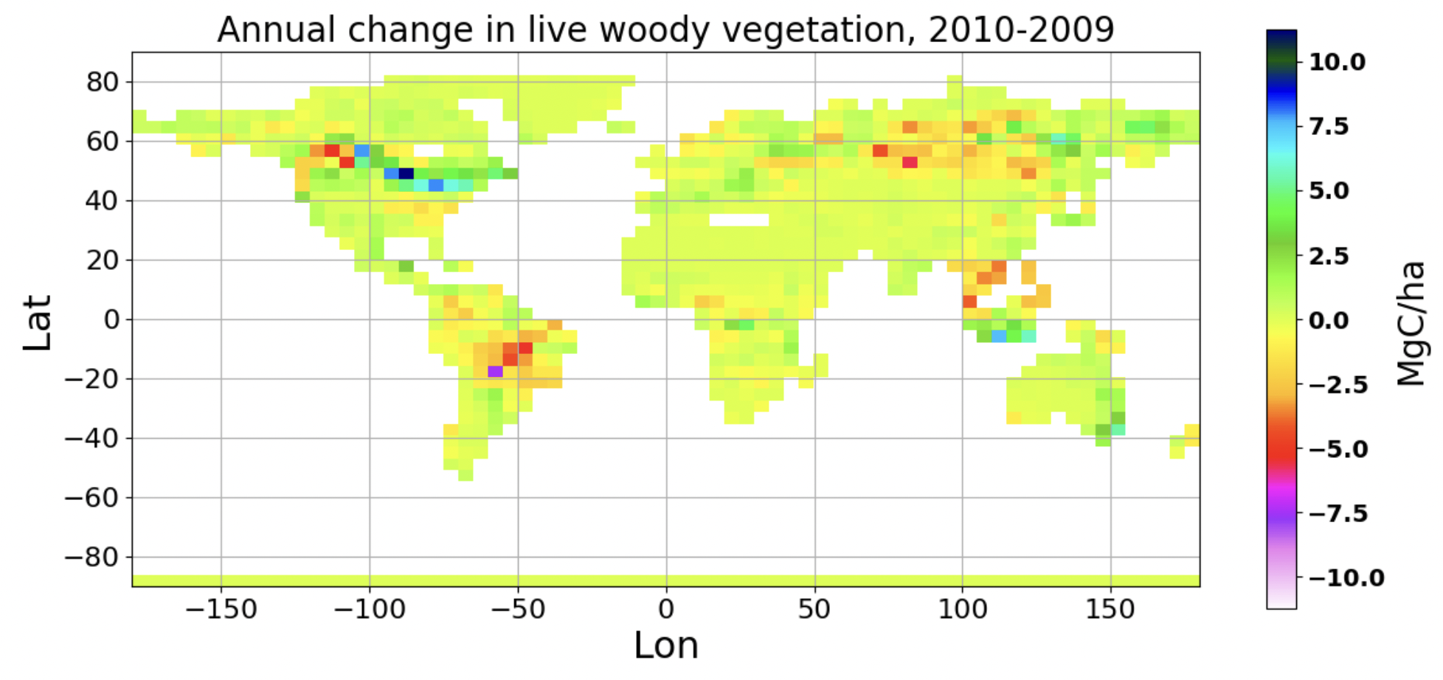
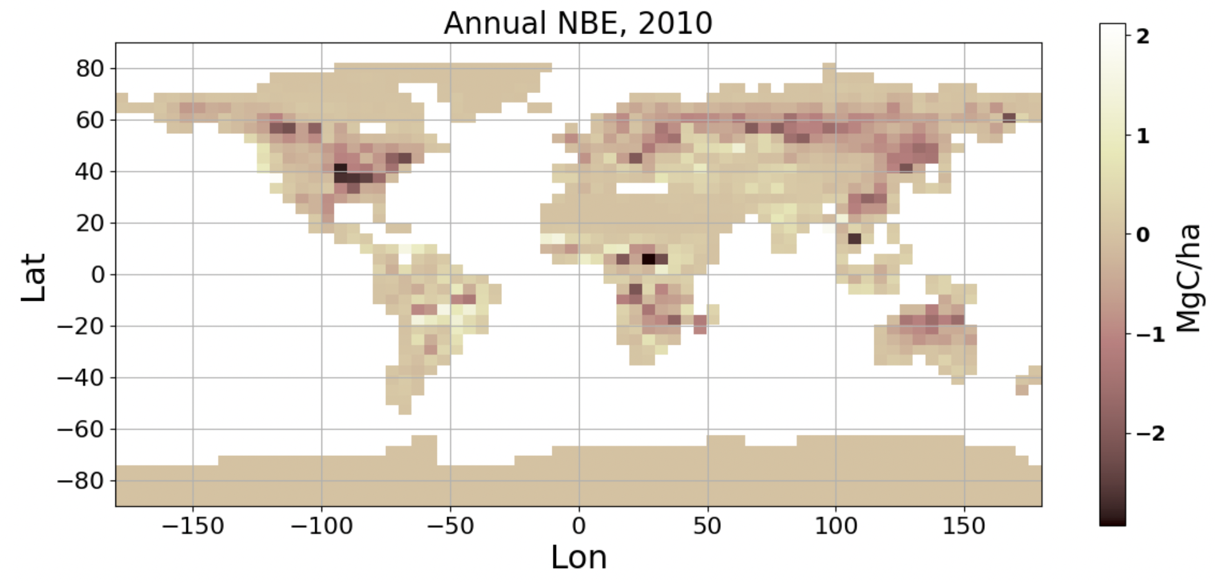
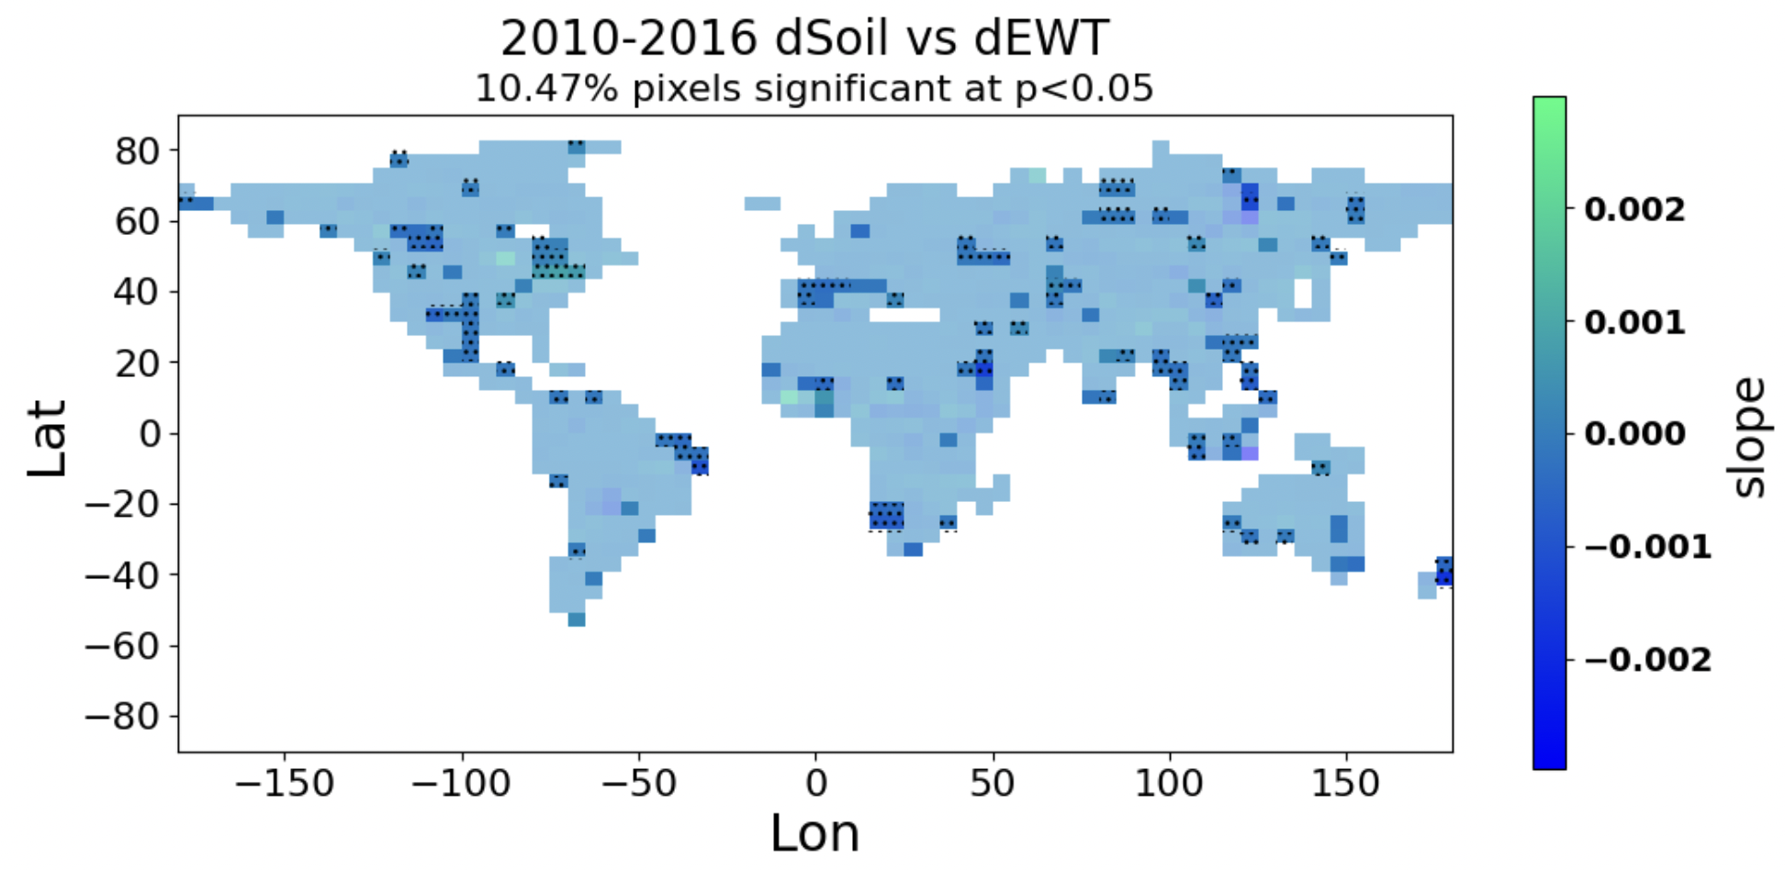
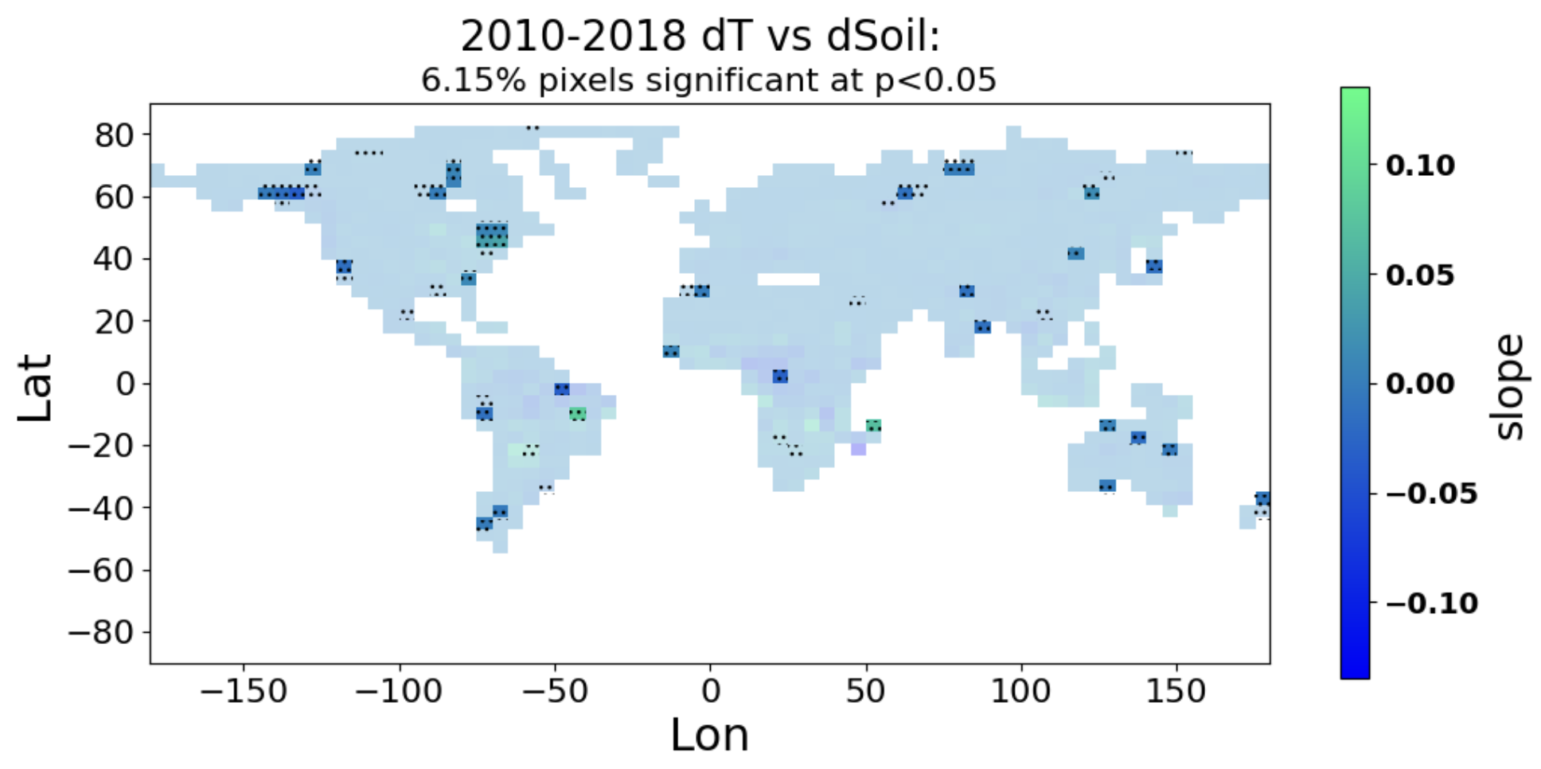
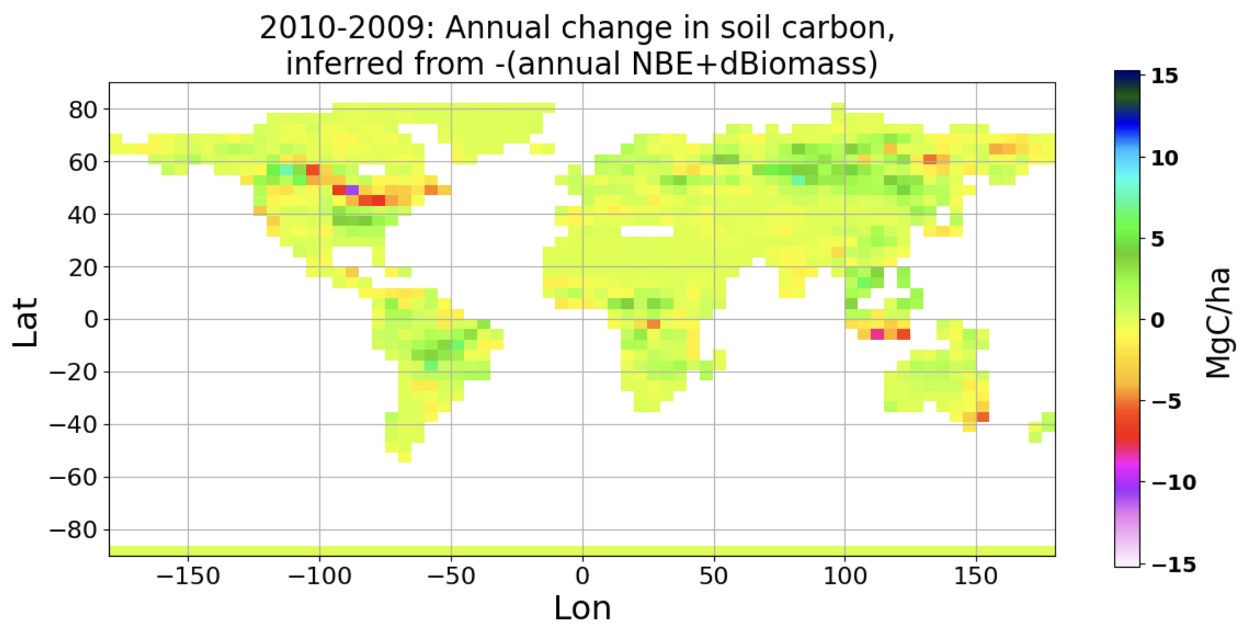
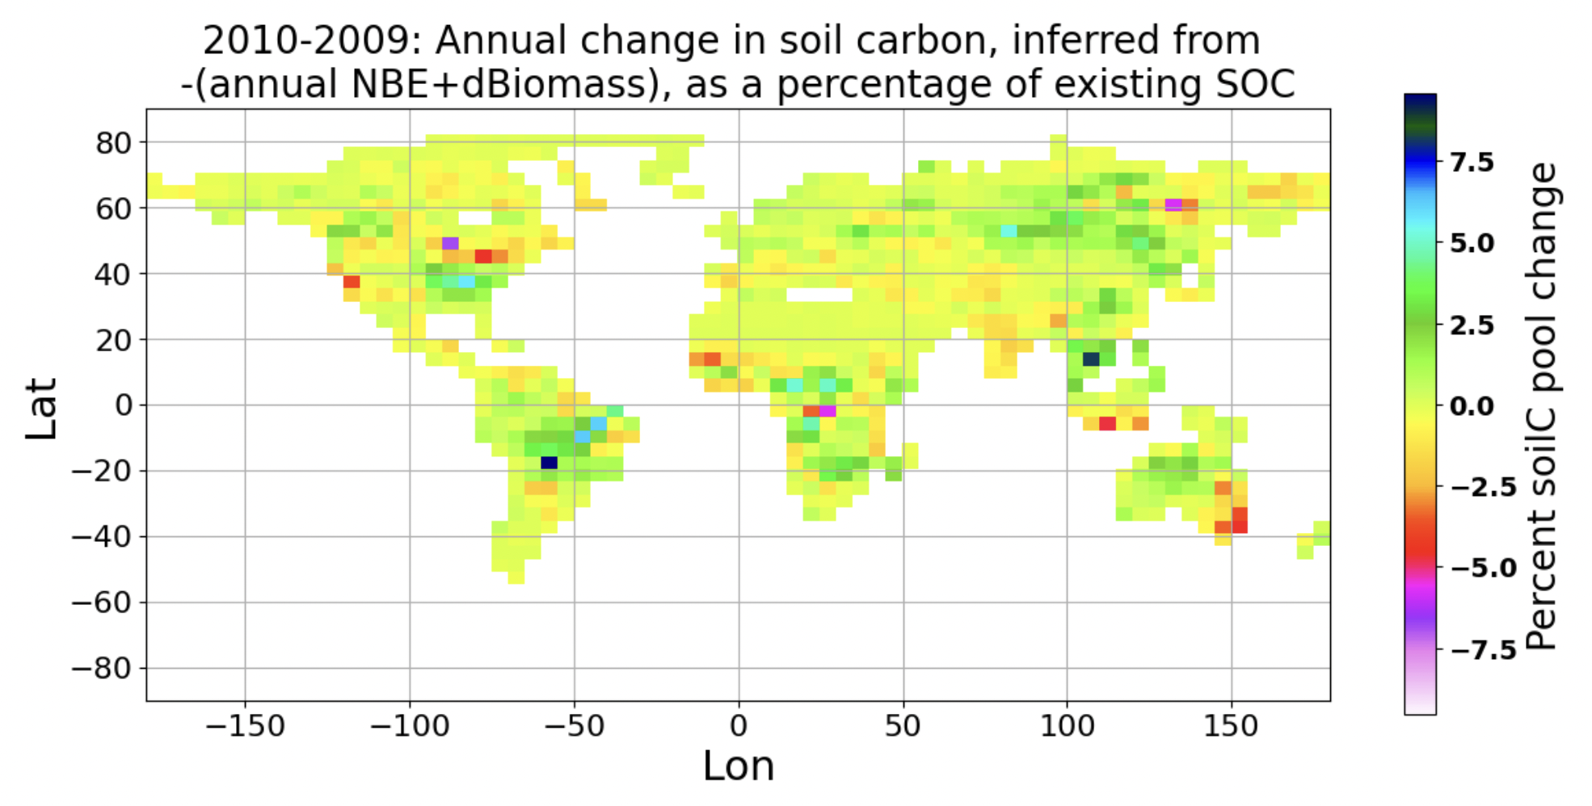
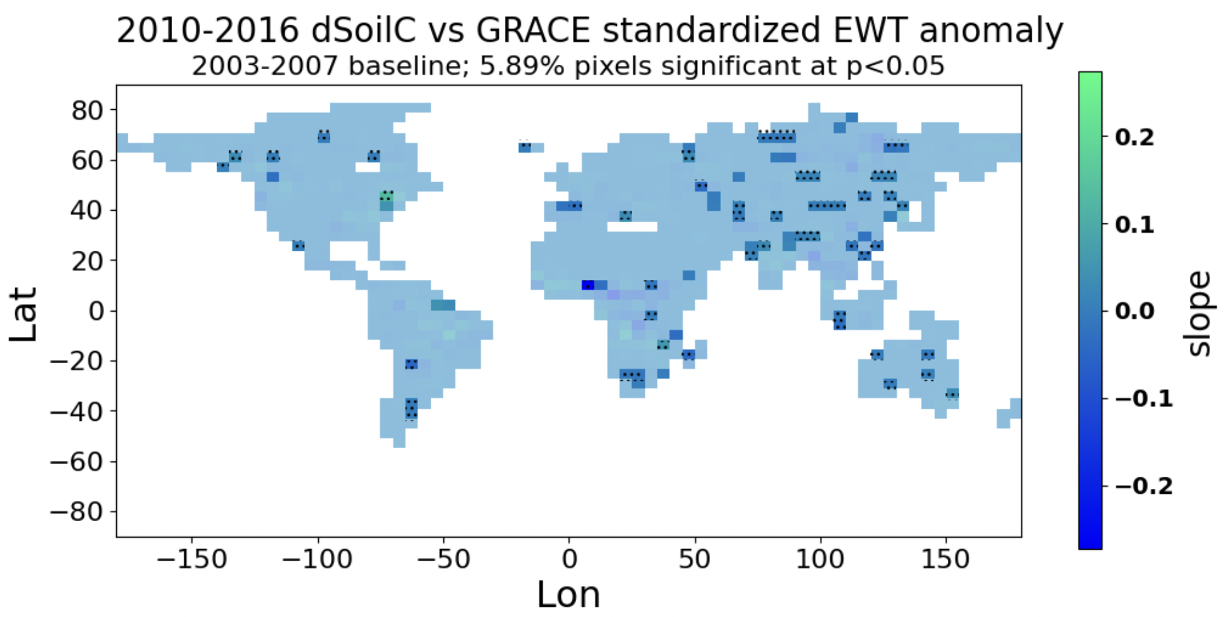
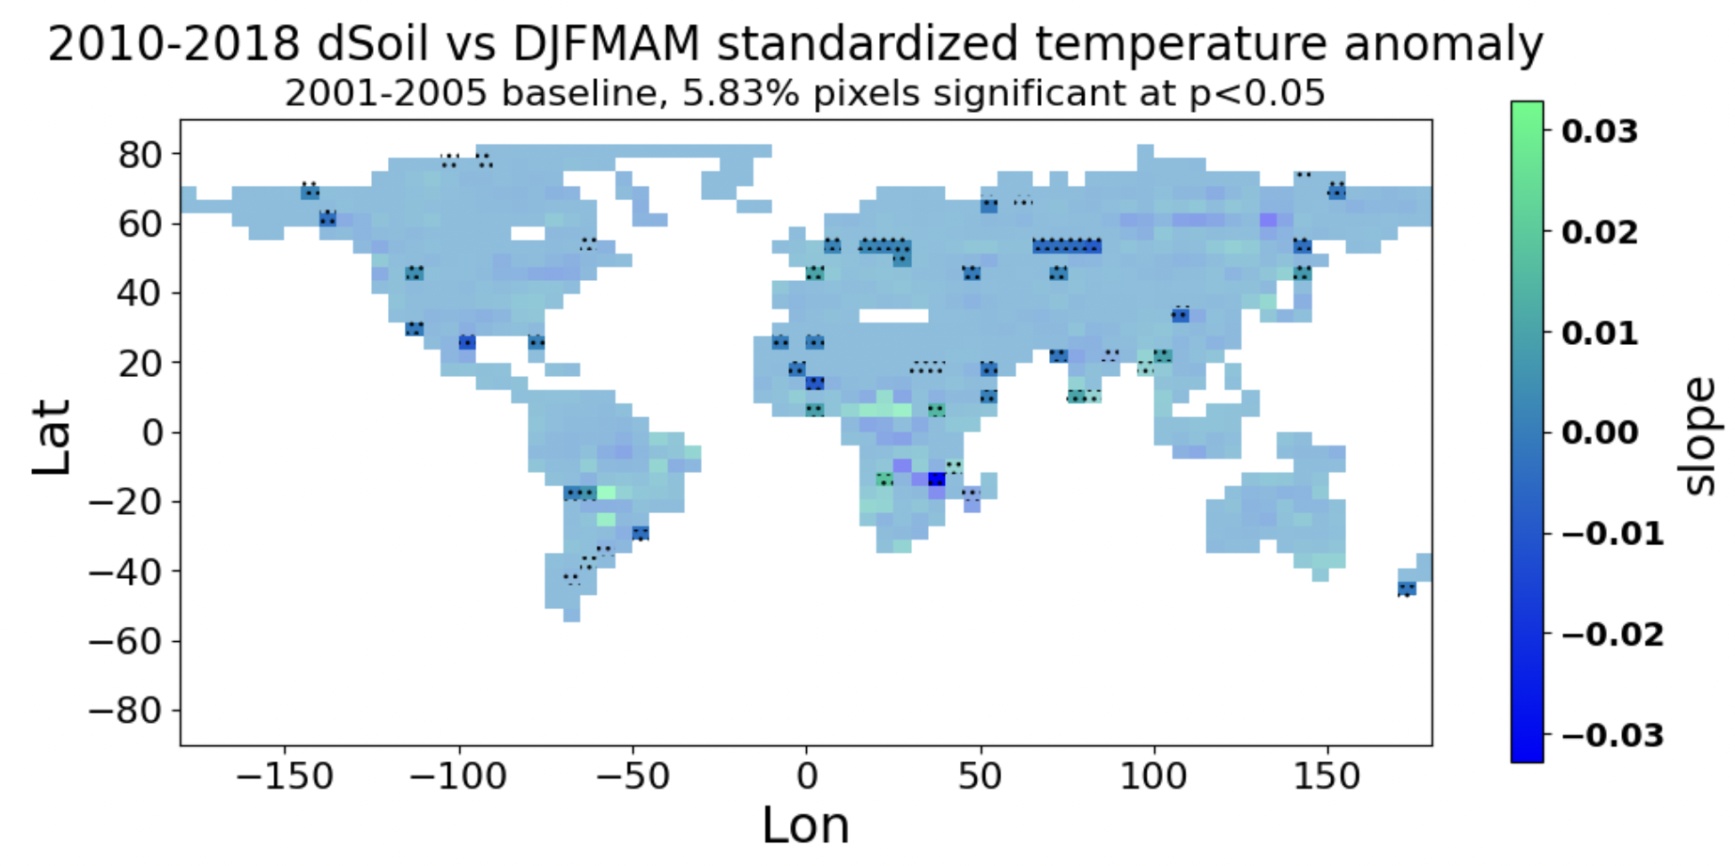
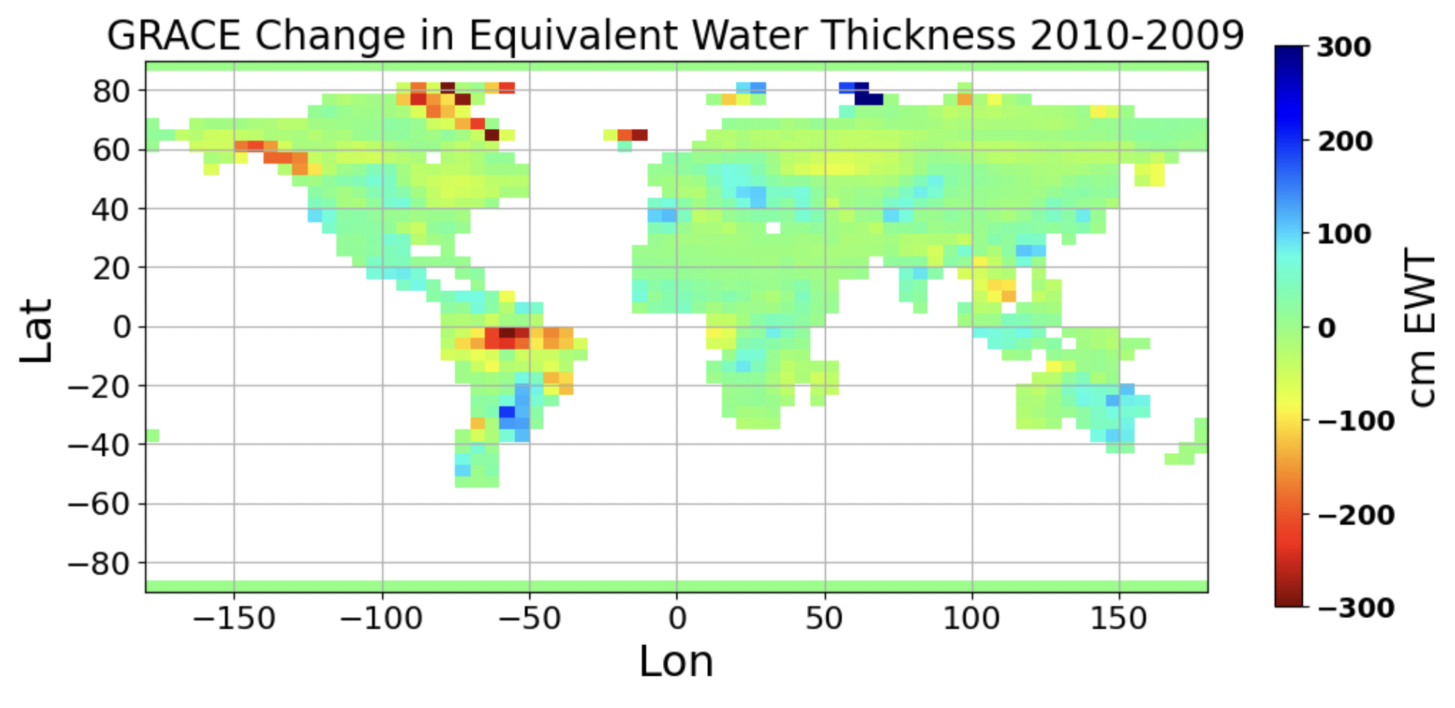
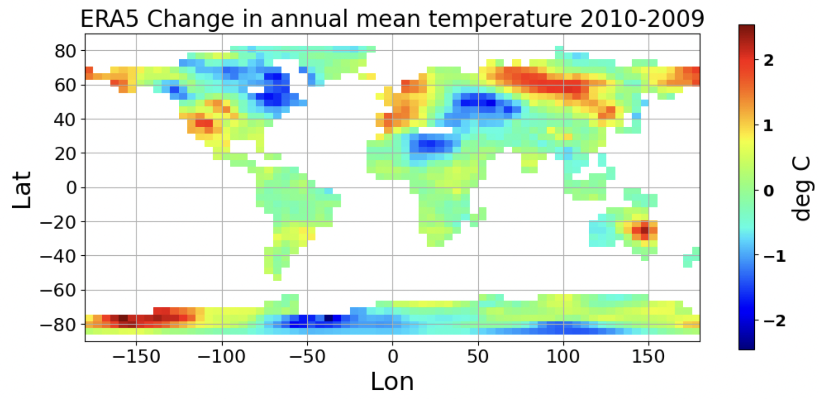
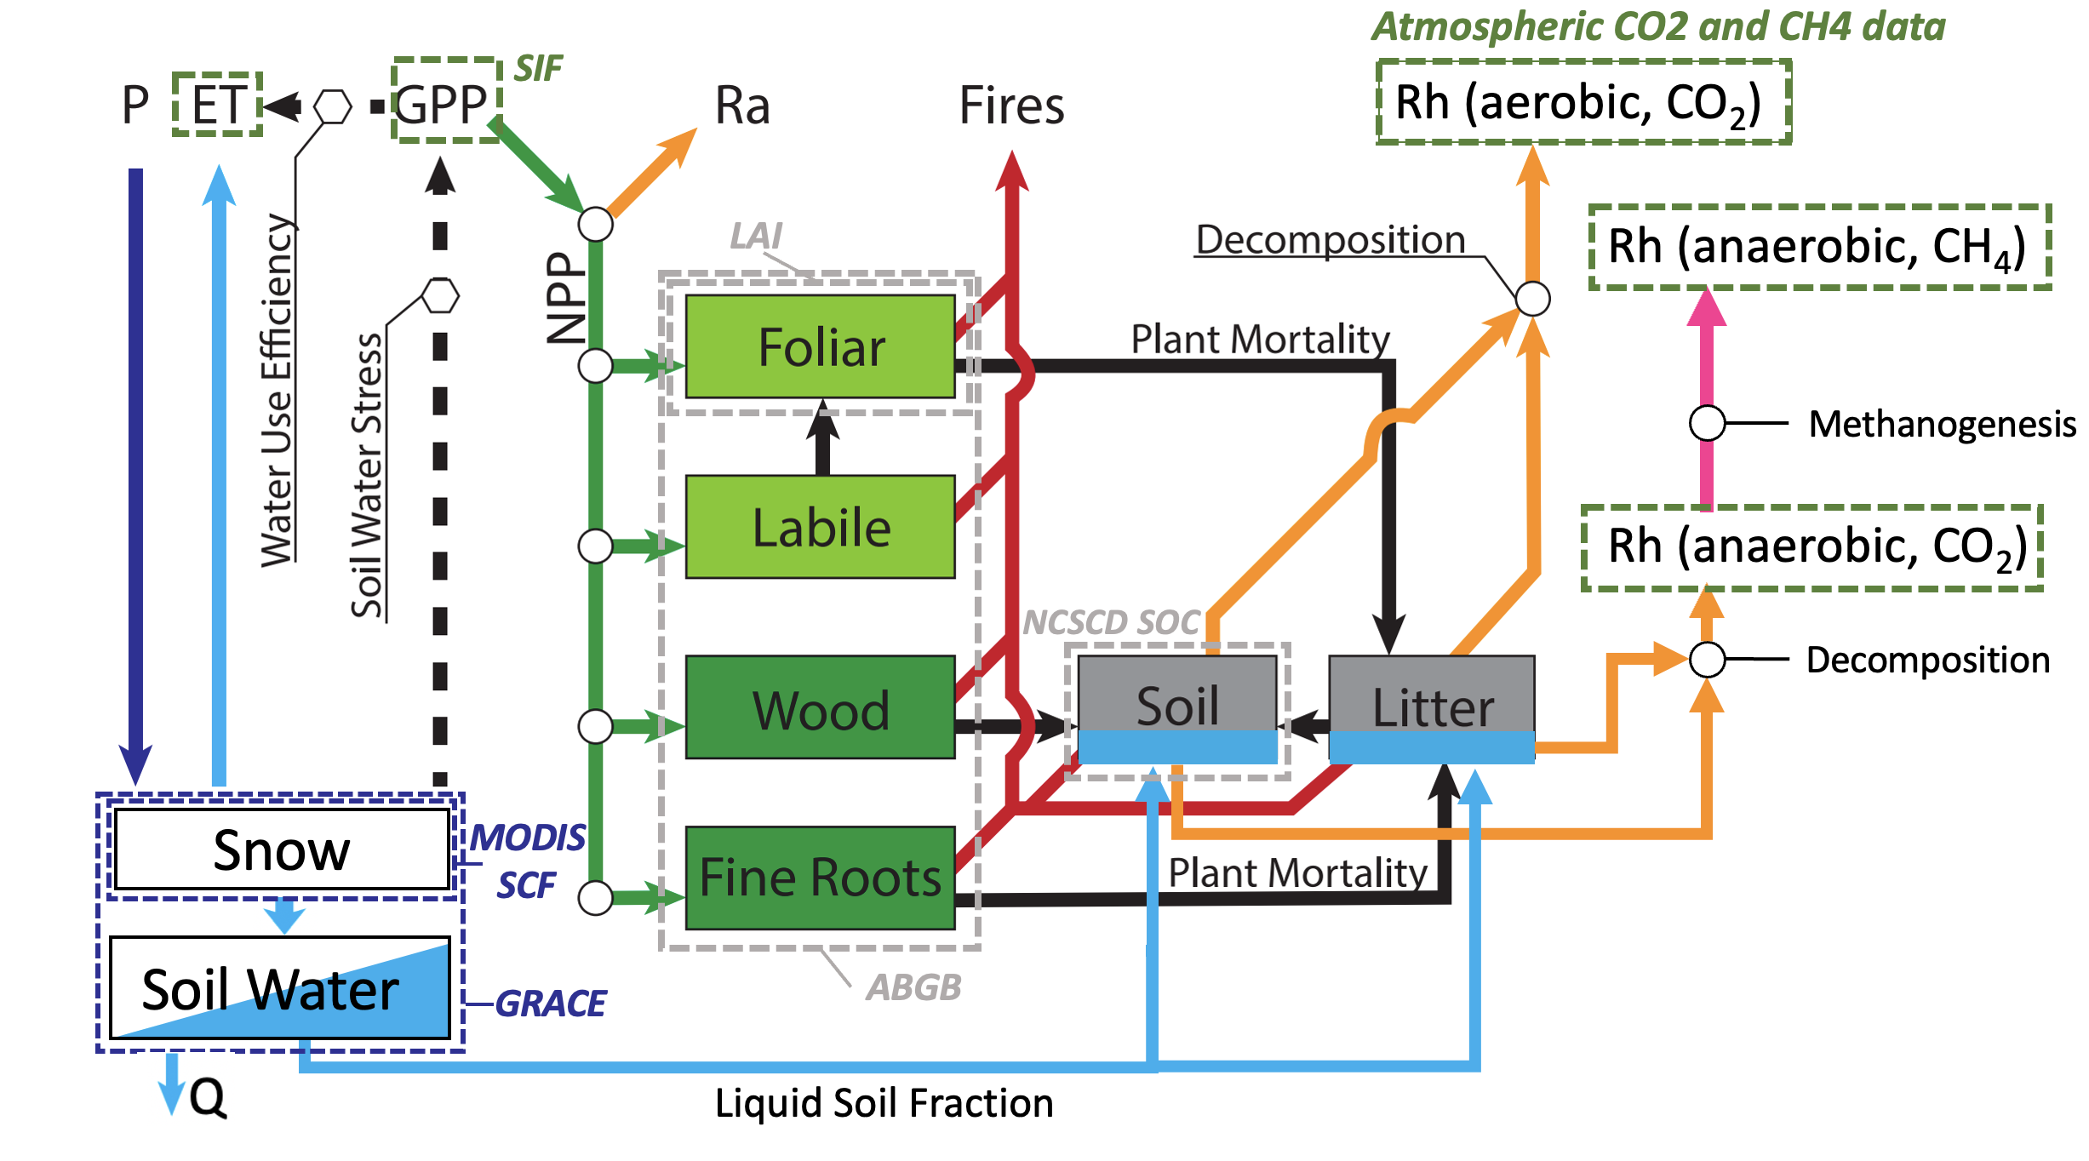
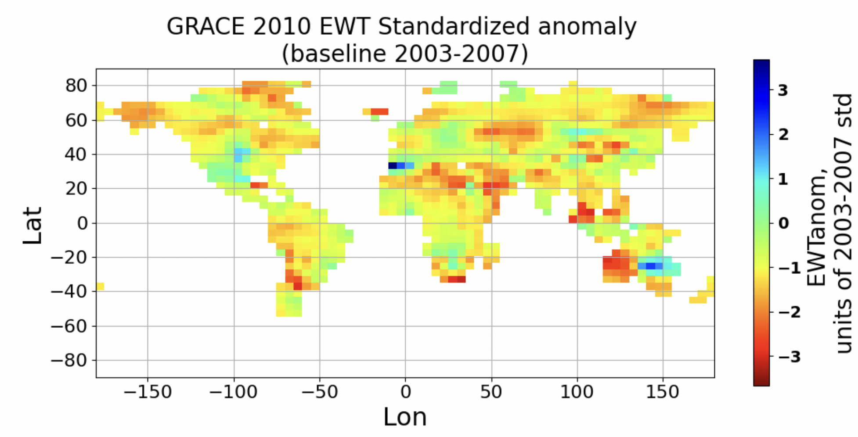
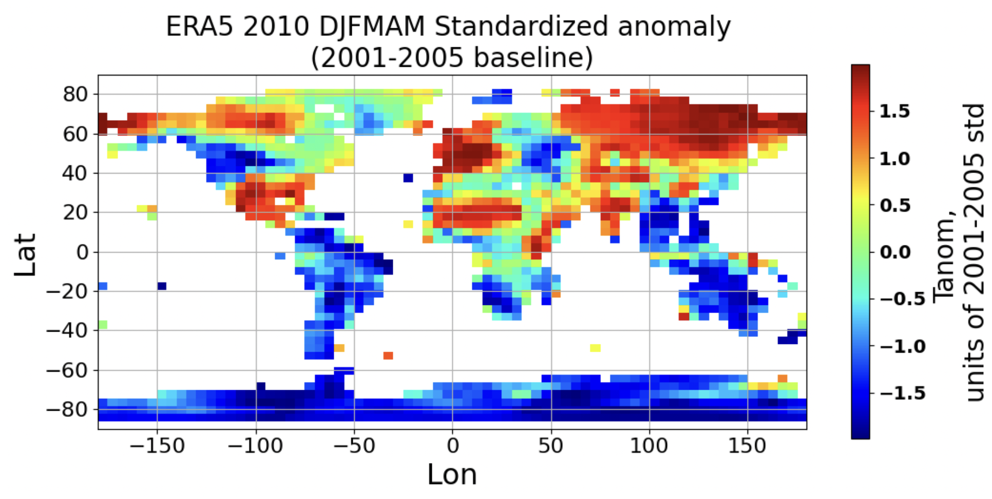

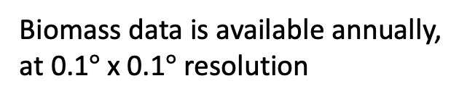

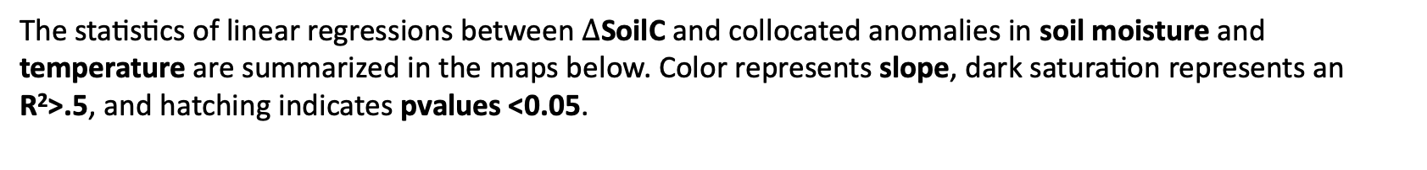


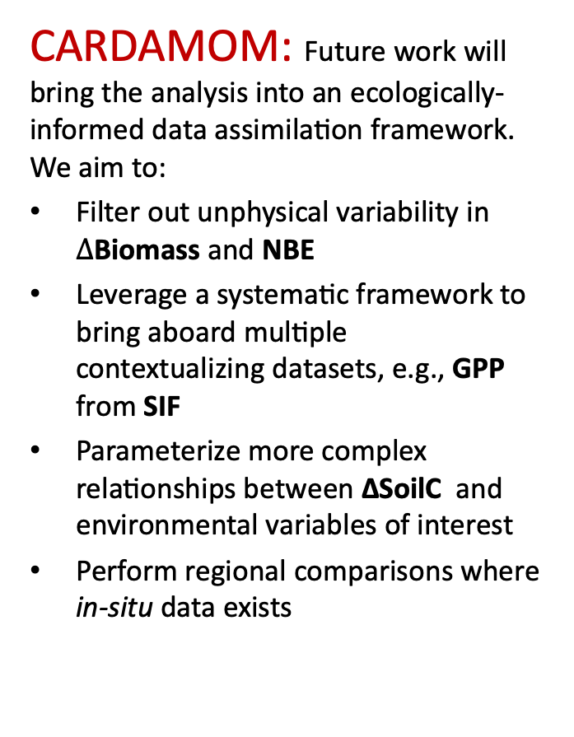

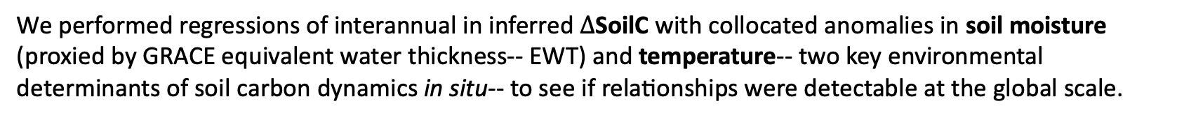
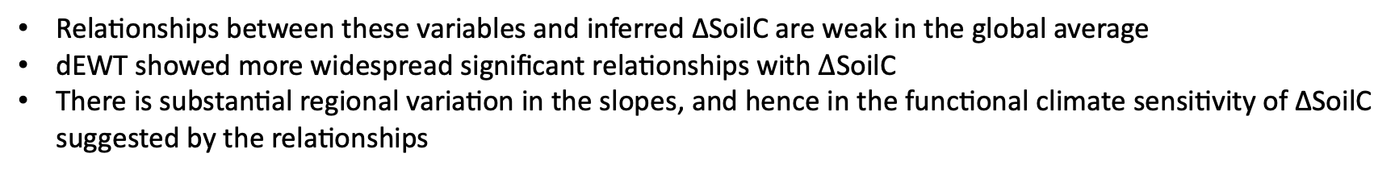
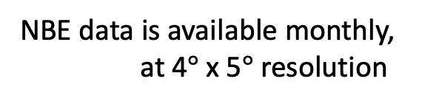
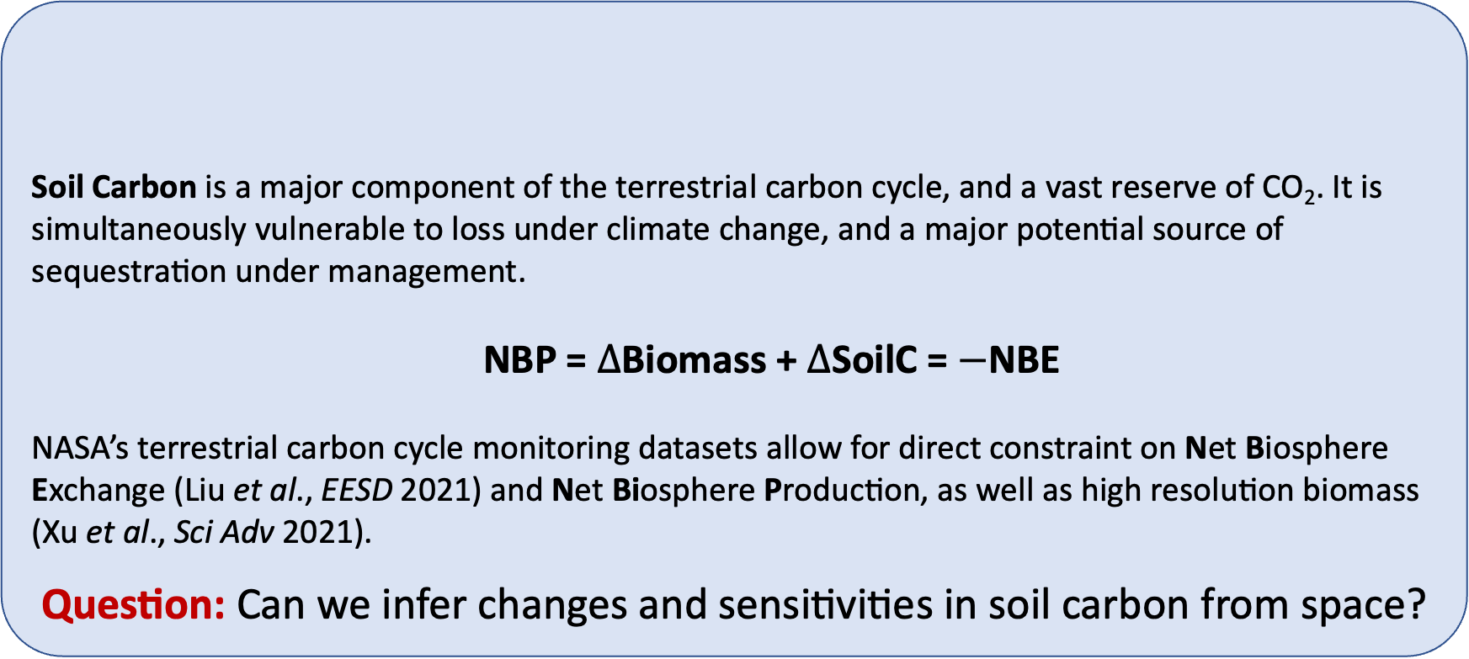
National Aeronautics and Space Administration
Digging into soil carbon from space
Author: Eren Bilir (329F) JPL Postdoctoral Fellow
Anthony Bloom (329F), Renato Braghieri (329F-Caltech), Paul Levine (329F), Junjie Liu (329G), Shuang Ma (329F), Alex Norton (329G), Nick Parazoo (329G)
1. Motivation
Soil Carbon is a major component of the terrestrial carbon cycle, and a vast reserve of CO₂. It is simultaneously vulnerable to loss under climate change, and a major potential source of sequestration under management.
NBP = $∆$Biomass + $∆$SoilC = $−$NBE
NASA’s terrestrial carbon cycle monitoring datasets allow for direct constraint on Net Biosphere Exchange (Liu et al., EESD 2021) and Net Biosphere Production, as well as high resolution biomass (Xu et al., Sci Adv 2021).
Question: Can we infer changes and sensitivities in soil carbon from space?
3. Preliminary results
Inferred $∆$SoilC, 2010-2018
2. Methods
Match data resolutions
Biomass data is available annually,
at 0.1$°$x 0.1$°$ resolution
NBE data is available monthly,
at 4$°$x 5$°$ resolution
Hotspots of loss emerge in the Sahel, Himalayas, northern Amazon, and California
Hotspots of gain emerge across temperate Eurasia, Southeastern North America, Central South America, and Southern Africa.
Interpretation of this signal as ∆SoilC is unvalidated, but some agreement of gain/loss regions with in-situ reports is promising
Regrid to 4$°$x 5$°$
Extract interannual change
Match units
Extract annual sum
Environmental sensitivities of $∆$SoilC
The statistics of linear regressions between $∆$SoilC and collocated anomalies in soil moisture and temperature are summarized in the maps below. Color represents slope, dark saturation represents an R²>.5, and hatching indicates pvalues <0.05.
Solve for $∆$SoilC
$∆$SoilC = $−$(NBE+ $∆$Biomass)
Interannual differences & anomalies in regional water content
Explore regional climate context
Interannual differences in temperature & its wintertime anomaly (northern hemisphere)
Relationships between these variables and inferred ∆SoilC are weak in the global average
dEWT showed more widespread significant relationships with $∆$SoilC
There is substantial regional variation in the slopes, and hence in the functional climate sensitivity of ∆SoilC suggested by the relationships
4. Future directions
CARDAMOM: Future work will bring the analysis into an ecologically-informed data assimilation framework. We aim to:
Filter out unphysical variability in $∆$Biomass and NBE
Leverage a systematic framework to bring aboard multiple contextualizing datasets, e.g., GPP from SIF
Parameterize more complex relationships between ∆SoilC and environmental variables of interest
Perform regional comparisons where in-situ data exists
We performed regressions of interannual in inferred $∆$SoilC with collocated anomalies in soil moisture (proxied by GRACE equivalent water thickness-- EWT) and temperature-- two key environmental determinants of soil carbon dynamics in situ-- to see if relationships were detectable at the global scale.
National Aeronautics and Space Administration
Jet Propulsion Laboratory
California Institute of Technology
Pasadena, California
www.nasa.gov
Author Contact Information:
teresa.e.bilir@jpl.nasa.gov
Poster Number: PRD-EB#018
Copyright 2022. All rights reserved.

