Slide 1

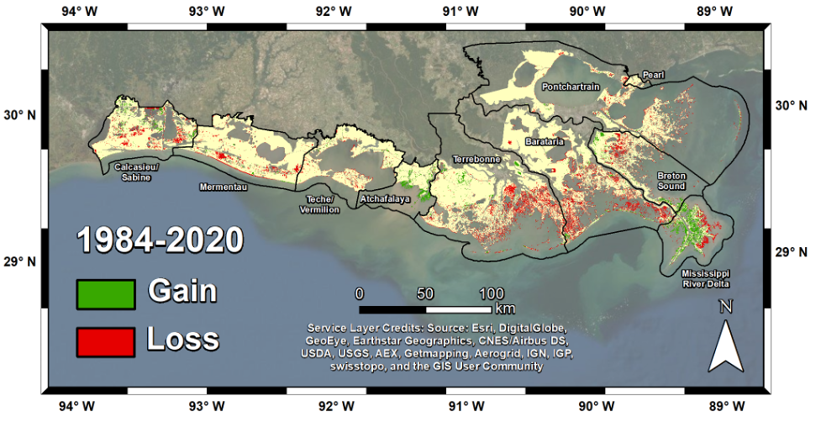
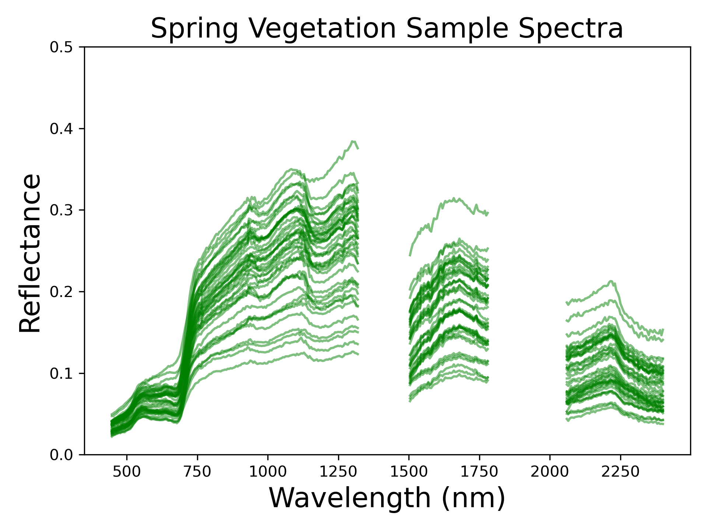
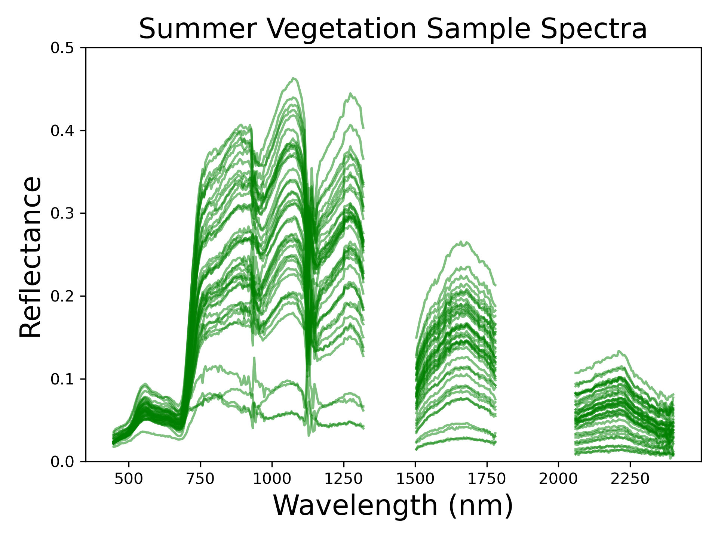
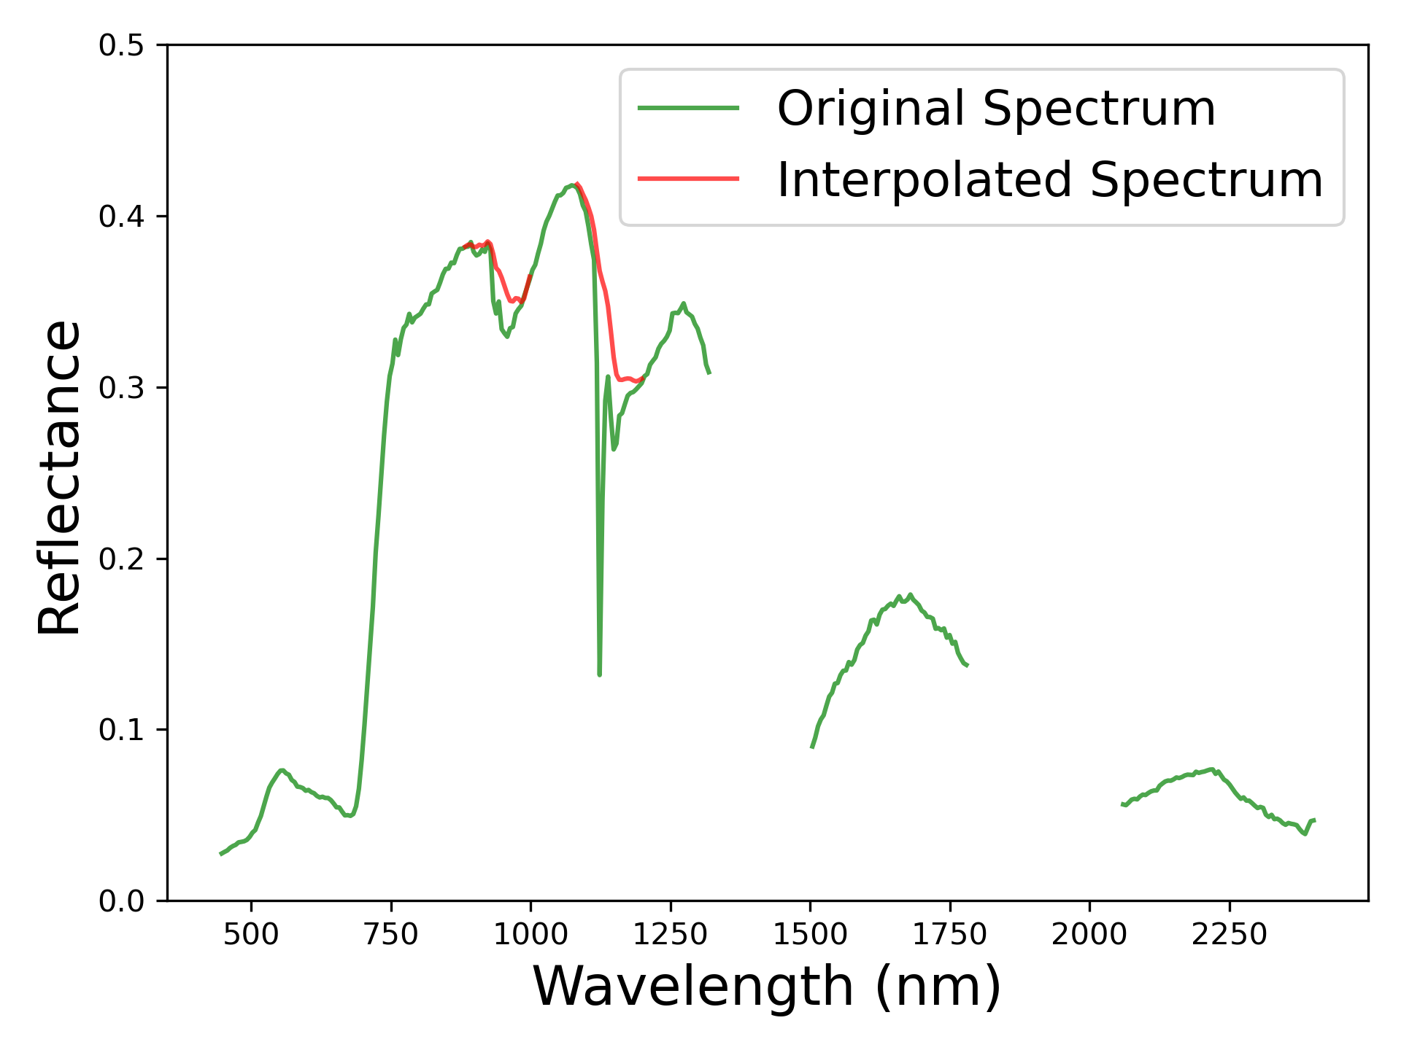
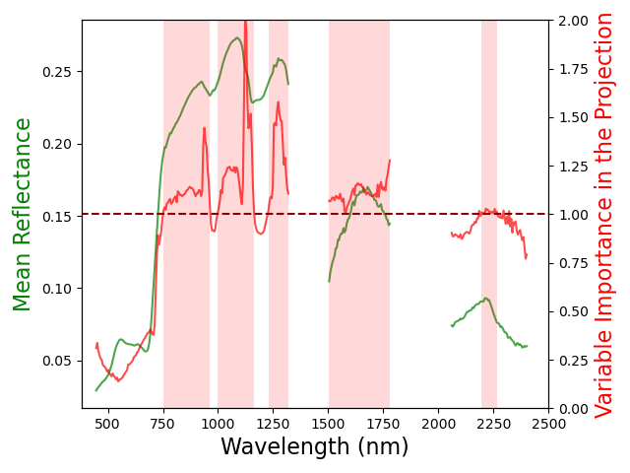
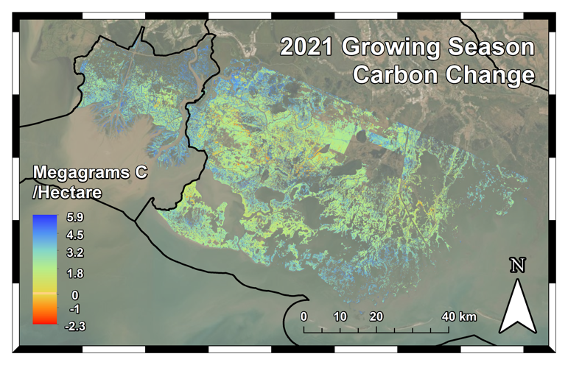
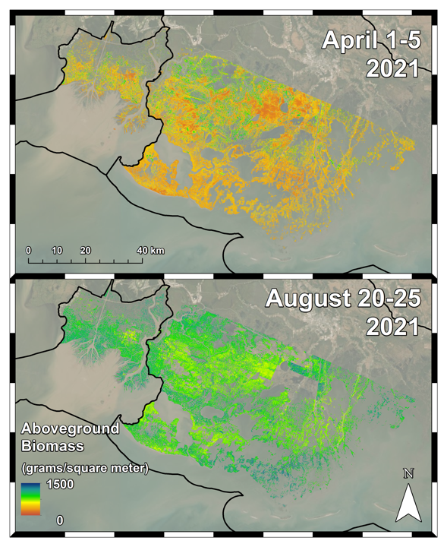

National Aeronautics and Space Administration
Towards consistent imaging spectroscopy-based aboveground biomass retrievals in coastal wetlands across atmospheric states
Author: Daniel Jensen, JPL Postdoctoral Fellow (334F)
David Thompson (382B), Marc Simard (334F), Elena Solohin (Florida International University), Edward Castañeda-Moya (Florida International University)
Abstract
Methods
Figure 1: Study area in Louisiana’s Atchafalaya and Terrebonne Basins. Map shows these basins’ contrasting patterns of wetland gain and loss from 1984-2020
(Jensen et al. 2022).
AVIRIS-NG
Spring and Summer mosaics produced for Atchafalaya and Terrebonne Basins
Field Samples
Herbaceous vegetation plots (0.25 m²)
AGB harvested, dried, and weighed (g/m²)
Aboveground biomass (AGB) plays a critical functional role in coastal wetland stability, as high biomass vegetation contributes to organic matter production, sediment accretion potential, and carbon storage. Here we use Airborne Visible/Infrared Imaging Spectrometer—Next Generation (AVIRIS-NG) data from NASA’s Delta-X mission in coastal Louisiana to map AGB and investigate the impact of atmospheric effects on retrievals.
AVIRIS-NG imagery was obtained with a coincident herbaceous vegetation survey that harvested biomass (n=84) in April and August 2021 (Castañeda-Moya and Solohin 2022). We used these paired samples and reflectance spectra in Partial Least Squares (PLS) regression models that leverage visible-shortwave infrared reflectances. These models quantify the following:
  Total estimated seasonal AGB and carbon across the Atchafalaya and Terrebonne Basins’ herbaceous wetlands.
  Identification of spectral features and characteristics that are closely associated with vegetation AGB and thus enable accurate AGB and carbon mapping with imaging spectroscopy.
  The impact of atmospheric correction artifacts (i.e. water vapor interference) on the quality of these models.
In our modeling, we develop a conditional Gaussian interpolation algorithm based on the EMIT vegetation spectral library that corrects noise in the 880-1000 and 1080-1200nm wavelengths. This algorithm preserves spectral information important for AGB estimation, enabling improved retrievals across humid atmospheres where increased water vapor causes excess noise.
  Last, we use a machine learning model with the corrected data to make final maps of herbaceous wetland AGB and carbon.
Figure 2 (top): AVIRIS-NG reflectance spectra coincident with each surveyed vegetation plot across Spring and Summer collections. Summer reflectance retrievals exhibit significant noise in the 880-1000 and 1080-1200nm wavelengths (highlighted in red) due to excess water vapor absorption in the extremely humid atmosphere.
Conditional Gaussian Interpolation
Parameterized with EMIT vegetation spectral library
Used to correct AVIRIS-NG bands in 880-1000, 1080-1200nm wavelengths
Figure 3 (right): Sample uncorrected reflectance spectrum with the conditional Gaussian interpolation applied.
Regression Modeling
Empirical performance tests for input bands using Partial Least Squares Regression
  Identified important bands for accurate AGB estimation
    High VIP scores in 880-1000 and 1080-1200 nm windows
  Best results with corrected bands vs. uncorrected or excised bands
Developed final machine learning model with Random Forests
  R² = 0.890, MAE = 109.3 g/m²
Figure 4: Variable Importance in the Projection (VIP) scores associated with each wavelength in the corrected PLSR model. Highlighted bands (VIP>1) indicate high relevance for AGB estimation and increased weighting in the model. Across all assessed models with the 880-1000 and 1080-1200nm wavelengths included, the H₂O absorption feature attains high VIP scores, indicating its strong correlation with AGB.
Herbaceous AGB and Carbon Maps
Figure 5 (left): Aboveground biomass (g/m²) maps derived from the corrected surface reflectance data and corresponding Random Forests model.
Figure 6 (right): Carbon allocated in herbaceous vegetation from early to peak growing season, 2021.
Conclusions
These experiments and corrections demonstrate the potential for data from AVIRIS-NG—and other airborne and spaceborne imaging spectrometers—to estimate AGB in wetland ecosystems and enable consistent analyses in humid atmospheric states often encountered in coastal regions.
  Field and spectral samples show that the 880-1000 and 1080-1200nm windows in the NIR attain the highest VIP values in the resulting AGB models. In addition to atmospheric water vapor absorption, these wavelengths are sensitive to H2O in the plant canopy—a key characteristic indicative of plant biomass.
The Atchafalaya Basin overall sees more significant seasonal growth. Saltmarshes in the southern Terrebonne Basin see significant seasonal growth, while the brackish marsh interiors exhibit less aboveground productivity. This is consistent with ongoing observations that coastal Louisiana’s brackish marsh interiors are less stable and seeing greater loss.
  Mean carbon concentrations from April-August: Atchafalaya 0.94 → 4.00 Mg/ha, Terrebonne 1.54 → 3.60 Mg/ha
With future imaging spectroscopy missions such as Surface Biology & Geology, spatially-correlated errors from atmospheric artifacts make it difficult to construct consistent global ecosystem trait maps. Our analysis highlights the need for additional corrections over the 880-1000 and 1080-1200nm wavelengths where water vapor presence interferes with the characterization of water content within plant canopies.
79,213 Mg C
412,926 Mg C
Publications:
Castañeda-Moya, E., and E. Solohin. 2022. Delta-X: Belowground Biomass and Necromass across Wetlands in the MRD, LA, USA, 2021. ORNL DAAC, Oak Ridge, Tennessee, USA. https://doi.org/10.3334/ORNLDAAC/1999
Jensen, D.J., E. Castañeda-Moya, E. Solohin, A. Rovai, D.R. Thompson, and M. Simard. 2022. Delta-X: Herbaceous Aboveground Biomass from AVIRIS-NG, MRD, Louisiana, USA, 2021. ORNL DAAC, Oak Ridge, Tennessee, USA. https://doi.org/10.3334/ORNLDAAC/2107
Jensen, D. J., Cavanaugh, K. C., Thompson, D. R., Fagherazzi, S., Cortese, L., & Simard, M. (2022). Leveraging the Historical Landsat Catalog for a Remote Sensing Model of Wetland Accretion in Coastal Louisiana. Journal of Geophysical Research: Biogeosciences, 127(6), e2022JG006794.
Author Contact Information:
(562) 972-3952
Daniel.J.Jensen@jpl.nasa.gov
National Aeronautics and Space Administration
Jet Propulsion Laboratory
California Institute of Technology
Pasadena, California
www.nasa.gov
Copyright 2022. All rights reserved.

