Slide 1

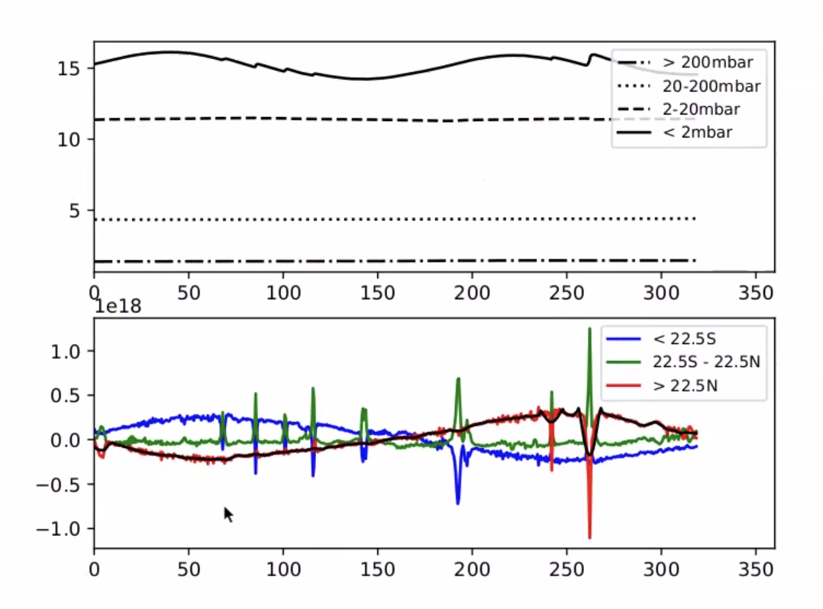
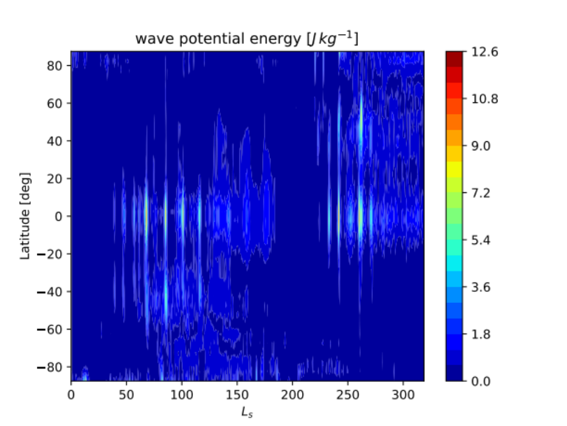
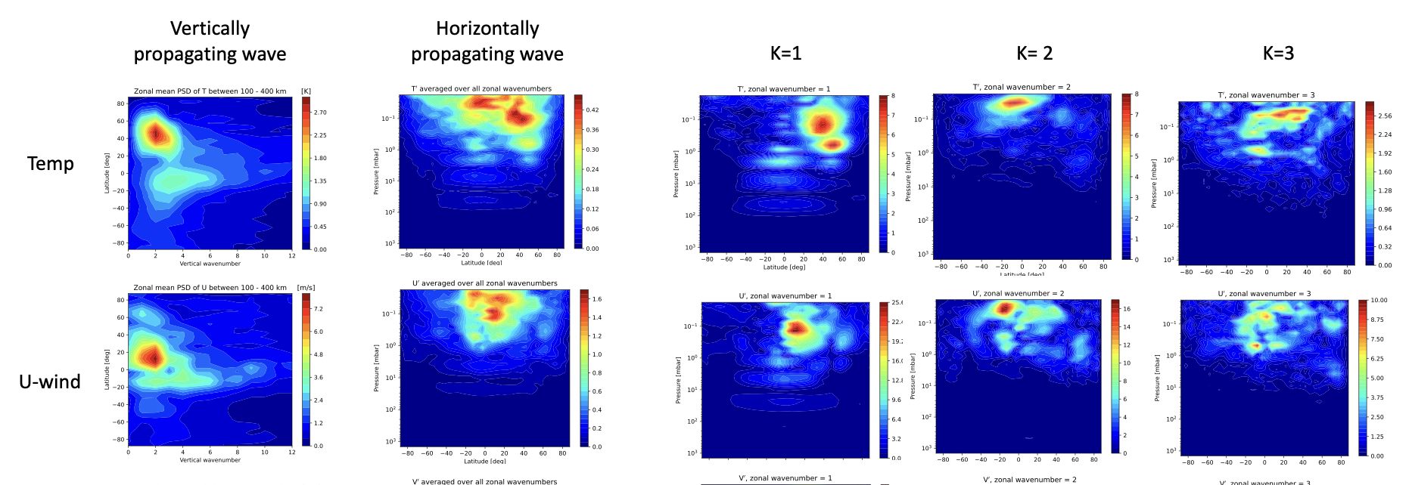
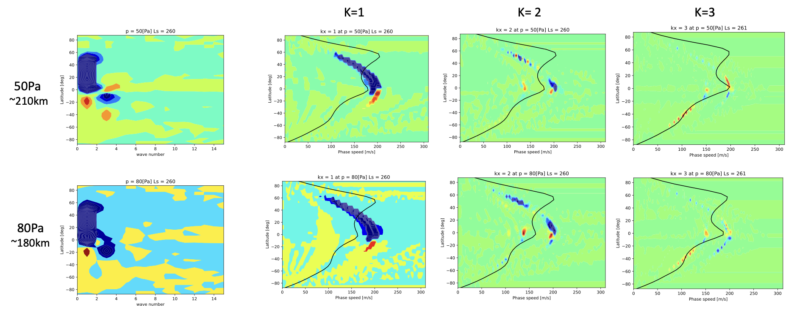
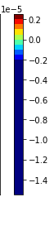
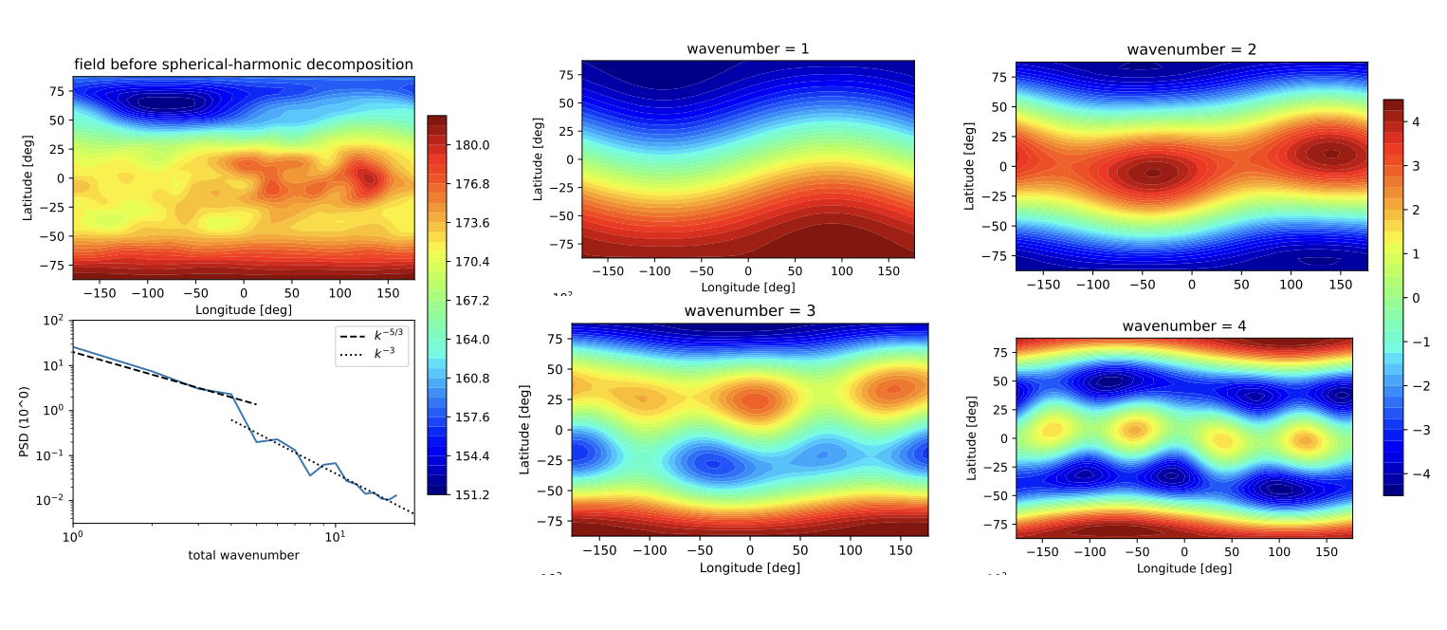
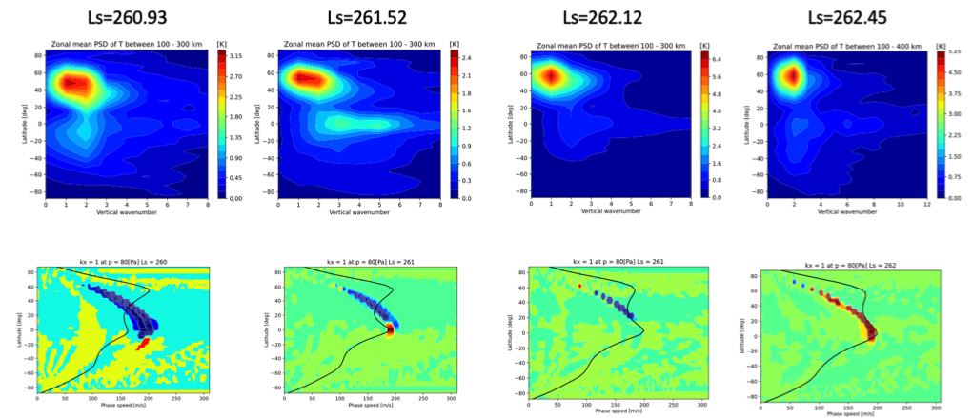
National Aeronautics and Space Administration
Wave Analysis of Titan’s Superrotation
Author: Cecilia W.S. Leung, JPL Postdoctoral Fellow (section 322)
Co-Investigators: Leslie Tamppari (322),
Yuan Lian (Aeolis Research), Claire Newman (Aeolis Research)
Objective: Characterize the dominant atmospheric wave modes driving and maintaining superrotation in Titan’s atmosphere,
using a combination of cospectral and a spherical harmonic wave analysis methods.
Background
Angular Momentum Transfer Events over one Titan Year
Titan’s dynamic atmosphere is laden with organic molecules of astrobiological significance. Circulation in the atmospheric determines how complex hydrocarbons, produced in the upper atmosphere, are distributed within the middle and lower atmosphere, influential further chemical and physical processing they undergo, and where they are deposited onto the liquid or solid surface.
A defining feature of Titan’s atmospheric circulation is the presence of strong, planet-wide superrotation in the stratosphere. The mechanisms driving and maintaining Titan’s stratospheric superrotation are not well understood. To achieve and sustain equatorial superrotation, it is thought that angular momentum must be transported up the angular momentum gradient by wave transport [1]. Yet the exact mechanisms driving stratospheric superrotation and whether these waves correlate to waves observed in the upper atmosphere, remain unknown.
Our analysis uses output from the Titan Weather Research and Forecasting (WRF) Global Circulation Model (GCM) to determine atmospheric state over the span of one Titan year. Plots of dM/dt and potential energy show specific seasons where detected angular momentum transfer events are hypothesized to contribute to maintaining superrotation in Titan atmosphere.
dM/dt
Solar Longitude (L_{s})
Cospectral & Spherical Harmonic Wave Analysis
Fig 1. Strength of transfer events as a function of season. During the large transfer event near northern winter solstice (L_{s}=260) the region north of 22deg latitude experiences a net decrease in angular momentum, whereas the equatorial region experiences a net increase in angular momentum.
During the large transfer event near northern winter solstice, at L_{s}=260, the peak zonally-averaged power spectral density (PSD) of temperature (T) and zonal winds (U) examines how the amplitudes of T & U perturbations varies with time. Decomposition of the horizontally propagating wave into zonal wavenumbers k=1, 2, 3 reveals the dominant wavenumber as a function of latitude associated with the momentum transfer event.
The eddy momentum flux, calculated using a combination of both the zonal & meridional (u, v) wind fields, shows that Near the equator, the convergence of southward eddy momentum flux (blue) and northward eddy momentum flux (red) carried by waves with phase speed greater than the zonal wind accelerates the eastward flow of the superrotating jet.
Fig 2. PSD of vertically and horizontally propagating waves. Comparison show that the dominant signal derives primarily from a combination of wavenumbers k=1 & 2 with a much smaller residual component from k = 3.
Fig 3. PSD of eddy momentum flux as function of phase speed at 50Pa and 80 Pa pressure levels.
We compared the spherical harmonics with all combined total wavenumbers as a function of latitude and longitude, and to the decomposition into wavenumbers k=1, 2, 3, 4. Energy transfer is concentrated at k<4 as shown by the fit to Kolmogorov's −5/3 Power Law.
Figure 5 shows the time evolution of the zonal k=1 phase speed during the transfer event. Convergence of southward (blue) and northward (red) flow when phase speeds faster than the mean wind speed (black line) indicate eastward “pumping” of the zonal winds when waves breaks leading to the maintenance Titan’s superrotation.
Fig 4. Spherical Harmonic with total wavenumber, and decomposed into zonal mean flow with k =1,2,3,4.
Fig 5. Time evolution of the temperature PSD and eddy momentum flux during the onset, peak, and decay at L_{s}=260.
Significance: While wave analyses from numerical models provide a valuable method to interpret mechanisms driving Titan’s superrotation, ultimately, Titan’s atmosphere must be directly measured to fully characterize the dynamical processes resulting in momentum transfer and trace gas transport. A sub-millimeter sounder would be a suitable instrument to directly measure Titan’s temperature and wind profiles, as well as key trace gas abundances. Influences of atmospheric waves can impact tropospheric and near-surface environments (ie. winds, methane convection, etc.) with implications for upcoming missions such as Dragonfly.
National Aeronautics and Space Administration
Jet Propulsion Laboratory
California Institute of Technology
Pasadena, California
www.nasa.gov
Publications:
[A] Cecilia Leung, Leslie Tamppari, Claire Newman, and Yuan Lian. “Angular Momentum Transfer in Titan’s Stratosphere,”,Europlanet Science Congress 2022, Granada, Spain, 18–23 Sep 2022, EPSC2022-716, 2022.
[B] Cecilia Leung, Yuan Lian, Leslie K Tamppari, Claire E Newman, William G Read, Nathaniel J Livesey, Goutam Chattopadhyay, Sven van Berkel and Subash Khanal, (2022) “Angular Momentum Transfer Events in Titan’s Stratosphere,” Abstract ID# 1097675 presented at 2022 AGU Fall Meeting, Chicago, USA. 12-16 Dec 2022.
Author Contact Information:
520-245-4050 | cecilia.leung@jpl.nasa.gov
Poster Number: PRD-P#009
Copyright 2022. All rights reserved.

