Slide 1

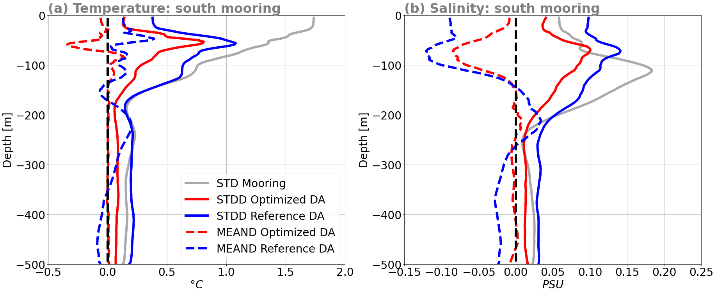
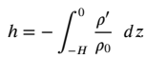
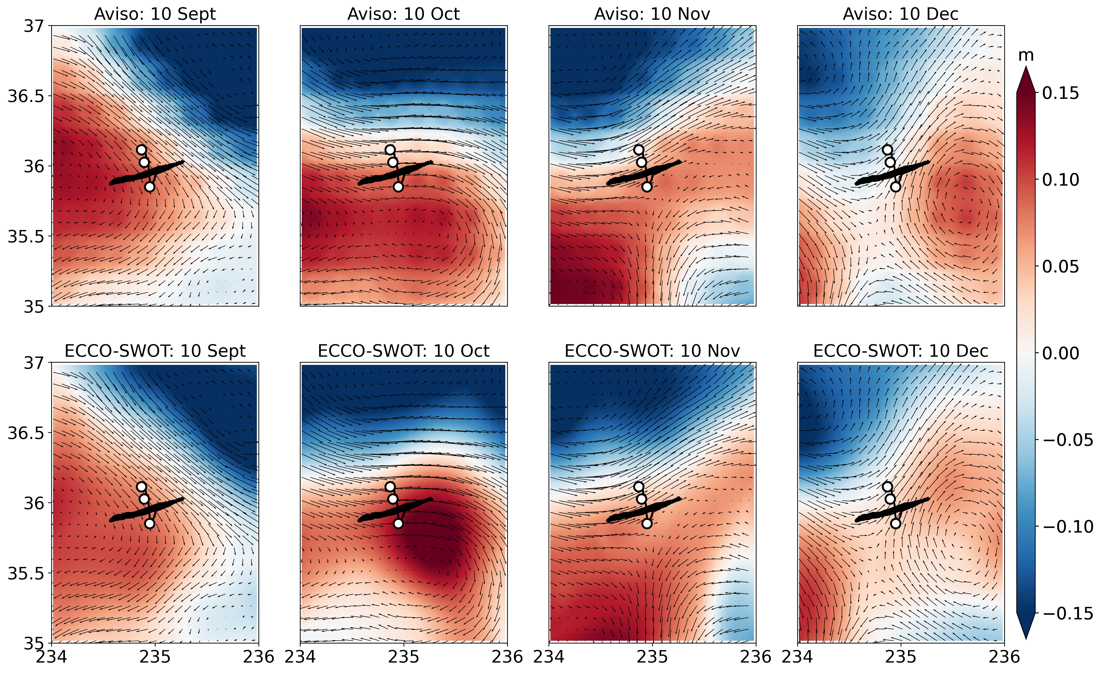
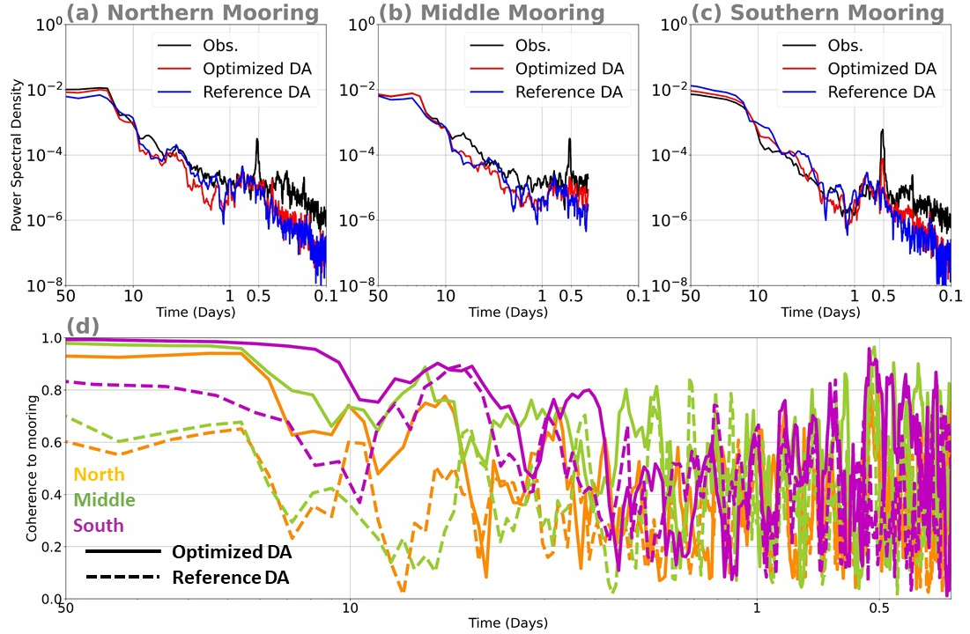
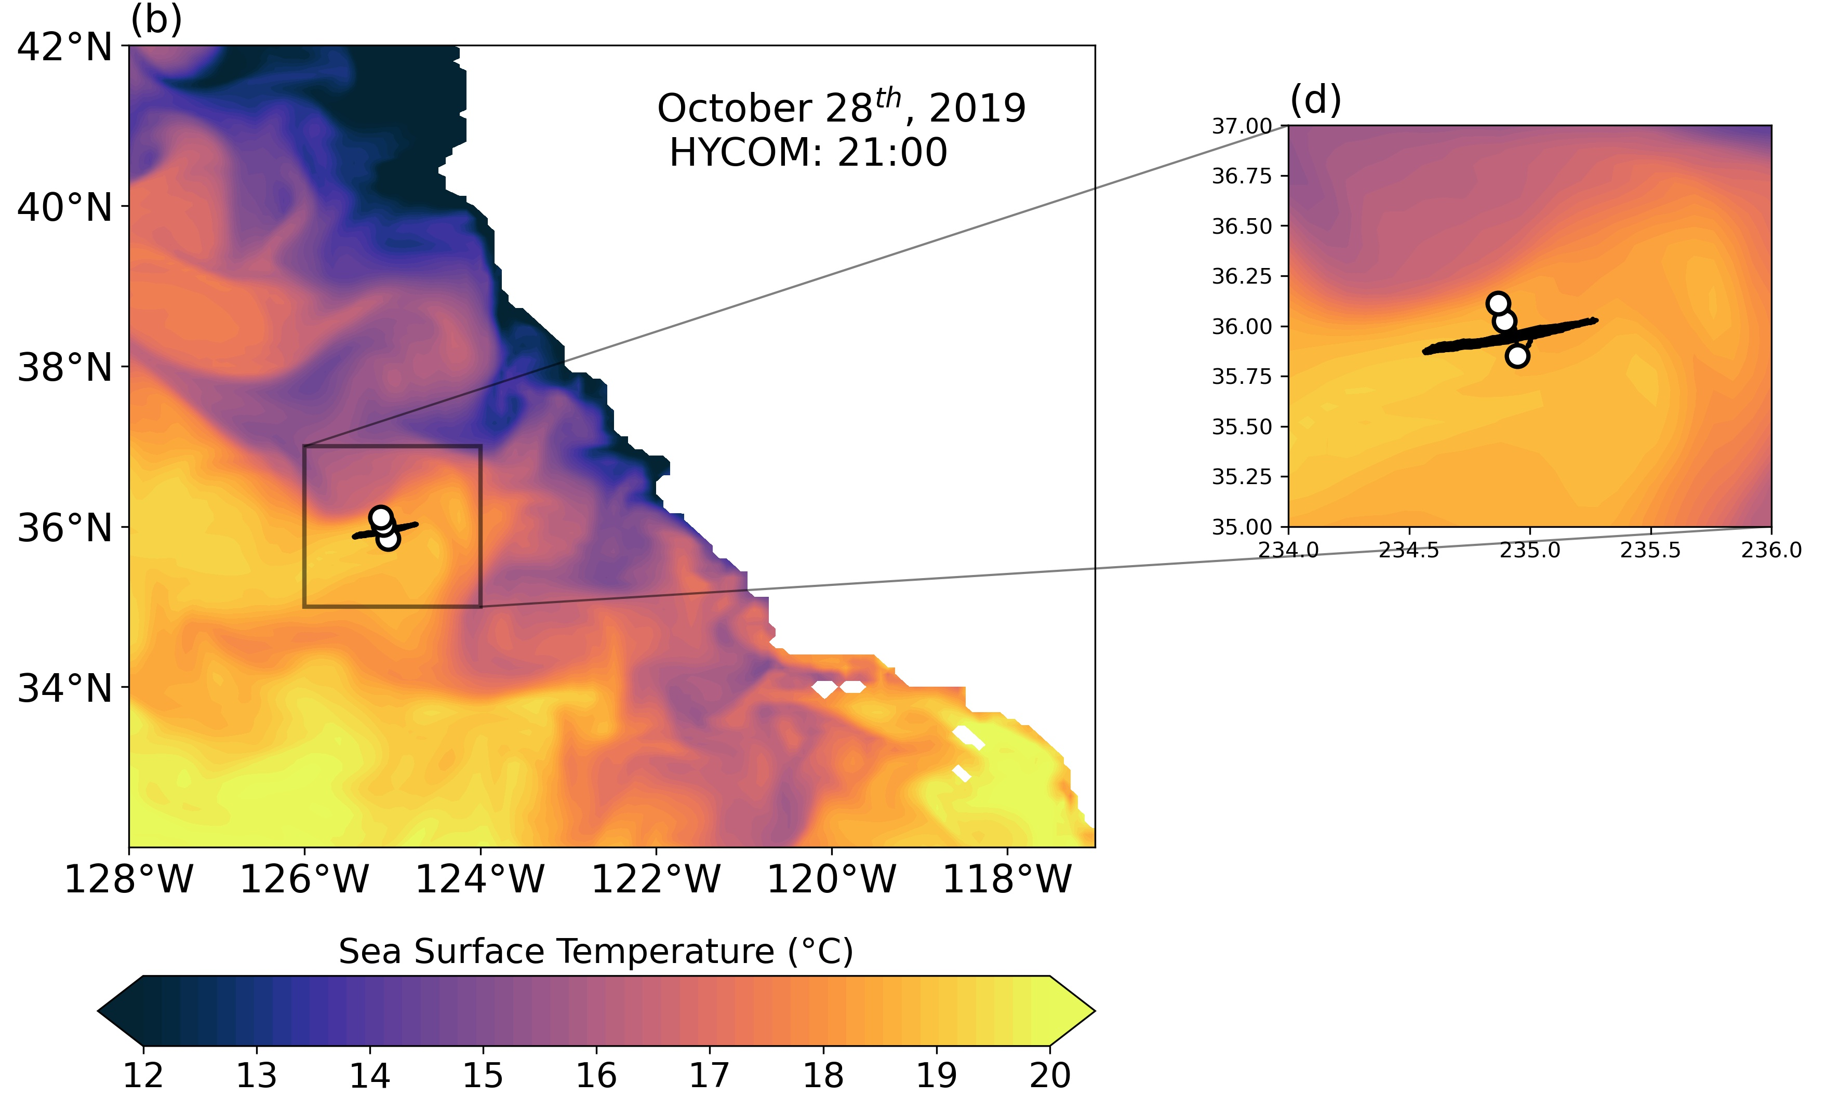
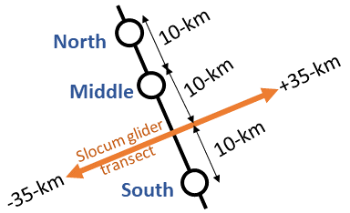
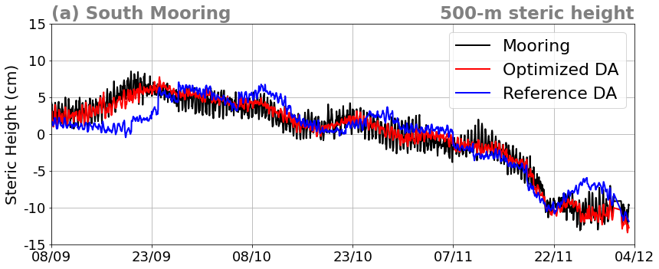
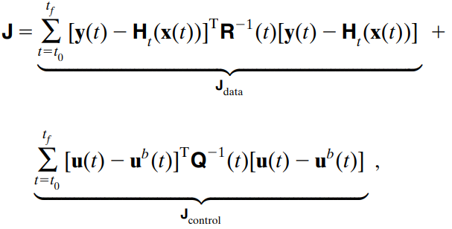
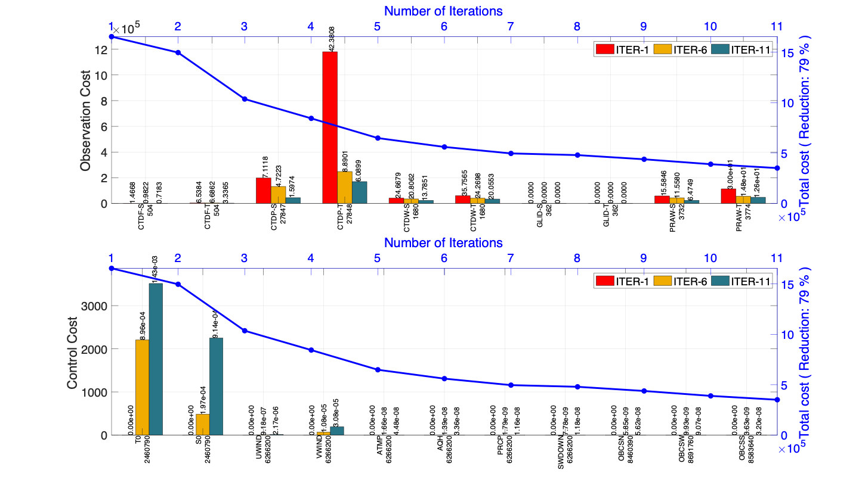
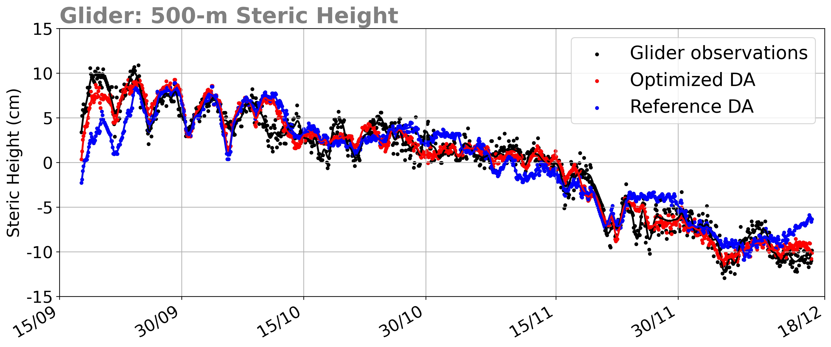
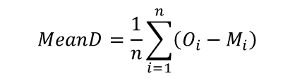
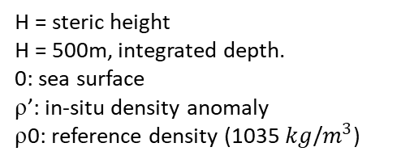
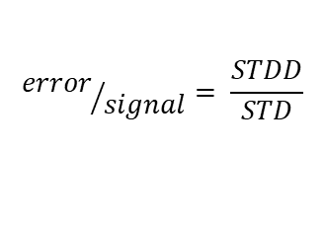
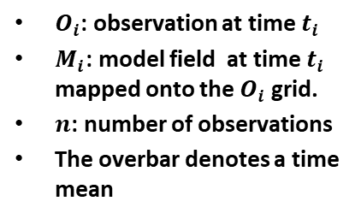
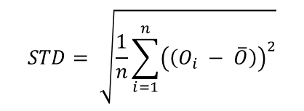
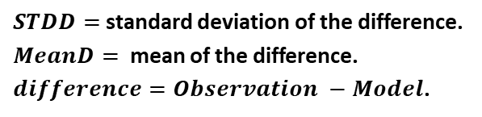
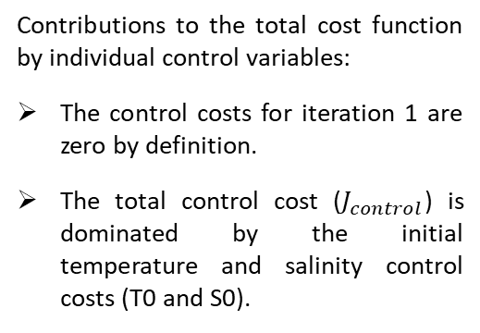
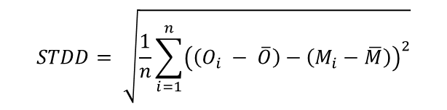
National Aeronautics and Space Administration
Evaluation of the ECCO-SWOT DA system in the California Current at the SWOT Calibration/Validation site based on the pre-launch oceanography field experiment.
Authors: Babette C. Tchonang, JPL Postdoctoral Fellow (329b)
Matthew R. Archer (329b), Jinbo Wang (329b), Lee-Lueng Fu (3200), Ganesh Gopalakrishnan (SIO), Matt Mazloff (SIO), Bruce Cornuelle (SIO), Sarah T. Gille (SIO)
Motivation
Results
Statistical results
This study evaluates the performance of a four-dimensional variational (4DVAR) data assimilation (DA) system developed to address the challenges posed by the small-scale observations of NASA’s upcoming Surface Water and Ocean Topography (SWOT) mission. SWOT will launch at the end of 2022 and is supposed to fill the Sea Surface Height (SSH) observations deficit observed with nadir altimeters by providing a spatial resolution of 15 km wavelength, against ~100 km for the conventional nadir altimeters (Dufau et al., 2016; Wang et al., 2019). Oceanographic validation, which will confirm the usefulness of SSH measurements for reconstructing the ocean current field, is therefore one of the main activities of the calibration and validation (Cal/Val) of SWOT measurements. While temperature/salinity (T/S) profiles, provided by mooring will validate the mission only at an effective resolution of a few hundred kilometers (Wang et. al., 2022), data assimilation offers an effective approach to estimate the true ocean state in three dimensions through a combination of in-situ measurements and ocean model.
The objective of this study is then to demonstrate the performance of a 4DVAR DA system using the SWOT pre-launch field campaign.
DA performance - temperature and salinity
$$MeanD=\frac{1}{n}\sum_{i=1}^{n}{\left(O_{i}−M_{i}\right)}$$
$$STDD= \sqrt{\frac{1}{n}\sum_{i=1}^{n}{{\left(\left(O_{i} − \overline{O}\right)−\left(M_{i}−\overline{M}\right)\right)}^{2}}}$$
The results shown are from the south mooring but the same performance is found at other mooring sites (not shown)
;
$O_{i}$: observation at time $t_{i}$
$M_{i}$: model field at time $t_{i}$ mapped onto the $O_{i}$ grid.
$n$: number of observations
The overbar denotes a time mean
$$STD= \sqrt{\frac{1}{n}\sum_{i=1}^{n}{{\left(\left(O_{i} − \overline{O}\right)\right)}^{2}}}$$
$${error}/{signal}= \frac{STDD}{STD}$$
;
Steric height (0-500m)
From north to south | North mooring | Middle mooring | Glider | South mooring
Assimilated/independent | Assimilated | Assimilated | independent | Assimilated
Start/end dates | 08/09/2019-27/12/2019 | 08/09/2019-27/12/2019 | 08/09/2019-22/12/2019 | 08/09/2019-03/12/2019
Signal STD (cm) | 6.7 | 5.8 | 5.9 | 5.1
STDD (cm) | 1.7 (3.2) | 1.1 (2.4) | 1.5 (2.4) | 1.02 (2.3)
MeanD (cm) | -0.7 (-0.3) | 0.4 (1.1) | 1.7 (2) | 0.4 (1.6)
error/signal (%) | 26% (47%) | 19% (42%) | 25% (40%) | 20% (46%)
$STDD=$standard deviation of the difference.
$MeanD=$ mean of the difference.
$difference=Observation −Model$.
Optimized DA
Reference DA
Main conclusion: The optimized DA shows a large improvement over the reference DA for all depths and times.
Experiment Info
AVISO SLA maps vs Optimized DA steric height
The values in brackets are for the reference DA
4DVAR using the Estimating the Circulation and Climate of the Ocean (ECCO) framework (Gopalakrishnan et al., 2021) based on a regional Massachusetts Institute of Technology general circulation model (MITgcm)
1 km of resolution, covering 200-km x 200-km area, centered at the SWOT Cal/Val site
72 vertical levels
Boundary and initial conditions are from the 1/12 degree global and operational HYCOM
7-day assimilation window
No tides included
Focus on the pre-launch field campaign period: 08 September to 27 December 2019
Where ➔
H = steric height
H = 500m, integrated depth.
0: sea surface
ρ’: in-situ density anomaly
ρ0: reference density (1035 $kg$/$m^{3}$)
The Optimized DA is the best fit to the observations shown by MeanD, STDD, and the error/signal metrics.
Velocity vectors show AVISO geostrophic currents. Both SLA and currents are interpolated onto the model grid (1km X 1km).
Evaluation of DA in the time domain
Region of Interest & observations
Sea Surface Temperature over the California Current System. The black box shows the Cal/Val site and the domain of the study
Assimilated data:
North mooring ➔ fixed Conductivity-Temperature-Depth (CTD)
Middle mooring ➔ 0-500m profiling CTD
South mooring ➔ 0-500m profiling CTD, 8 fixed CTD
Non Assimilated data
Slocum glider➔ pumped CTD. 500m to 1000m dives
Aviso Sea Level Anomaly (SLA) L4
Optimized DA well matches the AVISO SLA data.
Optimized DA compared to Reference DA:
matches the observations much more closely in all three mooring locations at the semi-diurnal period and, to a lesser extent, around the diurnal period with
coherence close to one for periods longer than 5 days.
None of the DA reproduces the high-frequency variance in observations.
DA performances - mooring steric height
Regional-ECCO 4DVAR system
The state estimation problem is posed as minimization of a cost function (J)
Conclusion and future work
y(t): a vector that contains all the observations available at the time t
x(t): model state vector
H_{t} : observation operator
R(t) and Q(t) :model background and observational error covariance matrices.
u^{b}(t): background estimate (first guess)
u(t): unknow true state.
We have explored the performance of a 4DVAR DA system designed for the SWOT Cal/Val. We focused on reconstructing fine-scale ocean variability by assimilating the high-frequency in-situ observations collected by the pre-launch SWOT campaign (2019-2020). The performance of the DA system was evaluated against the withheld in-situ observations. We found that:
Assimilating in-situ T/S profiles from three moorings improves the DA system compare to model forced with HYCOM. The statistics show that the Optimized DA fits to the observations much better than the Reference DA.
The DA system has a positive impact on the capacity of model to reproduce the independent glider observation through assimilation of mooring observations.
The regional ECCO was not forced with barotropic tides, but was able to generate baroclinic tides by assimilating high-frequency in-situ observations.
The future work is to conduct observing system simulation experiments (OSSEs) to prepare the system for assimilating (1) the is-situ data from SWOT post-launch observing system (March-June 2023 and (2) the real SWOT measurements (starting from August 2023).
The total cost function value for all iterations, as well as individual cost contributions of the observations variables of the iteration 1, iteration 6, and iteration 11 for the 8-14 September 2019 experiment:
The total cost function was reduced by 79% after 11 iterations
​​Both reference and optimized DA are able to capture the high frequency signal present in the mooring observations, with the optimized DA better than the reference DA. Similar performance is found at the North and Middle moorings.
DA performances - glider steric height
Data assimilation experiments
Contributions to the total cost function by individual control variables:
The control costs for iteration 1 are zero by definition.
The total control cost ($J_{control}$) is dominated by the initial temperature and salinity control costs (T0 and S0).
“Reference DA”: is the iteration 1 which is the first simulation of each state estimation experiment window ➔ without assimilation and constrained with HYCOM.
‘‘Optimized DA’’: is the Iteration 11 which is the final optimized state estimate of each window ➔ assimilated the three mooring datasets.
Glider data are independent i.e. not assimilated
The Optimized DA has the closest variability to the glider observation with respect to the Reference DA.
Main conclusion: the DA system reproduces an ocean estimate that matches the withheld glider observations through assimilating mooring data.
National Aeronautics and Space Administration
Jet Propulsion Laboratory
California Institute of Technology
Pasadena, California
www.nasa.gov
Publications:
Archer, M. R., Li, Z., Wang, J., & Fu, L. L. (2022). Reconstructing Fine‐Scale Ocean Variability via Data Assimilation of the SWOT Pre‐Launch In Situ Observing System. Journal of Geophysical Research: Oceans, 127(2), e2021JC017362.
Dufau, C., Orsztynowicz, M., Dibarboure, G., Morrow, R., & Le Traon, P. Y. (2016). Mesoscale resolution capability of altimetry: Present and future. Journal of Geophysical Research: Oceans, 121(7), 4910-4927.
Wang, J., & Fu, L. L. (2019). On the long-wavelength validation of the SWOT KaRIn measurement. Journal of Atmospheric and Oceanic Technology, 36(5), 843-848.
Wang, J., Fu, L. L., Haines, B., Lankhorst, M., Lucas, A. J., Farrar, J. T., ... & Stalin, S. (2022). On the Development of SWOT In Situ Calibration/Validation for Short-Wavelength Ocean Topography. Journal of Atmospheric and Oceanic Technology, 39(5), 595-617.
Gopalakrishnan, G., Cornuelle, B. D., Mazloff, M. R., Worcester, P. F., & Dzieciuch, M. A. (2021). State estimates and forecasts of the eddy field in the subtropical countercurrent in the northern Philippine Sea. Journal of Atmospheric and Oceanic Technology, 38(11), 1889-1911.
Tchonang B. C., Archer M. R., Gopalakrishnan G., Mazloff M., Wang J., Fu L. L., Cornuelle B., Gille S., T., (in prep). Evaluation of the ECCO-SWOT DA system in the California Current at the SWOT Calibration/Validation site based on the pre-launch oceanography field experiment.
Author Contact Information:
Phone: 626)-298-5750
Email: Tchonang@jpl.nasa.gov
Poster Number: PRD-EA#004
Copyright 2022. All rights reserved.

