Slide 1

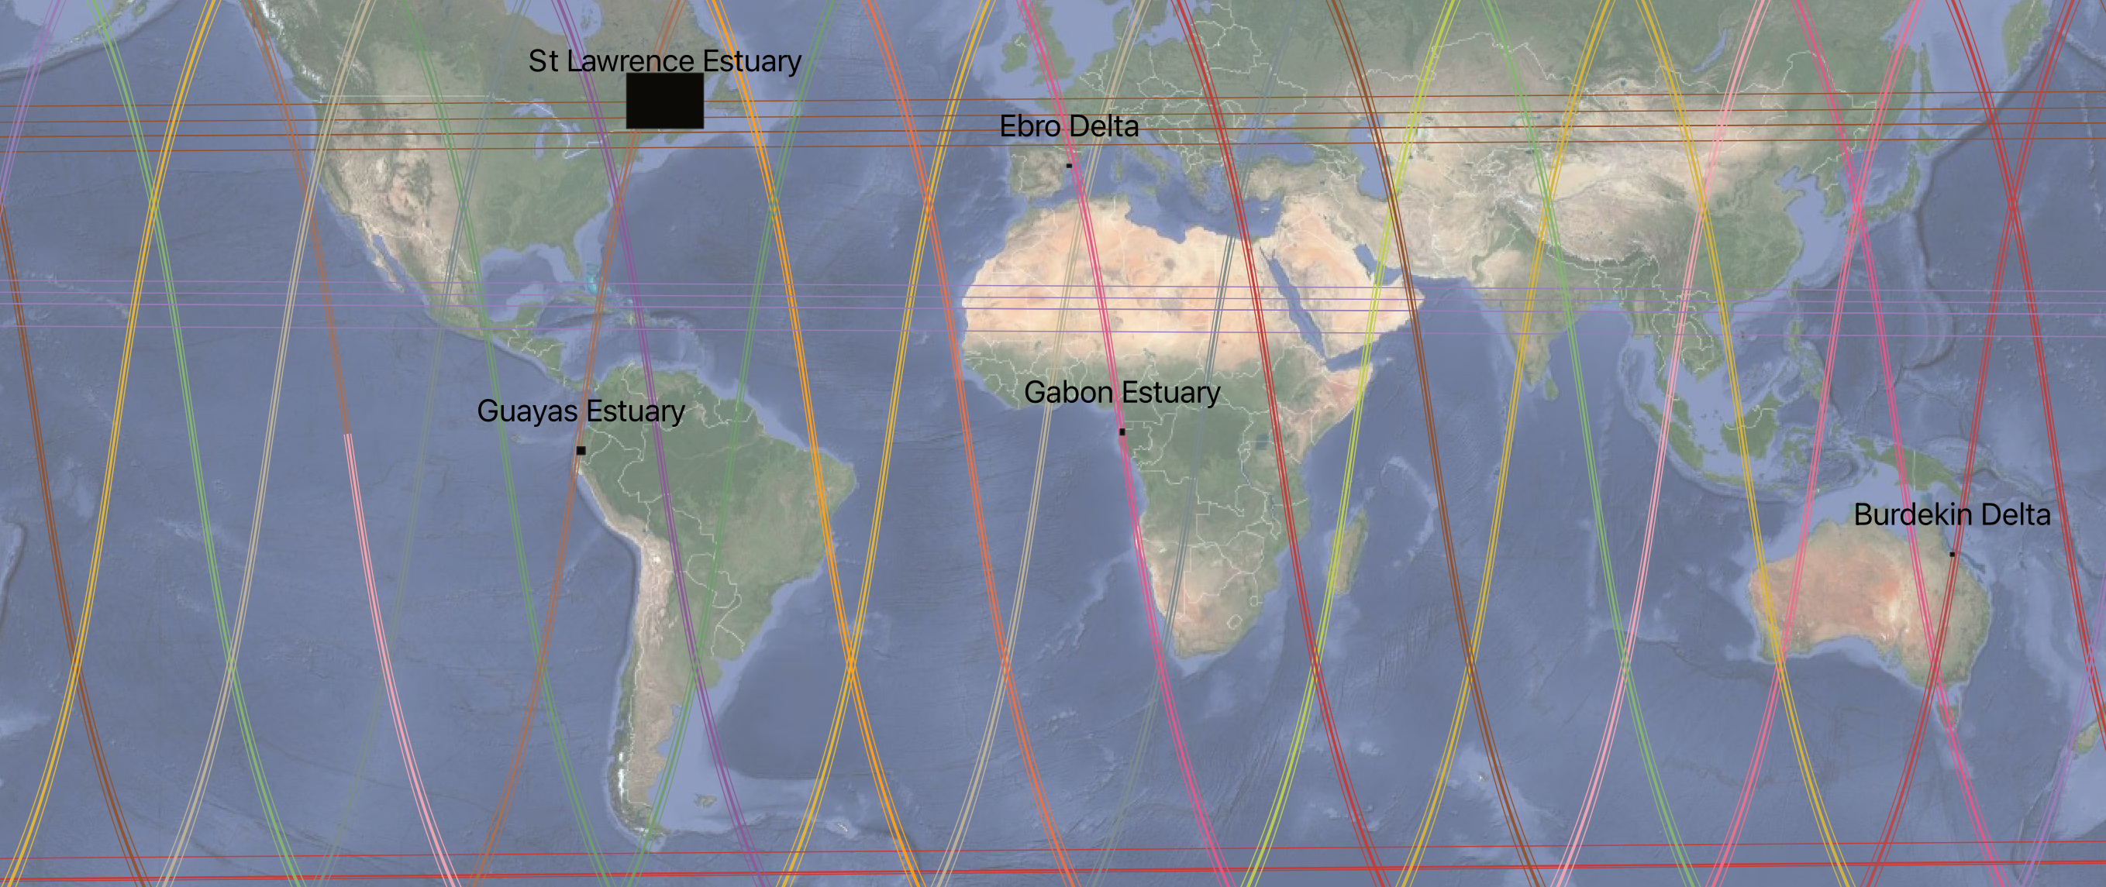
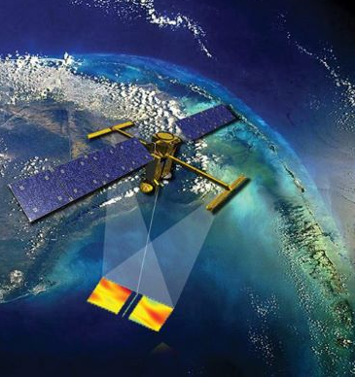
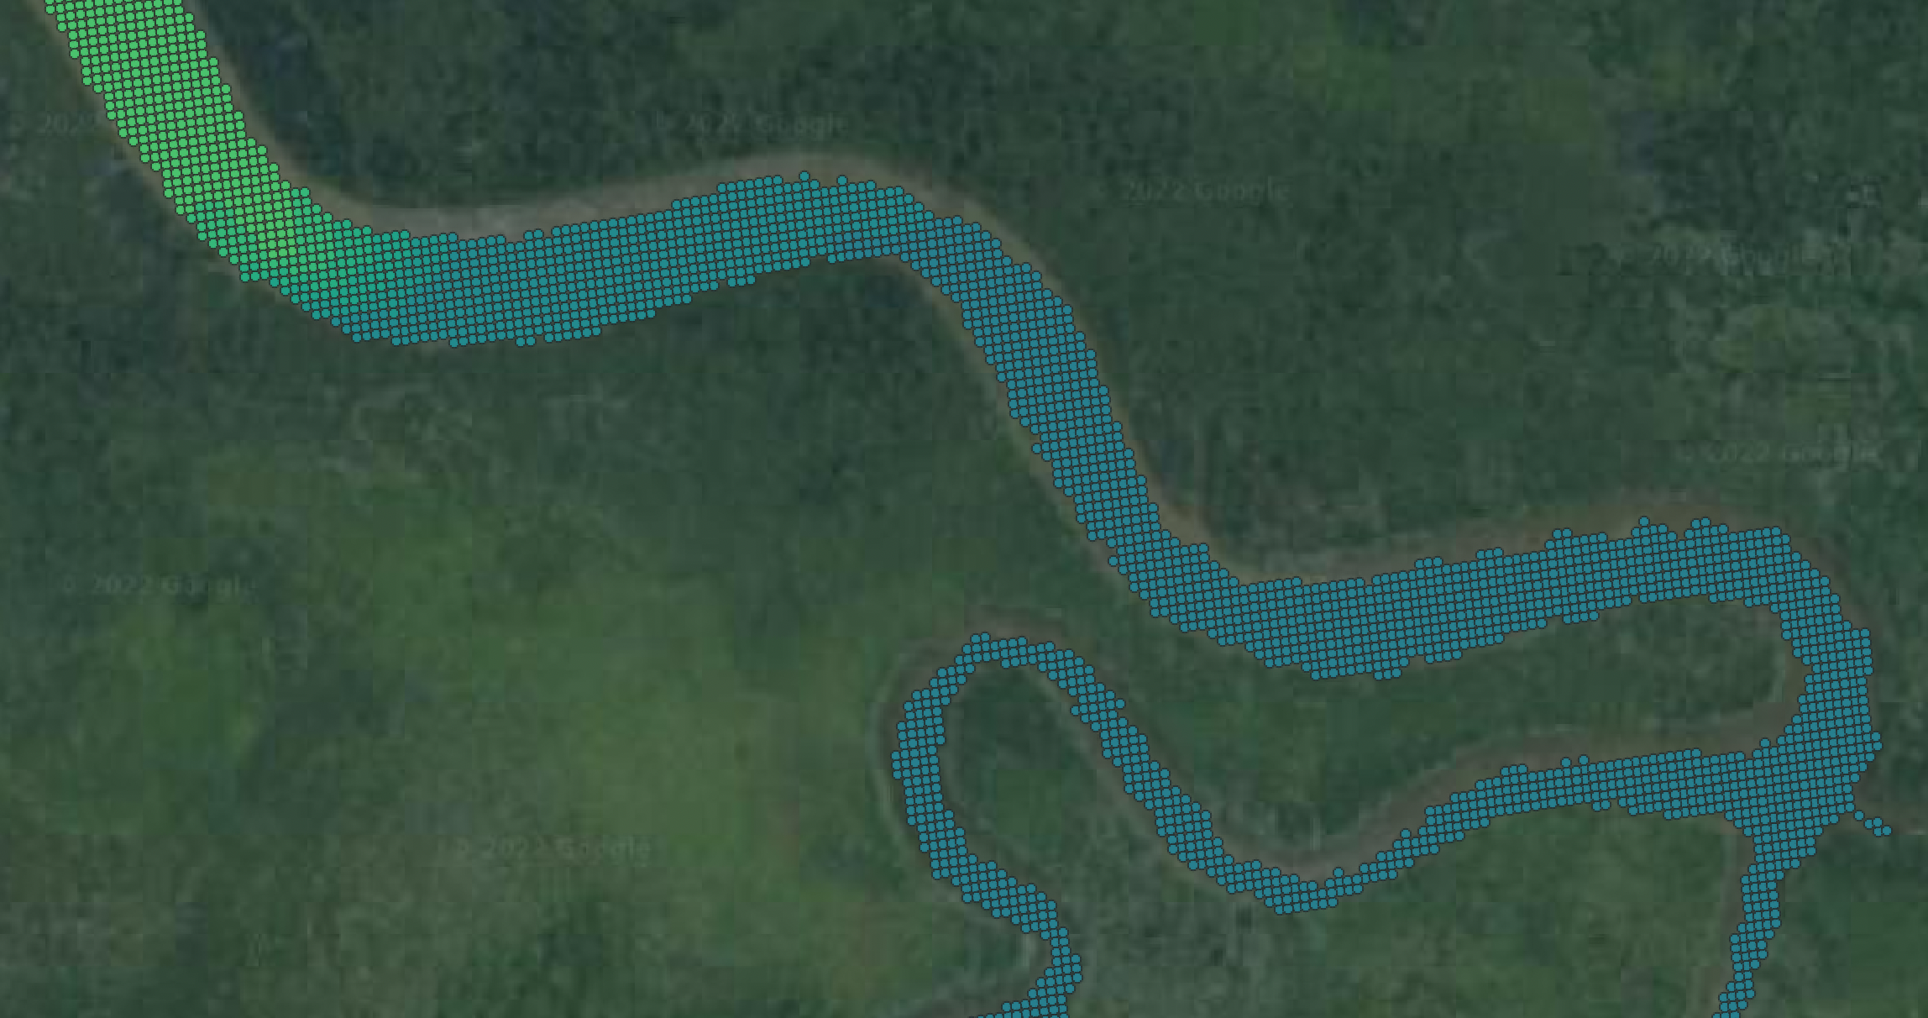
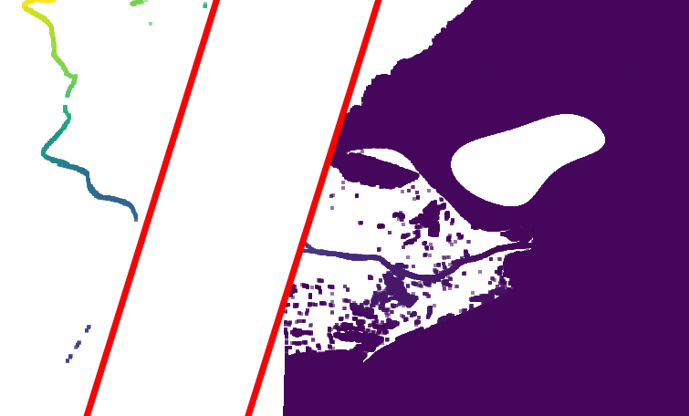
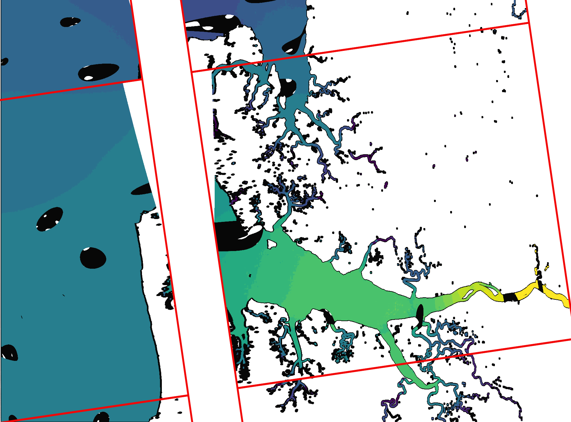
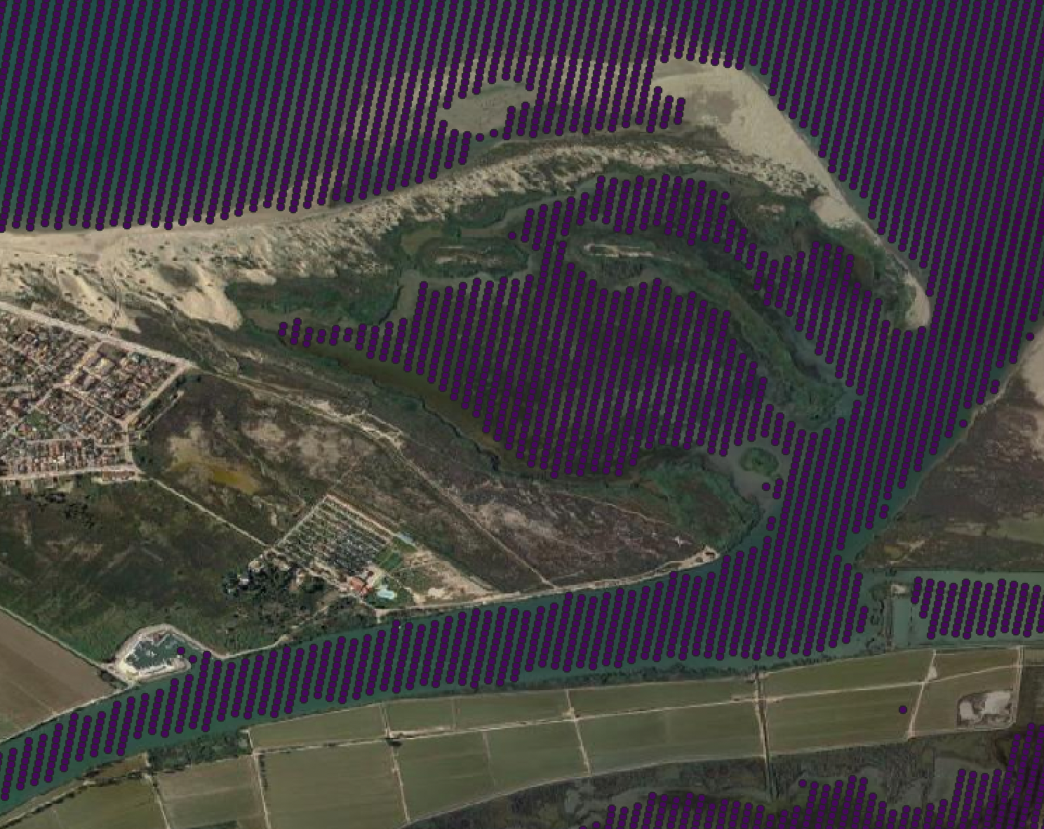
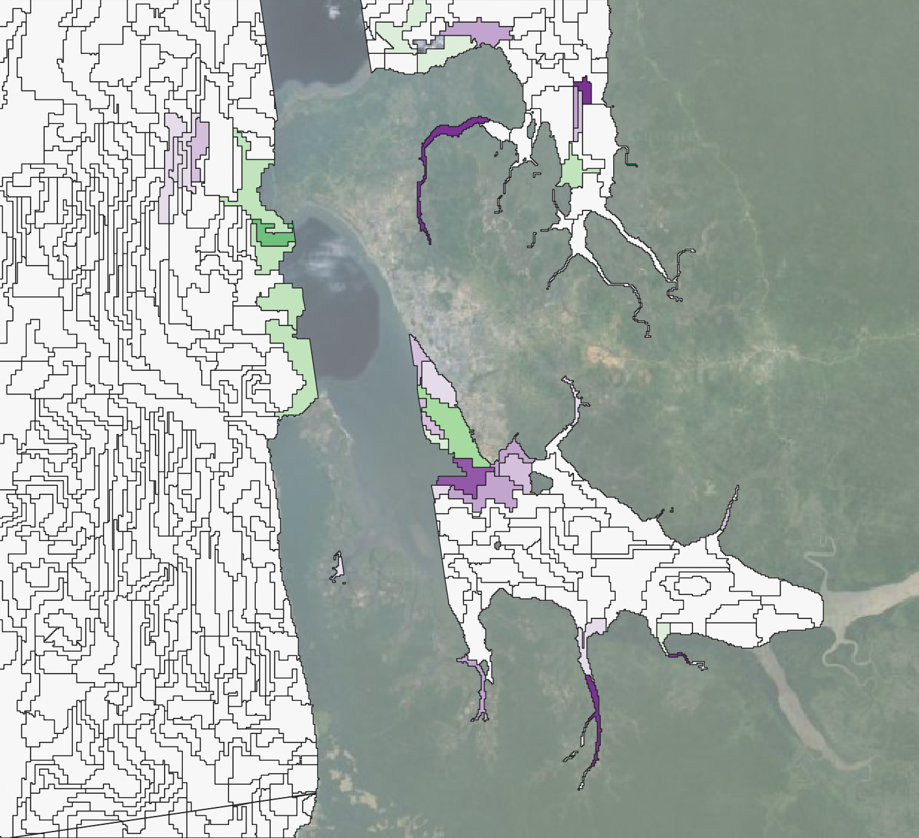
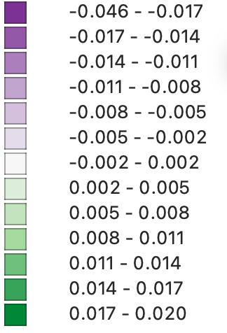
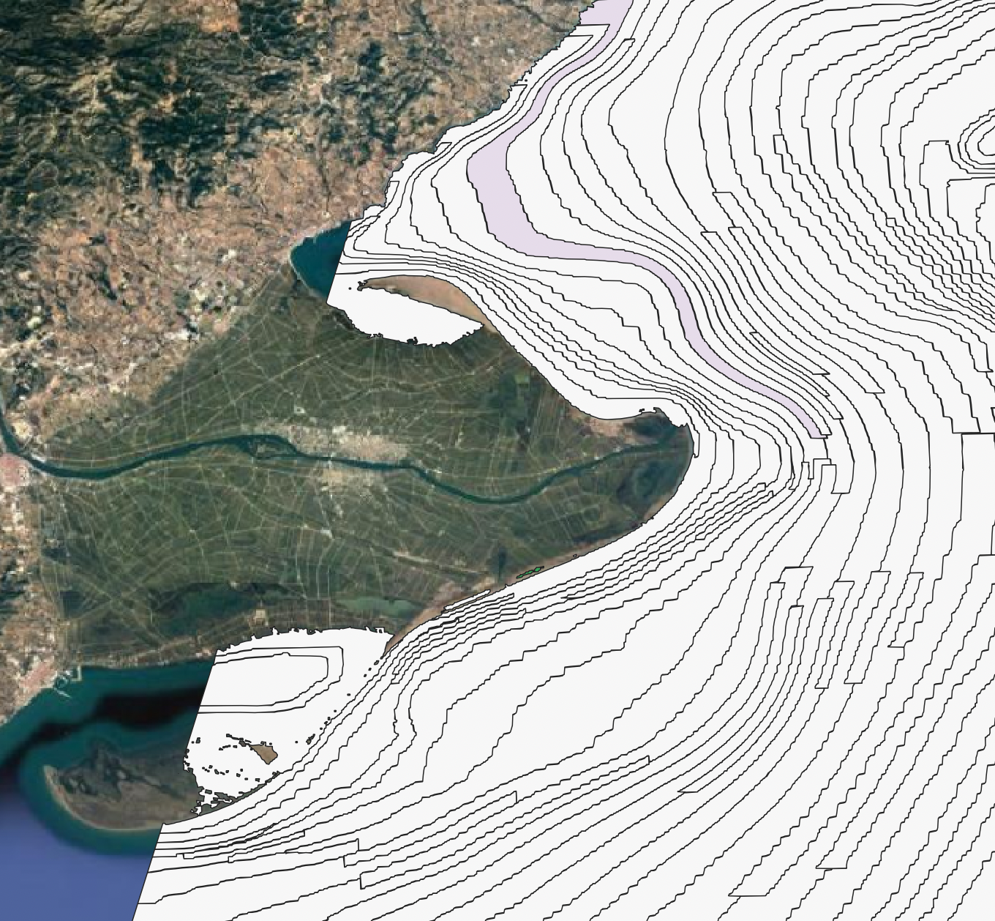
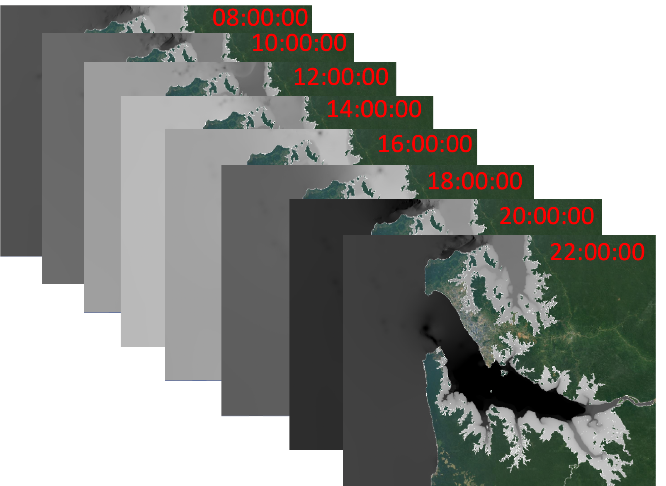
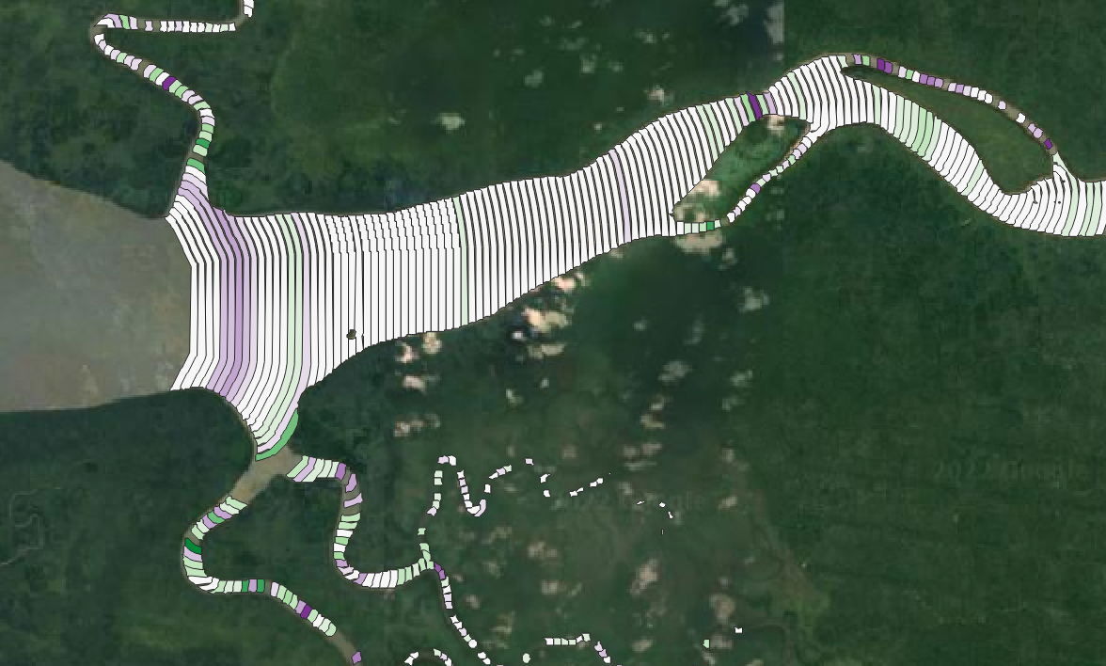
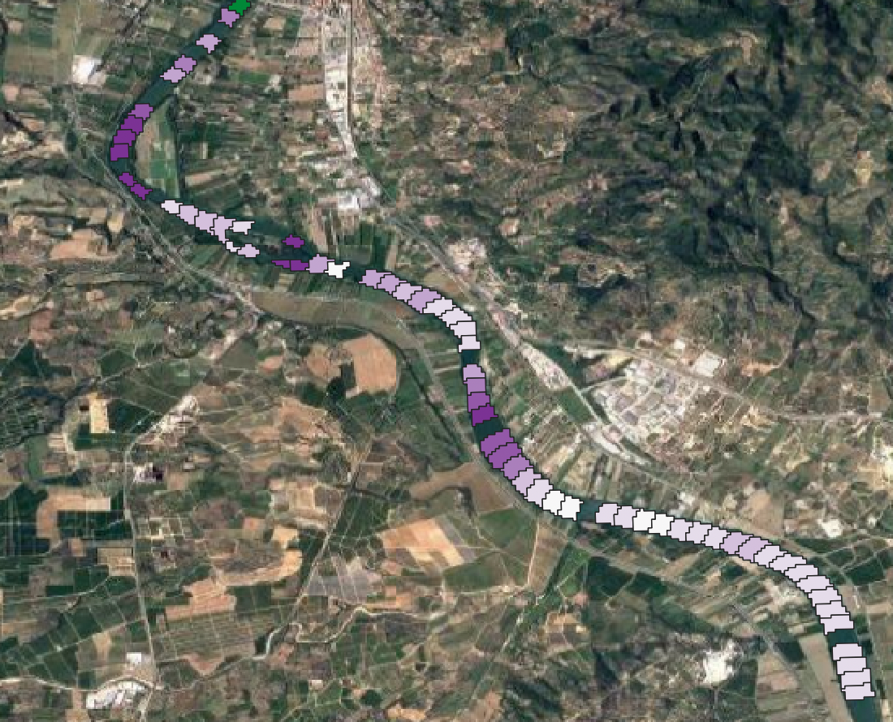
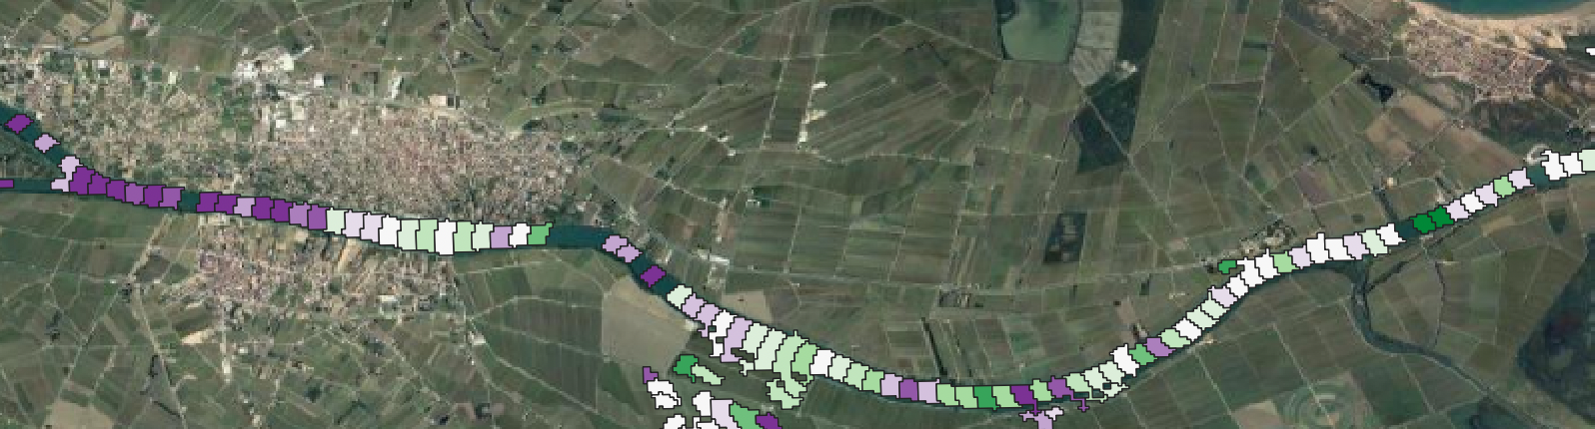
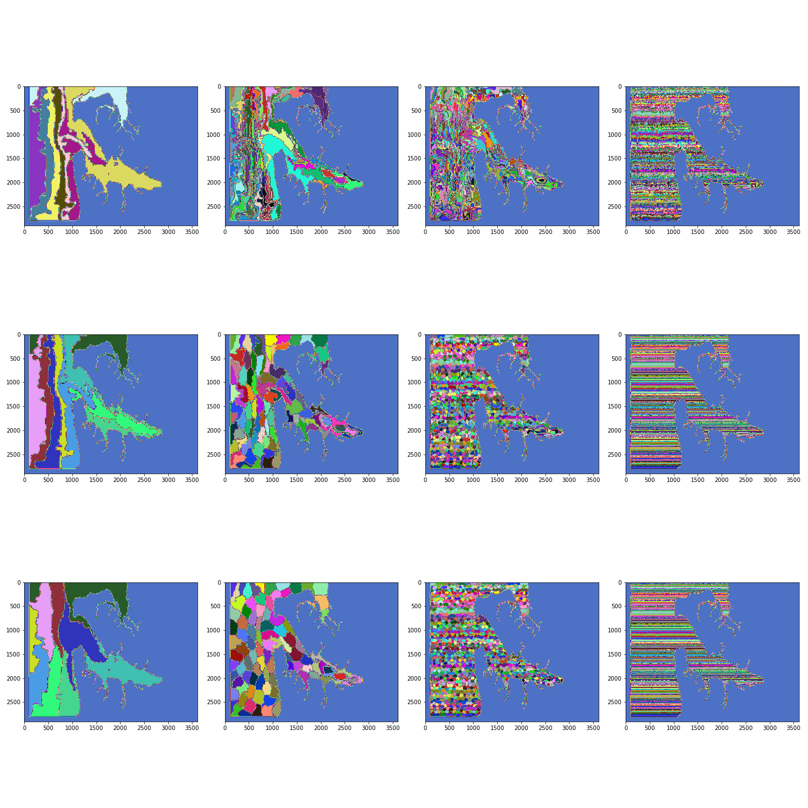
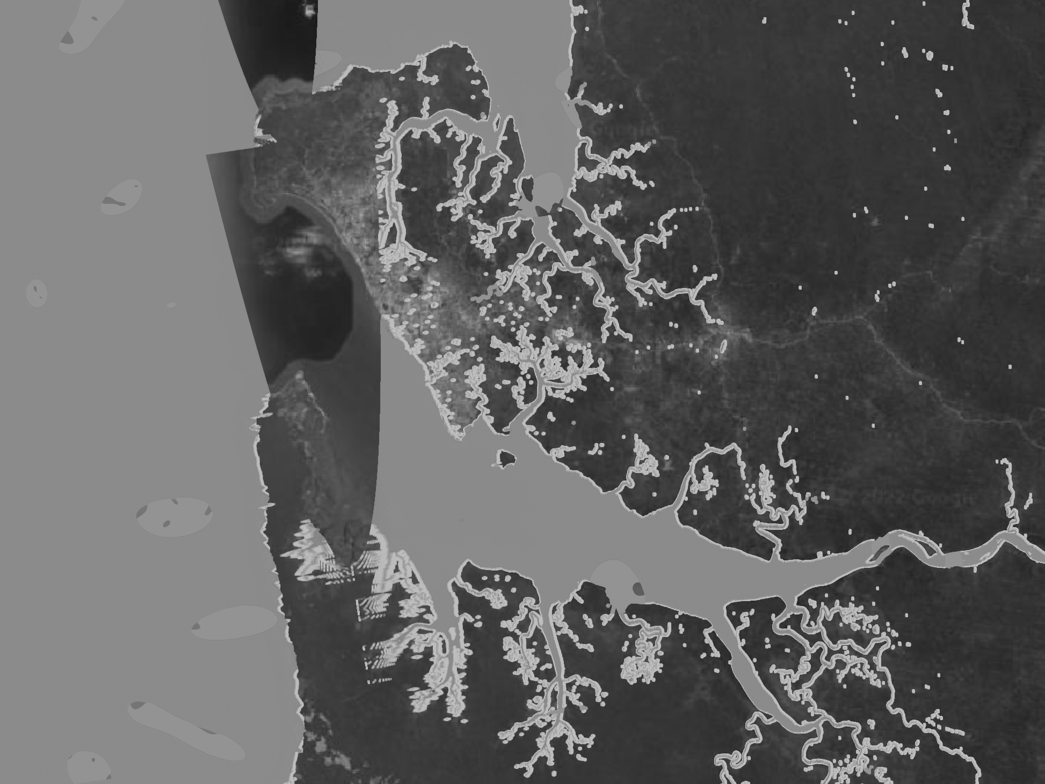
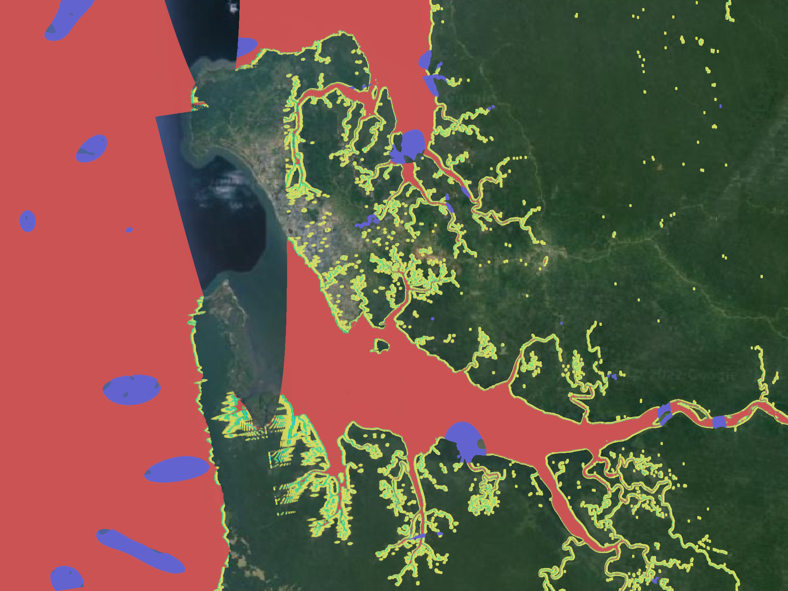
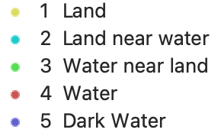
National Aeronautics and Space Administration
Developing Algorithms for Extracting Water Surface Slopes from SWOT in Coastal Areas
Authors: Alex Christensen (she/her), JPL Postdoctoral Fellow (334F)
Marc Simard, Senior Scientist (334F) and Michael Denbina, Signal Analysis Engineer (334F)
Background
Findings
The coastal zone supports human communities and diverse ecosystems such as estuaries, river deltas, mangroves, sea grass, coral reefs, and salt marshes.
They are extremely productive and provide many ecosystem services.
However, their complex hydro-, eco-, and geomorphic- dynamics often make them difficult to study
We tested spatial segmentation algorithms for averaging SWOT pixel clouds to minimize error in water surface elevation products using simulated SWOT data over coastal and river water bodies of 5 study areas
SWOT 1-day Cal/Val orbit and 5 coastal study sites: Ebro and Burdekin deltas, and Gabon, St. Lawrence, and Guayas estuaries
The Surface Water and Ocean Topography
Example 1: Komo Estuary
Gabon [9.61246º, 0.19818º]
~300 m³/s discharge, tidal range ~1-2m
Tide dominated
Cycle: 1, Orbit: 42, Frame: 153, 154, 155
Example 2: Ebro Delta
Spain [0.75576º, 40.70302º]
~400 m³/s discharge, tidal range ~ 30cm
Wave dominated
Cycle: 1, Orbit: 85, Frame: 226, 227
mission will survey global surface
water and could improve and expand
hydrologic research,
Ka-band radar interferometry
Water height error requirement = 10cm within a 1km² area
River slope error requirement = 1cm/km for 10km reach
01-04-2022 8:00
280m
Time = 0 Simulated SWOT Pixel Clouds of Water Surface Elevation (m)
01-06-2022 8:00
We are developing coastal-specific methods for detecting water surface slopes, which can be on the order of a few centimeters per km.
Descending Orbit
1
0
10
0
Ascending Orbit
200m
Data and Methods
Time = 0 True vs. Simulated Water Surface Elevations RMSE (m)
ANUGA Hydrodynamic Models
Solves the shallow water equations using a finite volume method
Open source software and publicly available data
Simulates surface water flow
Output = time series of modeled water surface elevation
Examples of coastal segments derived from bathymetry
Examples of channel segments at 150m length
CNES SWOT Hydrology Toolbox
Conclusions
Simulates SWOT data
With assumptions of:
Spherical earth
No topography and no layover
Added noise from:
Random instrument noise
Synthetic "dark water" model
Geoid, tropospheric and cross-over residual errors
Detecting small slopes of coastal areas will be an additional challenge for the SWOT mission and may depend on slope, scale and tide stage.
We must optimize segmentation algorithms by balancing spatial heterogeneity and error reduction.
Examples of segmentation
Output = time series of simulated SWOT pixel clouds
While full SWOT processing will introduce additional error to water elevation measurements (ie. layover, radar distortions, processing error), these exercises give us an idea of errors we can expect when data become available in 2023.
National Aeronautics and Space Administration
Jet Propulsion Laboratory
California Institute of Technology
Pasadena, California
www.nasa.gov
Acknowledgements:
The High Performance Computing resources used in this investigation were provided by funding from the JPL Information and Technology Solutions Directorate.
Author Contact Information:
Alexandra.L.Christensen@jpl.nasa.gov
@AC_intheWater
Poster Number: PRD-EB#001
Copyright 2022. All rights reserved.
Notes:
20210104080000

