Slide 1
Observations on Past Decadal Surveys
Keith Warfield
Chief Engineer
Exoplanet Exploration Program
July 25, 2016
©2016 California Institute of Technology. Government sponsorship acknowledged.
CL#16-1856

Slide 2
Compelling and Feasible
APD Decadal Success Criteria: APD defines "full success" as delivery to the Decadal Survey Committee of compelling and executable concepts for all four large missions so that science can be adequately prioritized by the Committee.
  By executable we mean feasible with respect to technical, cost, and risk resources outlined in the Study Report
My interpretation: compelling and feasible* will be determined by the Decadal Survey Committee prioritizing the concept.
  *The CATE team will assess cost and risk for the Decadal Survey.

Slide 3
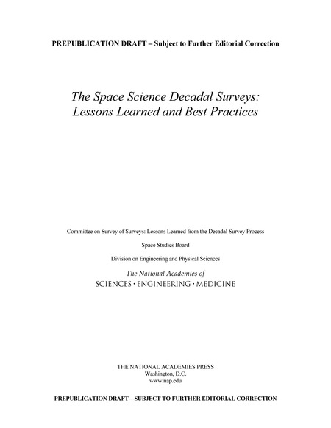
Decadal Survey Data Sources
The National Academies has released 10 Decadal Surveys since 1964
  First Decadal was ground-based only
  Astrophysics has done the most Decadal Surveys (6)
  Decadal Surveys are now done by all Divisions in SMD
  All Survey reports can be downloaded for free from the National Academies
In 2015 the Academies issued a report on Decadal Survey best practices
  Report looked to minimize challenges experienced in the last round of surveys
  Report chartered by SMD
  http://www.nap.edu/catalog/21788/the-space-science-decadal-surveys-lessons-learned-and-best-practices

Slide 4
2015 Report – Selected Process Findings and Recommendations
2015 report discussed how missions are prioritized
  Finding balance is key
    Example: balance across the sub-disciplines, between mission and non-mission activities, between new and continued observations, across mission sizes, and between competed and directed missions.
  All surveys used science merit, cost and technology readiness as prioritization factors
  All disciplines must make progress during the decade
Recommends using “reference missions” to avoid over specifying the mission implementation
Recommends including all past survey large concepts that have not started
Surveys should avoid recommending “discipline-disrupting” missions
Decision Rules and Cost Management
  Recognizes that science creep on large missions is a major contributor to cost growth.
  Recommends that the survey clearly state what science must remain to retain consensus priority
    “It is imperative that survey committees make clear which parts of a performance-driven mission are truly required, and where any compromises or de-scopes might be acceptable.”
  Recommends using decision rules to change or reevaluate survey priorities during the decade
  Recommends including descope and cancellation triggers in the decision rules
  For the full list of recommendations, see the 2015 Decadal Survey report.

Slide 5
Reference Mission
Astro 2010 “Reference Mission”
1.5m JDEM Omega
Current Mission Concept
2.4m WFIRST

Slide 6
Report Data Assessment Method
My goal was to see if there are patterns in past Decadal Survey selections that might give us insight into Committee tolerances for mission concept cost and new technologies (risk)
  Was not interested in actual mission cost or number of actual technologies developed, but rather what the Committee thought a mission would cost and how many technologies they thought it needed
Collected all reported cost data on all large (>$1B FY16) space missions in all past reports
  Converted reported costs to $ FY16 using the 2015 NASA New Start Inflation Index
  Sorted into “prioritized” and “deferred” groupings
Then took the reported cost data and divided by the expected Astrophysics Division funding level at the time of the report
  Most Survey reports made reference to at least an annual funding level
  One report did not have the funding data but the following report identified the funding level during the prior Survey
  Another report also had no funding data. Data found in a presentation by the then APD Manager on-line. All other reports contained at least annual funding levels.
Finally, read all reports back to Astro1991 for information on the number of new technologies required for each concept listed in Survey cost estimates.

Slide 7
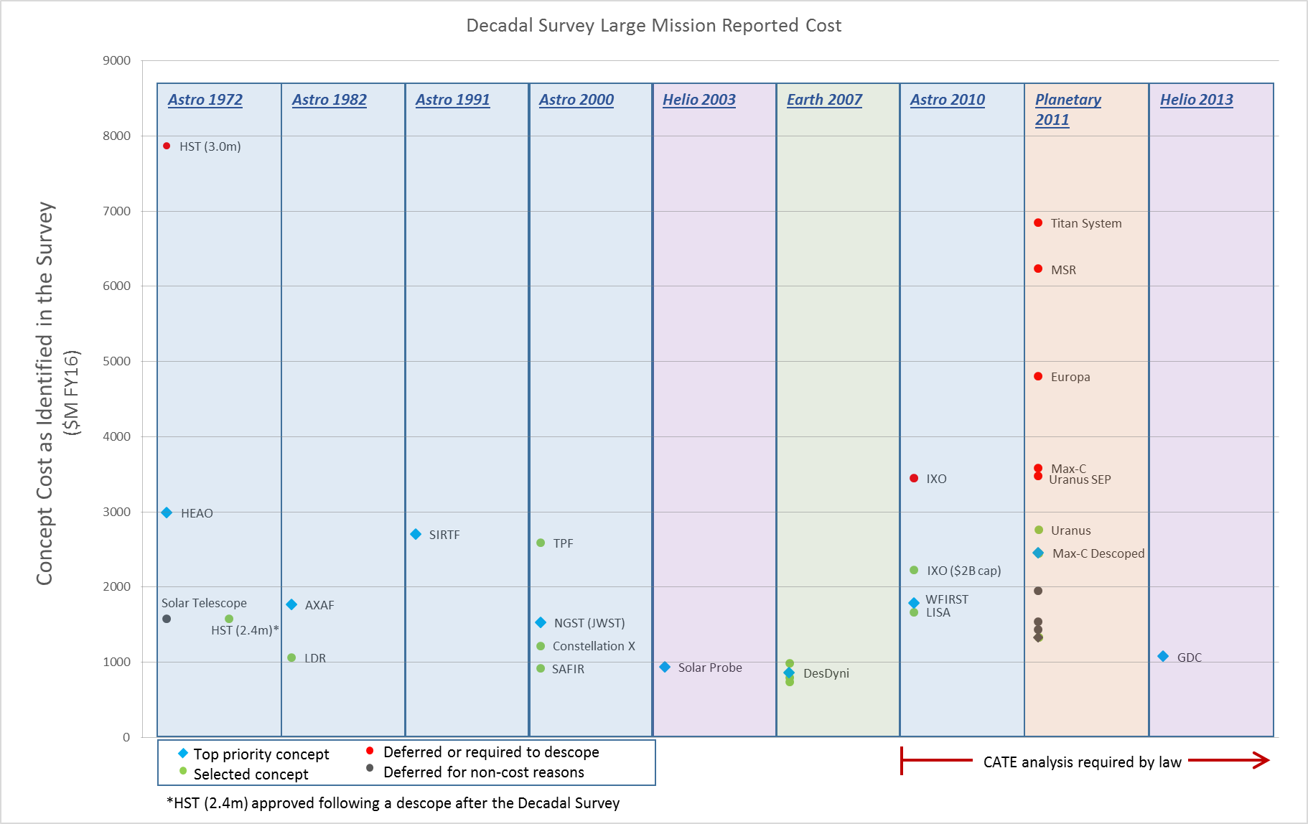
Notes:
Start by defining the axes

Slide 8
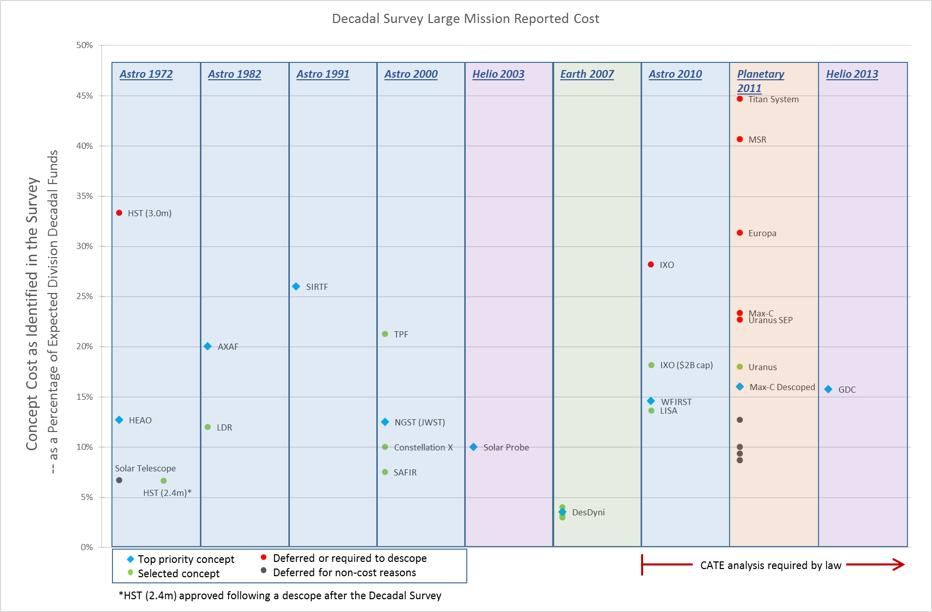

Slide 9
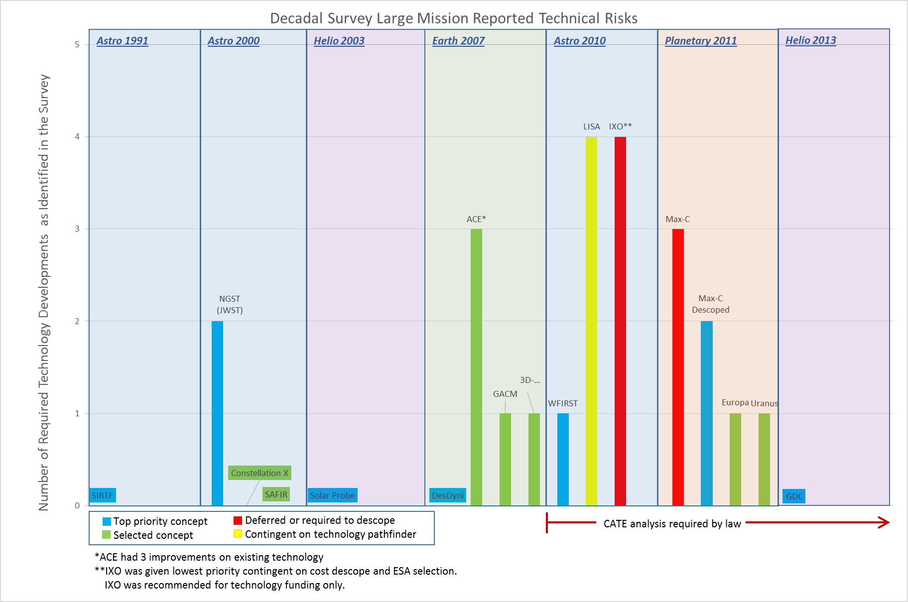

Slide 10
Congressional Requirements on the Decadal Survey
From the NASA Appropriations Act of 2008:
SEC. 1104. NATIONAL ACADEMIES DECADAL SURVEYS.
In General.—The Administrator shall enter into agreements on a periodic basis with the National Academies for independent assessments, also known as decadal surveys, to take stock of the status and opportunities for Earth and space science discipline fields and Aeronautics research and to recommend priorities for research and programmatic areas over the next decade.
(b) Independent Cost Estimates.—The agreements described in subsection(a) shall include independent estimates of the life cycle costs and technical readiness of missions assessed in the decadal surveys whenever possible.
(c) Reexamination.—The Administrator shall request that each National Academies decadal survey committee identify any conditions or events, such as significant cost growth or scientific or technological advances, that would warrant NASA asking the National Academies to reexamine the priorities that the decadal survey had established.

Slide 11
2015 Report – CATE Findings and Recommendations
CATE develops cost and risk estimates for all major mission concepts in the survey
  The estimates are spread over the decade and used to evaluate portfolio options by the survey committee
CATE is considered a best practice and is viewed as highly successful
  “…without a technical and cost risk metric relative science value between missions cannot be properly judged.”
Recommended a two-step CATE process
  Cost box criteria for initial round
  Detailed estimate for final round

Slide 12
Observations about the Decadal Survey Process
The Decadal Survey has always prioritized only missions that appear to leave money for other astrophysics communities
      “A successful federal research program must also be balanced. There is a tradeoff between investing in the development and construction of ambitious new telescopes and supporting broad-ranging observational and theoretical research that optimizes the return from operating facilities. The goal of the committee, consistent with its charge, has been to maximize the science return for a given budget.” – Astro2010
All past missions prioritized by the Decadal Survey were thought to be under $3B*
    *$FY16, cost to NASA.
It’s a new mission start or technology money, but not both
  Missions prioritized for a start (without required precursor missions or descopes) have always been seen as having 3 or less technologies to develop.
  For a new mission start “we must use the tools we have”.
The Decadal Survey has deferred extremely compelling mission concepts in the past
  Examples: 3m Hubble (Astro 1972), Lunar Telescope (Astro 1991), 4m Theia and New Worlds concepts (Astro 2010), Mars Sample Return (Planetary 2011)
  Compelling is not enough…technology readiness and cost must be part of the design process

Slide 13
The CATE
Process, Models and Data

Slide 14
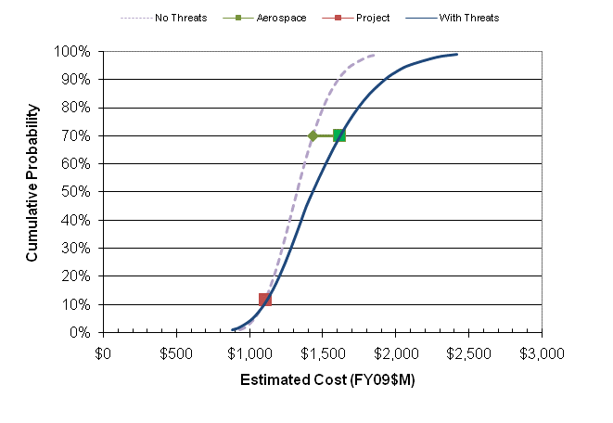
CATE Cost Estimating Process
Estimate Instruments & Spacecraft
Multiple analogies and models
Estimate Other Elements
Based on historical data
Estimate Cost Reserves
Based on probabilistic cost risk analysis
Estimate Mass and Power Contingency Threat
Re-run estimate with Aerospace contingencies
Estimate Schedule Threat
Based on ISE results and project burn rates
Integrate Results & Level Across Concepts
Cross-check with CoBRA

Slide 15
Example Hardware Estimate Results
Notional Results

Slide 16
CATE Models and Analogue Data
Instruments and spacecraft buses
  Multiple analogies are used for each element
    Analogue costs and technical descriptions taken from NASA CADRe, NICM and internal Aerospace sources
    Analogies chosen based on similarity to proposed instrument and by supplier
  Multiple cost models are also used for each element
    Instruments - MICM, NICM
    Spacecraft - NAFCOM, SSCM
    NICM, MICM and SSCM used on Probe studies. PRICE-H used for starshade

Slide 17
Stahl Telescope Model
Stahl, et.al., “Update to Single-variable Parametric Cost Models for Space Telescopes”, 2013
Model data is current and independent parameters are objective
Model is publicly available
Primary model used by CATE on Probe studies

Slide 18
Analogy-Based Estimate Process
Ties the Estimated Cost to Historical Actuals
Analogy-based estimates use historical items as the basis for an estimate
  Technical and programmatic differences often require adjustment to the historical costs
  Every historical program has “unique” aspects that affected the cost, but should not affect the cost of a new element
    Using multiple analogies can potentially average out the impacts of these unique aspects
Analogy-based Estimate = Actual cost of analogy x CER (new) / CER (analogy)

Slide 19
Example Cost Estimate Table
Notional Results

Slide 20
Notional CATE Technical Assessment
Project X Technical Risk Rating is Medium
Medium new development, mostly in the engineering implementation
  Increase in detector array size
  Migration from FPGAs to ASICs
  Modernization of heritage instrument control unit
Mass margins and power margins are aggressive and launch mass margin is very sensitive to changes in dry mass
  Concept design is closer than recommended to Atlas V 551 capacity limit and the system is very sensitive to changes in mass
  Several mass liens against concept design
Time critical mission operations contributes to medium operational risk
  Fault management for autonomous mode requires further definition
  Sampling operations and hardware need further definition

