Slide 1
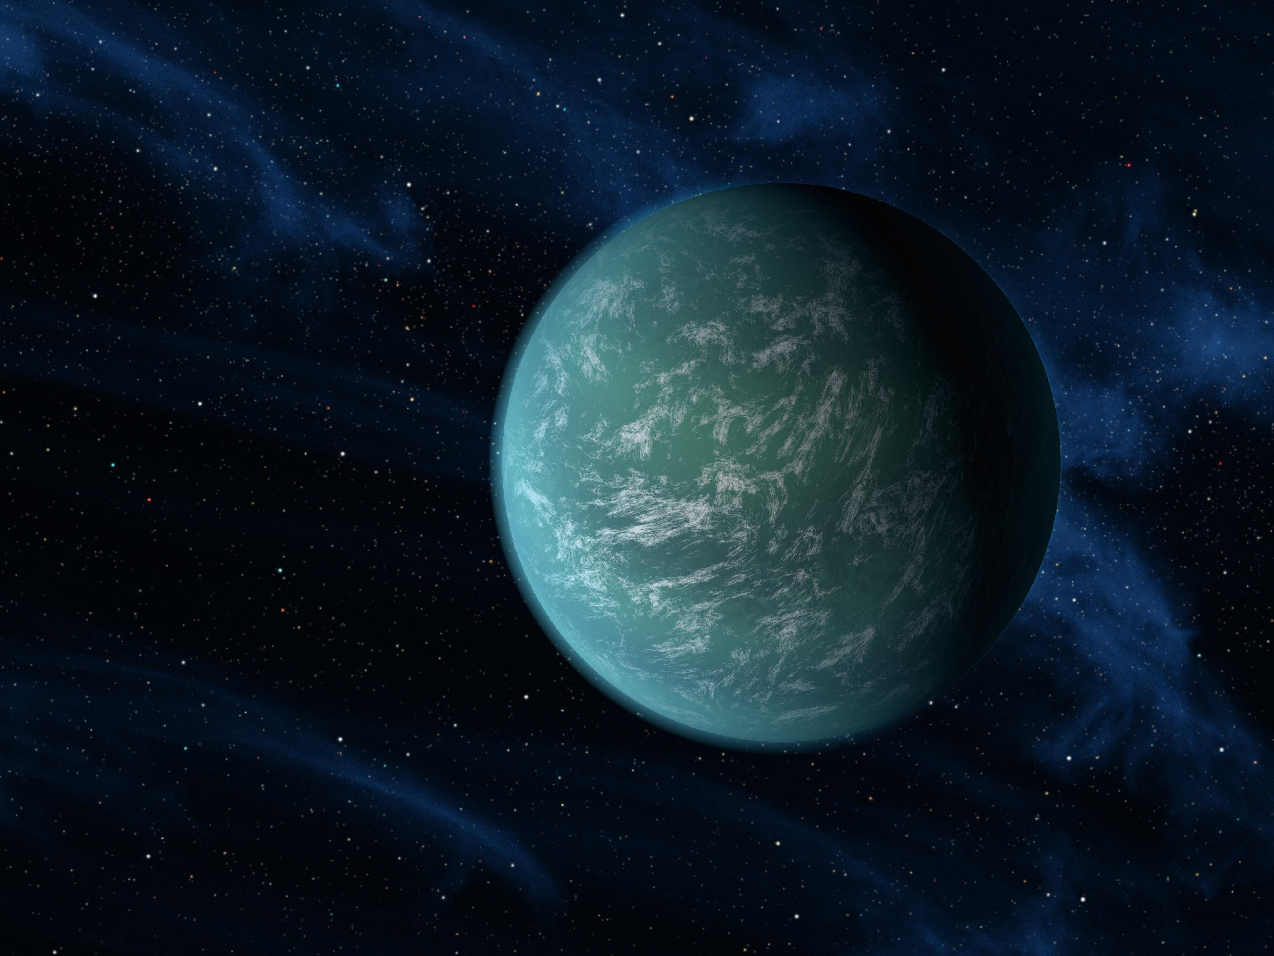
Current (and Future Predicted) η_{Earth} Constraints
Leslie Rogers
NASA Sagan Fellow, UC Berkeley
Future Assistant Professor, University of Chicago (09/2016)
larogers@caltech.edu
HabEx STDT First In Person Meeting – May 16, 2016

Slide 2
Outline
Defining η_{Earth}
Current Constraints on η_{Earth}
SAG13 Update (Curtesy of Rus Belikov)
Future Prospects

Slide 3
Defining η_{Earth}
R_{p}
(or M_{p})
η_{Earth}=Number of Habitable Zone rocky planets per star
(depends on boundaries chosen)
R_{max}
R_{min}
S_{min}
S_{max}
Insolation, S (or P_{orb})
Notes:
Now, when fitting RV and transit Light Curves of one planet system at a time, it’s typical to assume flat priors on the planet mass and radius. A priori, any mass-radius pair is equally likely,

Slide 4


Defining Γ_{Earth}
R_{p}
(or M_{p})
(does not depend on boundaries chosen)
R_{max}
R_{Earth}
R_{min}
S_{min}
S_{Earth}
S_{max}
Insolation, S (or P_{orb})
Notes:
Now, when fitting RV and transit Light Curves of one planet system at a time, it’s typical to assume flat priors on the planet mass and radius. A priori, any mass-radius pair is equally likely,

Slide 5
Outline
Defining η_{Earth}
Current Constraints on η_{Earth}
SAG13 Update (Curtesy of Rus Belikov)
Future Prospects

Slide 6
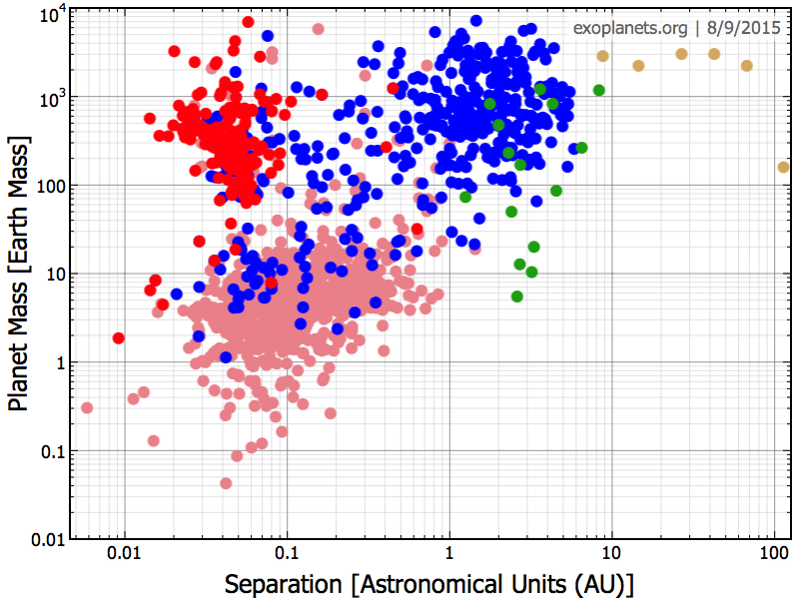
Exoplanet Discoveries to Date
Radial Velocity
Transit
Kepler
Direct Imaging
Microlensing
Astrometry
Notes:
To gain insights about the underlying distributions of planets, we must correct for the selection effects, survey completeness, (potential) false positives, stellar multiplicity, and propagate measurement uncertainties
To do: Add Gaia and GPI/Sphere parameter space
Astrometry area is for 1 Mearth star at 200 pc (filled)
0.4-M⊙ M dwarf at 25 pc (not-filled line)
Smaller filled triangle is approximate Sahlmann et al. (2014) sensitivity region (ground-based survey of nearby M-L transition objects)
Filled triangle at longer orbits is the Lurie et al. (2014) approximate sensitivity region for the RECONS survey of nearby M dwarfs on CTIO/SMARTS 0.9 m telescope
Orange shaded region is from Nielsen & Close 2010 NICI survey
Orange line is estimate of 50% completeness area for GPIES survey (from Graham 2007).

Slide 7
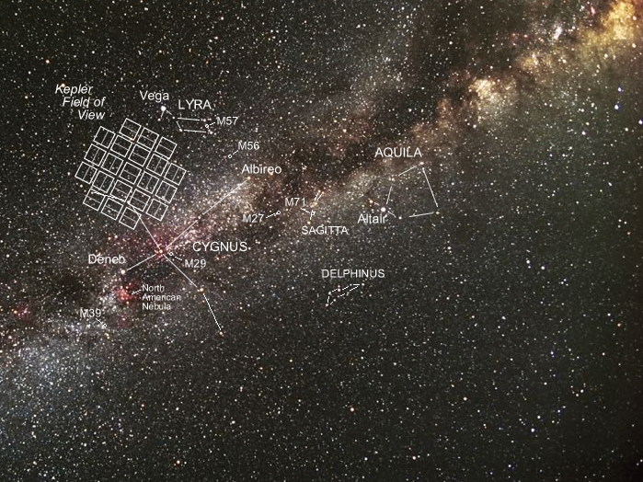
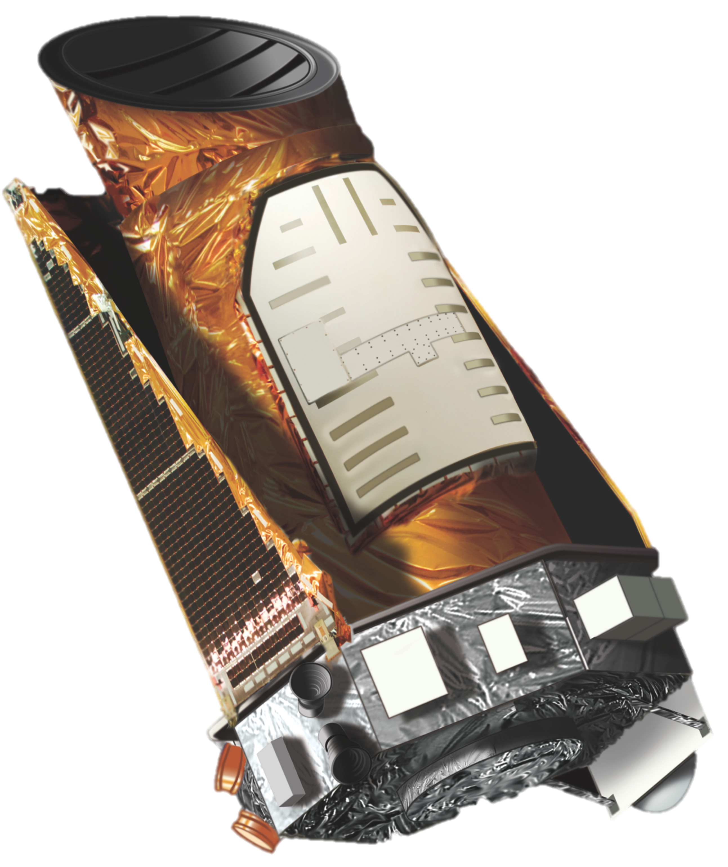
Kepler Mission
Notes:
Kepler is 0.95 m aperture (1.4m primary mirror diameter) space telescope FOV 105 square degrees monitoring the brightness of 150 000 stars looking for transits.

Slide 8
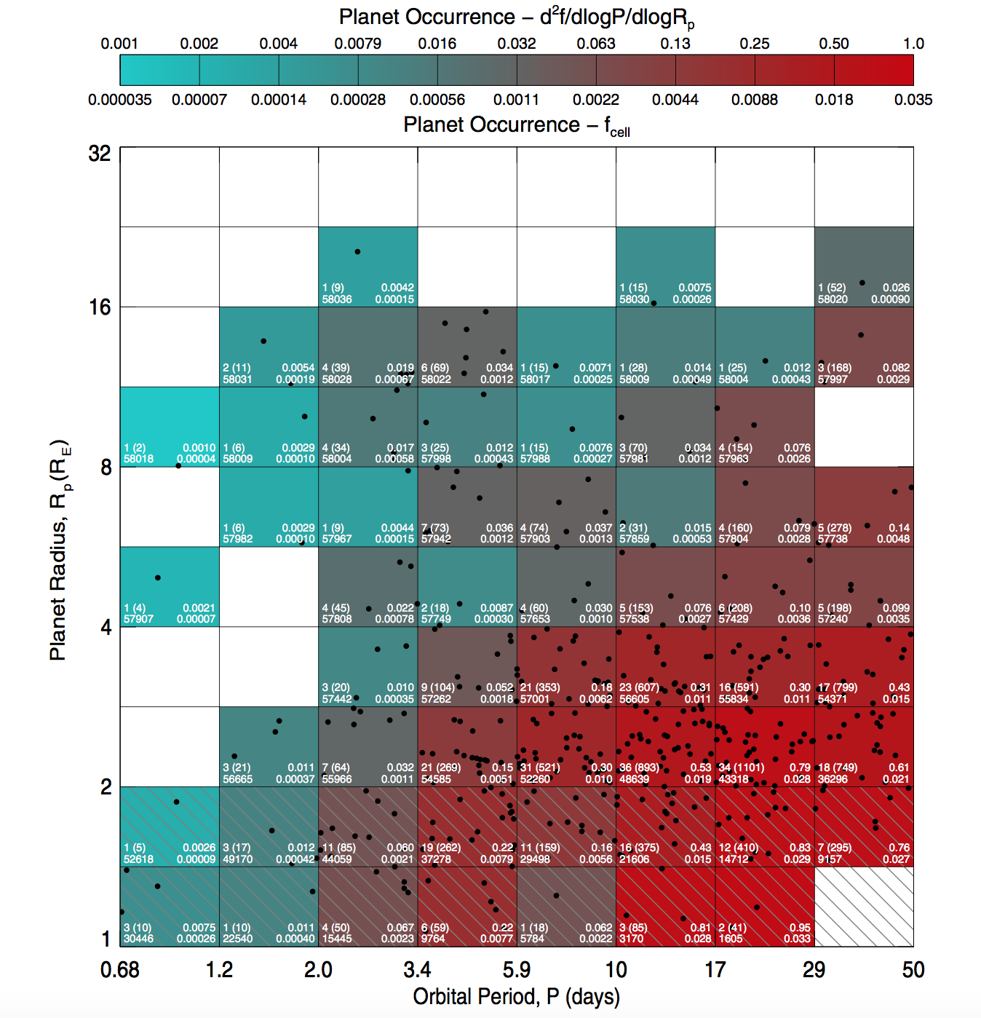
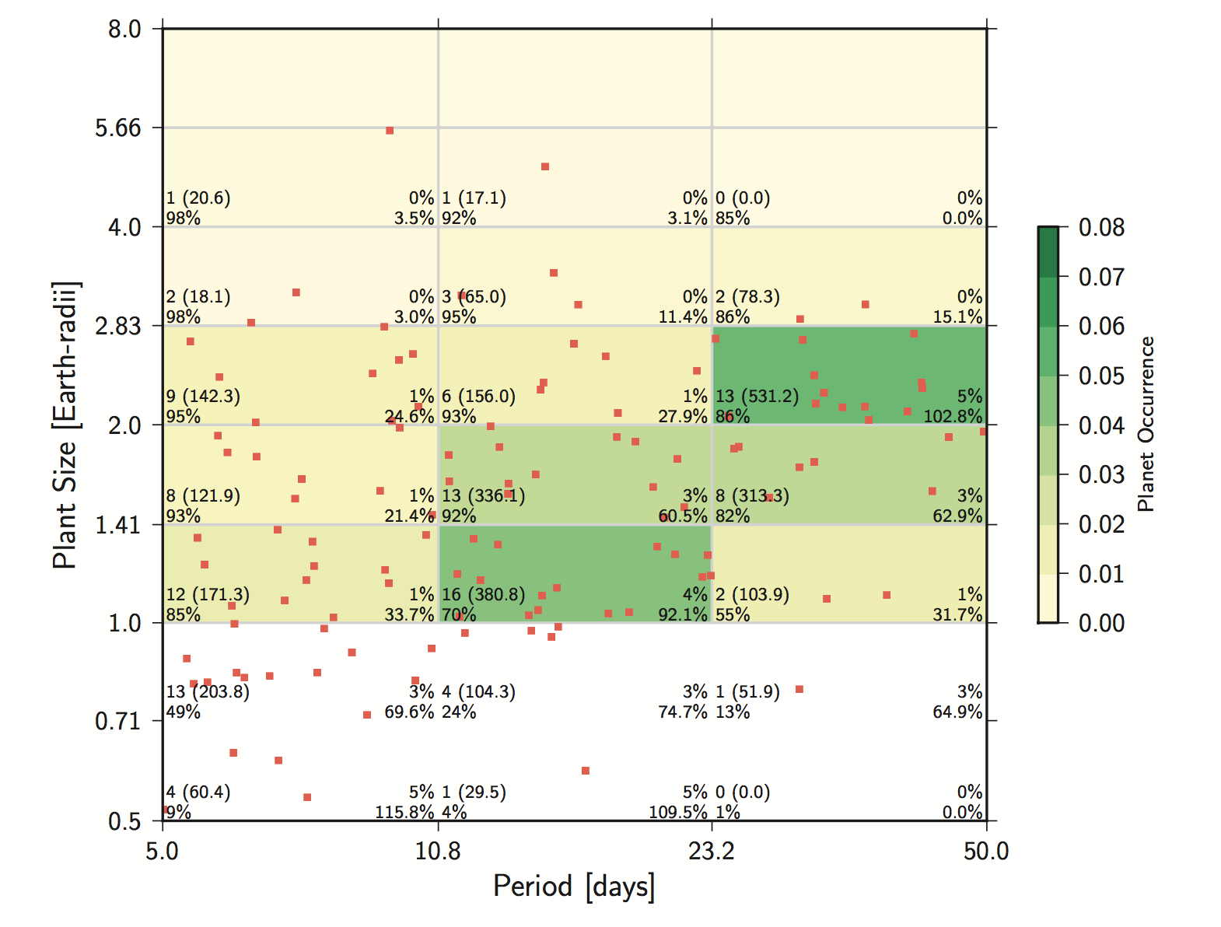
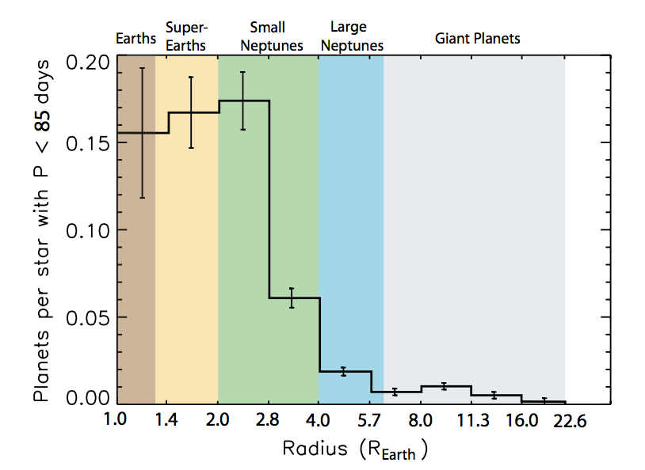
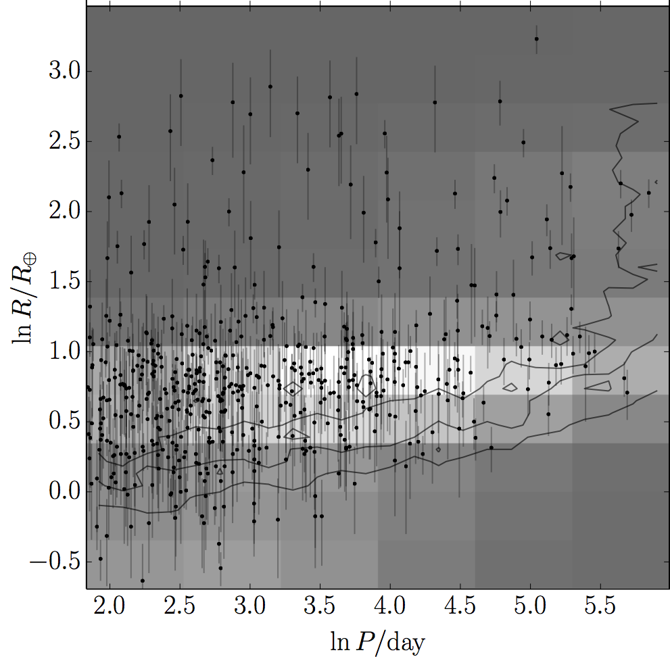
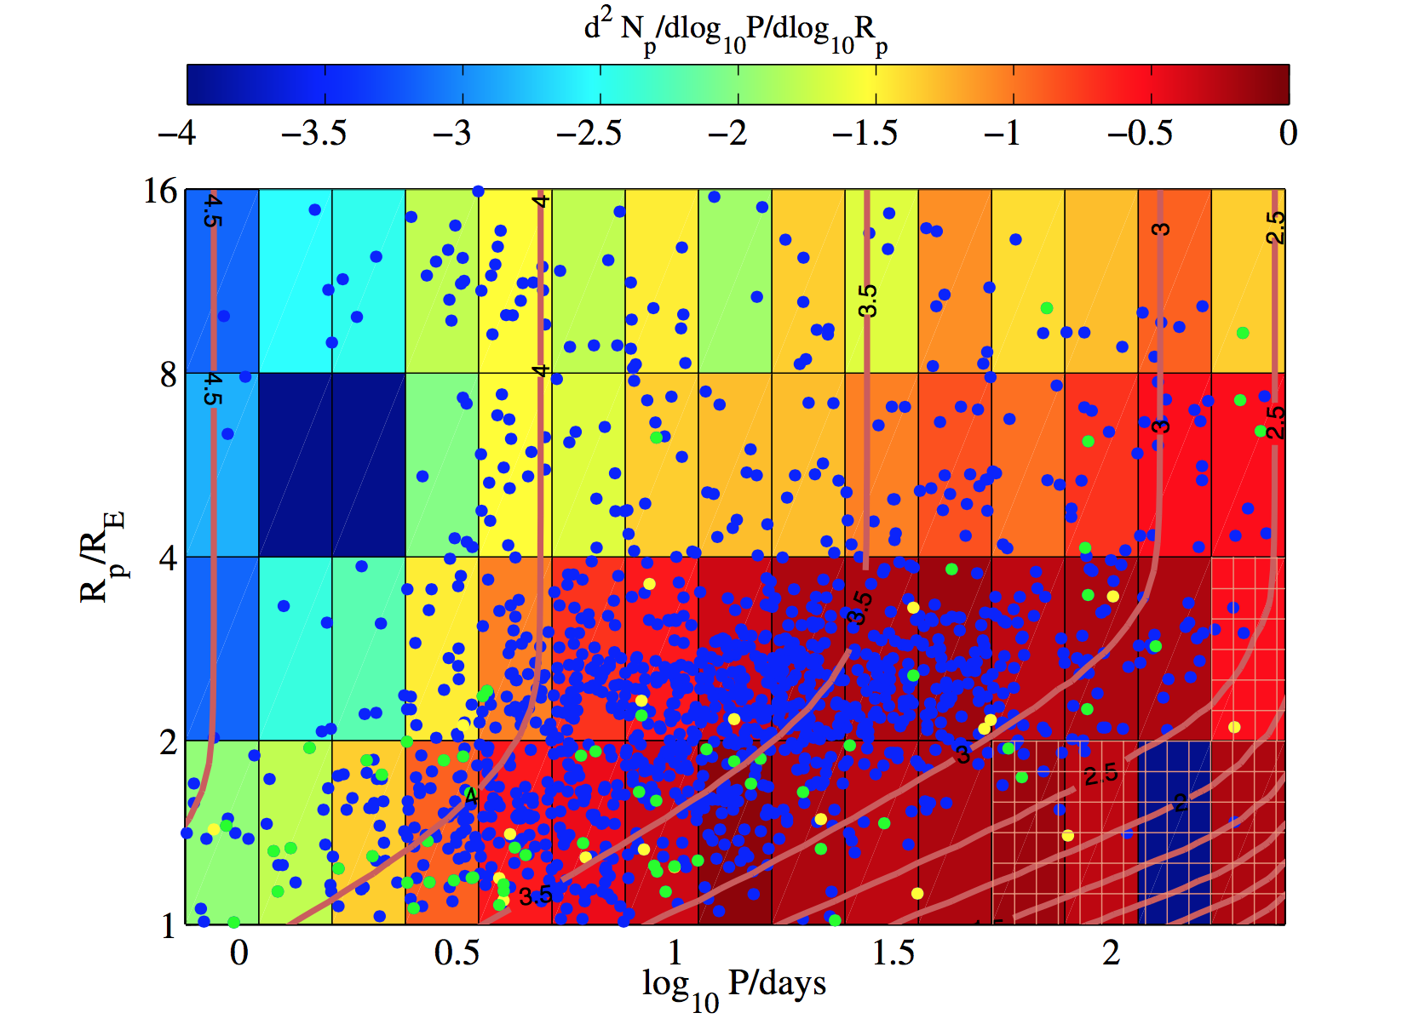
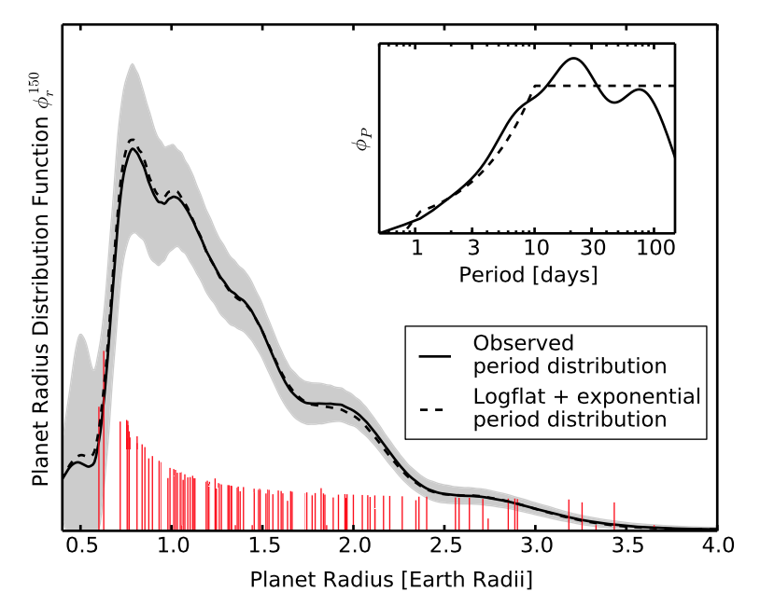
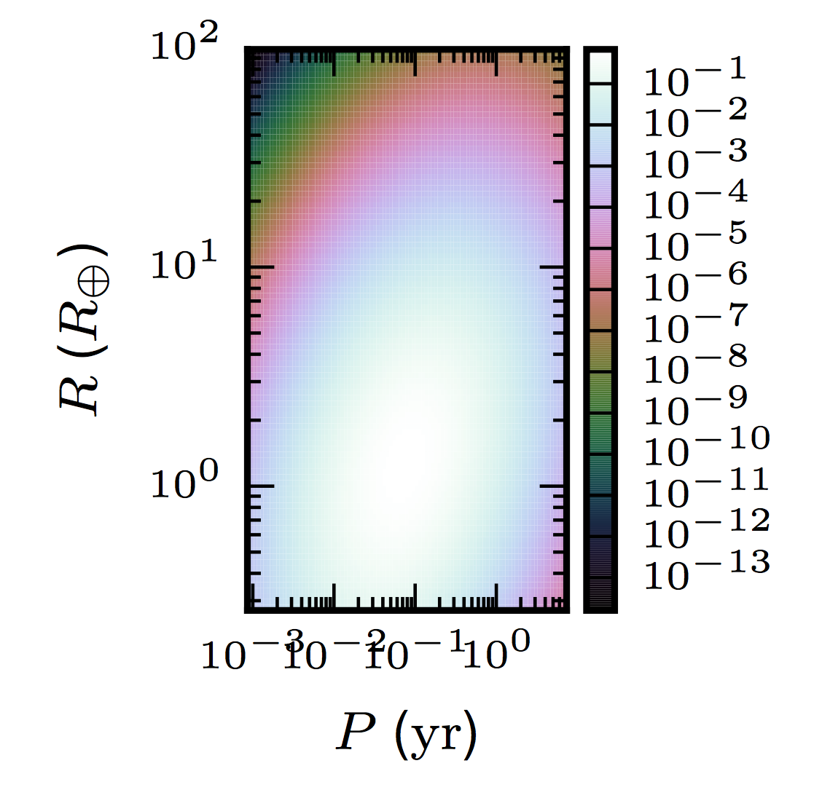
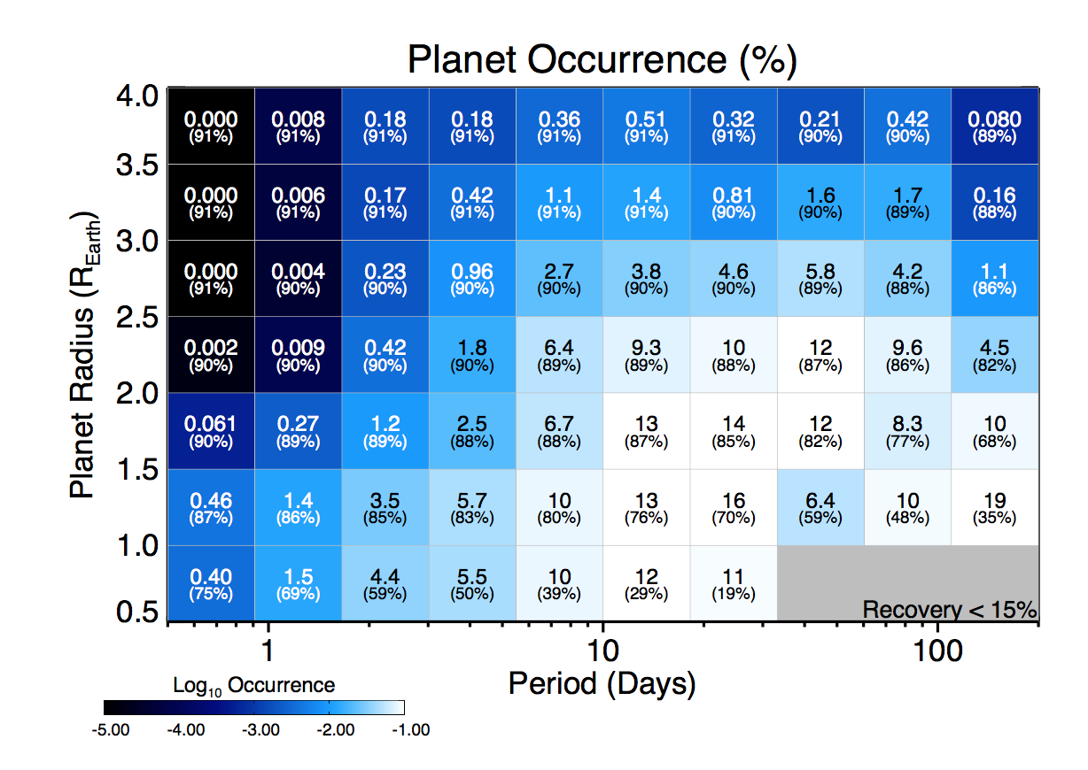
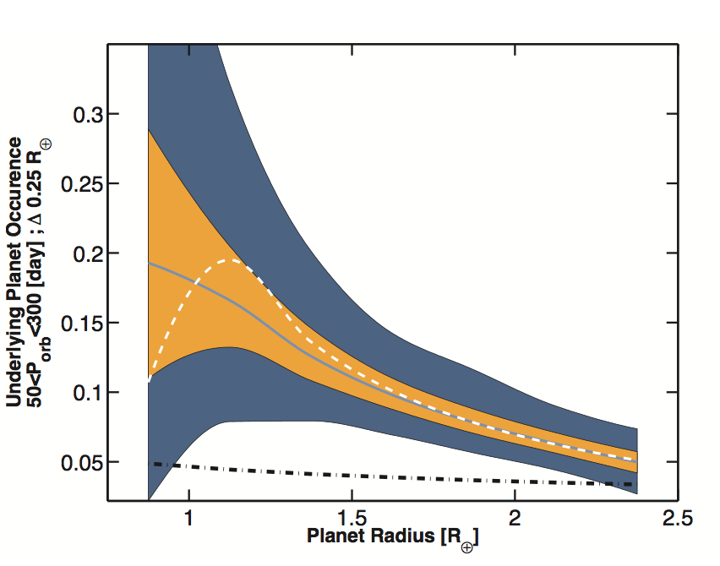
Planet Occurrence from Kepler (Incomplete)
Fressin et al. (2013)
Petigura et al. (2013)
Howard et al. (2012)
Morton & Swift (2013)
Dong & Zhu (2013)
Foreman-Mackey et al. (2014)
Dressing & Charbonneau (2015)
Farr et al. (2015)
Burke et al. (2015)

Slide 9
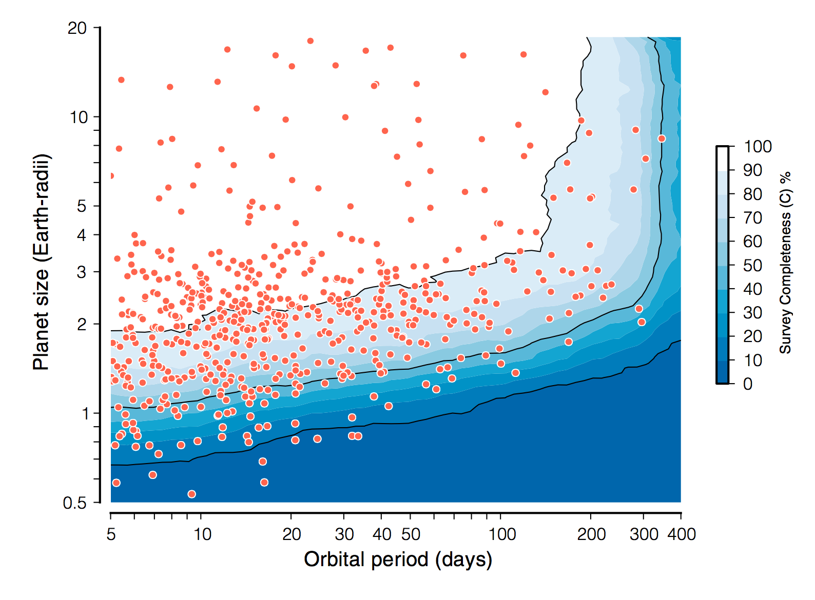
TERRA Pipeline Detections and Completeness
Petigura et al. (2013b)
Notes:
Petigura et al. (2013)b 603 detected planets in our survey of 42,557 bright Sun- like stars (Kp = 10–15 mag, GK spectral type).

Slide 10
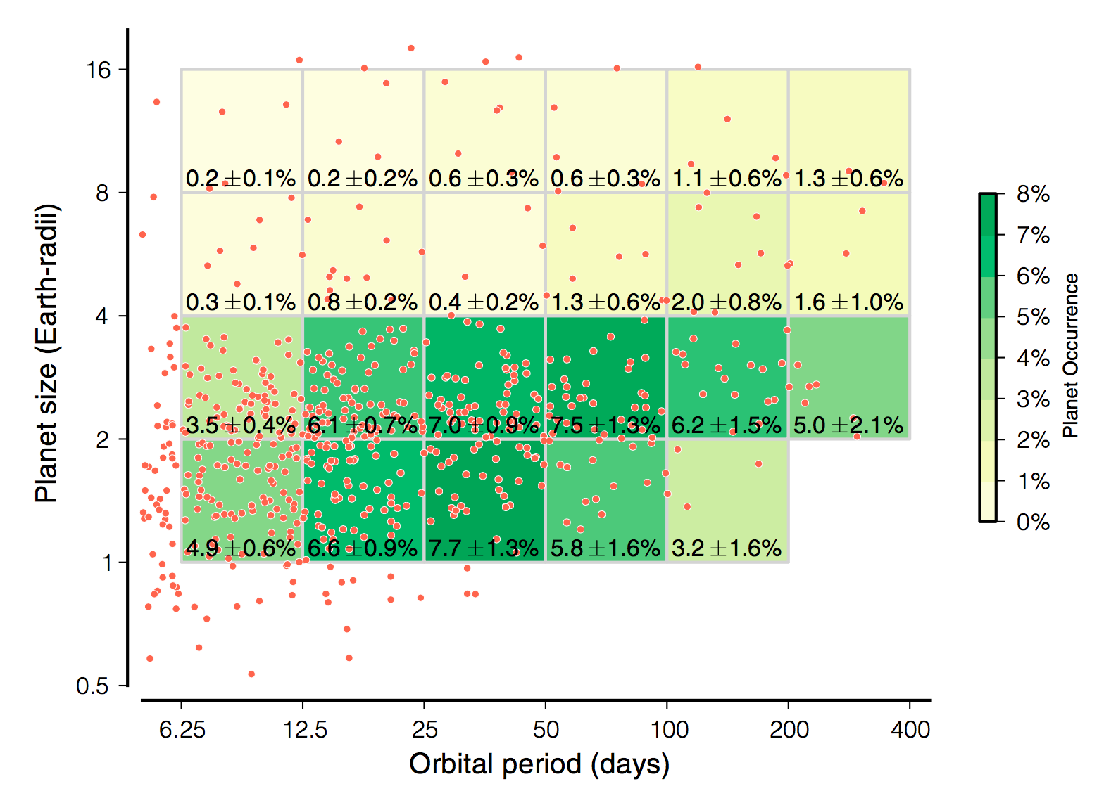
Planet Radius-Period Joint Distribution
Petigura et al. (2013b)

Slide 11
Need to Extrapolate to Estimate η_{Earth}
Fewer planets found by direct imaging than predicted (e.g., Lafreniere et al. 2007, Nielsen & Close 2010, Biller et al. 2013, Brandt et al. 2014)
Extrapolate Cumming et al. (2008) df = C M^{-0.31±0.2}P^{0.26±0.1} dlnM dlnP
Radial Velocity
Transit
Kepler
Direct Imaging
Microlensing
Astrometry
You Are Here
Notes:
To do: Add Gaia and GPI/Sphere parameter space
Astrometry area is for 1 Mearth star at 200 pc (filled)
0.4-M⊙ M dwarf at 25 pc (not-filled line)
Smaller filled triangle is approximate Sahlmann et al. (2014) sensitivity region (ground-based survey of nearby M-L transition objects)
Filled triangle at longer orbits is the Lurie et al. (2014) approximate sensitivity region for the RECONS survey of nearby M dwarfs on CTIO/SMARTS 0.9 m telescope
Orange shaded region is from Nielsen & Close 2010 NICI survey
Orange line is estimate of 50% completeness area for GPIES survey (from Graham 2007).
Cumming et al. 2008 normalization constant C such that 10.5% of solar type stars have a planet with mass in the range 0:3–10 MJ and orbital period 2–2000 days

Slide 12
Γ_{Earth} Estimates Affected by Extrapolation, Small Number Statistics, and Systematics
FGK Dwarf Hosts
M Dwarf Hosts
Notes:
From David Hogg:
I checked with Dan Foreman-Mackey (UW) right after the meeting, and his view is that the principal reason that we are getting lower rates (for Earth-like planets) than Burke et al is that our rates were measured with an incompleteness function (not computed by us, but *adopted* by us, so we take responsibility!) that was not conservative.
When this is changed to a more conservative incompleteness function, our rates of Gamma_Earth or eta_Earth will probably rise substantially. It won't come quite up to Burke et al, because our conservative marginalization of noisy exoplanet radius inferences almost always decreases the amplitude of any extrapolation to Earth radii, but it will rise. So our few-percent number is at this point likely low, possibly even by a factor of five-ish. (It is very sensitive to completeness because Earth lies right at the cusp where completeness is dropping rapidly to zero.) Foreman-Mackey also said that although he has some detailed disagreements with Burke et al (especially in the treatment of radius uncertainties), it is the best measurement in the business at this point.
Executive summary: Gamma_Earth (which is similar to eta_Earth) of 0.1 is not unreasonable as a fiducial at this point, with the caveat that there is lots of posterior probability density at much lower values.

Slide 13
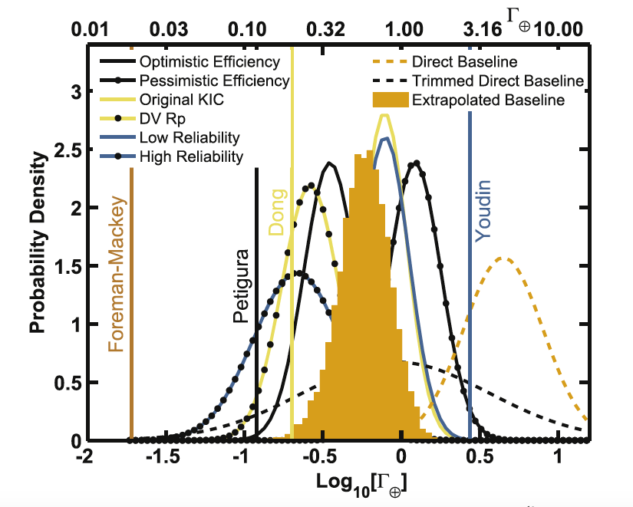
η_{Earth} Estimates Affected by Extrapolation, Small Number Statistics, and Systematics
Burke et al. (2015)
Notes:
“ The current results are dominated by systematic uncertainties.
Unlike statistical uncertainties that are limited by the
quantity and quality of data, these systematic uncertainties can
be minimized with additional study. From our analysis, we
identify the leading sources of systematics: instrumental false
alarm contamination of the planet candidate sample, determining
planet radii ( independent of the degeneracy with R) ,
pipeline completeness, and stellar parameters.

Slide 14
η_{Earth} Estimates Affected by Extrapolation, Small Number Statistics, and Systematics
FGK Dwarf Hosts
M Dwarf Hosts

Slide 15
SAG13 update
Chair: Rus Belikov
(Note: these slides are a status update. Conclusions have not been endorsed by all of SAG13 yet)

Slide 16
SAG13 Goals
“The primary goal of this SAG is to evaluate what we currently know about planet occurrence rates, and especially eta_Earth, by consolidating, comparing, and reconciling discrepancies between different studies.”
Full Charter: https://exep.jpl.nasa.gov/files/exep/ExoPAG-SAG13-Charter.pdf
Key objectives and questions:
Propose standard nominal conventions, definitions, and units for occurrence rates/distributions to facilitate comparisons between different studies.
Do occurrence estimates from different teams/methods agree with each other to within statistical uncertainty? If not, why?
For occurrence rates where extrapolation is still necessary, what values should the community adopt as standard conventions for mission yield estimates?
v.4 of
standards
document
created
Current
focus
Ucoming
activity

Slide 17
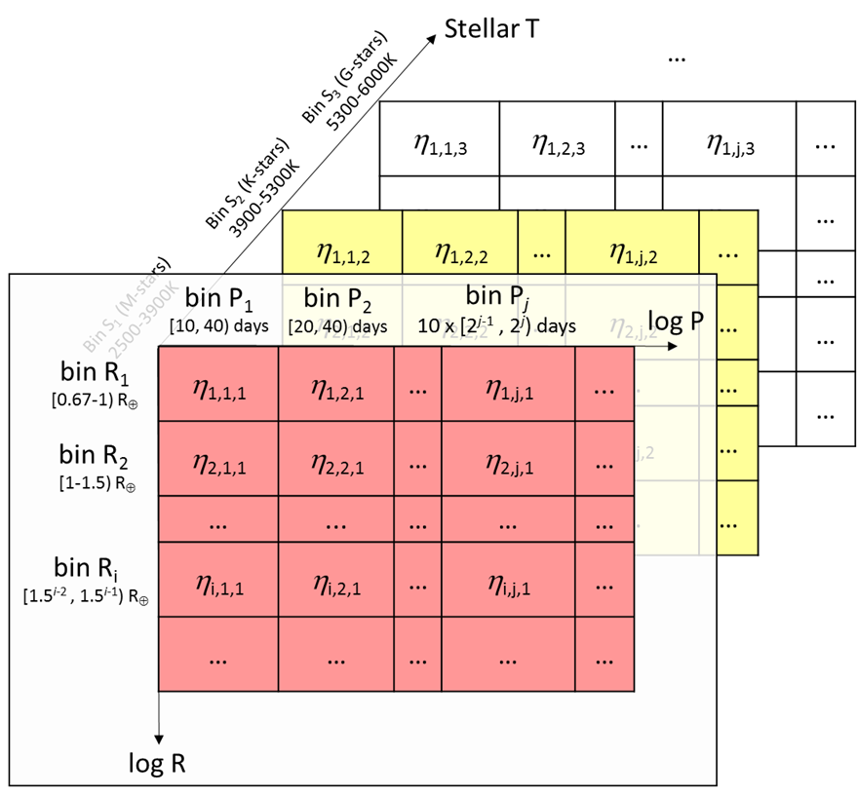
Standardized eta grid
[10 20) days
See SAG13 document “SAG13_Standard_eta_definitions.pdf” at
https://drive.google.com/drive/folders/0B520NCfkP4aOQUJYdmUzQTJkdkE

Slide 18
Crowdsourcing participants
Data on https://drive.google.com/open?id=0B520NCfkP4aOQUJYdmUzQTJkdkE
Name | Status
Batalha, Natalie | Submission complete (2 versions: up to Q16 and Q17)
Belikov, Rus | Partial submission (G)
Burke, Chris | Submission complete (and one update)
Catanzarite, Joe | Submission complete
Dressing, Courtney | Submission complete (by Chris Burke)
Farr, Will | Partial submission (G)
Foreman-Mackey, Daniel | Submission complete (by Chris Burke)
Kopparapu, Ravi | Submission complete
Mulders, Gijs | Submission complete
Petigura, Erik (or Andrew Howard) | Submission complete (by Chris Burke)
Traub, Wes | Pending
11 crowdsourced datasets
Anybody is welcome to participate!
(contact Ruslan.Belikov@nasa.gov)

Slide 19
Submitted occurrence rates for G-dwarfs
(=NaN)
habitable planets span (very approximately) the 4-6 bins in the bottom right corner
Data from Petigura and Foreman-Mackey are done by Burke, using distributions from their papers

Slide 20
Crowdsourced statistics (for G-dwarfs)
High
crowdsourced
variance
for hab_planets
crowdsourced
variance is
on the order of
poisson vairiance
Low # of
crowdsourced
submissions
for hab planets

Slide 21
Some preliminary observations
(not yet endorsed by SAG13)
Occurrence rates for G-dwarf habitable planets are *highly* dependent on whether we include the 0.5-1 planet size range or not.
  If it is excluded, most submitted rates are on the order of a few 10s of %.
  If it is included, rates require extrapolation, but are typically >50%. (I.e., the 0.5-1 bin usually contains a few times more planets than 1.0-1.5 bin and dominates eta_Earth.)
The occurrence rate in the ~0.5-1.0 planet size range can potentially swing the science yield of HabEx by a large factor (with appropriate contrast requirements). It is critical to get a better estimate of planets in that size range.
Note: SAG13 has not yet officially adopted integration bins for eta_Earth.

Slide 22
Outline
Defining η_{Earth}
Current Constraints on η_{Earth}
SAG13 Update (Curtesy of Rus Belikov)
Future Prospects

Slide 23
Future Prospects
Radial Velocity
Transit
Kepler
Direct Imaging
Microlensing
Astrometry
Notes:
To do: Add Gaia and GPI/Sphere parameter space
Astrometry area is for 1 Msun star at 200 pc (upper line)
0.4-M⊙ M dwarf at 25 pc (lower not-filled line)
Smaller filled triangle is approximate Sahlmann et al. (2014) sensitivity region (ground-based survey of nearby M-L transition objects)
Filled triangle at longer orbits is the Lurie et al. (2014) approximate sensitivity region for the RECONS survey of nearby M dwarfs on CTIO/SMARTS 0.9 m telescope
Orange shaded region is from Nielsen & Close 2010 NICI survey
Orange line is estimate of 50% completeness area for GPIES survey (from Graham 2007).

Slide 24
Summary
Currently, all estimates of η_{Earth} and Γ_{Earth} for GK stars are extrapolations with large systematic uncertainties.
  Possible range of Γ_{earth} spans 3 orders of magnitude
Future improvements in η_{Earth} and Γ_{earth} from:
  Continued analysis of Kepler dataset
    single transit events
    more sophisticated noise models
  Combining Kepler and WFIRST microlensing
  Others Suggestions... ?

Slide 25
Extra Slides

Slide 26
Charter
Over 5000 exoplanets and exoplanet candidates have been discovered to date. Many studies have been published and are on-going to determine exoplanet occurrence rates and distributions, particularly for potentially habitable worlds. These studies employ different statistical and debiasing methods, different definitions of terms such as eta_Earth and habitable zone, different degrees of extrapolation, and present distributions in different units from each other. The primary goal of this SAG is to evaluate what we currently know about planet occurrence rates, and especially eta_Earth, by consolidating, comparing, and reconciling discrepancies between different studies. A secondary goal is to establish a standard set of occurrence rates accepted by as much of our community as possible to be used for mission yield estimates for missions to be considered by the decadal survey.
Key objectives and questions:
Propose standard nominal conventions, definitions, and units for occurrence rates/distributions to facilitate comparisons between different studies.
Do occurrence estimates from different teams/methods agree with each other to within statistical uncertainty? If not, why?
For occurrence rates where extrapolation is still necessary, what values should the community adopt as standard conventions for mission yield estimates?
v.4 of
standards
document
created
Current
focus
Ucoming
activity

Slide 27
Example SAG13 dataset
roughly eta_Earth
for G-twins
(integration region
spans ~ 4-6 SAG13 bins)
Data by Burke et al. 2015, table made by code from Gijs Mulders

Slide 28
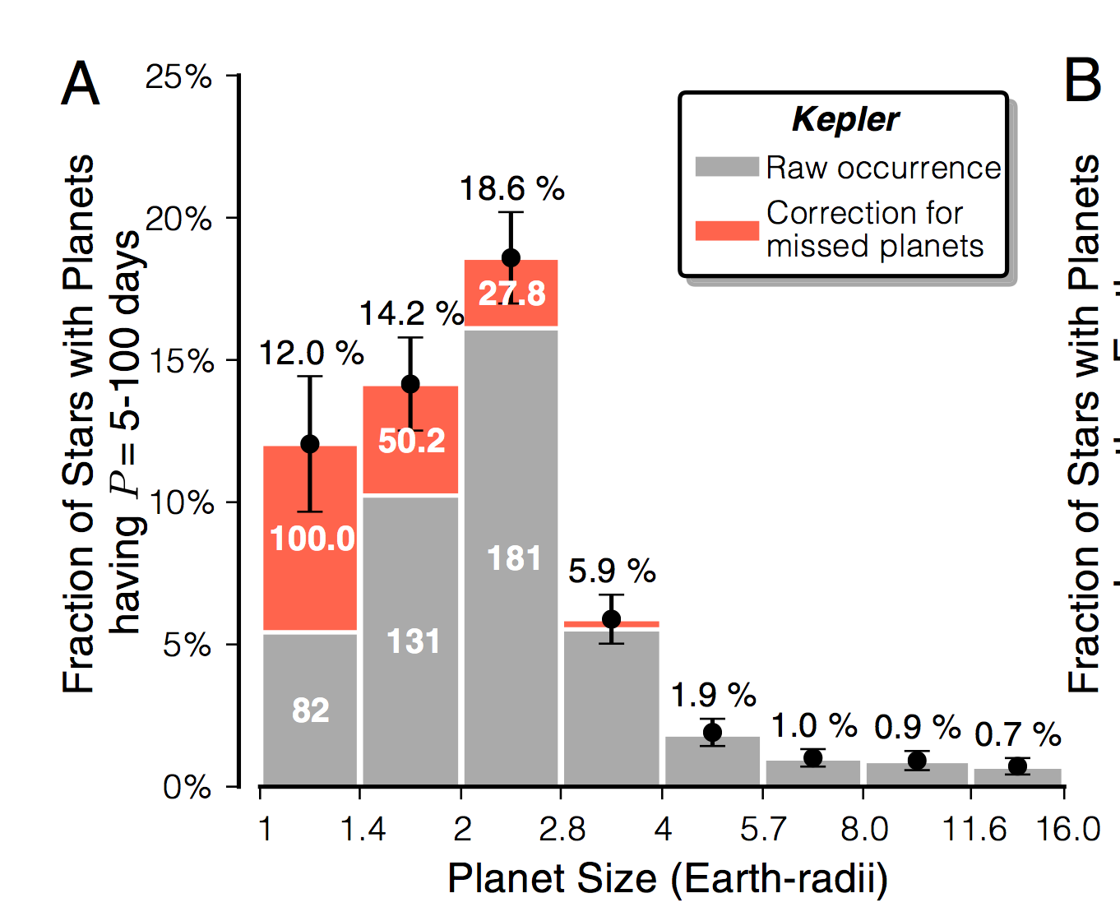
Sub-Neptune-Size planets are common!
Petigura et al. (2013b)
Notes:
Petigura et al. (2013)b 603 detected planets in our survey of 42,557 bright Sun- like stars (Kp = 10–15 mag, GK spectral type).
About 50% of stars have planets smaller than Neptune (Rp =1-4 Rearth) with orbital periods less between 5 and 100 days (Petigura et al. 2013)
Based on 42000 lowest noise Kepler G & K stars Petigura 2013b
Extrapolating the cumulative period distribution
predicts 5:7+1:7 % occurrence of Earth-size 1 − 2 R⊕ planets with orbital periods of ∼1 y (P = 200–400 d).
Outnumber planets larger than 4 Earth radii at these orbital periods by more than an order of magnitude.
About 24.5% +2.1%/-3.4% of stars have planets smaller than Neptune with orbital periods less between 5 and 50 days (Petigura et al. 2013)
Based on 12000 lowest noise Kepler G & K stars Petigura 2013a
Fressing et al. 0.649±0.047 planets per star
For planets with:
0.8 < R_{p}< 4.0 R
P_{orb}< 85 days
Observational techniques are now sensitive to smaller planets.
Microlensing, radial velocity and transit surveys have revealed that sub-Neptune and super-Earth planets are common around other stars. More than 80% of the transiting planet candidates found by Kepler are smaller than Neptune.
Understanding the nature of sub-Neptune planets can has important implications for our understanding of planet formation.
*********
Microlensing: Sumi et al. (2010)
Beyond the snow-line, Neptune-mass planets are at least three times more common than Jupiters at the 95% confidence level.
Radial Velocity:
Transit Observations:
Over 74% of the Kepler planetary candidates are smaller than Neptune (Borucki et al. 2011).
Howard et al. (2011) predict occurrence rates of 0.130 ± 0.008 (2-4 Rearth), 0.023 ± 0.003 (4-8 Rearth), and 0.013 ± 0.002 (8-32 Rearth)
Kepler: Earth Size (<1.25 Rearth) SE (1.25-2Re) N (2-6 Re) J (6-15 Re) SJ (15-22 Re)

Slide 29
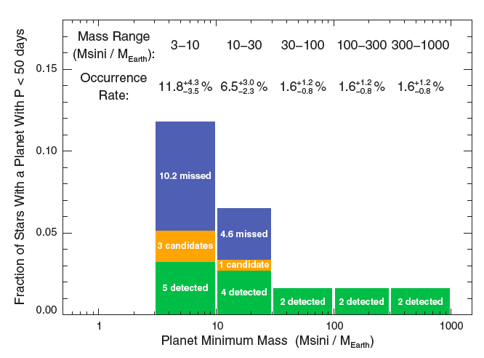
Neptunes are Common!
Microlensing:
62±36% of stars have a 5-10 M_{Earth} planet at 0.5-10 AU. Cassan et al. (2012)
Transits:
Radial Velocity:
Howard et al (2010)
Petigura et al. (2013)
Notes:
Microlensing, radial velocity and transit surveys have revealed that sub-Neptune and super-Earth planets are common around other stars.
Understanding the nature of sub-Neptune planets can has important implications for our understanding of planet formation.
Planets smaller than Neptune are common, but what are they?
*********
Microlensing: Sumi et al. (2010)
Beyond the snow-line, Neptune-mass planets are at least three times more common than Jupiters at the 95% confidence level.
Radial Velocity:
Transit Observations:
Over 74% of the Kepler planetary candidates are smaller than Neptune (Borucki et al. 2011).
Howard et al. (2011) predict occurrence rates of 0.130 ± 0.008 (2-4 Rearth), 0.023 ± 0.003 (4-8 Rearth), and 0.013 ± 0.002 (8-32 Rearth)
Kepler: Earth Size (<1.25 Rearth) SE (1.25-2Re) N (2-6 Re) J (6-15 Re) SJ (15-22 Re)

Slide 30
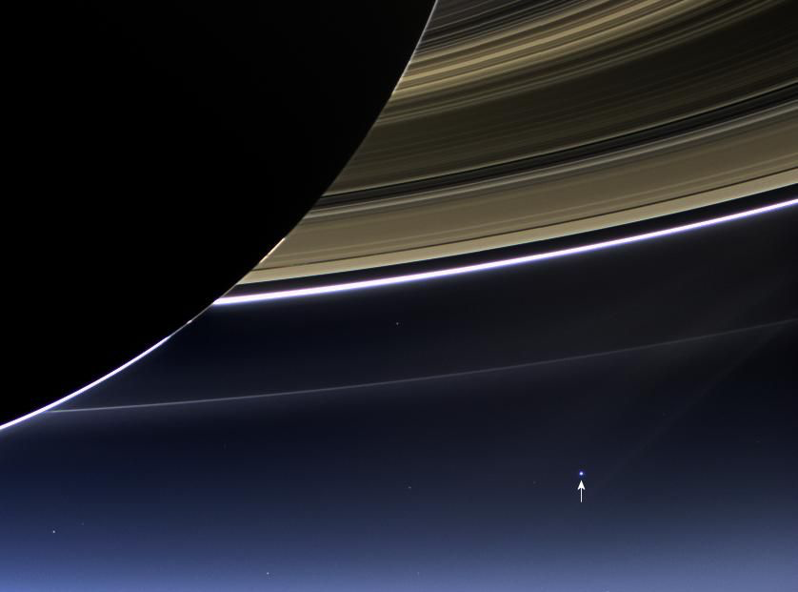
Image Credit: NASA/JPL-Caltech/Space Science
Cassini wide-angle camera, July 19, 2013
You Are Here
Notes:
Imaging a true earth-Analog exoplanet (a potenially the visible, tially habitable rocky planet orbiting a sun-like star) is a driving impetus in the field of exoplanets. Imaging an exo-Earth analog is also a tremendous technological challenge, since the Earth is 10 billion times fainter than the sun, While the Cassini wide-angle camera used Saturn as an external occulter to blo

