Slide 1
Briefing to the Astrophysics Science and Technology Definition Teams
May 2016
Paul Hertz
Director, Astrophysics Division
Science Mission Directorate
@PHertzNASA

Slide 2
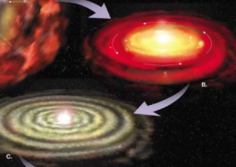
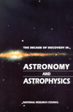
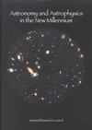
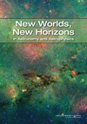
Why Astrophysics?
Astrophysics is humankind’s scientific endeavor to understand the universe and our place in it.
1. How did our universe begin and evolve?
2. How did galaxies, stars, and planets come to be?
3. Are We Alone?
These national
strategic drivers
are enduring
1972
1982
1991
2001
2010

Slide 3
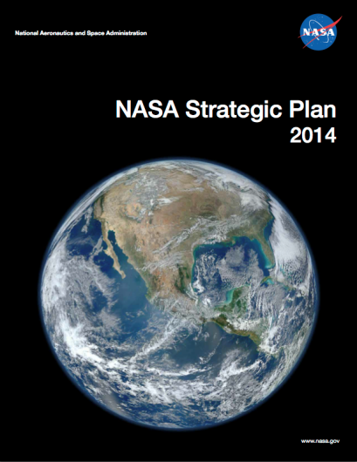
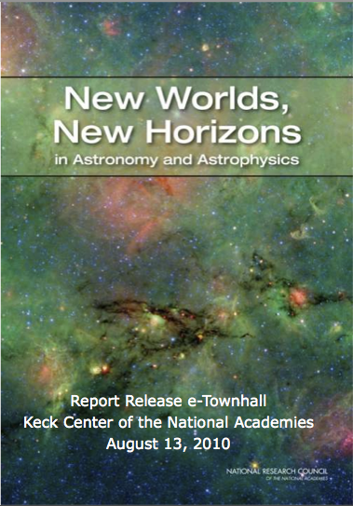
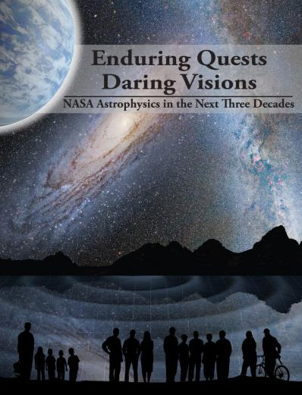
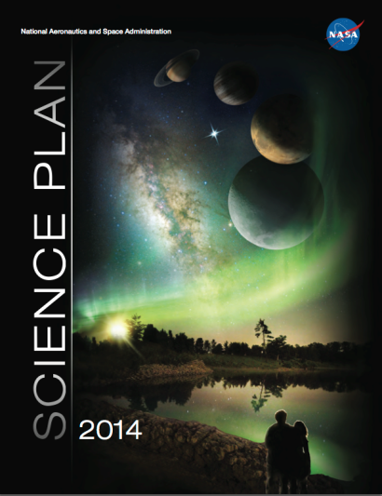
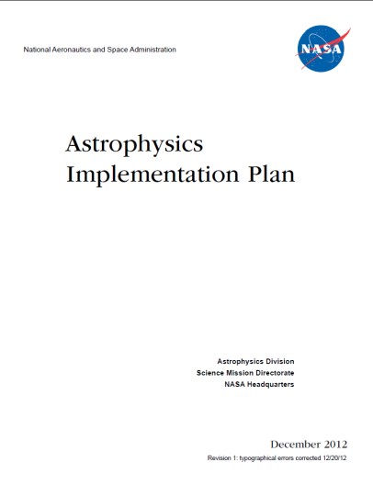
Astrophysics Driving Documents
http://science.nasa.gov/astrophysics/documents

Slide 4
Launch 2018
LRD: 2018
LRD: 2020s
Launch mid-2020s
2003
Launch 2003
1999
Launch 1999
Launch 1990
1990
4

Slide 5
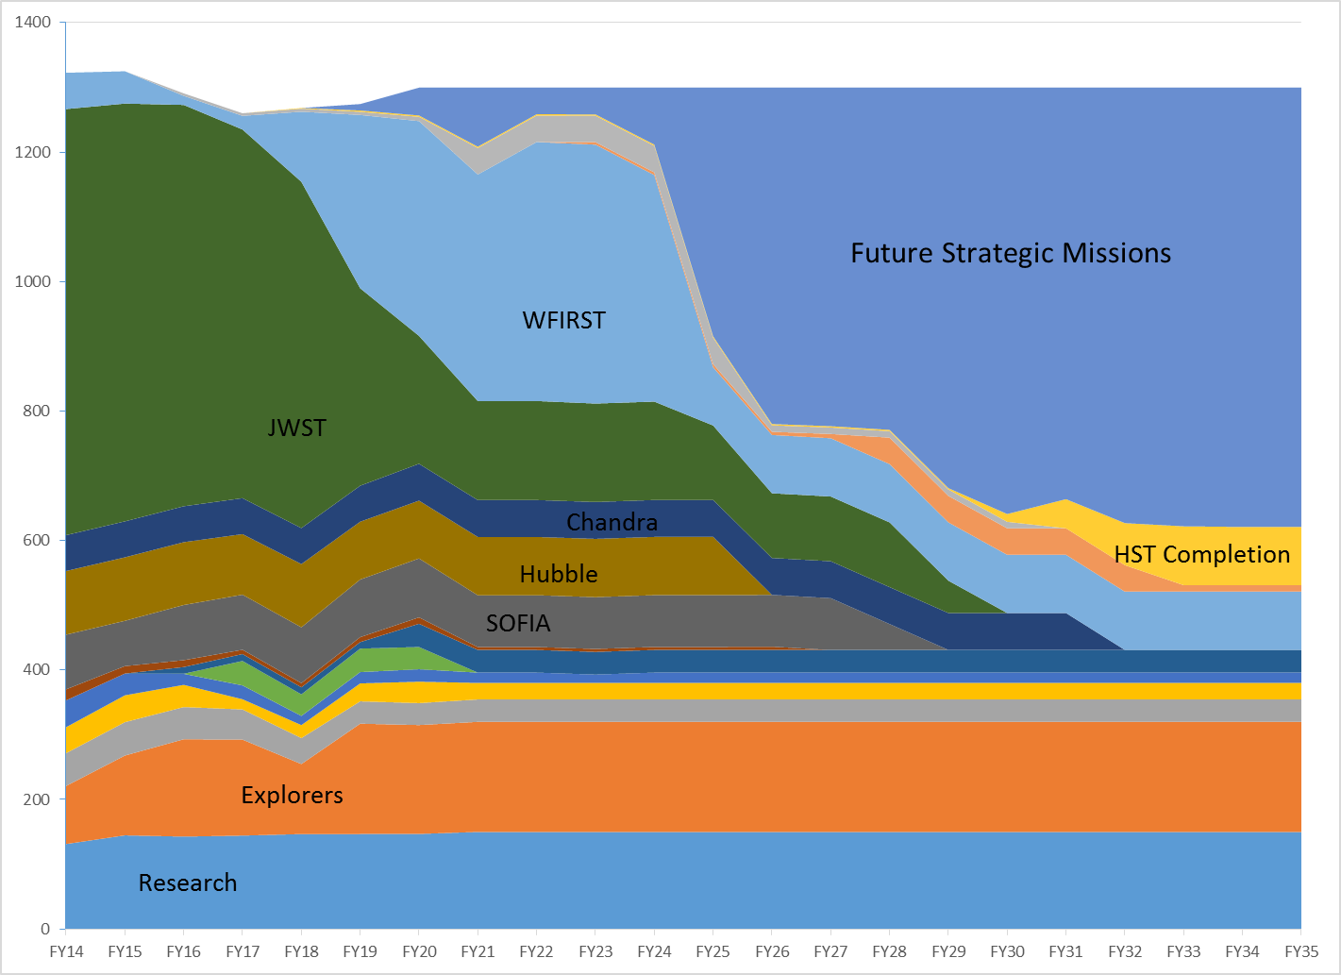
The Landscape after WFIRST (notional)
Assumes (1) President’s FY16 budget request and notional runout through FY20, (2) flat funding for Astrophysics for FY21 through FY35, (3) completion of WFIRST and other missions planned for new starts in FY16-FY20.

Slide 6
A Community-driven Vision for the 2030s
Far Infrared Surveyor
Habitable Exoplanet Imaging Mission
Large UV/Optical/Infrared Surveyor
X-ray Surveyor
These four missions were endorsed by the Program Analysis Groups (PAGs) and recommended by the NAC’s Astrophysics Subcommittee as the four mission concepts that NASA should study in preparation for the 2020 Decadal Survey.

Slide 7
Preparing for the 2020 Decadal Survey Large Mission Concepts
NASA has assembled Science and Technology Definition Teams (STDTs) for each of the four large mission candidates to enable Mission Concept Studies as input to the 2020 Decadal Survey.
 | Community STDT Chairs | Center Study Team | Study Lead Center | HQ Program Scientists
Far IR Surveyor | Asantha Cooray Margaret Meixner | David Leisawitz Ruth Carter | GSFC | Kartik Sheth Dominic Benford
Habitable Exoplanet Imaging Mission | Scott Gaudi Sara Seager | Bertrand Mennesson Keith Warfield | JPL | Martin Still Doug Hudgins
Large UV/Optical/IR Surveyor | Debra Fischer Bradley Peterson | Aki Roberge Julie Crooke | GSFC | Mario Perez Erin Smith
X-ray Surveyor | Feryal Ozel Alexey Vikhlinin | Jessica Gaskin Gregg Gelmis | MSFC | Dan Evans Lou Kaluzienski
http://science.nasa.gov/astrophysics/2020-decadal-survey-planning/

Slide 8
Correcting Five Myths about the Large Mission Concept Studies
This is not a competition and HQ will not select among the studies.
This is not an AO proposal or a Phase A study.
NASA will not build the design you come up with even if the Decadal Survey recommends your mission.
A precise cost estimate is neither expected nor achievable.
The Center and the Program Office are not in charge of the study; the Community Chairs are responsible for the final product.

Slide 9
Success Criteria
NASA defines a successful outcome of these studies to be four compelling and executable mission concepts, which will subsequently be prioritized by the 2020 Decadal Survey.
COMPELLING: Worthy of a Decadal Survey recommendation (i.e., worth spending billions of $$ for the science return)
Strong science motivation with well articulated objectives
Groundbreaking science to be performed in the 2030s
Synergies with existing/planned major ground- and space-based observatories
EXECUTABLE: Technically feasible with a believable path to technology maturation
Architecture, mission design, + payload in the STDT report is notional.
NASA has never launched the mission design that was specified in the Decadal Survey.
Precise costing is neither expected or achievable.

Slide 10
Science comes first
First objective: A compelling science case for addressing critical science questions in the following decades
Only then: The technical parameters necessary to achieve these goals, which will include:
Design Reference Mission, including notional payload.
Technology assessment.
Notional time to mature technology and develop mission.
And at the very end: Cost assessment, major technical issues, and risk reduction plans as a function of science capability.

Slide 11
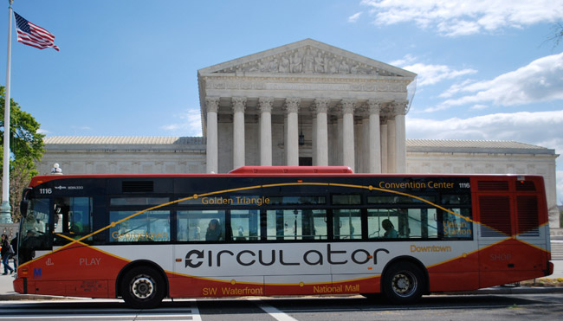
A Community Driven Process
The Liaison
Center Study Scientist
The STDT Members
Design the compelling science / technology case
The Drivers
The Community Chairs
The Engine
Center Study Team
Center Study Manager manages resources
Notes:
Thank you to Kartik and Dominic for these two viewgraphs with roles and responsibilities

Slide 12
Interactions with NASA
The Community Chairs are ultimately responsible for the delivery of a compelling and feasible mission concept. The Community Chairs and the Center Study Scientist interact directly with the HQ Program Scientists.
The Program Scientists for your study are the Division Director’s eyes and ears for this activity.
The Center Study Manager leads the technical work in support of your study.
The Program Offices facilitate the implementation of your study.
The Management Plan is a work in progress. Changes will be made based on feedback from Study Teams and experience of the last few months.

Slide 13
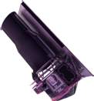
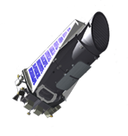
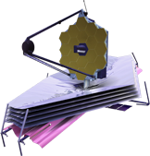
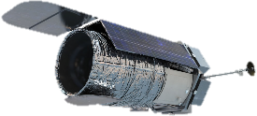
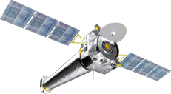
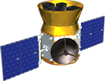
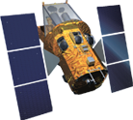
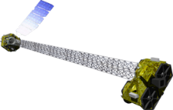
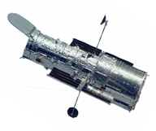
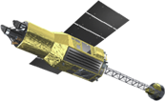
Spitzer
8/25/2003
Kepler
3/7/2009
Formulation
Implementation
Primary Ops
Extended Ops
LISA Pathfinder (ESA)
12/3/2015
JWST
2018
WFIRST
Mid 2020s
Euclid (ESA)
2020
Chandra
7/23/1999
XMM-Newton (ESA)
12/10/1999
TESS
2017
NuSTAR
6/13/2012
Your Mission Here
Swift
11/20/2004
Hitomi (JAXA)
2/17/2016
Fermi
6/11/2008
Hubble
4/24/1990
CREAM (on ISS)
2017
NICER (on ISS)
2017
SOFIA
Full Ops 5/2014

