Slide 1
Northrop Grumman Starshade Design
Briefing to HabEx STDT
3rd August
Steve Warwick
Starshade Program Manager
Approved for public release; NGAS 16-0337 dated 2/18/16.

Slide 2
Impacts of Size and Bandpass
70m
80m
30m
60m
100m
40m
80m
100m
60m
Two starshades, one 40m, one 80m make a good combination to find planets and
orbits, Then characterize them

Slide 3
NWO Full Scale Mission Design
(2006 TPF Coronagraph Workshop)

Slide 4
Multiple Occulters is Necessary
We realized early on that a single occulter was inefficient
  Long telescope separation, very fuel intensive to move and re-point
    Revisits become problematic once target moves away from occulter
  The TPF mission parameters require survey AND characterization of exoplanetary systems
    A single occulter performs optimally at a single distance and IWA
  Occulter recurring costs are low
    Difficulties are technical (e.g. accurate figure control), not material (starshade made from cheap plastics)
    Technical challenges solved by building a single occulter, making subsequent occulters very cheap to manufacture
Optimum mission architecture involves multiple occulters

Slide 5
Full Scale Mission: Occulters
Baseline mission
  Two occulters
    Survey occulter (40m): quickly scan and discovery signatures of planets
      Look for large Jupiter like planets
      IWA = 100 mas, Stellar suppression = 10⁻¹⁰
      5 day travel time, 1 day integration time
    Big occulter (80m): aligns with target star and provides deep integration
      Capable of observing entire system at once
      IWA = 50 mas, Stellar suppression = 10⁻¹¹ or better
      12 day travel time, 5 day integration time
Mission lifetime | Survey Pointings | Big Pointings | Total Pointings
1 year | 52.1 | 21.5 | 73.6
5 years | 261 | 107 | 368
10 years | 521 | 215 | 736

Slide 6
Full Scale Mission: Telescope
Baseline mission
  Dedicated NWO telescope
    No special optics on telescope
    50% planet hunting duty cycle, 50% general astrophysics
    A Hubble replacement: 4 to 4.5 meter class telescope
      Fits inside currently available fairing without deployment
    Covers from UV to near-IR, representing the most essential space telescope

Slide 7
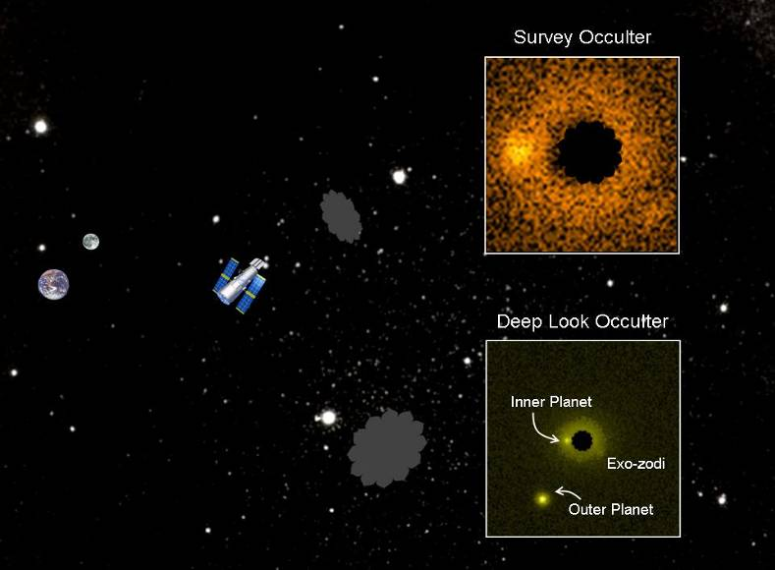
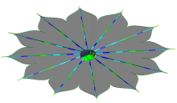
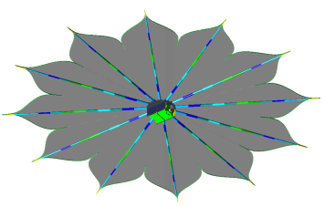
Full Scale NWO Mission Realization

Slide 8
Flowdown of Operation Time
Small Detection Occulter (40m)
132 TPF core targets, 2 visits each for detection = 264 pointings
5 year minimum mission duration = 53 pointings/year
Average separation of targets = 25 degrees
Duty cycle for planet detection ~ 1 pointing per week
Saving fuel by slewing for 5 days
  1 day alignment and observation
  duty cycle of 6 days
Total # of pointings in 5 years = 304
  Contingency: 40 (15%) pointings
Large Deep-Look Occulter (80m)
20 targets, 4 deep look visits for “characterization” = 80 pointings
5 year minimum mission duration = 27 pointing/year
Average separation of targets = 25 degrees
Duty cycle for planet detection ~ 1 pointing per 2 weeks
Saving fuel by slewing for 12 days
  5 day alignment and observation
  duty cycle of 17 days
Total # of pointings in 5 years = 107
  Contingency: 27 (34%) pointings
Long slew time a necessity due to large occulter-telescope separation

Slide 9
Full Scale Mission Parameters
Occulter Parameter | Symbol | Small Occulter (40m) | Large Occulter (80m)
solid disk radius | a | 6.25 | 12.5
Gaussian radius parameter | b | 6.25 | 12.5
the petal shape parameter | n | 6 | 6
Occulter Separation | F | 25 Mm | 80 Mm
Number of petals | P | 12 | 12

Slide 10
Mission Concept
Two occulter perform the separate missions of Survey and Characterization of terrestrial planets
During the first year, the Survey occulter can perform ~50 surveys, while the Big occulter looks at known exoplanetary systems
  Known exoplanets are usually Jupiter sized objects
  Observations of known systems will help answer questions regarding planet formation
  Appropriate systems with known giant planets have higher probability of having terrestrial planets
    Some formation scenarios suggest that Earth’s stability is due to the protective influence of Jupiter
Subsequent years, the Big occulter may
  look at systems newly discovered by the survey occulter
  Look at known and promising exoplanets
  Revisit previously seen systems for better characterization

Slide 11
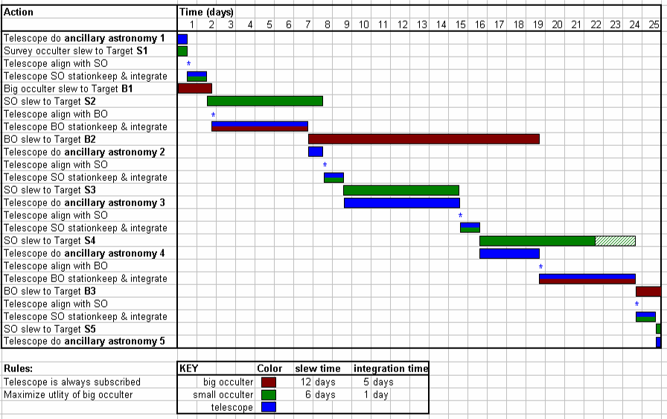
Reference Mission Month

Slide 12
62m Starshade, Detail Design

Slide 13
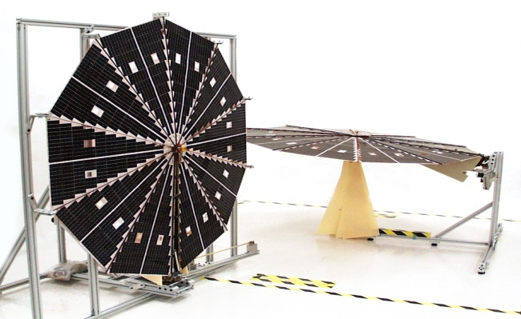
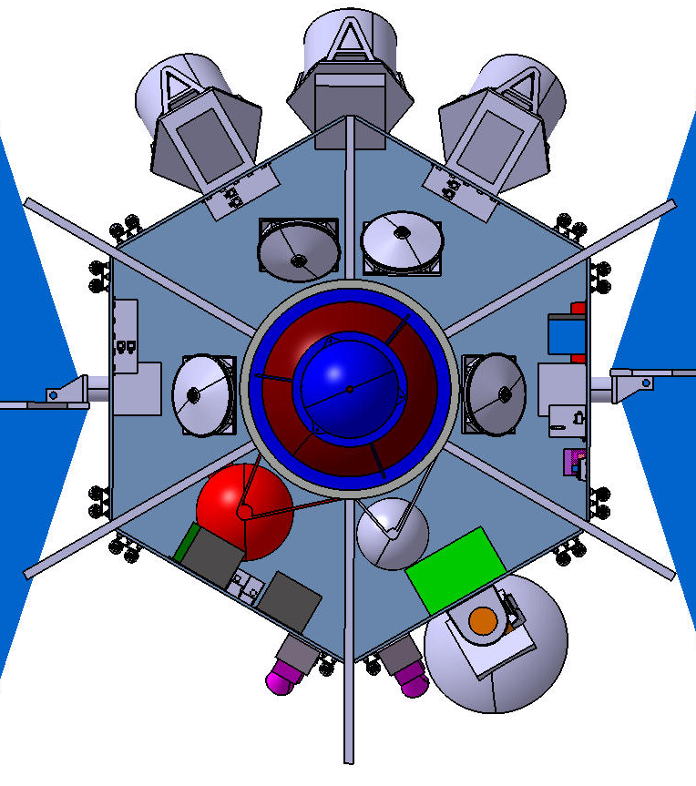
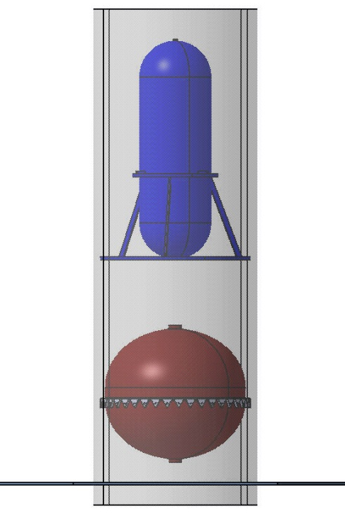
Spacecraft
ATK Ultraflex Solar Array
Top View
NEXT thruster & gimbal system
Reaction wheels
Central Cylinder Side View
Hydrazine tank
NEXT SEP Thruster and Gimbal
Xenon tank
5-lb DTM
NEXT SEP Power Processing Unit
S-band gimbaled HGA
STR

Slide 14
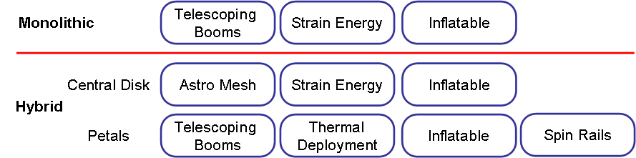
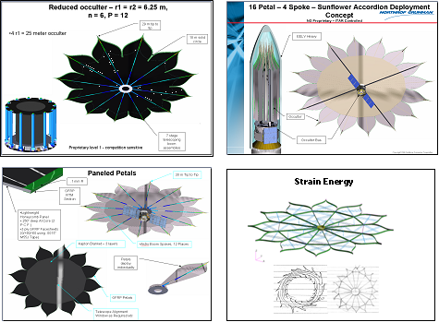
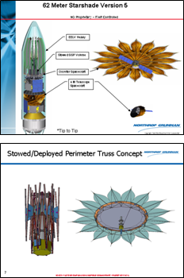
Starshade Design Architecture
A wide range of Deployment design trades have been looked at.
Approved for public release; NGAS 16-0337 dated 2/18/16.

Slide 15
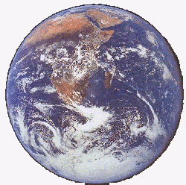
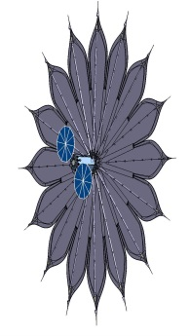
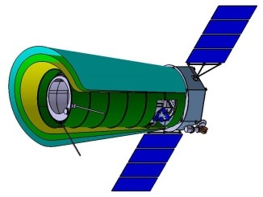
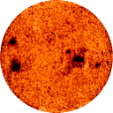
Final Design Selected
Work carried out for the New Worlds Observer Final Report
Hypergaussian shape
Bandpass: Everything blue of 800nm
Fresnel Number: 10
62m
4 m
Telescope
Exoplanet
Starshade
IWA 65mas
Star
80,000 km
Approved for public release; NGAS 16-0337 dated 2/18/16.

Slide 16
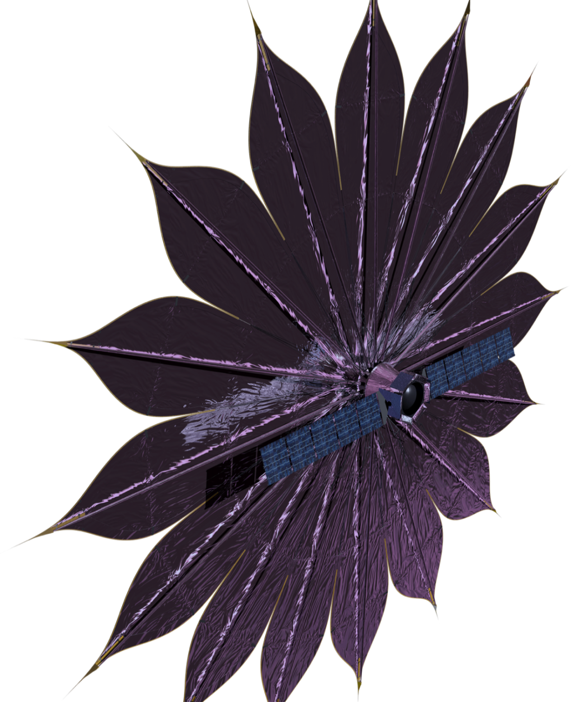
Why Deployment Design Was Selected
Telescoping Boom Hub and Spoke Design with interior multilayer Kapton membrane
62 meters tip to tip for NWO version
  34 meters WFIRST design
Scalable Architecture. The same fundamental design works for Starshades from 25 to 80m diameter
Controllable Deployment. Boom motion is directly controlled and can be stopped and restarted at any time
Simple deployment. Two actuations required
Solid edges provides stable jitter and thermal solution in deployed state
Shape independent. Hypergaussian and Numerically Determined can be deployed with this architecture
Approved for public release; NGAS 16-0337 dated 2/18/16.

Slide 17
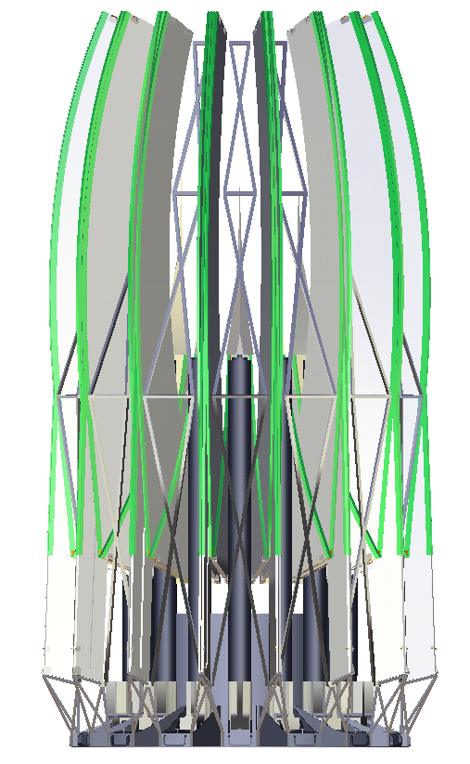
Design Details
Petal edges made from 7 hinged pieces per petal
Petals edges are ridged honeycomb carbon fiber panels
Sharp edge material bonded to edge of panels
Launch lock structure
Petal tip directly connected to the end of…
… the telescoping boom
Sharp optical edges are on the outside, away from the membrane
Telescoping booms hinge from vertical to horizontal. Driven by springs
Approved for public release; NGAS 16-0337 dated 2/18/16.

Slide 18
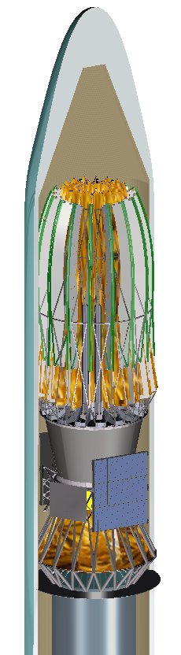
Launch Vehicle Compatibility
Atlas V – 5 M Long Fairing
Stowed Starshade
Designs up to 80m tip to tip have been shown to work in a long 5m EELV Fairing.
(62m tip to tip shown)
Payload to S/C I/F Plane
stowed notional Starshade bus
Approved for public release; NGAS 16-0337 dated 2/18/16.

Slide 19
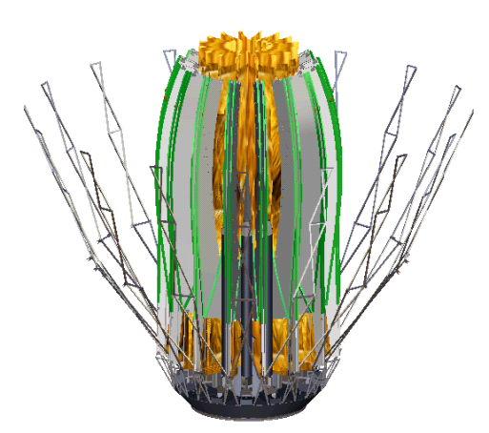
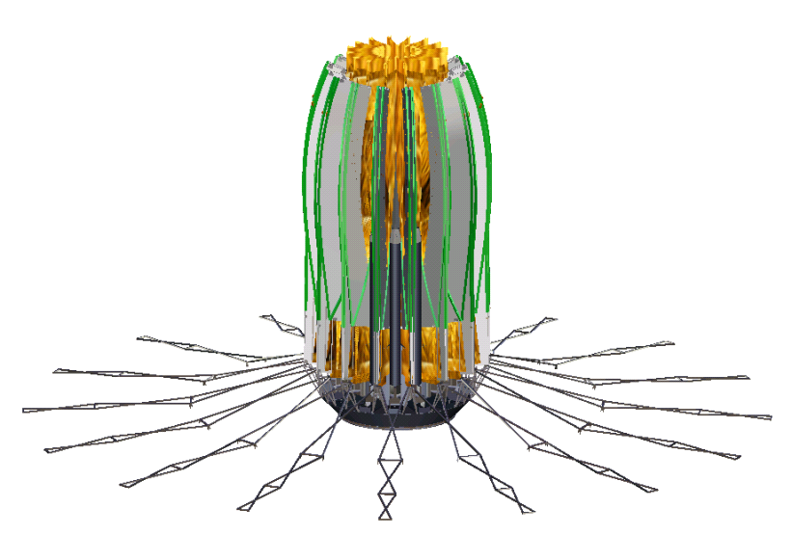
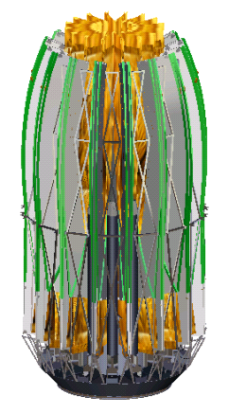
Deployment Motion 1 of 4: Launch Lock Release
0 (Start condition)
1
Perimeter Hoop
Restraint is
Simple spring driven
released
deployments & latching
Approved for public release; NGAS 16-0337 dated 2/18/16.

Slide 20
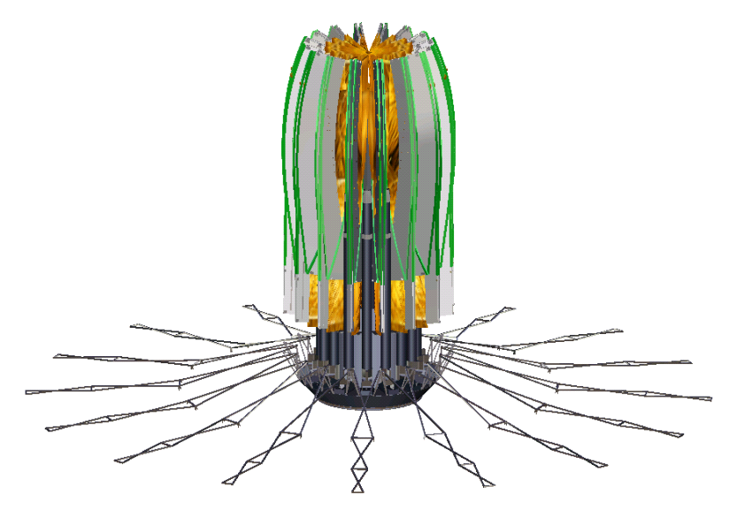
Deployment Motion 2 of 4: Lift
1
Stowed Starshade
raised by STEM Drives
2
Lower petal ends driven up
to clear Base Restraints
Approved for public release; NGAS 16-0337 dated 2/18/16.

Slide 21
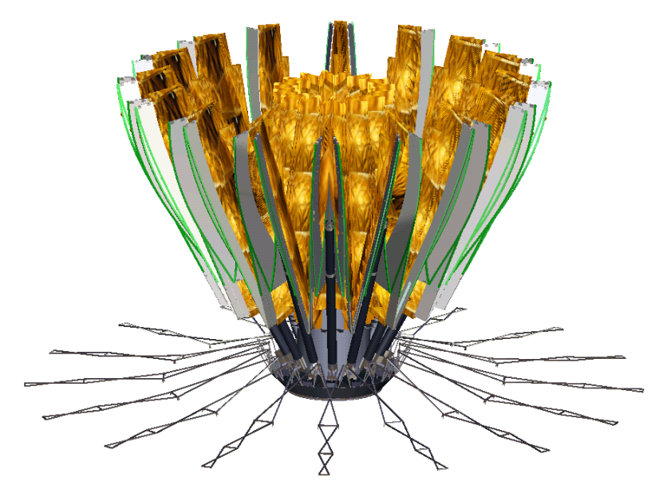
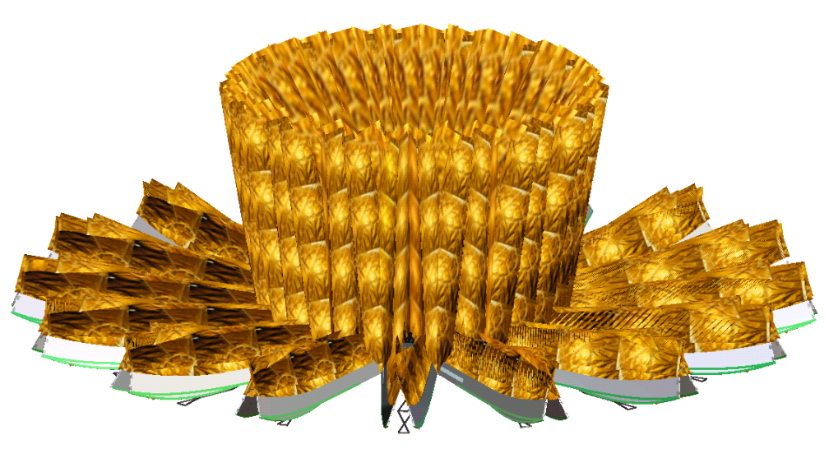
Deployment Motion 3 of 4: Boom Hinge
2
Initial Starshade “blooming” during root hinge deployment
3
•
Root Hinge restraints released
•
Spring driven root hinge rotates
•
Spring Drive designed with very large torque margin
•
Root Hinge deployment has high passive damping
•
Active rotation damping option available using STEM
•
Gearmotor rotation of the hinge an open trade
•
Positive Root Hinge latching against hard stop
Approved for public release; NGAS 16-0337 dated 2/18/16.

Slide 22
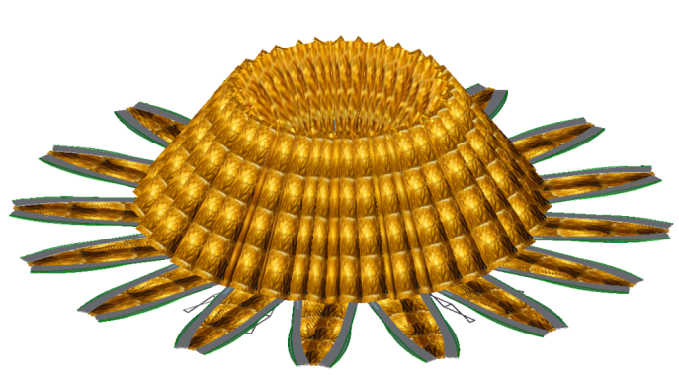

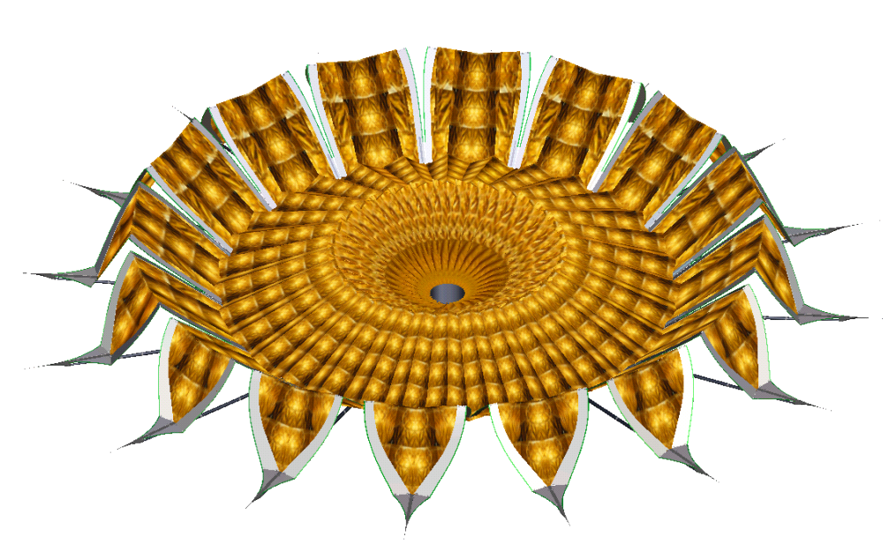
Deployment Motion 4 of 4: Stem Deployment
Starshade unfolds, driven by STEM Drives & Panel Hinge Springs
4a
4b
Petals lie flat
4c
4d
2nd and 3rd hinge lines unfold
Valleys close to maximum extent
Approved for public release; NGAS 16-0337 dated 2/18/16.

Slide 23
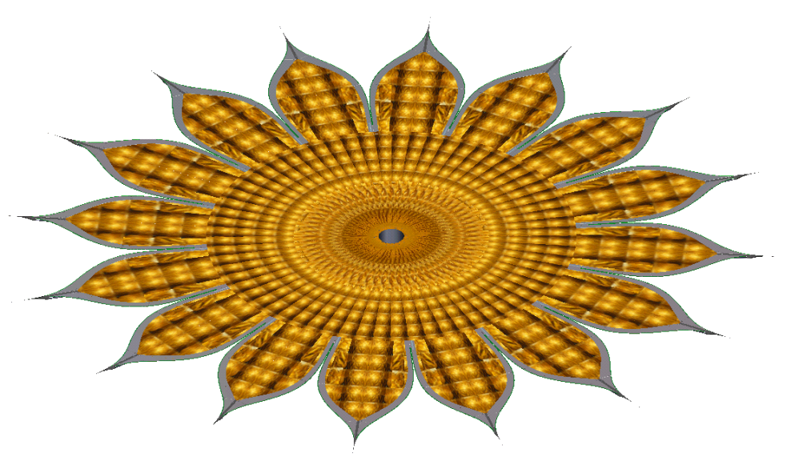
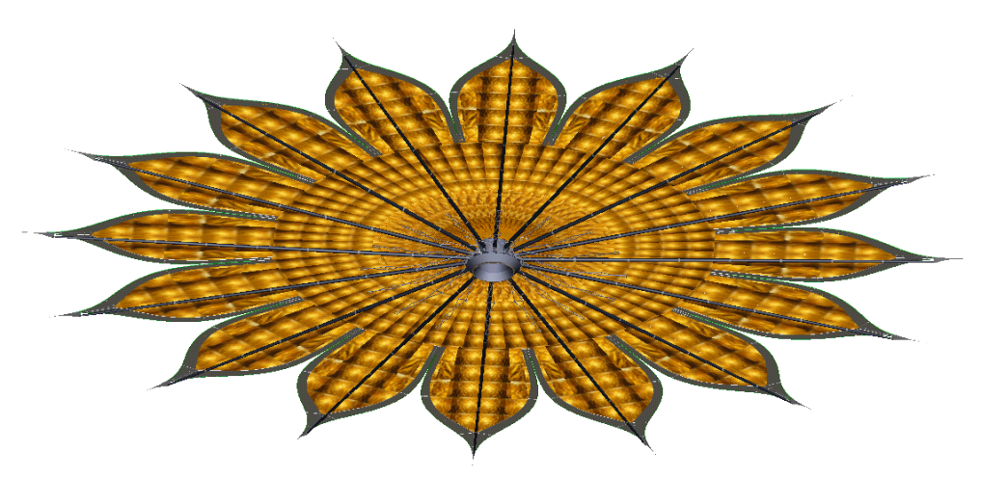
Final Configuration: Full Stem Deployment
Radial Boom deployment completes by latching final stage out and preloading boom in compression with slight bending preload, Petal Tip and Edge assemblies in tension
Approved for public release; NGAS 16-0337 dated 2/18/16.

Slide 24
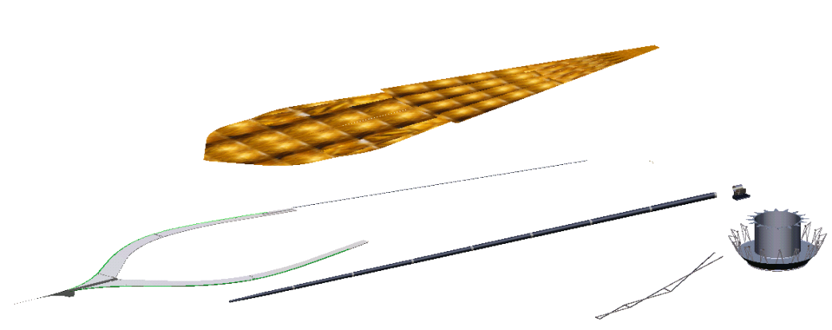
Breakdown of a Single Petal
In deployed configuration the petal shape is controlled by the ridged Petal Tip and Edge assembly
The Tip and Edge assembly is connected to its neighbors by a ball joint at the base of the valley
The Boom in compression and the tension link in tension hold the radial position of the petal
The MLI blanket is not in tension
MLI Blanket
Assembly
Tension Links
(Part of Petal
Tip Assembly)
Root Hinge
Assembly
Astro Boom
Tiedown
Hub
Petal Tip and Edge
Assembly
Assembly
Assembly
Assembly
Approved for public release; NGAS 16-0337 dated 2/18/16.

Slide 25
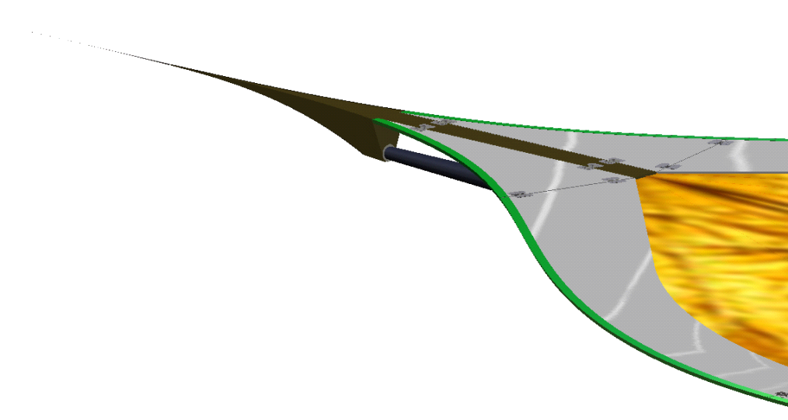
Tip Closeup
Petal
Tip Wire
Latching Hinges
Perimeter
Panels
Tip Wire
Hinge Line
Graphite Petal Tip
Fitting
Tip Fitting/Astro
Boom Tip Interface
Astro Boom
Approved for public release; NGAS 16-0337 dated 2/18/16.

Slide 26
Hinge Closeup
Hinge Lug Fitting
Shimmed Lug
Driven Link
Power Spring
Drive Spring
Drive Link
Hinge Clevis Fitting
Approved for public release; NGAS 16-0337 dated 2/18/16.

Slide 27
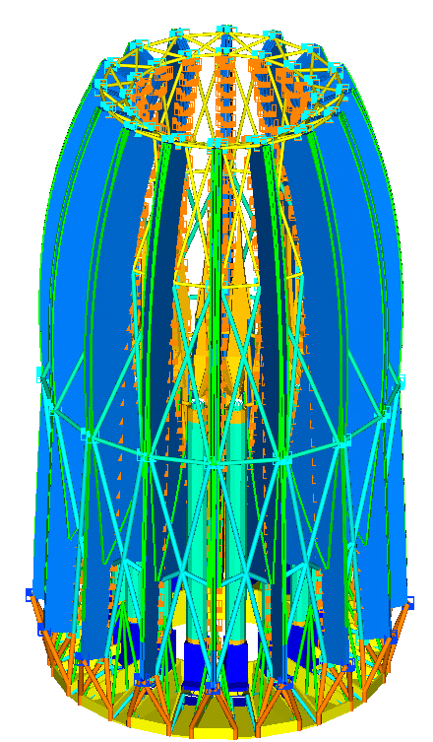
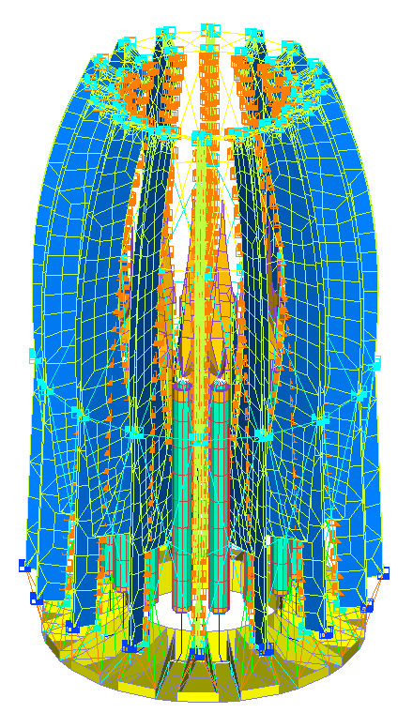
Launch Dynamics
Stowed Restraint
System
Nastran analysis shows meets first lateral mode requirements
Goal
è
First
Lateral Mode > 8 Hz
Approved for public release; NGAS 16-0337 dated 2/18/16.

Slide 28
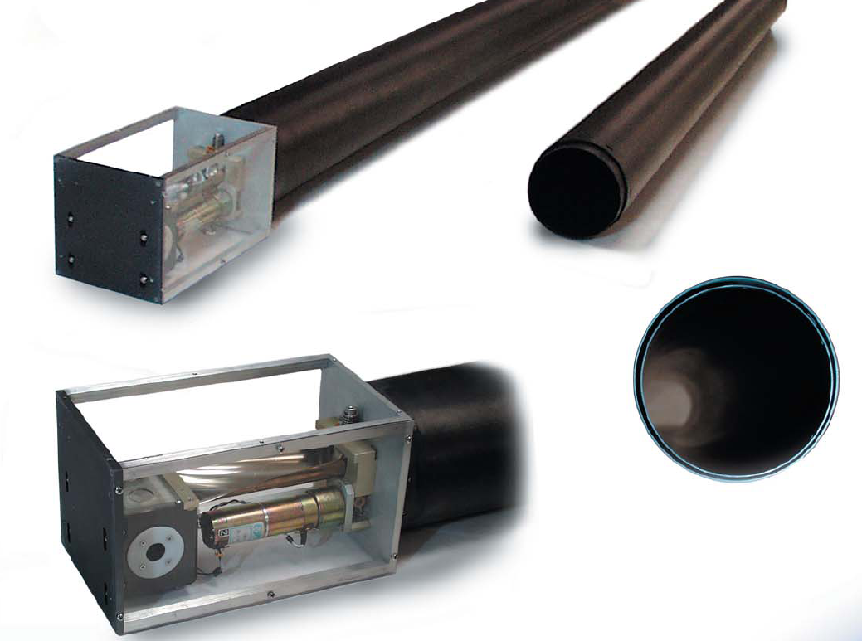
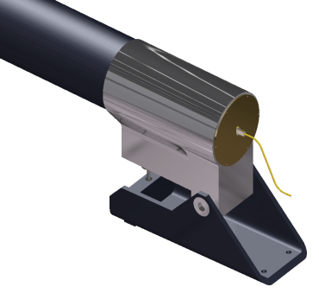
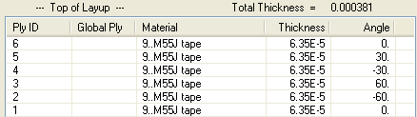

Stem Drive Details
Currently assumed as 250 mm O.D. x noted wall
Stem drive motor is packaged in Base Tube
STEM drive motor
STEM drive motor
Drive STEM
Dimensions for a 62m Starshade
Spring Driven, Damped Root Hinge Deployment
3.899 m
88.5 Degrees
33m Deployable boom built for flight (TRL7+)
26.628m
Approved for public release; NGAS 16-0337 dated 2/18/16.

Slide 29
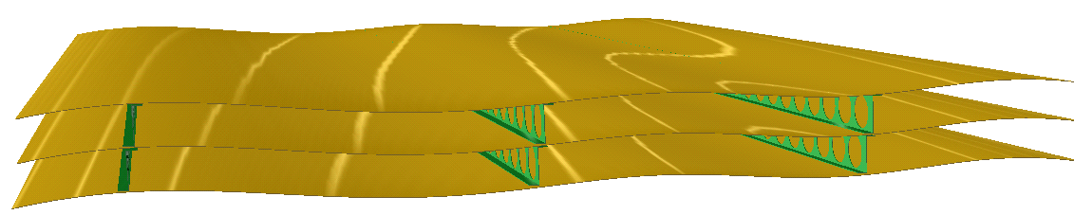
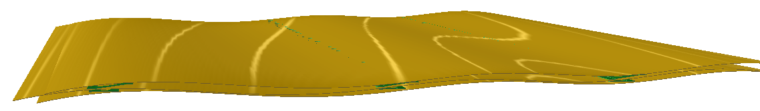
Membrane Solution
Multi layer membrane management approach using JWST heritage
On orbit separation of layers to avoid alignment of vent holes, release device holes and micrometeorite damage
Starshade shape is solely determined by hard edges
  I.e. Membrane is not in tension when deployed
Silicon Coating Outside/VDA Inside
VDA Coating Both Sides
Staggered (non-overlapping) vent holes
~150 mm
~50 mm separation for micrometeoroid protection
25 um Kapton – 4 Layers
Kapton “Pop-up” Z-Stringers Stitch/bonded into Blanket Assembly
VDA Coating Both Sides
Silicon Coating Outside/VDA Inside
Z-Stringers Fold Flat during Stowing
< 5 mm
Approved for public release; NGAS 16-0337 dated 2/18/16.

Slide 30
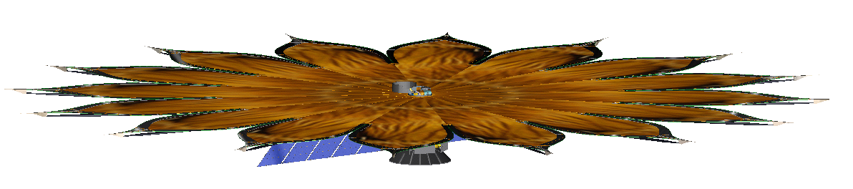
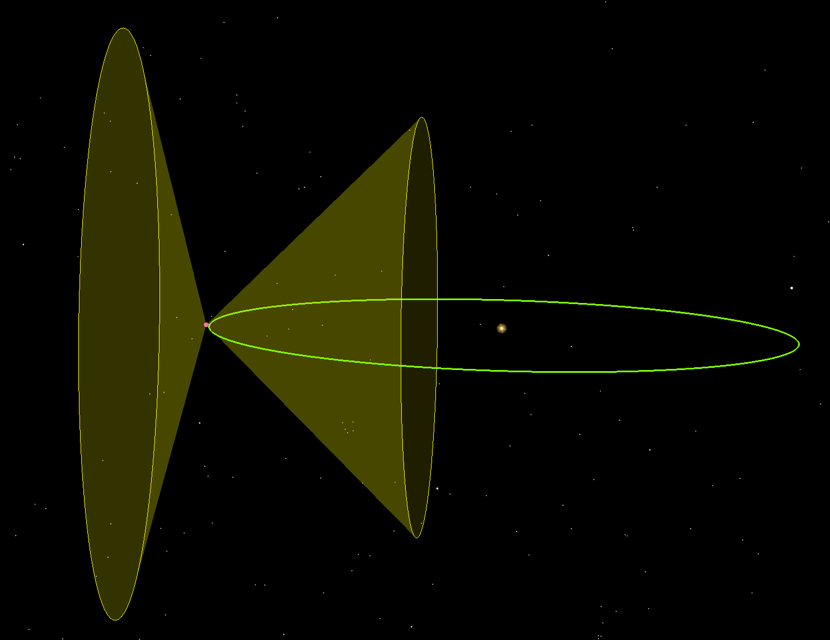
Sun Angle on Starshade
Sun
ß
Sunlight Across Petal Edge
ß
Sunlight Through
Shade
Valley truncation point
Slack & Mechanically Separated
Scope Side
Multi
-
layer Kapton Blanket Assembly
Sensor platform
Field of Regard: 45º to 105° from Sun
Minimal Telescope side protrusions and limitations on membrane billowing define the maximum sun angle
Starshade does not need to be perpendicular to the line of sight, allowing extension to the field of regard
105º
Sun
45º
Earth Orbit
Approved for public release; NGAS 16-0337 dated 2/18/16.

Slide 31
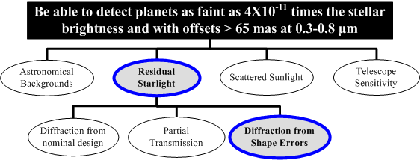
Error Budget Analysis
Analysis here focusses on the contribution to detection limit from Diffraction from Shape Errors
  Dynamics and Jitter analysis
  Thermal Distortion
  Simple Shape Errors
Approved for public release; NGAS 16-0337 dated 2/18/16.

Slide 32
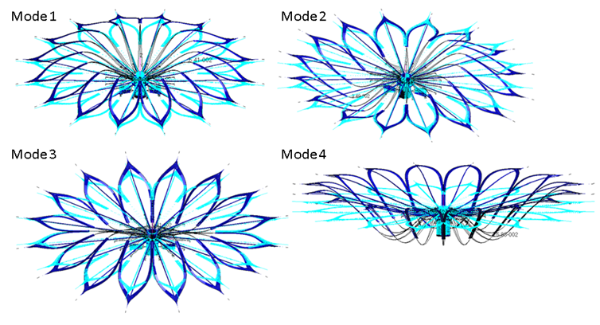
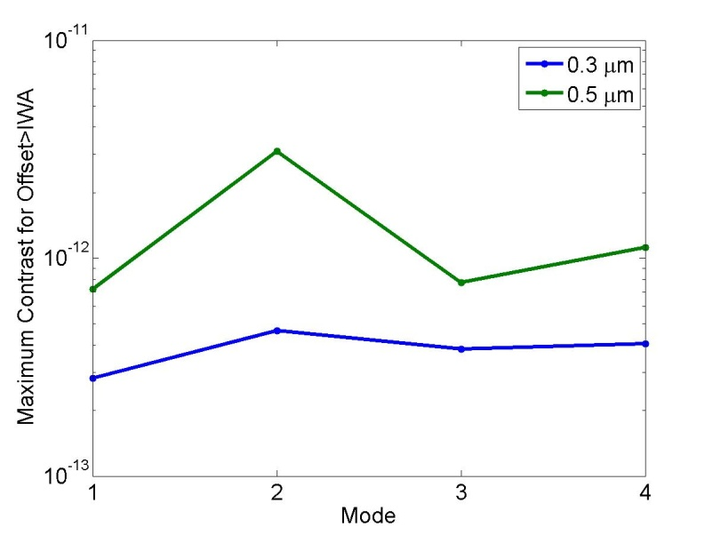
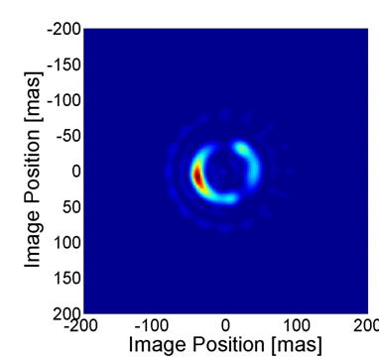
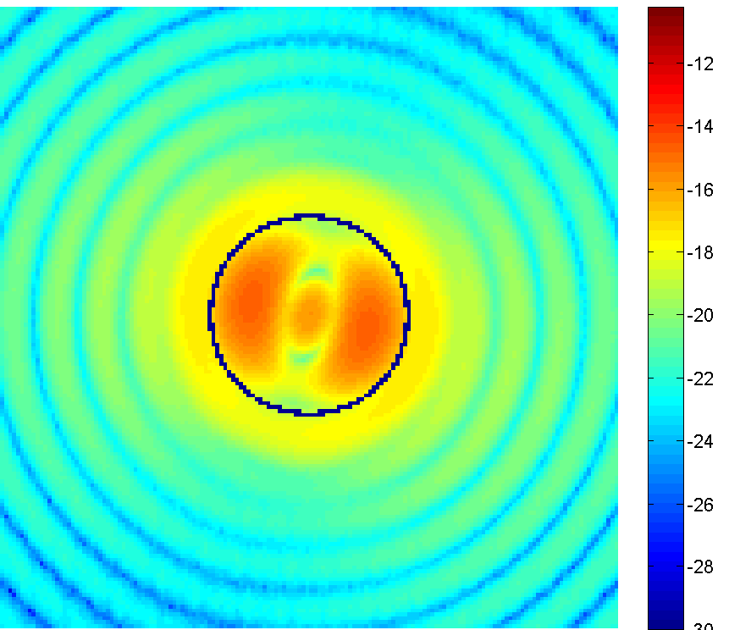
Starshade Contrast with Disturbance
The four dynamic modes of the starshade with the biggest contrast impact, with the vertical axis exaggerated by 100x
The full contrast map for one dynamics mode (mode 2)
Valleys and tips contribute the most to the contrast loss, seen here as relatively bright rings, but still below 10⁻¹².
Dynamics Do NOT Contribute Significant Error
Approved for public release; NGAS 16-0337 dated 2/18/16.
Notes:
We present summaries of some of our analysis, more can be found in the paper. We have a starshade design and a spacecraft design, and we have set of coordinated mechanical, thermal, and dynamics model, linked to ACS analysis. What we have shown here is our modeled behavior of the starshade due to firing of our stationkeeping thrusters. It is expected that after the initial deployment, the stationkeeping thrusters will be the biggest perturbation to the starshade. We performed an analysis of the maximum contrast loss due to the motion induced, shown here for two wavelengths 0.5 and 0.3 microns. In both cases, contrast loss was around 1e-12, meeting the 1E-12 threshold per error source. The lower right figure shows the contrast map due to the dynamics of mode 2.

Slide 33
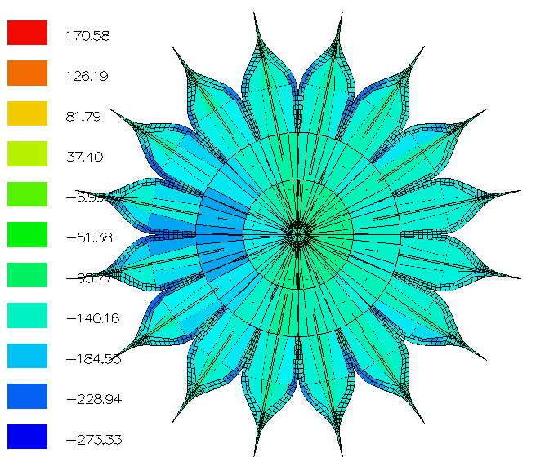
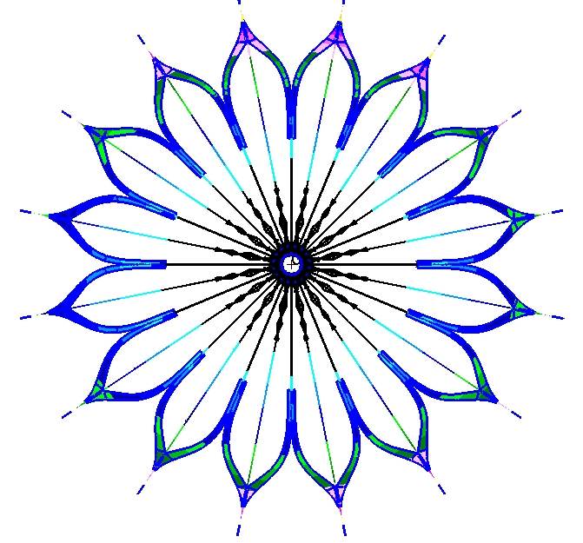
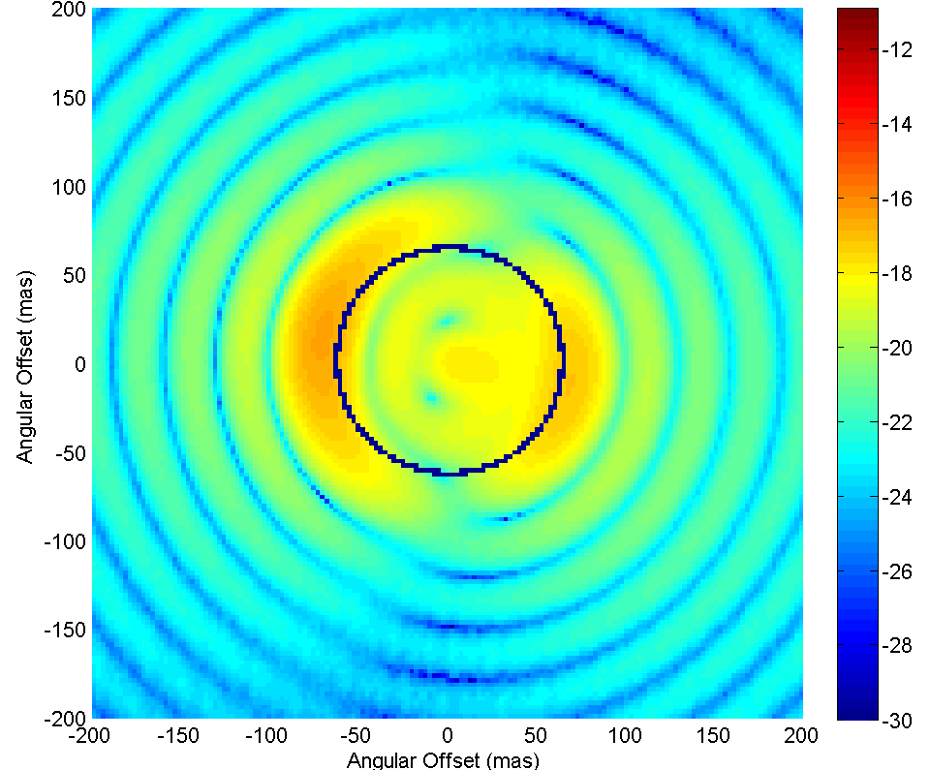
Starshade Contrast Due to CTE
Temperature in °C
Displacement
in meters
Log(contrast)
at 0.55μm
5° Sun, EOL Case
Case | RMS motion in plane (mm) | RMS motion out of plane (mm) | Max contrast 0.3μm | Max contrast 0.55μm | Max contrast 0.8μm
5° BOL | 1.2 | 22 | 1x10⁻¹¹ | 1x10⁻¹¹ | 1x10⁻¹¹
45° BOL | 0.87 | 17 | 4x10⁻¹² | 5x10⁻¹² | 1x10⁻¹¹
5° EOL | 1.2 | 22 | 1x10⁻¹¹ | 1x10⁻¹¹ | 1x10⁻¹¹
45° EOL | 0.80 | 17 | 3x10⁻¹² | 4x10⁻¹² | 1x10⁻¹¹
Thermal Expansion May be a Source of Errors
Approved for public release; NGAS 16-0337 dated 2/18/16.
Notes:
These charts show representative results from a thermal analysis where the leftmost figure is a plot of the temperature of the starshade, with End of Life conditions on the starshade at a 5 degrees tilt from the sun. This presents one of the worse cases. The middle figure shows the differential expansion w.r.t to a non-perturbed starshade, and the rightmost figure shows the contrast map as a result. In plane motion induced by thermal expansion is on the order of 1 mm, and out of plane motion is on the order of 20 mm, but the starshade is significantly more tolerant to this motion. The maximum contrast in this case is at 1E-11, which is right at the threshold where we become concerned for the starshade. We conclude that thermal expansion may be a source of errors and we may need to alter our thermal design. Note that we currently rely completely on a passive thermal design, and have not done any optimization. We expect to be able to iterate the design and reduce the thermal impact significantly

Slide 34
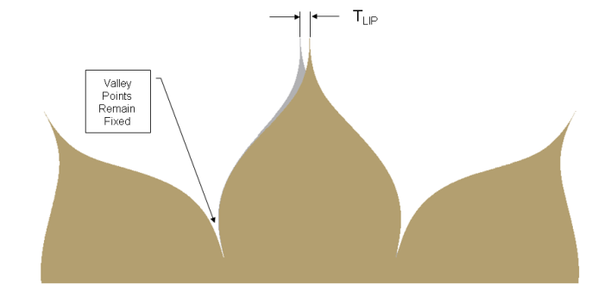
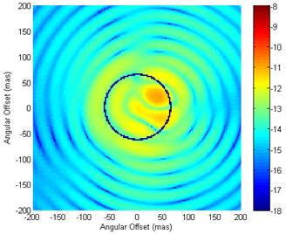
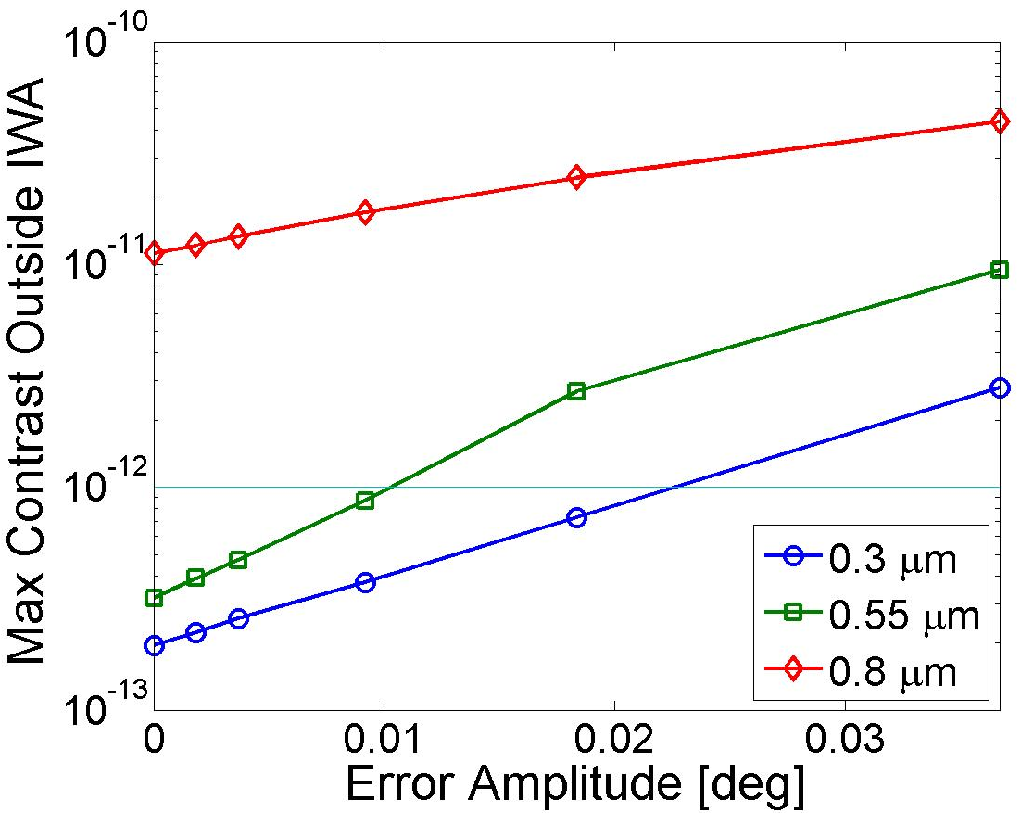
Simple Shape Errors
Shape Name | Shape Term | Limiting Amplitude @ λ=0.55µm
Lateral Alignment Offset |  | 2.4 m
Axial Alignment Offset |  | >10,000 km
Tip Truncation |  | 0.2 m
Valley Truncation |  | 0.8 m
Lateral Tip Motion in Plane | n=1: n=2: n=3: | 0.01° 0.1° 2°
Lateral Tip Motion in Plane – just tip section |  | 13°
Radial Tip Motion |  | -2 m / +0.2 m
Lateral Tip Motion out of Plane |  | 20°
Lateral Valley Motion in Plane | n=1: n=2: n=3: | 0.02° 0.2° >0.4°
Radial Valley Motion |  | -1 m / +2 m
Lateral Valley Motion out of Plane |  | 20°
Edge Sine | n≤2.5/petal: n=5/petal: n=10/petal: n=15/petal: n≥25/petal: | ≥300 µm 40 µm 3 µm 60 µm ≥200 µm
Illustration of “Lateral Tip Motion in Plane” shape: rotation of whole petal as Δθ∝r^{n}, centered at r=0, with zero motion at R_{min}
Contrast vs. amplitude for this error. Cyan line is the error limit at 0.55µm (1x10⁻¹²), passed at amp~0.01°
Log contrast map for this error (w/λ=0.55 µm, n=1, amp=0.02°). Max contrast ~3x10⁻¹², past IWA (blue ring)
Shape Error Limits Defined
Approved for public release; NGAS 16-0337 dated 2/18/16.

Slide 36
6. Tip Deployment (Hypergaussian Not Required for Numerically Determined)
Stowed Tip
Wire
End Wire Hinge
End Wire Hinge
Deployed Tip
Wire
Graphite Tip
Fitting
Approved for public release; NGAS 16-0337 dated 2/18/16.

Slide 37
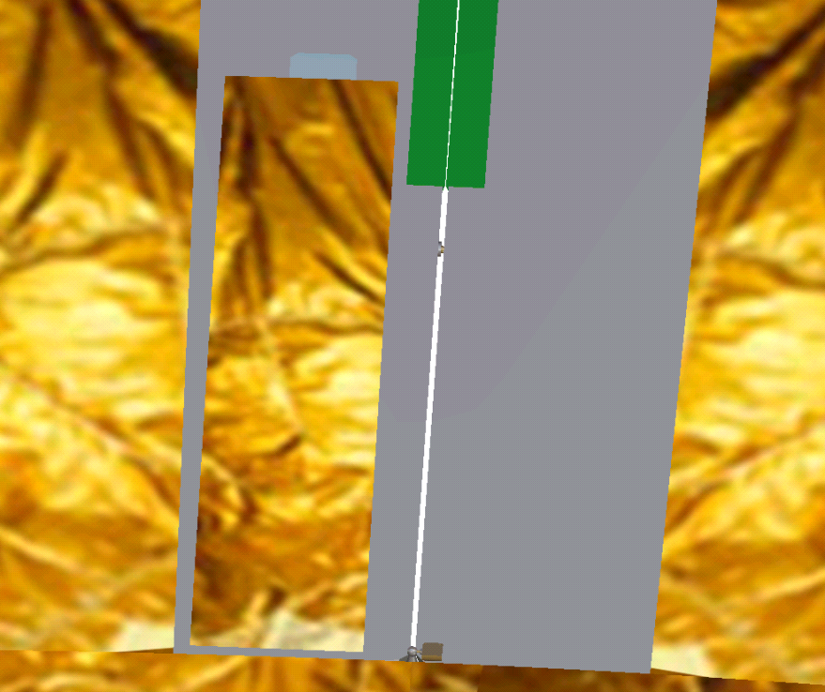



7. Valley Deployment (Hypergaussian Not Required for Numerically Determined)
Stowed
Deployed
Start of
Valley Gap
Valley Gap
Deployable
Flap
Flap
HG Curve
(2 mm Gap)
Ball in
Conical
Stop
Oversized
Deployment
Gap
Required to
Prevent
Binding
Valley Gap
Oversized
Fabric
Fitting Opens
Fabric
Deployment Gap
Hinge Line
Hinge Line
Covered
Valley Gap
Flap
Deployment
Petal to
Petal Ball
Joint
Approved for public release; NGAS 16-0337 dated 2/18/16.

