Slide 1
General Astrophysics for HabEx
Paul Scowen

Slide 2
Tracing the Life Cycle of Baryons
The question:
To understand the nature of material in the Intergalactic Medium (IGM), and what can we learn about the cycle of material between star formation in galaxies and how the resulting material is ejected from those galaxies and subsequently returned via other mechanisms.
To constrain the cosmic baryon cycle over the past 10 Gyr
  measure the amount of gas and heavy elements around z<1 galaxies
  Do we finally have a complete census of baryons in the local universe?
  what is the dynamical state of this gas -- what fraction of primordial accretion, outflowing material, recycled accretion, etc?

Slide 3
Observational Methodologies
use QSOs as backlights to allow absorption line studies of the intervening IGM
use of AGNs as backlights that would also allow determination of how BHs accrete matter and grow over time
trace and conduct a census of baryonic matter in the low redshift universe in the various phases of the IGM
use IGM/CGM emission mapping to probe baryonic structure formation across cosmic time
to map and track the metallic evolution of the IGM, and through that data the physics and contents of galactic haloes
understanding of how material, and in particular the chemical elements, are distributed and dispersed into the CGM and the IGM - of particular interest is how baryonic matter flows from the IGM into galaxies and from there into stars and planets - high-resolution multiband UVOIR survey imaging of the Magellanic Clouds (MCs) with a complementary FUV spectroscopic survey of early-type stars
use of massive stars as a tool to measure the range of properties stars can be formed with: the range of mass, composition, convection, mass-loss, rotation rate, binarity, magnetic fields, and ultimately cluster mass

Slide 4
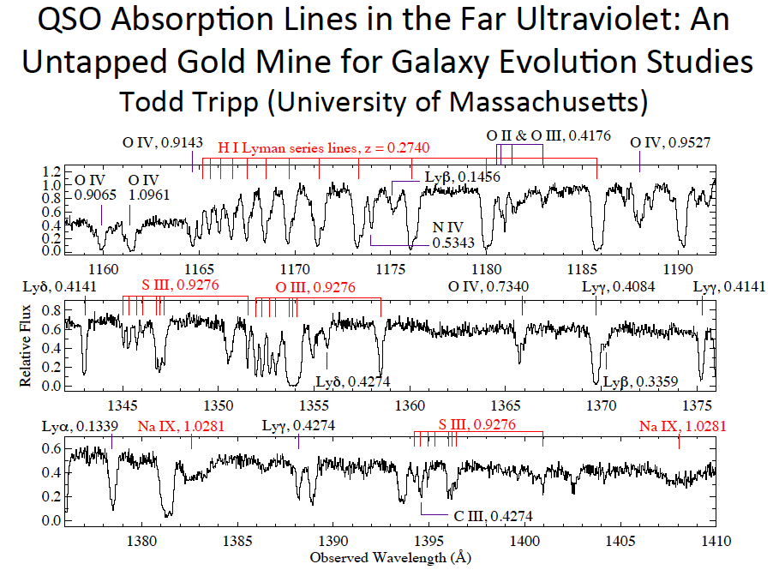

Slide 5
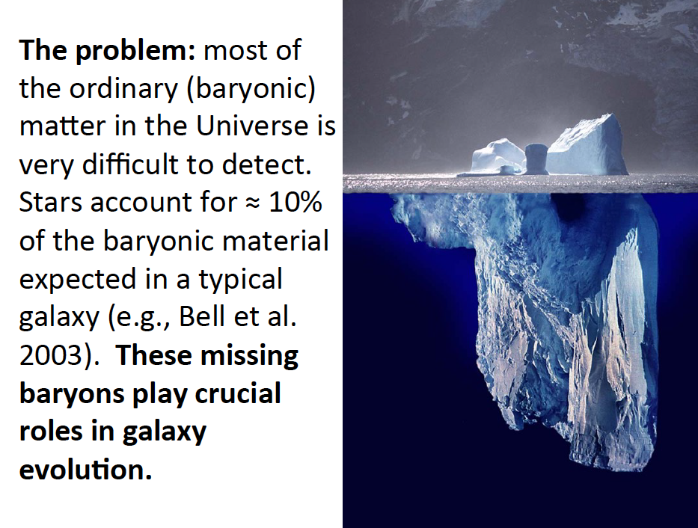

Slide 6
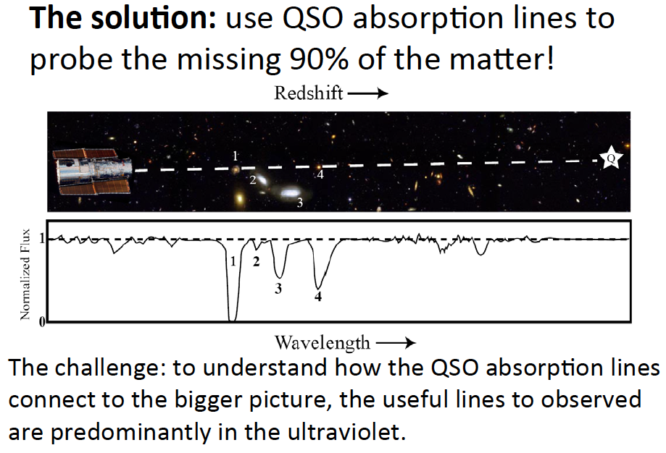

Slide 7
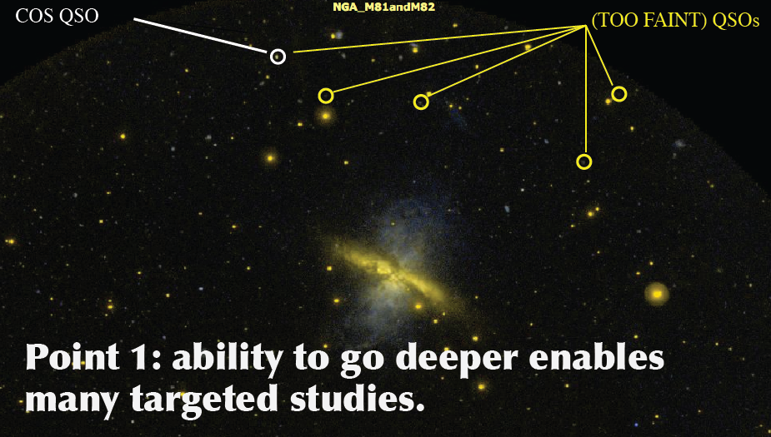

Slide 8
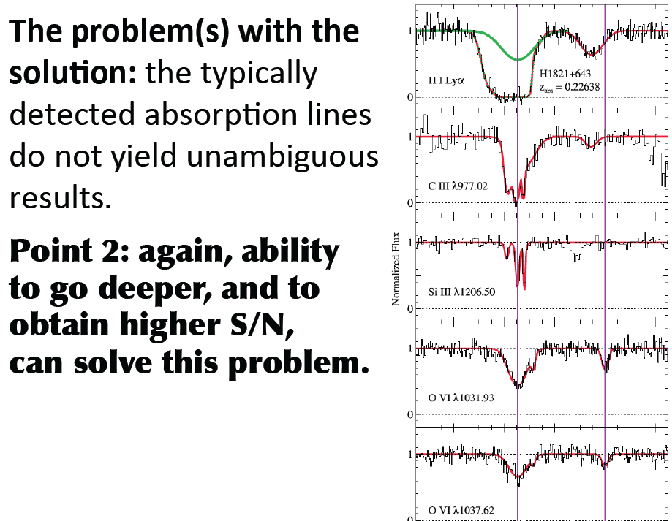

Slide 9
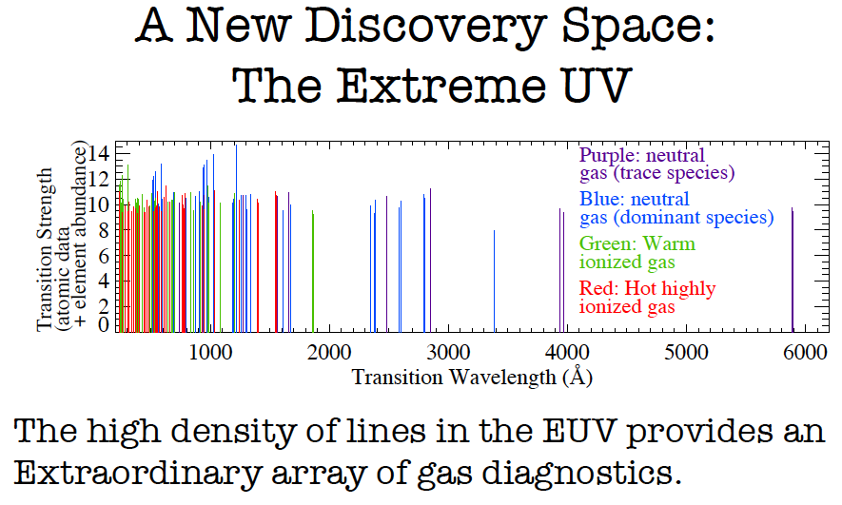

Slide 10
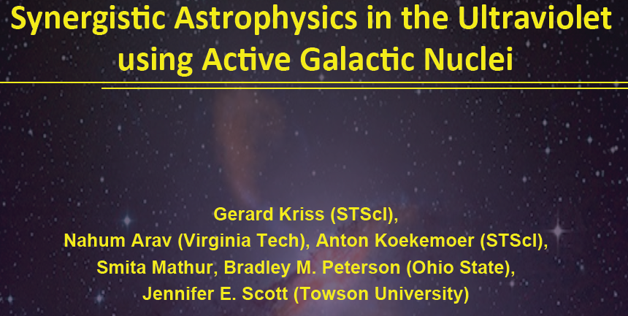

Slide 11


Slide 12
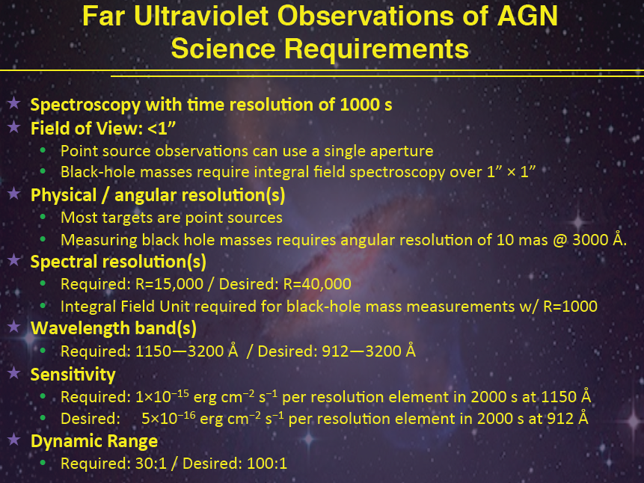

Slide 13

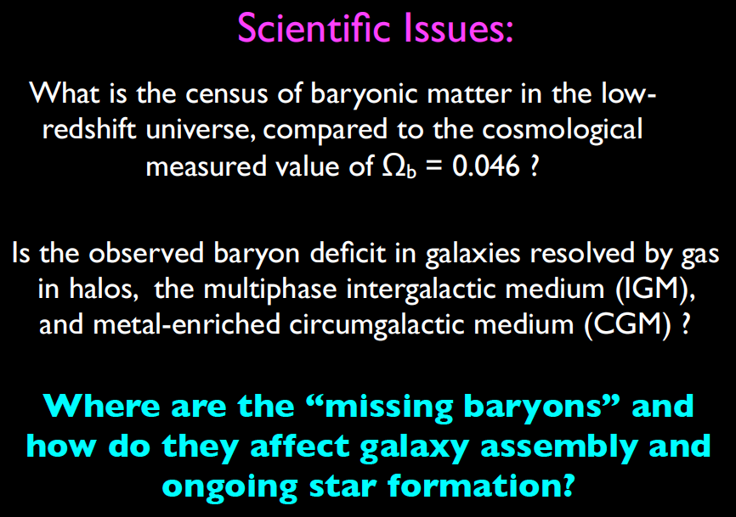

Slide 14
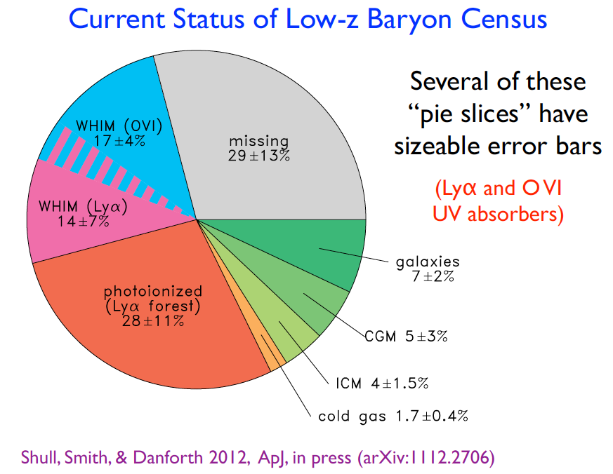

Slide 15
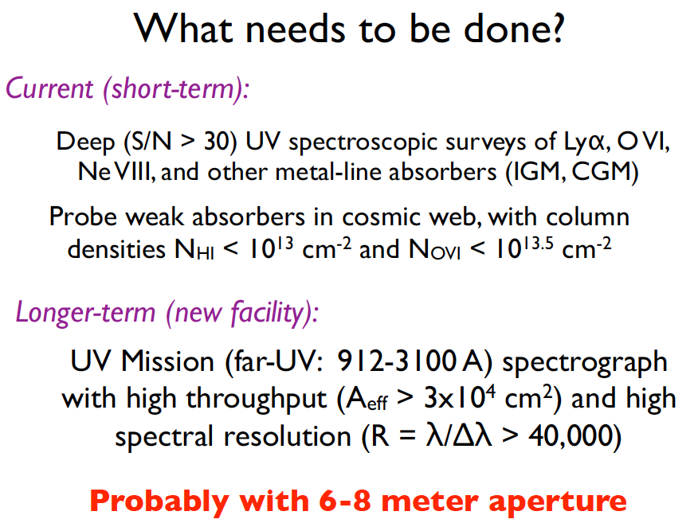

Slide 16
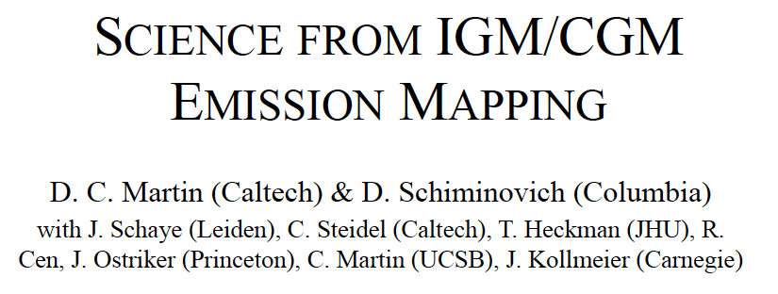
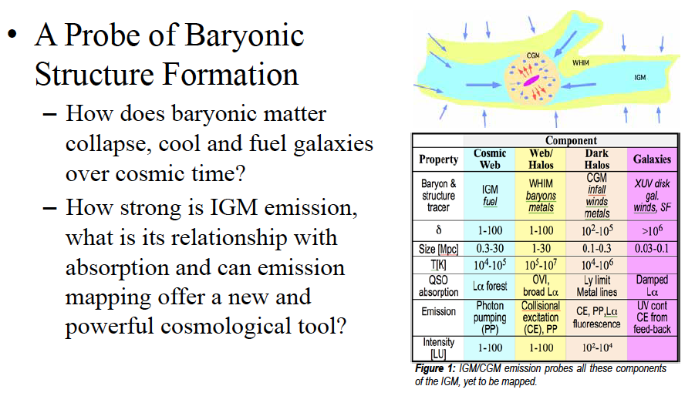

Slide 17
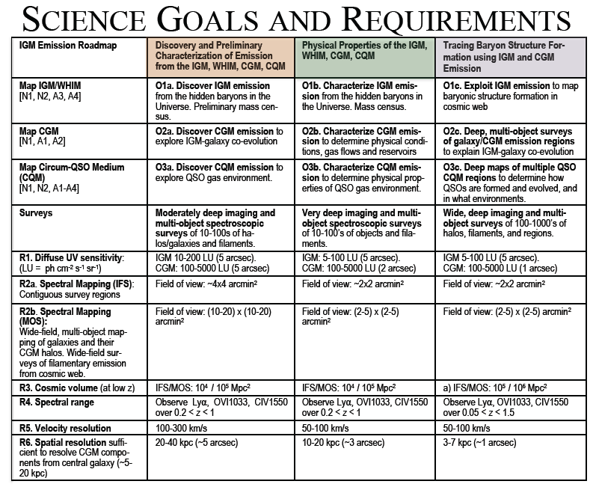

Slide 18
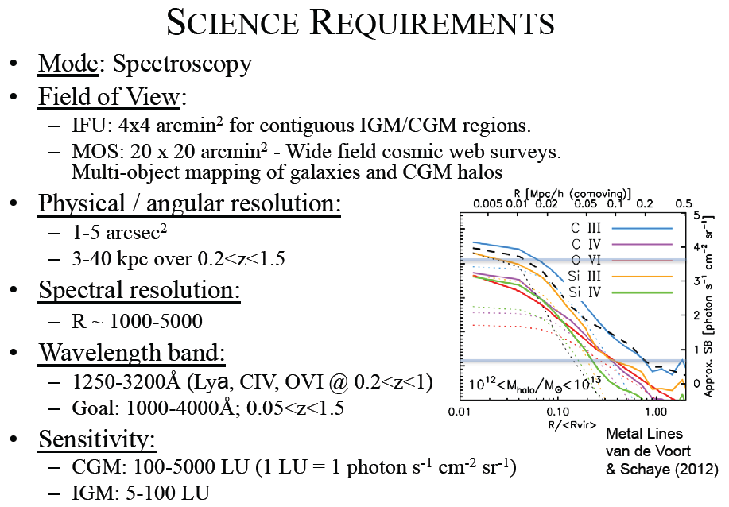

Slide 19
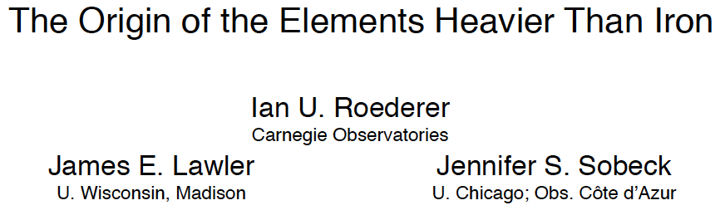
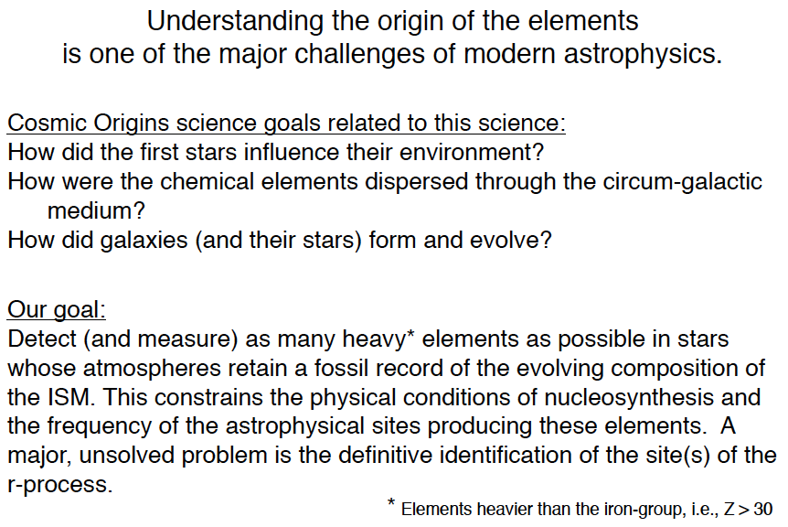

Slide 20
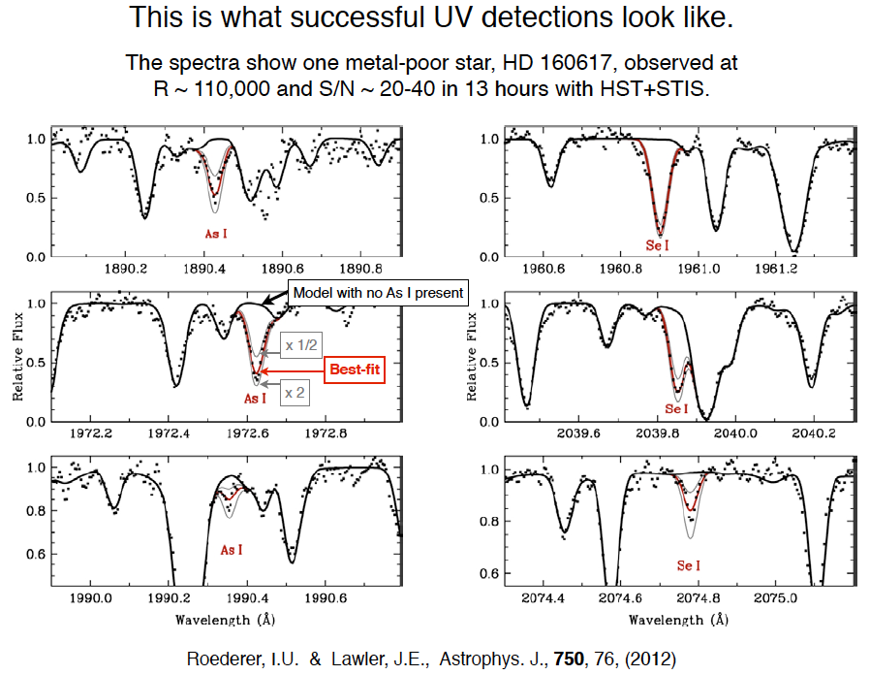

Slide 21
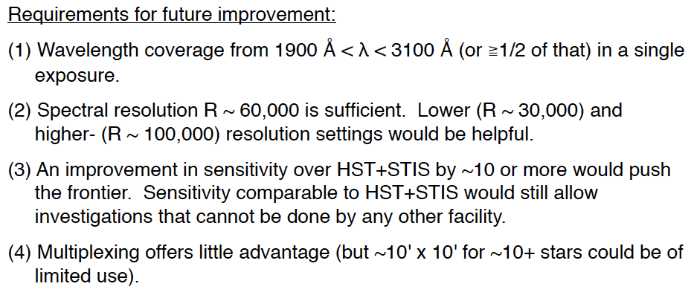

Slide 22

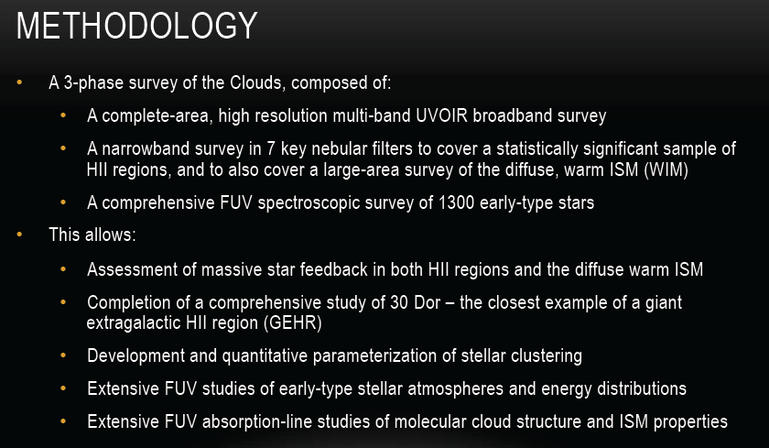

Slide 23


Slide 24
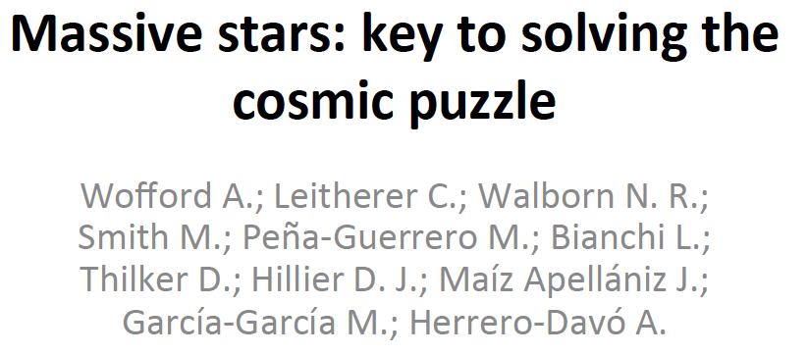


Slide 25
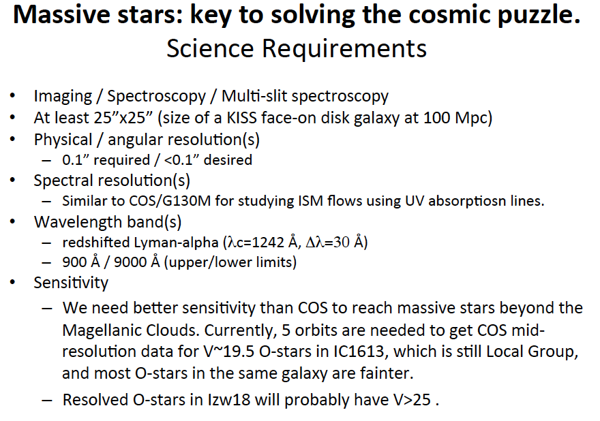

Slide 26
Tracing the Life Cycle of Baryons
Sub-Program | Mode | FoV | Passband | Resolution | Aperture
QSOs | Spectroscopy |  | 92-115nm and higher | R >20,000 | 4m+
Census | Spectroscopy |  | 92-310nm | R > 40,000 | 6-8m
AGNs | Spectroscopy | 1” | 115-320nm | R=40,000 | 6m
IGM/CGM Emission | Spectroscopy | 4x4’, 20x20’ | 125-320nm | R=1,000-5,000 | 4m+
IGM Metals | Spectroscopy | 10’ | 190-310nm | R~60,000 | 4m
MC Survey | Imaging | 200 sq arcmin | 250-1050nm | Diff Limit @ 300nm | 4m
 | Spectroscopy |  | 100-250nm | R>30,000 | 4m
Massive Stars | Imaging | 25” | 90-900nm | 0.1” | 4m
 | Spectroscopy |  | 100-200nm | R~40 | 4m
FUV Diagnostics | Spectroscopy |  | 92-350nm | R~30,000 | 4m+

Slide 28
Understanding the Impact of Massive Stars
The question:
Massive stars are recognized as being important objects to understand their formation and evolution mechanisms since they deposit so much energy and material back into the ISM and affect star formation propagation.
As part of an ensemble program we would seek to quantitatively measure:
  the impact of massive star formation on their local environments through the injection of material and energy,
  the subsequent formation and destruction of second-generation stars and their associated planets,
  on a larger scale how the evolution of massive stellar populations shapes and directs the evolution of entire galaxies over cosmic time.

Slide 29
Observational Methodologies
to conduct a wide field UV/visible imaging survey of massive star forming complexes to understand the formation mechanisms and survival rates of the star formation process in such environments
use of massive stars as a tool to measure the range of properties stars can be formed with: the range of mass, composition, convection, mass-loss, rotation rate, binarity, magnetic fields, and ultimately cluster mass
use the best performance available in both imaging resolution and sensitivity to extend the state-of-the-art for galaxy evolution studies – to understand how does SF proceed in different environments
to understand is how molecules and dust form in the interacting winds of massive stars

Slide 30
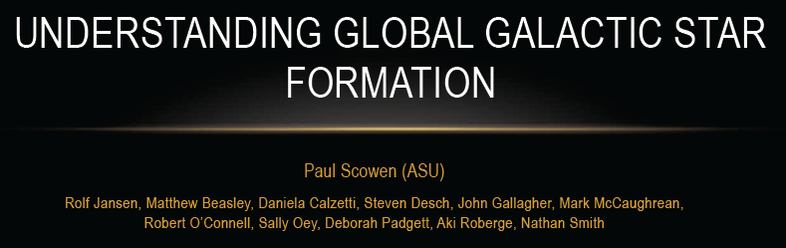
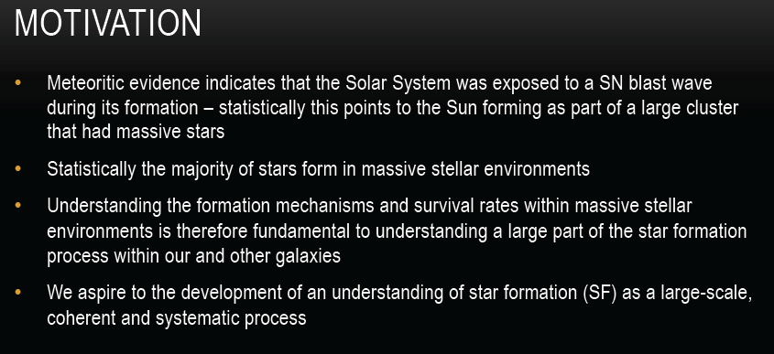

Slide 31
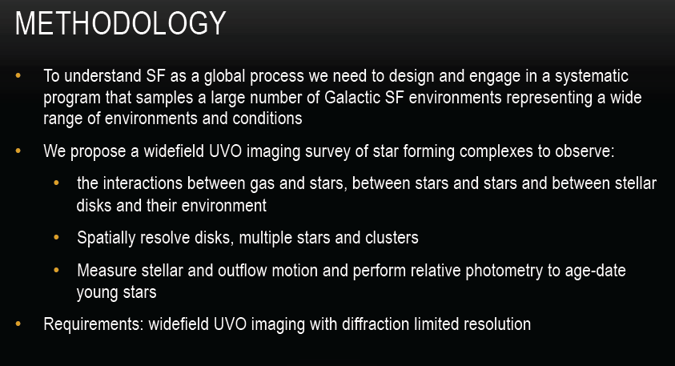

Slide 32
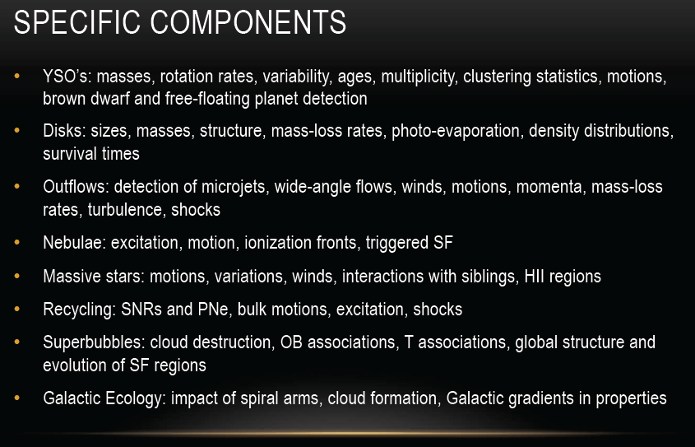

Slide 35
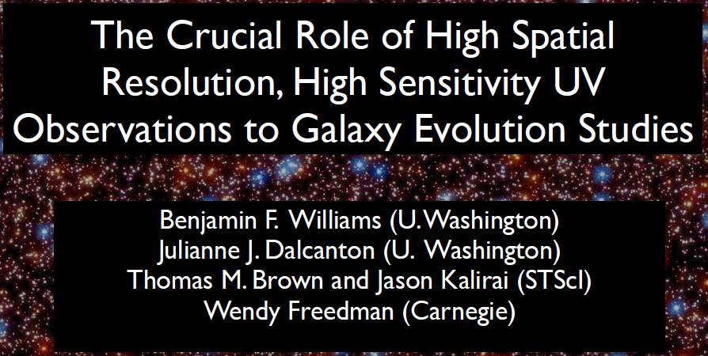
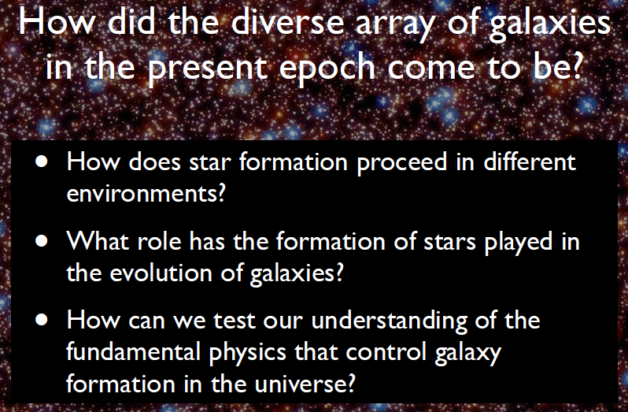

Slide 36
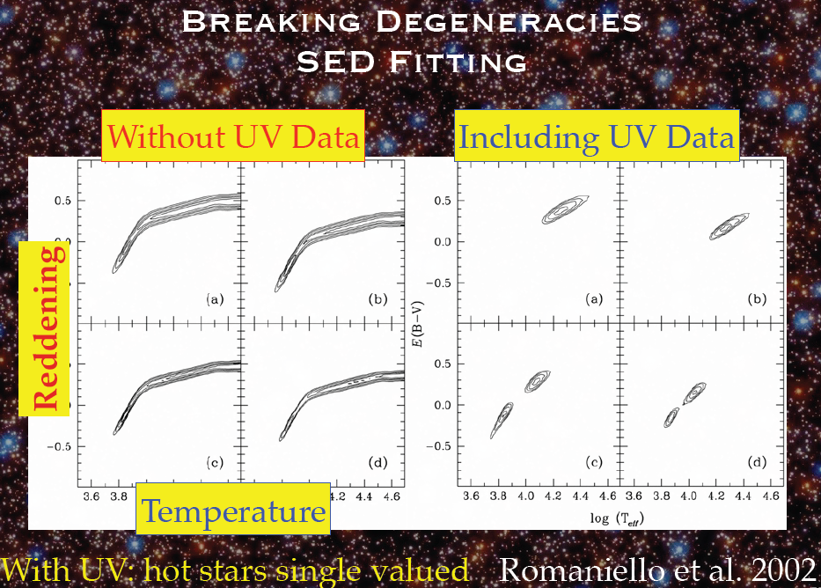

Slide 37
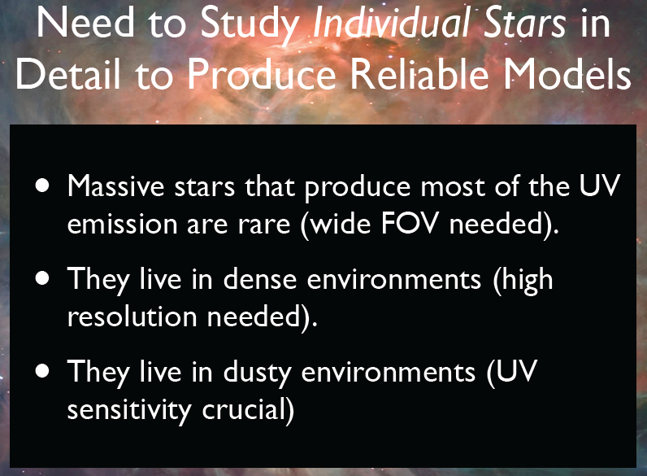

Slide 38
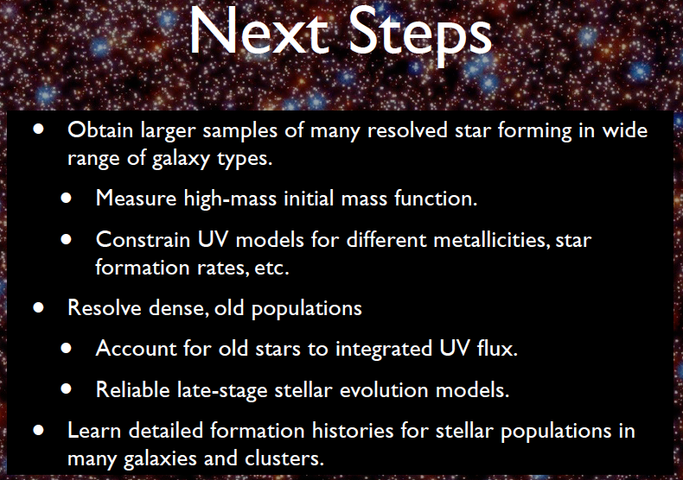

Slide 39
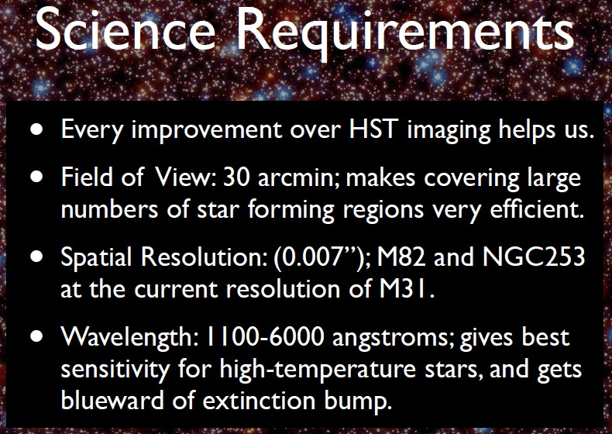

Slide 40


Slide 41
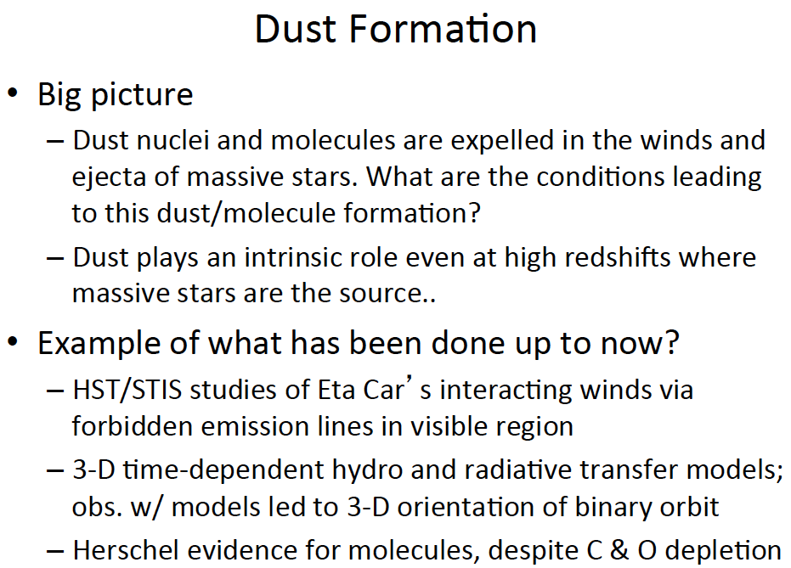

Slide 42
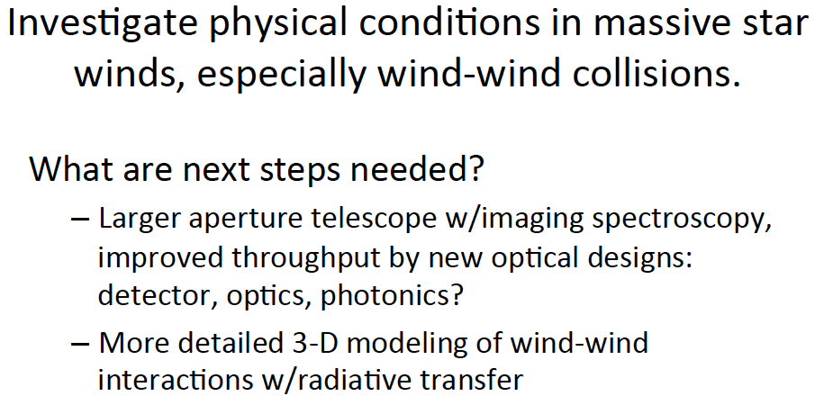

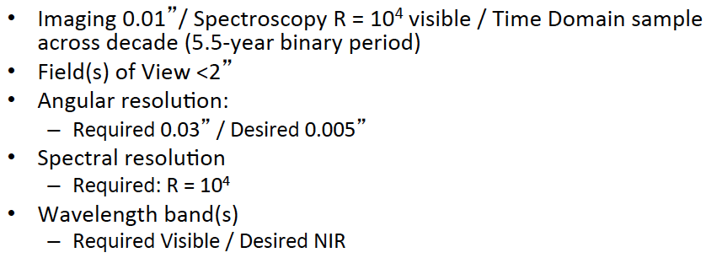

Slide 43
Understanding the Impact of Massive Stars
Sub-Program | Mode | FoV | Passband | Resolution | Aperture
SF Survey | Imaging | 200 sq arcmin | 250-1050nm | 40mas @ 300nm | 4m+
Massive Stars | Imaging | 25” | 90-900nm | 0.1” | 4m
 | Spectroscopy |  | 100-200nm | R~40 | 4m
Galaxy Evolution | Imaging | 30’ | 110-600nm | 7mas @ 300nm | 4m+
Dust Formation | Imaging | 2” | Visible-NIR | 10mas @ 300nm | 4m
 | Spectroscopy | 2” | Visible-NIR | R=10,000 | 4m

Slide 44
Overall Capabilities Matrix

Slide 45
Backup Slides

Slide 46
Baryonic Life Cycle – Xray or UV?
Most of the missing baryons are supposed to be at temperatures where O is mostly O VII and O VIII. O VI is a few percent of the O at 10^6 K, and it drops sharply at about 2 or 3x10^6 K.
The difficulties with detecting the gas in X-rays are:
  The absorption cross sections are 10 times smaller
  The number of photons available for either absorption line targets or emission lines is far smaller
  The resolving power available in the X-rays is limited to a few thousand, so you can barely get line profiles and can probably only see lines strong enough that they are approaching the logarithmic part of the curve of growth.
While most of the *oxygen* is in OVII / O VIII, most of the total mass is *not* seen in the Xray.
This means that if you want to track all the baryons, you can’t just observe in the X-ray.
The cold / warm gas is doing something interesting too - accreting / outflowing / recycling.
O VII and O VIII don’t do you any good in low metallicity gas, which is common enough that a metal-selected observation may detect only 1/2 the mass in the CGM. But in the UV you have a chance at broad Lya lines that probe hot gas even if it’s metal-free.
Galaxies below around a few L* shouldn’t, and don’t appear to, have much hot gas in their halos. Maybe even the Milky Way doesn’t.
X-ray telescopes tend to have very low sensitivity by comparison with the UV, and even if they *can* detect O VII it won’t be around many galaxies, but just a few. If they think they can do big samples the burden of proof is on them to show that. It doesn’t matter if most of the O is in O VII if all that signal is below your limits or you can only study a few galaxies.

Slide 47
Baryonic Life Cycle – Xray or UV?
The Astro2010 white papers addressed many of the issues, but highlights are:
  Even with the very best possible outcome, there will only be a small number of targets (of order 40) in the entire sky that will be bright enough for absorption spectroscopy in the X-ray regime.
  Absorption is much more sensitive than emission, which is critical for fully mapping the baryon cycle. It's not enough to only study the higher density, high-metallicity regions. We need to be able to probe ALL phases of the baryon cycle.
  A spectral resolving power of only a few thousand (the very best that an X-ray spectrometer can conceivably achieve) is inadequate. It has been shown that there is abundant cool gas in galaxy halos, the CGM, and the IGM. To gain insight on this important part of the baryon cycle, high spectral resolution is required.
  If we study absorption systems in the redshift range from z = 1 to 3.0, we can detect UV absorption lines from species like Fe XVI, Si XII, and Mg IX (all have strong resonance transitions and all are abundant elements) that can probe gas at T > 10^6 K. Thus, O VII and O VIII are not the only games in town.
The Oppenheimer paper is only a simulation. It is well known that simulations have many serious uncertainties due to the fact that the sub-grid prescriptions for handling a wide variety of important physics is not adequate. Bear in mind that the paper does not get the OBSERVED cool gas right at all. When asked about this, the author had no satisfying answer. Basing a choice about a >> $1 billion investment on one simulation paper is unwise.

