Slide 1
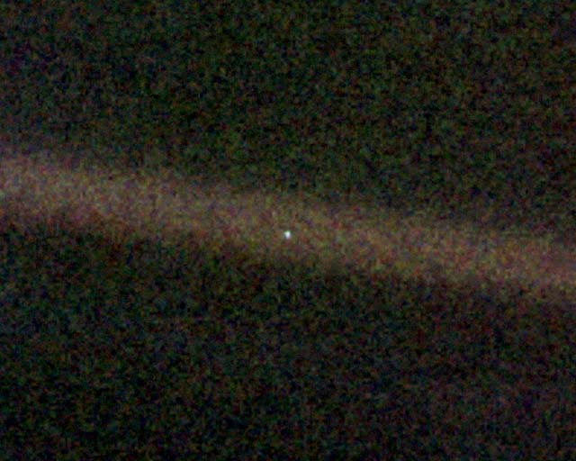
Constraining Habitability of Pale Blue Dots
Tyler D. Robinson
Sagan Fellow – UC Santa Cruz
HabEx F2F – Aug. 5th, 2016
tydrobin@ucsc.edu

Slide 2
Habitable planet:
“A habitable planet is a terrestrial planet on whose surface liquid water can exist in steady state.”
TPF-C Final Report

Slide 3
Key questions when characterizing terrestrial exoplanets
Is the planet habitable?
Is the planet inhabited?

Slide 4
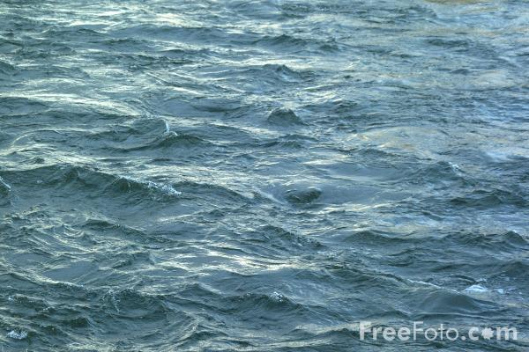
direct detection of surface
liquid water
direct measurement
of surface
pressure and temperature
combination of data and modeling
to argue for a habitable surface
Notes:
Three ways to detect habitability

Slide 5
Two approaches
determine all climate-relevant parameters
  allows for forward climate modeling
  concentration of all GHG; surface gravity; total atm. pressure; surface albedo; rotation rate

Slide 6
Two approaches
determine all climate-relevant parameters
  allows for forward climate modeling
  concentration of all GHG; surface gravity; total atm. pressure; surface albedo; rotation rate
detect evidence of H₂O condensation
  especially at/near surface
  clouds
    spectral signatures (NIR)
    height
  water vapor profile

Slide 7
Two approaches
determine all climate-relevant parameters
  allows for forward climate modeling
  concentration of all GHG; surface gravity; total atm. pressure; surface albedo; rotation rate
detect evidence of H₂O condensation
  especially at/near surface
  clouds
    spectral signatures (NIR)
    height
  water vapor profile

Slide 9
O₃
H₂O
H₂O
H₂O
O₂
O₂
CO₂
H₂O
H₂O
O₂
H₂O
H₂O
CO₂

Slide 10
O₃
H₂O
H₂O
H₂O
O₂
O₂
CO₂
H₂O
H₂O
O₂
H₂O
H₂O
Requires resolution of about 200
For Earth-twin at 5 pc, need >1,000 hr
CO₂

Slide 11
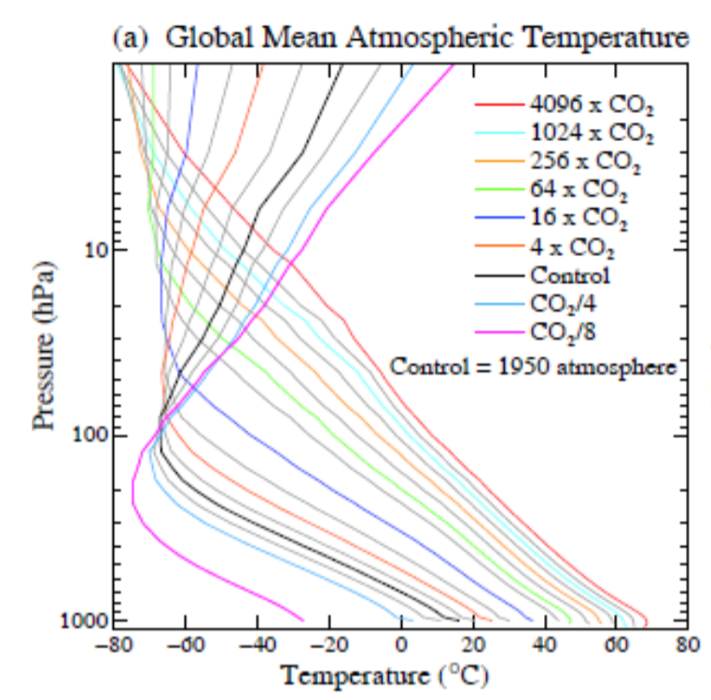
Hansen et al. (2013)

Slide 12
Venus
Earth
CO₂
Mars

Slide 13
Two approaches
determine all climate-relevant parameters
  allows for forward climate modeling
  concentration of all GHG; surface gravity; total atm. pressure; surface albedo; rotation rate
detect evidence of H₂O condensation
  especially at/near surface
  clouds
    spectral signatures (NIR)
    height
  water vapor profile

Slide 15
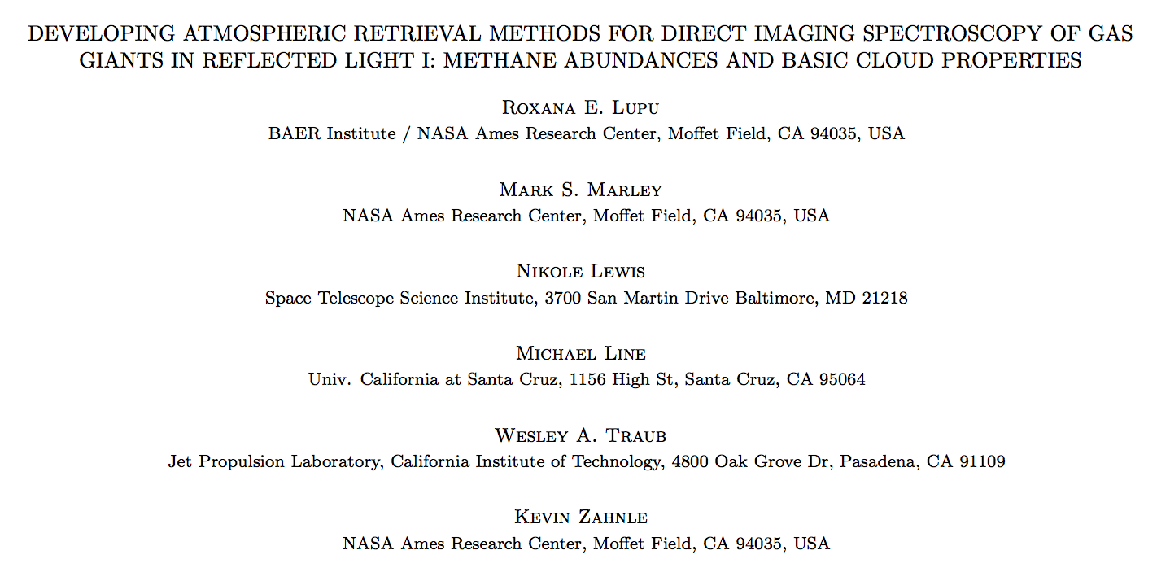
arXiv:1604.05370

Slide 16
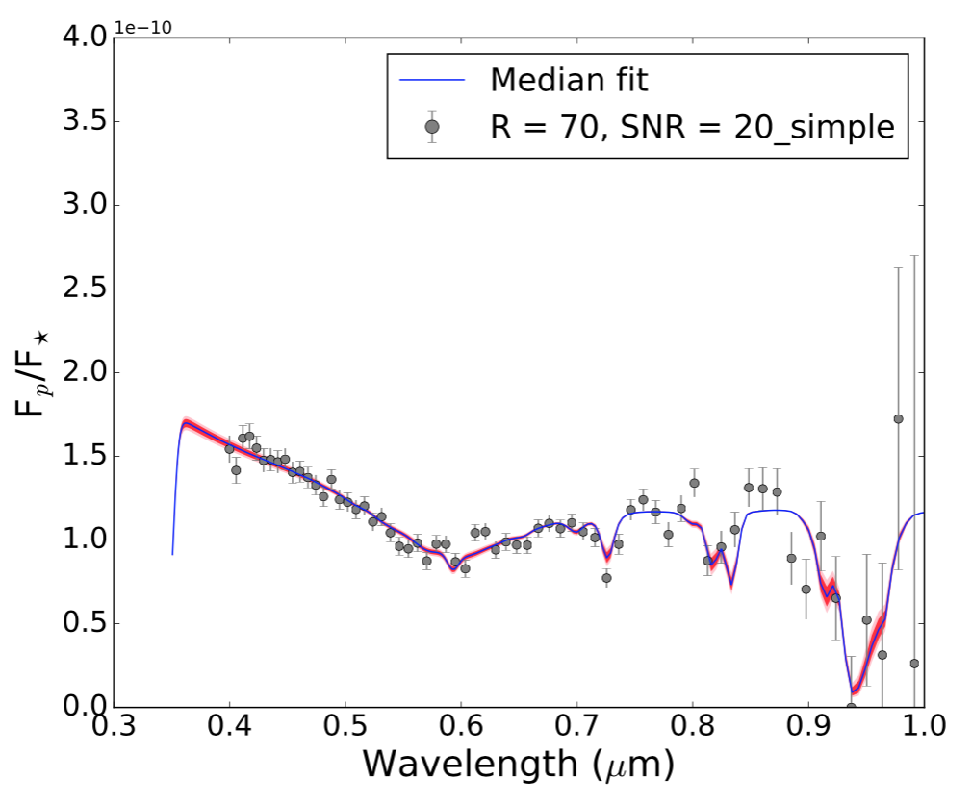
Feng, Robinson, et al. (in prep.)

Slide 17
From Warm Neptunes to Earths
Tr
Things that go bump in the night…
^

Slide 18
CH₄
CH₄
CH₄
F_{p}/F_{s}
H₂O
H₂O
log(λ)

Slide 19
CH₄
CH₄
CH₄
Will want:
  atmospheric mean molecular weight
  planetary
    radius
    mass
    surface gravity
F_{p}/F_{s}
H₂O
H₂O
log(λ)

Slide 20
Take-Away Points
Measuring CO₂ amounts will be very difficult (for Earth twins).
  Constraining the greenhouse effect will be extremely challenging.
The 0.95, 1.1, and 1.4 μm water vapor bands offer key opportunities to characterize the:
  water vapor abundance.
  water vapor profile shape.
Utilizing these features requires achieving SNR > 5 (at a resolution of roughly 70) throughout the band.
Sub-Neptunes in the Habitable Zone could masquerade as habitable planets. Could distinguish with:
  atmospheric mean molecular weight
  bulk parameters -> interior structure understanding

Slide 21
Caveats
studies done at resolution (λ/Δλ) of 70
most results are cloud-free
  over-estimate strength of visible H₂O features
  as cloudiness increases, sensitivity to surface decreases
only explored relative humidity at 100%
  controls “dryness” of planet
  see Zsom, Seager et al. (2013)
whatever else you all think of…

Slide 25
Crude Estimate of Required Integration Time:
dark current dominated (D = 10⁻⁴ e/pix/s)
8-meter telescope
throughput = 10%
Sun-like host at 5 pc
in (Kasting+) Habitable Zone

Slide 26
Crude Estimate of Required Integration Time:
dark current dominated (D = 10⁻⁴ e/pix/s)
8-meter telescope
throughput = 10%
Sun-like host at 5 pc
in (Kasting+) Habitable Zone
=> of order 20-40 hr to distinguish at SNR=5

Slide 27
Crude Estimate of Required Integration Time:
dark current dominated (D = 10⁻⁴ e/pix/s)
8-meter telescope
throughput = 10%
Sun-like host at 5 pc
in (Kasting+) Habitable Zone
=> of order 20-40 hr to distinguish at SNR=5
(but scales as distance⁴)

Slide 29
Signs of H₂O condensation?
vs.
altitude
log(H₂O)

Slide 31
of order line profile
thermal effects

